Slide 1
BELLABEAT · CASE STUDY
Can a Wellness Tech
Company Play It Smart?
Insights from Fitbit Fitness Tracker Data · 35 Users · March – May 2016
35
62
1,373
901
Users Tracked
Days of Data
Activity Records
Sleep Records

Slide 2
The Story in 3 Acts
Every number tells us something about how people live — and where Bellabeat can help.
01
02
03
Activity & Steps
Sleep & Calories
Trends Over Time
Only 21% of users hit 10,000 steps/day
Tuesday is the most active day
Users are sedentary 81% of the time
Very active time = just 1.6%
Avg sleep: 6.6 hours (below 7–9 rec.)
Most restful night: Sunday
Calories consistent ~2,295/day
Strong link: active mins → more calories
Steps peaked in Week 17 at 1.78M
Activity dropped sharply in Week 19
Clear weekly patterns in steps
Heatmap reveals highly variable users

Slide 3
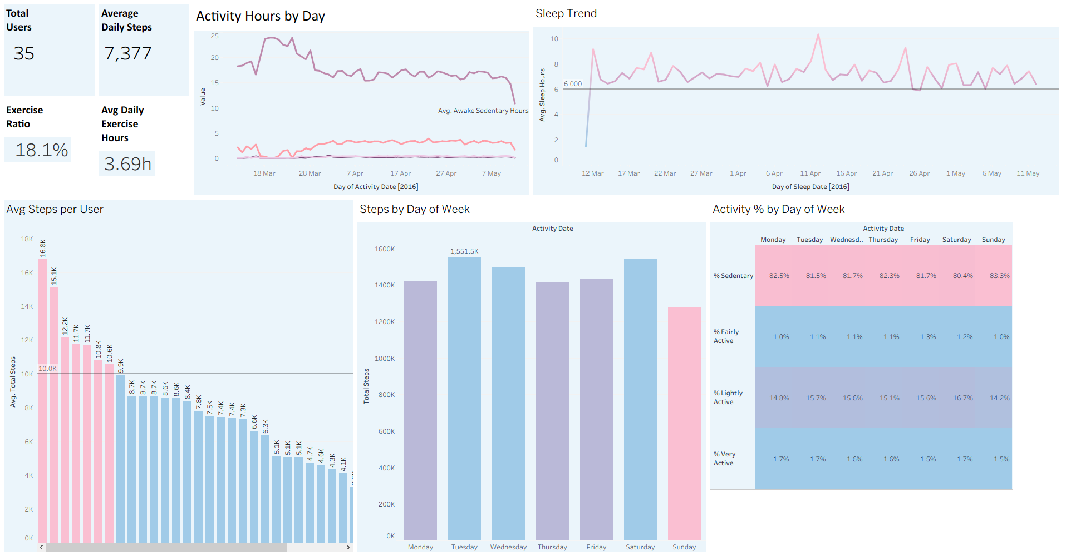
ACT 01
Activity
& Steps
21%
Users reach 10K steps
7,377
Avg daily steps
81%
Time sedentary
35
Active users tracked
💡 Tuesday is the most active day of the week

Slide 4
What the Activity Data Tells Us
Sedentary behaviour dominates — but there are clear opportunities for Bellabeat to intervene.
🚶 Step Gap is Real
🛋️ Sedentary = 81%
The average user walks 7,377 steps/day — 26% below the 10,000-step CDC recommendation. Only 7 of 33 users consistently hit the target.
Users spend 81% of their tracked time sedentary. Very active time is just 1.6% — highlighting a major wellness opportunity.
📅 Tuesday Peak
👤 Big User Variation
Steps are highest on Tuesdays (1.55M total) and lowest on Sundays. Weekend engagement drops sharply — a key nudge moment.
Avg steps range from 16.8K (top user) to 0.8K (lowest). Personalised coaching could help the bottom 50% improve significantly.

Slide 5
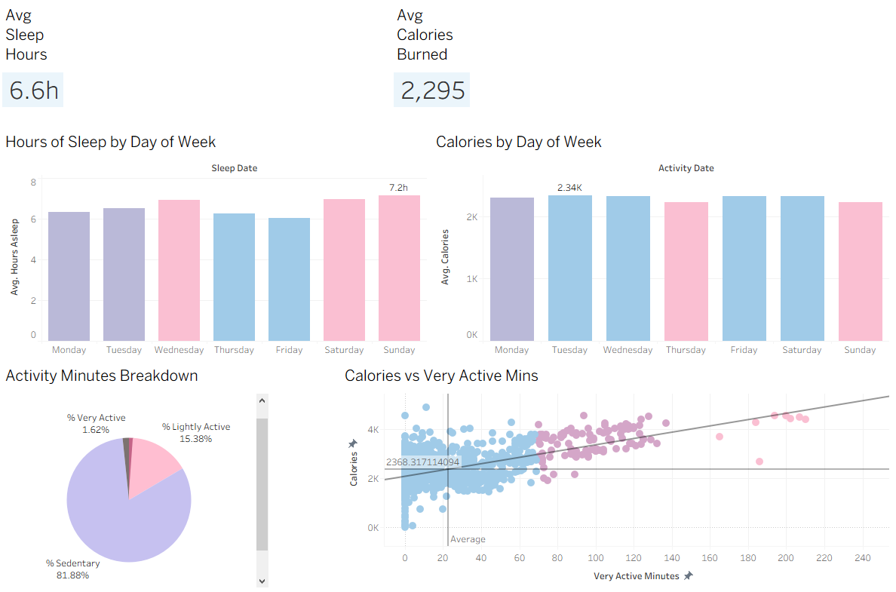
ACT 02
Sleep
& Calories
6.6h
Avg sleep per night
2,295
Avg calories burned/day
Sunday
Best sleep day
+ve
Calories vs activity link
💡 More active minutes = significantly more calories burned

Slide 6
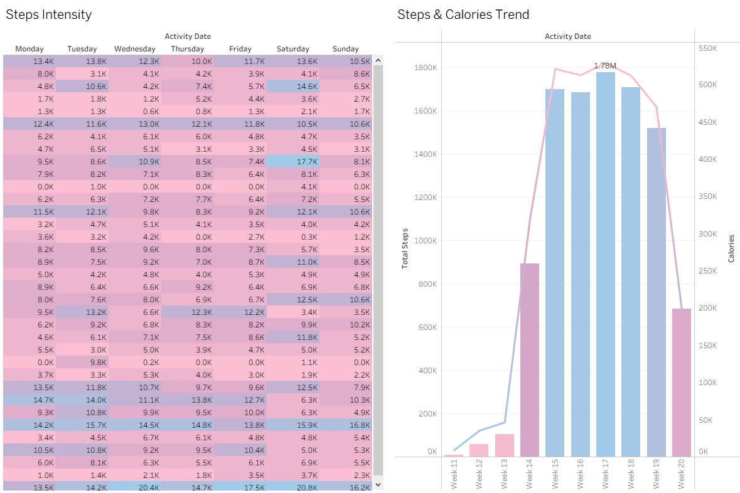
ACT 03
Trends
Over Time
Wk 17
Peak activity week
1.78M
Steps in peak week
↓ Wk19
Sharp drop-off point
33
Users in heatmap
💡 The heatmap shows huge variance between users — personalisation is key

Slide 7
Recommendations for Bellabeat
Three data-driven actions to grow user engagement and market position.
01
02
03
Step Challenge Nudges
Sleep Improvement Programme
Calorie & Activity Dashboard
WHAT
WHAT
WHAT
Push notifications on low-activity days (Sun/Thu) with personalised step goals based on each user's baseline.
In-app sleep coaching with bedtime reminders, especially Sunday nights when restless minutes peak.
Show users a live correlation score between their active minutes and calories burned — making the payoff visible.
WHY IT WORKS
WHY IT WORKS
WHY IT WORKS
81% sedentary time + big user variance = huge room for small-win motivation. Even a 10% increase moves users closer to the 10K target.
Avg sleep of 6.6h is below the 7–9h recommendation. Sunday is the hardest night to fall asleep — a targeted nudge could meaningfully improve recovery.
The scatter plot proves a strong positive link. Making this visible in-app creates a feedback loop that drives more activity and retention.

Slide 8
THE ANSWER IS YES
Bellabeat Can Play It Smart.
The data shows exactly where users struggle — and where Bellabeat can step in with
smart, personalised features that turn passive trackers into active health partners.
Target the 79%
who don't hit 10K steps
Help users sleep
better, especially Sundays
Show the calorie
activity connection visually
Data Source: Fitbit Fitness Tracker Data via Kaggle (Möbius) · 33 Users · March–May 2016 · Visualised in Tableau

