Slide 1
Driver Monitoring System using YOLOv8 and YOLOv9
Presented by: Harsh Prajapati
Project Presentation
Date: November 2025

Slide 2
Introduction
Driver distraction is a major cause of road accidents.
This project develops a Driver Monitoring System capable of detecting
critical driver behaviors using YOLOv8 and YOLOv9 models.

Slide 3
Project Objectives
- Detect driver behaviors in real time
- Compare YOLOv8 vs YOLOv9 performance
- Improve road safety using deep learning
- Prepare model for smart vehicle deployment

Slide 4
Dataset Description
Dataset Format: YOLOv8
Classes Detected:
1. Open Eye
2. Closed Eye
3. Cigarette
4. Phone
5. Seatbelt
Dataset annotated manually for training, validation, and testing.

Slide 5
Model Architecture
YOLOv8:
- Anchor-free
- Lightweight backbone
- Real-time optimized
YOLOv9:
- GELAN backbone
- Programmable Gradient Information (PGI)
- Higher accuracy and better object handling
Framework: Ultralytics YOLO

Slide 6
Training Process
Training Setup:
- 70% Training, 20% Validation, 10% Testing
- Image size: 640x640
- Optimizer: AdamW, Epochs: 100, Batch size: 16
- Augmentations: flips, brightness/contrast
Same dataset used for both models.

Slide 7
Evaluation Metrics
Metrics used:
- Precision
- Recall
- mAP@50
- mAP@50-95
These measure accuracy, coverage, and detection quality.

Slide 8
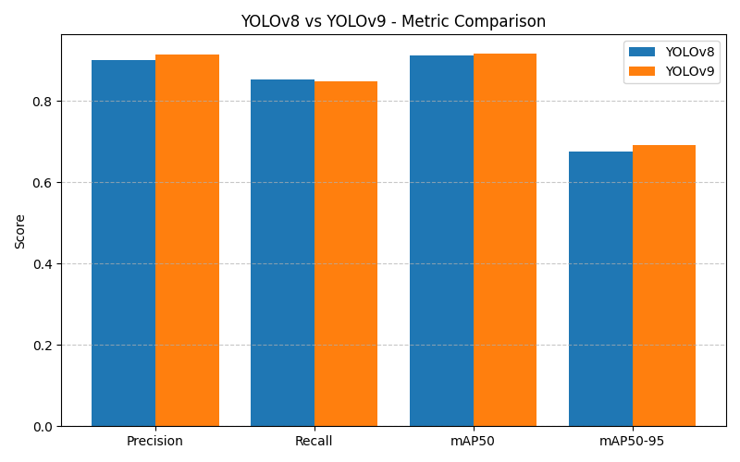
Results Comparison
YOLOv9 outperformed YOLOv8 across most metrics.
Higher mAP and precision for YOLOv9.

Slide 9
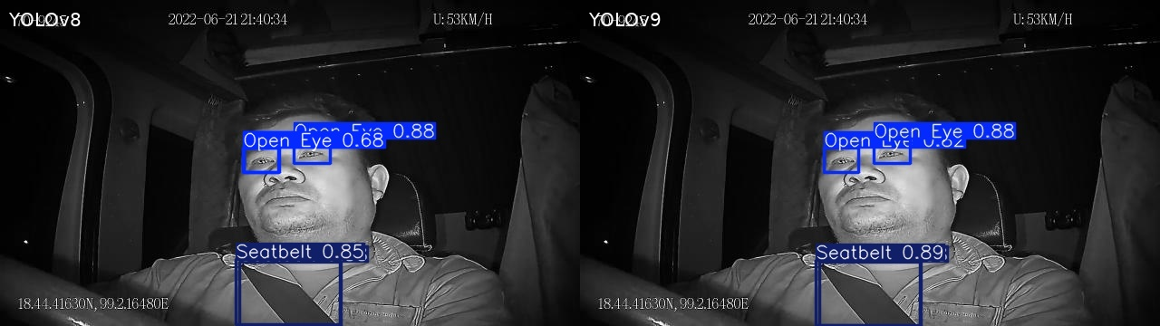
Detection Examples
YOLOv8 vs YOLOv9 predictions on sample images.
YOLOv9 shows clearer bounding boxes and more confident detection.

Slide 10
Conclusion
- YOLOv9 demonstrated stronger performance.
- The system accurately identifies dangerous driver behaviors.
- Suitable for real-time implementation in cars.
Future Work:
- Deploy on Jetson/Raspberry Pi
- Full video stream monitoring

