Slide 1

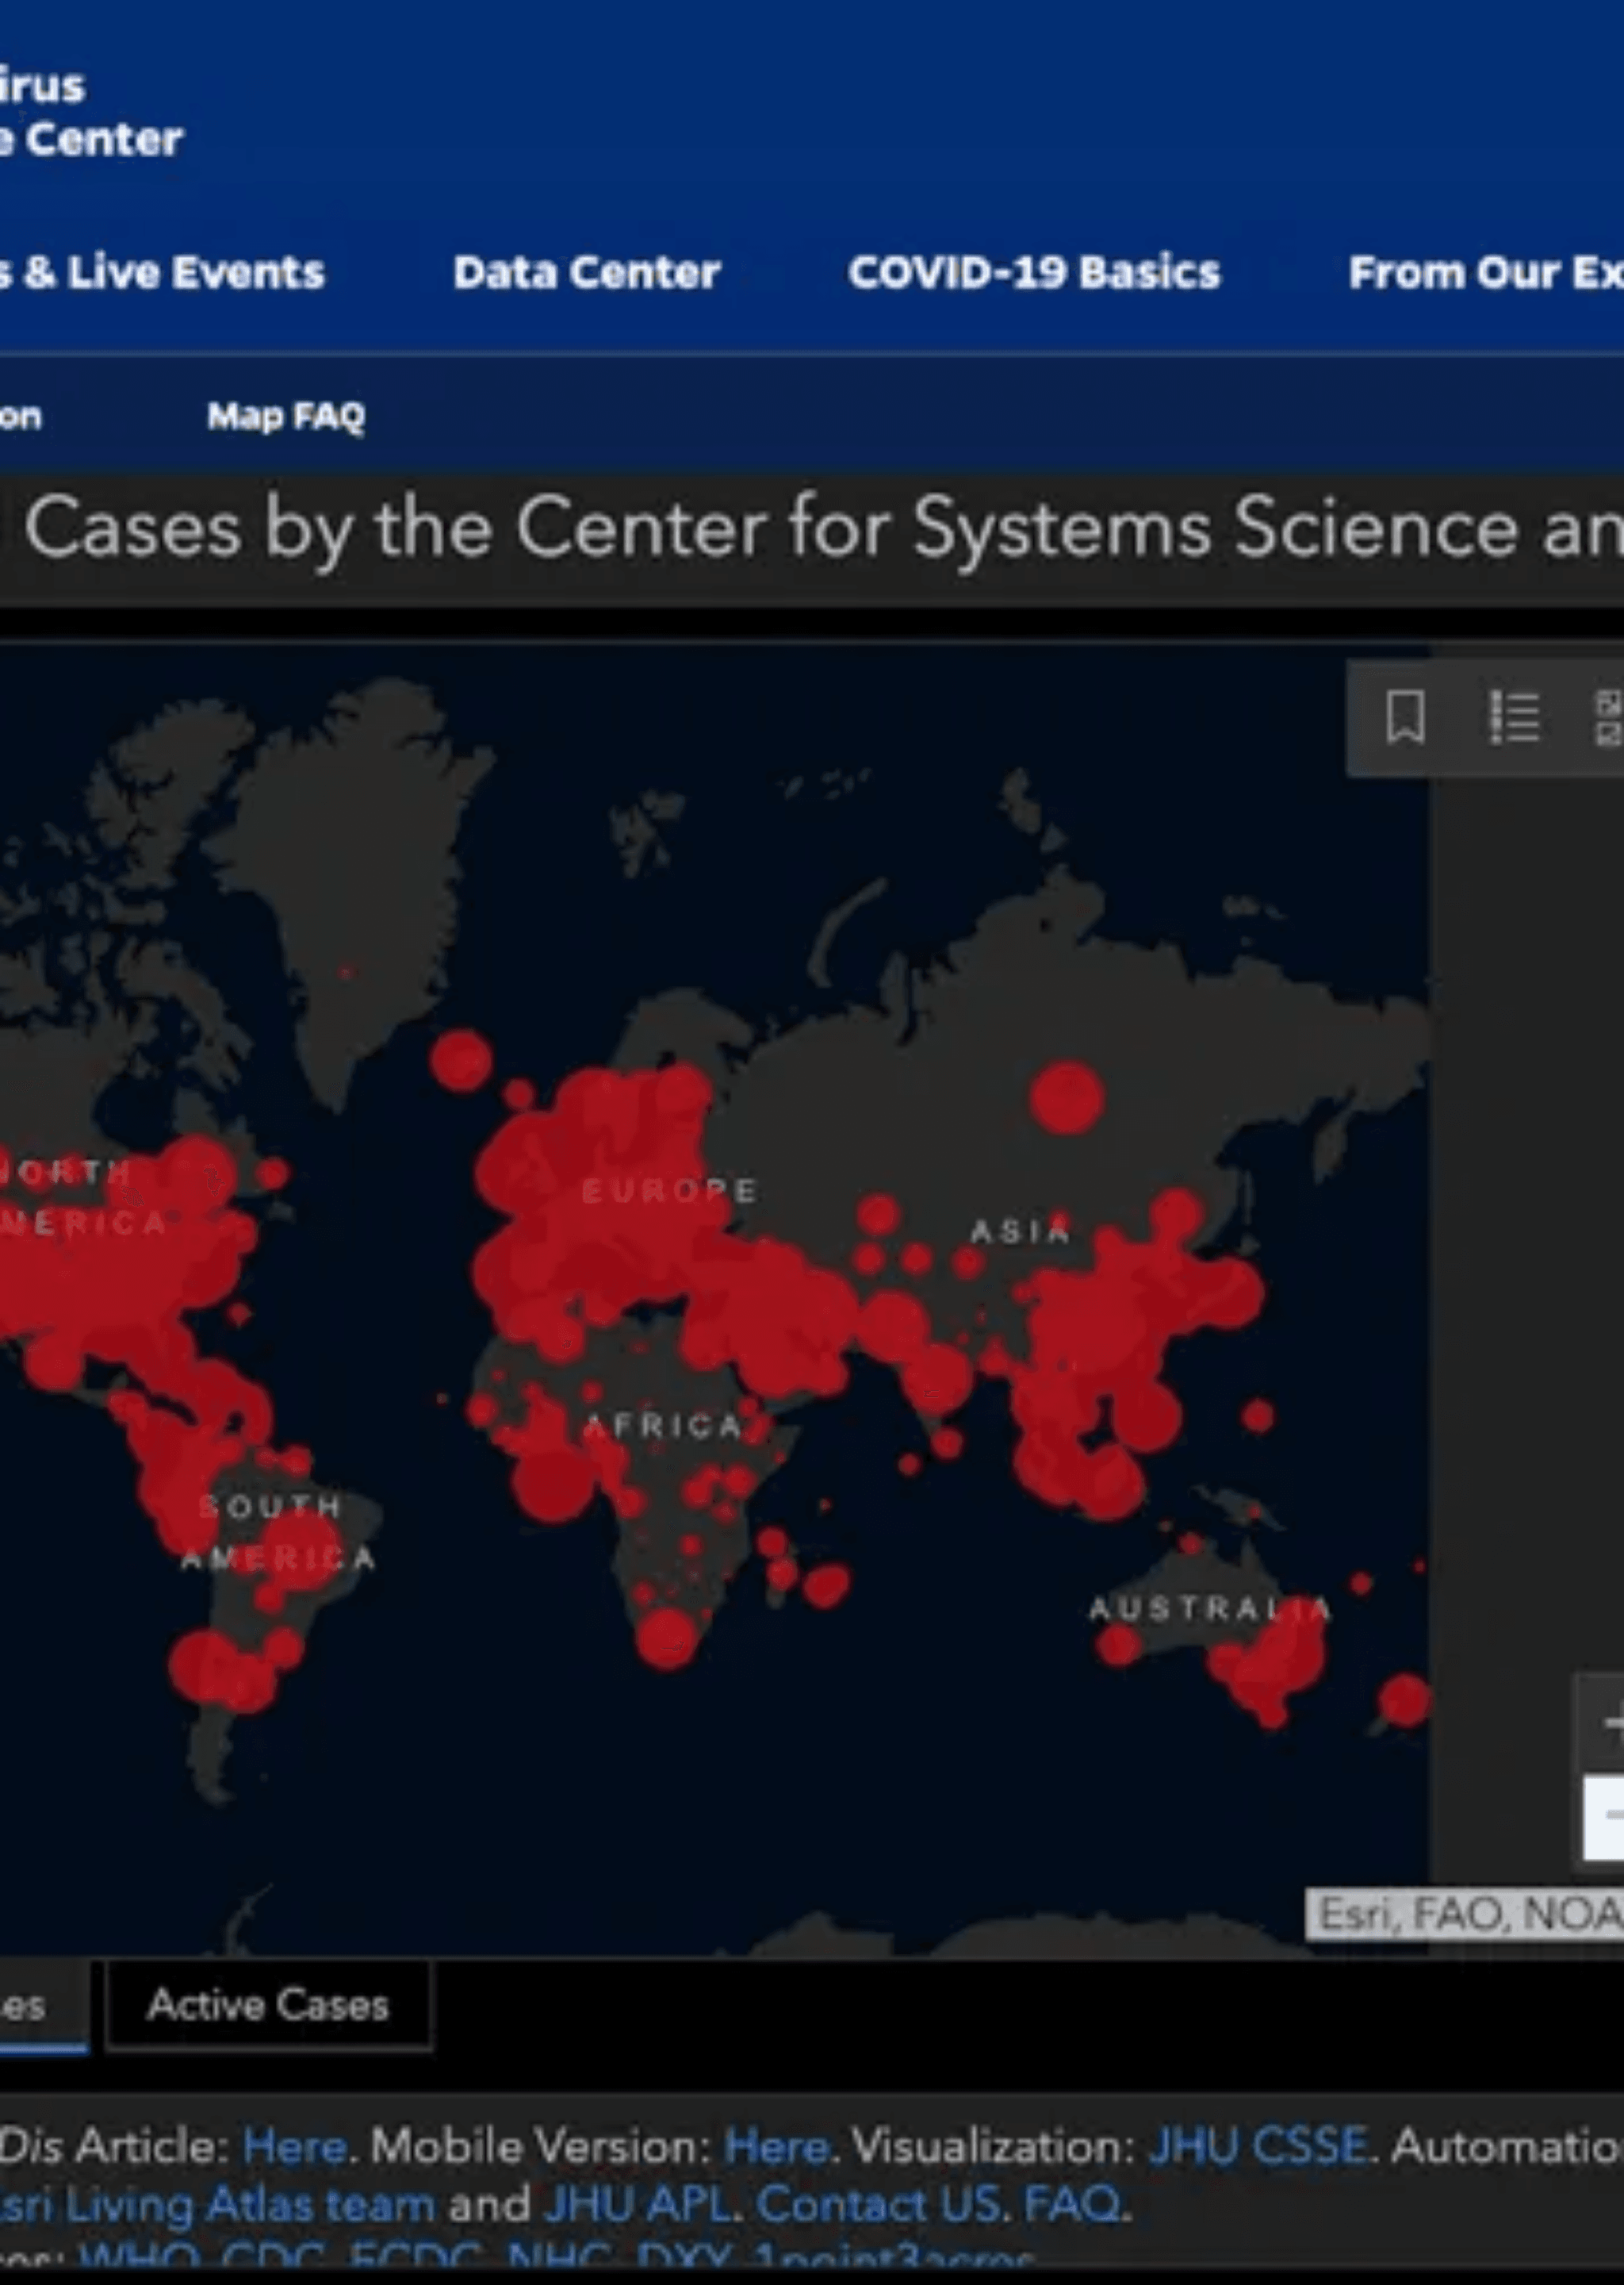
COVID-19 Risk Classification
A Data-Driven Approach with PySpark
Leveraging Big Data Analytics to Predict High-Risk Public Health Scenarios through Distributed Computing.

Slide 2

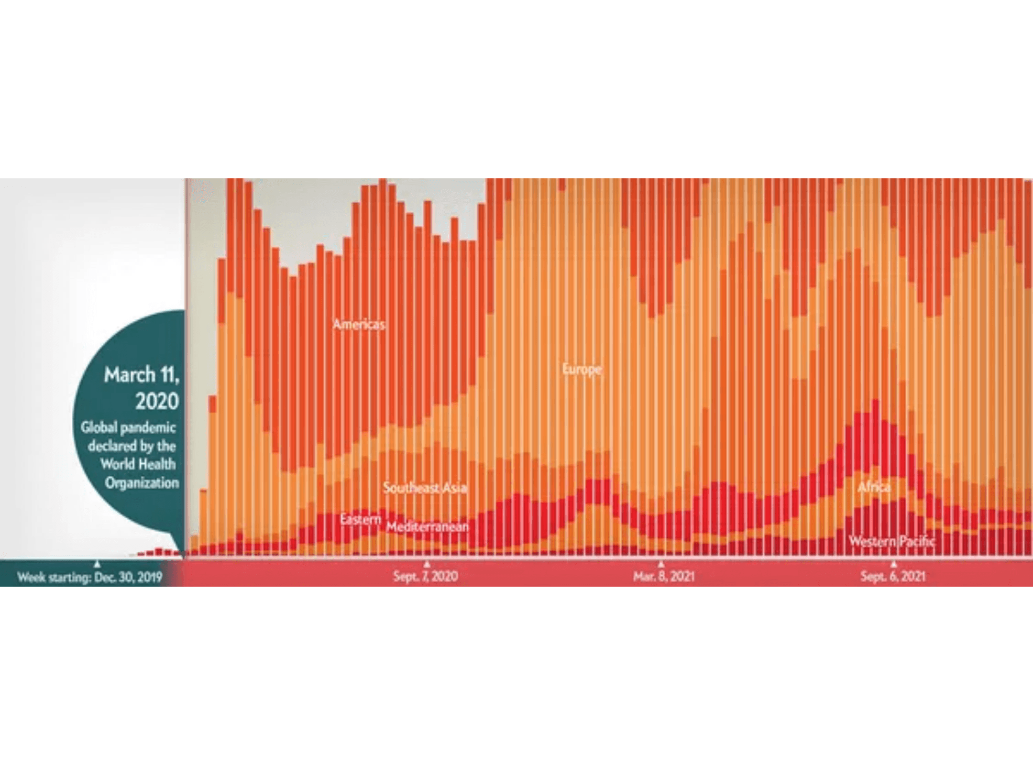
Project Objective: Proactive Risk Mitigation
Shifting from descriptive reporting to predictive classification is essential for pandemic management.
Identify high-risk "province-day" scenarios using multi-source data integration.
Build a scalable pipeline capable of processing millions of records in real-time.
Provide actionable insights for targeted public health interventions and resource allocation.

Slide 3

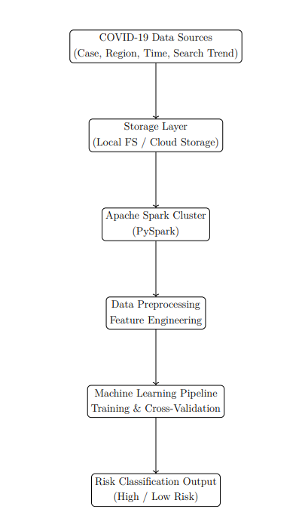
Data Ecosystem: Integrating Diverse Streams
Risk is multi-dimensional; single-source data is insufficient for accurate prediction.
Clinical
Demographic
Confirmed cases, deceased, and released counts from TimeProvince and TimeGender datasets.
Gender ratios, age distribution, and nursing home density from Region and TimeGender.
Behavioral
Geospatial
Digital search trends for respiratory symptoms (Coronavirus, Flu, Cold) from SearchTrend.
Latitude and Longitude coordinates for regional mapping and spatial analysis.
System Architecture

Slide 4
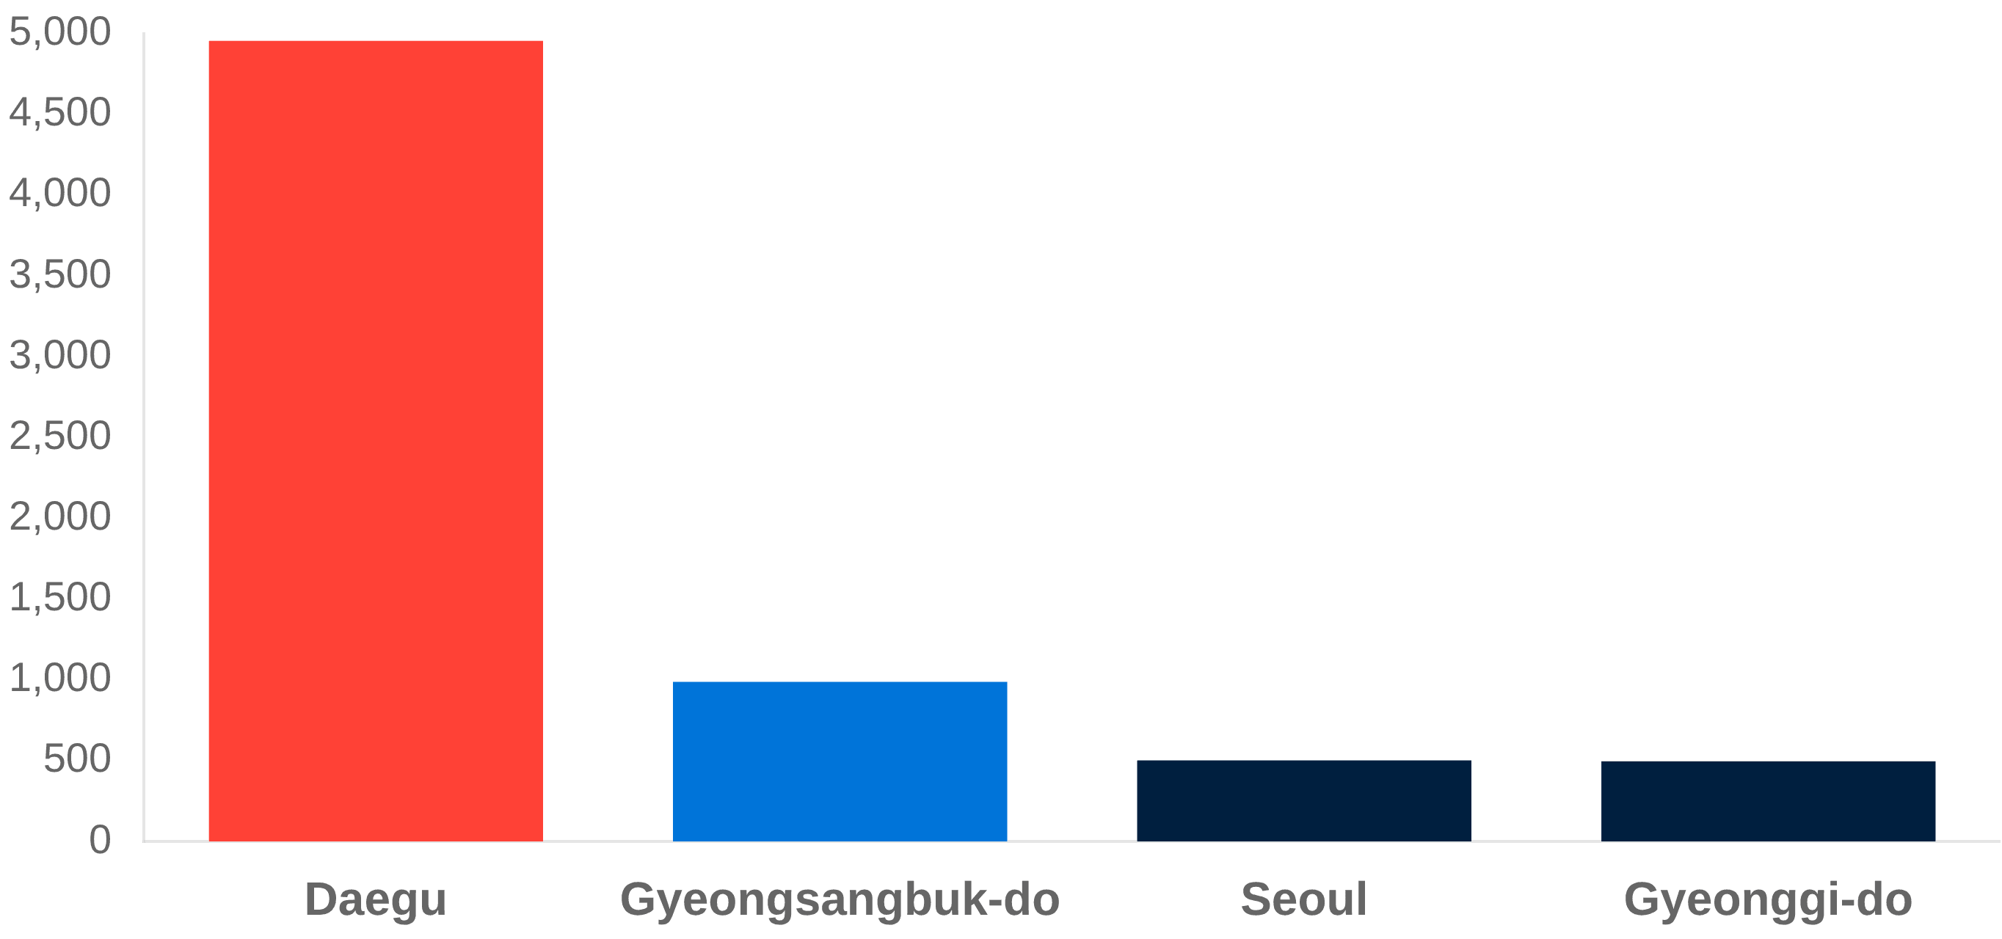
Regional Disparity: Daegu as the Epicenter
Extreme Concentration
Regional patterns show an extreme concentration of risk. Daegu recorded an average of 4,954 confirmed cases, nearly 10x the volume of Seoul (~502 cases).
Secondary Hotspots
Gyeongsangbuk-do followed as the second most impacted region with ~988 average cases, while other provinces remained significantly lower.
Strategic Implication
Resource allocation must be dynamically prioritized based on these regional "hotspots" rather than uniform distribution across the country.

Slide 5
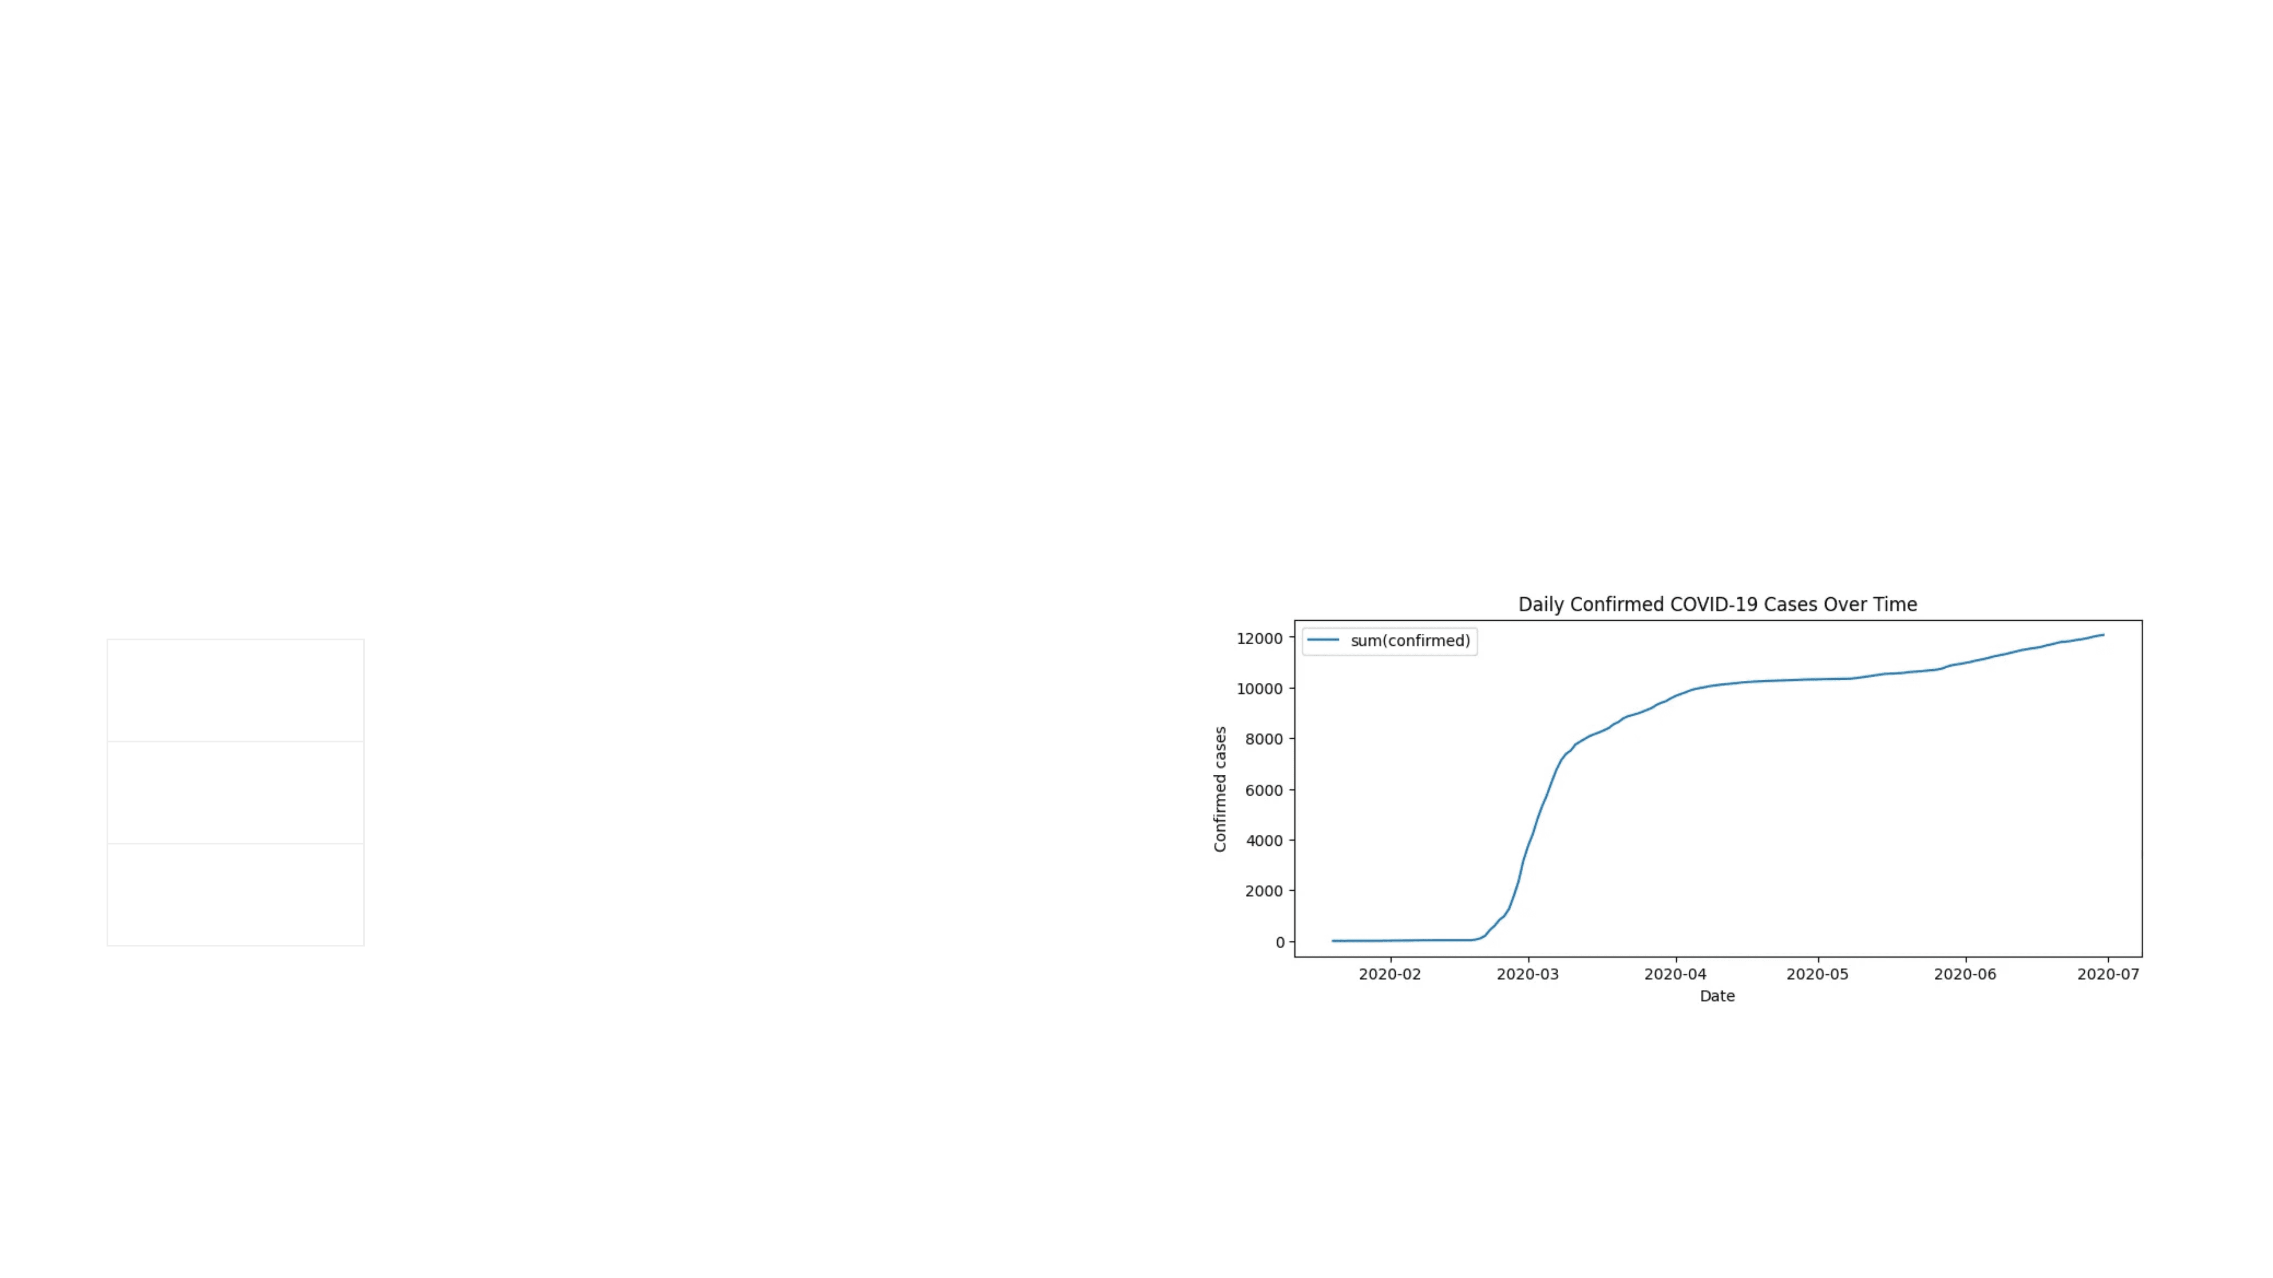
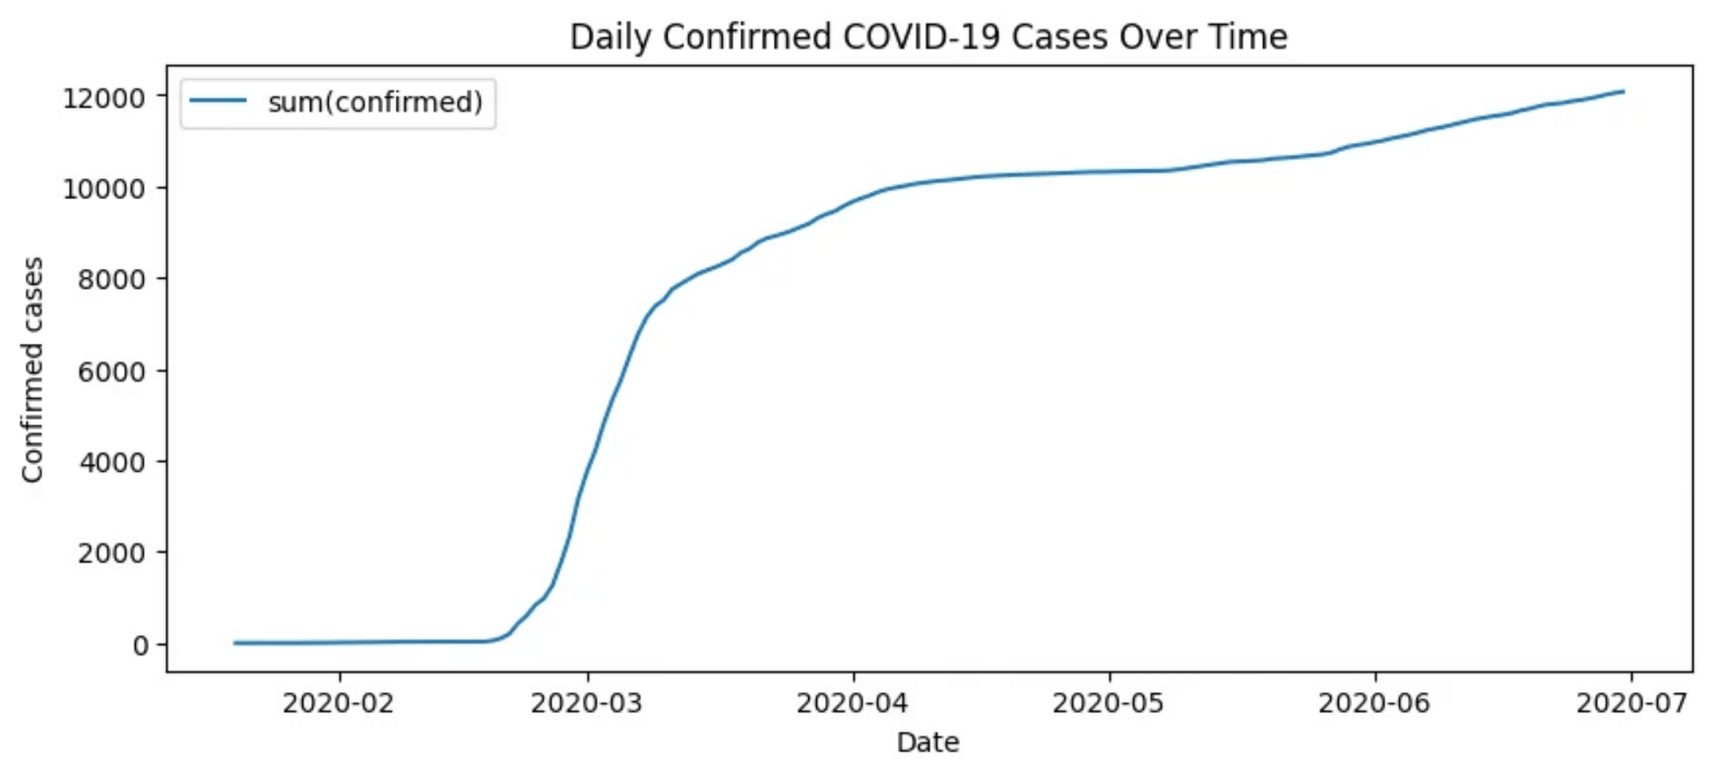
Digital Footprints: Search Trends as Leading Indicators
Pearson Correlation Matrix
Feature
Confirmed
Released
Deceased
1.00
0.93
0.95
Confirmed
0.93
1.00
0.99
Released
0.95
0.99
1.00
Deceased
Public search behavior for respiratory symptoms (Coronavirus, Flu, Cold) is a high-fidelity predictor of case surges, providing a 7-14 day lead time for capacity planning.
Exploratory Data Analysis: Daily cases over time.

Slide 6

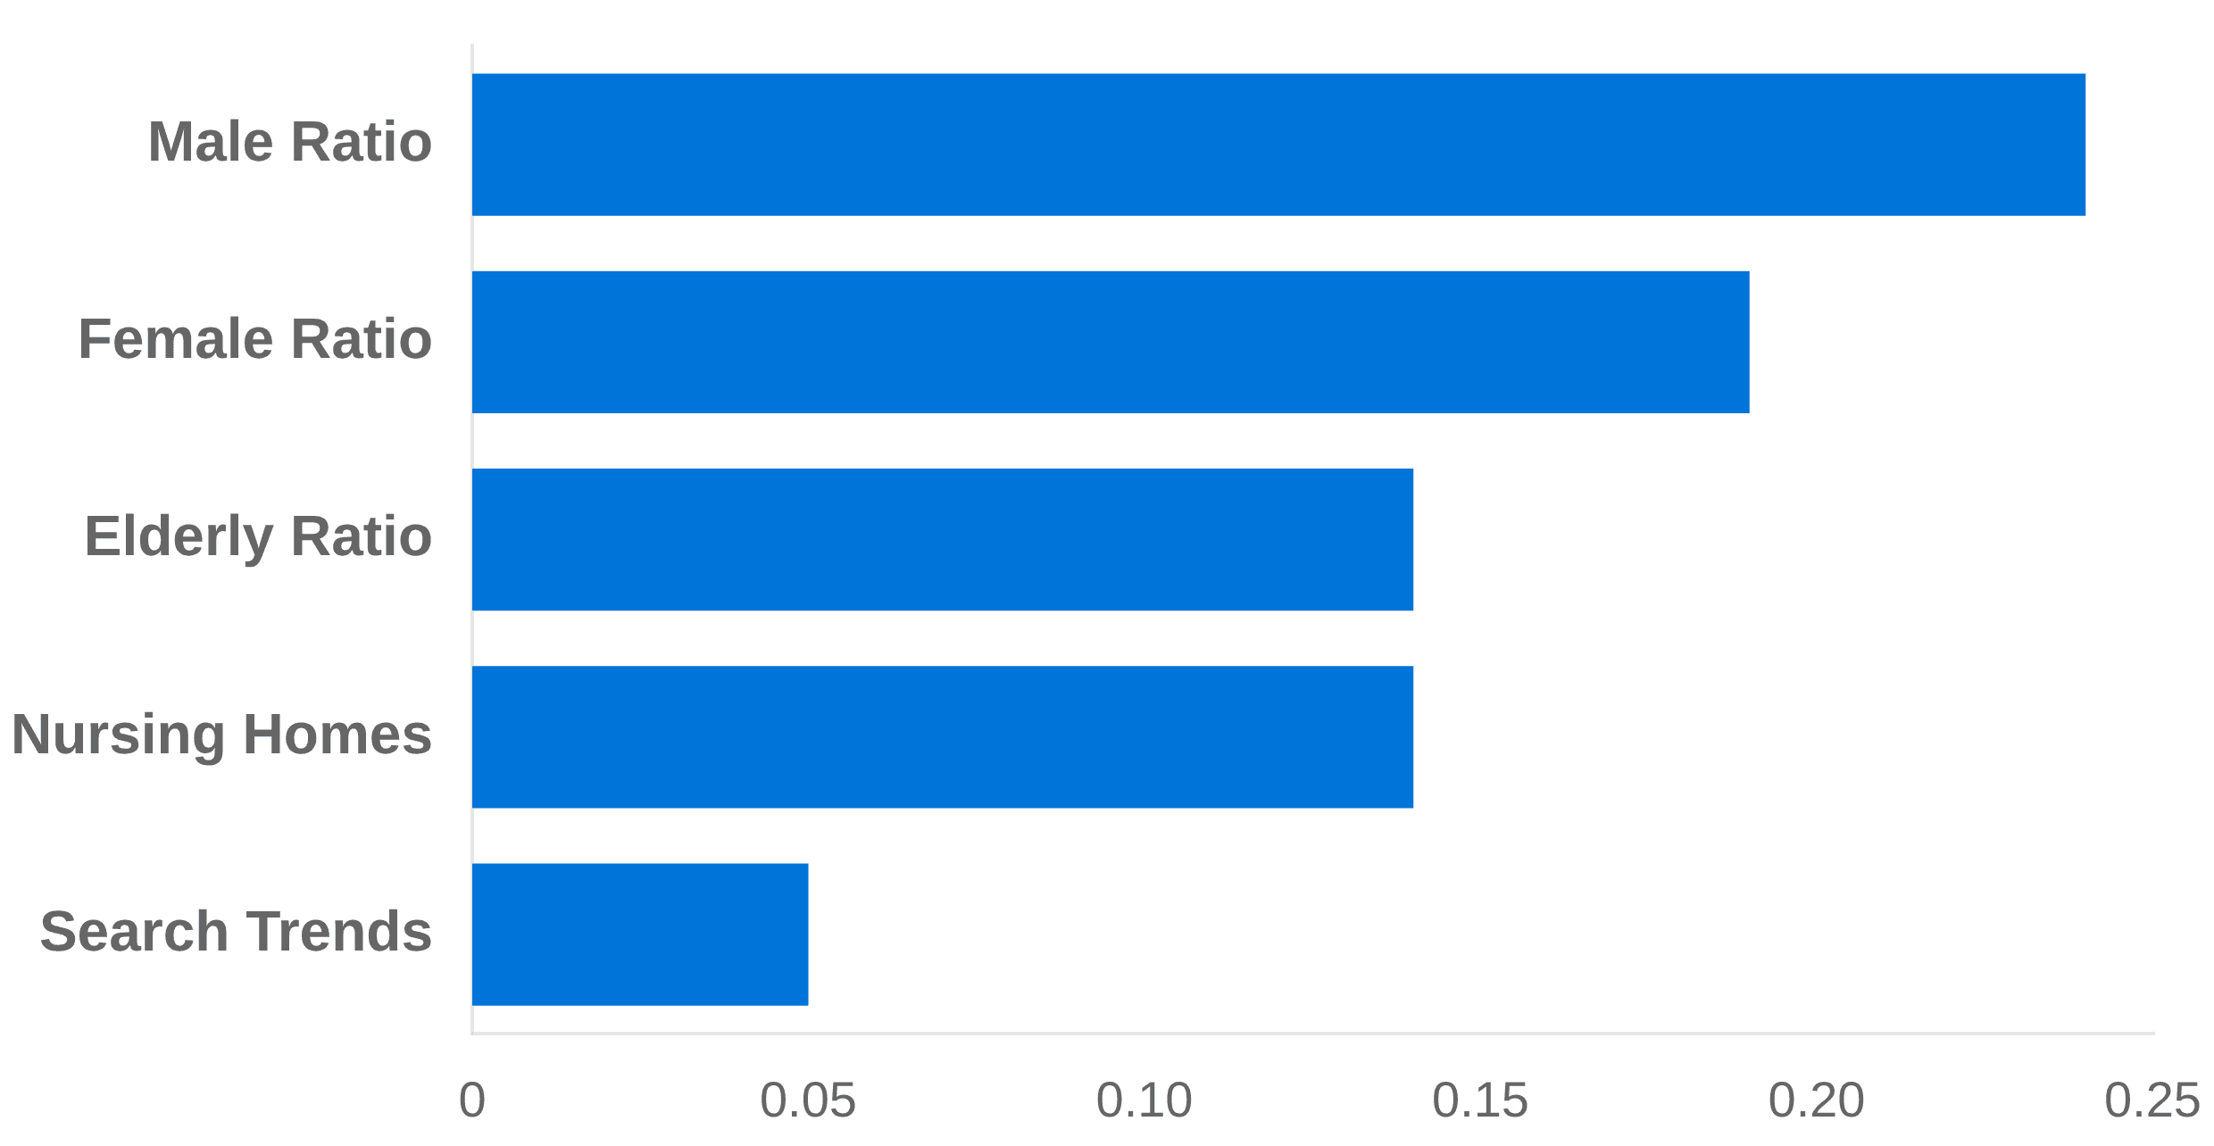
The Demographic Factor: Gender and Age as Risk Predictors
Top Feature Importances (Random Forest)
Gender as a Primary Driver
Population demographics are highly predictive. Gender Ratios (Male/Female) emerged as the top two most important features in the Random Forest analysis, with importance scores of 0.24 and 0.19 respectively.
Vulnerability in Elderly Areas
The Elderly Population Ratio and Nursing Home Counts showed significant correlation with high-risk classification, highlighting specific demographic vulnerabilities.
Predictive Insights
Demographics are not just descriptive; they are highly predictive of risk levels, allowing for targeted public health interventions.

Slide 7
Technical Pipeline: Scalable Preprocessing
Distributed computing is required to handle the complexity of feature engineering and real-time data integration at scale.
Stage 01
Stage 02
Stage 03
Label Creation
Feature Engineering
ML Pipeline
Defining risk thresholds through statistical
Synthesizing multi-source data while
Standardized transformation steps for
analysis of confirmed cases.
maintaining temporal integrity.
distributed model training.
65th Percentile Threshold
Multi-Dataset Joins
StringIndexer & OHE
Binary Classification (High/Low)
Leakage Prevention
VectorAssembler
Temporal Alignment
Missing Value Imputation
StandardScaler

Slide 8
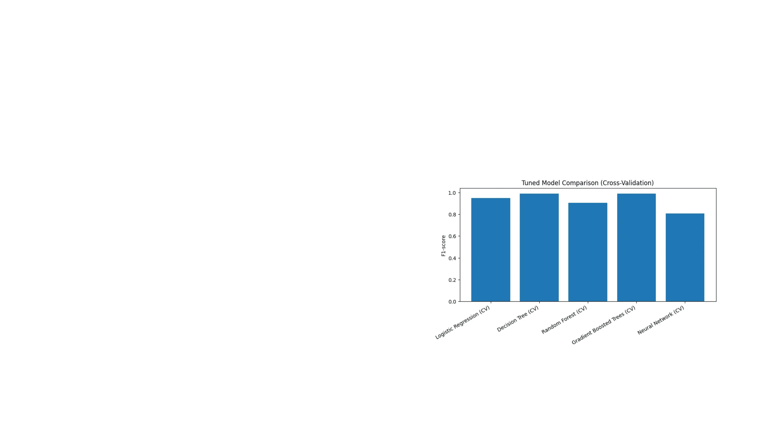
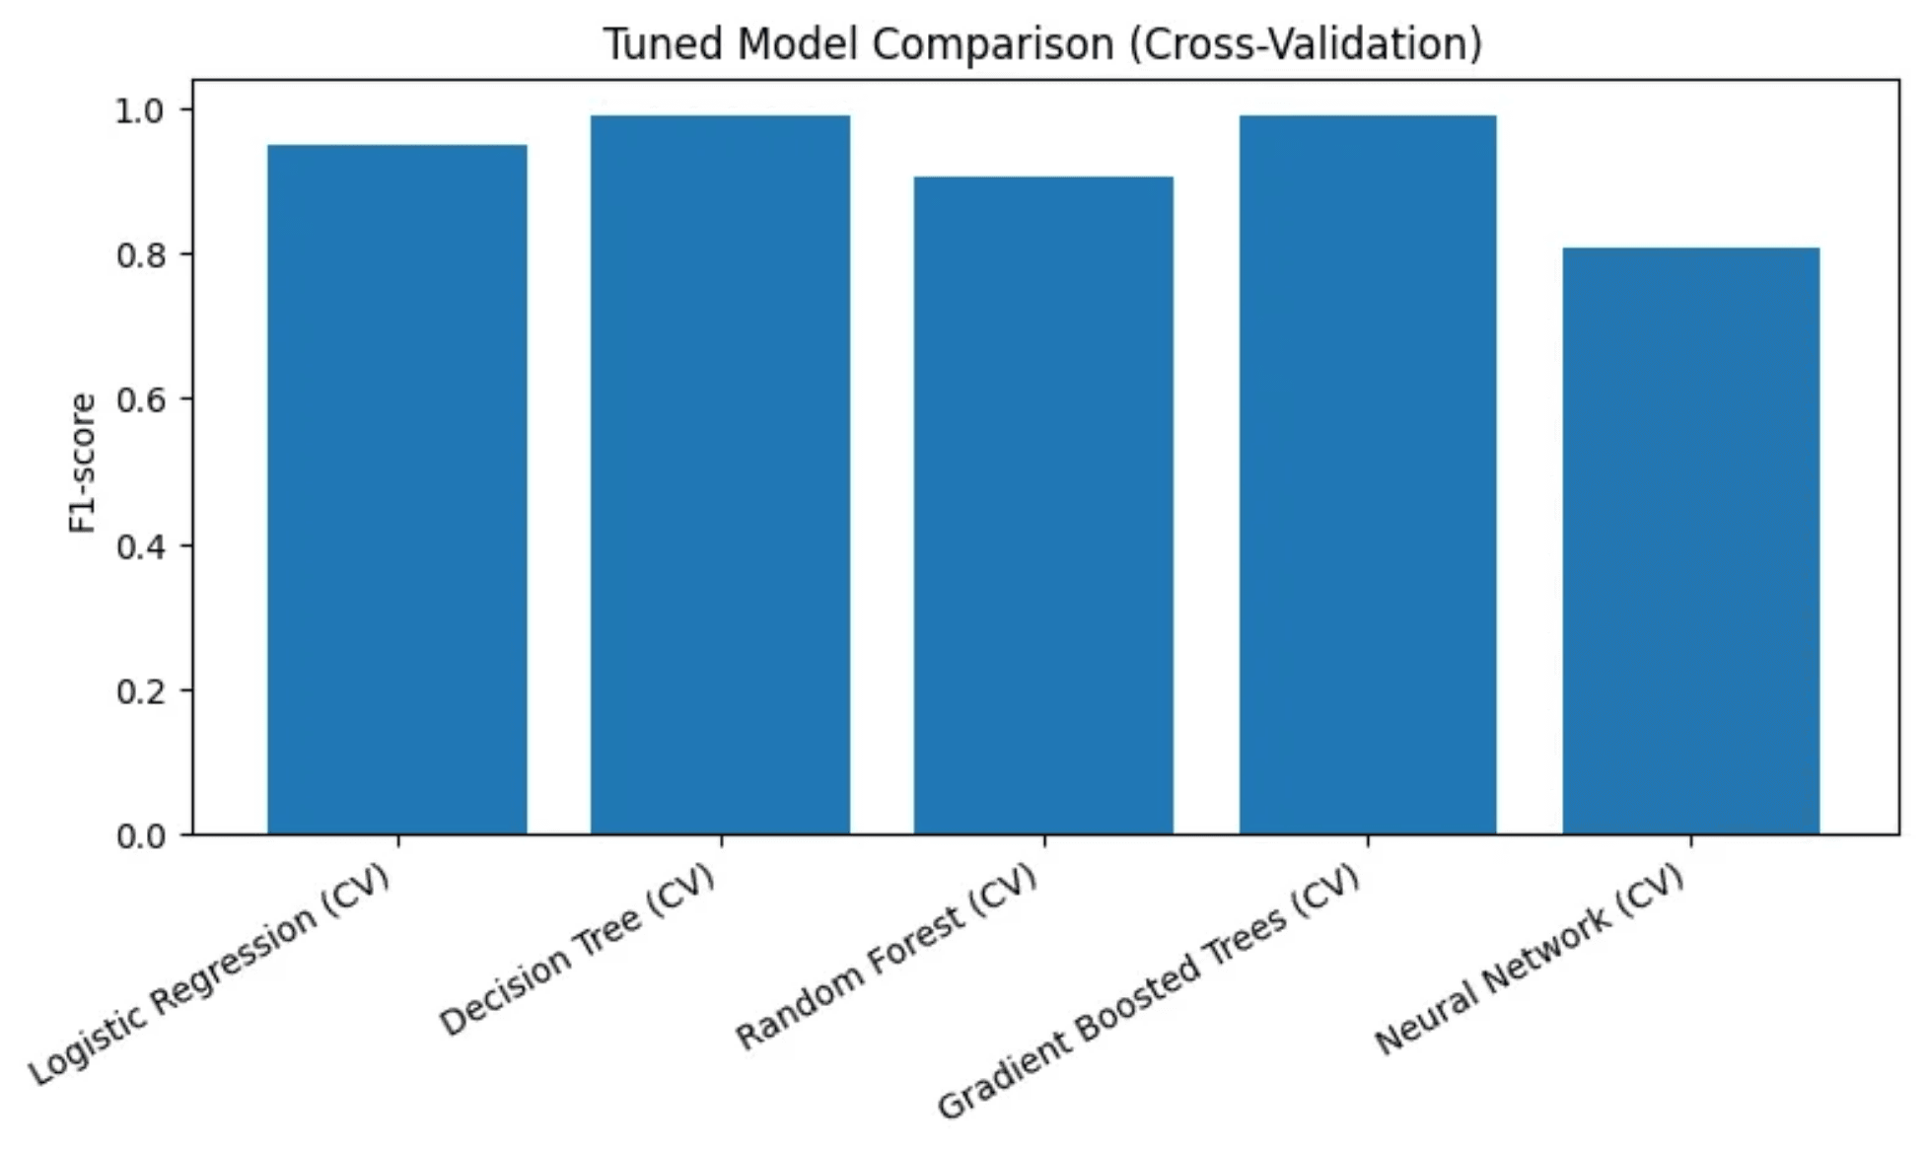
Model Selection: Why Gradient Boosted Trees?
Non-linear models are superior at capturing the complex interactions between demographics and behavioral search patterns.
Logistic Regression
Struggled with high-dimensional non-linear relationships between regional features and infection surges.
Decision Trees
Prone to overfitting on regional noise and lacked the stability required for reliable public health forecasting.
Gradient Boosted Trees (GBT)
Iteratively corrects errors from previous trees, providing the most robust and accurate risk profile across diverse provinces.

Slide 9
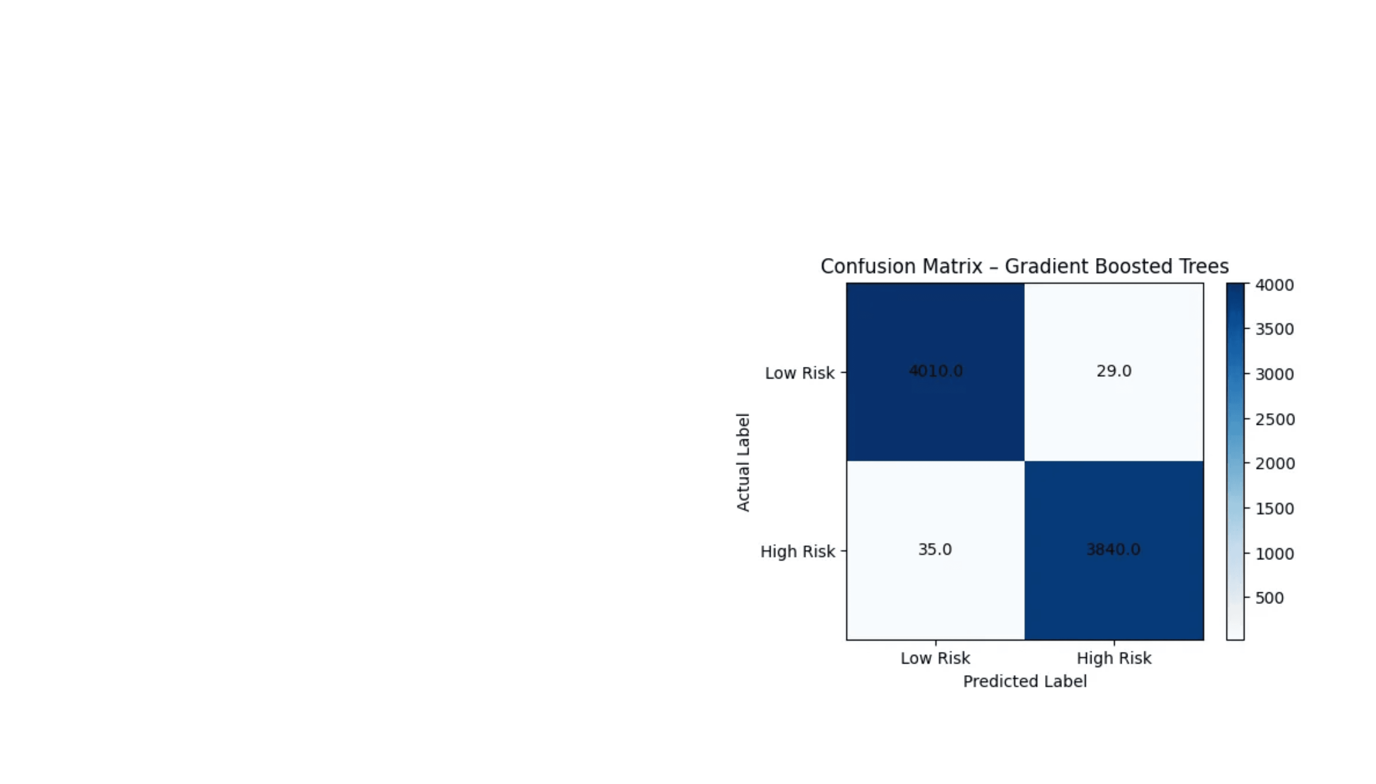
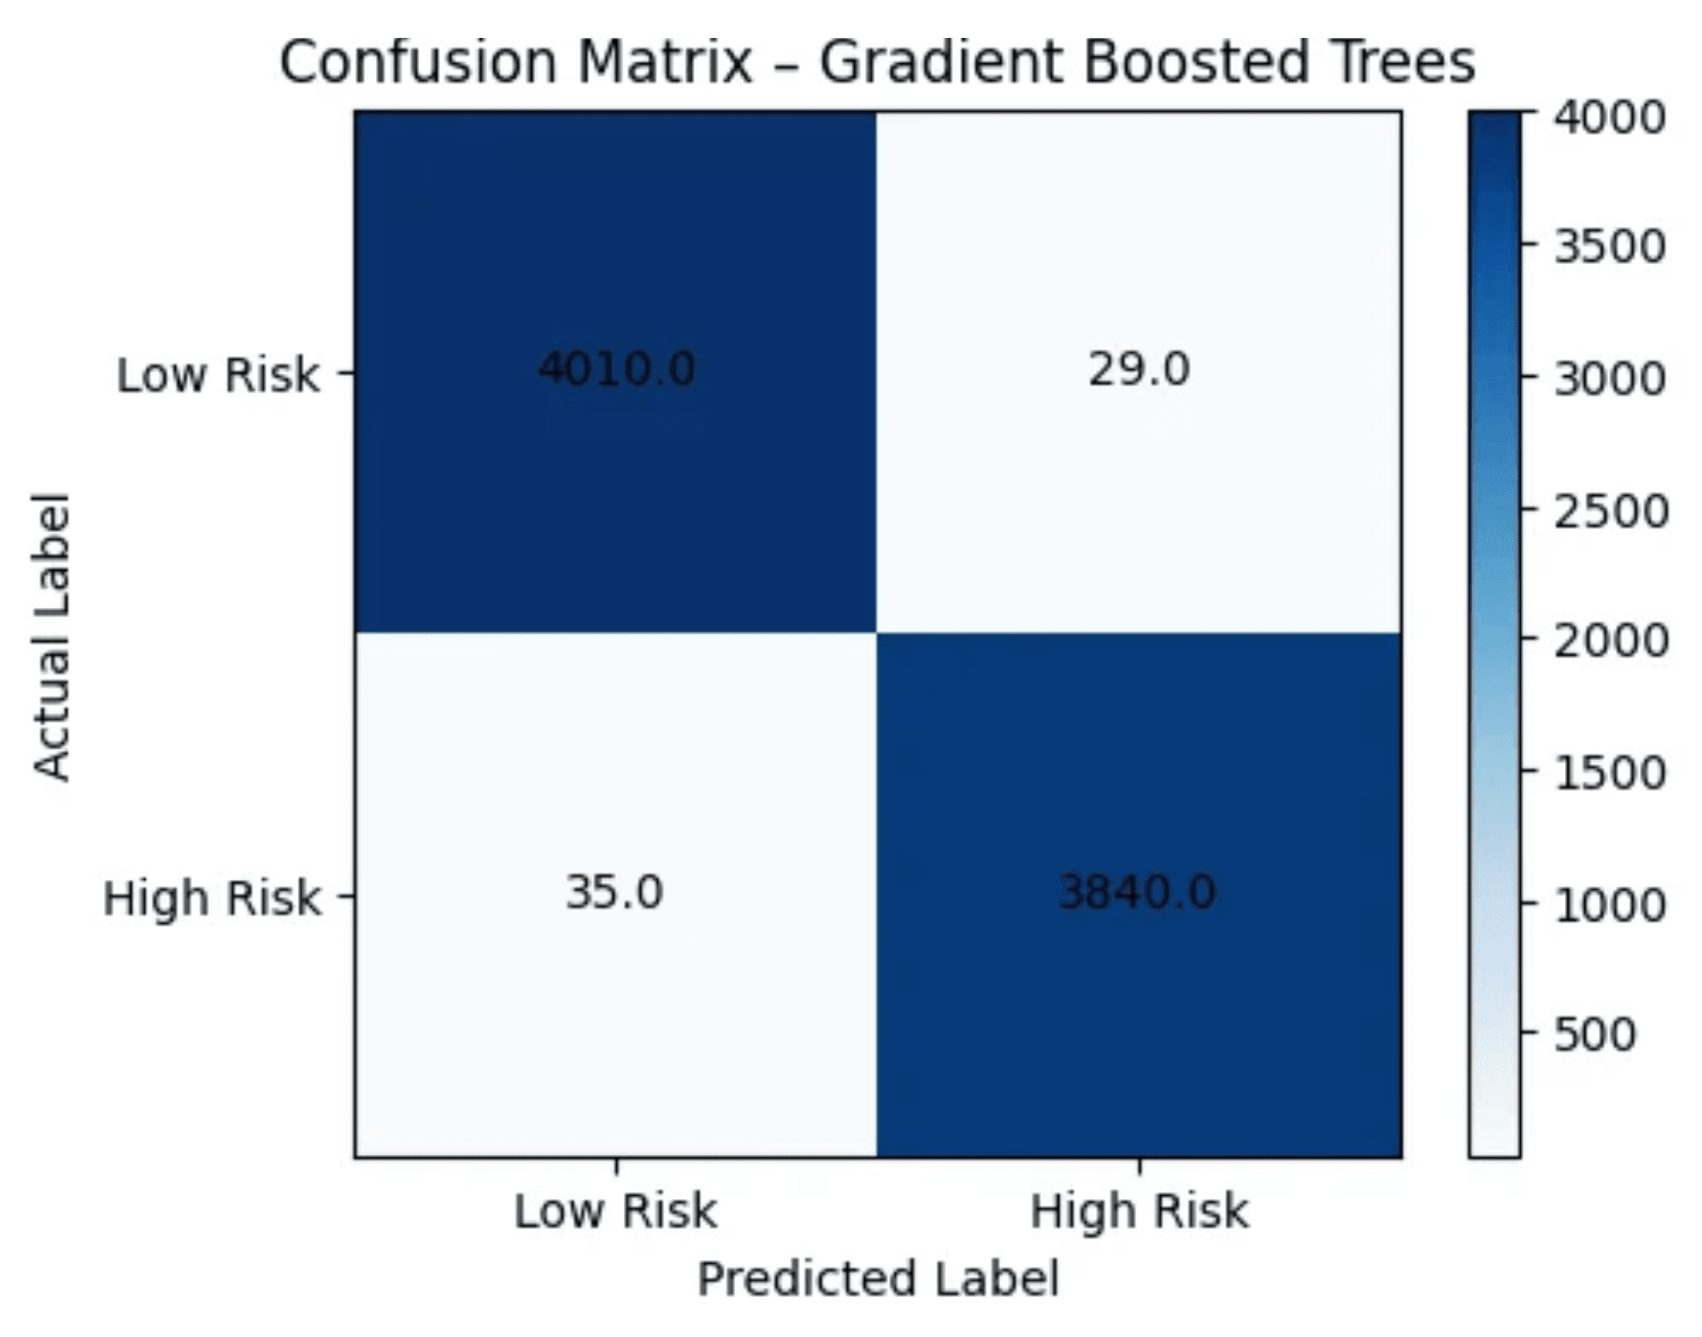
Predictive Power: Achieving 99.19% Accuracy
99.19%
Model Accuracy & F1-Score
Optimized Performance
Hyperparameter tuning on Gradient Boosted Trees (GBT) with Cross-Validation yielded near-perfect classification performance.
Reliable Decision Support
The high F1-score ensures that both "False Alarms" and "Missed Risks" are minimized, making the model reliable for critical policy decisions.

Slide 10

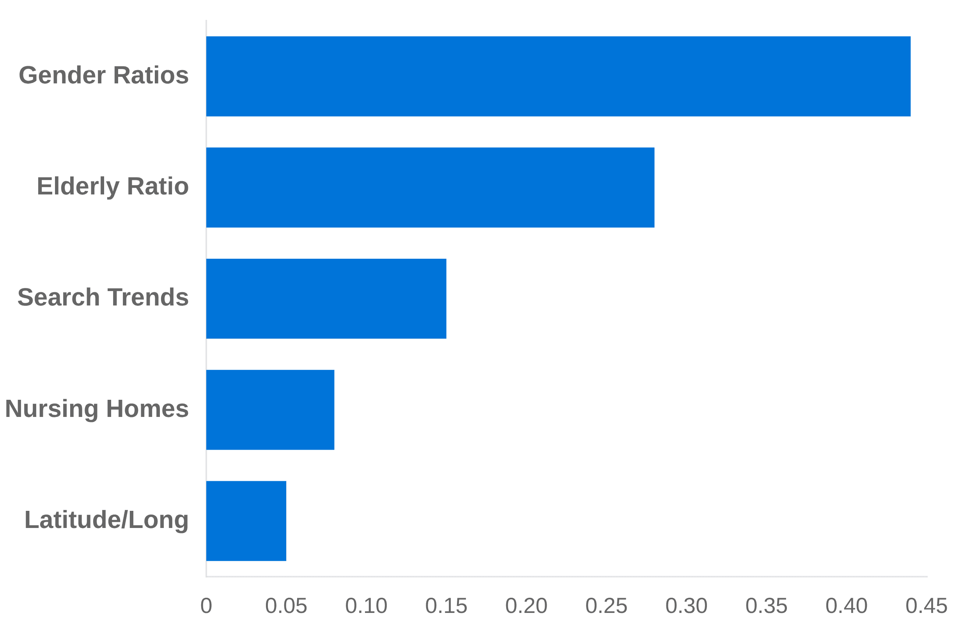
Feature Importance: What Drives the Model?
Relative Predictive Weight (GBT Model)
Primary Demographic Drivers
The model relies heavily on Gender Ratios and the Elderly Population Ratio, which represent the highest predictive weights for identifying high-risk regions.
Behavioral Signals
Search Trends for "Coronavirus" and "Flu" provide critical real-time behavioral signals that anticipate clinical case surges.
Localized Risk Multipliers
The Nursing Home Count acts as a localized risk multiplier, significantly increasing the probability of a high-risk classification in specific districts.

Slide 11
Strategic Value: Real-time Risk Assessment
Transitioning from reactive reporting to proactive risk classification enables public health officials to anticipate surges and deploy resources with surgical precision.
Data Integration
Enterprise Scalability
Actionable Policy
Combining demographic profiles, digital search behavior, and clinical data creates a robust, multi-dimensional risk profile that traditional surveillance methods miss.
Built on the PySpark distributed computing framework, the pipeline is engineered to process massive, real-time data streams for national-level monitoring.
Provides a reliable early-warning tool for evidence-based policy decisions, including targeted lockdowns and hospital capacity optimization.
Conclusion: COVID-19 Risk Classification Framework

