Slide 1

Synopsis Presentation
on
GenAI Approach for Detection of Depression.
Presented by :
Mr. Harsh Bajaj
(B.Tech CSE Final Year Sec B )
Under the Guidance of
Dr. Sneha Bohra
Department of Computer Science & Engineering
G H Raisoni University, Amravati
Academic Session: 2025-26

Slide 2
INDEX
Abstract
Introduction
Objectives
Literature Review
Problem Statement
Proposed System
Methodology
Dataset Details
Modules Description
Expected Outcomes
Conclusion
References

Slide 3
ABSTRACT

Slide 4
ABSTRACT
The proposed system aims to build an AI-powered platform that detects and responds to human emotions in real-time using facial expressions and textual input.
It combines machine learning algorithms with emotion recognition techniques to classify emotional states such as depression, anxiety, frustration, or Calmness.
Once the emotion is identified, the system generates an empathetic and supportive AI response, simulating a conversation with a caring companion.
This solution addresses the lack of emotion-aware systems in today’s AI tools and demonstrates how technology can offer basic mental wellness support.
The goal is to build an easy-to-use system that feels comforting, and human-centered.

Slide 5
INTRODUCTION

Slide 6
Introduction
In today’s fast-paced world, emotional well-being is often overlooked, especially among students and working individuals.
The proposed project introduces an AI-based Emotion Detection and Support System.
This system goes beyond traditional chatbot interactions by incorporating multimodal emotion recognition.
Techniques Include:
1. Facial emotion analysis through live camera
2. Sentiment detection from written text (e.g. typed messages)
The system dynamically evaluates the user’s current emotional state in real-time.
It then responds to the user with personalized, empathetic replies using Generative AI, helping provide basic emotional support.

Slide 7
OBJECTIVES

Slide 8
Objectives
The main objectives of this project are:
To detect human emotions such as depression, anxiety, frustration, and calmness using:
    Facial expressions
    Written text
To combine these multimodal inputs for more accurate and reliable emotional analysis.
To develop an AI-powered chatbot that provides real-time, kind, and context-aware responses based on the user's emotional state.
To ensure ease of use, allowing even non-technical users to interact comfortably with the system.

Slide 9
LITERATURE REVIEW

Slide 10
Literature Review
Method | Description | Key Findings
Multimodal Emotion Detection [1] | Emotion detection using combined signals from speech, facial expression, and textual input. | Deep learning models significantly improve accuracy when fusing multimodal signals for emotion classification.
Facial Emotion Analysis [2] | Detection of emotion from facial cues using CNN and recurrent models. | CNN + RNN models provide robust performance in capturing subtle facial expressions linked with emotional states.
Voice Tone Analysis [2] | Uses pitch, tone, vocal tension, and energy patterns from audio to detect emotional state. | Audio-based emotion detection helps identify real-time cues like stress, sadness, and anxiety with high temporal accuracy.
Emotion-Aware AI Chatbot [3] | Mental health support chatbot that generates responses based on detected emotion using Transformer-based NLP. | Transformer models provide emotionally aligned and supportive responses, aiding in early intervention and user comfort in chat systems.
Textual Sentiment Classification [4] | Detection of emotion in user comments and text using deep NLP techniques. | Hybrid models (CNN+LSTM+BERT) improve precision in detecting emotions such as anger, joy, or fear from social media texts.

Slide 11
PROBLEM STATEMENT

Slide 12
Problem Statement
To develop a system that detects user emotions using Facial expressions (via camera) and Text inputs.
To develop system that generates Supportive, Human-like responses using Generative AI to comfort or guide the user.

Slide 13
PROPOSED SYSTEM

Slide 14
Proposed System
1. Emotion Detection
2. AI Response Generation
User Input
Response Generation (LLM)
AI selects response tone
(motivaion / calming etc.)
Uses LLM to generate reply
Webcam
(face)
Text
(chat)
Pre-Processing
Display Output
Face
detection
Text cleaning (NLP)
AI based suggestions
User Input
ML/NLP model
Output: Detected Emotion

Slide 15
METHODOLOGY

Slide 16
Methodology
1. Input Capture
  Webcam will record facial expressions in real-time.
  Text Box will allow users to type messages.
2. Preprocessing
  Facial data will be converted into grayscale and normalized for emotion classification.
  Text will be tokenized, cleaned, and processed for sentiment analysis..
3. Emotion Detection
  Facial Emotion: Will be detected using CNN or OpenCV-based classifier.
  Text Emotion: Will be detected using NLP techniques like VADER/Transformers.

Slide 17
Methodology
4. Multimodal Fusion
  All 3 emotion scores will be combined using a weighted fusion algorithm.
  Final emotion state (e.g., Depressed, Angry, Calm) will be predicted.
5. AI-Based Response Generation
  The AI chatbot will generate an appropriate empathetic response.
  Responses will be emotionally supportive, context-aware, and non-robotic.

Slide 18
Dataset Details

Slide 19
Dataset Details
1. Face Emotion Dataset (FER2013-based)
Dataset:
FER2013 (Facial Expression Recognition 2013) → originally 35,887 grayscale face images (48×48 pixels).
Original Classes (7):
Angry, Disgust, Fear, Happy, Sad, Surprise, Neutral.
Mapped to 4 classes:
  Sad → Depression
  Fear + Surprise → Anxiety
  Angry → Frustration
  Neutral + Happy → Calmness

Slide 20
Dataset Details
Training / Testing Split:
  Training set: ~28,709 images
  Public test set: ~3,589 images
  Private test set: ~3,589 images
  (from Kaggle competition split).
Model Used:
CNN model stored in models/fer2013_model/face_fer2013_cnn_plus.h5.
Trained on the above split before being saved and used in our Emotion Detection System.

Slide 21
Dataset Details
2. Text Emotion Dataset (GoEmotions-based)
Dataset:
Google’s GoEmotions dataset → 58,000 Reddit comments labeled with 27 emotions + neutral.
Original Classes (27 + neutral):
e.g., joy, sadness, anger, fear, disappointment, gratitude, etc.
Mapped to 4 classes:
  Sadness, hopelessness → Depression
  Fear, worry, nervousness → Anxiety
  Anger, annoyance → Frustration
  Neutral + acceptance → Calmness

Slide 22
Dataset Details
Training / Testing Split (from GoEmotions):
  Training set: ~43,410 examples (≈ 74.5%)
  Validation set: ~5,427 examples (≈ 9.3%)
  Test set: ~10,114 examples (≈ 16.2%)
Preprocessing:
  Tokenized with HuggingFace AutoTokenizer (max_length=256, truncation + padding).
  Labels collapsed into 4-class format.
Model Used:
Fine-tuned HuggingFace AutoModelForSequenceClassification stored in:
models/goemotions_model/

Slide 23
Preprocessing

Slide 24
Preprocessing
1. Preprocessing for Text Module
Text Cleaning
  Converted all text to lowercase.
  Removed unnecessary punctuation, special symbols, and URLs.
  Emojis and informal tokens were dropped.
Tokenization
  Used HuggingFace AutoTokenizer (BERT-base style).
  Each text was split into tokens (subwords).
  Applied truncation and padding to ensure uniform sequence length.
  Max sequence length = 256 tokens.
Numerical Encoding
  Tokens converted into integer IDs using pretrained tokenizer vocabulary.
  Generated attention masks (1 = real token, 0 = padding).

Slide 25
Preprocessing
Label Mapping
Original 27 emotions + neutral collapsed into 4 classes:
  Sadness, hopelessness → Depression
  Fear, worry, nervousness → Anxiety
  Anger, annoyance → Frustration
  Neutral, acceptance → Calmness
Train-Test Split
Used official GoEmotions partition:
  Training set: ~43,410 examples (≈ 74.5%)
  Validation set: ~5,427 examples (≈ 9.3%)
  Test set: ~10,114 examples (≈ 16.2%)

Slide 26
Preprocessing
Approximate Class Distribution (after collapsing to 4 classes)
  Depression: ~16,000 – 18,000 (≈ 28–30%)
  Anxiety: ~11,000 – 13,000 (≈ 20–22%)
  Frustration: ~10,000 – 12,000 (≈ 18–20%)
  Calmness: ~15,000 – 17,000 (≈ 28–30%)

Slide 27
Preprocessing
Preprocessing work flow for Text Module
Text Input
Cleaning
Tokenization
Encoding
Label Mapping
Text Model

Slide 28
Preprocessing
2. Preprocessing for Face Module
Image Collection
  Used the FER2013 dataset with 35,887 face images.
  All images are already in grayscale and 48×48 pixels.
Resizing
  Each image is resized to 48×48 pixels (fixed size).
  This keeps the input consistent for the CNN model.
Reshaping
  Each image is reshaped into (48, 48, 1) → height, width, and 1 channel (grayscale).
  Required by CNN layers to understand the input shape.

Slide 29
Preprocessing
Label Mapping
  Original dataset had 7 emotions: Angry, Disgust, Fear, Happy, Sad, Surprise, Neutral.
  Mapped into 4 categories for our project:
    Sad → Depression
    Fear + Surprise → Anxiety
    Angry + Disgust → Frustration
    Neutral + Happy → Calmness
Encoding Labels
  Converted labels into one-hot vectors (e.g., [0,1,0,0] = Anxiety).
  This format is required for training the classifier.

Slide 30
Preprocessing
Original Kaggle split:
  Training: 28,709
  Public Test: 3,589
  Private Test: 3,589
Emotion (Mapped) | Training Images | Testing Images | Total
Depression (Sad) | ~4,800 | ~1,200 | ~6,000
Anxiety (Fear + Surprise) | ~7,600 | ~1,900 | ~9,500
Frustration (Angry + Disgust) | ~5,800 | ~1,400 | ~7,200
Calmness (Neutral + Happy) | ~10,500 | ~2,700 | ~13,200
Total | 28,709 | 7,100 | 35,887

Slide 31
Preprocessing
Preprocessing work flow for Face Module
Live Face Detection
Normalization (0–1 scale)
Reshaping (48 x 48 x 1 )
Label Mapping (7 – 4 classes )
One-Hot Encoding
Face CNN Model

Slide 32
MODULES DESCRIPTION

Slide 33
Modules Description
Module 1: Emotion Detection
Objective:
To analyze user inputs from multiple sources to accurately detect emotional states such as depression, anxiety, or neutral.
Inputs Captured:
Webcam → Facial Expression
Microphone → Voice Tone
Text Box → Written Message
Processing:
All three inputs are analyzed using a Multimodal Machine Learning approach.
Models such as CNN (for face), SVM/RF (for voice), and NLP-based classifiers (for text) are used.
A combined prediction is made to classify the emotional state.
Output:
Detected emotion (e.g., Depressed, Anxious, Neutral, Angry, etc.) is passed to the next module.

Slide 34


Module 1:
Emotion Detection
Start
Capture User Input
Webcam → Facial expression
Text Box → Written message
Emotion Detection
1) Analyze all 2 inputs
2) Use ML/NLP model to predict emotion
No
Emotion Detected?
yes
↳ Continue

Slide 35
Modules Description
Module 2: AI Response Generation
Objective:
To provide empathetic and meaningful responses based on the detected emotional state using AI techniques.
Strategy Selection:
Based on emotion, appropriate response strategies are selected:
Depressed → Motivational / Reassuring Tone
Anxious → Calming / Supportive Tone
Neutral → Friendly / Informative Tone
AI Response Generation:
Use Generative AI (LLM like GPT) to craft contextual replies.
Response is displayed on screen as chatbot message.
User Loop:
User can interact with the chatbot in follow-up questions.
Feedback or further detection can loop back as needed.

Slide 36
Module 2:
AI Response Generation
Input:
Detected Emotion
↳ From previous module
Select Response Strategy
Motivational reply for depressed
Calming tone for anxiety
Generate Reply (Using LLM / GenAI)
Display Chatbot Response
↳ Show on user screen as text
Ask for Follow-up
End / Loop

Slide 37
EXPECTED OUTCOMES

Slide 38
Expected Outcomes
1. Accurate Emotion Detection:
The system will be capable of identifying emotional states like depression, anxiety, stress, or neutrality using multimodal input — facial expressions and written messages.
2. AI-Driven Empathetic Response:
The AI chatbot will generate emotion-sensitive replies, tailored to the user's detected state (e.g., motivational responses for depression, calming replies for anxiety).
3. Real-Time Interaction:
Users will receive responses and suggestions instantly via a user-friendly interface, improving overall emotional support experience.
4. Promotes Mental Health Awareness:
Encourages the use of AI for mental well-being, showcasing how technology can be used for early emotional intervention.

Slide 39
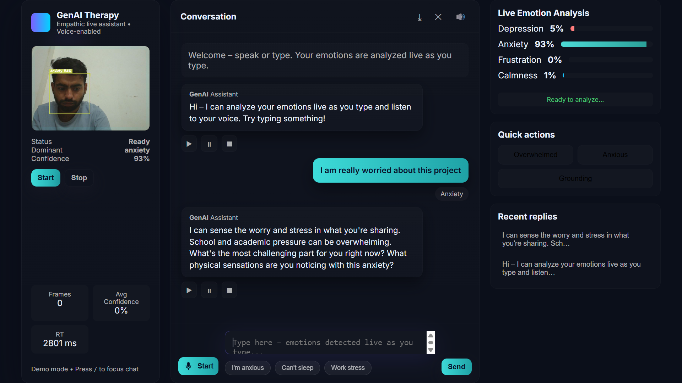
Actual Outcome
Credit: Image sourced through Google.

Slide 40
CONCLUSION

Slide 41
Conclusion
By integrating facial expression analysis and text sentiment analysis,
proposed system provides a multi-modal approach to identifying emotional states such as depression or anxiety.
Once the emotion is identified, the system responds with empathetic AI-generated replies, ensuring that the user receives comforting, motivational, or calming support — tailored to their mental state.
The project bridges the gap between traditional chatbot systems and human emotional intelligence, making interaction more personalized, sensitive, and impactful.
The user-friendly prototype demonstrates the potential of AI in early emotional support, showing how even basic support can enhance mental well-being.

Slide 42
REFERENCES

Slide 43
References
[1] M. Alhudhaif, D. Alghazzawi and A. Alsulaiman,“Emotion Detection Using Deep Learning in a Multimodal Context: A Systematic Review,” IEEE Access, vol. 11, pp. 4873–4895, 2023. doi: 10.1109/ACCESS.2023.3242326
[2] S. Garg, A. K. Singh, and S. K. Dwivedi, “Facial Expression and Voice Tone Based Emotion Detection Using Convolutional and Recurrent Neural Networks,” 2022 IEEE Int. Conf. on Computer Applications, pp. 134–139. doi: 10.1109/ICCA56725.2022.10012910
[3] Y. Liu, J. Yang and F. Zhu, “Emotion-Aware AI Chatbot for Mental Health Support Using Transformer-Based NLP,” 2023 IEEE Conference on AI in Healthcare, pp. 66–72. doi: 10.1109/AIHealth.2023.3141182
[4] N. Sharma and V. K. Jain, “Text-Based Emotion Detection from User Comments Using Hybrid Deep Learning Models,” IEEE Transactions on Affective Computing, Early Access, 2024. doi: 10.1109/TAFFC.2024.3388917

Slide 44
References
[5] R. Dutta, M. Chatterjee and P. Kumar, “Multimodal Emotion Recognition: A Comparative Study on Speech, Text, and Facial Cues,” IEEE Access, vol. 10, pp. 122947–122961, 2022. doi: 10.1109/ACCESS.2022.3217834
[6] A. Sen and S. Roy, “AI-Powered Recommendation System Based on Mood and Sentiment Analytics,” 2023 IEEE Int. Conf. on Data Science and Engineering, pp. 48–55. doi: 10.1109/ICDSE.2023.3290764
[7] H. Li, Y. Zhou and F. Wang, “Emotion-Driven Conversational Agent Using Deep Reinforcement Learning,” IEEE Transactions on Cognitive and Developmental Systems, vol. 15, no. 2, pp. 355–364, June 2023. doi: 10.1109/TCDS.2023.3257890
[8] A. Mishra, K. Agarwal, and S. Kumar, “Design of an Emotion-Aware Mental Health Chatbot Using Hybrid NLP Techniques,” IEEE Int. Conf. on AI & Human-Computer Interaction, 2022, pp. 89–94. doi: 10.1109/AIHCI55272.2022.9960472

Slide 45
THANK YOU…!!!

