Slide 1
SIMULATION DESIGN
The environment in our simulation is a two-dimensional array of cells modelled against the progression of time.
Time is expressed as ‘generations’ which represent a discrete step in time.
In each new generation, the state of every cell in the environment is updated according to a set of rules.
Each cell is square in shape.

Slide 2
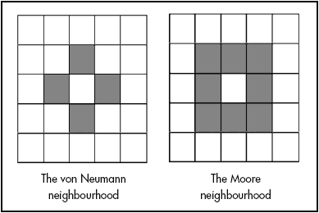
SIMULATION DESIGN
Each cell has a Moore neighbourhood consisting of its immediate cell neighbours.
Each cell can have one of three states: empty (Black), prey (green) and predator (red).

Slide 3
ASSUMPTIONS
All predators are identical to one another, there are no differences between individuals.
All prey are identical to one another, there are no differences between individuals.
Prey can only die to predation , there are no other forms of death for them.
Predators can only die of starvation, there are no other forms of death for them.

Slide 4
ASSUMPTIONS
It is assumed that prey have an unlimited supply of food and do not suffer from any other variables which may kill them (disease, accidents, other predators etc). This means that the prey population should grow exponentially in the absence of predators and fill up all available space. This falls in line with the Lotka-Volterra model.
The predator and prey exist in a vacuum, no other entities are present in this system.
Every cycle is the same and executes the same set of rules. Time-related cycles such as day/night do not exist.
When predators eat prey, prey change to an empty space which the predator then fills with another predator automaton.

Slide 5
Attempt-1 Rules
Prey (1) | Predator (2) | Blank (0)
if (predNeighbors > 0) next[x][y] = 2; //Eaten else next[x][y] = board[x][y]; //Stasis | if (preyNeighbors < 1) next[x][y] = 0; //Starvation else next[x][y] = board[x][y]; //Stasis | if (predNeighbors > 0 || preyNeighbors == 0) next[x][y] = 0; //Remain Blank else if (preyNeighbors > 0) next[x][y] = 1; //Breed prey

Slide 6

Attempt-1 Result
giving the prey some form of detection and evasion or
giving the predators a limit to their hunger so they will not hunt the prey to extinction

Slide 7
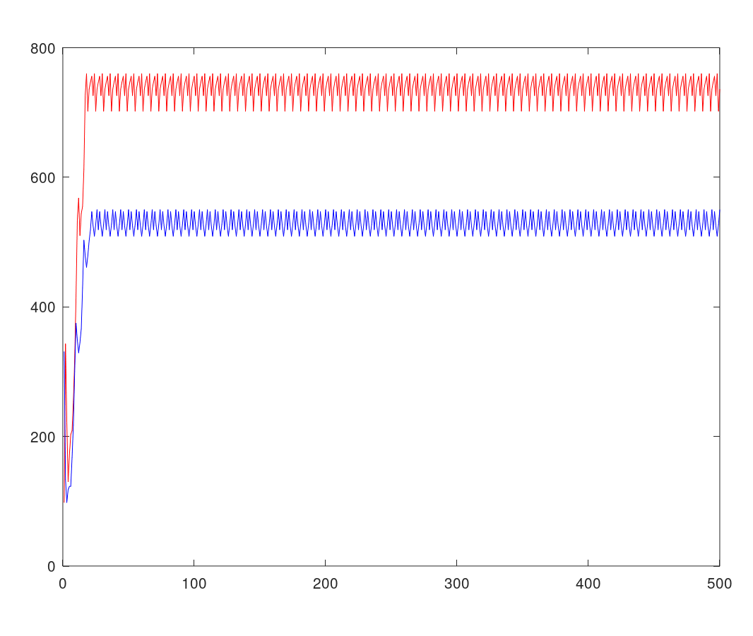
Attempt-1 Result
giving the prey some form of detection and evasion or
giving the predators a limit to their hunger so they will not hunt the prey to extinction

Slide 8
Changes made
Added a stochastic Monte Carlo picker method to determine the probability that a predator successfully catches its prey. Using random function, chance of predator catching prey is implied. It represents the a in aNP of Lotka-Volterra model. it provided a way for prey to escape the predators.
float r = random(0,1);
if (r > catchRate) rtn = 1;
else rtn = 2;

Slide 9
Attempt-2 Rules
Prey (1) | Predator (2) | Blank (0)
if (predNeighbors > 0) next[x][y] = eatEscapePicker(); //Hunted else next[x][y] = board[x][y]; //Stasis | if (preyNeighbors >0) next[x][y] = 0; //moving else if (preyNeighbors < 1) next[x][y] = 0; //Starvation else next[x][y] = board[x][y]; //Stasis | if (predNeighbors >= 2 && preyNeighbors >= 1) next[x][y] = 2; //Breed pred else if (preyNeighbors >= 2) next[x][y] = 1; //Breed prey else next[x][y] = 0; //Statis

Slide 10
Attempt-2 Result
presents the accurate representation of the Lotka-Volterra model produced by this simulation,
Catch rate - 0.33

Slide 11
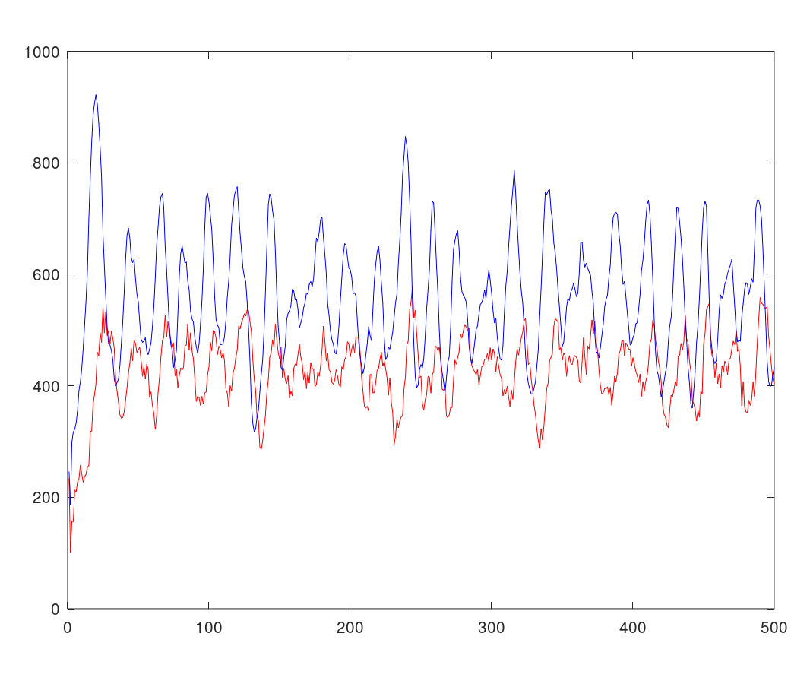
Attempt-2 Result
presents the accurate representation of the Lotka-Volterra model produced by this simulation,
Catch rate - 0.33

Slide 12
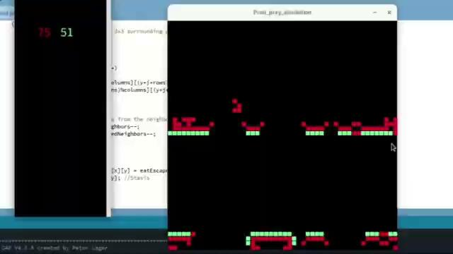
Other Results

Slide 13
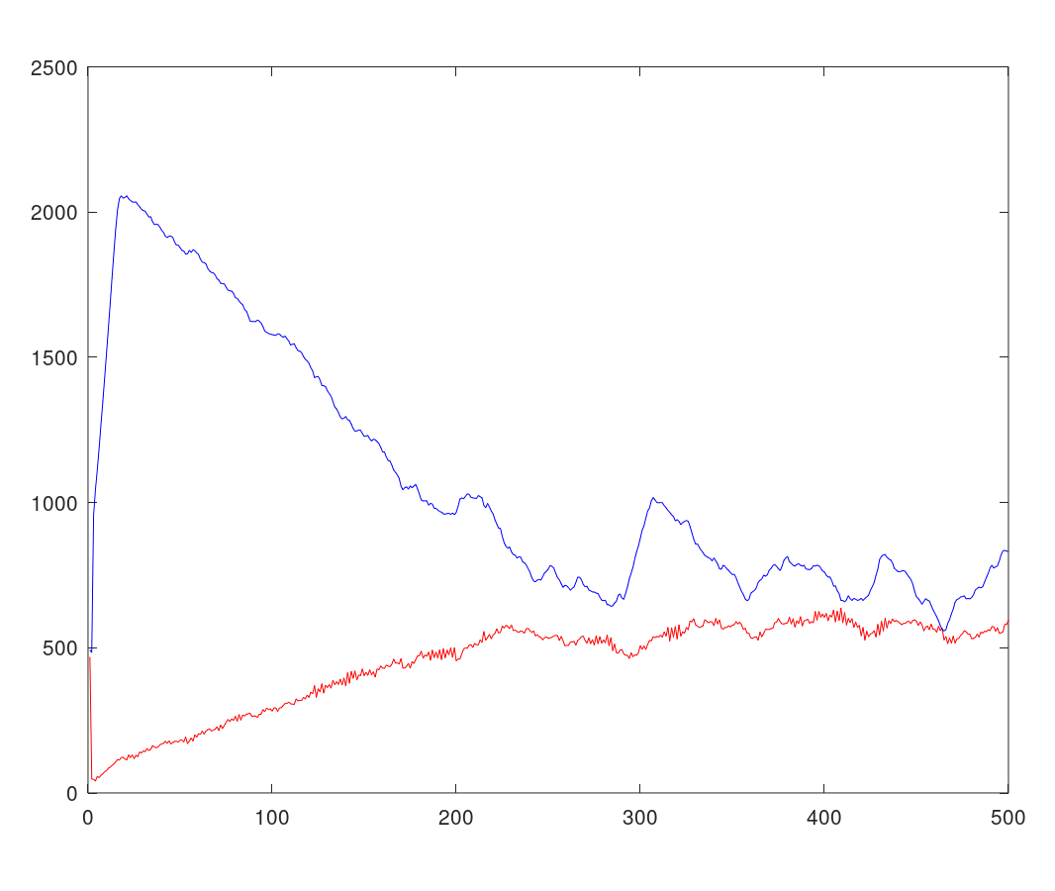
Result
With very low catch rate, prey can escape easily.
Catch rate - 0.05

Slide 14
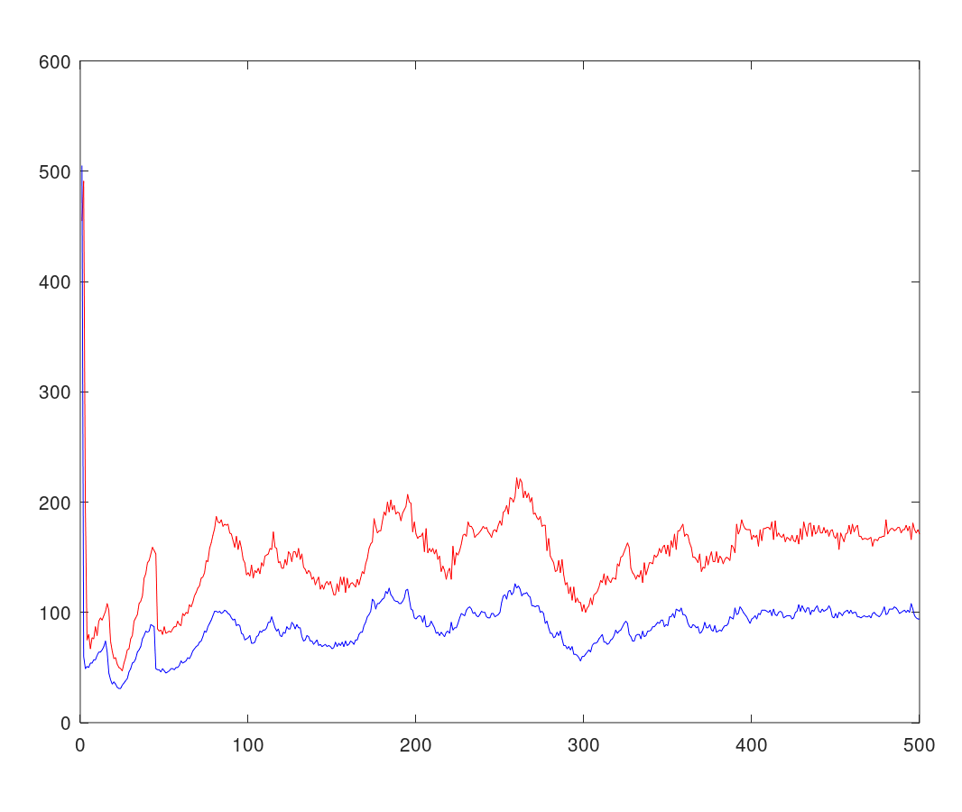
Result
With very high catch rate, prey can escape easily.
Catch rate - 0.95

Slide 15
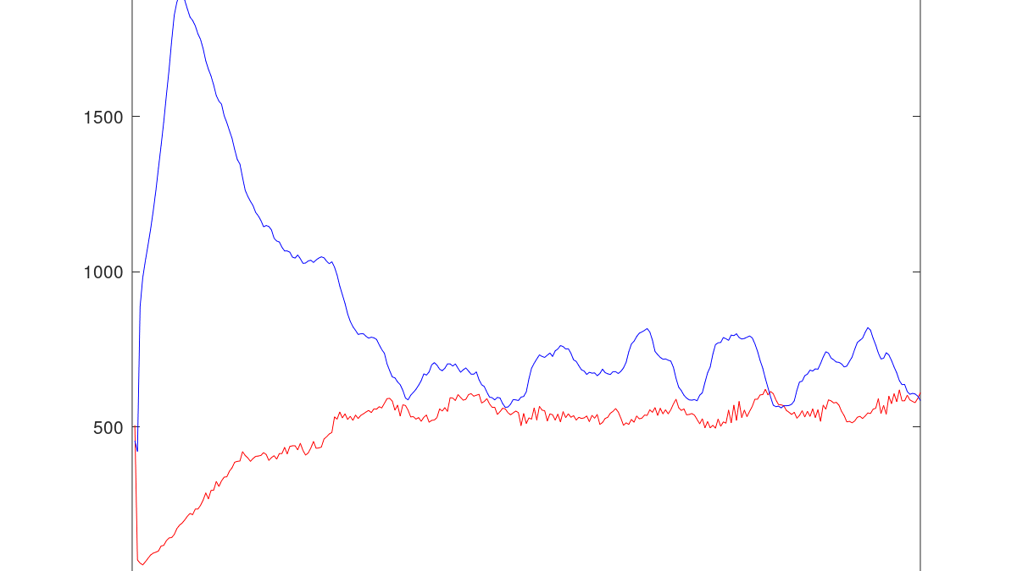
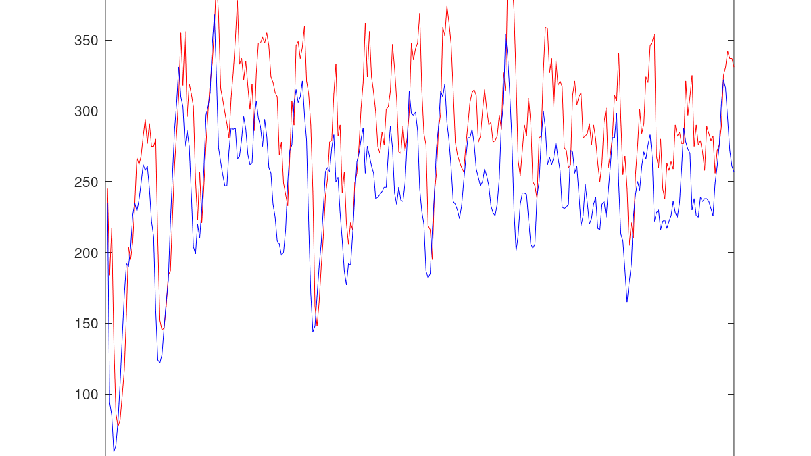
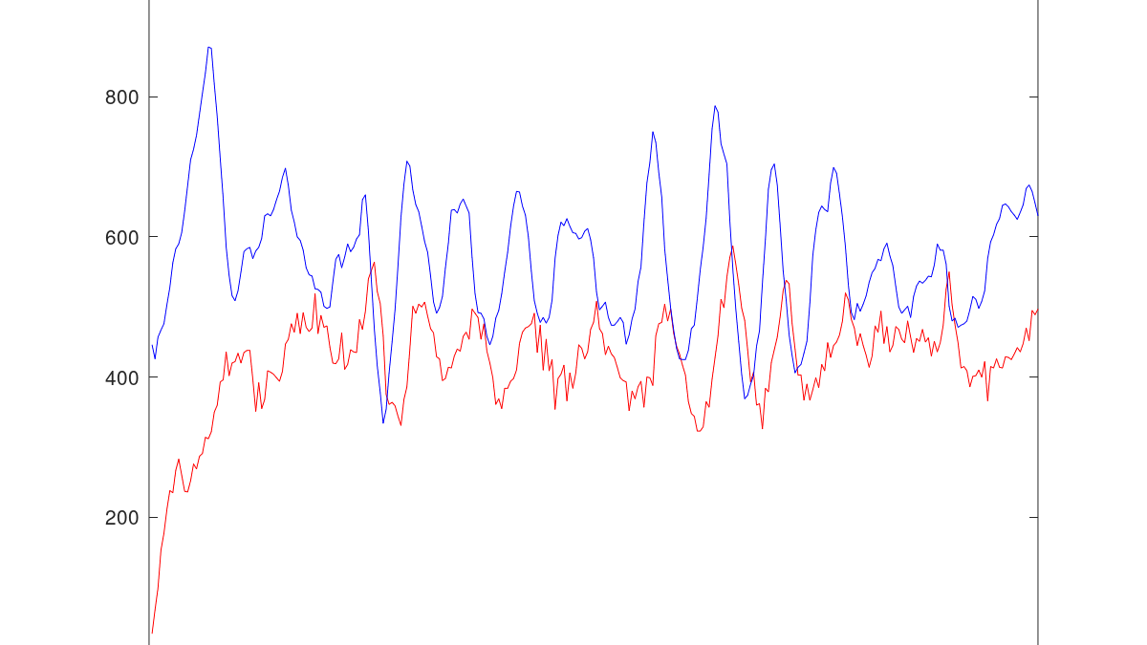
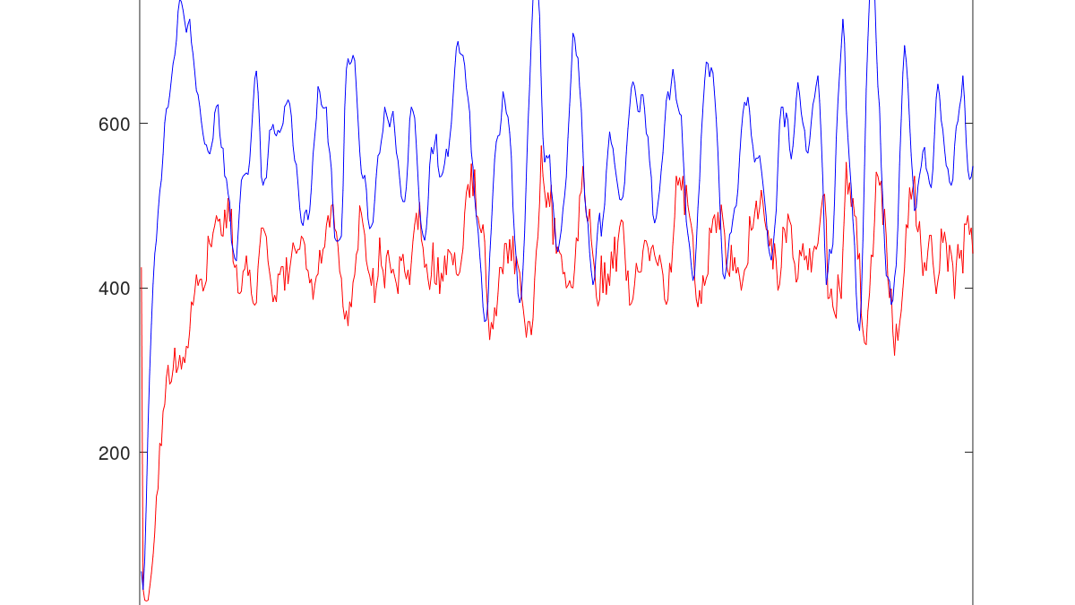

Slide 16
Features of Simulation
Prey population is typically higher than the predator population.
The system is stable.
The system exhibits oscillation.
The prey curve leads the predator curve.
The predator population tracks the peaks of the prey population.

Slide 17
Elementary cellular automaton pattern
one-dimensional array of cells, each of which holds a single binary value, either 0 or 1.
The automaton is given an initial configuration, and then progresses through other configurations in a sequence of discrete time steps.
At each step, all cells are updated simultaneously.
A pre-specified rule determines the new value of each cell as a function of its previous value and of the values in its two neighboring cells.

Slide 18
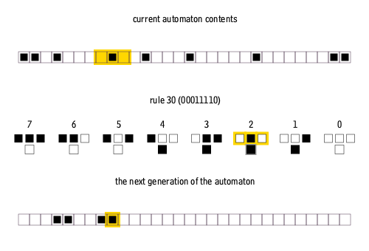

Slide 19
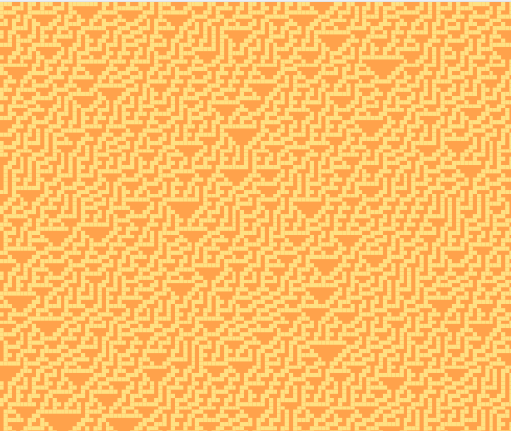
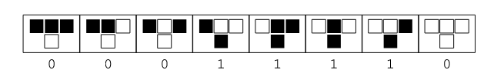
Rule - 30
00011110 = 30

Slide 20
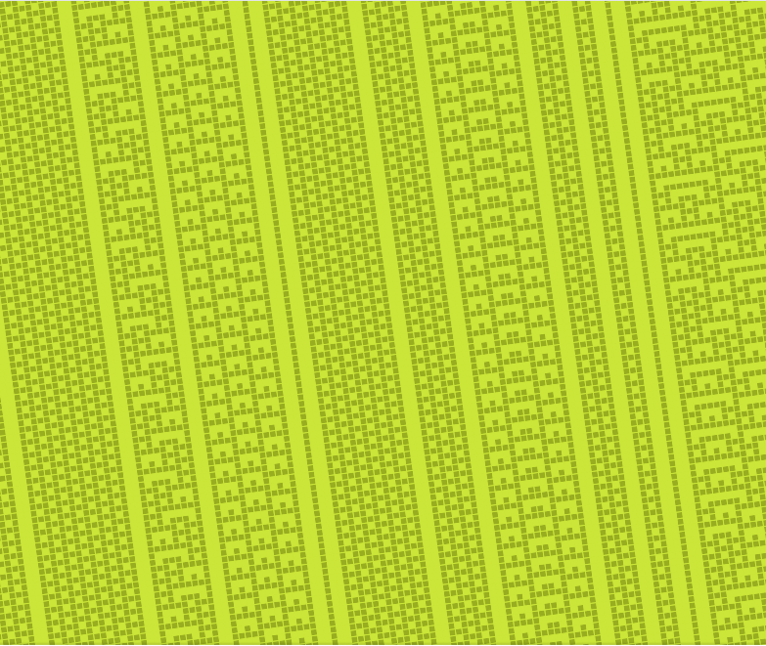

Rule - 73

Slide 21
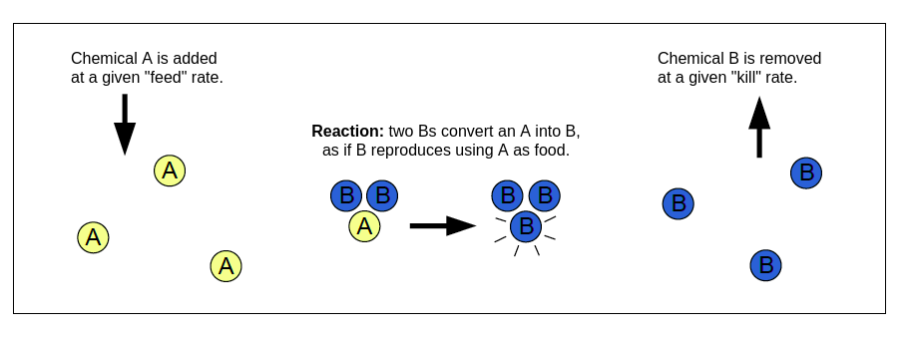
Reaction-Diffusion

Slide 22
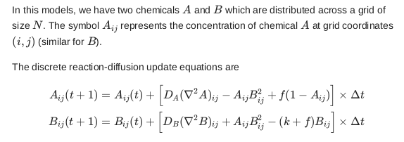
Gray Scot model

Slide 23
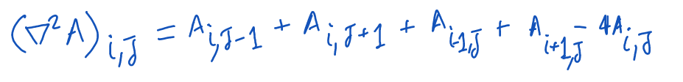
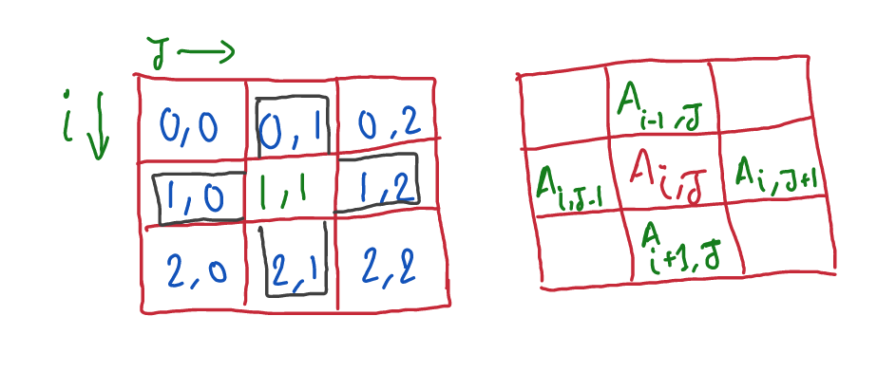
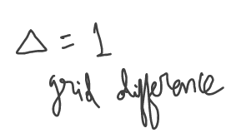
Discrete Laplacian

Slide 24
Discrete Laplacian
def discrete_laplacian(M):
L = -4*M
L += np.roll(M, (0,-1), (0,1)) #right neighbor
L += np.roll(M, (0,+1), (0,1)) #left neighbor
L += np.roll(M, (-1,0), (0,1)) #top neighbor
L += np.roll(M, (+1,0), (0,1)) #bottom neighbor
return L
numpy.roll shifts all elements in a certain direction,
with periodic boundary conditions.

Slide 25
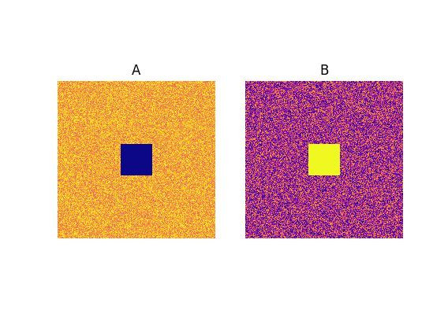
Initial conditions
We start with a configuration where on every grid cell, there's a lot of chemical A, so the concentration is high.
Let's assume there's only a bit of B everywhere.
We disturb with a square in the center of the grid.

Slide 26
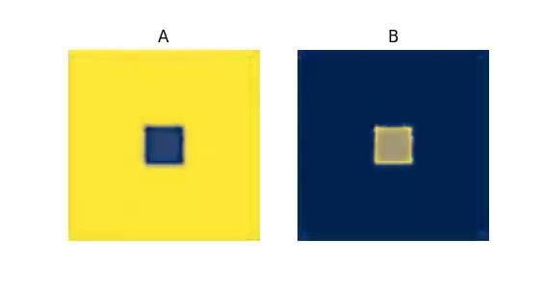
Patterns
DA, DB,f, k = 0.16, 0.08, 0.060,0.062 DA, DB,f , k= 0.14, 0.06, 0.035, 0.065

Slide 27
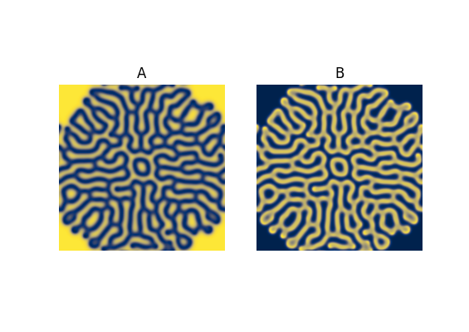
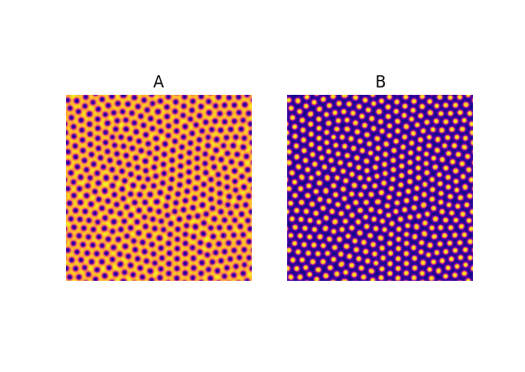
Patterns
DA, DB,f, k = 0.16, 0.08, 0.060,0.062 DA, DB,f , k= 0.14, 0.06, 0.035, 0.065

Slide 28
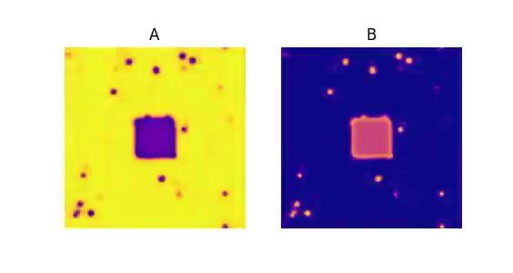
Patterns
DA, DB, f, k = 0.15, 0.034, 0.035, 0.057 DA, DB, f , k= 0.16, 0.09, 0.050, 0.055

Slide 29
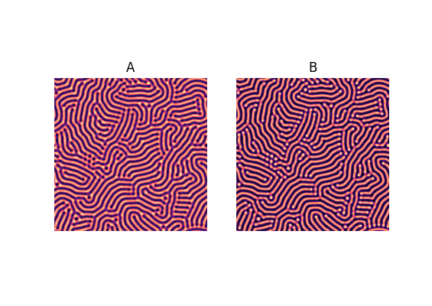
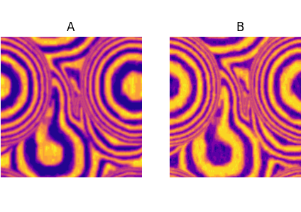
Patterns
DA, DB, f, k = 0.15, 0.034, 0.035, 0.057 DA, DB, f , k= 0.16, 0.09, 0.050, 0.055

