Slide 1
Sentient Scripters

Slide 2
Base Difference Procedure Vectorization
Presented By:- Sentient Scripters
Date: 30\04\2024
Name | Roll Number
Harsh Bari | P23DS004
Aditi Das | P23DS008
Aniket Pasi | P23DS020

Slide 3
Contents
Introduction
Base Difference Procedure Vectorization (BDP Vectorization)
Architecture of BDP
Working of BDP
Comparison with existing Vectorization Methods
Future Work
References

Slide 4
1. Introduction

Slide 5
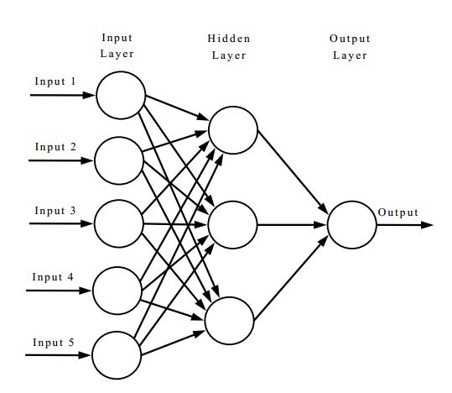
Artificial Neural Network (ANN)
A | B | C
2 | 4 | 5
7 | 9 | 10
8 | 1 | 9

Slide 6
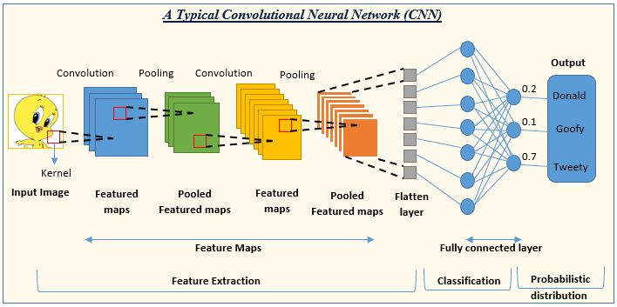
Convolutional Neural Network (CNN)

Slide 7

Recurrent Neural Network (RNN)
“Apple is red”
“My name is Arsh”
“Roses are red”
“Sky is blue”
“I play football”

Slide 8
2. Base Difference Procedure Vectorization (B.D.P. Vectorization)

Slide 9
Example
A pilot has fear of height.
A doctor has fear of height.
A dentist gets cavity due to excessive sweets.
A watchman gets cavity due to excessive sweets.

Slide 10
3. B.D.P. Vectorization Architecture

Slide 11
BDP Vectorization Architecture
BDP Vectors (150 d)
Output
Size = n x 150
3. Add Statistics
2. BDP Operation
BDP Vectorization
1. Preprocessing
Input Dataset (Corpus)
Size = n sentences

Slide 12
Preprocessing
Lowercasing
Removing External Links
Removing Punctuation Marks
Removing Special Characters
Removing Stop Words
Tokenization
Lemmatization using NLTK
POS Tagging using NLTK

Slide 13
BDP Operation
100d Vectors
op_vector = base_word
for tag in postags:
if tag==Noun:
op_vector = (op_vector + (1 + similarity(base_word, tag_word)) * tag_word) / 1.5
else:
op_vector = (op_vector + tag_word) / 2
return (base_word - op_vector)
get base_word
Tag 1
Tag 2
Tag 3
Tag n-1
Tag n

Slide 14
Adding Statistics
150d Vectors
PosTag Proportion
Special Character Counts
Token Counts
Size
100d Vectors

Slide 15
4. Working of B.D.P Vectorization

Slide 16
Example 1
Y
A pilot has fear of height.
A doctor has fear of height.
POS Tagging
A / Determiner
(Pilot, Doctor) / Noun
Has / Verb
Fear / Noun
Of / Preposition
Height / Noun
Pilot
Deviated Pilot
Deviated Doctor
X
Z
Doctor

Slide 17
Example 2
A dentist gets cavity due to excessive sweets.
A watchman gets cavity due to excessive sweets.
POS Tagging
A / Determiner
(Dentist, Watchman) / Noun
Gets / Verb
Cavity / Noun
Due / Preposition
To / Preposition
Excessive / Adjective
Sweets / Noun
Y
Deviated Dentist
Dentist
Watchman
X
Deviated Watchman
Z

Slide 18
6. Comparison with Existing Techniques

Slide 19
Comparison with standard techniques
 | BDP Vectors | Average Word Embeddings | Doc2Vec | BERT
precision | 0.7553 | 0.7641 | 0.7800 | 0.7550
recall | 0.9583 | 0.9011 | 0.8216 | 0.8845
f1-score | 0.8447 | 0.8269 | 0.8002 | 0.8146
accuracy | 0.8572 | 0.8353 | 0.7995 | 0.8230
vector creation time | 4.66 mins | 13.532 secs | 9.752 mins | 4 hours plus
Confusion matrix | [[6334 2051] [275 7623]] | [[6407 1978] [703 7195]] | [[6541 1844] [1420 6478]] | [[6331 2054] [827 7071]]

Slide 20
7. Future Work

Slide 21
Future Work
Need more accurate and light weight word embeddings before performing the operations on words of sentences.
Need more precision in capturing the position of each POS tags.
Determine separate actions for each type of POS tags.

Slide 22
8. References

Slide 23
References
ANN: https://tex.stackexchange.com/questions/132444/diagram-ofan-artificial-neural-network
CNN: https://www.analyticsvidhya.com/blog/2022/01/convolutionalneural-network-an-overview/
RNN: https://tex.stackexchange.com/questions/494139/how-do-idraw-a-simple-recurrent-neural-network-with-goodfellows-style
Dataset: https://www.kaggle.com/datasets/nikhiljohnk/tweets-with-sarcasm-and-irony
Github: https://github.com/harshbari-153/BDP-Vectorization

Slide 24


