Slide 1
RESEARCH FOUNDATION & 36-HOUR BUILD ROADMAP
Statutory Protections & Multimodal Literature | Rapid Hackathon Execution Architecture
50/50 SPLIT
📚 RESEARCH, LEGAL FRAMEWORK & REFERENCES
⏱️ 36-HOUR HACKATHON BUILD ROADMAP
🏛️ Statutory Legislation
• PoA Act 1989 / 2015: Offense taxonomy & relief norms (GoI Gazette)
• PCR Act 1955: Deterrence against civil discrimination
• NHAA 14566: National helpline SOPs & grievance data
🏥 Clinical & Privacy
• Tele-MANAS: National crisis triage & referral (14416)
• Mental Health Act 2017: Sec 115 suicide decriminalization
• DPDP Act 2023: Dual consent & zero voice retention
H 00 – 06 | Foundation & Security
• Next.js 14 + FastAPI setup
• DPDP consent modal & PII filter
• Twilio dialer sandbox init
🚩 M1: Audio Bridge Live
H 06 – 12 | Dual AI Pipeline
• Whisper STT speech stream
• Librosa pitch & jitter extractor
• RoBERTa distress classifier
🚩 M2: Core AI Active
H 12 – 18 | Decision Fusion
• Multimodal fusion (40% A + 60% T)
• Dynamic 0-100 Trauma Index
• Severity tier thresholding
🚩 M3: Risk Engine Tested
H 18 – 24 | Agent & Auto-SOS
• LangGraph ReAct + MedGemma
• Twilio 112 emergency auto-dial
• Nearby NGO & therapist lookup
🚩 M4: Autonomous SOS
🧠 NLP & Clinical LLM
• RoBERTa / DistilBERT: Emotion & distress text classification
• IndicBERT & MuRIL: Indian multilingual embeddings
• MedGemma & ReAct: Clinical grounding & LangGraph SOS
🎙️ Speech & Prosody
• Whisper STT: Noise-resilient speech transcription
• Librosa Biomarkers: Pitch (F0), jitter & vocal tremor
• Late Fusion: Weighted 40% Audio + 60% NLP fusion
H 24 – 30 | Counsellor Portal
• Live WebSockets triage queue
• Acoustic stress meter & PoA tags
• 1-Click counselor override
🚩 M5: Human-in-Loop UI
H 30 – 36 | Testing & Finale
• Noisy audio stress test
• Zero-storage DPDP privacy audit
• Live demo rehearsal & pitch
🏆 M6: Grand Finale Ready
🛡️ Validated: 4 Statutory Acts & Helplines | 6 Peer-Reviewed AI Citations
🎯 Key Gates: H12 (Audio MVP) • H24 (Agent SOS) • H30 (Portal) • H36 (Pitch)
SVI Production Stack: Next.js 14 • FastAPI • Whisper • Librosa • RoBERTa • MedGemma • DPDP Act 2023 Compliant

Slide 2
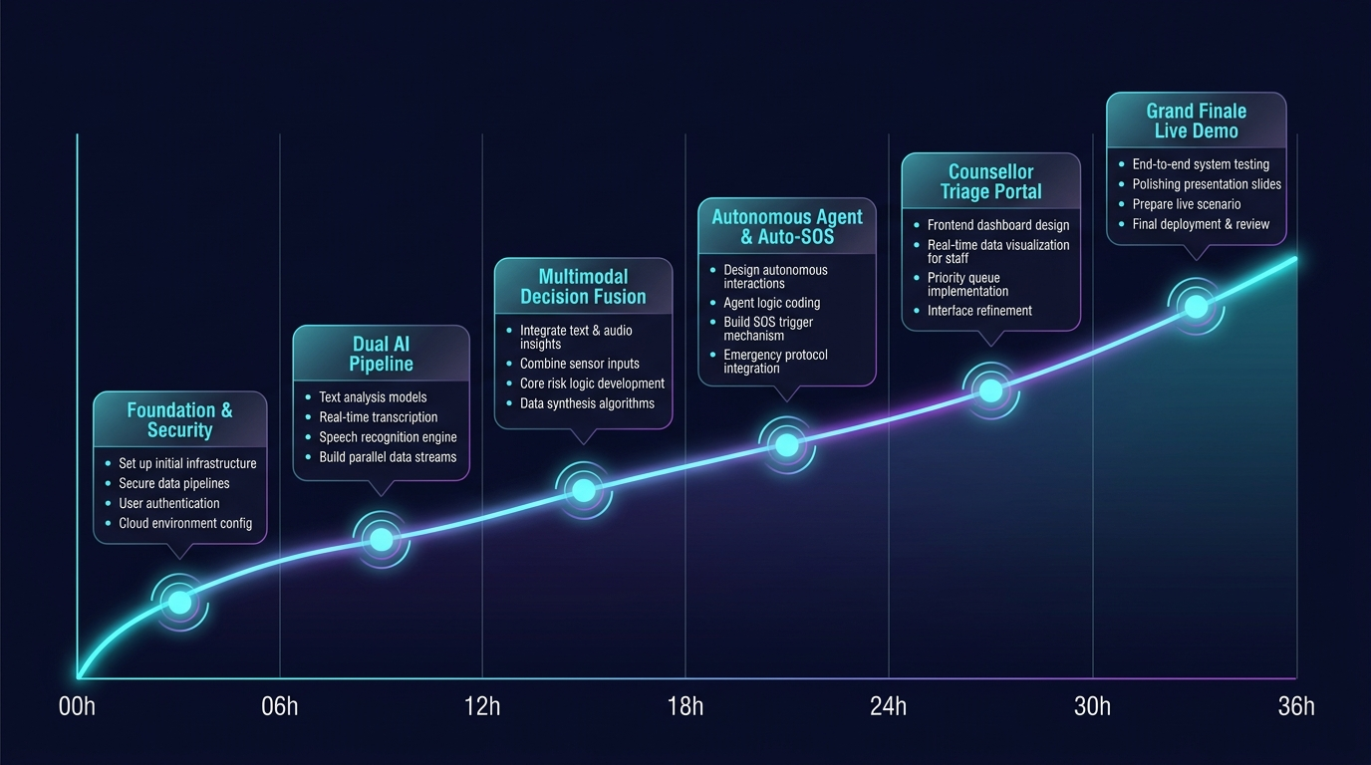
36-HOUR SPRINT PROGRESSION: LINE GRAPH TIMELINE
Ascending Technical Progress Curve from Monorepo Setup to Grand Finale Demo
LINE GRAPH

