Slide 1
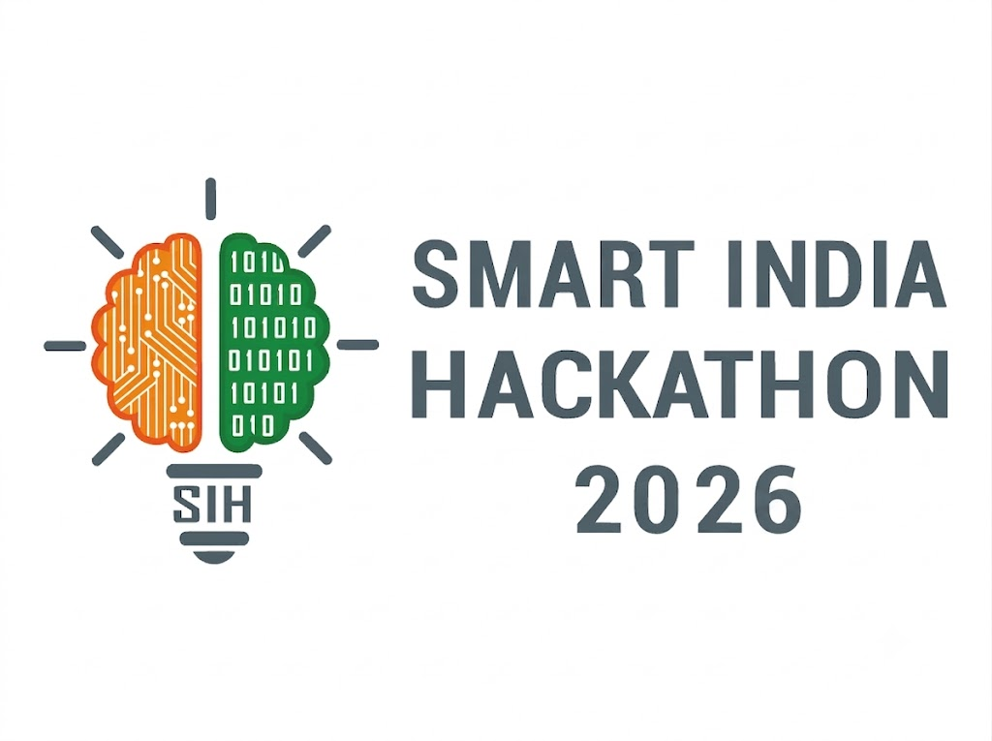

SMART INDIA HACKATHON 2026
TITLE PAGE
• Problem Statement ID — SIH26093
• Problem Statement Title — AI-Based Real-Time Stress & Trauma Assessment Module for Victims Accessing NHAA (14566) & Integrated Portal
• Theme — MedTech / BioTech / HealthTech | Category — Software
• Team ID — [Team ID / e.g. 12345] | Team Name — Veom Vegas
• Institution — SAGE University, Indore
👥 Team Members & Roles:
1. [Member 1 (Team Leader)] — AI/ML & System Architecture
2. [Member 2] — Full-Stack & FastAPI Backend Engineer
3. [Member 3] — Frontend & UI/UX Specialist
4. [Member 4] — Speech Processing & NLP Engineer
5. [Member 5] — Security, DB & Cloud Infrastructure
6. [Member 6 (Female)] — Data Analyst & Ethics/Compliance
🎓 Mentor: [Mentor Name] — Faculty / Domain Expert, SAGE University

Slide 2

IDEA TITLE
IDEA/SOLUTION: SVI — Smart Victim Intelligence
“From Listening to Meaningful Support”
Problem Resolution:
➤ Detects emotional distress during the interaction itself.
➤ Helps identify high-risk cases earlier.
➤ Supports prioritization of cases requiring human attention.
➤ Converts unstructured conversations into actionable assessment insights.
➤ Enables consistent assessment across helpline and digital channels.
SVI is an AI-powered real-time stress and trauma assessment module integrated with NHAA (14566) and its digital access channels. It analyzes voluntary interactions such as text, voice and user responses to identify indicators of emotional distress and trauma.
The proposed system will :
➤ Perform real-time stress and trauma assessment using AI/ML.
➤ Analyze textual and conversational signals to identify indicators such as distress, fear, anxiety, hopelessness and emotional overload.
➤ Use multimodal AI to combine linguistic, conversational and, where consented, voice-based indicators.
➤ Generate a non-diagnostic stress/trauma risk score and categorize cases into appropriate severity levels.
➤ Provide early alerts and priority indicators to authorized support personnel.
➤ Recommend appropriate support pathways, such as counselling, human intervention or emergency escalation based on predefined protocols.
➤ Maintain privacy, consent and secure handling of sensitive information throughout the assessment.
Unique Value Propositions:
➤ Real-time AI-assisted assessment.
➤ Multimodal stress & trauma analysis.
➤ Early identification of high-risk cases.
➤ Human-in-the-loop intervention.
➤ Multilingual and accessible design.
➤ Privacy-first and consent-driven architecture

Slide 3
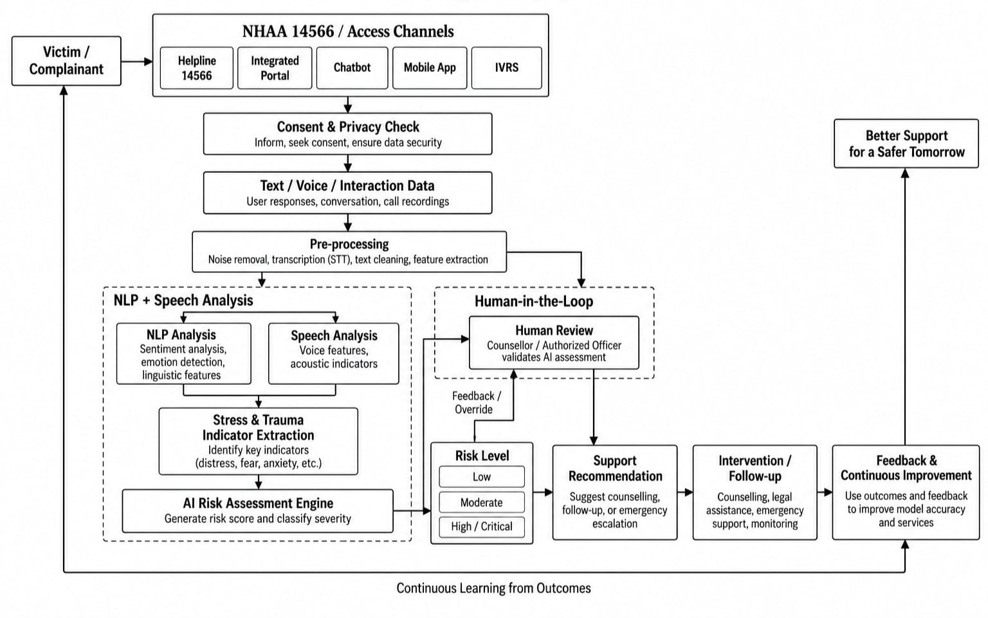
Work Flow
Tailwind CSS • MongoDB • Express • React • Node.js
PyTorch • Keras • Python • OpenCV
Google Maps • GraphQL • AWS • Django

Slide 4
FEASIBILITY AND VIABILITY
Feasibility of the Idea:
Potential Challenges, Risks and its overcomings:
➢ Technical Feasibility: Uses established AI technologies including NLP, speech processing, transformer models and classification algorithms, making real-time assessment technically achievable.
➢ Operational Feasibility: The module can operate as an assessment layer over existing NHAA channels without requiring complete replacement of the current infrastructure.
➢ Scalability: A modular API-based architecture allows deployment across:
14566 Helpline → Web Portal → Chatbot → Mobile App → IVRS
➢ Economic Feasibility: Cloud-based deployment and modular AI services can reduce infrastructure requirements while allowing resources to scale according to demand.
➢ AI Bias & Accuracy:-
Challenge: Emotional expressions vary across languages, cultures and individuals.
❖ Solution: Diverse datasets, continuous evaluation, fairness testing and human validation.
➢ False Positives / False Negatives:-
Challenge: AI may incorrectly classify emotional states.
❖ Solution: Use AI as a decision-support system, not an autonomous diagnostic system, with human review for high-risk cases.
➢ Privacy & Data Security:-
Challenge: Victim conversations can contain extremely sensitive information.
❖ Solution: Consent-based collection, encryption, access control, data minimization and secure storage.
➢ Multilingual & Dialect Variation:-
Challenge: Users may communicate in different Indian languages and dialects.
❖ Solution: Multilingual NLP/STT models with language detection and continuous dataset improvement.
➢ Adversarial / Manipulated Responses:-
Challenge: Users may unintentionally or intentionally provide incomplete information.
❖ Solution: Combine multiple interaction signals and use confidence scores instead of relying on a single response.

Slide 5
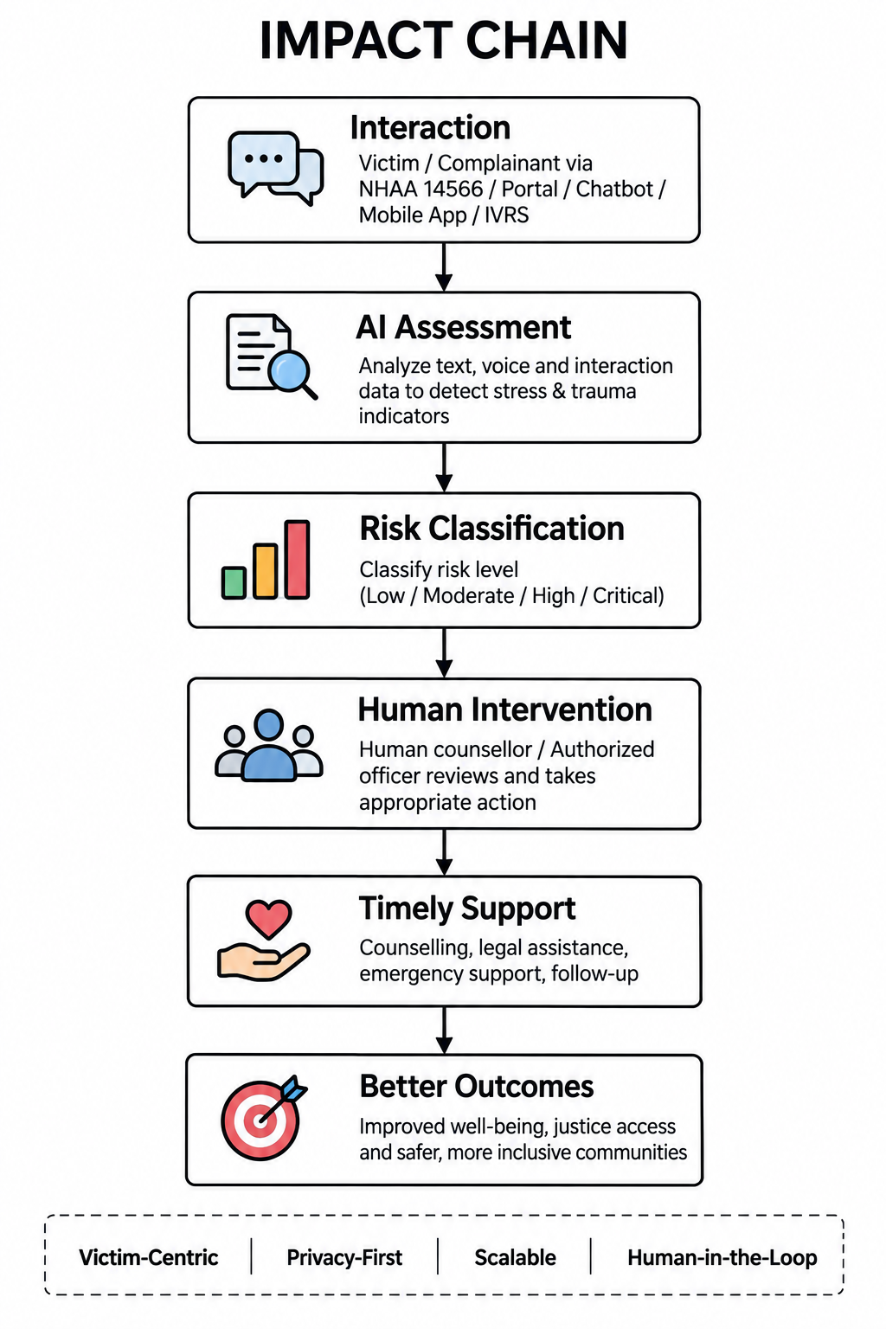
IMPACT AND BENEFITS
Early Detection of Distress:
➢Impact: Real-time identification of stress and trauma indicators during victim/complainant interactions.
➢ Benefit: Enables earlier attention to individuals who may require additional support.
Prioritized Human Intervention:
➢ Impact: AI-generated risk levels help authorized personnel identify cases requiring urgent attention.
➢ Benefit: Better allocation of limited counselling and support resources.
Improved Victim Support:
➢ Impact: Converts conversational information into structured support insights.
➢ Benefit: More responsive and personalized assistance while reducing dependence on manual screening alone.
Multilingual Accessibility:
➢ Impact: Supports interactions across diverse linguistic backgrounds.
➢ Benefit: Makes AI-assisted assessment accessible to a wider range of complainants.
Data-Driven Decision Making:
➢ Impact: Aggregated, privacy-preserving analytics can reveal patterns in stress and trauma indicators.
➢ Benefit: Helps authorities improve support services, resource planning and intervention strategies.
Scalability & Integration:
➢ Impact: API-based architecture can integrate with multiple NHAA access channels.
➢ Benefit: A single assessment engine can support helpline, portal, chatbot, mobile and IVRS ecosystems.

Slide 6
RESEARCH AND REFERENCES
# Problem & Domain Research:
➤ National Helpline Against Atrocities (14566) resources
➤ Ministry of Social Justice & Empowerment resources
➤ Government resources related to SC/ST protection and grievance redressal
➤ Research on psychological impact of violence, discrimination and trauma
TECHNICAL APPROACH
AI /ML TECHNOLOGIES
NLP / LLM
Transformer-based language models • LLM-based conversational analysis
Sentiment & emotion analysis • Context-aware distress detection
# AI / ML Research:
➤ Transformer-based NLP models
➤ Emotion and sentiment recognition
➤ Stress detection from conversational data
➤ Speech emotion recognition
➤ Multimodal affective computing
➤ Risk classification and human-in-the-loop AI
SPEECH AI
Speech-to-Text • Voice feature extraction • Prosodic/emotional indicators
MACHINE LEARNING
Stress classification • Trauma-risk classification
Risk scoring • Anomaly/high-risk detection
APPLICATION TECHNOLOGIES
Frontend: React / Next.js
Backend: FastAPI / Node.js
Database: PostgreSQL
Authentication: Secure role-based access
API Layer: REST APIs
Deployment: Cloud infrastructure
#Technology Research:
➤ Python
➤ PyTorch / TensorFlow
➤ Hugging Face
➤ FastAPI / Node.js
➤ React / Next.js
➤ PostgreSQL
➤ Cloud infrastructure
ADDITIONAL TECHNOLOGIES
Python • PyTorch / TensorFlow • Hugging Face
OpenAI-compatible LLM/API layer (if used) • Speech-to-Text model
Encryption • Secure logging • Analytics dashboard

Slide 7
PROTOTYPE & DEMONSTRATION
1️⃣ Victim Complainant Portal (Web / Mobile / IVRS)
• Multimodal Ingestion: Accepts real-time microphone voice input, text chat, and automated telephony (IVRS) streams.
• Informed Consent & Privacy Check: Mandatory, accessible consent modal before session begins. Zero raw audio persistence for victim protection.
• Real-Time Speech-to-Text: Whisper STT transcribes speech into Hindi & English with live acoustic prosody extraction.
• Empathetic Non-Intrusive UX: Clean, calm interface designed to minimize cognitive load and panic during high-stress reporting.
• Emergency SOS Escalation: Immediate one-tap access to emergency police & medical assistance if immediate harm is detected.
2️⃣ Real-Time Counselor Triage Dashboard
• Prioritized Case Queue: Calls dynamically ranked by AI Risk Score: Critical (Red), High (Orange), Moderate (Yellow), Low (Green).
• Live Acoustic Distress Meter: Tracks vocal pitch variability, intensity, and tremor in real-time alongside conversational sentiment.
• Trauma & Urgency Indicators: Flags specific distress triggers (e.g., helplessness, physical threat, acute panic) from live conversation.
• Human-in-the-Loop Override: Counselor retains full authority to validate, adjust, or dismiss AI assessment scores.
• Protocol-Driven Support Pathways: Instant automated routing to legal aid, psychiatric counseling, or immediate field intervention.

Slide 8
36-HOUR TIMELINE & EXECUTION PLAN
⏱️ Hours 00 – 06: Architecture & Streaming Gateway
• Initialize FastAPI & Next.js repo with Tailwind
• Build WebSocket audio streaming & session manager
• Implement consent gate & PII masking pipeline
⏱️ Hours 06 – 14: AI Multimodal Engine
• Integrate Whisper STT (Hindi & English speech)
• Deploy Librosa acoustic prosody extractor (pitch/jitter)
• Load RoBERTa/DistilBERT distress NLP classifier
⏱️ Hours 14 – 22: Risk Scoring & Triage Engine
• Multimodal fusion algorithm (Text 60% + Audio 40%)
• Calculate non-diagnostic trauma score (0-100)
• Dynamic triage queue prioritization logic
⏱️ Hours 22 – 28: Counselor Dashboard & Workflows
• Live queue UI with real-time WebSocket updates
• Interactive stress meter & distress indicator breakdown
• Counselor override & 1-click referral pathways
⏱️ Hours 28 – 34: Security Hardening & Testing
• Bias & fairness evaluation across varied accents
• Synthetic audio stress testing & load simulation
• End-to-end security audit (RBAC, zero-storage)
⏱️ Hours 34 – 36: Demo Polish & Viva Rehearsal
• End-to-end live caller simulation demo
• Fail-safe offline fallback caching
• Final pitch alignment & judge Q&A readiness
🎯 KEY GRAND FINALE MILESTONES: Hour 12: Core MVP Live | Hour 24: End-to-End Multimodal System Integrated | Hour 30: Stress-Tested & Demo Ready

