Slide 1

Department of Information Technology
A.P. Shah Institute of Technology G.B.Road,Kasarvadavli, Thane(W), Mumbai-400615
UNIVERSITY OF MUMBAI
Academic Year 2019-2020

Slide 2
A Project Report on
AUTOMATIC TIMETABLE GENERATOR USING GENETIC ALGORITHM
Submitted in partial fulfillment of the degree of
Bachelor of Engineering(Sem-8)
in
INFORMATION TECHNOLOGY
By
Harsh Bhanushali(16104043) Greshma Sapra(16104038) Surbhi Saroliya(16104037)
Under the Guidance of
Ms. Rujata Chaudhari Ms. Nahid Shaikh

Slide 3
1.Project Conception and Initiation

Slide 4
1.1 Abstract
Time table generation is tedious job.
The project will generate time table automatically thereby saving time required to design manually.
The system will take various inputs like number of subjects, teachers, workload of a teacher, semester priority of subject. By relying on these inputs, it will generate possible time tables for working days of the week for teaching faculty.
Generate timetable automatically in such a way that that their timings do not overlap.
The traditional hand operated method of time table is very time consuming

Slide 5
1.2 Objectives
To reduce the load on Time table co-ordinator, as it's time consuming and it takes lots of effort.
To optimize the use of the resources such as teachers, labs and classrooms, etc and get the best use of the IT infrastructure.
To minimize the manual intervention in creation of the timetable.
Generates multiple useful views from timetable.
To make timetable system generic so that it can work equally well for different Schools, Colleges and Universities.

Slide 6
1.3 Literature Review
Paper Title : On line helpdesk for college departmental activities.
Authors : Asha,V.G.,&Babu,K.N.R.M.(2017).
Publicationdetails : 2017 International Conference on Intelligent Computing and Control Systems (ICICCS).
Findings : Timetable generation using Genetic Algorithm
Advantages : Accurate and gives output in short time.
Disadvantages : Complex Algorithm, time consuming.

Slide 7
Literature Review
Paper Title : A study on heuristic timetabling method for faculty course timetable problem.
Authors : Bong ChiaLih,SzeSanNah,&Bolhassan,N.A.(2015).
Publication details : 2015 9thInternational Conference on Itin Asia(CITA).
Findings : Timetable generation using Genetic Algorithm with two-heuristic approach.
Advantages : Gives a better solution.
Disadvantages : Complex Algorithm, time consuming

Slide 8
Literature Review
Paper Title : An investigation of timetable satisfaction factors for a practical university course timetabling problem.
Authors : Yang,X.F.,Ayob,M.,&Nazri,M.Z.A.(2017).
Publication details : 2017 6th International Conference on Electrical Engineering and Informatics(ICEEI).
Findings : Timetable generation using Scheduling Algorithm
Advantages : Moderate result.
Disadvantages : There is no optimal solution.

Slide 9
1.4 Problem Definition
Timetable generation manually requires time and it’s difficult for the person to handle all the constrains that need to be considered.
Utilization of the resources cannot be done completely due to multiple constrains.
Above problem will be handled by the software, as we will be predefining all the constrains in our system and provide a proper utilization of the resources.

Slide 10
1.5 Scope
Separate timetable for the individual class, faculty and labs will be generated automatically by this system.
The project reduces time consumption and the pain in framing the timetable manually.
The project is developed in such a way that, no slot clashes occur providing features to tailor the timetable as of wish.
Additional features that is included in the project is that there is no headache of giving much input.
This system can be used by Schools and Colleges to create Time-Table.

Slide 11
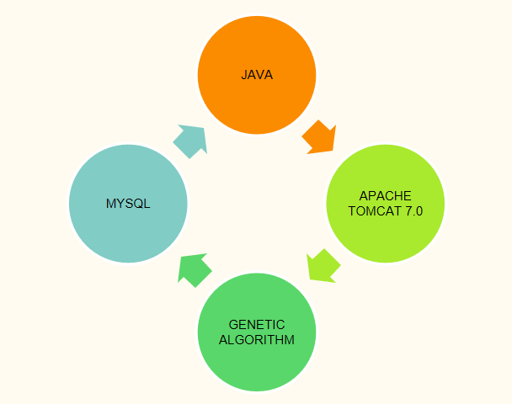
1.6 Technology stack

Slide 12
1.7 Benefits for environment & Society
It will be beneficial for the environment by saving papers and ink on basic level.
The stress of making timetable manually sometimes irritates the person which in some or other way effects the society.
The human time will be saved.

Slide 13
2. Project Design

Slide 14
2.1 Proposed System
System will take the basic inputs such as subjects, classrooms, laboratories, faculties, semester through load sheet.
These inputs will be processed and further it will be validated and the system will check whether its requirements is fulfilled or not.
The system generates the timetable which if approved will be stored in the database.

Slide 15
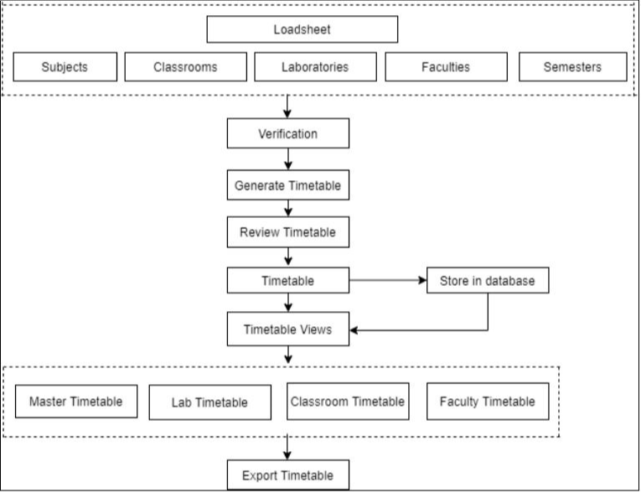
2.2 Design(Flow Of Modules)

Slide 16
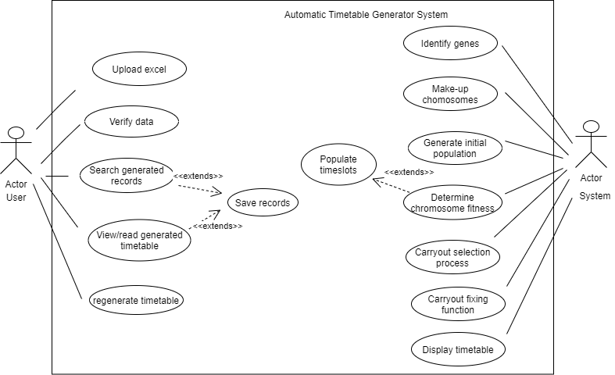
2.3 Description Of Use Case
Use case provides an easier way for understanding
the roles of the actors to the different users involved in
project.
In this project there are two actors, one is actor
User which performs various tasks such as upload excel, verify data, view/read generated
timetable etc.
Another actor is System which performs various
tasks such as identify genes, generate initial population,
display timetable etc.

Slide 17
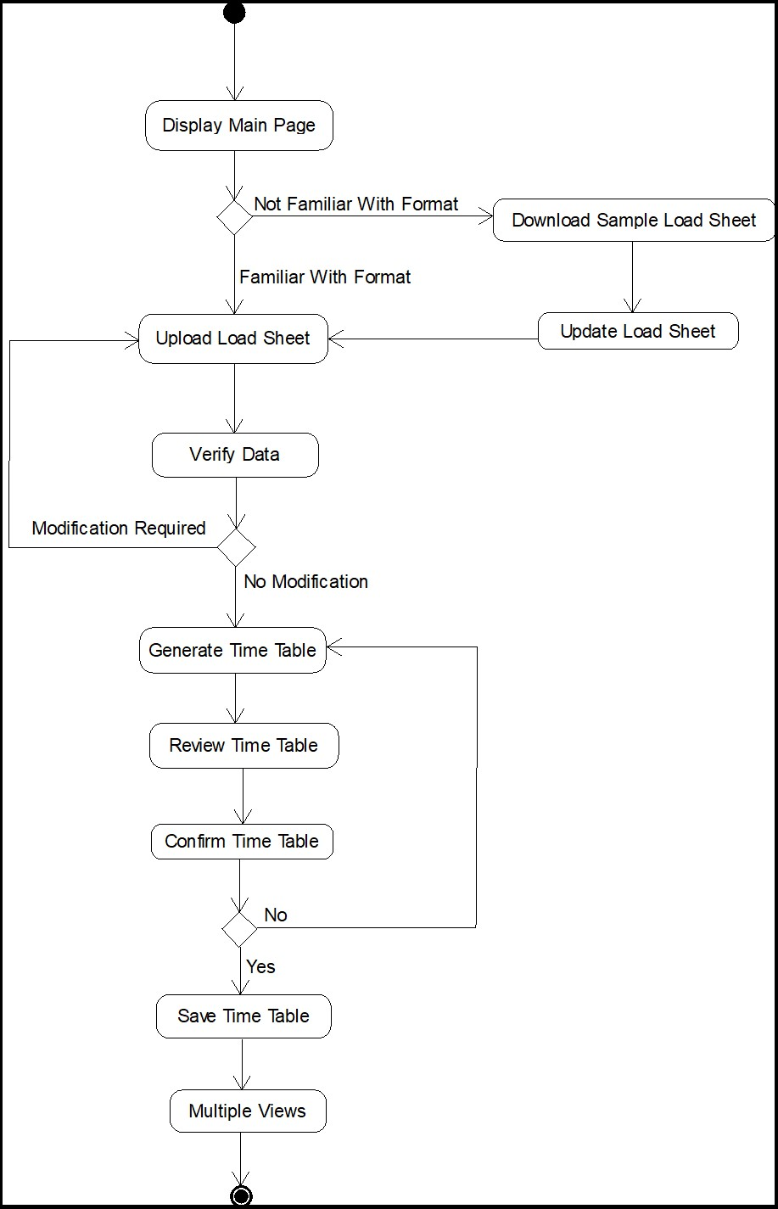
2.4 Activity diagram

Slide 18
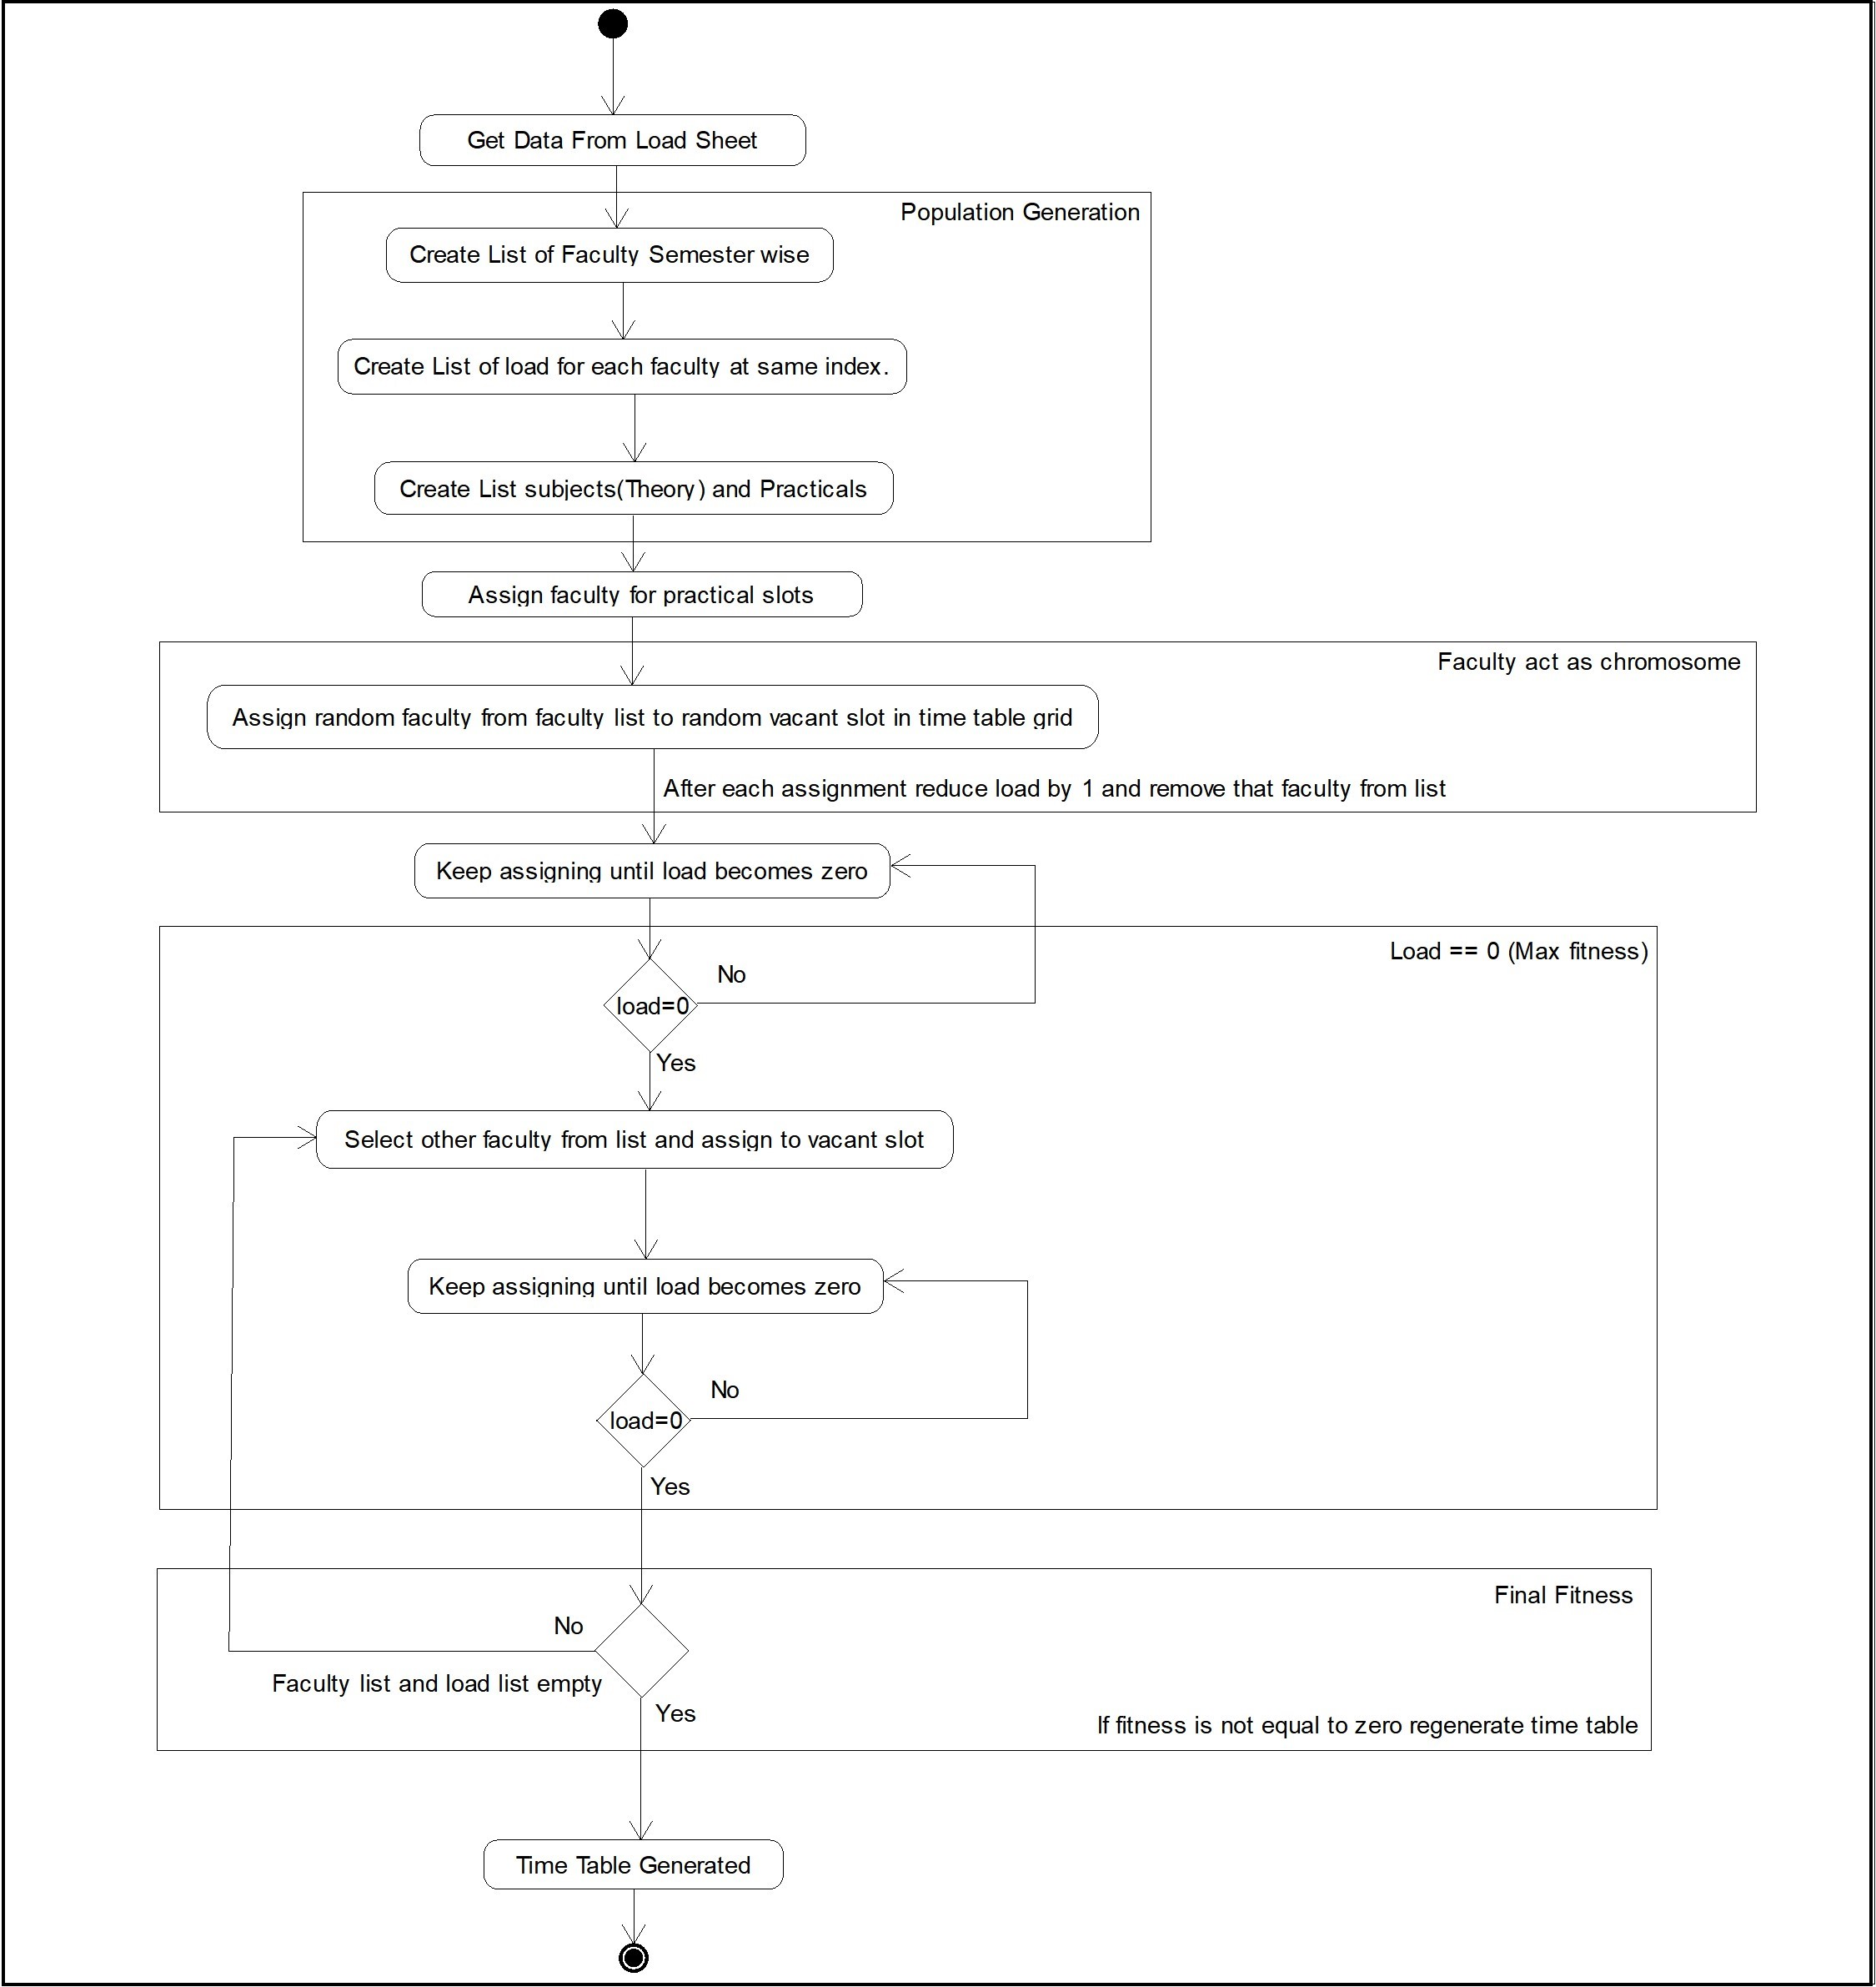
2.4 Activity diagram to Generate TimeTable

Slide 19
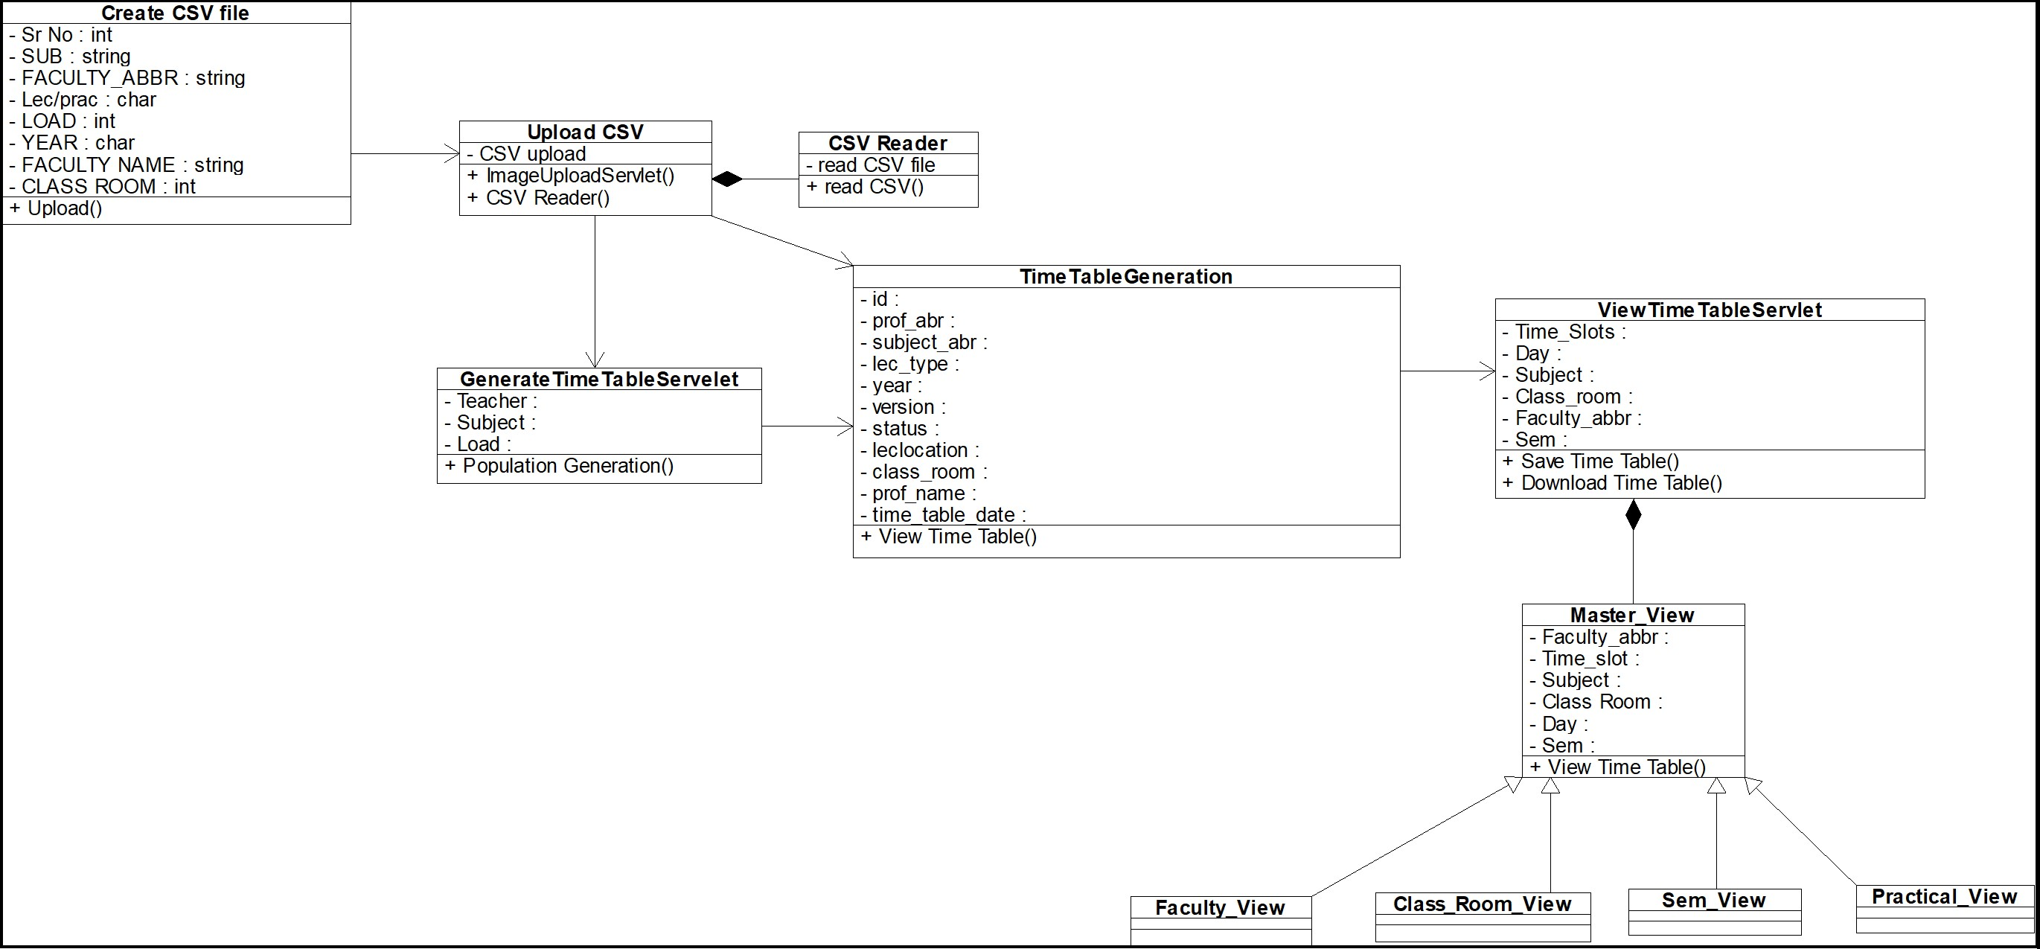
2.5 Class Diagram

Slide 20
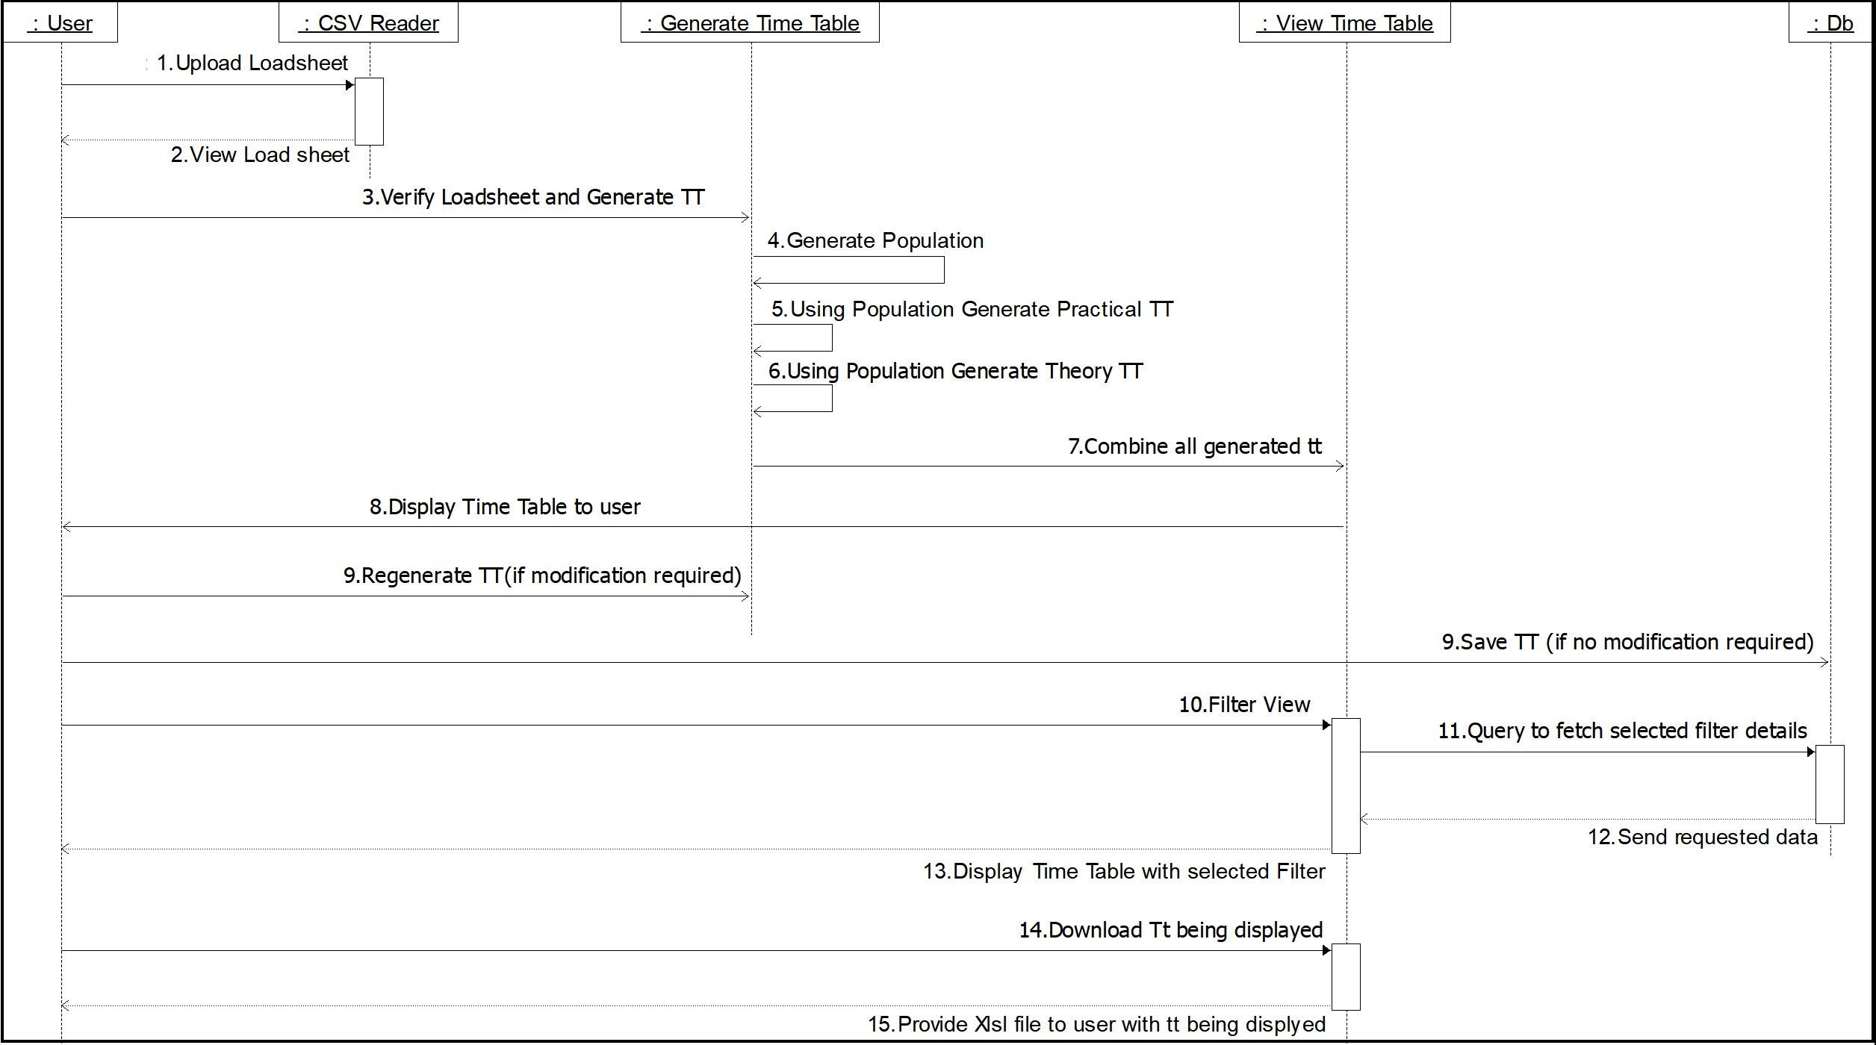
2.6 Sequence Diagram

Slide 21
2.6 Module-1
CSV Uploading
Downloadable required format has been included on the page.
User can modify the data and upload the csv file with all the set of data.
CSV reader library is used to read the csv file and further the data is stored in list and arrays.

Slide 22
Module-2
Data Verification
The CSV file data is shown on GUI to user for verification.
The user has option to verify or modify data.
Once, the user verifies the data, it is sent to GA for processing.

Slide 23
Module-3
GENETIC ALGORITHM
The data received from csv is used for population generation on faculty basis.
From the generated population the algorithm picks up random value which is known as chromosome ,which in our case is faculty name, load of faculty, lecture type (theory(l)/practical(p)).
This chromosome are arranged in multiple combinations on the grid of timetable,and once all the faculties are assigned for their loads the final timetable is generated.

Slide 24
Module-4
Timetable view
Time table generated by GA will be displayed here and user will be asked to approve or regenerate the time table.
If the user doesn’t likes the arrangement he/she can regenerate it,this will result in re-running of GA for the same data but with new result.
If user approves the timetable generated,it will be stored in database and available to user at few clicks.

Slide 25
2.7 References
1. Asha,V.G.,&Babu,K.N.R.M.(2017).
On line helpdesk for college departmental activities. 2017 International Conference on Intelligent Computing and Control Systems (ICICCS).
https://ieeexplore.ieee.org/document/8250600/
2. Yang,X.F.,Ayob,M.,&Nazri,M.Z.A.(2017).
An investigation of timetable satisfaction factors for a practical university course timetabling problem. 2017 6thInternational Conference on Electrical Engineering and Informatics(ICEEI).
https://ieeexplore.ieee.org/document/8312409
3. BongChiaLih,SzeSanNah,&Bolhassan,N.A.(2015). A study on heuristic timetabling method for faculty course timetable problem. 2015 9thInternational Conference on ITin Asia(CITA).
https://ieeexplore.ieee.org/document/7349832

Slide 26
3. Conclusion and Future Scope

Slide 27
Conclusion
Automizes the process of generating the timetable taking into consideration all the basics constraints kept in mind while generating the timetable manually, it uses genetic algorithm steps to implement the process.
The system is efficiently generating the timetable fulfilling all the requirements and that to in few minutes, which in manual process took hours for same output to be generated.
To use the system there is a basic input format which needs to followed to get the algorithm working, any place where the input format is followed, this system can be used. For example, it can be used by all institutes, schools, etc.

Slide 28
Future Scope
Implementation of various constraints like Aptitude slots, PBL(Project Based Learning) activities, Mentoring slots(same for every semester), Departmental and Institutional electives.
If required working on security factor.
Assignment of slots for various activities for diﬀerent initiatives taken by the institute.
Generation of special timetable i.e. one day timetable or occasional timetable.

Slide 29
Thank You

