Slide 1

Department of Information Technology
A.P. Shah Institute of Technology
G.B.Road,Kasarvadavli, Thane(W), Mumbai-400615
UNIVERSITY OF MUMBAI
Academic Year 2019-2020

Slide 2
A Project Report on
Novel Framework Smart Library
Submitted in partial fulfillment of the degree of
Bachelor of Engineering(Sem-7)
in
INFORMATION TECHNOLOGY
By
Pravin Jaiswal(16104058)
Mohit Jain(16204033)
Sanjog Mashde(15204006)
Under the Guidance of
Prof. Kaushiki Upadhyaya

Slide 3
1.Project Conception and Initiation

Slide 4
1.1 Abstract
The basic idea behind the project is to develop a library in which there is no queue for books.To reduce the work of librarian and also want to reduce or save the time of both librarian as well as student also.In our project there is reccomendation system which you don’t see in traditional libraries. You can search book by author name,publication,chapter so it will recommend you the best book for that particular subject you will also find the book as a level wise like beginner,intermediate and advance. You will send the book request to admin in the case you are at home and you want a book which is important for exam and thier is only 10 books so you can send a request to librarian he will register a book by your name and it will also calculate the fine.

Slide 5
1.2 Objectives
Online book issue.
A search column to search availability of books.
Borrowing and returning function.
Scan ID number of members using QR code scanner.
Using QR scanner to borrowing books.
Scan QR code of member using QR scanner.
Member record menegement.
Studewnt login page where student can find books issued by him/her and date of return.
Scan report using date from and date to.

Slide 6
1.3 Literature Review
Development of an Intelligent Web Interface to Online Library Catalog Databases.
Authors: Danny C. C. Poo| Christopher S.G. KHOO | Glenn HONG
Publication :2018 International Conference on Inventive Research in Computing Application(ICIRCA)
Advantage: To help users search library catalog’s on the Internet more effectively.

Slide 7
1.3 Literature Review
Library in Everyone’s Pocket With reference to Bundelkhand University App
Author: Mohit Gupta | Sridevi Jetty
Publication : 2018 International Conference on Information and Communication technology.
Advantage:There is a rapid increase in the number of users who uses internet on mobile App and web apps.

Slide 8
1.3 Literature Review
National University Library System: A Mobile and Web Application Framework for National University Learning Resource Center.
Authors: Joyce A. Balinquit| Jeremiah T. Malicdem
Publication : 2017 10th international congress on web and mobile processing ,BioMedical Engineering and informaytics(CWMP-BMEI 2017)
Advantage: The proposed NU Library System will integrate the library process such as circulation, inventory, acquisition, and cataloging into a one web application. The mobile app will help the users to uncover books for a particular topic, borrow books and receive notification regarding due date or penalty..

Slide 9
1.3 Literature Review
A Desktop Application of QR Code for Data Security and Authentication.
Authors: Partiksha Mittra | Nitin Rakesh
Publication : 2016 IEEE International Conference on Advance in Computer applications (ICACA)
Advantage: It reduced the memory storage by redirecting to a webpage through the transmission and online acceptance of data.

Slide 10
1.3 Literature Review
Neurorehabilitation Control Application: Development Using Ionic Framework.
Authors : Lyudmila V. Babich, Dmitriy A. Svalov, Aleksey L. Smirnov and Mikhail V. Babich .
Publication : 26th Telecommunications forum TELFOR 2018 .
Publisher : IEEE.
Advantage: It reduce the financial costs of application development and make application compatible with 98% of mobile devices users.

Slide 11
1.4 Problem Definition
Educational institute have library which traditionally reply on pen paper method to manually get data analyse and generate records of the student.
Some institutes may use computer to done work which take less time as compared to manual.
There is no smart library for students each institute may consider different parameters. If you don’t have library card , you cant get book. First , you make library card and then issue the book form library. Then you will fill the details given by librarian and librarian also fill the book details for their record get to
know on which date which book is given to whom.

Slide 12
1.5 Scope
It helps to reduce manual tasks in libraries.
Student can search the available book online.
Students will have facilities like requesting for a book extending deadline for return.
If any other person wants to use they will use by paying the monthly or yearly fee.

Slide 13
1.6 Technology stack
For Web Application Front-end :
HTML, CSS, Javascript, Bootstrap
For Web Application Back-end :
PHP SERVER(WAMP/XAMPP/LAMP),MySQL
For Mobile Application front-end :
IONIC-4 IONIC-CLI (IONIC 4 and angular7 using typescript)
For Mobile Application back-end :
MySQL, PHP

Slide 14
1.7 Benefits for environment & Society
Any education institute can make use of it for providing information about author,content of the available books.
It can be used in offices and modification can be easily done according to requirements.
Due to this massive changes come in library in terms of queue and time it is beneficial for both student as well as librarian.

Slide 15
2. Project Design

Slide 16
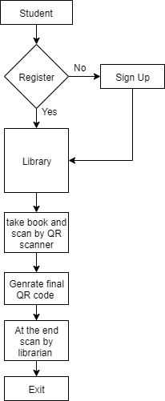
2.1 Proposed System

Slide 17
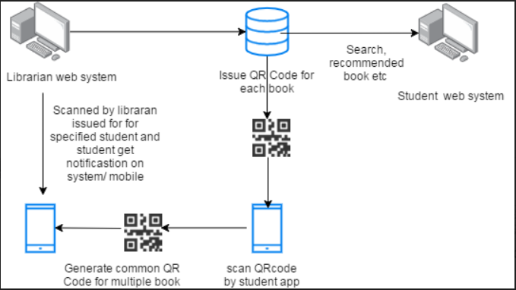
Design

Slide 18
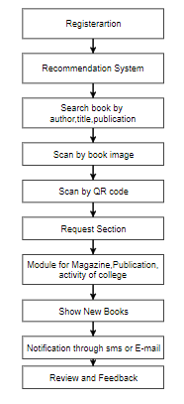
2.2 Design(Flow Of Modules)

Slide 19

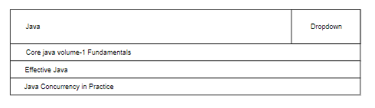
2.3 Sequance Diagram

Slide 20
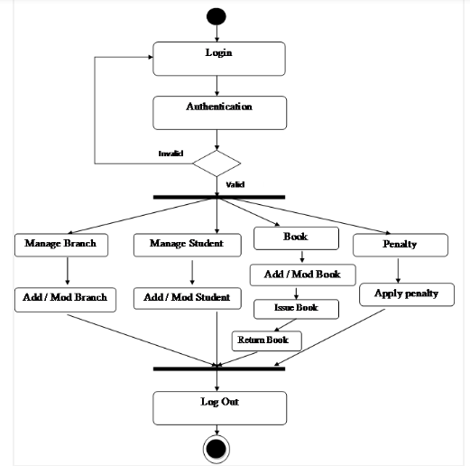
2.4 Activity diagram

Slide 21
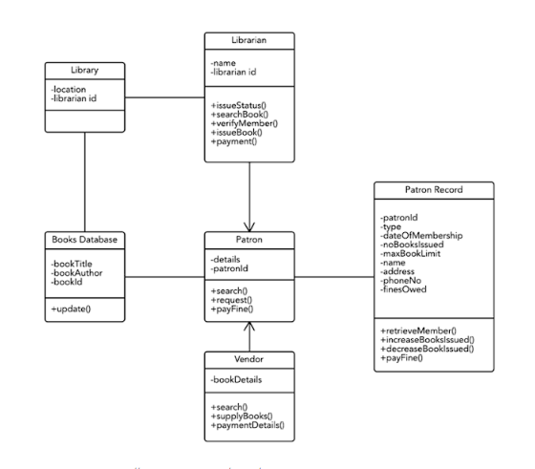
2.5 Class Diagram

Slide 22
2.6 Module-1(Recommendation System)
A recommendation system broadly recommends books to students best suited to their department and Domain.
When a recommender is well implemented, it can greatly reduce the information overload and guide the student towards the information or book he or she is looking for. A good recommender can make the user feel empowered to make the right decisions in a short amount of time.
Such a user experience is good for profit and student retention.

Slide 23
Module-2(Request for a book)
It help students in the way of if he or she wants a new book then he or she can request for a book to librarian in request module.
If there is 10 book only and you want a book you can send request to librarian he or she will registering book by your name.
This module is very helpful in respect to students as well as for college,University and office people.

Slide 24
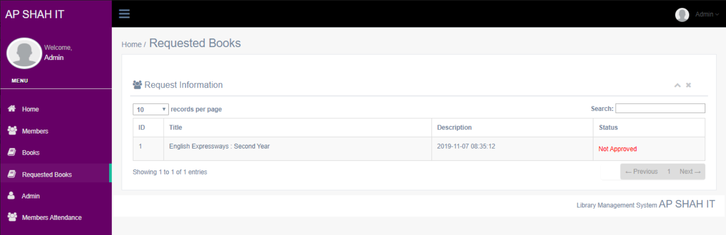
Module-2(continued)

Slide 25
Module-3(Notification)
This module help students to remind them when they have to return the books.
They can also get a message if they haven’t return a book to the library on date and also get a message of fine for the late return.

Slide 26
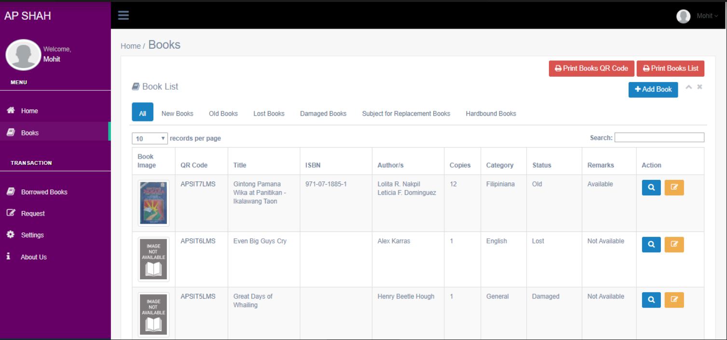
Module-4(Books)
In this student can see the availability of books.
Also see the amount of books of a particular subject.

Slide 27
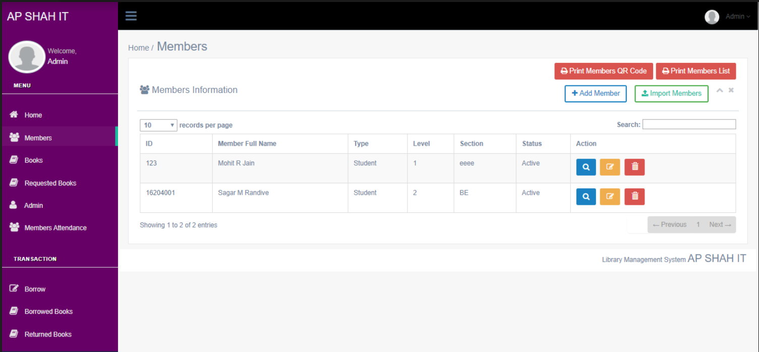
Module-5(Members)
In this module admin can see how many students/members are present.

Slide 28
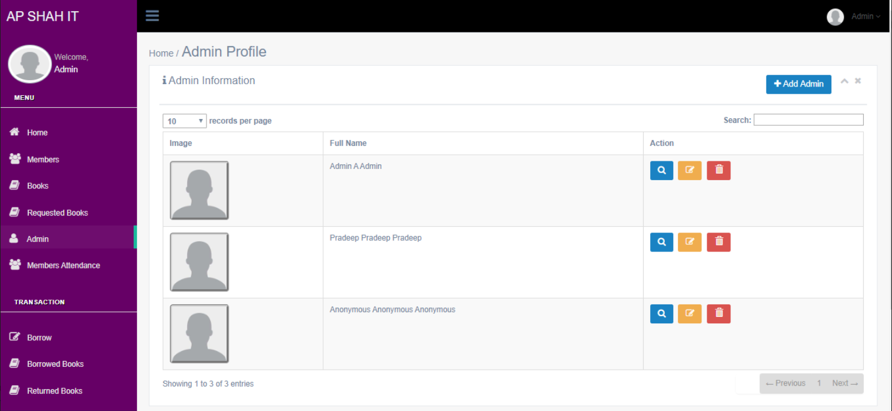
Module-6(Admin Profile)
In this module if you want you can add admin.
The part of this project is admin who can handle all this stuff.

Slide 29
2.7 References
Development of an Intelligent Web Interface to Online Library Catalog Databases.
Library in Everyone’s Pocket With reference to Bundelkhand University App.
National University Library System: A Mobile and Web Application Framework for National University Learning Resource Center.
A Desktop Application of QR Code for Data Security and Authentication.
Neurorehabilitation Control Application: Development Using Ionic Framework

Slide 30
3.Future Scope

Slide 31
Future Scope
It will help student to find the good book for their better understanding.
It will help to education industry to save their manual work.
Where all the other way to save time and manual work are costly it is comparatively cheaper.

Slide 32
Thank You

