Slide 1
SQL and Databases
Project Report
By: Harshavardhana Shridhar Bhat
Batch – AIML Online December 2023 A

Slide 2
Business Overview
Total Revenue
124.71 M
Total Orders
1000
Total Customers
994
Average Rating
3.135
Last Quarter Revenue
23.347 M
Last Quarter Orders
199
Average Days to Ship
97.964
% Good Feedback
44.1%

Slide 3

Customer Metrics

Slide 4
Distribution of Customers across States
Key Findings
California and Texas lead with 97 customers each.
Florida follows closely with 86 customers.
New York has 69 customers
District of Columbia has 35 customers and other states have fewer than 33 customers

Slide 5
Average Customer Ratings by Quarter
Key Findings
Throughout the year, the average customer rating demonstrates a declining trend.
Achieved an average rating of 3.55 in Q1.
Maintained a slightly lower average rating of 3.35 in Q2.
Q3 and Q4, experienced further declines, with average ratings of 2.95 and 2.39, respectively.

Slide 6
Trend of Customer Satisfaction
Key Findings
Quarter by quarter, there has been a gradual decline in customer satisfaction throughout the year.
There was a slight decrease in the “Very Good” rating between Q1 and Q2.
“Very Good” and “Good” ratings declined from 30% in Q1 to 10% in Q4.
The “Okay” category remained steady at around 20% throughout all quarters.
However, “Very Bad” and “Bad” ratings surged from 10% in Q1 to 30% in Q4.
Between Q1 and Q2, there is slight decrease in ‘Very Good’ rating.

Slide 7
Top Vehicle Makers Preferred by Customers
Key Findings
Chevrolet is a prominent vehicle maker with 83 customers.
Ford has 63 customers.
Toyota serves 52 customers.
Both Pontiac and Dodge have 50 customers each.
Mercedes-Benz has 45 customers.

Slide 8
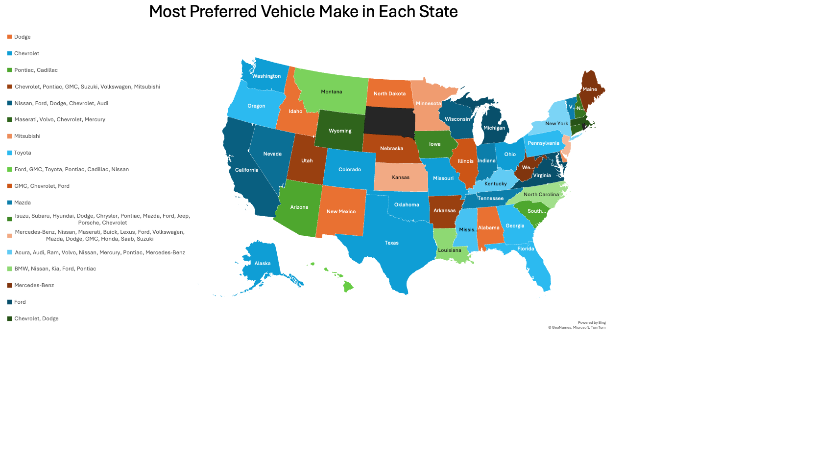

Slide 9

Revenue Metrics

Slide 10
Trend of Purchases by Quarter
Key Findings
The order volume has exhibited a consistent decline over successive quarters.
The highest number of orders was recorded in Q1, with 310 orders.
In Q2, the number of orders decreased to 262.
The number of orders further decreased to 229 in Q3.
Q4 had the lowest number of orders, with only 199 orders.

Slide 11
Quarter on Quarter change in Revenue
Key Findings
Overall, there is a gradual decline in revenue from Q1 to Q4:
Q1 had the highest revenue of $39 million.
In Q2, there was a 17% decrease from Q1 to $33 million.
In Q3, there was a further 11% decrease from Q2 to $29 million.
Finally, in Q4, there was a strong 20% decline from Q3 to $23 million.

Slide 12
Trend of Revenue and Orders by Quarter
Key Findings
Overall, there is a gradual decline in both revenue and orders from Q1 to Q4:
Q1 had the highest revenue of $39 million with 310 orders.
In Q2, there was a decrease from Q1 to $33 million with 262 orders.
In Q3, there was a further decrease from Q2 to $29 million with 229 orders.
Finally, in Q4, there was a strong decline in revenue from Q3 to $23 million with 199 orders.

Slide 13

Shipping Metrics

Slide 14
Average Discount offered by Credit Card Type
Key Findings
Overall, there is no substantial variation in discounts among different credit card types:
Laser has the highest average discount of 64%.
Diners Club International has the lowest average discount of 58%.
There are 16 different Credit Card Types

Slide 15
Time taken to ship orders by Quarter
Key Findings
Throughout the year, the average time taken to ship orders shows an upward trend:
In Q1, the average time was 57 days.
In Q2, it increased to 71 days.
Further increasing in Q3, the average time reached 118 days.
Finally, in Q4, the highest average time taken to ship orders was 174 days.

Slide 16

Insights and Recommendations

Slide 17

Insights
Revenue Decline: Orders have consistently decreased each quarter, resulting in reduced revenues.
Customer Satisfaction: Customer satisfaction has declined every quarter, leading to a drop in orders.
Shipping Delays Impact: Significant shipping delays have contributed to customer dissatisfaction.

Slide 18

Recommendations
Address Delays: The Shipping department needs immediate attention to reduce significant delays.
Increase Fleet: Consider adding more trucks or expanding the fleet to decrease average shipping time.
Strategic Distribution: Allocate trucks based on customer demand, prioritizing states with the highest number of customers.

