Slide 1

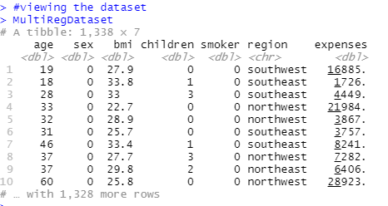
Description of the research requirement
The details of the features are as follows:
Independent (Input) variables:
• Age
• Sex
• BMI
• Children
• Smoker
• Region
Dependent (Output) variable:
• Expenses
Requests to analyze dataset and provide with information on the following:
a) The effect of smoking on expenses by creating a linear regression model.
b) The effect of all input variables on expenses by creating a multivariate regression model.

Slide 2
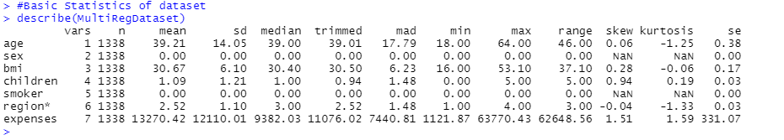
BASIC STATISTICS
Above is the basic statistics of the Dataset. From the statistics we have the following Insights:
> The value of n is 1338 that means the number of observation is 1338.
> For the Independent variable Age the Mean value is 39.21, Median is 39, Maximum is 64, Minimum is 18 and Standard Deviation is 14.05 > For the Independent variable BMI the Mean value is 30.67, Median is 30.40, Maximum is 53, Minimum is 16 and Standard Deviation is 6.10
> For the Expenses the Mean value is 13270.42, Median is 9382.03, Maximum is 63770.43, Minimum is 1121.87 and Standard Deviation is 6.10
> Also for Children the max is 5 that means Maximum children are 5.

Slide 3

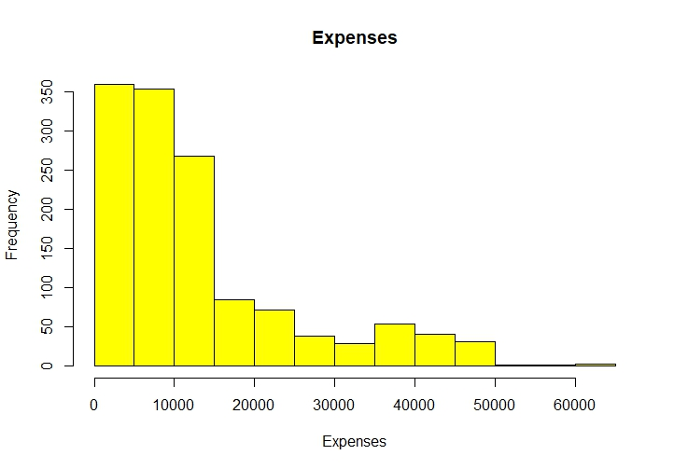
Histogram of Expenses

Slide 4
Insights of Histogram
> In general, a histogram displays the frequency with which data values for a certain bin occur.
> The skewness of the data can be determined using a histogram.
> In the histogram, the y-axis shows the Frequency, and the x-axis shows the Expenses.
> In the above histogram, the distribution is positively right skewed because of the distribution's long right tail.
> Also the expenses from 0-20000 is where data occur most frequently.

Slide 5
HYPOTHESIS STATEMENT (T-Test)
Performing T-Test analysis. According to the above Hypothesis will be set : Step 1: Null and Alternative Hypothesis as follows: Null Hypothesis : In this study, the null hypothesis is, mean for expenses is 10,000. H0: µ = 10000 , The mean of expenses is equal to 10000.
Alternate Hypothesis : In this study, the Alternate hypothesis is, mean for expenses is not 10,000. H0: µ ≠ 10000 , The mean of expenses is not equal to 10000.
Step 2: Significance Level:
For this, the significance Level(α) = 0.05

Slide 6
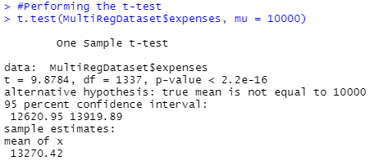
Step 3: Performing the Test : Running the R-Code to conduct the test. t.test(MultiRegDataset$expenses, mu = 10000) Step 4: Conclusion: • So now, we got the p value as 2.2e-16, which is much lower than our significance level i.e., 0.05.
• Now, we have enough evidence to reject the null hypothesis with a 95% confidence level (or 5% significance level). Therefore, null hypothesis will be rejected.
• This states, the mean of expenses is not equal to 10000.

Slide 7
Insights of T-Test
> After performing the T-Test we got the p-value 2.2e-16 which is less than significance level 5%(0.05). i.e., 2.2e-16 < α
> Also from the test,
- the value of T-test statistic(t) is 9.8784 - df i.e., Degree of Freedom is 1337 - mean of x is 13270.42
> As p-value is less than 0.05(α) we reject the Null Hypothesis i.e., H0: µ = 10000 , The mean of expenses is equal to 10000.

Slide 8
HYPOTHESIS STATEMENT (SIMPLE LINEAR REGRESSION)
> Linear regression is used to predict the value of an outcome variable Y based on one or more input predictor variables X. The aim is to establish a linear relationship between the predictor variables and the response variable. > A simple linear regression model can be described by the following linear equation since it only considers one explanatory variable:
Y = β1 + β2X + ϵ
Where, - β1 is the intercept, - β2 is the slope, collectively, they are called regression coefficients.
- ϵ is the error term.
- Y is independent variable
- X is Dependent Variable > Now Linear Regression analysis will be performed. According to the data Hypothesis will be set : Null Hypothesis : H0: β = 0 , The coefficient β of predictor variable(smoker) is zero and not statistically significant.
Alternate Hypothesis : Ha: β ≠ 0, The coefficient β of predictor variable(smoker) is not equal to zero and is statistically significant.

Slide 9
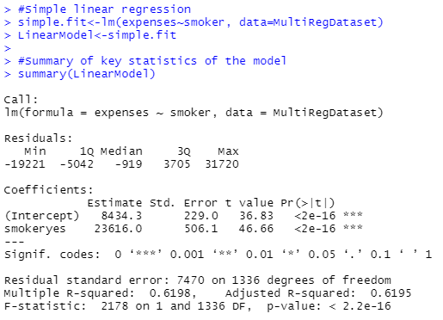
Significance Level : For this, the significance Level(α) = 0.05.
Performing the Test : Y = β1 + β2X + ϵ Here β1 is the intercept and β2 is the slope, ϵ is the error term. Running the R-Code to conduct the test. Conclusion :
We got the p value as 2.2e-16, which is lower than our significance level i.e., 0.05. Now, This shows that our null hypothesis for this study was not correct. And we have enough evidence to reject the null hypothesis with a 95% confidence level (or 5% significance level). Therefore, null hypothesis will be rejected. This means the coefficient β of predictor variable(smoker) is not equal to zero and is statistically significant. Linear Regression Model
Intercept (β1) = 8434.3 , β2 = 23616. We can write the Linear Regression Model equation as - Y = β1 + β2X + ϵ Y(expenses) = 8434.3 + 23616*X(smoker) + ϵ

Slide 10
LINEAR REGRESSION ANALYSIS SUMMARY
Summarizing the Output: Call: In this case, we have applied a general linear model function to our dependent and independent variables, and this function is called call. Residual: The residuals, or the difference between the model's forecast and the actual results, are summarized in this section. Better residuals are smaller ones. Coefficients:
> Estimate: This is the weight given to the variable. Our model show our Intercept’s estimate is 8434.3 and estimate for smoker is 23616.0.
> Std. Error: Reveals the degree of accuracy used to measure the estimate. Really, its only use is to determine the t-value. In our dataset, the standard error is 506.1. > T-value and P-value: In our model, the t-value is 46.66. The coefficient is divided by the standard error to determine the t-value. The coefficient is then put to the test to see if it differs significantly from zero. In this the p-value is 2.2e-16 which is lower than the significance level i.e., 0.05. So this stats that the predictor variable is not equal to zero and is statistically significant. Performance Measures: > Residual Standard Error: The residuals' standard deviation is indicated here. Better is smaller. In this analysis's Residual Standard Error is 7470.
> Multiple / Adjusted R-Square: The amount of variance that the model can explain is displayed by R-Squared. The most helpful application of adjusted R-Square is for multiple regression, which takes into account the number of variables. Our model’s Adjusted R-Squared is 0.6195 and Multiple R-Squared is 0.6198.
> F-Statistic: The F-test determines if the weight of at least one variable is significantly different from zero. The coefficient is significant in our analysis because the p-value is lower than 0.05.

Slide 11
HYPOTHESIS STATEMENT (MULTIPLE LINEAR REGRESSION)
> Multiple Linear regression is a statistical technique in which a single dependent variable and a number of independent variables can be analyzed. > In order to anticipate the value of the single dependent value, multiple regression analysis uses independent variables whose values are known. Multiple Regression Model Equation - yi = B0 + B1xi1 + B2xi2 + ... + Bpxip + E where i = 1,2, ..., n > Now Multiple Linear Regression analysis will be performed. According to the data Hypothesis will be set : Null Hypothesis : H0: β = 0 , No model exist and there is no relationship with dependent variable(expenses).
Alternate Hypothesis : Ha: β ≠ 0, Model Exist and there is a relationship with at least one variable which predicts dependent variable(expenses).

Slide 12
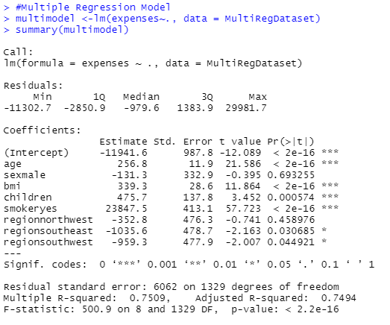
Significance Level : For this, the significance Level(α) = 0.05.
Performing the Test : Yi = B0 + B1xi1 + B2xi2 + ... + Bpxip + E where i = 1,2, ..., n Running the R-Code to conduct the test. Conclusion :
We got the p value as 2.2e-16, which is lower than our significance level i.e., 0.05. Now, This shows that our null hypothesis for this study was not correct. And we have enough evidence to reject the null hypothesis with a 95% confidence level (or 5% significance level). Therefore, null hypothesis will be rejected. This means model Exist and there is a relationship with at least one variable which predicts dependent variable(expenses). Multiple Linear Regression Model
We can write the Multiple Linear Regression Model equation as - Y(expenses) = -11941.6 + (23847.5)*smoker + (256.8)*age + (-131.3)*sex + (339.3) * bmi + (475.7)*children + (-352.8)*regionnorthwest + (-1035.6)*regionsoutheast + (-959.3)*regionsouthwest

Slide 13
MULTIPLE LINEAR REGRESSION ANALYSIS SUMMARY
Summarizing the Output: Call: In this case, we have applied a multiple linear model function to our dependent and independent variables, and this function is called call. Residual: The residuals, or the difference between the model's forecast and the actual results, are summarized in this section. Better residuals are smaller ones. Coefficients:
> Estimate: This is the weight given to the variable. Our model shows estimate of age: 256.8, sex: -131.3, bmi: 339.3, children: 475.7,smoker: 23847.5,regionnorthwest: -352.8, regionsoutheast: -1035.6 and for regionsouthwest: -959.3.
> Std. Error: Reveals the degree of accuracy used to measure the estimate. Really, its only use is to determine the t-value. In our dataset, the standard error of age: 11.9, sex: 332.9, bmi: 28.6, children: 137.8, smoker: 412.1, regionnorthwest: 476.3, regionsoutheast: 478.7 and for regionsouthwest: 477.9. > T-value and P-value: The coefficient is divided by the standard error to determine the t-value. The coefficient is then put to the test to see if it differs significantly from zero. In our model, the t-value of age: 21.58, sex: -0.395, bmi: 11.86, children: 3.45, smoker: 57.72, regionnorthwest: -0.741, regionsoutheast: -2.163 and for regionsouthwest: -2.007. In this the p-value is 2.2e-16 which is lower than the significance level i.e., 0.05. So this stats that the predictor variable is not equal to zero and is statistically significant. Performance Measures: > Residual Standard Error: The residuals' standard deviation is indicated here. Better is smaller. In this analysis's Residual Standard Error is 6062.
> Multiple / Adjusted R-Square: The amount of variance that the model can explain is displayed by R-Squared. The most helpful application of adjusted R-Square is for multiple regression, which takes into account the number of variables. Our model’s Adjusted R-Squared is 0.7494 and Multiple R-Squared is 0.7509.
> F-Statistic: The F-test determines if the weight of at least one variable is significantly different from zero. The coefficient is significant in our analysis because the p-value is lower than 0.05.

Slide 14
Summary and Conclusion
> In our analysis, we have generated three model for the given dataset which contains both dependent variables and independent variable. > Also we have generated Histogram, where we got to know that the distribution is positively right skewed because of the distribution's long right tail. > Models we have generated are T-Test, Simple Linear Regression Model and Multiple Regression model. > For all the model Significance Level(α) is 0.05(i.e., 5%). > For the T- Test we got the p-value 2.2e-16 which is less than significance level 5%(0.05). i.e., 2.2e-16 < α. As p-value is less than 0.05(α) we reject the Null Hypothesis i.e., H0: µ = 10000 , The mean of expenses is equal to 10000. > When performing Linear Regression Algorithm we got the p value as 2.2e-16, which is lower than our significance level i.e., 0.05. So Null Hypothesis in the model was not true. Hence rejecting it with 95% confidence level. This means the coefficient β of predictor variable(smoker) is not equal to zero and is statistically significant.

Slide 15
> The impact of smoking on a person's household expenses is explained by the linear regression model. As a result, smoking and household expenses are directly related.
> When performing Multiple Linear Regression Algorithm we got the p value as 2.2e-16, which is lower than our significance level i.e., 0.05. So Null Hypothesis in the model was incorrect and hence with 95% confidence level we reject it. This means model exist and there is a relationship with at least one variable which predicts dependent variable(expenses).
> The created multiple linear regression model clarifies how each predictor variable affects a person's household expense.
> Multiple regression takes into account several independent variables, whereas linear regression only considers one independent variable that influences the relationship's slope. To ensure that each variable is given the proper weighting in multiple regression, each independent variable has its own coefficient. > So if comparing both Linear regression and Multiple Regression, Multiple Regression model produces better, reliable result and is more efficient model then Linear Regression.

