Slide 1
Title: Sales Dashboard Analysis
Subtitle: Data Analyst Internship – Task 4
Name: Harsh Biswas

Slide 2
OBJECTIVE
To design an interactive dashboard for business stakeholders
To analyze key metrics like Sales and Profit
To support data-driven decision-making

Slide 3
DATASET
Used Sales dataset (Superstore/Kaggle)
Data includes:
Sales
Profit
Category
Region
Order Date

Slide 4
TOOLS USED
Power BI
Data Cleaning (Power Query)
Data Visualization

Slide 5
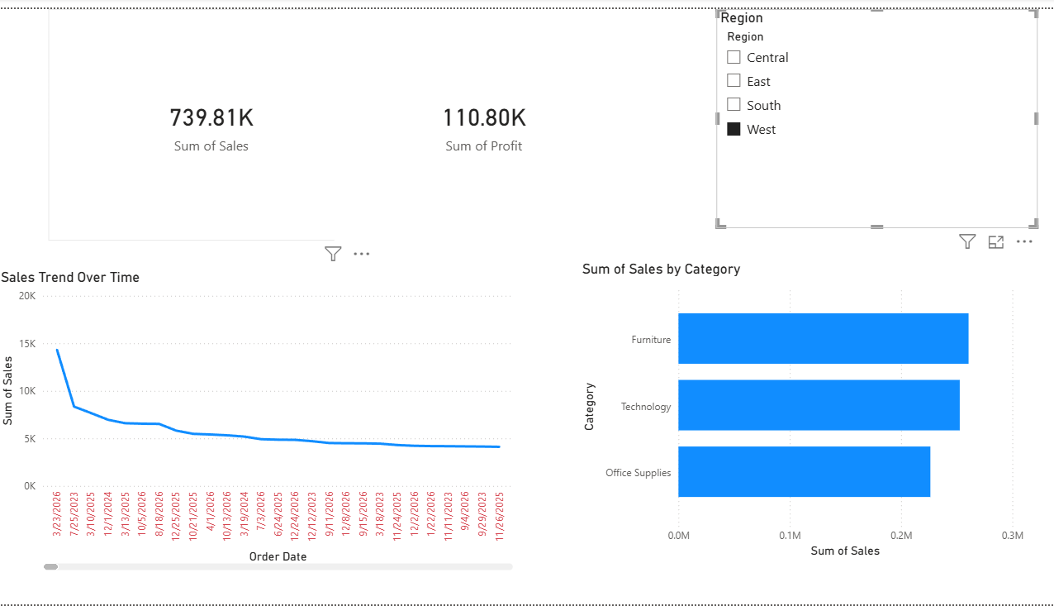
DASHBOARD OVERVIEW
Created KPI cards for Sales and Profit
Added charts for category and trend analysis
Included slicer for interactivity

Slide 6
KEY VISUALS
KPI Cards (Total Sales, Total Profit)
Bar Chart (Sales by Category)
Line Chart (Sales Trend Over Time)
Slicer (Region Filter)

Slide 7
CONCLUSION
Dashboard provides clear business insights
Helps in better decision-making
Interactive features improve user experience

Slide 8
Thank You

