Slide 1


i5/OS Application Modernization
IBM Modern ILE Training
Training Session 1
ILE - Modern Software Development
Training Out-Line
  **Free (Total Free)
  Naming Rules
  Prototype
  *Modules
  Sub-procedures
  Binding Language
  Binding Source
  *SRVPGM
Instructor: Hiram Hubbard, CCP
© 2021, 2022 All Rights Reserved. Property of Vision-C Consulting Inc. (VCCI)

Slide 2
i5/OS Application Modernization
IBM Modern ILE Training
Objectives
After completing this session, you will be able to:
Have a good understating of ILE Development
Understand the difference between bound by copy &
bound by reference
Identify all the key components of ILE development
Understand how to do modern development & best
practice
Have a good understanding of using ILE with MVC
© 2021, 2022 All Rights Reserved. Property of Vision-C Consulting Inc. (VCCI)

Slide 3
i5/OS Application Modernization
IBM Modern ILE Training
Who should attend
This training is design for the following:
IBM i Software Developer’s
Technical Leads
Software Architects
Database Architects
© 2021, 2022 All Rights Reserved. Property of Vision-C Consulting Inc. (VCCI)

Slide 4
i5/OS Application Modernization
IBM Modern ILE Training
Modern Tools
ILE - Modern Software Development
  ACS or System i Navigator (Testing Queries, GUI Debugger, etc.)
  https://www.ibm.com/support/pages/ibm-i-access-client-solutions
  IBM Rational Developer For i (Rdi v9.6, IDE)
  https://www.ibm.com/support/pages/rational-developer-i-v96-available
  Data Studio v4.1.3
  (Creating Database Model)
  https://www.ibm.com/support/pages/download-and-install-ibm-data-studio-41x
© 2021, 2022 All Rights Reserved. Property of Vision-C Consulting Inc. (VCCI)

Slide 5

i5/OS Application Modernization
IBM Modern ILE Training
Training Session 1
How Skills are Developed…
Skill Mastered
In the course
we have
provided…
Practice
Practice
Practice
Practice
Practice
Practice
Practice
Practice
You must…
Strong
Reasons to
Practice
First Try
Initial Knowledge
Awareness
Org Support
© 2021, 2022 All Rights Reserved. Property of Vision-C Consulting Inc. (VCCI)

Slide 6
i5/OS Application Modernization
IBM Modern ILE Training
ILE Thinking
ILE - A Different Way of Thinking
People find it easy to learn RPG-ILE, but hard to incorporate it because it requires
changing the way, you think about development because we develop patterns in
our mind and these patterns are now bad habits.
Some bad coding habits we need to break
Bad Habits
No Need to code sub-routine anymore. Code using ILE sub-procedures.
Stop using short program variable names, i.e., ( x, i, z) etc. They are not necessary anymore.
Don’t add program comments on the right side of the code. Keep the code clean.
Stop “Mod-Marking” your code. This is an outdated Standard. Use “Archive” source if you need to reference or if you want to see the old version.
Do Not Bind *PGM to *MODULE nor to *SRVPGM. This is NOT modern development.
Do not use “Color” in source code. Outdated.
Do not put unnecessary comments in your source code. Keep the source clean.
Bad Habits (Cont.…)
Use SQL whenever possible. Avoid RLA. Files in “F” spec. SQL is the best for I/O.
Stop Hard-coding Program Information Data Structure to get program name, user name. Use /copy book.
Don’t use “CallP”. It is old style not modern.
Do not comment out code that is not needed. Delete it. The old source should be in Archive if needed.
Stop writing big and large programs. Break the code into smaller units of work.
Do not code “*INZSR” in your program. You do not have control of it. Try using a “Housekeeping” procedure.
© 2021, 2022 All Rights Reserved. Property of Vision-C Consulting Inc. (VCCI)

Slide 7
i5/OS Application Modernization
IBM Modern ILE Training
MVC Pattern
Software Design using Model-View-Controller
Model
Data
The Data Logic
  Include MVC Document
Updates
e.g., list item to show added item
Manipulates
Sends input from User or Service Accounts
View or Interface
UI
Defines The Interface
Controller
The Brain
Controls the Business Logic
Sometimes updates directly
Model, View, Controller. Each architectural component is built to handle specific development aspects of an application.
© 2021, 2022 All Rights Reserved. Property of Vision-C Consulting Inc. (VCCI)

Slide 8
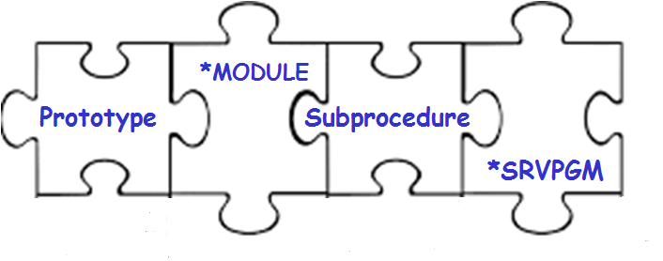
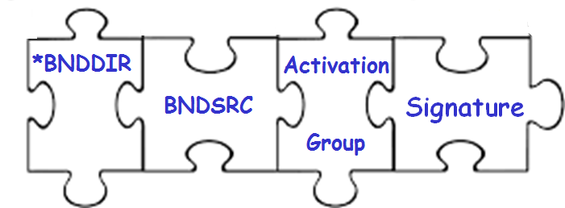
i5/OS Application Modernization
IBM Modern ILE Training
ILE Review…
Integrated Language Environment (ILE)
- So, What Exactly is ILE ?
© 2021, 2022 All Rights Reserved. Property of Vision-C Consulting Inc. (VCCI)

Slide 9

i5/OS Application Modernization
IBM Modern ILE Training
ILE Design Order
ILE Program Model Design Order
1
2
Prototype
*Module
2
Sub-Procedure
Key Points
Think in this order
Design in this order
Code in this order
Separate the work
Think about building
*SRVPGM First then App
Separate *SRVPGM from
Application Program
5
3
Binding Language
(Signatures)
5
*SRVPGM
5
Activation
Group
6
4
Application
Binding
Directory
Binding Source
7
All ILE Development should follow this order. This is the modern approach
This is Bound by Reference
© 2021, 2022 All Rights Reserved. Property of Vision-C Consulting Inc. (VCCI)

Slide 10
i5/OS Application Modernization
IBM Modern ILE Training
ILE Design Order
ILE Program Model Design Order
Application A
Local Procedures
HouseKeeping
DisPlay
GetData
CFSendMessage
*PGM
Exported Procedures
CFSendMessage
CFSendEmail
CFConformation
Application B
Local Procedures
*PGM
LoadSubFile
ClearSubFile
CFSendMessage
CFConformation
*SRVPGM
*MODULE
Application C
Local Procedures
*PGM
HouseKeeping
DoBLProcess
ShutDownPGM
CFSendMessage
CFSendEmail
This is Bound by Reference
© 2021, 2022 All Rights Reserved. Property of Vision-C Consulting Inc. (VCCI)

Slide 11
i5/OS Application Modernization
IBM Modern ILE Training
Training Session 1
ILE - Modern Software Development
**Free
© 2021, 2022 All Rights Reserved. Property of Vision-C Consulting Inc. (VCCI)

Slide 12
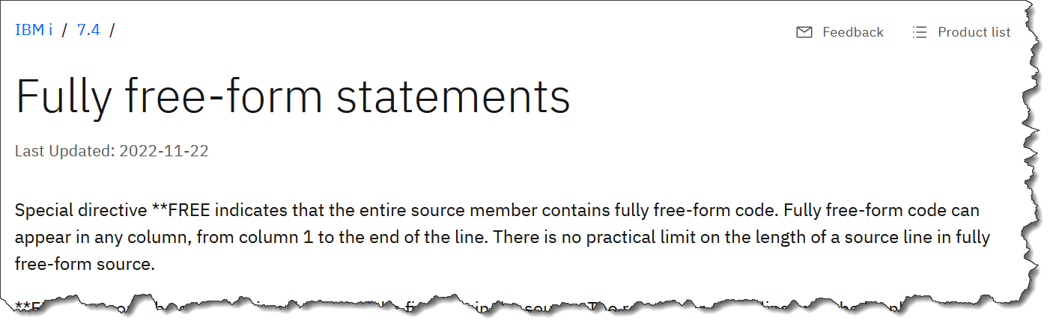
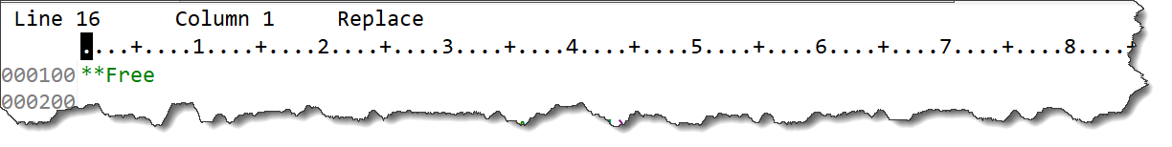
i5/OS Application Modernization
IBM Modern ILE Training
**FREE
ILE - Modern Software Development
MUST Starts in position (1) and on line number (1)
© 2021, 2022 All Rights Reserved. Property of Vision-C Consulting Inc. (VCCI)

Slide 13
i5/OS Application Modernization
IBM Modern ILE Training
**FREE
ILE - Modern Software Development
  **FREE Example
© 2021, 2022 All Rights Reserved. Property of Vision-C Consulting Inc. (VCCI)

Slide 14
i5/OS Application Modernization
IBM Modern ILE Training
Training Session 1
ILE - Modern Software Development
Naming Rules
© 2021, 2022 All Rights Reserved. Property of Vision-C Consulting Inc. (VCCI)

Slide 15
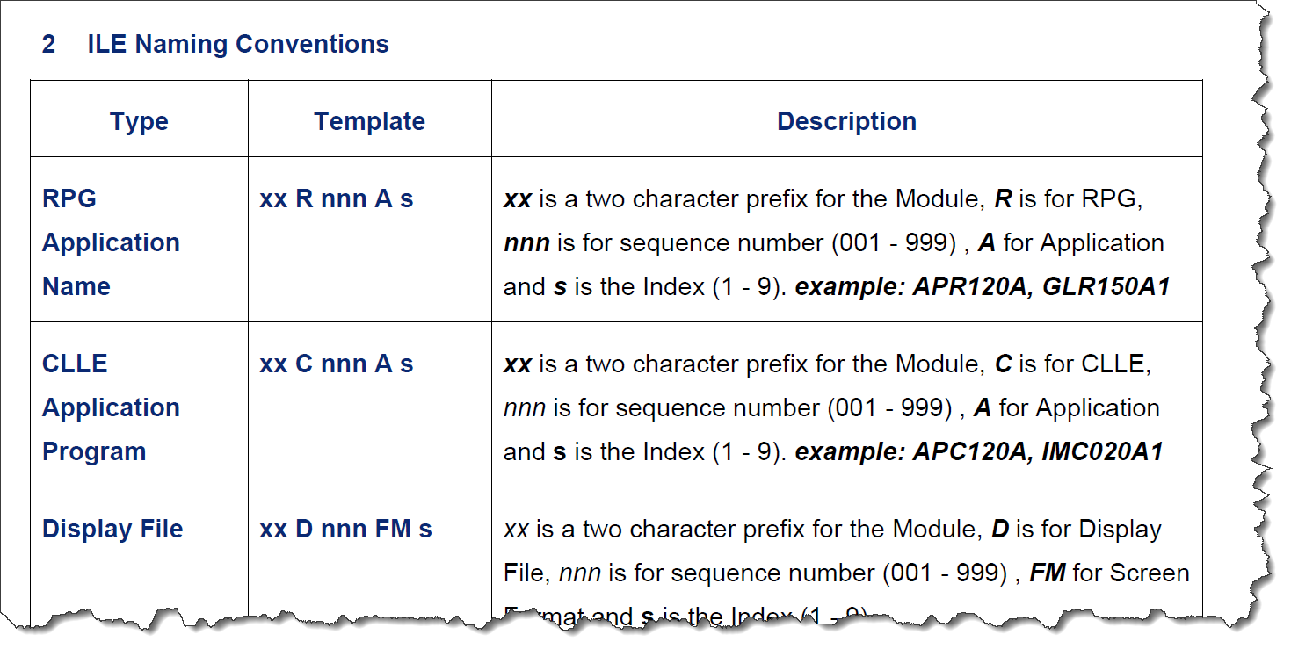
i5/OS Application Modernization
IBM Modern ILE Training
Naming Rule
ILE - Modern Software Development
Follow good naming conventions standards
© 2021, 2022 All Rights Reserved. Property of Vision-C Consulting Inc. (VCCI)

Slide 16
i5/OS Application Modernization
IBM Modern ILE Training
Naming Rules
ILE - Modern Software Development
  Naming Convention
© 2021, 2022 All Rights Reserved. Property of Vision-C Consulting Inc. (VCCI)

Slide 17
i5/OS Application Modernization
IBM Modern ILE Training
Training Session 1
ILE - Modern Software Development
Prototype
© 2021, 2022 All Rights Reserved. Property of Vision-C Consulting Inc. (VCCI)

Slide 18
i5/OS Application Modernization
IBM Modern ILE Training
Prototype
ILE - Modern Software Development
What is a prototype in RPGLE?
A prototype tells the compiler how the parameters of a called program or procedure are defined. The program may be an OPM program or an ILE program. It doesn't matter which language it was written in; you can prototype any *PGM object.
Prototype (/Copybook)
SAR100P
SAR100M
*Module
SAR100S
*SRVPGM
Source member use as a /copybook (reusable).
© 2021, 2022 All Rights Reserved. Property of Vision-C Consulting Inc. (VCCI)

Slide 19
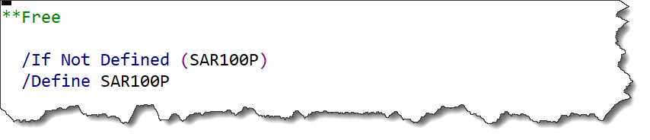
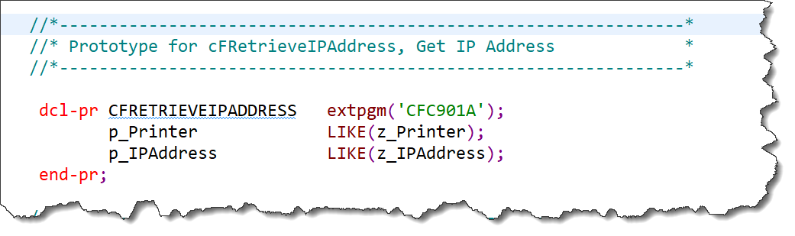
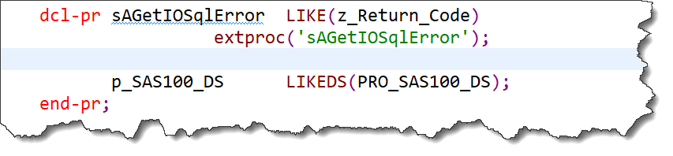
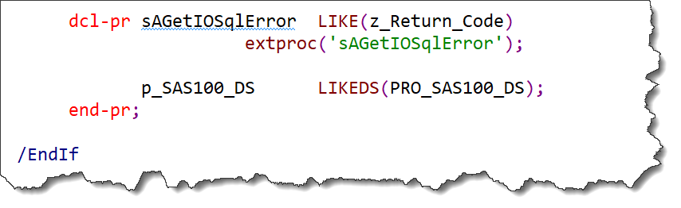
i5/OS Application Modernization
IBM Modern ILE Training
Prototype
ILE - Modern Software Development
is used by the compiler to call the program or procedure correctly and
to ensure that the caller passes the correct parameters.
Source member use as a /copybook (reusable).
Defend External Procedures or External Program
© 2021, 2022 All Rights Reserved. Property of Vision-C Consulting Inc. (VCCI)

Slide 20
i5/OS Application Modernization
IBM Modern ILE Training
Prototype
ILE - Modern Software Development
  Prototype Example A
  Prototype Example B
© 2021, 2022 All Rights Reserved. Property of Vision-C Consulting Inc. (VCCI)

Slide 21
i5/OS Application Modernization
IBM Modern ILE Training
Training Session 1
ILE - Modern Software Development
*Module
© 2021, 2022 All Rights Reserved. Property of Vision-C Consulting Inc. (VCCI)

Slide 22
i5/OS Application Modernization
IBM Modern ILE Training
*Module
ILE - Modern Software Development
What is a *Module in RPGLE?
A module is a nonrunnable object (type *MODULE) that is the output of an ILE compiler. It is the basic building block of an ILE program. An ILE RPG module consists of one or more procedures, and the file control blocks, and static storage used by all the procedures in the module.
SRVPGM
PGM A
Bound by Reference
Bound by Copy
Module M1
Module M1
Bound by Copy
All *Module should be “NOMAIN” Module. This is the modern approach.
© 2021, 2022 All Rights Reserved. Property of Vision-C Consulting Inc. (VCCI)

Slide 23
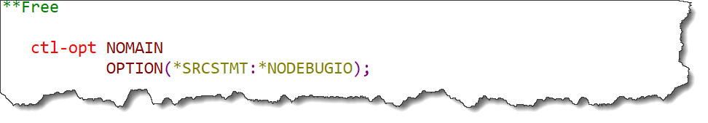
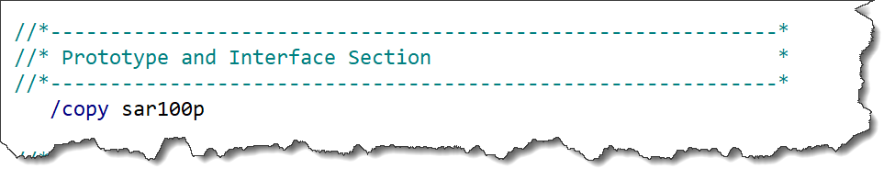
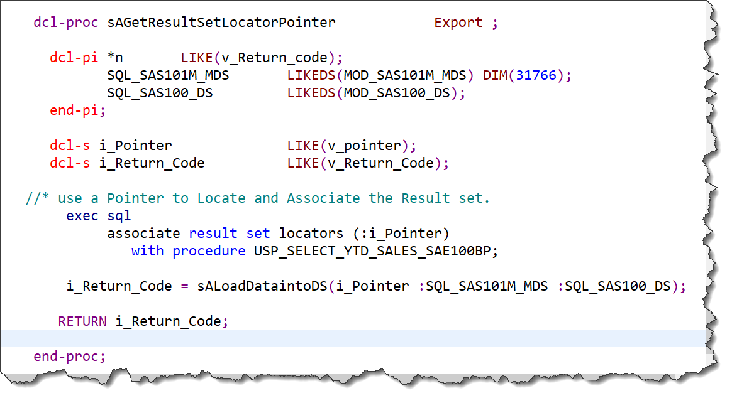
i5/OS Application Modernization
IBM Modern ILE Training
*Module
ILE - Modern Software Development
Non-Executable object which holds procedures. That can be bind to
*PGM and or *Service Program.
© 2021, 2022 All Rights Reserved. Property of Vision-C Consulting Inc. (VCCI)

Slide 24
i5/OS Application Modernization
IBM Modern ILE Training
*Module
ILE - Modern Software Development
  *Module Example A
  *Module Example B
  *Module Example C
© 2021, 2022 All Rights Reserved. Property of Vision-C Consulting Inc. (VCCI)

Slide 25
i5/OS Application Modernization
IBM Modern ILE Training
Training Session 1
ILE - Modern Software Development
Sub-Procedures
© 2021, 2022 All Rights Reserved. Property of Vision-C Consulting Inc. (VCCI)

Slide 26
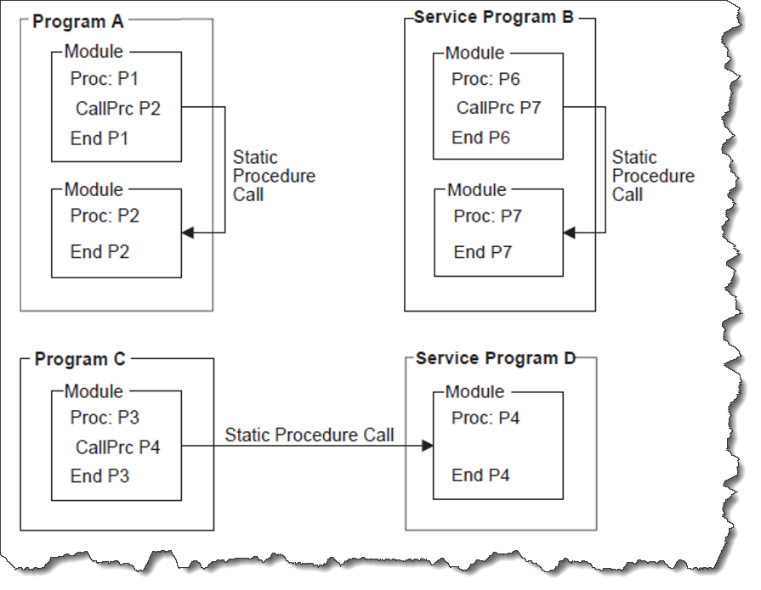
i5/OS Application Modernization
IBM Modern ILE Training
Sub Procedures
ILE - Modern Software Development
What is a sub procedure on the IBMi?
A subprocedure is a procedure that is specified after the main source section. A subprocedure differs from a main procedure primarily in that: Names that are defined within subprocedure are not accessible outside the subprocedure. No cycle code is generated for the subprocedure. The call interface must be prototyped.
Sub procedure are function. They perform a specific action.
It’s the smallest unit of work.
.
© 2021, 2022 All Rights Reserved. Property of Vision-C Consulting Inc. (VCCI)

Slide 27
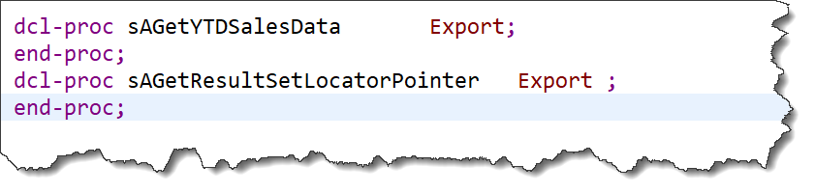
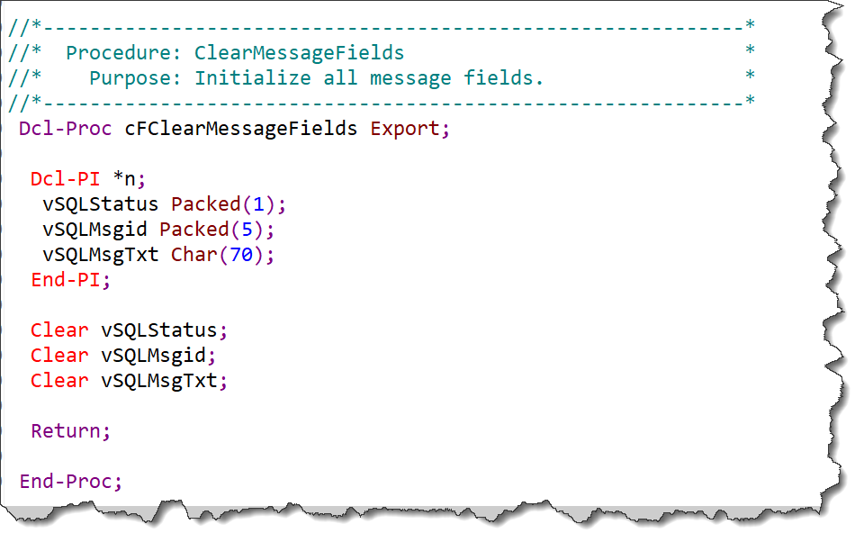
i5/OS Application Modernization
IBM Modern ILE Training
Sub Procedures
ILE - Modern Software Development
Sub procedure are function. They perform a specific action.
.
© 2021, 2022 All Rights Reserved. Property of Vision-C Consulting Inc. (VCCI)

Slide 28
i5/OS Application Modernization
IBM Modern ILE Training
Sub Procedures
ILE - Modern Software Development
Please refer to *Module for example.
© 2021, 2022 All Rights Reserved. Property of Vision-C Consulting Inc. (VCCI)

Slide 29
i5/OS Application Modernization
IBM Modern ILE Training
Training Session 1
ILE - Modern Software Development
Binding Language
© 2021, 2022 All Rights Reserved. Property of Vision-C Consulting Inc. (VCCI)

Slide 30
i5/OS Application Modernization
IBM Modern ILE Training
Binding Language
ILE - Modern Software Development
What is a Binding Language on the IBMi?
The binder language is a small set of nonrunnable commands that defines the exports for a service program. The binder language enables the source entry utility (SEU) syntax checker to prompt and validate the input when a BND source type is specified.
What is a Signature on the IBMi?
A signature is generated from the names of procedures and data items and from the order in which they are specified in the binder language. To make compatible changes to a service program, new procedure or data item names should be added to the end of the export list.
© 2021, 2022 All Rights Reserved. Property of Vision-C Consulting Inc. (VCCI)

Slide 31
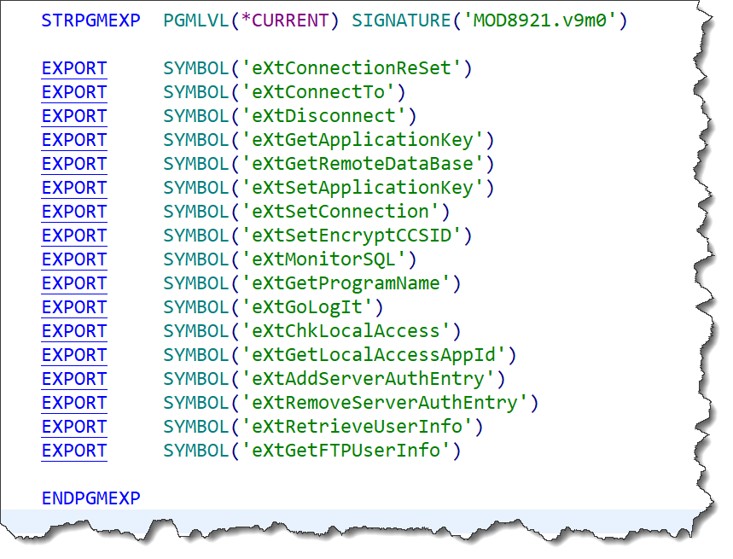
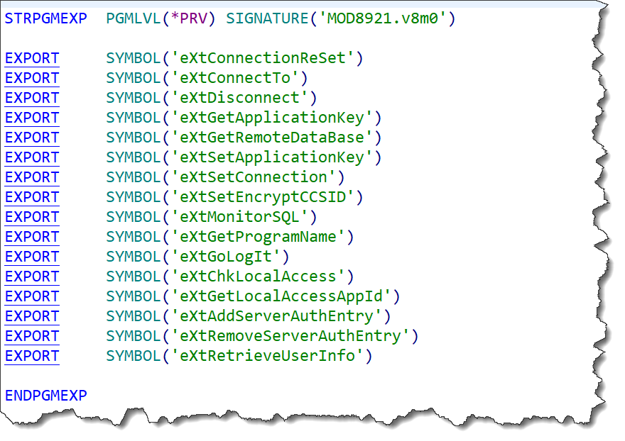
i5/OS Application Modernization
IBM Modern ILE Training
Binding Language
ILE - Modern Software Development
© 2021, 2022 All Rights Reserved. Property of Vision-C Consulting Inc. (VCCI)

Slide 32
i5/OS Application Modernization
IBM Modern ILE Training
Binding Language
ILE - Modern Software Development
  Binding Language Example A
  Binding Language Example B
© 2021, 2022 All Rights Reserved. Property of Vision-C Consulting Inc. (VCCI)

Slide 33
i5/OS Application Modernization
IBM Modern ILE Training
Training Session 1
ILE - Modern Software Development
Binding
Source
© 2021, 2022 All Rights Reserved. Property of Vision-C Consulting Inc. (VCCI)

Slide 34
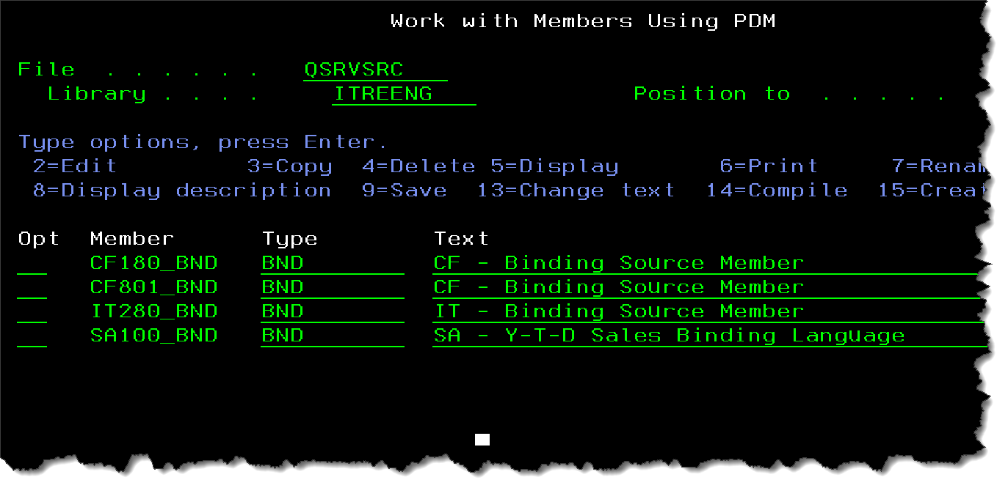
i5/OS Application Modernization
IBM Modern ILE Training
Binding Source
ILE - Modern Software Development
Simply put it is just an IBM i Source File. Default “QSRVSRC”.
.All members are “BND” members Type.
© 2021, 2022 All Rights Reserved. Property of Vision-C Consulting Inc. (VCCI)

Slide 35
i5/OS Application Modernization
IBM Modern ILE Training
Training Session 1
ILE - Modern Software Development
*SRVPGM
© 2021, 2022 All Rights Reserved. Property of Vision-C Consulting Inc. (VCCI)

Slide 36
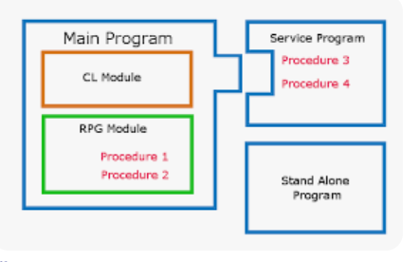
i5/OS Application Modernization
IBM Modern ILE Training
*SRVPGM
ILE - Modern Software Development
What is a Service program on the IBMi?
A service program is a collection of runnable procedures and available data items easily and directly accessible by other ILE programs or service programs. In many respects, a service program is like a subroutine library or procedure library.
© 2021, 2022 All Rights Reserved. Property of Vision-C Consulting Inc. (VCCI)

Slide 37
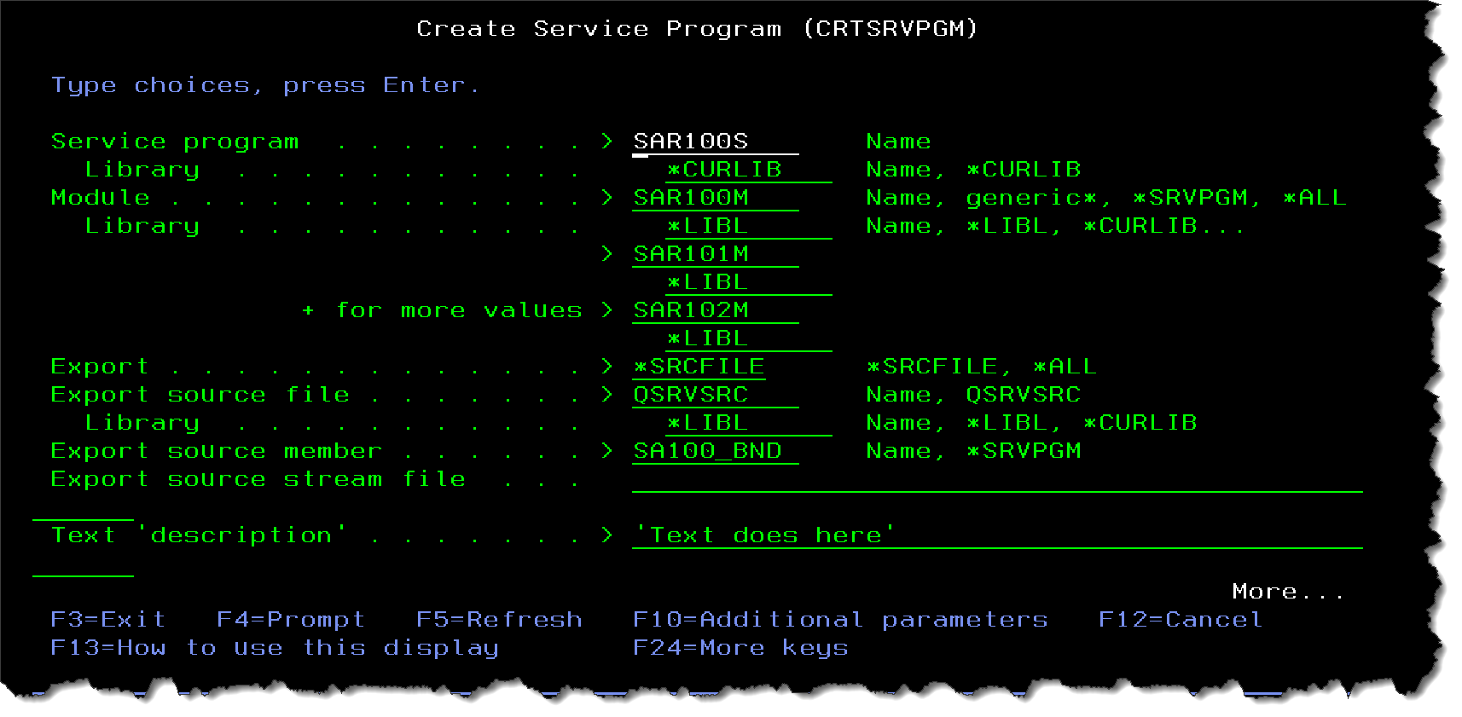
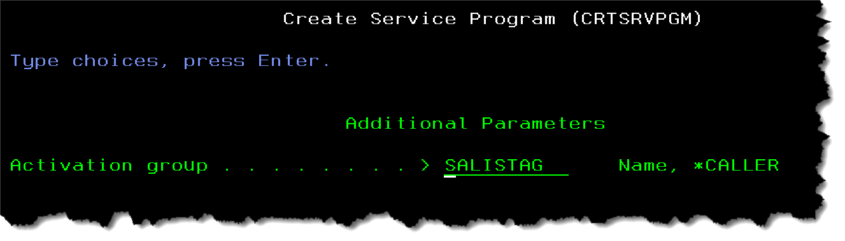
i5/OS Application Modernization
IBM Modern ILE Training
*SRVPGM
ILE - Modern Software Development
*Modules
Create Service program using “CRTSRVPGM” Command.
© 2021, 2022 All Rights Reserved. Property of Vision-C Consulting Inc. (VCCI)

Slide 38
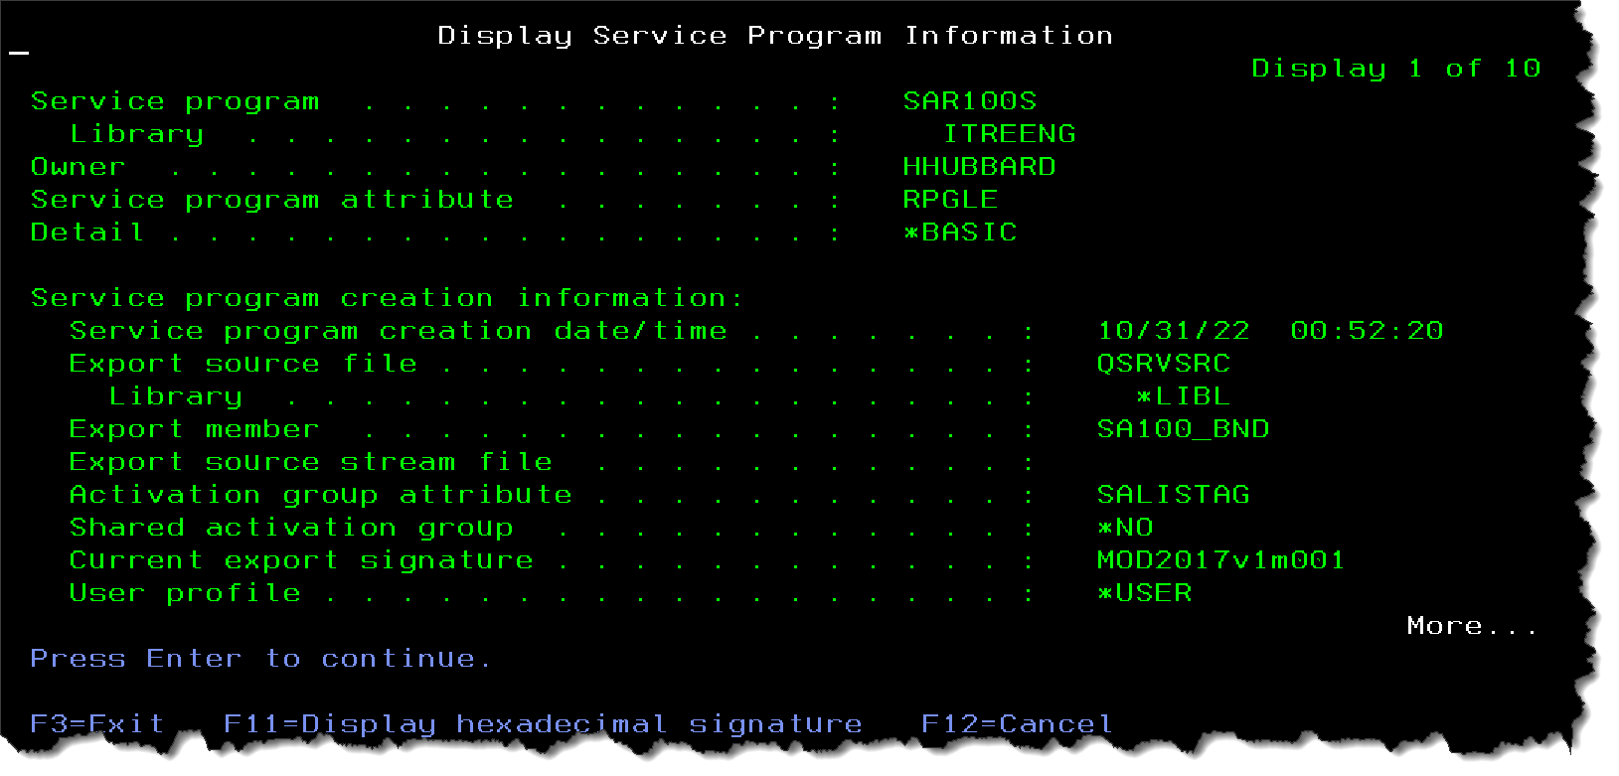
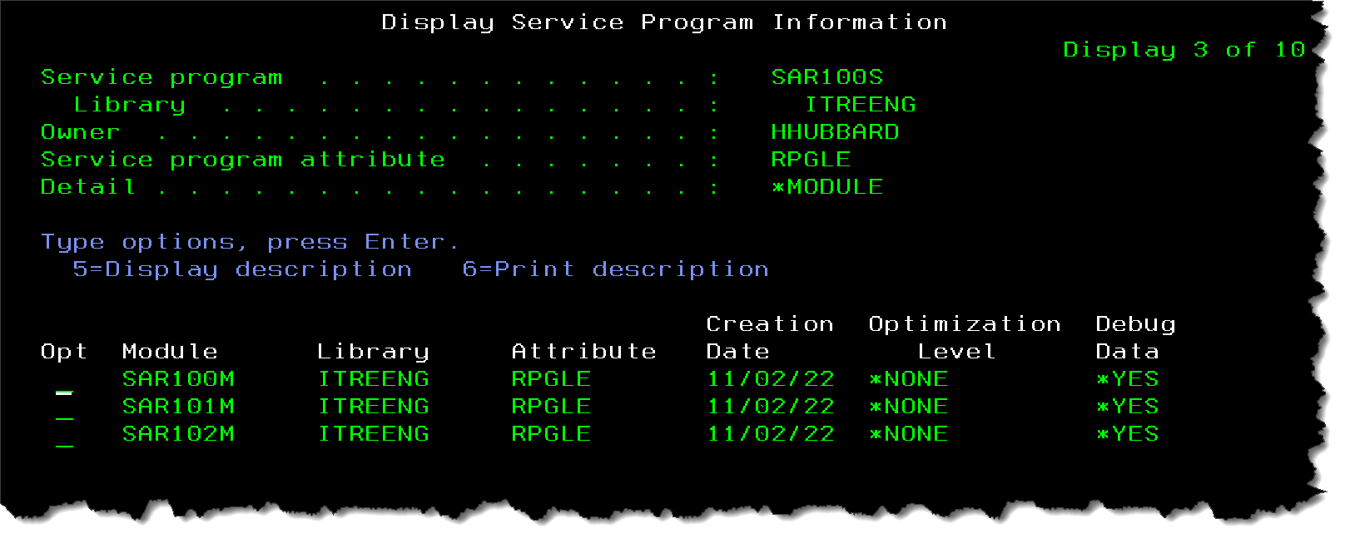
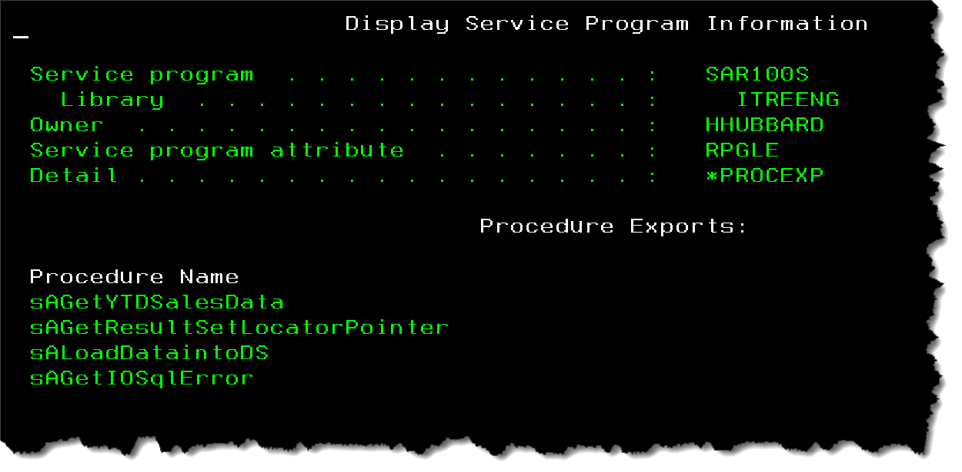
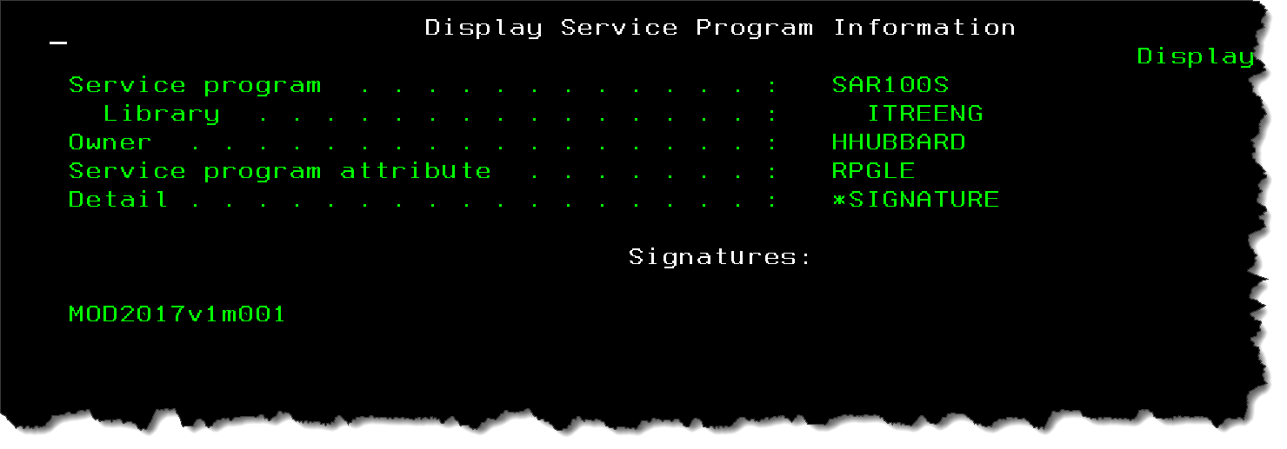
i5/OS Application Modernization
IBM Modern ILE Training
*SRVPGM
ILE - Modern Software Development
Update Service program using “UPDSRVPGM” Command.
© 2021, 2022 All Rights Reserved. Property of Vision-C Consulting Inc. (VCCI)

Slide 39
i5/OS Application Modernization
IBM Modern ILE Training
End Session
ILE - Modern Software Development
Thank You !
Instructor: Hiram Hubbard, CCP
© 2021, 2022 All Rights Reserved. Property of Vision-C Consulting Inc. (VCCI)

