Slide 1


i5/OS Application Modernization
IBM Modern ILE Training
Training Session 2
ILE - Modern Software Development
Training Out-Line
  Binding Directory
  Using Procedures in
  External Program
  Multi Row fetch in SQL
  Source Code Review
Instructor: Hiram Hubbard, CCP
© 2021, 2022 All Rights Reserved. Property of Vision-C Consulting Inc. (VCCI)

Slide 2
i5/OS Application Modernization
IBM Modern ILE Training
Objectives
After completing this session, you will be able to:
Have a good understating of ILE Development
Understand the difference between bound by copy &
bound by reference
Identify all the key components of ILE development
Understand how to do modern development & best
practice
Have a good understanding of using ILE with MVC
© 2021, 2022 All Rights Reserved. Property of Vision-C Consulting Inc. (VCCI)

Slide 3
i5/OS Application Modernization
IBM Modern ILE Training
Who should attend
This training is design for the following:
IBM i Software Developer’s
Technical Leads
Software Architects
Database Architects
© 2021, 2022 All Rights Reserved. Property of Vision-C Consulting Inc. (VCCI)

Slide 4
i5/OS Application Modernization
IBM Modern ILE Training
Modern Tools
ILE - Modern Software Development
  ACS or System i Navigator (Testing Queries, GUI Debugger, etc.)
  https://www.ibm.com/support/pages/ibm-i-access-client-solutions
  IBM Rational Developer For i (Rdi v9.6, IDE)
  https://www.ibm.com/support/pages/rational-developer-i-v96-available
  Data Studio v4.1.3
  (Creating Database Model)
  https://www.ibm.com/support/pages/download-and-install-ibm-data-studio-41x
© 2021, 2022 All Rights Reserved. Property of Vision-C Consulting Inc. (VCCI)

Slide 5

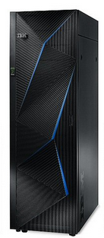
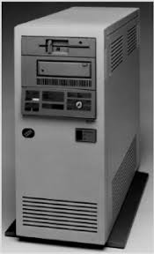
i5/OS Application Modernization
IBM Modern ILE Training
Training Session 2
Happy 34th Anniversary … IBM i
IBM i
AS/400
The 21^{st Century}
Power System server
It is the coolest
Server On the planet
AS/400 → iSeries → i5 → IBM i
© 2021, 2022 All Rights Reserved. Property of Vision-C Consulting Inc. (VCCI)

Slide 6

i5/OS Application Modernization
IBM Modern ILE Training
Training Session 2
How Skills are Developed…
Skill Mastered
In the course
we have
provided…
Practice
Practice
Practice
Practice
Practice
Practice
Practice
Practice
You must…
Strong
Reasons to
Practice
First Try
Initial Knowledge
Awareness
Org Support
© 2021, 2022 All Rights Reserved. Property of Vision-C Consulting Inc. (VCCI)

Slide 7
i5/OS Application Modernization
IBM Modern ILE Training
Training Session 2
ILE - Modern Software Development
Binding Directory
© 2021, 2022 All Rights Reserved. Property of Vision-C Consulting Inc. (VCCI)

Slide 8
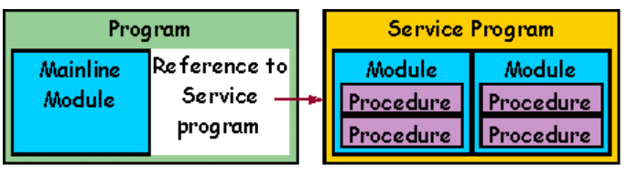
i5/OS Application Modernization
IBM Modern ILE Training
Binding Directory
ILE - Modern Software Development
What is a Binding Directory in IBMi?
A binding directory lists the names of modules and service programs that you may need when creating an ILE program Application or service program. Modules or service programs listed in a binding directory are used only if they provide an export that can satisfy any currently unresolved import requests.
Application
Binding Directory
Best Practice will be to have only *SRVPGM in a Binding Directory.
The Binding Directory is just a container that points to the objects.
© 2021, 2022 All Rights Reserved. Property of Vision-C Consulting Inc. (VCCI)

Slide 9
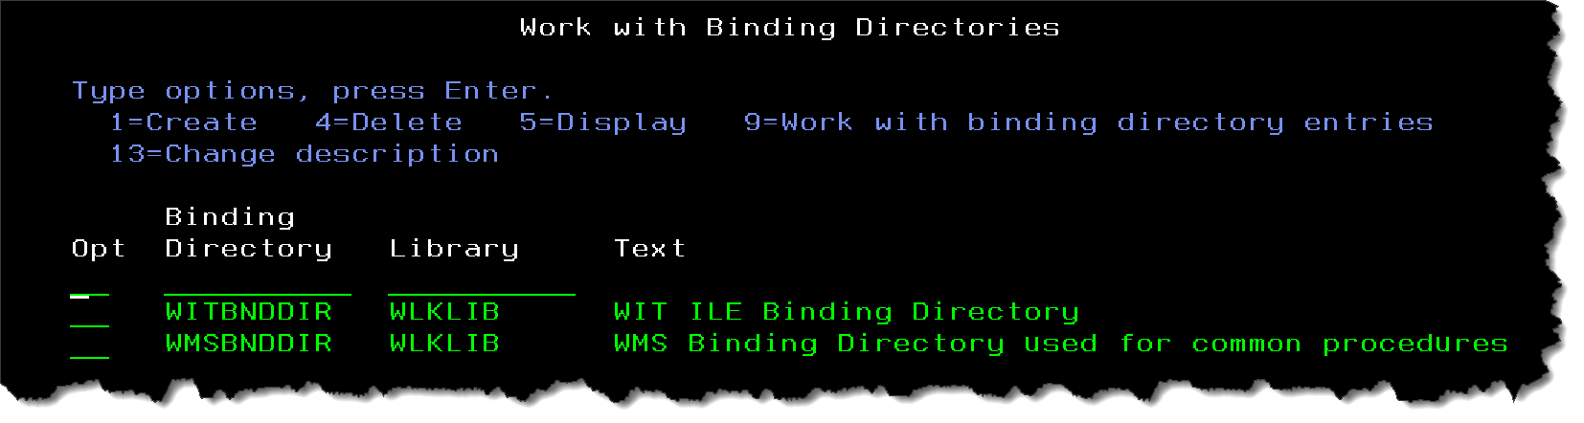
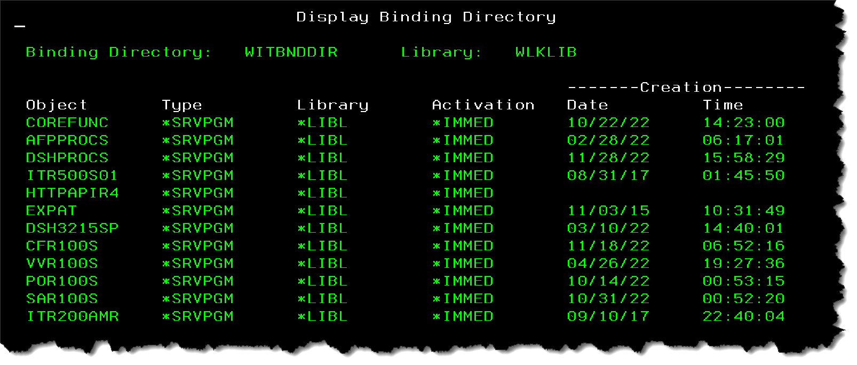
i5/OS Application Modernization
IBM Modern ILE Training
Binding Directory
ILE - Modern Software Development
Binding Directory only Points to the actual *SRVPGM or *Module.
© 2021, 2022 All Rights Reserved. Property of Vision-C Consulting Inc. (VCCI)

Slide 10

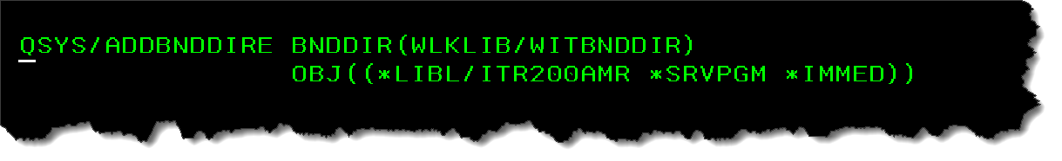
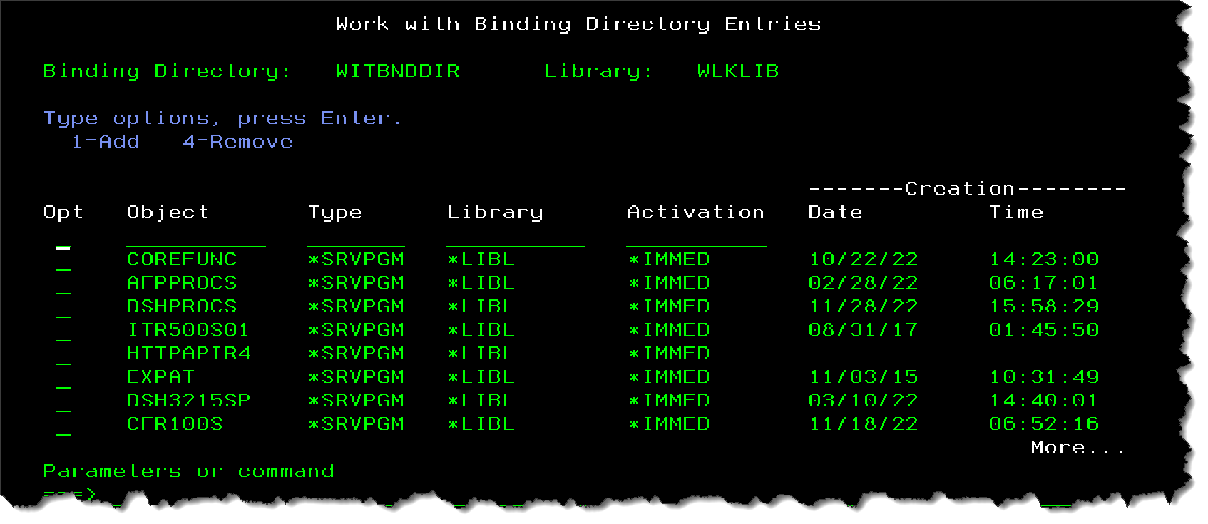
i5/OS Application Modernization
IBM Modern ILE Training
Binding Directory
ILE - Modern Software Development
ADDBNDDIRE add *SRVPGM or *Module to Binding Directory.
© 2021, 2022 All Rights Reserved. Property of Vision-C Consulting Inc. (VCCI)

Slide 11
i5/OS Application Modernization
IBM Modern ILE Training
Training Session 2
ILE - Modern Software Development
Procedures in External PGM
© 2021, 2022 All Rights Reserved. Property of Vision-C Consulting Inc. (VCCI)

Slide 12
i5/OS Application Modernization
IBM Modern ILE Training
External Program
ILE - Modern Software Development
What is an External Program in IBMi?
An External Program is a *SRVPGM sub procedure or a *PGM that is evoked from external SQL interface (API) or SQL Application. The primary purpose this to make the *SRVPGM or the *PGM available from a SQL Call statement.
PHP
Application
Catalog
SQL
Definition
Java
Application
External
Program
© 2021, 2022 All Rights Reserved. Property of Vision-C Consulting Inc. (VCCI)

Slide 13
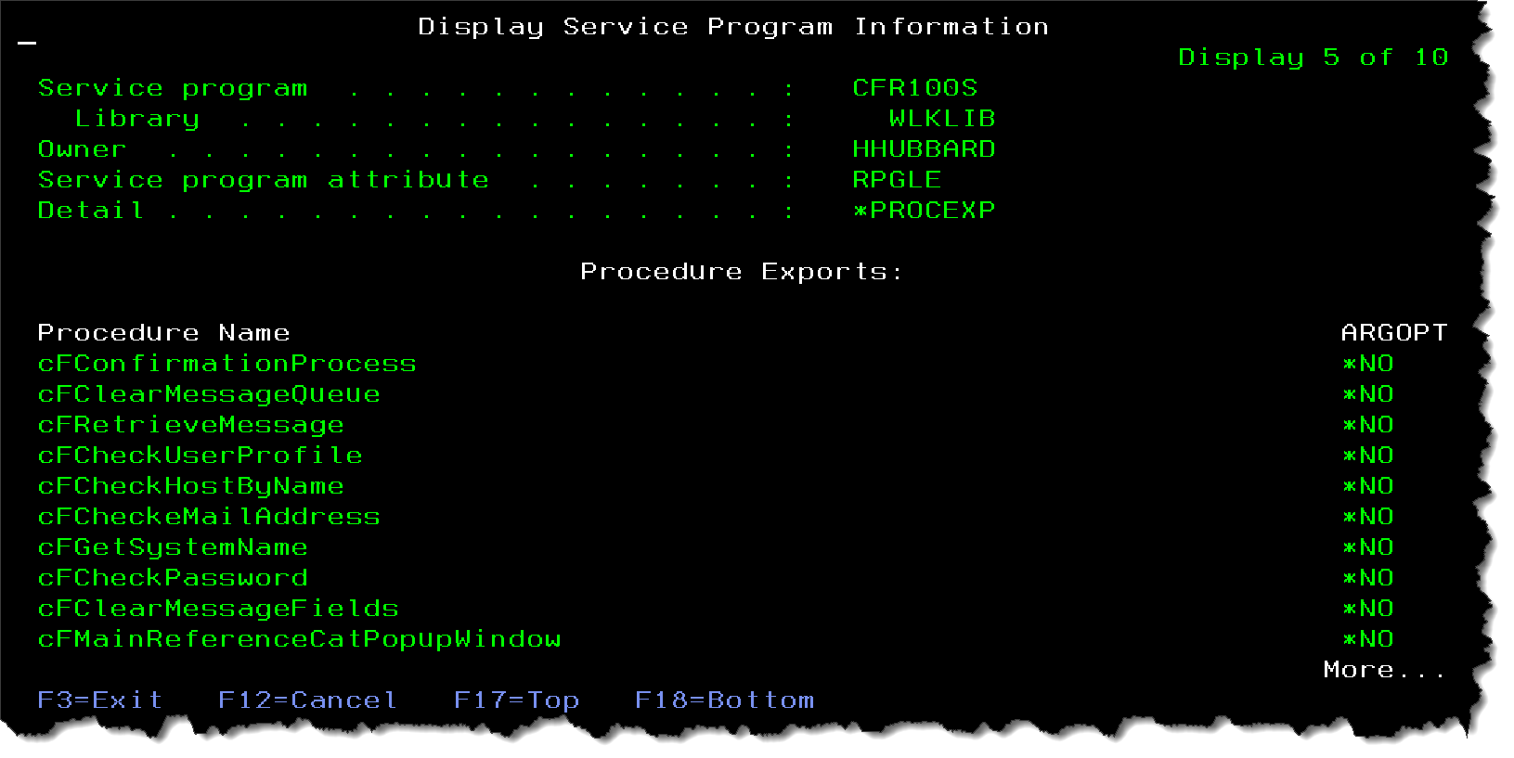
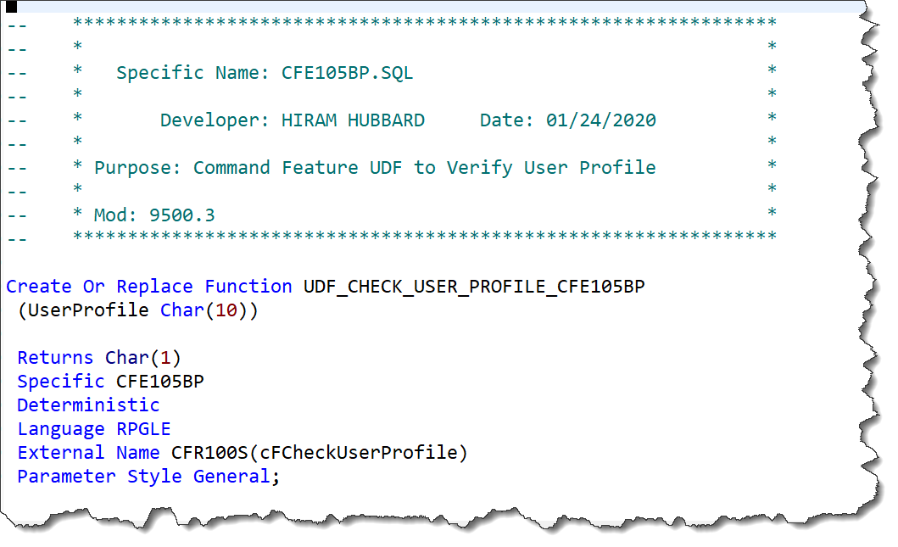
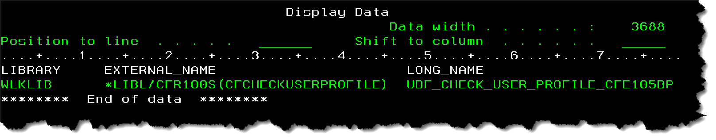
i5/OS Application Modernization
IBM Modern ILE Training
External Program
ILE - Modern Software Development
SQL Definition only…. No IBMi Object
External Application
PHP
Application
Java
Application
DB2 Catalog
© 2021, 2022 All Rights Reserved. Property of Vision-C Consulting Inc. (VCCI)

Slide 14
i5/OS Application Modernization
IBM Modern ILE Training
External Program
ILE - Modern Software Development
  External Program A
© 2021, 2022 All Rights Reserved. Property of Vision-C Consulting Inc. (VCCI)

Slide 15
i5/OS Application Modernization
IBM Modern ILE Training
Training Session 2
ILE - Modern Software Development
Multi Row Fetch in SQL
© 2021, 2022 All Rights Reserved. Property of Vision-C Consulting Inc. (VCCI)

Slide 16
i5/OS Application Modernization
IBM Modern ILE Training
Multi Row Fetch
ILE - Modern Software Development
What is Multi-Row Fetch in DB2 SQL?
The multiple-row FETCH statement can be used to retrieve multiple rows from a table or view with a single FETCH statement. The program controls the blocking of rows by the number of rows requested on the FETCH statement (The Override Database File (OVRDBF) command has no effect.).
ROW 1
ROW 2
DB2 For i
Table
Select
Fetch
ROW 3
ROW 4
Application
DB2 Multi-Row Fetch for better performance
© 2021, 2022 All Rights Reserved. Property of Vision-C Consulting Inc. (VCCI)

Slide 17
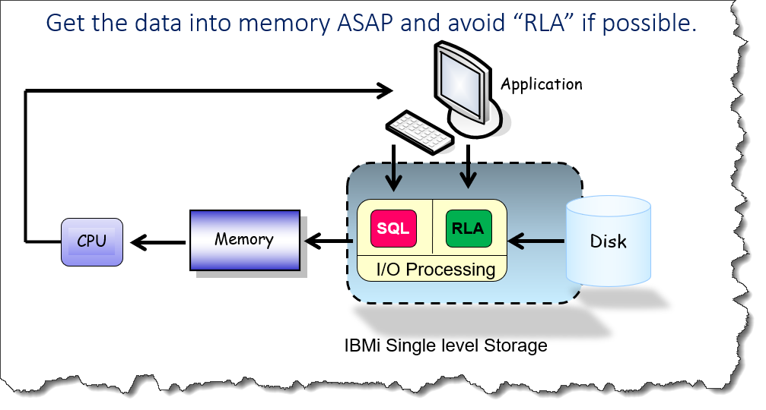
i5/OS Application Modernization
IBM Modern ILE Training
Multi Row Fetch
IBMi I/O Performance Overview
DB2 Multi-Row Fetch for better performance
© 2021, 2022 All Rights Reserved. Property of Vision-C Consulting Inc. (VCCI)

Slide 18
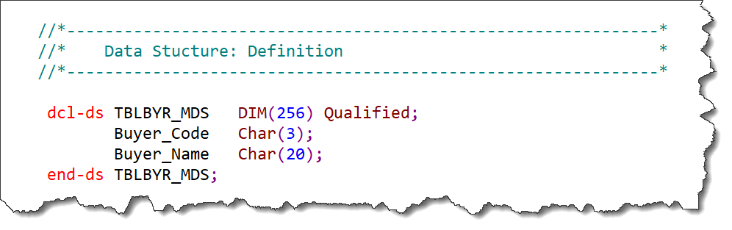
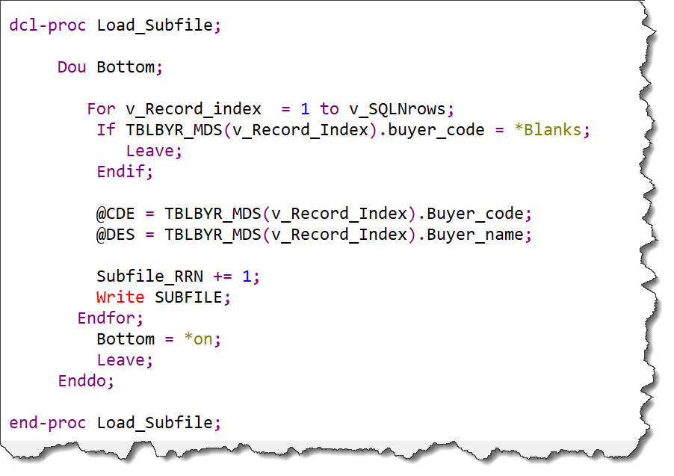
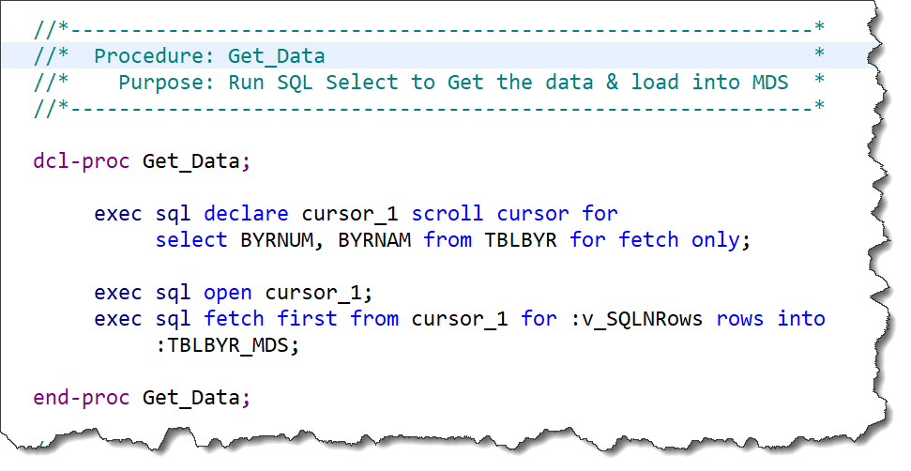
i5/OS Application Modernization
IBM Modern ILE Training
Multi Row Fetch
ILE - Modern Software Development
Read data from the Data Structure in memory
© 2021, 2022 All Rights Reserved. Property of Vision-C Consulting Inc. (VCCI)

Slide 19
i5/OS Application Modernization
IBM Modern ILE Training
Multi Row Fetch
ILE - Modern Software Development
  Multi-Row Fetch Example A
  Multi-Row Fetch Example B
© 2021, 2022 All Rights Reserved. Property of Vision-C Consulting Inc. (VCCI)

Slide 20
i5/OS Application Modernization
IBM Modern ILE Training
Training Session 2
ILE - Modern Software Development
Source Review
© 2021, 2022 All Rights Reserved. Property of Vision-C Consulting Inc. (VCCI)

Slide 21
i5/OS Application Modernization
IBM Modern ILE Training
End Session
ILE - Modern Software Development
Thank You !
Instructor: Hiram Hubbard, CCP
© 2021, 2022 All Rights Reserved. Property of Vision-C Consulting Inc. (VCCI)

Slide 22
i5/OS Application Modernization
IBM Modern ILE Training
Multi Row Fetch
IBMi I/O Performance Overview
Get the data into memory ASAP and avoid “RLA” if possible.
Application
Memory
SQL
RLA
Disk
CPU
I/O Processing
IBMi Single level Storage
DB2 Multi-Row Fetch for better performance
© 2021, 2022 All Rights Reserved. Property of Vision-C Consulting Inc. (VCCI)

