Slide 1
Event Caster

Slide 2
Contents
Definition of project
Technology stack
Project Explanation
Challenges faced
Conclusion
Future Work

Slide 3
Definition
Event Caster is an android application for event management that makes it easy for customer to book event of various types. It also allows customers to see the event history of completed events so that customer can get the review before book the event.
In this is user has access as manager then he can add the evnets to the system with their package.

Slide 4
Technology Stack Used
Android
.Net for backend

Slide 5
Project Features
Customer can book event
Customer can view existing or previously completed events
There is a gallery of completed events
Manager can create event
User can see the booking history
Customer can give the feedback

Slide 6
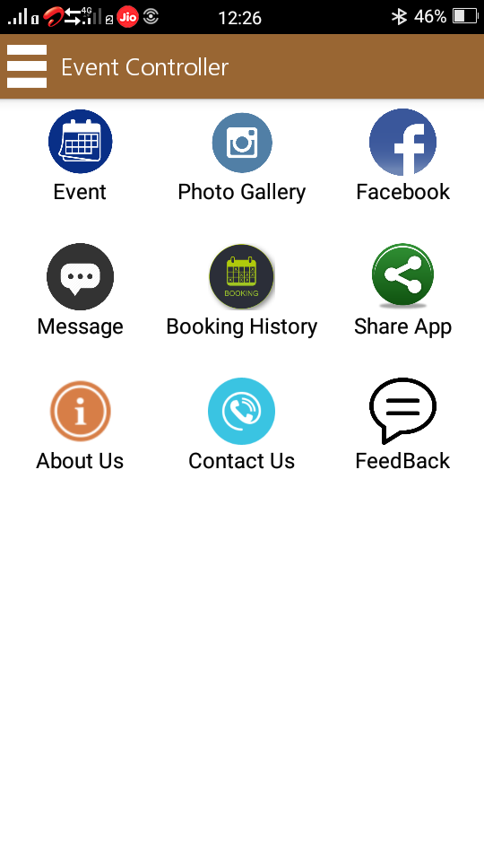
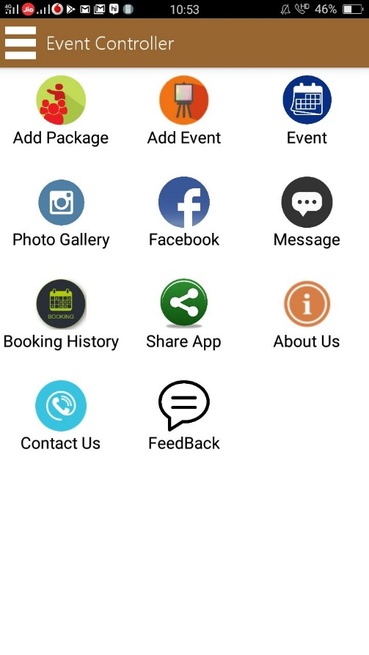
Project Explanation(Cont.)
Two types of user access :
User
Manager
User
Manager

Slide 7
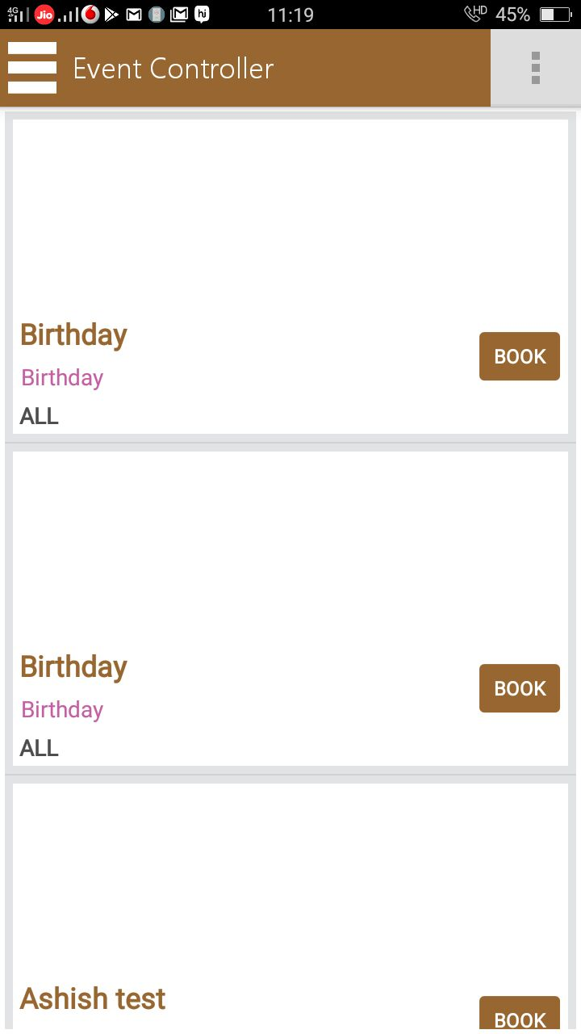
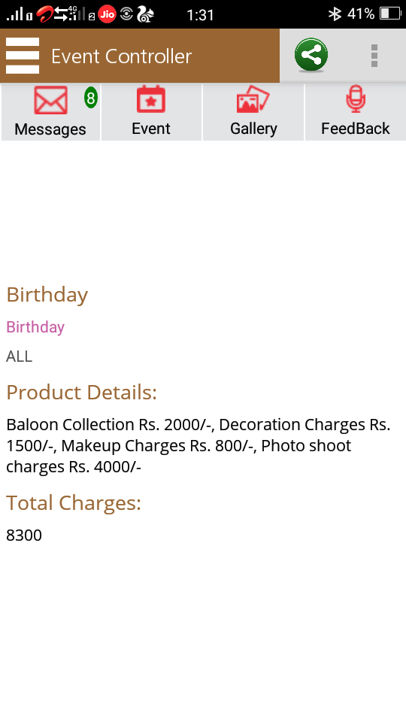
Project Explanation(Cont.) Customer Event Booking

Slide 8
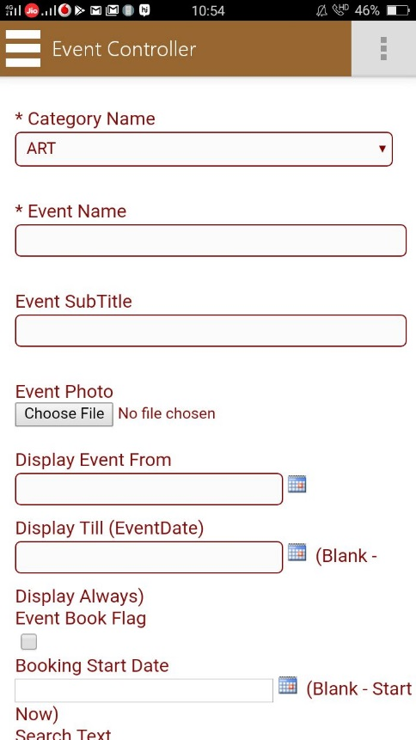
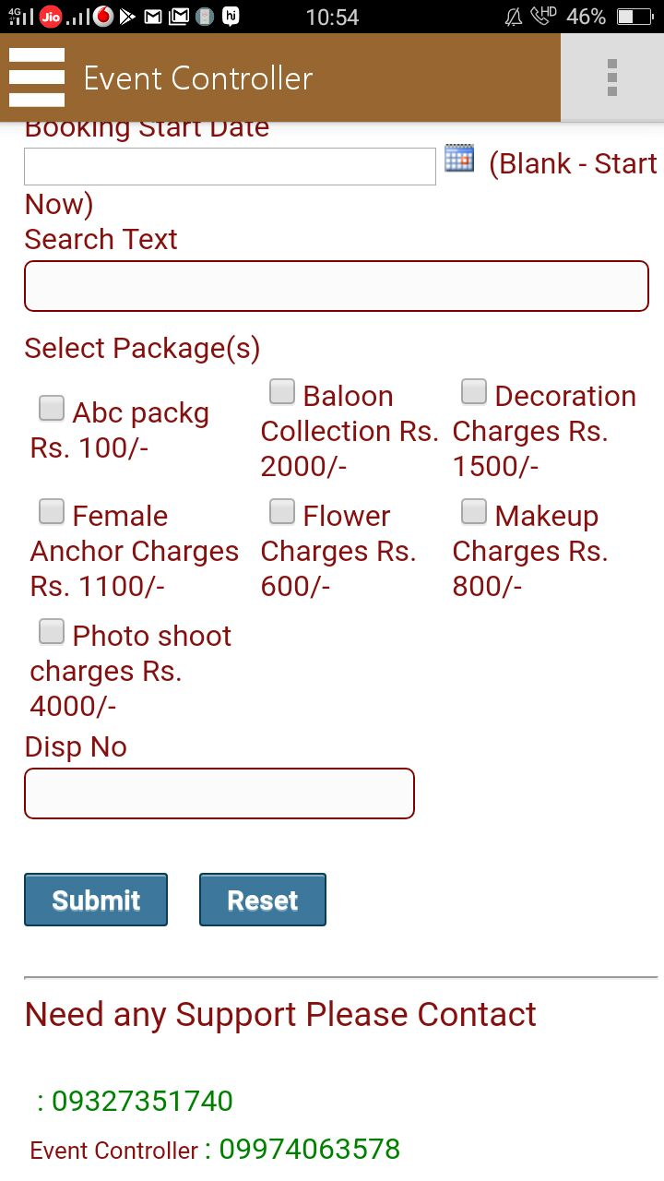
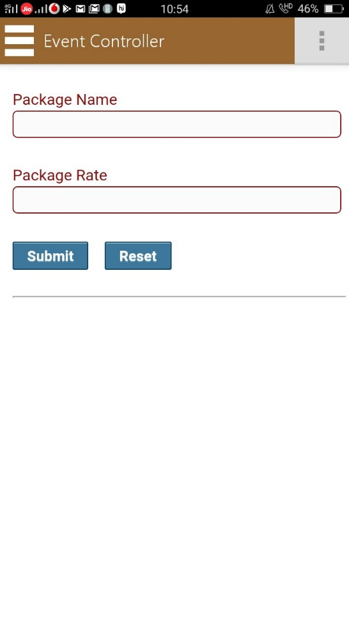
Project Explanation(Cont.) Manager create Event and Event package

Slide 9
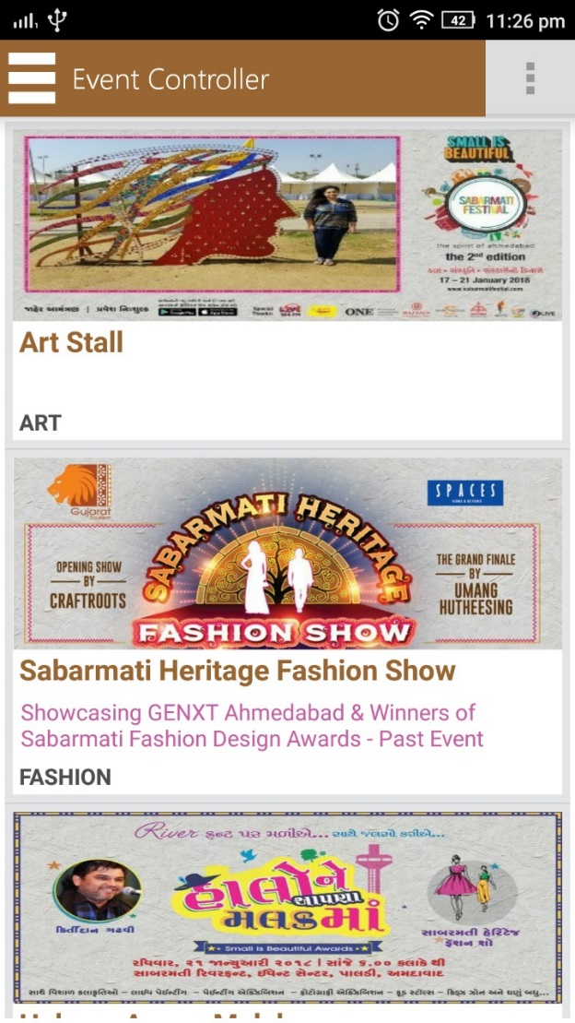
Project Explanation(Cont.) Event History
User can see the history of previously completed events and it’s photos and information as seen in image.

Slide 10
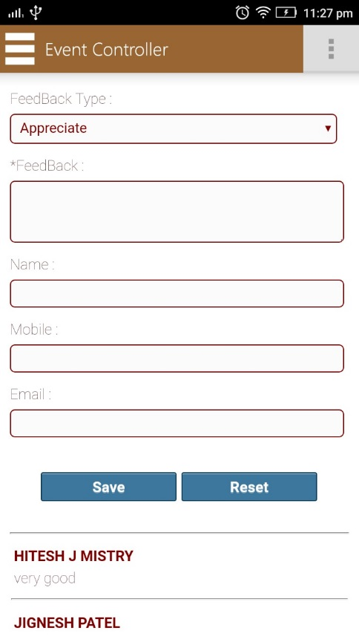
Project Explanation(Cont.) Feedback
User can give the feedback for the application either they have complain about application or appreciation or support.

Slide 11
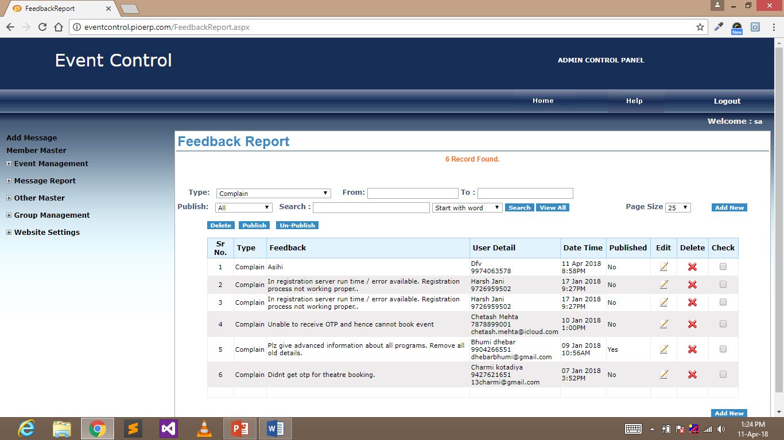
Project Explanation(Cont.) Feedback report on admin side
Feedback report is also generated on admin side.

Slide 12
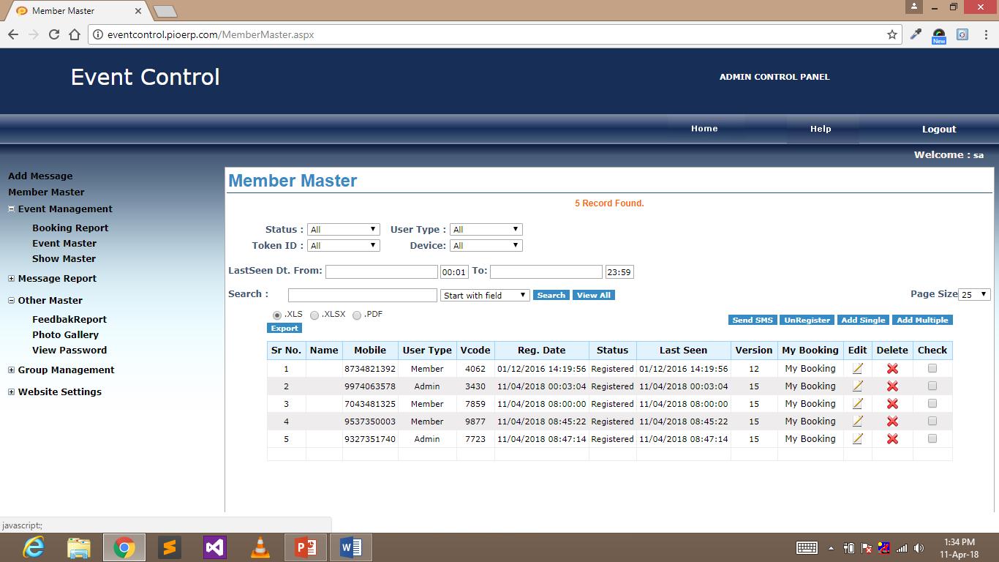
Project Explanation(Cont.) Member Master
It shows the users which are enrolled in the system.

Slide 13
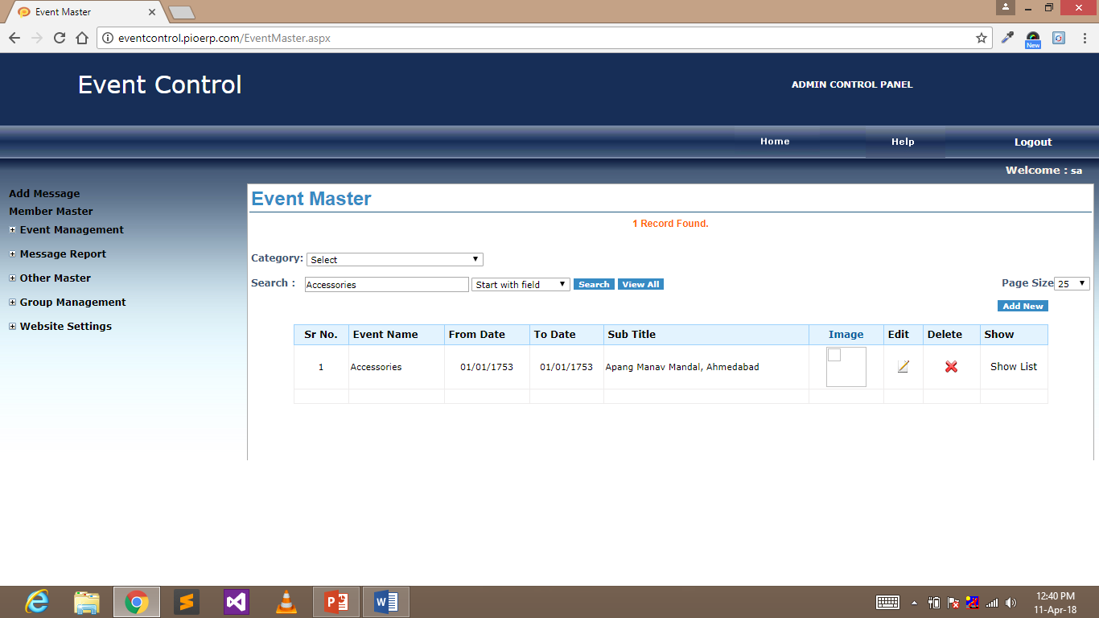
Project Explanation(Cont.) Event Master
It list out all the events registered in the system.

Slide 14
Challenges faced
In installation
In Web-services
In Designing

Slide 15
Future Work
We can create the profile for the users and manager
User can search for the event packages according to their budgets.
User can also see the manager profile

Slide 16
Thank You

