Slide 1

SenseShop
By: Harsh Chauhan

Slide 2
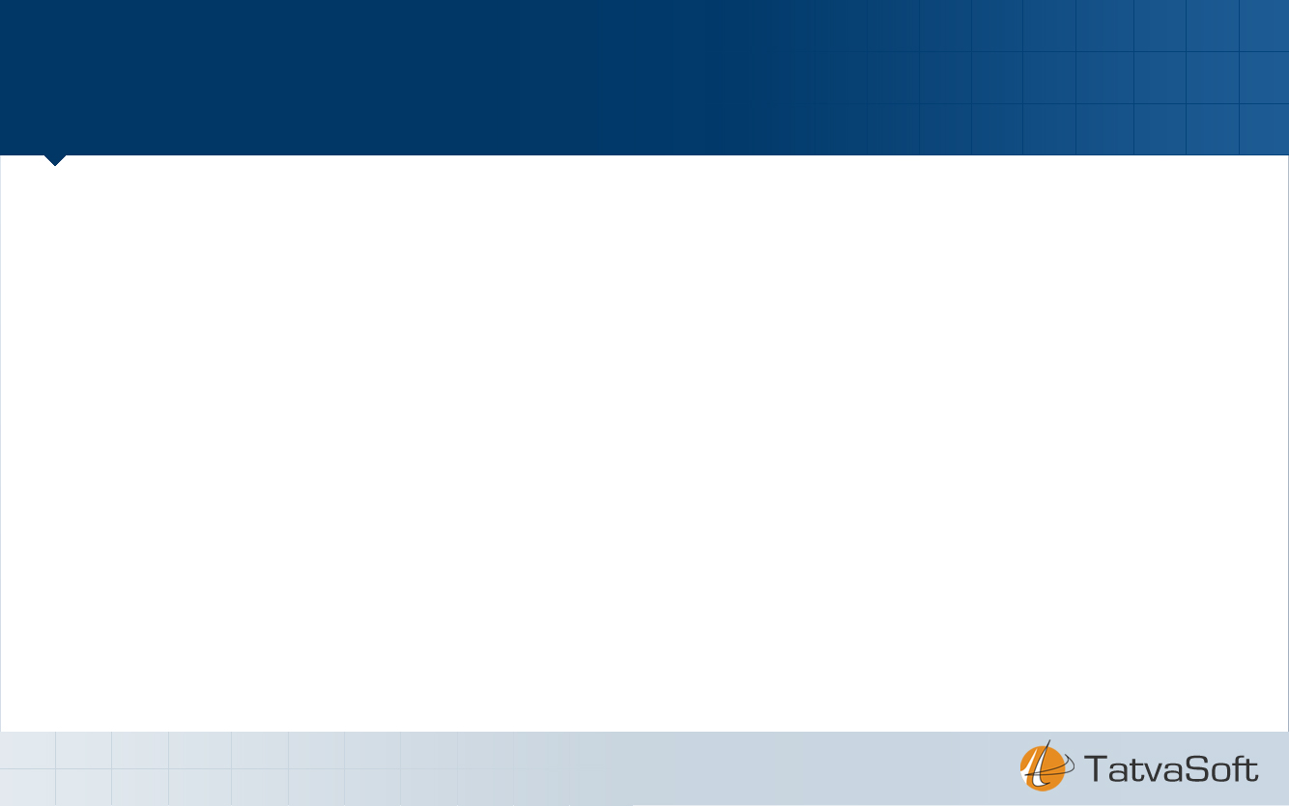
Index
Project Definition
System Architecture And Technology
Features
Screenshot
Challenges Faced And Over come
Conclusion
Future Extension

Slide 3
Project Deffination
SenseShop is a web based application that provides a very convenient way of shopping to the customer for faster checkouts and easy payments using various type of sensors.
Main goal for system is to save the valuable time of customer for purchasing of the daily needs. SenseShop system can also be used for the inventory management and the Warehouse management of the goods so that it can be efficient and helpful for the customer as well as the Retailer.

Slide 4
System Architecture And Technology
Language used : Python
Framework : “Django”/”Bootstrap”
Architecture : MVC
Database : Sqlite
Front End: HTML/CSS/Javascript

Slide 5
Features
Features:
Customer can shop without waiting for billings.
Registered customer can shop.
Previous recoreds of orders
Customer can complaints for particular products.
No lines in checkouts.
Admin modify the products and stocks.
Solution for better shopping experience
User add to cart products and checkouts.

Slide 6
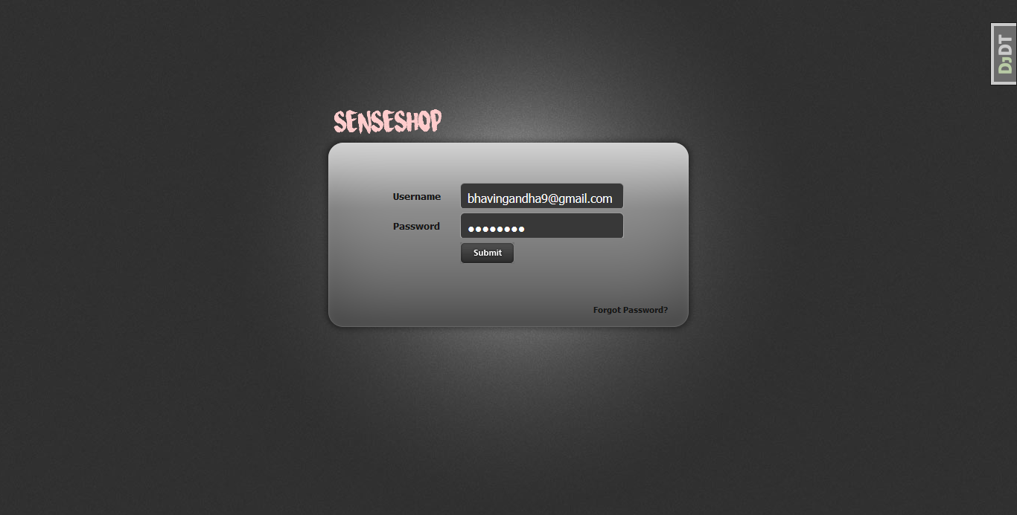
Screenshots Login

Slide 7
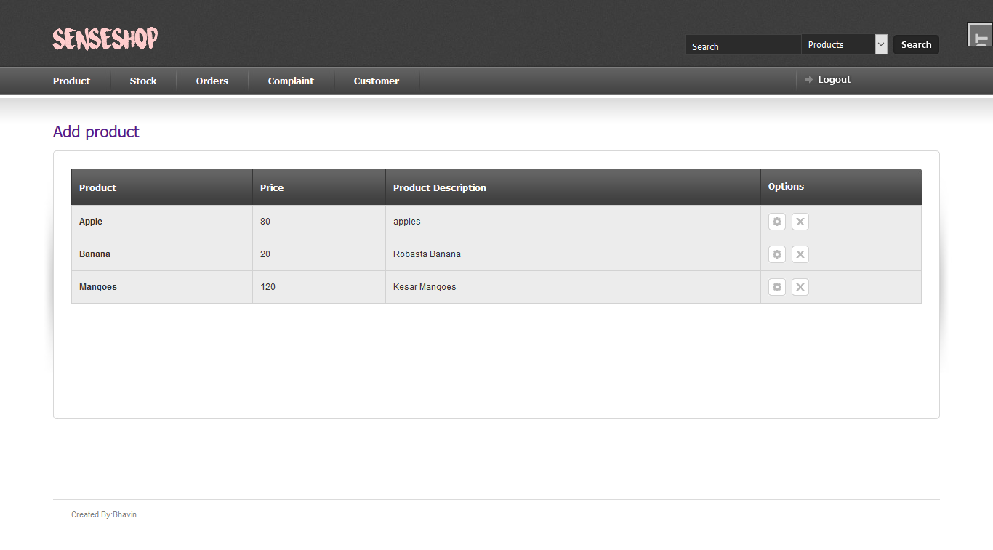
Admin Index

Slide 8
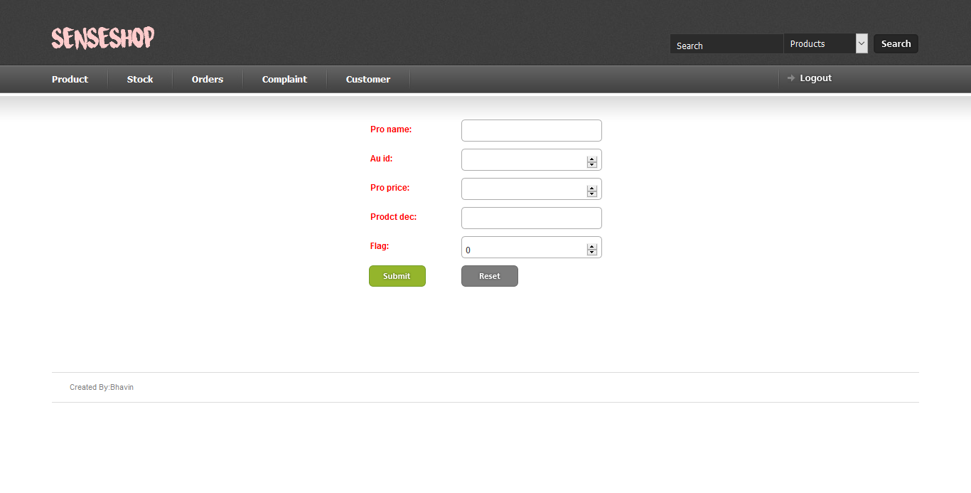
Add Products

Slide 9
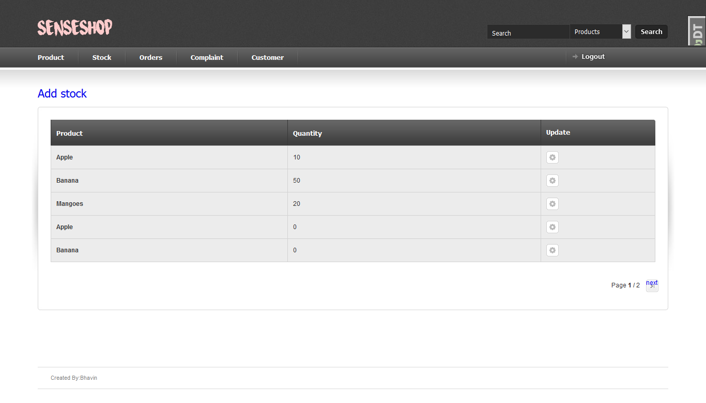
Stock

Slide 10
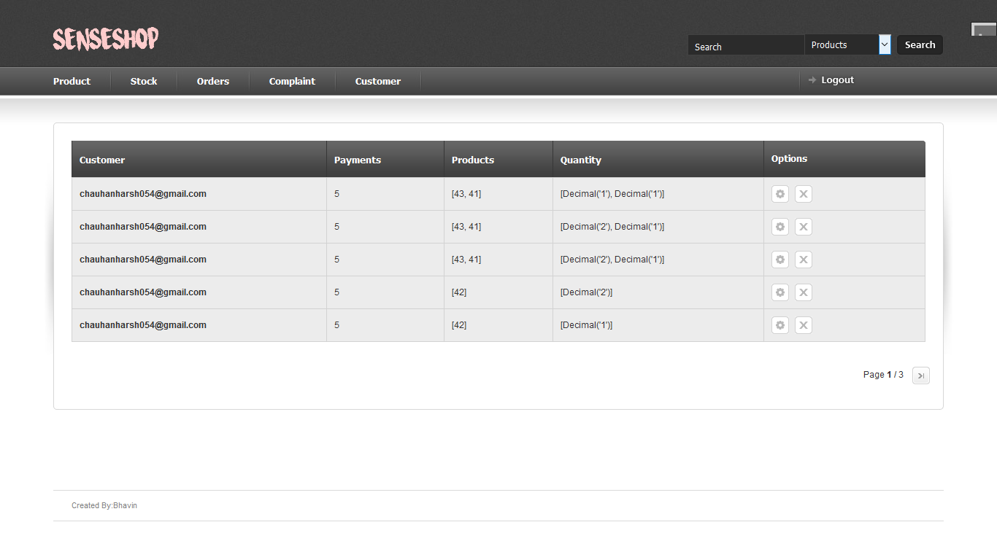
Order Details

Slide 11
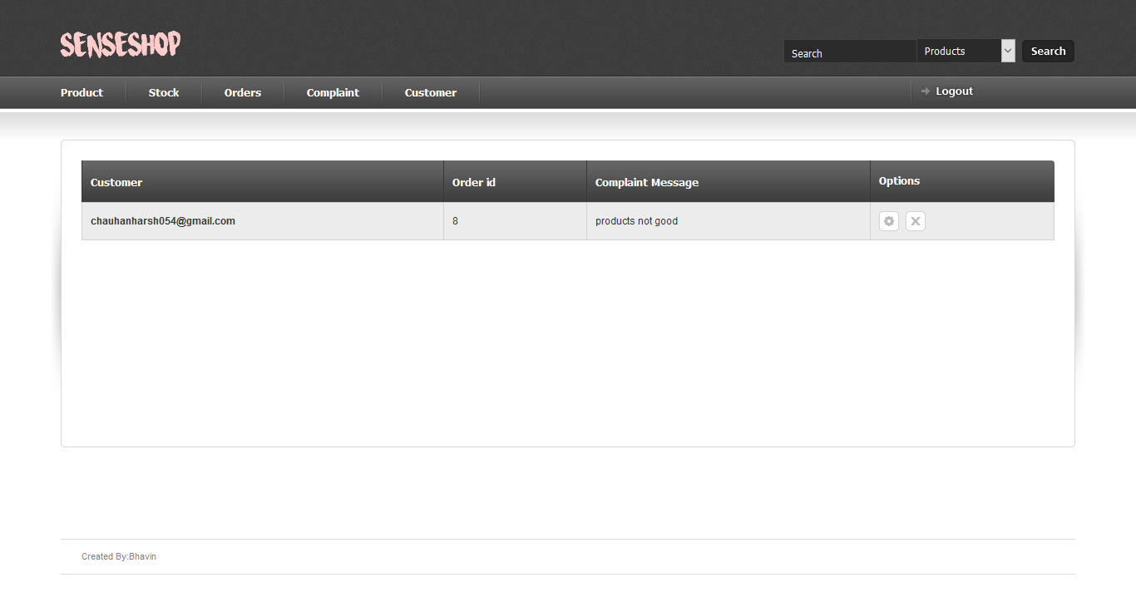
Complaint

Slide 12
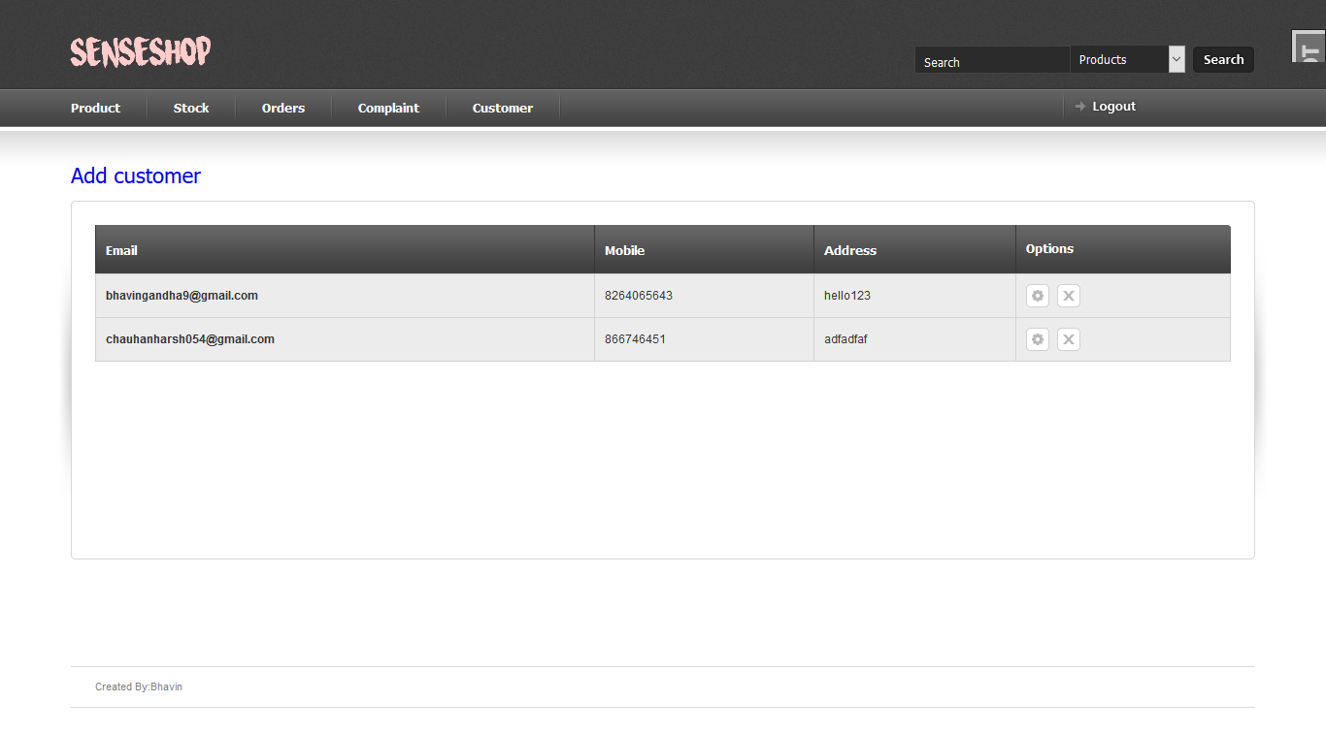
Customers

Slide 13
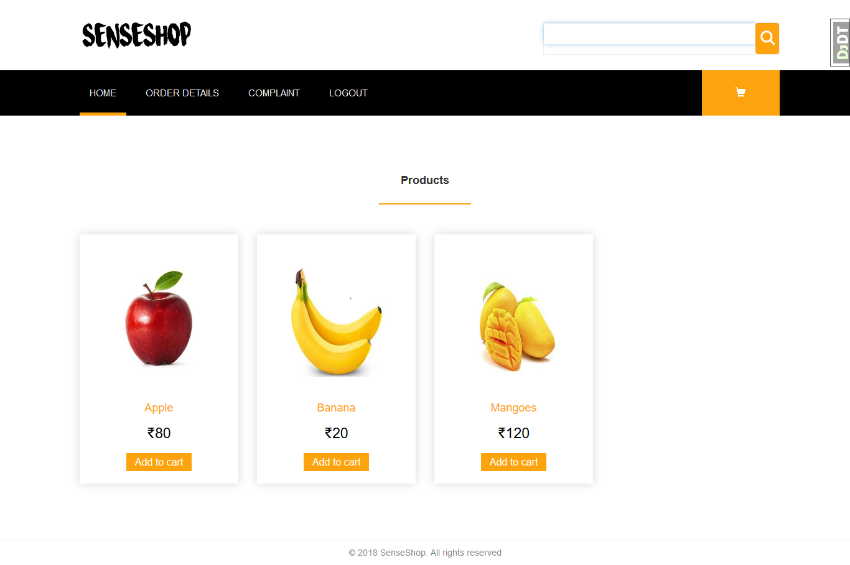
User Home

Slide 14
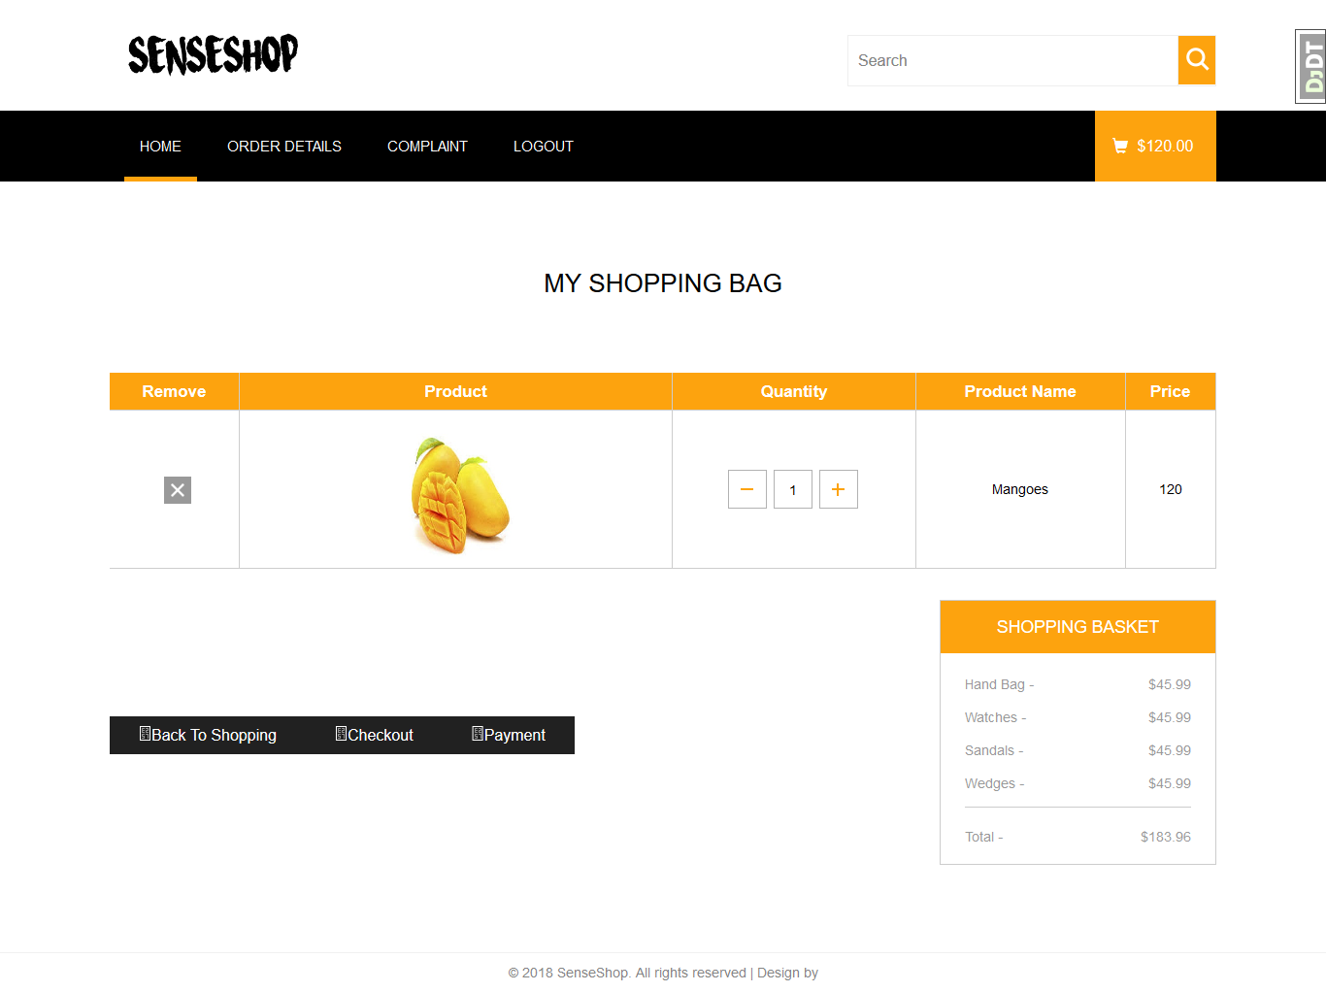
Cart

Slide 15
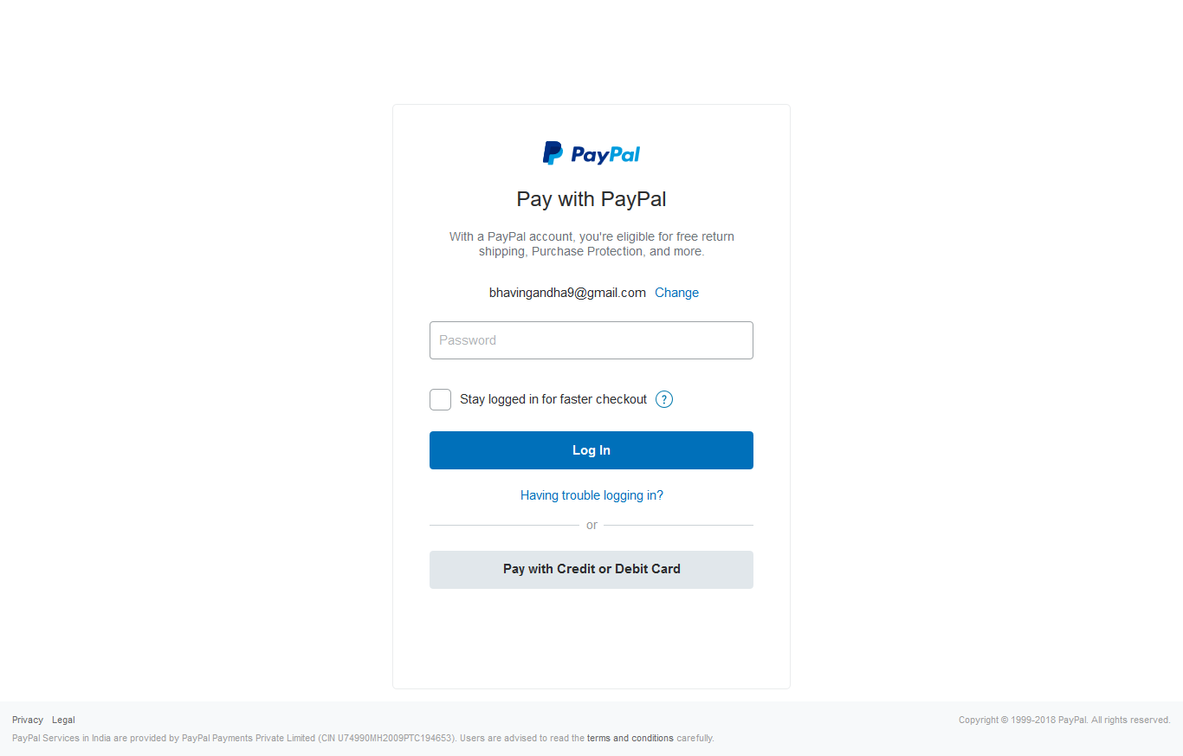
Payments Gateway

Slide 16
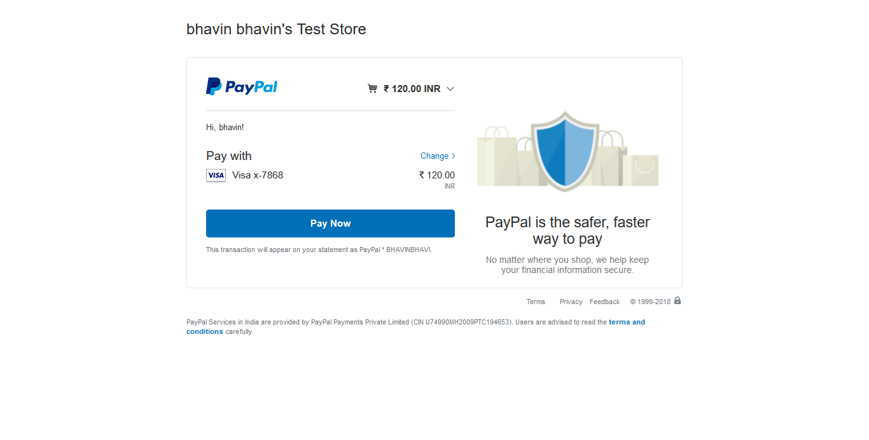
Payments Gateway

Slide 17
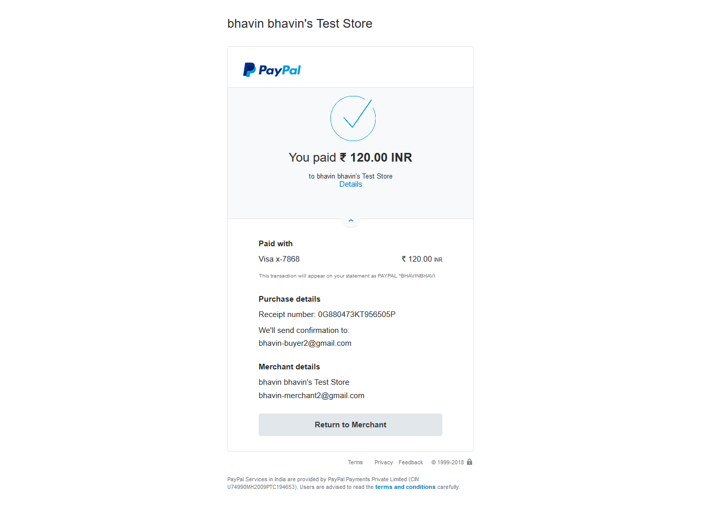
Payments Successfully

Slide 18
Challenges faced and over come
1. How to implements Web app in Python and Django framework use!
Now over come this challenges learn python and Django framework and implements
Web app.
2. Implements using MVC
Now over come this challenges learn MVC and Implements
3. Implements image detection.
Very big challenge to implements image detection in our projects implements small
Image detection like products is apple fruit then image are apple fruit or not.
4.Implements add to cart item using Smart trolly and arduino
This functionality is very hard to implements when user in mall and pick up the item and and drop in to the trolly then the item are add to user cart automatically. And user
Pay bill using app directly no wait for lines in checkouts. This challenges are not overcome

Slide 19
Conclusion
1.

Slide 20
Future Work
1.We are going to remove maximum limitations of the System.
2.To Implements Add to cart item using smart trolly and arduino.
3.Implements machine learning to add to cart item
4.Some weight sensors and many more sensors to implements add to virtual cart functionality.
5.Develop App to communicate user When they enter in mall and Register the user.

Slide 21
THANK YOU
ANY QUESTIONS ?

