Slide 1
Coursera Capstone IBM Applied Data Science Capstone Opening a New Shopping Mall in Mumbai, India
By: Harsh Chandak April 2020

Slide 2
Business Problem
Location of shopping mall is one of the most important decisions that will determine whether the mall will be a success or a failure
Objective: To analyze and select the best locations in the city of Mumbai, India to open a new shopping mall
Business question
In the city of Mumbai, India, if a property developer is looking to open a new shopping mall, where would you recommend that they open it?

Slide 3
Data
Data required
List of neighborhoods in Mumbai
Latitude and longitude coordinates of the neighborhoods
Venue data, particularly data related to shopping malls
Sources of data
Wikipedia page for neighborhoods (https://en.wikipedia.org/wiki/Category:Neighborhoods_in_Mumbai)
Geopy (geopy.geocoders) package for latitude and longitude coordinates
Foursquare API for venue data

Slide 4
Methodology
Web scraping Wikipedia page for neighborhoods list
Get latitude and longitude coordinates using Geopy
Use Foursquare API to get venue data
Group data by neighborhood and taking the mean of the frequency of occurrence of each venue category
Filter venue category by Shopping Mall
Perform clustering on the data by using k-means clustering
Visualize the clusters in a map using Folium

Slide 5
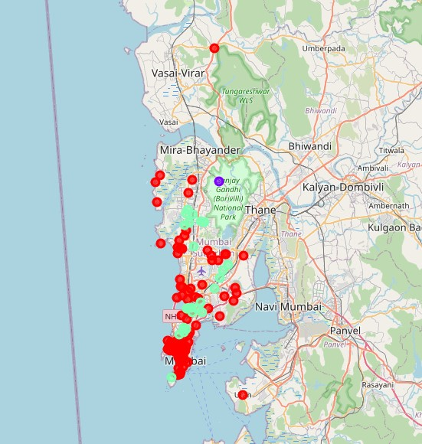
Results
Categorized the neighborhoods into 3 clusters:
Cluster 0: Neighborhoods with moderate number of shopping malls
Cluster 1: Neighborhoods with low number to no existence of shopping malls
Cluster 2: Neighborhoods with high concentration of shopping malls

Slide 6
Discussion
Most of the shopping malls are concentrated in the southern and central area of Mumbai
Highest number of shopping malls in cluster 2 and moderate number in cluster 0
Cluster 1 has very low number to no shopping mall in the neighborhoods
There is opportunity to make shopping malls in the northern area and central area of Mumbai

Slide 7
Conclusion
Answer to business question: The neighborhoods in cluster 1 are the most preferred locations to open a new shopping mall
Findings of this project will help the relevant stakeholders to capitalize on the opportunities on high potential locations while avoiding overcrowded areas in their decisions to open a new shopping mall

