Slide 1

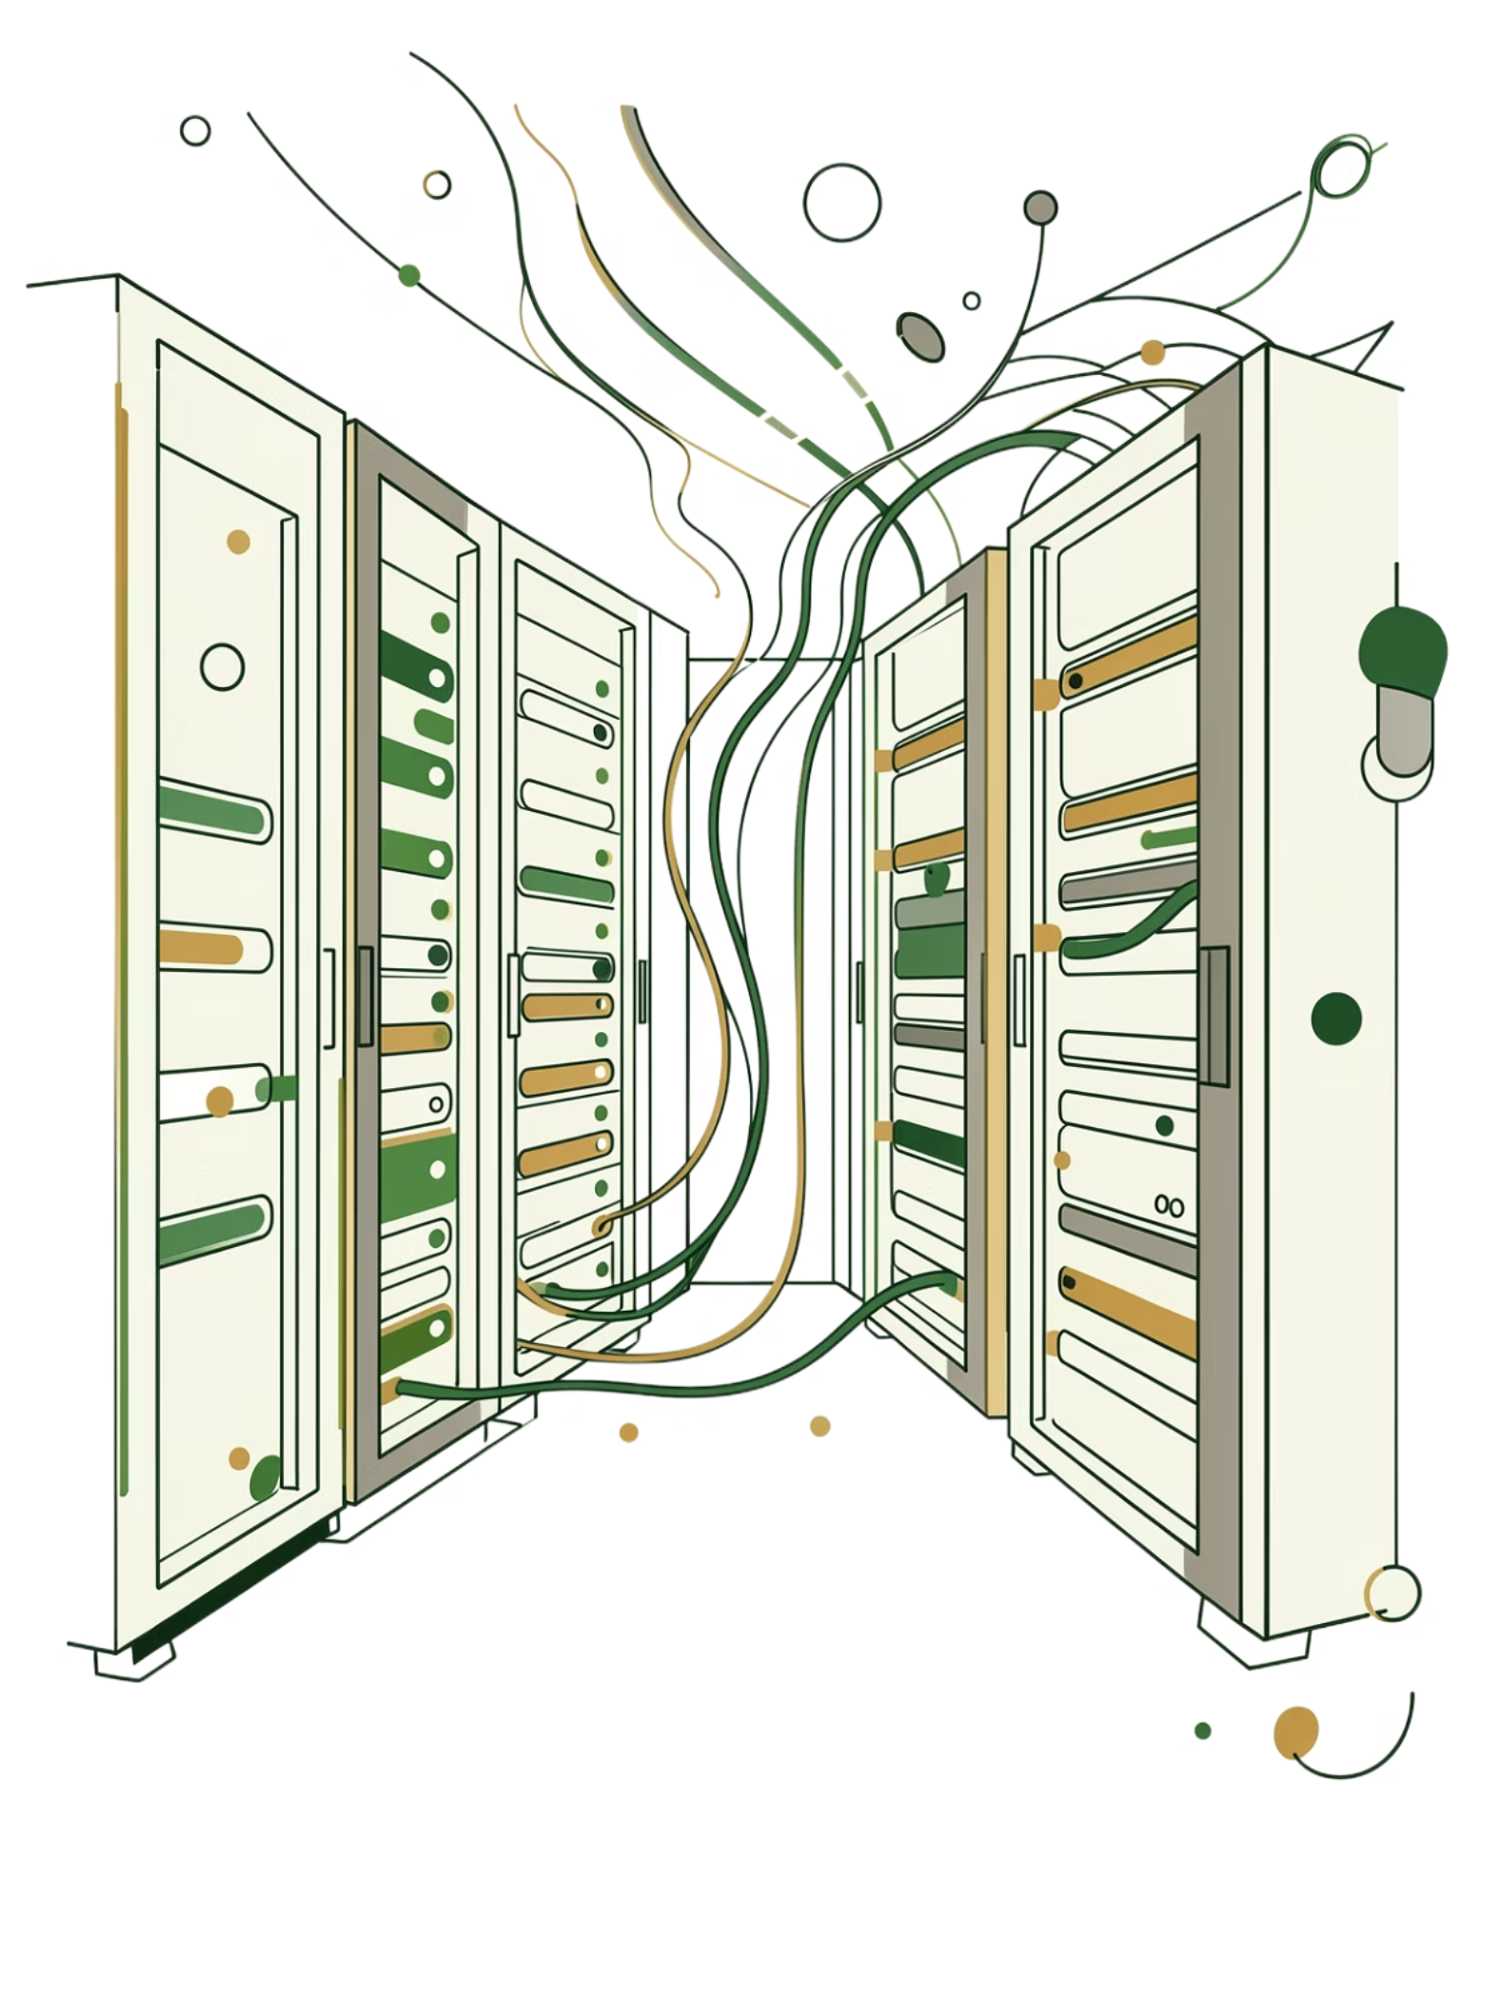
SlugAPI
Cloud-Native API Platform
A Django-based REST API, fully containerized and orchestrated — from code commit to production metrics.
DEVOPS ARCHITECTURE
CI/CD PIPELINE
OBSERVABILITY
Developed By: Harsh Chauhan (12319734)
Roll No. : 30
Section: 4OM56
Subject: INT 377
Submitted To: Miss. Arshiya (29453)

Slide 2
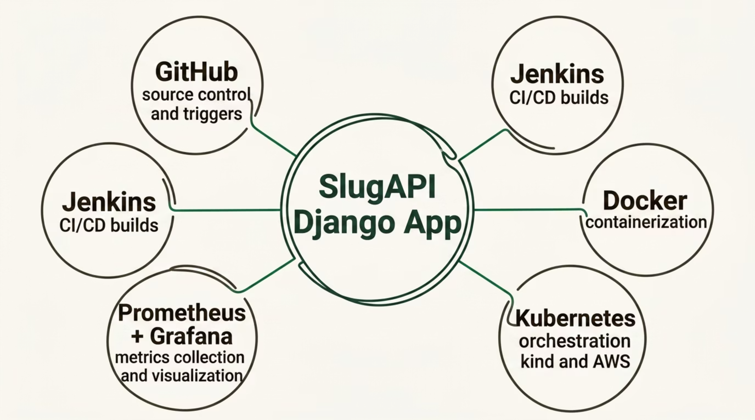

Architecture Overview
SlugAPI is built on a modern cloud-native stack. Every service plays a defined role — from source control to live dashboards.
Each layer is decoupled and automated, enabling rapid iteration, consistent deployments, and real-time observability.

Slide 3

CORE APPLICATION
SlugAPI — Django REST Framework
SlugAPI is the heart of the platform — a Django-based REST API that handles all business logic and data operations.
RESTful Design
Stateless & Scalable
Redis-Backed
Clean, versioned API endpoints built on Django REST Framework
Designed to run in containers — no local state, fully horizontal
Uses Redis for caching and async task queues

Slide 4

Docker — Containerization Layer
Every component of SlugAPI is packaged as a Docker image, ensuring environment parity from development to production.
🐳 Django App Image
🔒 Isolated Runtime
Multi-stage build minimizing image size and attack surface
Each service runs in its own container with defined resource limits
📦 Docker Hub Registry
Images are tagged and pushed to Docker Hub automatically via Jenkins
Image: harshchauhan01/slug-api:latest

Slide 5
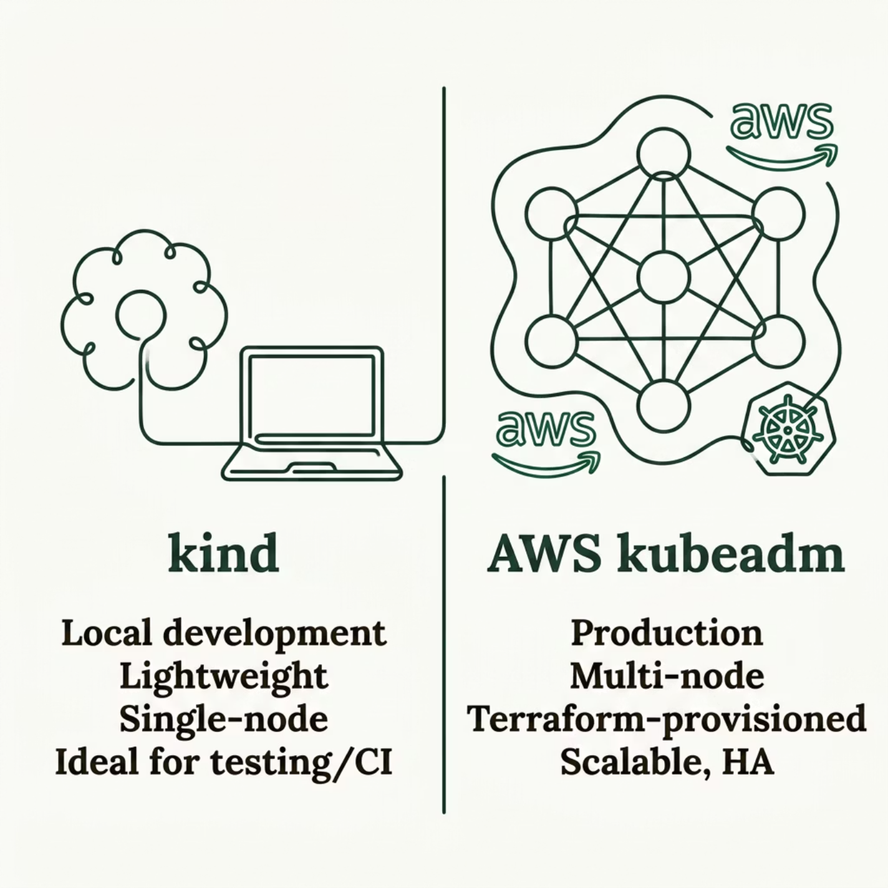

Kubernetes — Container Orchestration
SlugAPI runs on two Kubernetes environments, each serving a distinct purpose in the development lifecycle.
kind Cluster (Local)
AWS kubeadm Cluster (Production)
Kubernetes IN Docker — fast, lightweight local cluster used for development and pre-deployment testing
Provisioned via Terraform on AWS EC2 instances — multi-node, production-ready, scalable cluster

Slide 6
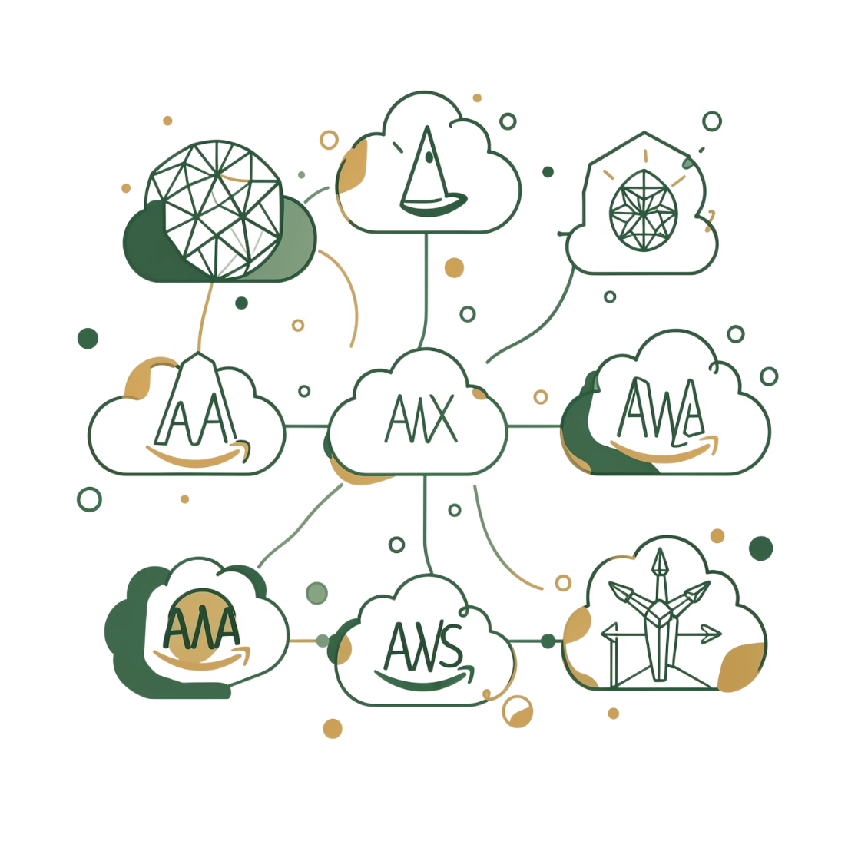
INFRASTRUCTURE AS CODE
Terraform — AWS Provisioning
Terraform automates the provisioning of the AWS infrastructure that hosts the production Kubernetes cluster.
EC2 Instances
VPC & Networking
State Management
Provisions and configures worker and control-plane nodes for the kubeadm cluster
Defines VPCs, subnets, security groups, and routing tables
Remote state stored in S3 with DynamoDB locking for team-safe operations

Slide 7

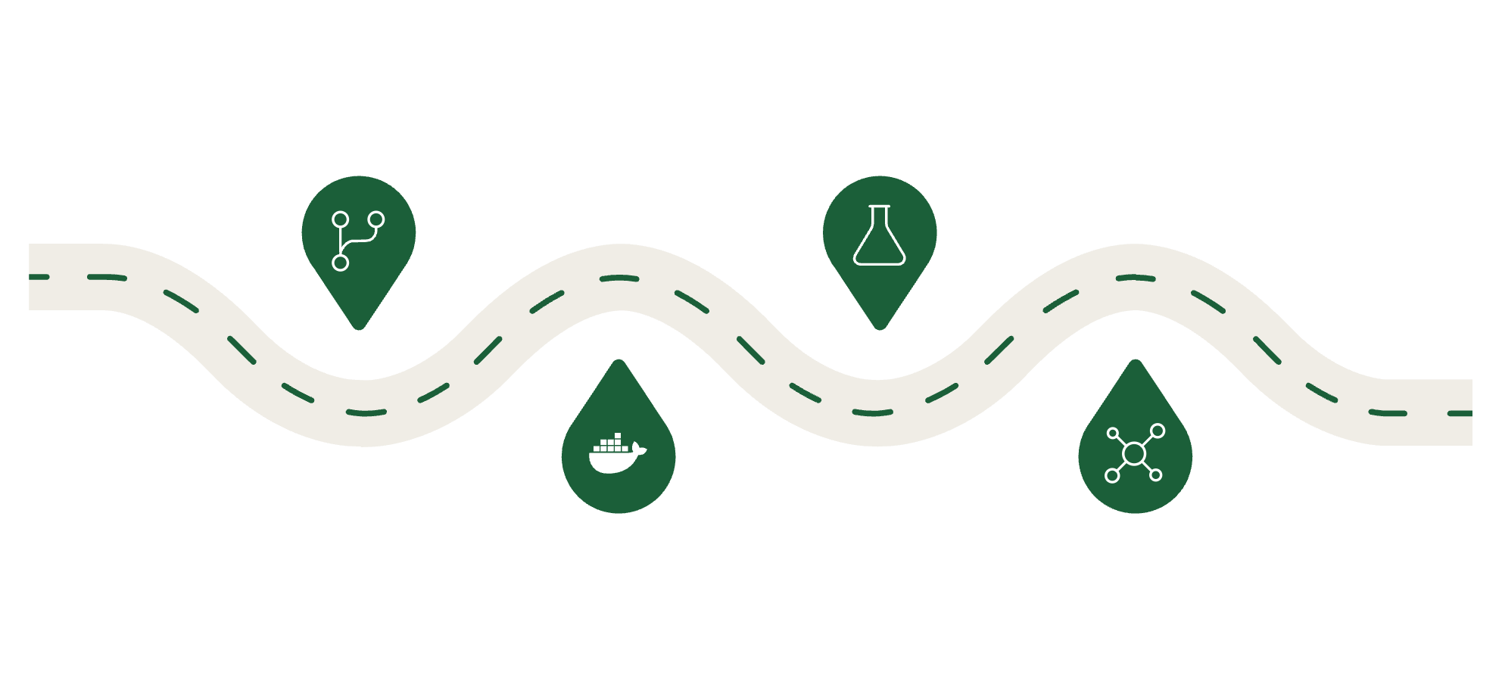
Jenkins — CI/CD Pipeline
Jenkins automates the entire build-and-deploy workflow. Every commit to GitHub triggers a pipeline that builds, tests, and publishes a new Docker image.
Webhook
Run Tests
GitHub triggers pipeline on commit
Execute Django test suite
Build Image
Push Image
Jenkins runs docker build
Tag and push to Docker Hub
The pipeline only pushes to Docker Hub if all tests pass — enforcing quality gates before any image is published.

Slide 8
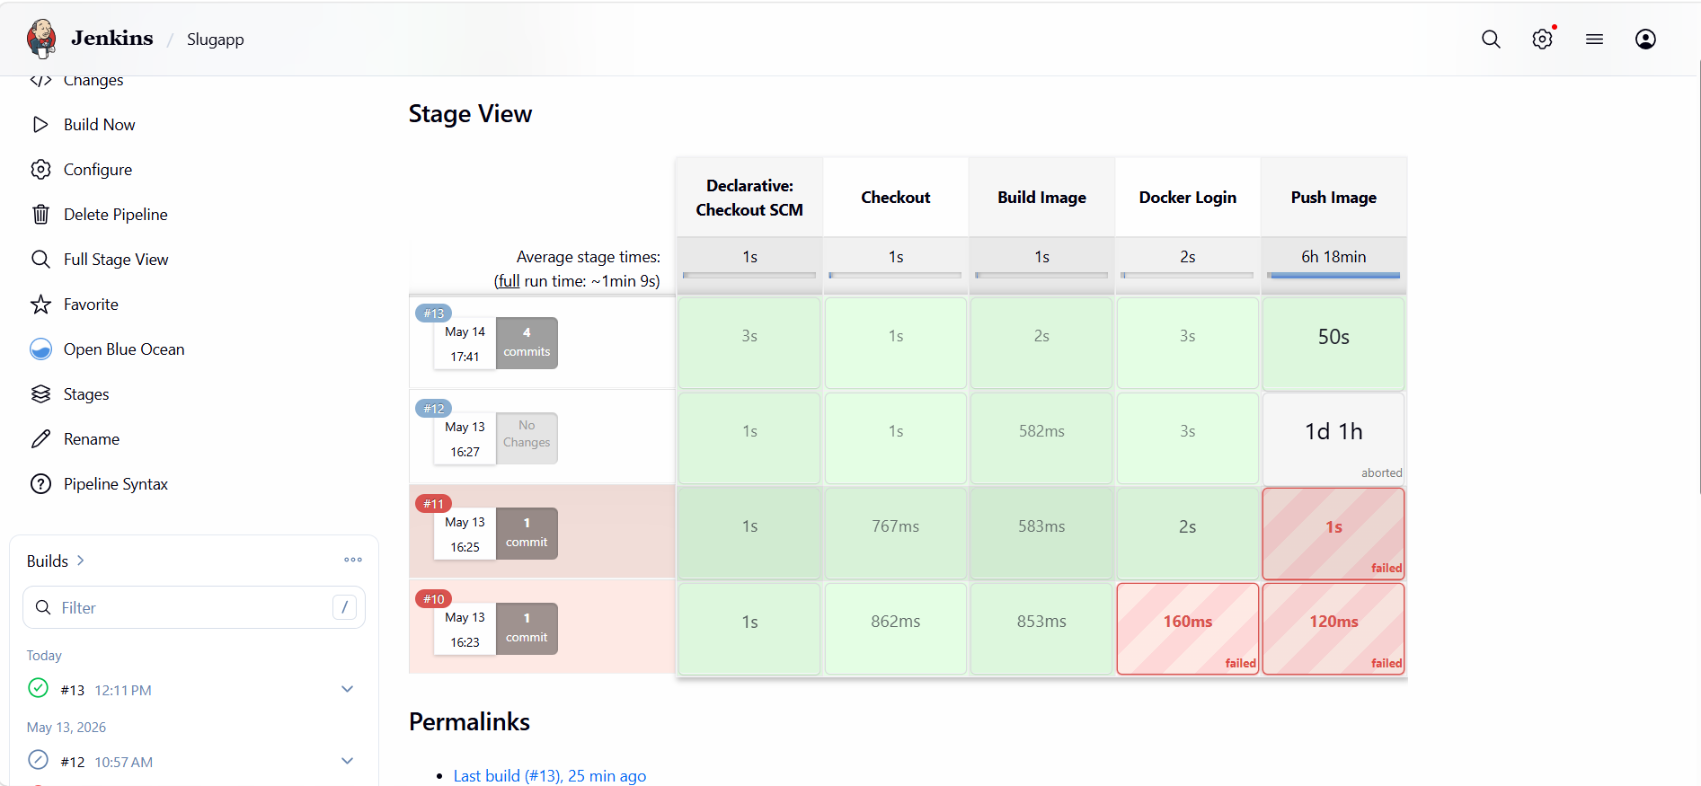

Slide 9
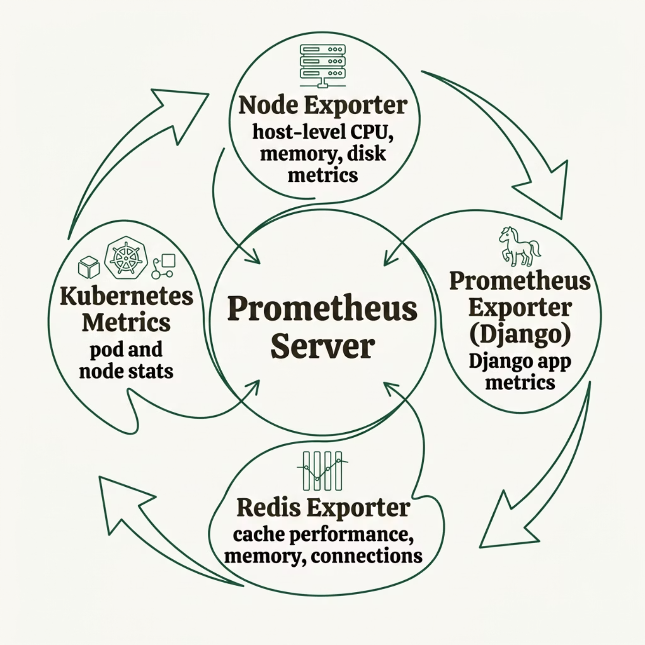

Prometheus — Metrics Collection
Prometheus scrapes metrics from multiple exporters across the stack, storing them in a time-series database for querying and alerting.
Node Exporter
Redis Exporter
App Exporter
Host-level CPU, memory, disk I/O
Cache hit rates, memory, connections
Request latency, error rates, throughput

Slide 10
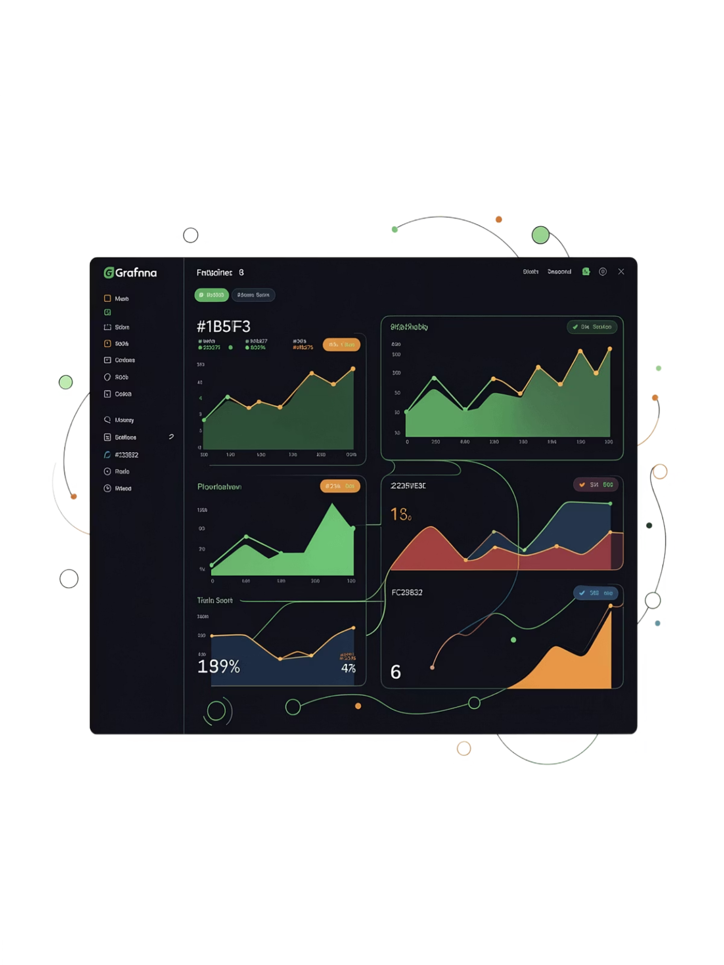
Grafana — Visualization & Dashboards
Grafana connects to Prometheus as a data source and renders real-time dashboards, giving engineers full visibility into SlugAPI's health and performance.
Live Metrics Graphs
Request rates, latency percentiles, error rates — visualized in real time
Alerting Rules
Threshold-based alerts for anomalies — CPU spikes, high error rates, pod restarts
Multi-Source Dashboards
Unified views combining Node, Redis, and application-level metrics in one place

Slide 11
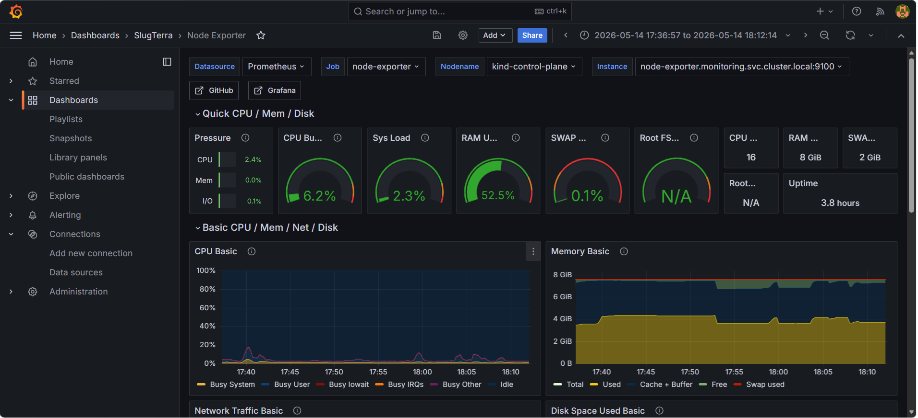

Slide 12
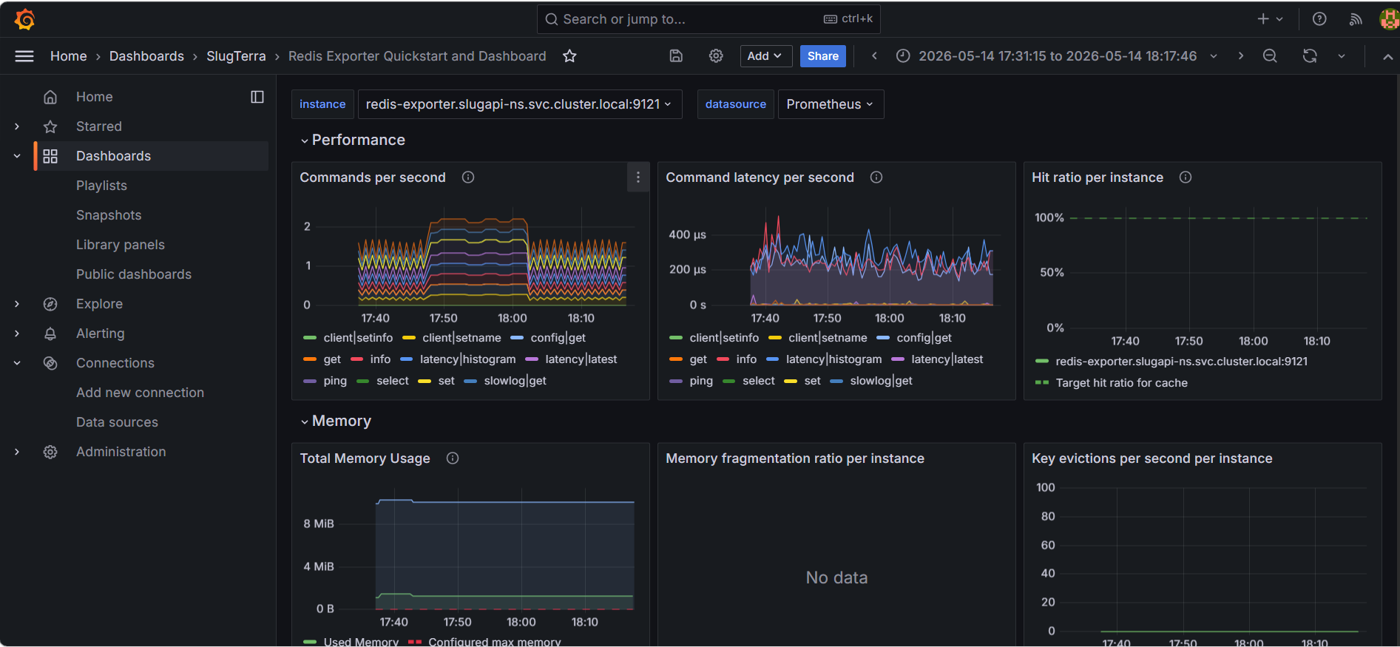

Slide 13
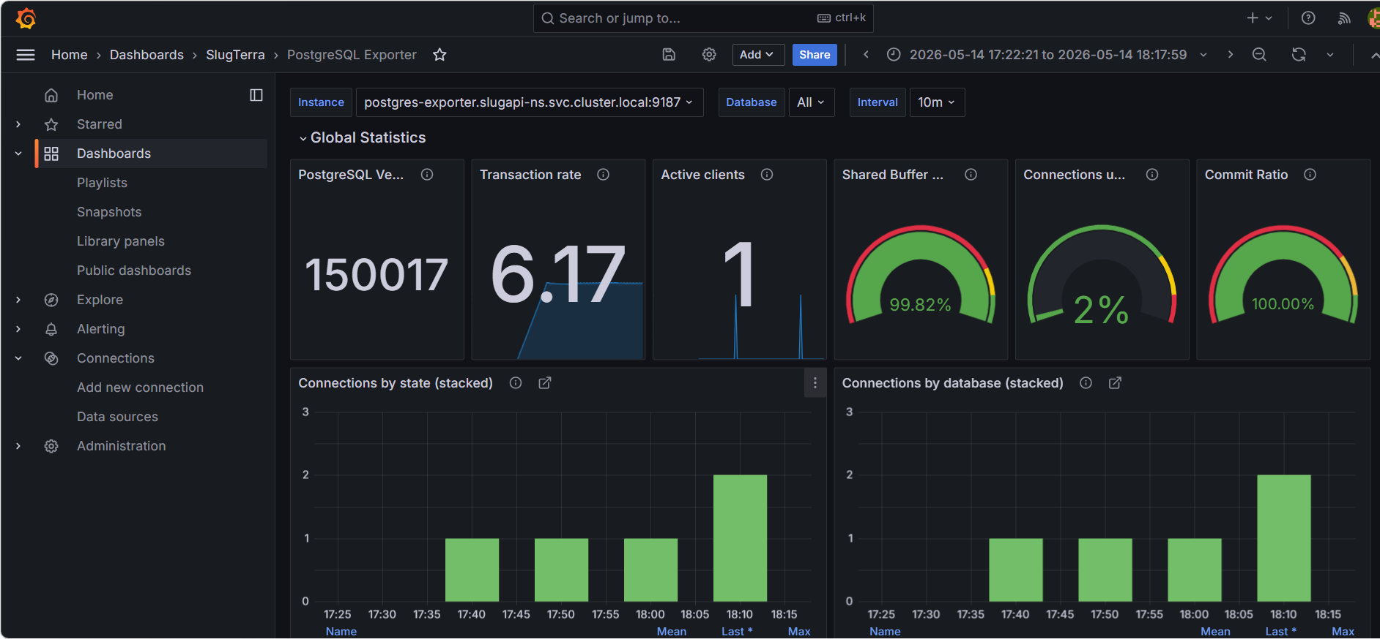

Slide 14
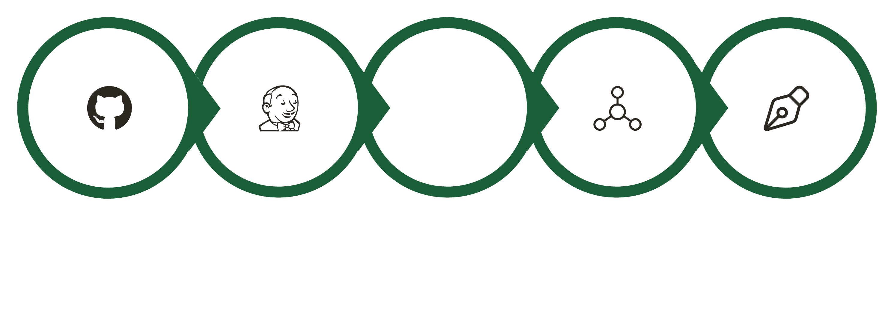
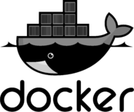
The Full Pipeline — End to End
Git Push
Jenkins Build
Docker Build
Push Image
K8s Deploy
From a single git push to live metrics — SlugAPI's pipeline is fully automated, observable, and production-ready.
6
2
3
Core Services
K8s Environments
Exporters
Django, Docker, K8s, Terraform, Jenkins, Prometheus/Grafana
kind (local) + AWS kubeadm (production)
Node, Redis, and App exporters feeding Prometheus

Slide 15
Thank You
GitHub: https://github.com/harshchauhan01/SlugTerraAPI
DockerHub: harshchauhan01/slug-api - Docker Image

