Slide 1
CALCULATOR AND BODY MASS INDEX USING ASSEMBLY LANGUAGE IN EMULATOR(8086)
HARSH CHOKSHI
92479
PROF. QING ZHU

Slide 2
CONTENT OF PROJECT PRESENTATION
INTRODUCTION OF ASSEMBLY LANGUAGE
BLOCK DIAGRAM
TYPES OF ASSEMBLY LANGUAGE
CALCULATOR
FLOWCHART OF PROJECT
CODE
CODE IMPLEMENTATION
BODY MASS- INDEX
INTRODUCTION TO BMI
DIFFERENT INSTRUCTION’S USED IN CODE
REASULT SUPPOSIATION
FLOWCHART
CODE-IMPLEMENTATION
CONCLUSION OF PROJECT
REFERANCE

Slide 3
INTRODUCTION ABOUT ASSEMBLY LANGUAGE
An assembly language is an extremely low-level programming language that has a 1-to-1 correspondence to machine code, the series of binary instructions which move values in and out of registers in a CPU (or other microprocessor). A microprocessor is a mechanical calculator. It has a number of named registers, which are like holding pens for numbers. It receives instructions in the form of machine code, which is represented by a series of binary bits (1s and 0s).
Each assembly language is specific to a particular computer architecture and sometimes to an operating system. However, some assembly languages do not provide specific syntax for operating system calls, and most assembly languages can be used universally with any operating system, as the language provides access to all the real capabilities of the processor, upon which all system call mechanisms ultimately rest. In contrast to assembly languages, most high-level programming languages are generally portable across multiple architectures but require interpreting or compiling. Assembly language may also be called symbolic machine code.
The assembler language is the symbolic programming language that lies closest to the machine language in form and content. The assembler language is useful when You need to control your program closely, down to the byte and even the bit level.

Slide 4
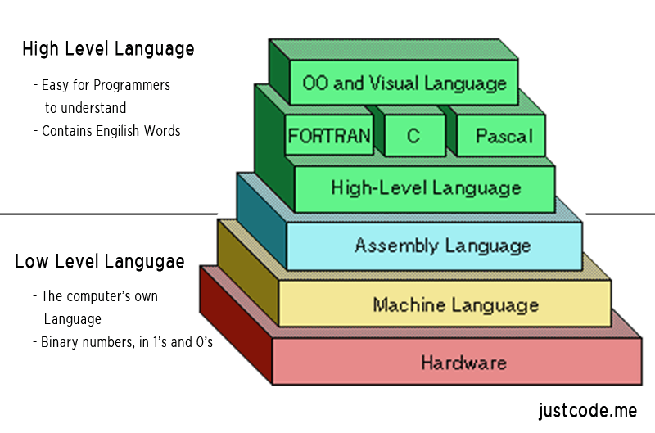

Slide 5
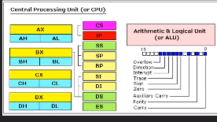
Memory address resister’s

Slide 6
Today, assembly language is used primarily for direct hardware manipulation, access to specialized processor instructions, or to address critical performance issues. Typical uses are device drivers, low-level embedded systems, and real-time systems. This is the only language your computer can speak directly.
Types of Assembly Languages
Assembly language closely tied to processor architecture At least four main types:
CISC: Complex Instruction-Set Computer Developed when people wrote assembly language Complicated, often specialized instructions with many effects Examples from x86 architecture String move, Procedure enter, leave Many, complicated addressing modes So complicated, often executed by a little program (microcode) Examples: Intel x86, 68000, PDP-11
RISC: Reduced Instruction-Set Computer
Response to growing use of compilers Easier-to-target, uniform instruction sets “Make the most common operations as fast as possible” Load-store architecture: Arithmetic only performed on registers, Memory load/store instructions for memory-register transfers Designed to be pipelined Examples: SPARC, MIPS, HP-PA, PowerPC
DSP: Digital Signal Processor designed specifically for signal processing algorithms Lots of regular arithmetic on vectors Often written by hand Irregular architectures to save power, area Substantial instruction-level parallelism Examples: TI 320, Motorola 56000, Analog Devices

Slide 7
VLIW Assembly Language Response to growing desire for instruction-level parallelism Using more transistors cheaper than running them faster Many parallel ALUs Objective: keep them all busy all the time Heavily pipelined More regular instruction set Very difficult to program by hand Looks like parallel RISC instructions Examples: Itanium, TI 320C6000
CALCULATOR
An electronic calculator is typically a portable electronic device used to perform calculations, ranging from basic arithmetic to complex mathematics. A calculator is a device that performs arithmetic operations on numbers. calculators can do only addition, subtraction, multiplication, and division which is pretty basic.
in this project we have computed the assembly language code(8086) to do the basic function’s, I have simulated the programmed in emulator software. This is a microprocessor emulator with an integrated 8086 Assembler. The emulator can run programs on a Virtual Machine, and emulate real hardware including screen, memory, and input and output devices. It helps you program in assembly language. The source code is compiled by assembler and then executed on Emulator step-by-step, allowing you to watch registers, flags and memory while your program runs.

Slide 8
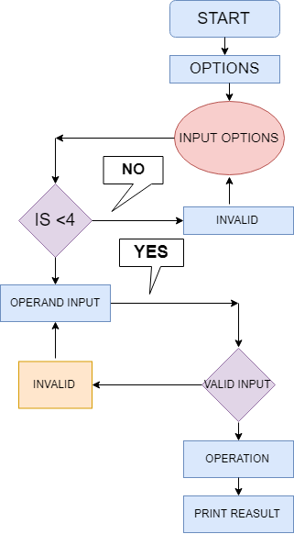
Flow-chart

Slide 9
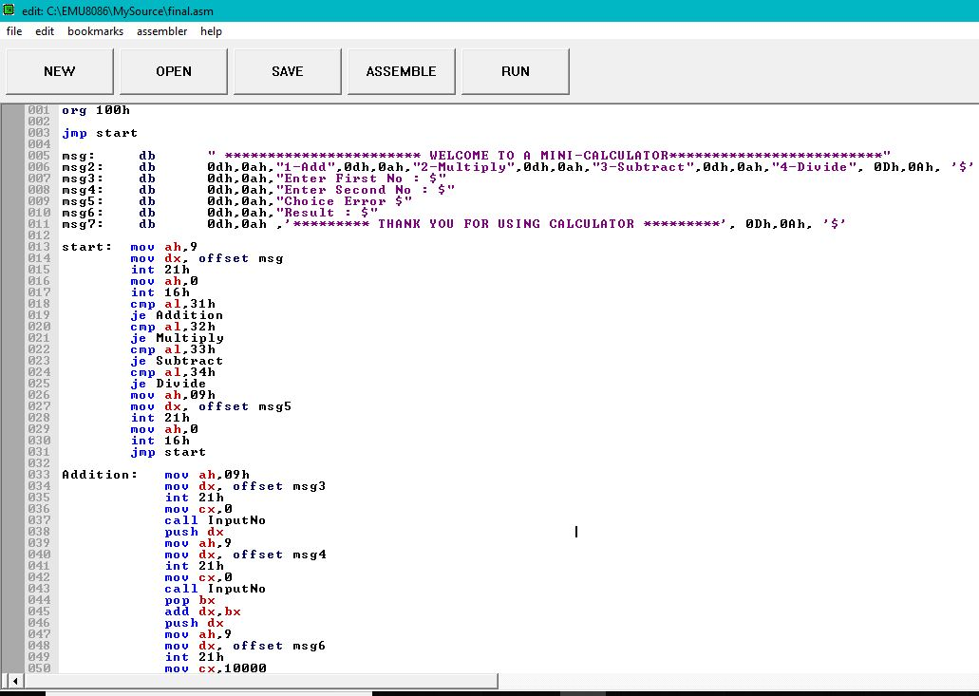
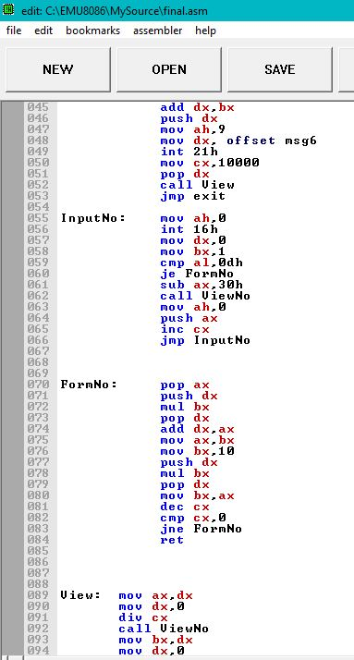
CALCULATOR CODE:-

Slide 10
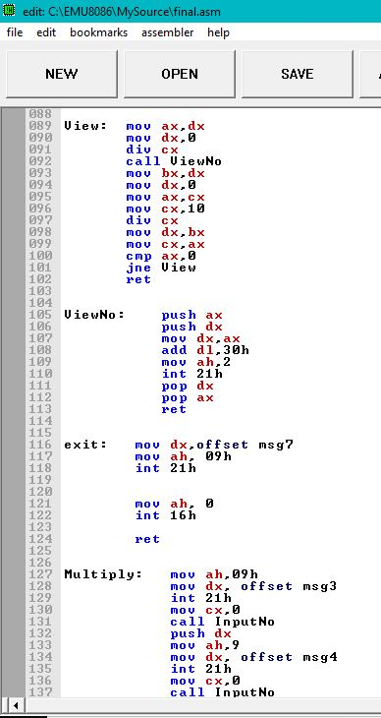
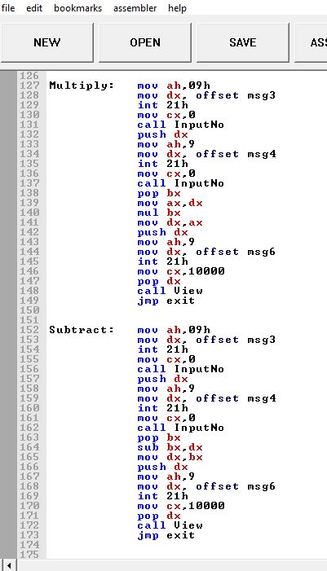
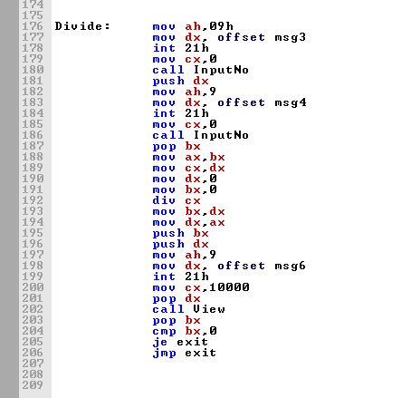

Slide 12
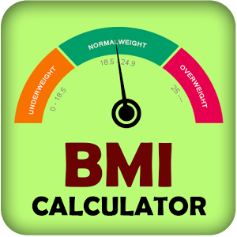

Slide 13
BODY MASS INDEX CALCULATOR
The body mass index (BMI) or Quetelet index is a value derived from the mass (weight) and height of an individual. The BMI is defined as the body mass divided by the square of the body height, and is universally expressed in units of kg/m², resulting from mass in kilograms and height in meters. The BMI is an attempt to quantify the amount of tissue mass (muscle, fat, and bone) in an individual, and then categorize that person as underweight, normal weight, overweight, or obese based on that value. Commonly accepted BMI ranges are underweight: under 18.5 kg/m², normal weight: 18.5 to 25, overweight: 25 to 30.
To calculate your BMI: Divide your height in centimeters (cm) by your weight in kilograms (kg) The formula is as shown below:
Height(cm)/Mass(kg) In our programmer we calculate our BMI applying this formula.

Slide 14
In this code we use some new syntax and the details is given bellows
INT 21h
Here INT 21h is used for getting input.
AND AX, 000FH
For converting the character into digit.
PUSH AX
For keeping the value of AX into the stack.
POP AX
For getting the value of AX from the stack.
MUL BX
For multiplying the value of AX with BX.
CMP AL, 0DH
For comparing the value of AL with Enter.
DIV BX
For dividing the value of AX by BX.

Slide 15
Here in the code we have taken the input weight(kg) and height in centimeter, the same way as calculator program I have divided the weight by height, and made the answer compare with 1,2,3,4,5.
In the standerd calculator for BMI With the metric system, the formula for BMI is weight in kilograms divided by height in meters squared. But it is little tough to take the square of the number so I simplified the same thing by comparing it with 1,2,3,4,5.
If ax=1 or 2 then it is over weight.
If ax=4 or 5 then it is under weight.
If ax=3 then it is perfect weight.

Slide 16
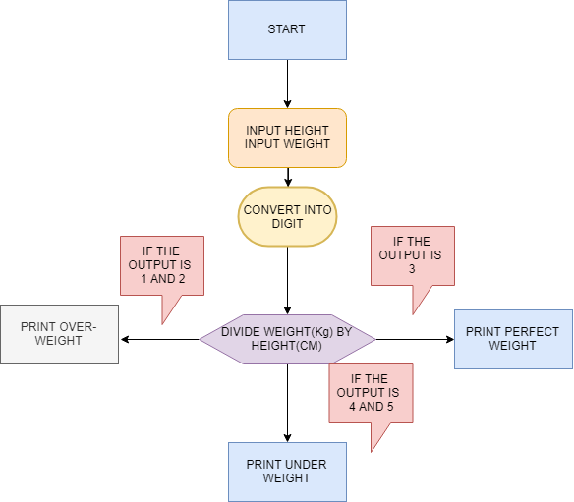
FLOW-CHART

Slide 18
CONCLUSION
AFTER COMPLETE EXECUTION OF CODE WE WERE ABLE TO SUCCESSFULLY COMPUTE THE BASIC INSTRUCTION OF CALCULATOR LIKE ADDITION, SUBTRACTION, MULTIPLICATION, DIVISION IN x86. ALSO WE SUCCESSFULLY CALCULATED THE BODY INDEX OF HUMAN BODY USING ASSEMBLY LANGUAGE x86 WHERE WE USED THE SAME DIVISION FUNCTION WHICH WAS DERIVED FROM THE CALCULATOR PROGRAME. ASSEMBLY LANGUAGE IS NOT A DAY-TO-DAY LANGUAGE BUT A COMPUTER ENGINEERING DEVELOPER SHOULD KNOW THE ASSEMBLY LANGUAGE SO THAT BY THE PIECE OF CODE ONE CAN UNERSTAND WHAT IS GOING IN THE CENTRAL PROCESSING UNIT AND MOST IMPORTANT THING ABOUT ASSEMBLY LANGUAGE IS WHERE A PERSON WANTS TO WORK AT BYTE-BIT LEVEL.

Slide 19
REFERENCES
1) Assembly Language for X86 Processors
Book by Kip R. Irvine
2) IEEE-CALVIS32: assembly language visualizer and simulator for intel x86-32 architecture
BY Jennica Grace Alcalde.
3) WIKIPEDIA ASSEMBLY LANGUAGE x86.
4) IBM-knowledge center on assembly language.

Slide 20
THANK YOU FOR YOUR KIND ATTENTION

