Slide 1
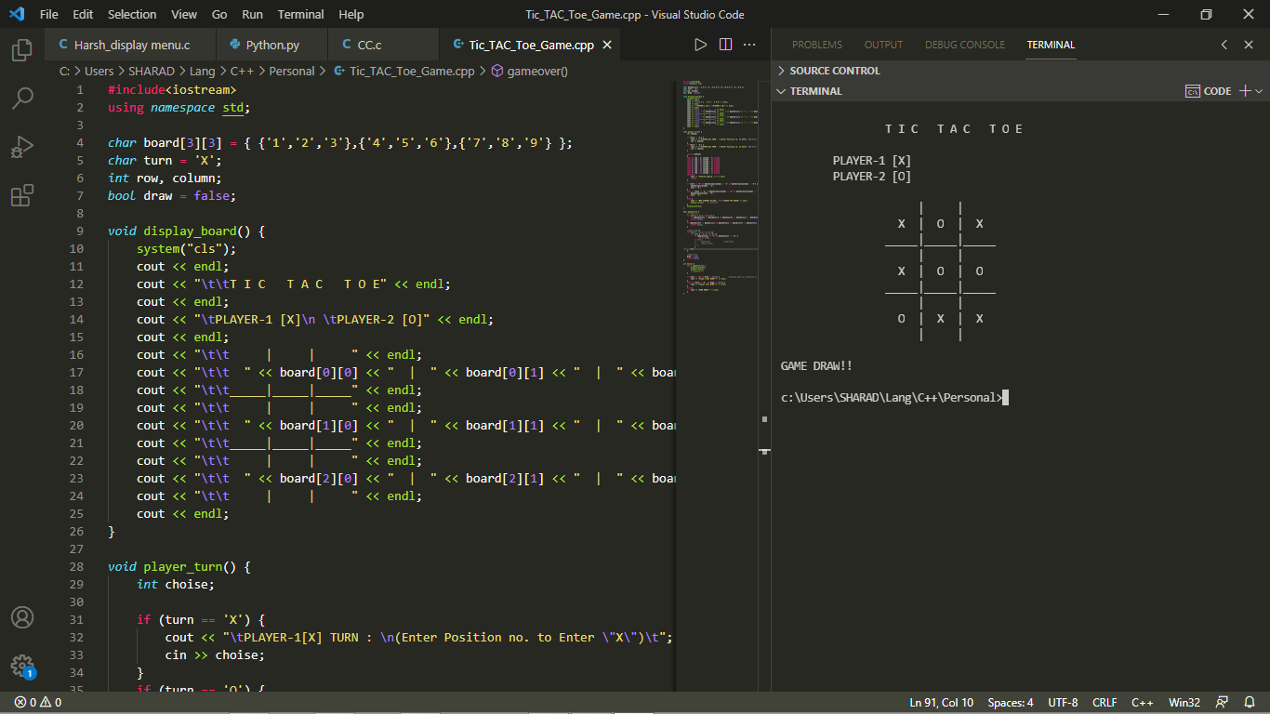
Name Of The Game:- Tic-Tac-Toe OR Noughts and Crosses
.

Slide 2
Introduction About My Game:- My github Link: Code of the Game (https://github.com/harshchouhan3122/)
Good Evening Everyone,
I’m Harsh Chouhan, First Year Student from Electronics and Telecommunication Department of “Yeshwantrao Chavan College of Engineering Nagpur”.
Now, I will Present TIC-TAC-TOE Game infront of you.
I Used C++ Programming Language in this game’s code.
I Used following topics of C++ Programing Language :-
Simple Inputs & Outputs
Array
Loops
Conditional Statements (If/Else).

Slide 3
Learning objectives of the game:-
It helps children apply their logic and develop strategy at an early age. It prepares children for more complex games because they have to think of multiple things at one time
By encouraging logical thinking, tic-tac-toe helps children to develop their fine motor skills, visual skills, coordination, spatial skills .
This skill is important for their problem solving abilities from everyday simple problems to complex mathematical equations.
It improves Our Thinking Ability which helps us in Coding and in our logic building.

Slide 4
How To Play :-
Two players alternately put ‘X’ and ‘O’ in compartments of a figure formed by two vertical lines crossing two horizontal lines and each tries to get a row of three ‘X’ or three ‘O’ before the opponent does.

Slide 5
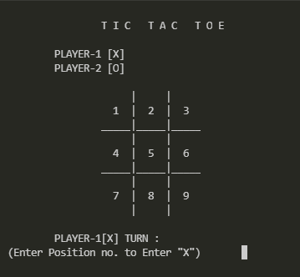
First Player’s Turn i.e.Player-1 [X]

Slide 6

Second Player’s Turn i.e.Player-2 [O]

Slide 7

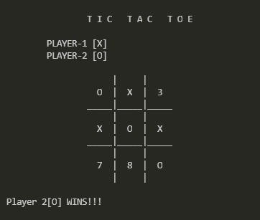
How to Win:-
The goal of the game is for players to position their marks so that they make a continuous line of three cells vertically, horizontally, or diagonally. An opponent can prevent a win by blocking the completion of the opponent's line

Slide 8
When Game is Draw:-

Slide 9
Thank you !
.

