Slide 1

Jumpman23
New Market analysis – NEW YORK CITY
9.14.2020

Slide 2

Agenda
INTRODUCTION
CURRENT PERFORMANCE
DATA INTEGRITY ISSUES
WHAT’S NEXT
CLOSING COMMENTS

Slide 3

INTRODUCTION
JUMPMAN23: On-demand delivery platform
This presentation is to highlight Jumpman23’s performance in its newest market – New York City.
It also delivers an insight on the next goals, i.e. to grow its business by 20%.
It will also present an overview on some of the identified data integrity issues in the transactional data from New York City operations.

Slide 4

Current Performance
how are things going in New York city ?

Slide 5
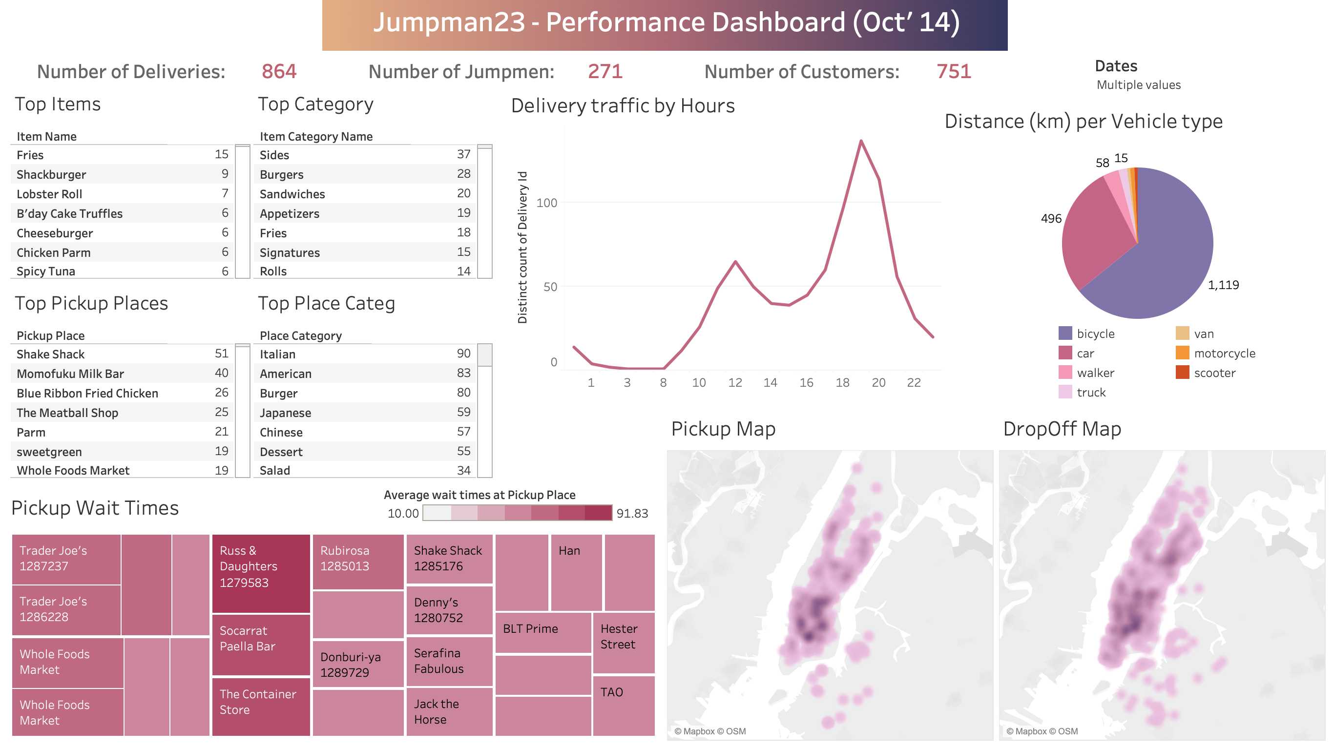
Dashboard created in tableau (Refer file: Jumpman23_FinalDash.twbx

Slide 6
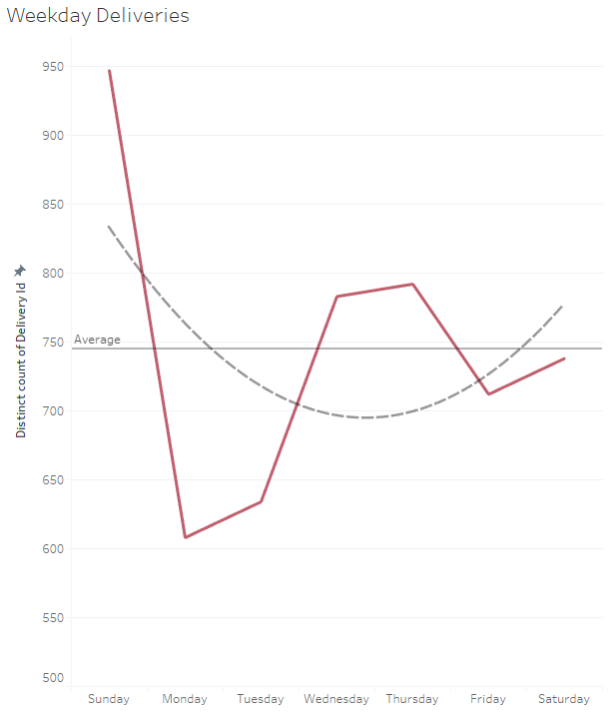
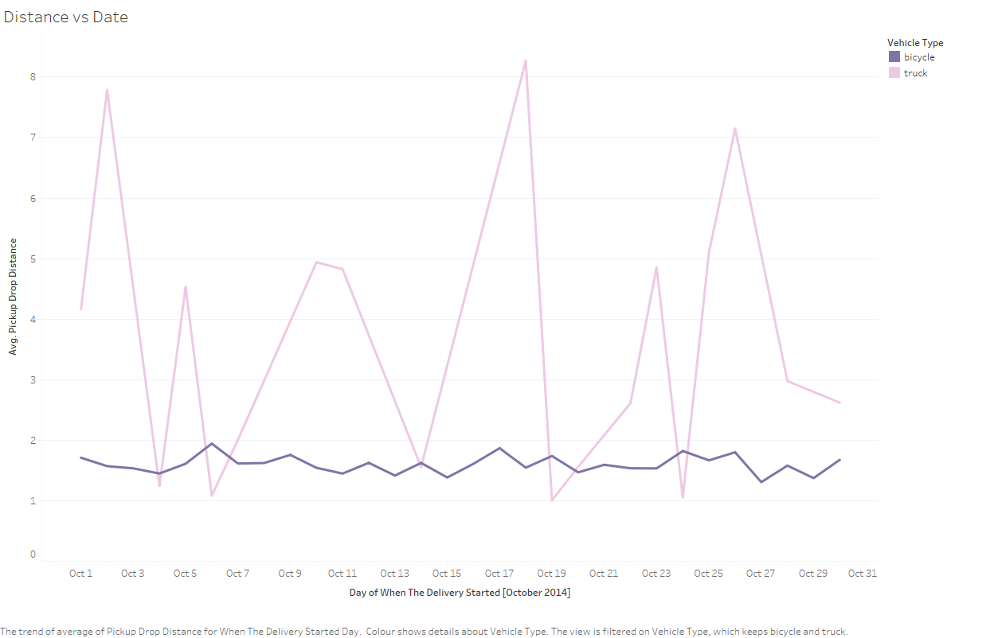
SOME MORE TRENDS TO LOOK AT
Most deliveries take place over the weekend i.e. Sunday and the number again rises mid-week (Figure on Left).
Avg. distance (in km) per delivery on Bicycles remains constant throughout the month, while those using Trucks have farther drop-off points (Figure on Right).
Around 60% of the customer base preferred to use the Jumpman23 service between 5 PM and 11 PM.
The median time it takes the customer to make an order is almost 6.5 minutes.
Close to 84% deliveries contain only 1 item.
Please refer to the Python notebook Postmates_Market_Analysis.ipynb for further analysis and plots (HTML: Postmates_Market_Analysis.html)

Slide 7

Data integrity issues
Outlining the issues identified from new York city data

Slide 8
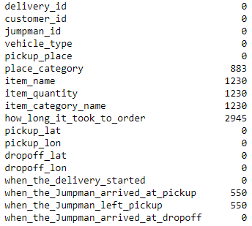
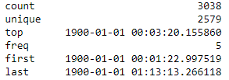
Concerns
MISSING DATA
ABNORMAL TIME TO PLACE ORDER
Many columns in the dataset were blank i.e. contained NULL values.
The count of missing data in each column is shown below.
Only 2579 out of 3038 records recorded a unique time interval for placing an order.
15.11% of the data rows with the exact same time to deliver order(including milliseconds)
This may be indicating a technical flaw in the platform.

Slide 9
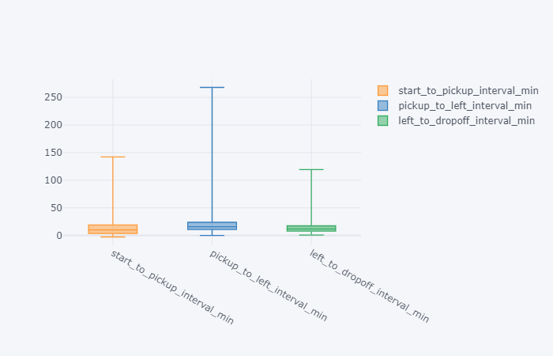
Concerns (contd.)
COMPROMISED TIME INTERVALS
Some data points for jumpman_arrive_pickup are timestamped before the delivery starts. Hence, the plot starts below 0.
The interval between pickup, arrive and left has a huge variance, which could be due to a platform technical issue.
ADDITIONAL DIFFICULTIES
Data set is unique only based on the Item_name and Item_category_name.
If the order contains more than 1 item, the delivery_id is replicated for each item and leads to multiple records.
Multiple Item_category_name for same Item_name, which shows lack of standardization on the Jumpman23 platform.
Ex: Item- Fries has Category- Sides, Fries, Appetizer, etc.

Slide 10

What’s next
recommendations for growth in the market

Slide 11
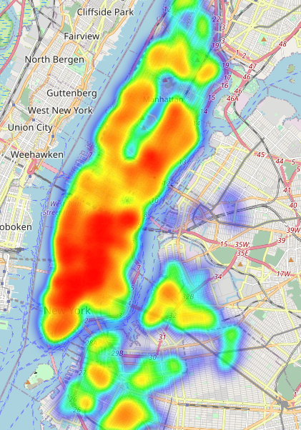
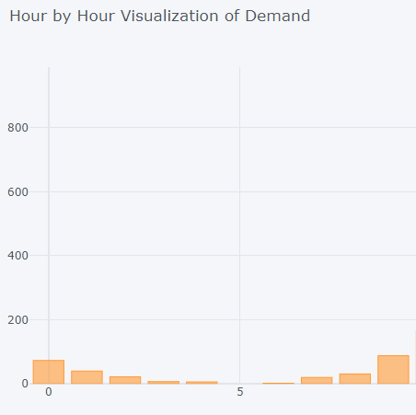

INCREASE VENDOR PARTNERSHIPS
Approach more vendors from suburban areas of NYC to give increased options to customers (Map highlights heat density based on DropOff locations)
Tie up with more vendors which offer breakfast options to increase orders during morning hours of the day as seen from hourly demand traffic.

Slide 12



STATISTICS & Goals
CUSTOMER ENGAGEMENT
CUSTOMER ENGAGEMENT
3192 unique customers overall.
70% of the current customer base has only used the service once.
Ask for feedback from the customers after every delivery.
Reduce Customer churn by analyzing feedback data and targeting customer preferences.
PRE-ORDERING ITEMS
Pickup places like Trader Joe’s & Whole Foods have very high wait times i.e. around 1 hour.
Aim to reduce Jumpmen wait times by ordering ahead of time.
RESOLVE DATA GAPS
Improve the quality of transactional data by eliminating null values.
Suggestion to standardize the Item category names to maintain consistency.
Timestamps should be accurately recorded by the Jumpmen.
PRE-ORDERING ITEMS
RESOLVING DATA GAPS

Slide 13

Closing comments
Steady growth observed in the Jumpman23 services in NYC.
Solving data integrity issues will drive the analytical initiatives more aggressively.
Discussions to follow over proposed strategies to aim market growth.
GITHUB REPOSITORY
Link: https://github.com/harshchovatia/Jumpman23
TECHNOLOGY STACK USED
Microsoft Excel
Python Programming
Tableau
IBM Cloud Watson Studio : Jupyter Notebooks

Slide 14



THANK YOU
HARSH CHOVATIA
+1 (480) 868-1679
harsh.chovatia@asu.edu
https://www.linkedin.com/in/harsh-chovatia/

