Slide 1
Devops
PRIYANKA SARODE
DATE

Slide 2
What is DevOps?
DevOps combines development and operations to increase the efficiency, speed and security of software development and delivery as compared to traditional sdlc.
DevOps is a collaboration between Development and IT Operations to make software production and Deployment in an automated & repeatable way.
DevOps helps increase the organization’s speed to deliver software applications and services. The full form of ‘DevOps’ is a combination of ‘Development’ and ‘Operations.’
It allows organizations to serve their customers better and compete more strongly in the market.
In simple words, DevOps can be defined as an alignment of development and IT operations with better communication and collaboration.

Slide 3
Why is DevOps Needed?
Before DevOps, the development and operation team worked in complete isolation.
Testing and Deployment were isolated activities done after design-build. Hence they consumed more time than actual build cycles.
Without using DevOps, team members spend a large amount of their time testing, deploying, and designing instead of building the project.
Manual code deployment leads to human errors in production.
Coding & operation teams have separate timelines and are not synch, causing further delays.
There is a demand to increase the rate of software delivery by business stakeholders. As per Forrester Consulting Study, Only 17% of teams can use delivery software quickly, proving the pain point.

Slide 4
How is DevOps different from traditional IT
In this DevOps training, let’s compare the traditional software waterfall model with DevOps to understand the changes DevOps brings.
We assume the application is scheduled to go live in 2 weeks, and coding is 80% done. We assume the application is a fresh launch, and the process of buying servers to ship the code has just begun-
Old Process | DevOps
After placing an order for new servers, the Development team works on testing. The Operations team works on extensive paperwork as required in enterprises to deploy the infrastructure. | After placing an order for new servers Development and Operations team work together on the paperwork to set up the new servers. This results in better visibility of infrastructure requirements.

Slide 5
How is DevOps different from traditional IT
Old Process | DevOps
The operations team has no clue about the progress of the Development team. The operations team develops a monitoring plan as per their understanding. | In DevOps, the Operations team is completely aware of the developers’ progress. Operations teams interact with developers and jointly develop a monitoring plan that caters to IT and business needs. They also use advanced Application Performance Monitoring (APM) Tools.
Before going go-live, the load testing crashes the application, and the release is delayed. | Before going go-live, the load testing makes the application a bit slow. The development team quickly fixes the bottlenecks, and the application is released on time.

Slide 6
Why is DevOps used?
DevOps allows Agile Development Teams to implement Continuous Integration and Continuous Delivery, which helps them launch products faster into the market.
Other Important reasons are:
1. Predictability: DevOps offers a significantly lower failure rate of new releases.
2. Reproducibility: Version everything so that earlier versions can be restored anytime.
3. Maintainability: Effortless recovery process in the event of a new release crashing or disabling the current system.
4. Time to market: DevOps reduces the time to market up to 50% through streamlined software delivery. It is particularly the case for digital and mobile applications.
5. Greater Quality: DevOps helps the team improve application development quality by incorporating infrastructure issues.

Slide 7
Why is DevOps used?
6. Reduced Risk: DevOps incorporates security aspects in the software delivery lifecycle, and it helps reduce defects across the lifecycle.
7. Resiliency: The Operational state of the software system is more stable, secure, and changes are auditable.
8. Cost Efficiency: DevOps offers cost efficiency in the software development process, which is always an aspiration of IT management.
9. Breaks larger code base into small pieces: DevOps is based on the agile programming method. Therefore, it allows breaking larger codebases into smaller and manageable chunks.
When to adopt DevOps? : DevOps should be used for large distributed applications such as eCommerce sites or applications hosted on a cloud platform.
When not to adopt DevOps?
It should not be used in mission-critical applications like banks, power and other sensitive data sites. Such applications need strict access controls on the production environment, a detailed change management policy, and access control policy to the data centres.

Slide 8
Continuous Integration-CI and Continuous Delivery-CD
Why are CI and CD Referred to as the Most Crucial DevOps Practice?
Continuous Integration and Continuous Delivery are among the most significant practices as they create an active process of integrating and delivering the product to the market.
Small code changes can be made in the software code, making the entire process simpler and more accessible.
CI and CD provide continuous feedback from the customers and the DevOps team, thus increasing the transparency of any problem within the team or outside it.
The overall process ensures the faster release of the product.
The failures can now be detected faster and hence fixed effortlessly and quickly, which increases the speed of release.

Slide 9
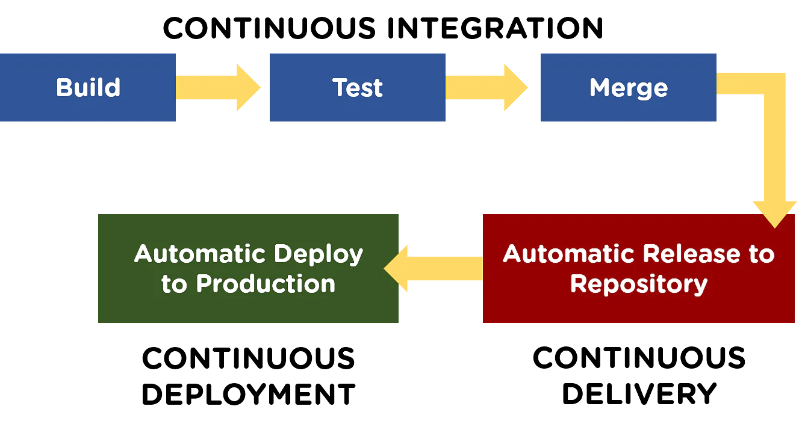
DevOps Workflow

Slide 10
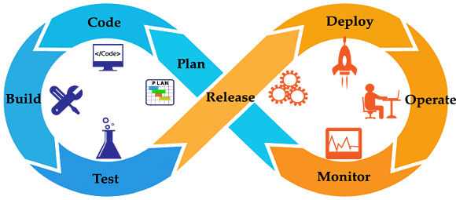
Continuous Integration and Delivery Concept
Continuous Integration (CI) is a DevOps software development practice that enables the developers to merge their code changes in the central repository. That way, automated builds and tests can be run. The amendments by the developers are validated by creating a built and running an automated test against them.
In the case of Continuous Integration, a tremendous amount of emphasis is placed on testing automation to check on the application. This is to know if it is broken whenever new commits are integrated into the main branch.

Slide 11
What is Continuous Delivery?
Continuous Delivery (CD) is a DevOps practice that refers to the building, testing, and delivering improvements to the software code. The phase is referred to as the extension of the Continuous Integration phase to make sure that new changes can be released to the customers quickly in a substantial manner.
This can be simplified as, though you have automated testing, the release process is also automated, and any deployment can occur at any time with just one click of a button.
Continuous Delivery gives you the power to decide whether to make the releases daily, weekly, or whenever the business requires it. The maximum benefits of Continuous Delivery can only be yielded if they release small batches, which are easy to troubleshoot if any glitch occurs.

Slide 12
What is SCM?
Source code management (SCM) is used to track modifications to a source code repository. SCM tracks a running history of changes to a code base and helps resolve conflicts when merging updates from multiple contributors. SCM is also synonymous with Version control.
As software projects grow in lines of code and contributor head count, the costs of communication overhead and management complexity also grow. SCM is a critical tool to alleviate the organizational strain of growing development costs.

Slide 13
Importance of SCM
When multiple developers are working within a shared codebase it is a common occurrence to make edits to a shared piece of code.
Separate developers may be working on a seemingly isolated feature, however this feature may use a shared code module. Therefore developer 1 working on Feature 1 could make some edits and find out later that Developer 2 working on Feature 2 has conflicting edits.
Before the adoption of SCM this was a nightmare scenario. Developers would edit text files directly and move them around to remote locations using FTP or other protocols.
Developer 1 would make edits and Developer 2 would unknowingly save over Developer 1’s work and wipe out the changes. SCM’s role as a protection mechanism against this specific scenario is known as Version Control.

Slide 14
Importance of SCM
SCM brought version control safeguards to prevent loss of work due to conflict overwriting. These safeguards work by tracking changes from each individual developer and identifying areas of conflict and preventing overwrites. SCM will then communicate these points of conflict back to the developers so that they can safely review and address.
This foundational conflict prevention mechanism has the side effect of providing passive communication for the development team. The team can then monitor and discuss the work in progress that the SCM is monitoring. The SCM tracks an entire history of changes to the code base. This allows developers to examine and review edits that may have introduced bugs or regressions.

Slide 15
What is a Version Control System and Why it is used? (VCS)
Version control, also known as source control, is the practice of tracking and managing changes to software code.
Version control systems are software tools that help software teams manage changes to source code over time.
As development environments have accelerated, version control systems help software teams work faster and smarter. They are especially useful for DevOps teams since they help them to reduce development time and increase successful deployments.
Version control software keeps track of every modification to the code in a special kind of database. If a mistake is made, developers can turn back the clock and compare earlier versions of the code to help fix the mistake while minimizing disruption to all team members.
VCS are sometimes known as SCM (Source Code Management) tools or RCS (Revision Control System).
One of the most popular VCS tools in use today is called Git. Git is a Distributed VCS, a category known as DVCS.

Slide 16
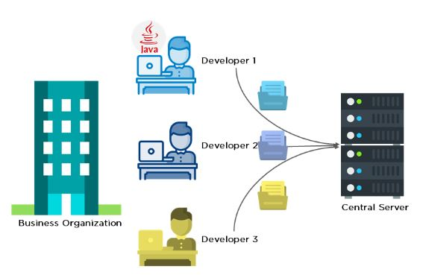
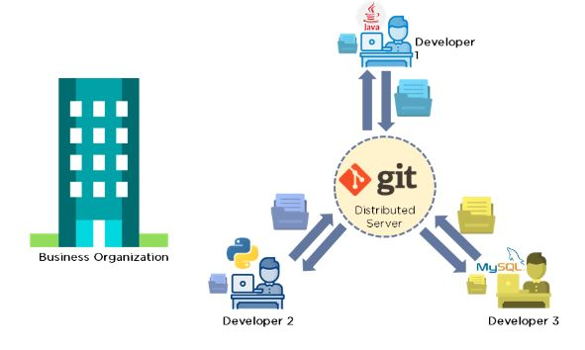
C-VCS
D-VCS

Slide 17
Git
Priyanka Sarode

Slide 18
Introduction to Git & GitHub
Git and GitHub are not the same thing.
Git is an open-source, version control tool created in 2005 by developers working on the Linux operating system.
GitHub is a website founded in 2008 that makes tools which integrate with git.
You do not need GitHub to use git, but you cannot use GitHub without using git.
There are many other alternatives to GitHub, such as GitLab, BitBucket, and “host-your-own” solutions such as gogs and gittea.
All of these are referred to in git-speak as “remotes”, and all are completely optional.
You do not need to use a remote to use git, but it will make sharing your code with others easier.

Slide 19
What is Git?
Git is a DevOps tool used for source code management.
It is a free and open-source version control system used to handle small to very large projects efficiently. Git is used to tracking changes in the source code, enabling multiple developers to work together on non-linear development. Linus Torvalds created Git in 2005 for the development of the Linux kernel.
It allows multiple developers to work together.
It supports non-linear development through its thousands of parallel branches.

Slide 20
Git-VCS
Local Repository
Ver1
Ver2
Ver3
Ver4
Version1
Commit
Version2
Commit
Any time we can switch to any version
Version3
Commit
Version4
Commit

Slide 21
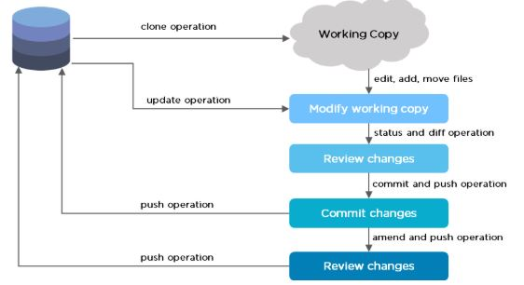
Git Workflow
The Git workflow is divided into three states:
Working directory - Modify files in your working directory
Staging area (Index) - Stage the files and add snapshots of them to your staging area
Git directory (Repository) - Perform a commit that stores the snapshots permanently to your Git directory. Checkout any existing version, make changes, stage them and commit.

Slide 22
Thank You

