Slide 1
Git-Branch and Git-Merge-Conflict
Priyanka Sarode

Slide 2
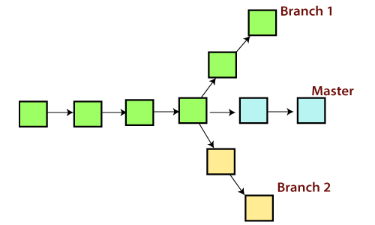
Git Branch
A branch is a version of the repository that diverges from the main working project. It is a feature available in most modern version control systems.
A Git project can have more than one branch. These branches are a pointer to a snapshot of your changes.
When you want to add a new feature or fix a bug, you spawn a new branch to summarize your changes.
So, it is complex to merge the unstable code with the main code base and also facilitates you to clean up your future history before merging with the main branch.

Slide 3
Git Master Branch
The master branch is a default branch in Git. It is instantiated when first commit made on the project.
When you make the first commit, you're given a master branch to the starting commit point.
When you start making a commit, then master branch pointer automatically moves forward. A repository can have only one master branch.
Master branch is the branch in which all the changes eventually get merged back. It can be called as an official working version of your project.

Slide 4
Managing Branches
We can perform various operations on Git branches.
The git branch command allows you create, list, rename and delete branches.
To Create new branch :git branch
To get list all of the available branches in your repository : git list
To delete branch : git delete -d<branch name>
To delete remote branch : git push origin -delete <branch name>
To switch to created branch : git checkout <branch-name>
To switch to master branch : git checkout master
To rename branch : git branch -m <old branch name><new branch name>
To merge branch with main/master branch : git merge branchname

Slide 5
Why do Merge-Conflict occurs?
Merge conflict is an event where Git is unable to automatically resolve differences in code between two commits.
When there are conflicting changes on the same lines, a “merge conflict” occurs because Git doesn’t know which code to keep and which to discard.
It occurs mostly when same file is modified in different branches and merge operation is performed.

Slide 6
Merge-Conflict
Master
File1.txt
File2.txt
Modify File1.txt
Merge Conflict
Modify File1.txt
NewBranch1
Head

Slide 7
Thank You

