Slide 1
JPA : Java Persistence API
Priyanka S.

Slide 2
Index
Object Persistence
ORM and its need
JPA and its need
Java Persistence API
Working with JPA
Entity Life Cycle
Association

Slide 3
What is Object Persistence?
Object persistence is where an object "persists" over space and/or time. An object that retains its state when it is saved to disk, and loaded from another location, or at a future time, is an object that exhibits the property of persistence.
For a computer gaming system, a gaming world can retain its state through a 'save_game'.
We can save the game, and load it at a future point in time. The characters, locations, and physical objects remain.
Most older computer games used a special file structure, that required special code to store and retrieve a gaming world.
Using object persistence, we can write a game to a file, or read it from a file, with a few lines of code - no matter how large or complex our gaming world is!

Slide 4
Object persistence in Java
Persistence means to make application’s data to outlive the applications process.
In Java, the objects to live beyond the scope of the JVM so that the same state is available later.
Class Student{
int rollno;
String name;
}
rollno | name
101 | Kajal
Object-World
Relational-World

Slide 5
Object Relation Impedance Mismatch
Relational objects are represented in a tabular format, while object models are represented in an interconnected graph of object format. While storing and retrieving an object model from a relational database, some mismatch occurs due to the following reasons:
Granularity : Object model has more granularity than relational model.
Subtypes : Subtypes means inheritance are not supported by all types of relational databases.
Identity : Like object model, relational model does not expose identity while writing equality.
Associations : Relational models cannot determine multiple relationships while looking into object domain model.
Data navigation : Data navigation between objects in an object network is different in both models.

Slide 6
Object Relation Impedance Mismatch
Granularity
Sometimes you will have an object model which has more classes than the number of corresponding tables in the database thus we says the object model is more granular than the relational model.
Class Student{
int rollno;
String name;
Address address;
}
Class Address{
String city;
String area;
}
rollno | name | city | area
101 | Kajal | Nagpur | Pratap Nagar
Relational-World
Object-World

Slide 7
Object Relation Impedance Mismatch
Inheritance (subtypes)
Inheritance is a natural paradigm in object-oriented programming languages. However, RDBMSs do not define anything similar on the whole
Student
Online Learning
College
Student
Online Learning
College
Object-World
Relational-World

Slide 8
Object Relation Impedance Mismatch
Identity
A RDBMS defines exactly one notion of 'sameness': the primary key. Java, however, defines both object identity a==b and object equality a.equals(b).
a==b
a.equals(b)
Student
PK | Rollno
- | Name
Object-World
Relational-World

Slide 9
Object Relation Impedance Mismatch
Association : Linking between tables in database is done in different way as compared to linking between classes and application. Relational models cannot determine multiple relationships while looking into object domain model.
Class Product{
----------
Supplier[] list;
}
Class Supplier{
-----
}
Product
Product_Id Name Price Phone
Supplier
Supplier_Id Name Address Phone
Object-World
Relational-World

Slide 10
What is ORM?
To remove the impedance mismatch problem, map the data representation in an object model (Java Types) to relational model(SQL Types) this process is called ORM : Object Relation Mapping.
Storing object-oriented entities in a relational database is often not a simple task and requires a great deal of repetitive code along with conversion between data types.
Object-relational mapper, or O/RM, were created to solve this problem. An O/RM persists entities in and retrieves entities from relational databases without the programmer having to write SQL statements and translate entity properties to statement parameters and result set columns to entity properties.

Slide 11
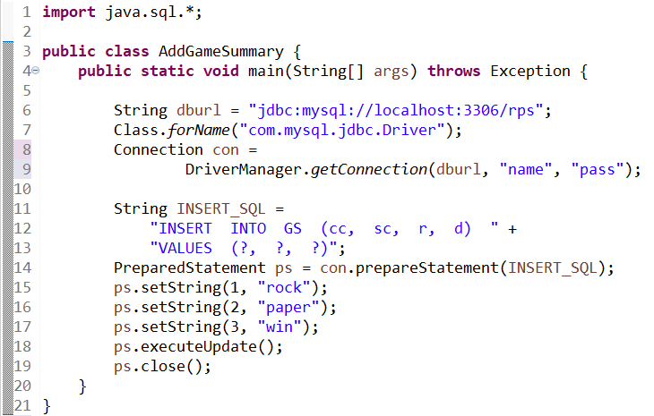
Boilerplate code using JDBC

Slide 12
Object Relation Mapping
An ORM solution consists of the following four entities −
Sr.No. | Solutions
1 | An API to perform basic CRUD operations on objects of persistent classes.
2 | A language or API to specify queries that refer to classes and properties of classes.
3 | A configurable facility for specifying mapping metadata.
4 | A technique to interact with transactional objects to perform dirty checking, lazy association fetching, and other optimization functions.

Slide 13
Why ORM?
First of all you get to write in the language you are already using. It is sometime tough to write SQL queries directly as they are complicated in some cases. So, to maintain the fluency we use ORM, so that we can write in the language we know.
Second, it hides the SQL or any other database query away from your application logic.
Third, for heavy database usage like creating 10+ tables and using many queries in them, then it is good to use ORM as it reduce the code and give better understanding of the code to you and as well as to your team mates and it makes your application faster and easier to maintain.

Slide 14
Java ORM Frameworks
There are several persistent frameworks and ORM options in Java. A persistent framework is an ORM service that stores and retrieves objects into a relational database.
Enterprise JavaBeans Entity Beans
Java Data Objects
Castor
TopLink
Spring DAO
Hibernate
And many more

Slide 15
What is JPA?
JPA : Java Persistence API is a collection of classes and methods to persistently store the vast amount of data into a database.
JPA is just an specification from Sun, which is released under JEE5 specification. JPA standardized the ORM persistence technology for Java developers. JPA is not a product and can't be used as it is for persistence. It needs an ORM implementation to work and persist the Java Objects.
It forms a bridge between object models(Java Program) and relational models (Database).
JPA is the Java standard for mapping Java objects to the relational database.

Slide 16
Why we need JPA?
The main purpose to have JPA is to have persistent objects in the form of JAVA objects which can be used later while interacting with the database.
To reduce the impedance and make the front-end application independent of the backend we use ORMs as a middleware.
JPA facilitates the use of ORMSs thus making the whole process flexible and modular.

Slide 17
Advantages of JPA
It eliminates the use of SQL queries and JDBC connectors thus reducing the complexities of database programming.
Significantly reduces the dependency on the database system one is using at the backend. This is very useful at the time of DBMS migrations saving a lot of energy and effort.
The code looks clean and the developer only needs to know JAVA rather than learning SQL or PL/SQL.

Slide 18
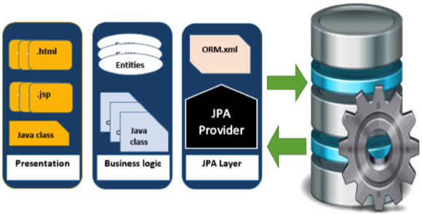
Where to use JPA?
To reduce the burden of writing codes for relational object management, a programmer follows the ‘JPA Provider’ framework, which allows easy interaction with database instance. Here the required framework is taken over by JPA.
JPA is an open source API, therefore various enterprise vendors such as Oracle, Redhat, Eclipse, etc. provide new products by adding the JPA persistence flavor in them. Some of these products include:
Hibernate, Eclipselink, Toplink, Spring Data JPA, etc.

Slide 19
JPA Overview
EntityManagerFactory — This is a factory class of EntityManager. It creates and manages multiple EntityManager instances.
EntityManager — It is an interface; it manages the persistence operations on objects. It works like a factory for Query instance.
Entity — Entities are the persistence objects, stored as records in the database.
EntityTransaction — It has one-to-one relationship with EntityManager. For each EntityManager, operations are maintained by the EntityTransaction class.
Persistence — This class contains static methods to obtain the EntityManagerFactory instance.
Query - This interface is implemented by each JPA vendor to obtain relational objects that meet the criteria.

Slide 20
JPA Runtime Overview
Application
Persistence Context
Entity Manager
Object1
Object2
Object1
Database
Object2
Managed Entities

Slide 21
Persistence Context
Entity Manager:
The EntityManager is the primary interface used by application developers to interact with the JPA runtime.
Persistence Context:
Persistence context defines a scope under which particular entity instances are created, persisted, and removed.
Persistence context is to manage the entity lifecycle in an application.
Every EntityManager manages its own persistence context. In short, persistence context is a memory area for EntityManager to work on entity instance.
The persistence context is the first-level cache where all the entities are fetched from the database or saved to the database. It sits between our application and persistent storage.

Slide 22
Entity Life Cycle
Object/Entity managed by ORM by using EntityManager passes through different stages during its persistence.
Detached
Database
Doesn't Exists
New
Managed
Removed

Slide 23
New/Transient State
When an entity object is initially created its state is New. In this state the object is not yet associated with an Entity Manager and has no representation in the database.
a newly instantiated entity object is called transient. The entity hasn’t been persisted yet, so it doesn’t represent any database record.
Detached
Student s1 = new Student()
Database
Doesn't Exists
New
Managed
Removed

Slide 24
Managed State
Managed State : An entity object becomes Managed when it is persisted to the database via an EntityManager’s persist method which must be invoked within an active transaction. On transaction commit, the owning Entity Manager stores the new entity object to the database.
The managed state is maintained by below three methods:
1. EntityManager.persist(s1);
2. EntityManager.find()
3. EntityManager.flush()
Detached
persist(s1)
flush()
Database
Doesn't Exists
New
Managed
find()
Removed

Slide 25
Detached State
The entity instance is an instance with a persistent identity that is no longer associated with a persistence context, usually because the persistence context was closed or the instance was evicted from the context.
This state represents entity objects that have been disconnected from the EntityManager. For instance, all the managed objects of an EntityManager become detached when the EntityManager is closed.
Detached
Persistence Closed
detach(s1)
Database
Doesn't Exists
New
Managed
Removed

Slide 26
Removed State
A managed entity object can also be retrieved from the database and marked for deletion, by using the EntityManager’s remove method within an active transaction. The entity object changes its state from Managed to Removed, and is physically deleted from the database during commit.
Detached
flush()
Database
Doesn't Exists
New
Managed
remove(s1)
Removed

Slide 27
JPA Working
javax.persistence
2. Persistence unit
Persistence
loads
persistence.xml
3. creates
EntityManagerFactory
configures
4. creates
EntityManager
Entity Transaction
database
5. manages
Entity-A
Entity-B
Entity-C
1. Entity Classes

Slide 28
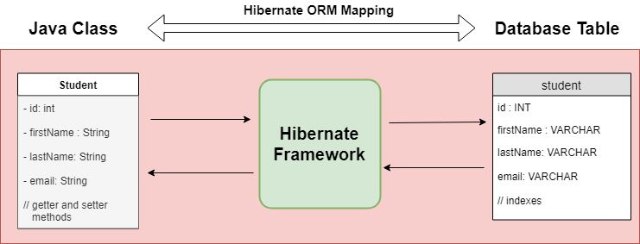
What is JPA Entity?
Entities in JPA are nothing but POJOs representing data that can be persisted to the database. An entity represents a table stored in a database. Every instance of an entity represents a row in the table.
To map Entity classes using xml file specifications or annotations.
@Entity - JPA Annotation : Creating the JPA Entity Class(Persistent class)

Slide 29
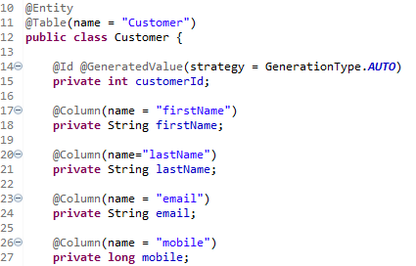
Entity Annotations
Mandatory Annotations
@Entity
@Id
More Annotations
@Table
@GeneratedValue
@Column

Slide 30
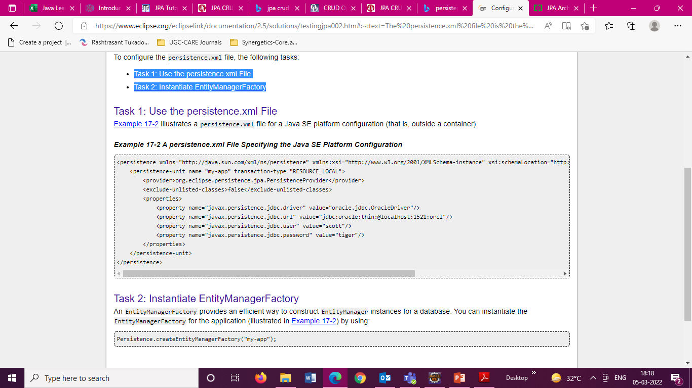
Persistence Configuration
The persistence.xml file is the deployment descriptor file for persistence using JPA. It specifies the persistence units and declares the managed persistence classes, the object/relation mapping, and the database connection details.

Slide 31
Entity Manager
EntityManager responsible for managing entities. Create an Entity manager by following code :
Entity Manager is an interface to perform main actual database interactions.
Creates persistence instance.
Removes persistence instance.
Finds entities by entity’s primary key.
Allows queries to be run on entities.
Persistence Context : A persistence context handles a set of entities which hold data to be persisted in some persistence store (e.g. database).
Each EntityManager instance is associated with a PersistenceContext.

Slide 32
Entity Manager Methods
Persist() – Make an instance managed and persistent.
merge() – Merge the state of the given entity into the current persistence context.
remove() – Remove the entity instance.
find() – Find by primary key. Search for an entity of the specified class and primary key. If the entity instance is contained in the persistence context, it is returned from there.
getReference() – returns and instance which is lazily fetched and will throw EntityNotFoundException when the instance is accessed for the first time.
flush() – Synchronizes the persistence context with the database.
close(): Flush entity instances first, clears persistence context and nullify the entity manager

Slide 33
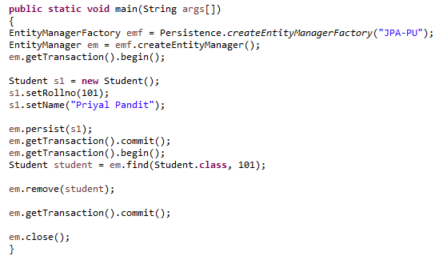
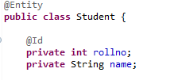
Persisting Entity with Entity Manager

Slide 34
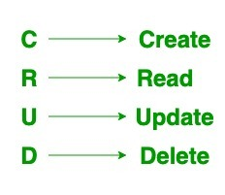
JPA CRUD Operations
persist(Object entity): This method is used to persist a managed Entity.
remove(Object entity): This method is used to remove an Entity from the persistence context.
merge(T entity): This method is used to save the current state of Entity to the persistence context.
find(Class entityClass, Object primaryKey): This method is used to load an Entity based on its primary key.

Slide 35
Practical Demo
Creating Entity class and Perform CRUD Operations

Slide 36
JPA Association
Priyanka Sarode
12-03-2022

Slide 37
What is Entity Association?
Association represents relationship between entities.
When two DB tables are in relationship their JPA persistence classes must be designed and configured supporting that relationship, this work is called “Association Mapping”.
A Java class can contain an object of another class or a set of objects of another class.
There is no directionality involved in relational world, its just a matter of writing a query. But there is notion of directionality which is possible in java.
Hence association is classified as
Unidirectional
Bidirectional

Slide 38
Unidirectional and Bidirectional
By using owner persistence class object of Owner table we are able to access the associated Reference class object/objects data of reference table, and if reverse is not possible then it is called Unidirectional association.
If reverse is also possible then it is called Bidirectional association.
For a bidirectional relationship, we usually define:
the owning side
inverse or the referencing side
Owner persistence class: Persistence class for owner table (table having PRIMARY KEY)
Reference persistence class: Persistence class for reference table (table having FOREIGN KEY)
The JPA programmer should always design persistence classes based on the E-R diagrams (Entity-Relationship Diagram).

Slide 39
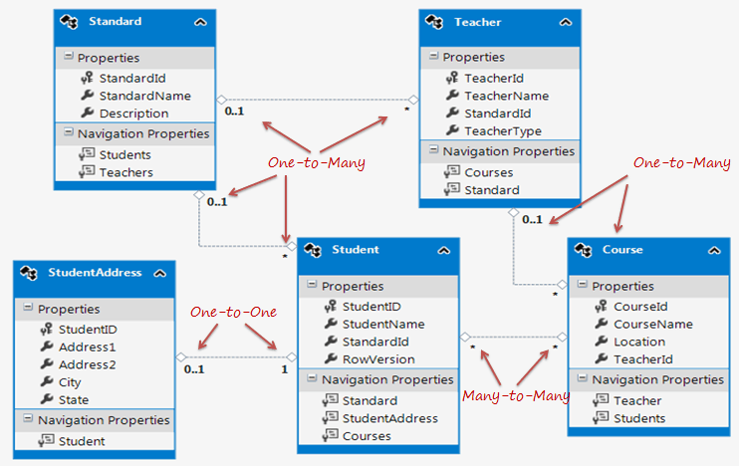
Different types of Association
Unidirectional
One To One
One To Many
Bidirectional
One To One
One To Many/Many To One
Without join table
With join table
Many To Many

Slide 40
Unidirectional One To One
Consider the relationship between Employee and his/her Account.
According to relationship each employee should have unique account.
Relationship model is given below for EMPLOYEE and ACCOUNT.
Employee
1 : 1
Has A
1 : 1
Account
Employee
Employee_Id Employee_Name Employee_Account_Id
Account
Account_Id Account_no
1
1

Slide 41
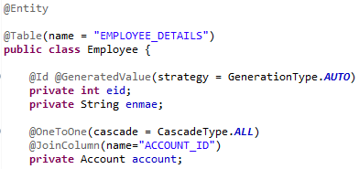
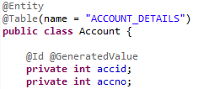
Unidirectional One To One
Employee
Employee_Id Employee_Name Employee_Account_Id
Account
Account_Id Account_no
1
1

Slide 42
Cascading associated entities
Cascade attribute is mandatory, whenever we apply relationship between objects, cascade attribute transfers operations done on one object onto its related child objects.
ALL : All cascade operations will be applied to the parent entity’s related entity. All is equivalent to specifying cascade={DETACH, MERGE, PERSIST, REFRESH, REMOVE}
DETACH : If the parent entity is detached from the persistence context, the related entity will also be detached.
MERGE : If the parent entity is merged into the persistence context, the related entity will also be merged.
PERSIST : If the parent entity is persisted into the persistence context, the related entity will also be persisted.
REFRESH :If the parent entity is refreshed in the current persistence context, the related entity will also be refreshed.
REMOVE :If the parent entity is removed from the current persistence context, the related entity will also be removed.

Slide 43
Implementation of Unidirectional One To One
Employee Has A Account

Slide 44
Bidirectional One To One
One-To-One mapping is an association between one persistence object and another one related persistence object.
If one persistence object uses other and in back if other using the first persistence object then it becomes bidirectional.
If one persistence object uses other and in back if other is not using the first persistence object then it becomes unidirectional.
As an example, the association between, Citizen and Passport, here one citizen has one Passport.
Citizen needs Passport and also Passport does need Citizen and hence it becomes bidirectional association.

Slide 45
Bidirectional One To One
The direction of a relationship can be either bidirectional or unidirectional. A bidirectional relationship has both an owning side and an inverse side. A unidirectional relationship has only an owning side. The owning side of a relationship determines how the Persistence runtime makes updates to the relationship in the database.
In a bidirectional relationship, each entity has a relationship field or property that refers to the other entity. Through the relationship field or property, an entity class’s code can access its related object. If an entity has a related field, the entity is said to “know” about its related object. Such relationship field must be marked with mappedBy attribute.
The inverse side of a bidirectional relationship must refer to its owning side by using the mappedBy element of the @OneToOne, @OneToMany, or @ManyToMany annotation.

Slide 46
Implementation of Bidirectional One To One
Citizen and Passport

Slide 47
Unidirectional One To Many
One-to-many mapping is an association between one persistence object holding the collection of same related persistence objects.
One persistence object mapped to many persistence objects. Tables of both the persistence classes will be related in database.
As an example, one person can have many address(current/permanent).
If one persistence object uses other and in back if other is not using the first persistence object then it becomes unidirectional.
In the Person class we annotate the address field by @OneToMany annotation.

Slide 48
Implementation of Unidirectional One To Many
Person with current address and permanent address

Slide 49
Bidirectional One To Many
One-to-many mapping is an association between one persistence object holding the collection of same related persistence objects. One persistence object mapped to many persistence objects.
Tables of both the persistence classes will be related in database.
If one persistence object uses other and in back if other using the first persistence object then it becomes bidirectional.
If it is bidirectional, then one-to-many bidirectional association mapping and many-to-one bidirectional association mapping both become one and same.

Slide 50
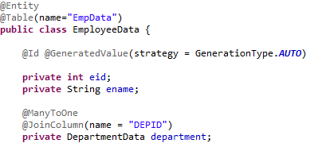
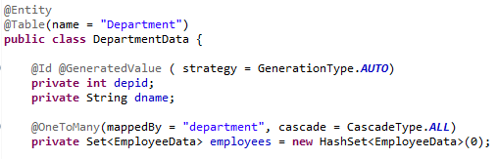
Bidirectional One To Many
@ManyToOne in Employee class
@OeToMany in Department class

Slide 51
Implementation of Bidirectional One To Many
One Employee belongs to one Department but one Department can have many Employee.

Slide 52
Bidirectional Many To Many
Many-To-Many mapping is an association between one many persistence object and many other related persistence object. In Many-To-Many mapping, relationship will be always bidirectional.
Let us consider persistence object A holding persistence objects X, Y, Z.
Persistence object Z can hold persistence objects M, N, O. Now these persistence objects M, N, O are related to persistence object Z.
But not related to persistence object A. But persistence object Z is related to persistence object A.
In this way it becomes conflict in keeping the relationship. To handle this situation in Many-To-Many Bidirectional Association Mapping, we take the support of third table called relationship table.
This table maintains the relationship between records.

Slide 53
Bidirectional Many To Many
To store data of many to many relationship, join table can be used. As shown in slide, the orders stored in ORDER_MASTER table, products stored in PRODUCT_MASTER and there association is stored in PRODUCT_ORDERS.
ORDER_MASTER
Order_Id Order_Date
PRODUCT_MASTER
Product_Id Product_Name
PRODUCT_ORDER
Order_Id Product_Id

Slide 54

Bidirectional Many To Many
ORDER_MASTER
Order_Id Order_Date
PRODUCT_MASTER
Product_Id Product_Name
PRODUCT_ORDER
Order_Id Product_Id

Slide 55
Implementation of Bidirectional Many To Many
Product-Order

Slide 56
Thank You
Priyanka Sarode

