Slide 1
Application designed in Spring Boot, Spring REST, Spring Data
PRIYANKA SARODE

Slide 2
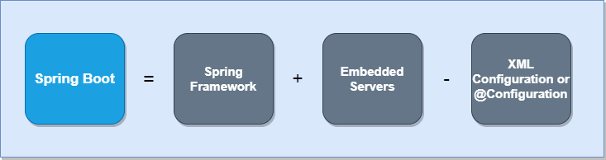
What is Spring Boot?
Spring Boot is built on top of Spring Framework so it has all the features of Spring.
As we know, when we want to run any application we need to have a Tomcat server or any other server. So, Spring Boot also provides the Embedded Server inside the JAR file. It provides the combination of Spring Framework functionality with Embedded Servers.

Slide 3
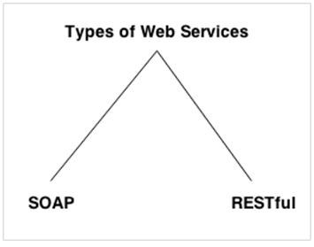
Spring REST
A Web Service is can be defined by following ways:
It is a client-server application or application component for communication.
The method of communication between two devices over the network.
It is a software system for the interoperable machine to machine communication.
It is a collection of standards or protocols for exchanging information between two devices or application.
There are mainly two types of web services.
SOAP web service (Simple Object Access Protocol)
RESTful web service (Representational State Transfer)

Slide 4
Difference between SOAP and REST
No. | SOAP | REST
1) | SOAP is a protocol. | REST is an architectural style.
2) | SOAP stands for Simple Object Access Protocol. | REST stands for REpresentational State Transfer.
3) | SOAP can't use REST because it is a protocol. | REST can use SOAP web services because it is a concept and can use any protocol like HTTP, SOAP.
4) | SOAP uses services interfaces to expose the business logic. | REST uses URI to expose business logic.
5) | JAX-WS is the java API for SOAP web services. | JAX-RS is the java API for RESTful web services.
6) | SOAP defines standards to be strictly followed. | REST does not define too much standards like SOAP.
7) | SOAP requires more bandwidth and resource than REST. | REST requires less bandwidth and resource than SOAP.
8) | SOAP defines its own security. | RESTful web services inherits security measures from the underlying transport.
9) | SOAP permits XML data format only. | REST permits different data format such as Plain text, HTML, XML, JSON etc.
10) | SOAP is less preferred than REST. | REST more preferred than SOAP.

Slide 5
RESTful webservice
REST stands for REpresentational State Transfer. It is developed by Roy Thomas Fielding, who also developed HTTP. The main goal of RESTful web services is to make web services more effective. RESTful web services try to define services using the different concepts that are already present in HTTP. REST is an architectural approach, not a protocol
It does not define the standard message exchange format. We can build REST services with both XML and JSON. JSON is more popular format with REST. The key abstraction is a resource in REST. A resource can be anything. It can be accessed through a Uniform Resource Identifier (URI). For example:
The resource has representations like XML, HTML, and JSON. The current state capture by representational resource. When we request a resource, we provide the representation of the resource.

Slide 6
RESTful webservice
The important methods of HTTP are:
GET: It reads a resource.
PUT: It updates an existing resource.
POST: It creates a new resource.
DELETE: It deletes the resource.
POST /users | : It creates a user.
GET /users/{id} | : It retrieves the detail of a user.
GET /users | : It retrieves the detail of all users.
DELETE /users | : It deletes all users.
DELETE /users/{id} | : It deletes a user.
GET /users/{id}/posts/post_id | : It retrieve the detail of a specific post.
POST / users/{id}/ posts | : It creates a post of the user.

Slide 7
RESTful webservice
HTTP also defines the following standard status code:
404: RESOURCE NOT FOUND
200: SUCCESS
201: CREATED
401: UNAUTHORIZED
500: SERVER ERROR

Slide 8
RESTful webservice Constraints
There must be a service producer and service consumer.
The service is stateless.
The service result must be cacheable.
The interface is uniform and exposing resources.
The service should assume a layered architecture.

Slide 9
Advantages RESTful webservice
RESTful web services are platform-independent.
It can be written in any programming language and can be executed on any platform.
It provides different data format like JSON, text, HTML, and XML.
It is fast in comparison to SOAP because there is no strict specification like SOAP.
These are reusable.
They are language neutral.

Slide 10
Practical Demo
Spring REST with Spring Boot

Slide 11
Thank You
Priyanka Sarode

