Slide 1
Project Title: Healthcare Management Analytics
Name: Pankaj Kumar
Date: 21-09-2026

Slide 2
BUSINESS CONTEXT
The dataset represents a Healthcare Management System that integrates information about patients, doctors, appointments, treatments, and billing across five interconnected tables.
Healthcare organizations generate large volumes of operational and financial data every day.
Management needs visibility into patient demand, appointment efficiency, doctor workload, treatment utilization, and revenue collection.
Raw transactional data makes it difficult to identify no-shows, operational bottlenecks, high-demand specialties, treatment trends, and outstanding payments.
An integrated analytics solution can convert this data into actionable KPIs, dashboards, and predictive insights.
The ultimate goal is to improve patient experience, operational efficiency, resource utilization, and financial performance.
To develop an integrated Healthcare Analytics Solution that transforms operational data into meaningful KPIs, dashboards, and predictive insights, enabling management to improve patient experience, optimize resources, increase operational efficiency, and strengthen financial performance.

Slide 3
PROBLEM STATEMENT
The healthcare organization stores critical information across patients, doctors, appointments, treatments, and billing, but raw transactional data does not provide a clear picture of overall operational and financial performance.
Fragmented Data: Patient, doctor, appointment, treatment, and billing information needs to be integrated for end-to-end analysis.
Appointment Inefficiency: Management needs to identify patterns in completed, cancelled, and no-show appointments and understand peak scheduling periods.
Doctor Workload Imbalance: Different doctors, specializations, and branches may have different appointment volumes, making workload optimization difficult.
Treatment Performance Visibility: The organization needs to understand which treatments are frequently performed and how treatment costs vary.
Billing & Collection Gaps: Unpaid or delayed bills can affect cash flow, requiring monitoring of payment status, methods, and billing trends.
Limited Predictive Capability: Historical data can potentially be used to forecast appointment demand and identify operational risks before they become problems.

Slide 4
TECHNOLOGY STACK - I
Category | Technology | Purpose
Data Source | CSV / Healthcare Transactional Data | Source data for patients, appointments, doctors, treatments, and billing
Data Engineering | Databricks | Data processing and analytics environment
Programming | Python | Data analysis, preprocessing, machine learning, and application development
Data Analysis | Pandas, NumPy | Data manipulation, exploratory analysis, and calculations
SQL | SQL / Snowflake SQL | Data extraction, joins, aggregations, validation, and KPI calculations
ML Models | Logistic Regression, Random Forest | Classification and predictive modelling

Slide 5
TECHNOLOGY STACK - II
Category | Technology | Purpose
Visualization | Power BI | Interactive dashboards, KPIs, drill-downs, and business reporting
BI Calculations | DAX | Measures, calculated columns, KPIs, and time/business calculations
Web Application | Streamlit | Interactive healthcare analytics and prediction application
Version Control | Git & GitHub | Source-code management and project collaboration

Slide 6
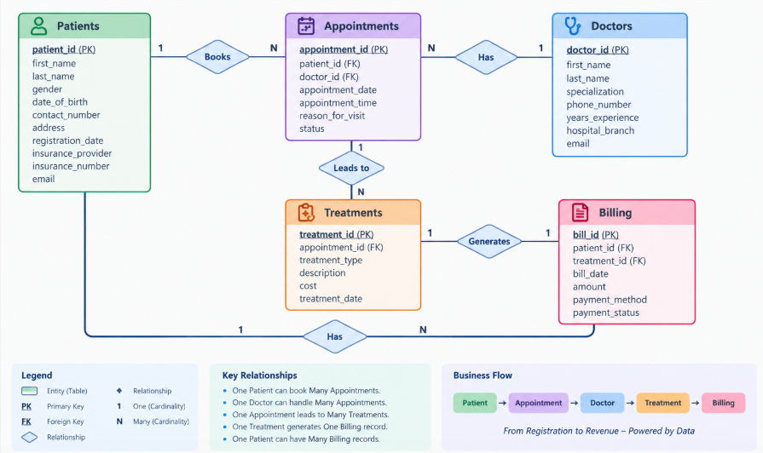
ER DIAGRAM

Slide 7
DATA DICTIONARY
Table | Key Columns | Purpose
Patients | patient_id (PK), gender, date_of_birth, registration_date, insurance_provider | Stores patient demographic, registration and insurance information
Doctors | doctor_id (PK), specialization, years_experience, hospital_branch | Stores doctor profile, specialization and experience details
Appointments | appointment_id (PK), patient_id (FK), doctor_id (FK), appointment_date, appointment_time, status | Records patient appointments and their outcomes
Treatments | treatment_id (PK), appointment_id (FK), treatment_type, cost, treatment_date | Records treatments provided during appointments
Billing | bill_id (PK), patient_id (FK), treatment_id (FK), amount, payment_method, payment_status | Tracks treatment-related billing and payment information

Slide 8
DATA AUDITING
Completeness
Identify missing/null values.
Check mandatory fields such as IDs, dates and amounts.
Uniqueness
Check duplicate patient_id, doctor_id, appointment_id, treatment_id and bill_id.
Referential Integrity
Every patient_id in Appointments should exist in Patients.
Every doctor_id in Appointments should exist in Doctors.
Every appointment_id in Treatments should exist in Appointments.
Every treatment_id in Billing should exist in Treatments.
Validity
Validate date and time formats.
Check that cost and amount are non-negative.
Check realistic ranges for years_experience.
Consistency
Ensure dates follow logical sequences: Registration → Appointment → Treatment → Billing
Check for inconsistent patient/treatment relationships.
Standardize categorical values and text formats.

Slide 9
ANALYTICAL METHODOLOGY
Stage | What We Do | Tools | Output
1. Data Cleaning | Handle nulls, duplicates, incorrect formats and inconsistent values | SQL + Python | Clean dataset
2. Data Integration | Join the five tables using PK–FK relationships | SQL | Analytical dataset
3. Exploratory Analysis | Analyze distributions, trends, correlations and outliers | Python, Pandas, Matplotlib | EDA insights
4. Descriptive Analytics | Understand what happened | SQL + Power BI | KPIs & trends
5. Diagnostic Analytics | Identify why it happened | SQL + Python + Power BI | Root-cause insights
6. Predictive Analytics | Estimate what may happen next | Python + ML | Forecasts / risk scores
7. Visualization | Present insights to stakeholders | Power BI | Interactive dashboards
8. Business Impact | Convert insights into decisions | Analytics + Business Strategy | Better operations & financial control

Slide 10
DESCRIPTIVE ANALYSIS
Area | Analysis | Key Metrics
Patient Analysis | Registration and demographic trends | Total Patients, New Registrations, Gender Distribution, Age Groups
Appointment Analysis | Appointment volume and outcomes | Total Appointments, Completed %, Cancelled %, No-show %
Doctor Analysis | Workload and specialization | Appointments/Doctor, Experience, Specialty-wise Demand
Treatment Analysis | Treatment utilization and cost | Total Treatments, Treatment Count, Avg. Treatment Cost
Billing Analysis | Financial performance | Total Billing, Avg. Bill Amount, Paid %, Unpaid %
Branch Analysis | Hospital branch performance | Patients, Appointments, Treatments, Billing by Branch

Slide 11
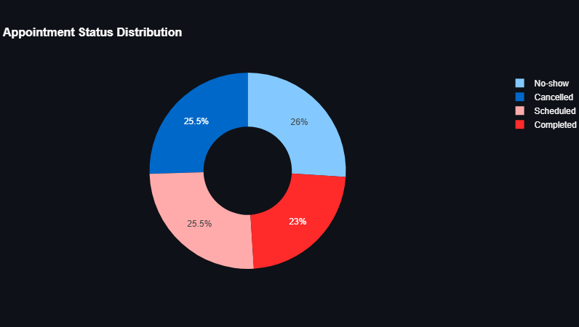
No-show: 52 appointments (26.0%) — the highest proportion of all appointment statuses.
Scheduled: 51 appointments (25.5%) remain scheduled.
Cancelled: 51 appointments (25.5%) were cancelled.
Completed: 46 appointments (23.0%) were successfully completed.
Out of 200 total appointments, only 46 (23%) are recorded as completed, while 103 appointments (51.5%) are either no-show or cancelled.

Slide 12
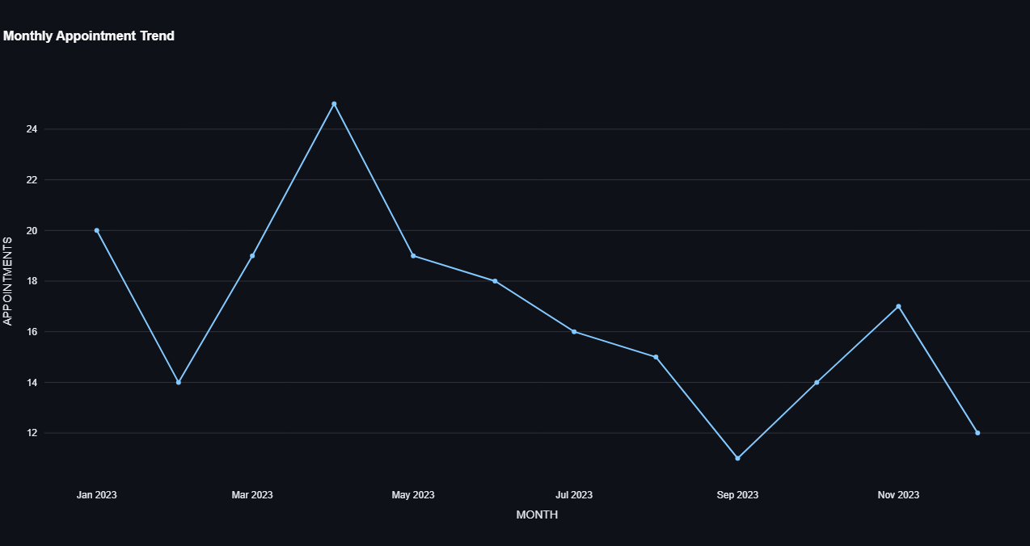
April 2023 recorded the highest appointment volume with 25 appointments.
September 2023 recorded the lowest volume with 11 appointments.
Appointment volume fluctuated throughout the year, with no consistent upward or downward trend.
Stronger appointment activity was observed in January (20), March (19), April (25), and May (19).
Appointment volume declined during July–October, reaching the yearly low in September.
The dataset contains 200 appointments across 12 months, averaging approximately 16.7 appointments per month.

Slide 13
DIAGNOSTIC ANALYSIS
Diagnostic analysis identifies the root causes behind operational and patient-service issues in the Healthcare Management System. By analyzing appointment patterns, doctor workload, department performance, waiting times, cancellations, no-shows, and resource utilization, management can identify bottlenecks, improve staff allocation, optimize appointment scheduling, reduce waiting times, and improve overall healthcare service efficiency.
Appointment Completion Rate
Appointment Cancellation Rate
Patient No-Show Rate
Average Waiting Time
Doctor Utilization Rate
Patients per Doctor
Department Patient Load
Average Consultation Time
Repeat Visit Rate
Patient Outcome Rate

Slide 14


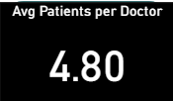
The Appointment Cancellation Rate is 25.50%, indicating that approximately one-fourth of scheduled appointments were cancelled. This highlights a significant level of appointment disruption and suggests an opportunity to improve scheduling efficiency and patient commitment.
The Patient No-Show Rate is 26.00%, meaning more than one-fourth of appointments were missed without the patient attending. This represents a significant operational challenge for appointment capacity and healthcare resource utilization.
The average number of patients per doctor is 4.80, providing an overview of the average patient workload handled by each doctor during the analyzed period.

Slide 15
PREDICTIVE ANALYSIS
Predictive analysis enables the Healthcare Management System to anticipate future patient demand, appointment no-shows, readmission risks, length of stay, and resource requirements. By applying machine learning and forecasting techniques to historical healthcare data, hospital management can proactively allocate resources, optimize scheduling, reduce operational bottlenecks, and improve patient service delivery.
Prediction Problem | ML Type | Suitable Models
No-show prediction | Classification | Logistic Regression, Random Forest, XGBoost
Readmission prediction | Classification | Logistic Regression, Random Forest, XGBoost
Patient volume | Forecasting | ARIMA, Prophet, LSTM
Appointment demand | Forecasting | ARIMA, Prophet, XGBoost
Length of stay | Regression | Linear Regression, Random Forest, XGBoost
Resource demand | Forecasting/Regression | Random Forest, XGBoost, ARIMA

Slide 16
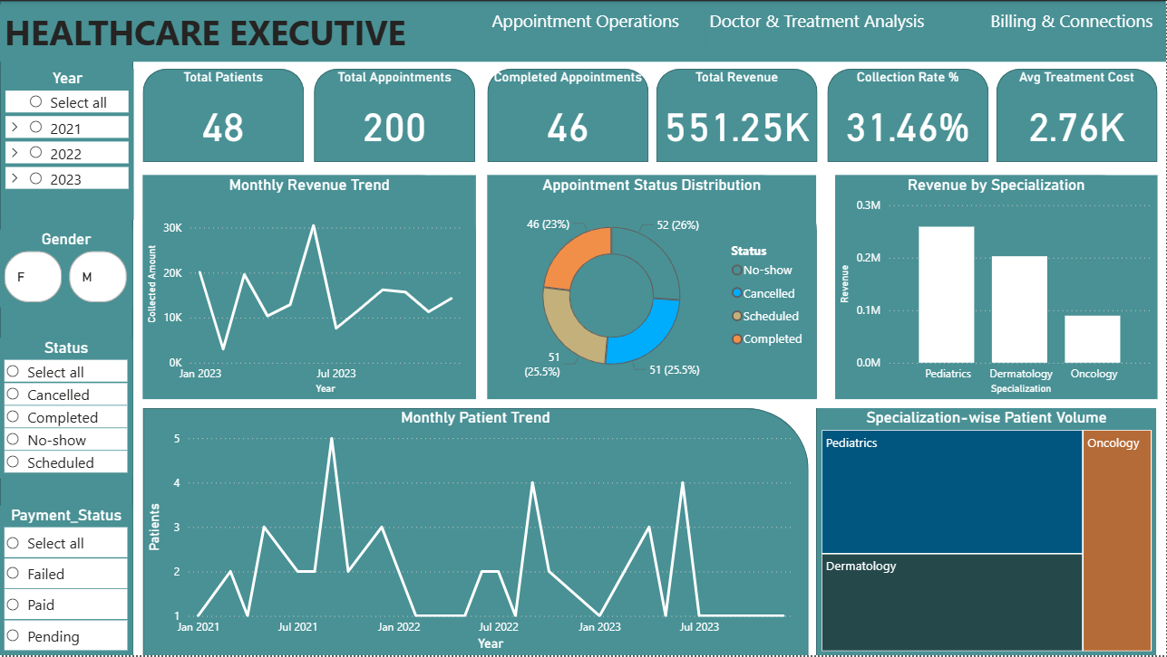
HEALTHCARE EXECUTIVE
Date
(slicer)
Total Patients
(KPIs)
Total Appointments
(KPIs)
Completed Appointments
(KPIs)
Total Revenue
(KPIs)
Collection Rate %
(KPIs)
Avg Patient Waiting Time
(KPIs)
Monthly Patient & Appointment Trend
(Line Chart)
Department
(slicer)
Doctor
(slicer)
Department-wise Patient Volume
(Bar Chart)
Appointment Status
(Donut Chart)
Appointment Status
(slicer)
Revenue by Department
(Column Chart)
Revenue & Collection Trend
(Line Chart)

Slide 17
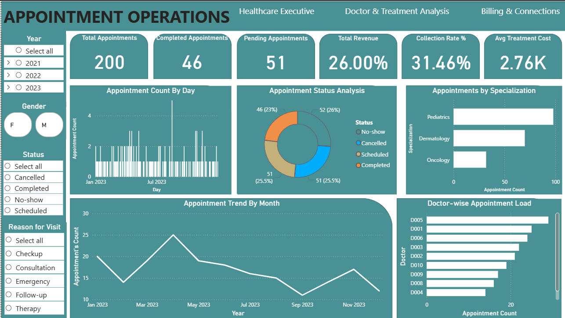
APPOINTMENT OPERATIONS
Date
(slicer)
Total Appointments
(KPIs)
Completed Appointments
(KPIs)
Pending Appointments
(KPIs)
No – Show Rate %
(KPIs)
Collection Rate %
(KPIs)
Avg Patient Waiting Time
(KPIs)
Appointment Trend by Month
(Line Chart)
Appointment Status Analysis
(Donut Chart)
Department
(slicer)
Doctor
(slicer)
Appointments by Department
(Bar Chart)
Appointments by Day of Week
(Column Chart)
Appointment Type
(slicer)
Doctor-wise Appointment Load
(Bar Chart)
Average Waiting Time by Department
(Bar Chart)

Slide 18
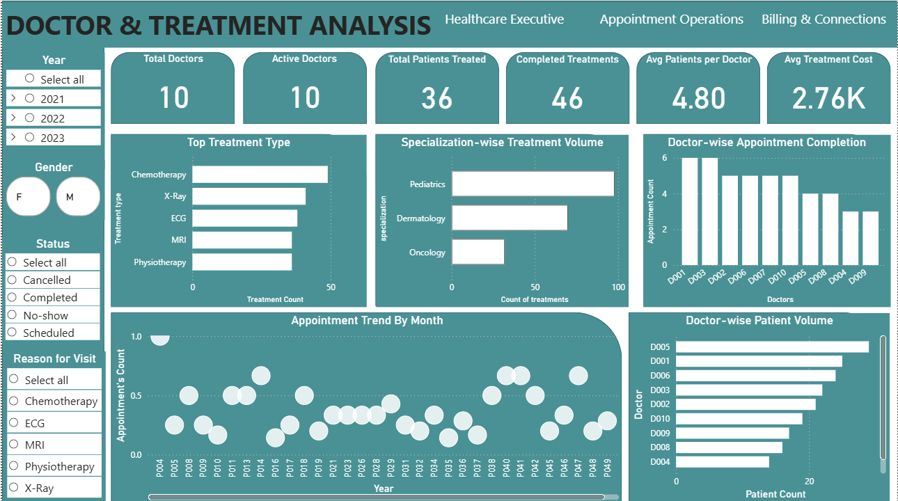
DOCTOR & TREATMENT ANALYTICS
Date
(slicer)
Total Doctors
(KPIs)
Active Doctors
(KPIs)
Total Patient Treated
(KPIs)
Completed Treatments
(KPIs)
Avg Patient per Doctor
(KPIs)
Avg Treatment /
Consultation Time
(KPIs)
Doctor-wise Patient Volume
(Bar Chart)
Doctor-wise Appointment Completion
(Column Chart)
Department
(slicer)
Doctor
(slicer)
Department-wise Treatment Volume
(Bar Chart)
Top 10 Treatments
(Bar Chart)
Patient Gender
(slicer)
Treatment Trend Over Time
(Line Chart)
Doctor Workload Distribution
(Bar Chart)

Slide 19
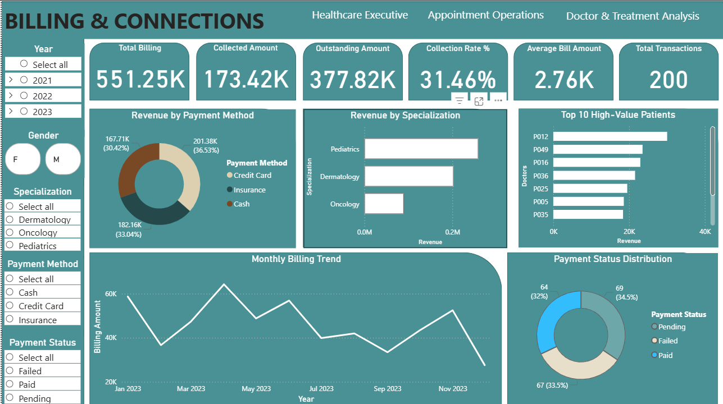
BILLING & COLLECTIONS
Date
(slicer)
Total Billing Amount
(KPIs)
Total Amount Collected
(KPIs)
Outstanding Amount
(KPIs)
Collection Rate%
(KPIs)
Average Bill Amount
(KPIs)
Total Transactions
(KPIs)
Monthly Billing & Collection Trend
(Line Chart)
Payment Status Distribution
(Donut Chart)
Payment Method
(slicer)
Bill type
(slicer)
Revenue by Department
(Bar Chart)
Revenue by Payment Method
(Donut Chart)
Payment Status
(slicer)
Outstanding Amount by Department
(Bar Chart)
Billing vs Collection Analysis
(Scatter Plot)

Slide 20
WEB APPLICATION
Developed an interactive Streamlit healthcare analytics web application integrating patient, appointment, doctor, treatment, and billing data.
Created interactive KPIs and Plotly visualizations for patient volume, appointments, treatments, revenue, collections, and outstanding amounts.
Built a machine learning module for appointment no-show prediction using Python and Scikit-learn.
Provided actionable business insights and recommendations to improve appointment utilization, reduce no-shows, monitor doctor workload, and improve billing collections.
WEB APP LINK: https://healthcare-management-system-7474658118016042.aws.databricksapps.com
GITHUB: https://github.com/harshcodeer/Healthcare-Management-System

Slide 21
INSIGHTS
Appointment Performance: Analysis of appointment statuses — Scheduled, Completed, Cancelled, and No-show — helps identify appointment utilization and attendance patterns.
No-Show Risk: The predictive analysis shows that historical patient and appointment information can be used to identify patients who may be more likely to miss scheduled appointments, supporting proactive reminder strategies.
Doctor & Specialization Workload: Doctor-wise and specialization-wise appointment and treatment analysis helps identify variations in patient demand and workload distribution across healthcare providers.
Treatment & Revenue Patterns: Linking treatments with billing data provides visibility into treatment volumes, treatment costs, revenue generation, and financial activity across specializations.
Operational & Financial Monitoring: Combining appointment, treatment, patient, and billing analytics in interactive dashboards gives management a centralized view for monitoring patient activity, operational performance, and financial collections and supports data-driven planning.

Slide 22
BUSINESS RECOMMENDATIONS
Reduce Appointment No-Shows
  Use the no-show prediction model to identify potentially high-risk appointments.
  Send automated SMS/email reminders before scheduled appointments.
  Provide easy appointment confirmation and rescheduling options.
Optimize Doctor Workload
  Monitor doctor-wise appointment and patient volumes.
  Adjust appointment slots based on demand across specializations.
  Identify periods of high workload and redistribute appointments where appropriate.
Improve Appointment Utilization
  Track Scheduled, Completed, Cancelled, and No-show appointments.
  Analyze no-show and cancellation patterns by day, month, doctor, and specialization.
  Use these patterns to improve scheduling and capacity planning.
Strengthen Billing & Collections
  Monitor outstanding amounts and payment-status trends.
  Send automated payment reminders for outstanding bills.
  Track collection rates regularly through the Billing & Collections dashboard.

Slide 23
THANK YOU!

