Slide 1


MLSA : FULL STACK INTERNSHIP
By Harsh Chandra Srivastava
2300290120105 || CS 2nd B

Slide 2
OVERVIEW
Introduction
Description
Projects Made
Conclusion
Website Preview
Thank You

Slide 3
INTRODUCTION
Most recently, I had the opportunity to participate in a MLSA Full-stack Web Development Internship, which allowed me to gain hands-on experience in building full-stack applications and integrating cloud technologies.

Slide 4
PROJECTS MADE
Simple Recipe Website (Easy-Level Project): I built a recipe website using HTML and CSS, focusing on creating a clean and responsive layout. The project helped me practice the principles of responsive design and user-centric UI development.
Weather App (Intermediate-Level Project): This project involved building a weather application that fetches data from an external API. I implemented real-time weather updates for different locations using JavaScript and handled API integration effectively. This project was more complex as it required managing asynchronous API calls and displaying dynamic data based on user input.

Slide 5

WEBSITE PREVIEW
Recipe Website

Slide 6
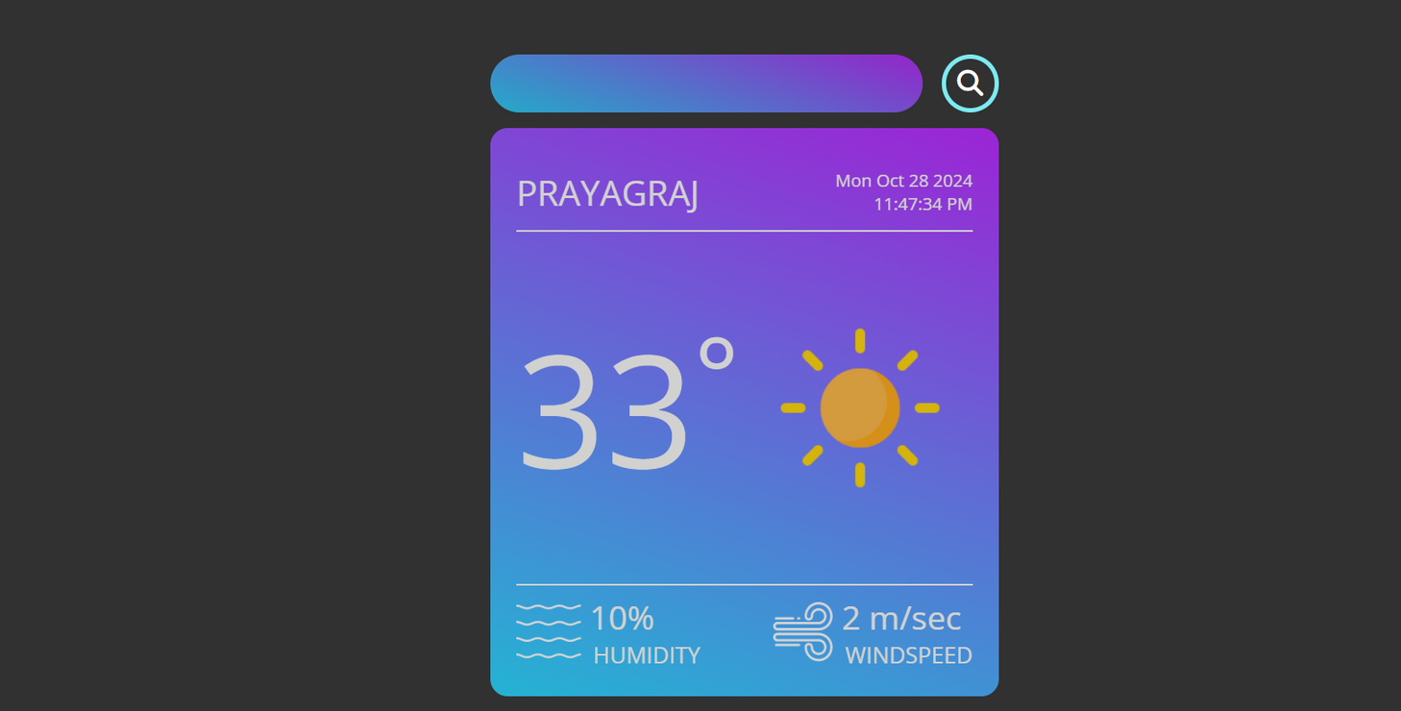
WEBSITE PREVIEW
Weather Site

Slide 7
DESCRIPTION
Recipe Page
Weather Site
The project is made using plain HTML and CSS in Visual Studio Code. To complete this project I took stock images from unsplash used MDN Guides for any help.
The project has basic UI which fetches data from a third party site which offers free API for weather. The project use async along with try and catch to display data.

Slide 8
CONCLUSION
Overall, the Full-stack Web Development Internship was an enriching experience that significantly improved my technical skills. I gained practical knowledge in both frontend and backend development, cloud integration with Azure, and completed challenging projects. This internship has equipped me with the confidence and expertise to take on more complex full-stack development tasks in the future.

Slide 9
Thank You
For your attention

