Slide 1

Turtle Games
An analysis of customer data using predictive modelling and machine learning
Harshdeep Kohli

Slide 2
Context
Problem: Turtle Games have observed that their sales performance has not been meeting quarterly targets.
Business objective: Improve sales performance by understanding patterns and relationships within the data.
How do customers accumulate loyalty points?
How can customers be segmented into groups?
How can customer reviews be used to inform marketing campaigns?
How can descriptive statistics be used to enhance insights?

Slide 3
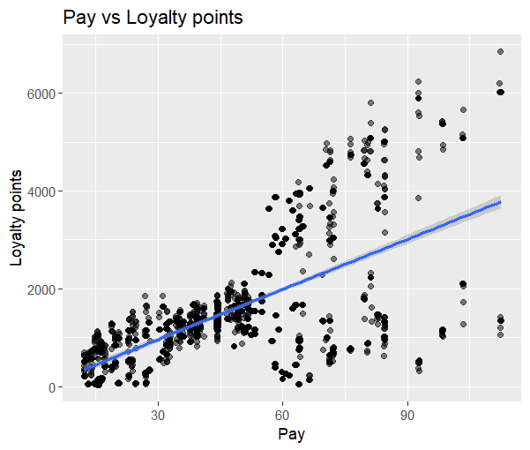
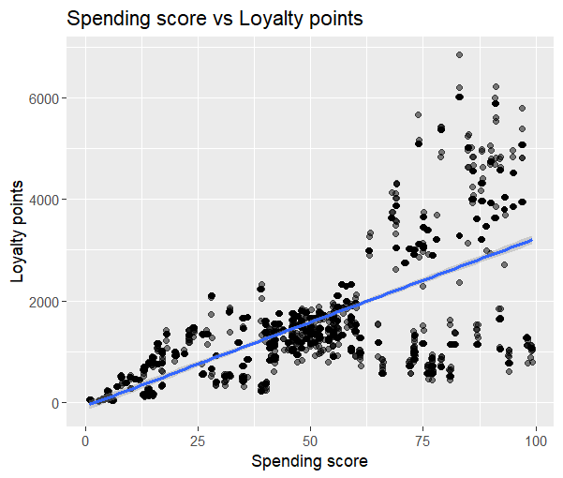
Customer insights What does our data tell us about how customers accumulate loyalty points?
Correlation between pay (remuneration) and loyalty points = 0.62
Correlation between spending score and loyalty points = 0.67
Strong linear relationship between pay & spend to loyalty points = MULTIPLE LINEAR REGRESSION MODEL (MLR)

Slide 4
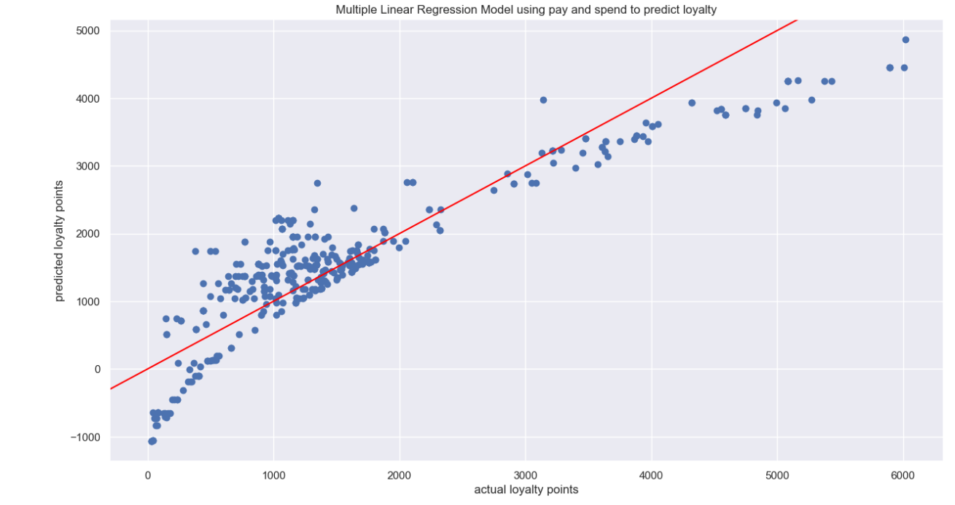
What was the outcome of our MLR model? Positives: strong explanation in loyalty point variation Negatives: violation of MLR assumption of heteroscedasticity and high average error (RMSE)
Key metrics
R-Squared = 83%
RMSE (average error) = 548.6
Outliers
Good predictive accuracy in this section
Outliers

Slide 5
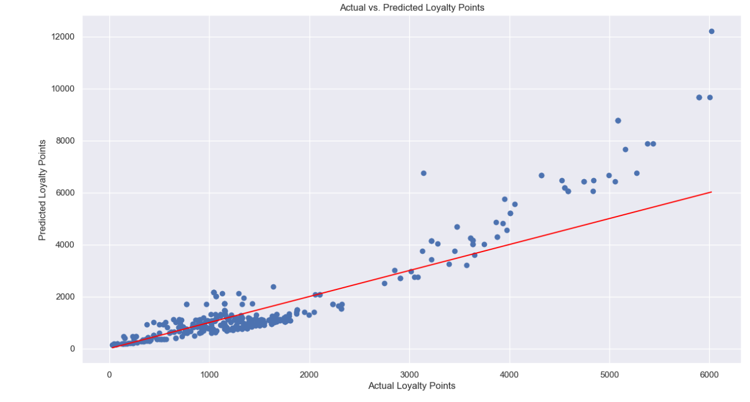
Did our updated LOG transform model do better? No – Lower R-Squared, higher average error (RMSE) and violation of MLR assumption of heteroscedasticity
Key metrics
R-Squared = 80%
RMSE = 864.1
Outliers
Good predictive accuracy in this section

Slide 6
What do Turtle Games need to do for improved predictive modelling?
Improve data collection and feature engineering
Alternative modelling techniques
How can success be measured?
A/B Testing – calculate conversion rate metrics
Improvements in key metrics (R-Squared, RMSE)
Elimination/ reduction of heteroscedasticity using BP test

Slide 7
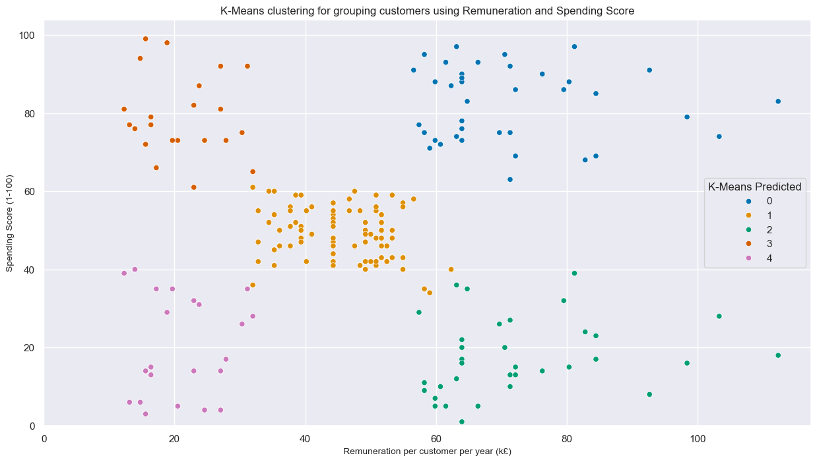
How can customers be segmented? Do any of our customers share similar characteristics?
Action: 5 distinct customer segments at Turtle games to be targeted differently through marketing campaigns
Note: full details of distinct customer segmentation marketing strategies can be found in the technical report
Cluster 0 (Blue) - "Luxury Enthusiasts" (18% of customers)
Cluster 1 (Orange) - "Value Seekers" (39% of customers)
Cluster 2 (Green) - "Practical Professionals" (17% of customers)
Cluster 3 (Red) - "Aspirational Shoppers" (13% of customers)
Cluster 4 (Purple) - "Budget-Conscious Consumers" (14% of customers)

Slide 8
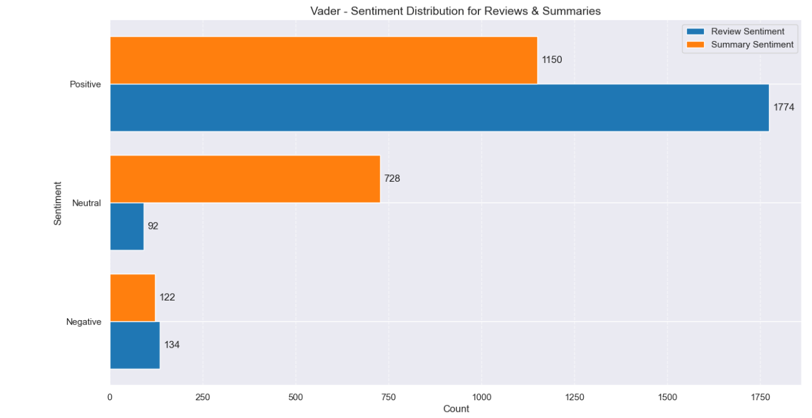
Customer feedback analysis (2000 reviews/summaries) Customer reviews and summaries are mainly positive Strong presence of neutral summaries
Customer summaries – 58% positive sentiment
Customer reviews – 89% positive sentiment
Customer summaries – 36% neutral sentiment

Slide 9
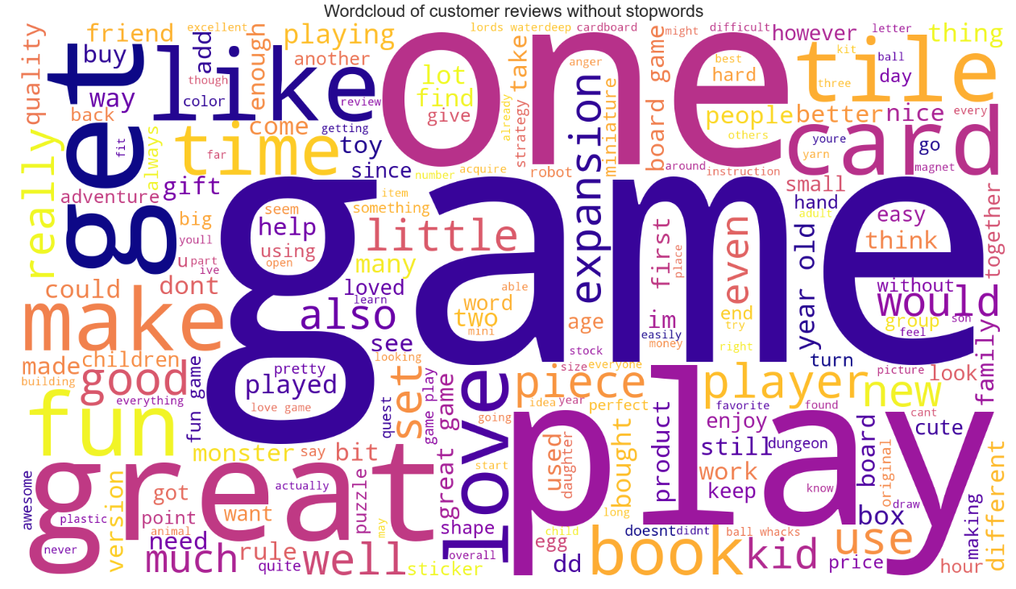
What are customers saying? – The positive stuff Common positive words mentioned: ‘great’, ‘fun’, ‘love’ How can we do better? Speak to our customers to understand successful factors / amplify words in advertising

Slide 10
What are customers saying? – The negative stuff Common negative words mentioned: ‘difficult’, ‘boring’ ‘disappointed’ (negative reviews/summaries can be found in the Jupyter Notebook)
What does this tell us?
Usability Issues: Customers find some games overly complex or poorly designed, hindering enjoyment.
Quality Concerns: Product quality is inconsistent, failing to meet customer expectations
What do we need to address?
Optimize Product Design & Experience - Simplify game mechanics and adjust complexity for target audiences to enhance usability. Prioritize functional design and interactive elements over purely aesthetic features. Ensure products deliver engaging experiences that match marketing promises.
Improve Product Quality & Value - Implement rigorous quality control to meet customer expectations. Reassess pricing to align with perceived value and quality.

Slide 11
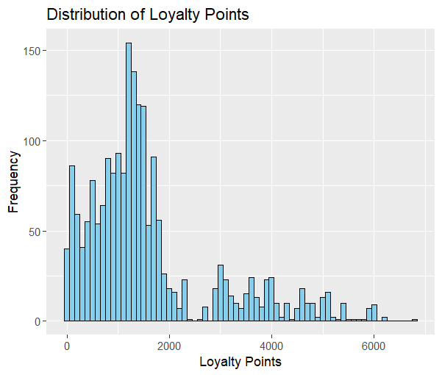
Statistical Analysis Loyalty point data is right/positive skewed and NOT normally distributed What does that mean? It means there is a distinct but small customer segment of high-value customers with substantially larger loyalty point balances
But theres a small group of highly loyal customers here (outliers)
Action: Understand who these customers are and target them as they are Turtle Games most valuable customers
Most customers are segmented here
Shapiro Wilk normality test (W = 0.84307, p < 2.2e-16): Strongly rejects normality
Pareto principle (80/20 rule) where a smaller percentage of customers typically account for a disproportionate amount of business value. A commonality in loyalty programs

Slide 12
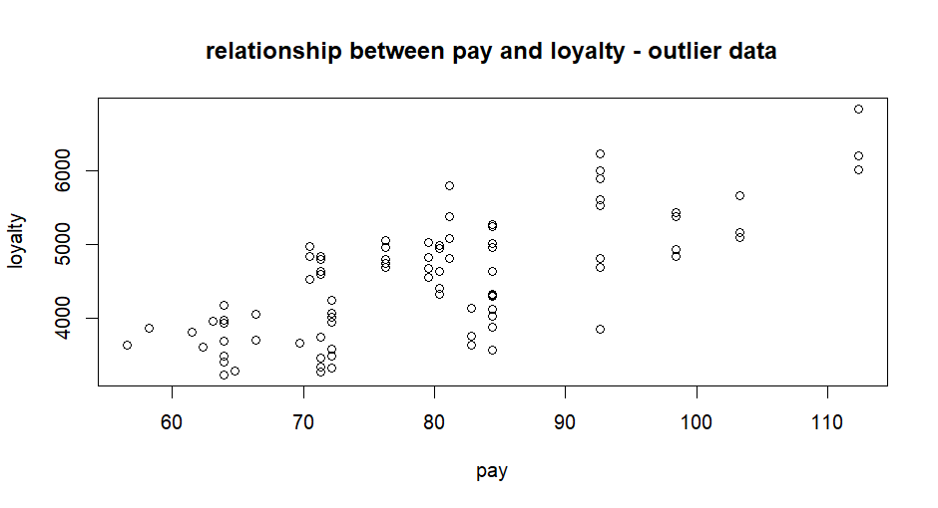
Why does this distinct customer segment have, on average, 4 times a many loyalty points? Income and Loyalty are strongly correlated (79%)
Average Loyalty Points
Outlier data | 4,328
Non outlier data | 1,156
Average Loyalty Points by income range (outlier data)
Top 25% pay | 5,535
Middle 50% pay | 4,270
Bottom 25% pay | 3,694
“If your analysis suggests that 80% of sales come from 20% of customers, it makes sense to reallocate some of your marketing budget and most marketing initiatives to target the 20%” (American express, June 22)

Slide 13
Challenges
Product data not at a granular level
Mismatch between reviews & summaries
Focusing on only MLR
Analytical recommendations
Investigate multimodal distribution in loyalty points
Outlier management
Inclusion of sales data

Slide 14
Final recommendations
Prioritize the outlier segment – They are our most loyal customers. Consider options such as exclusive loyalty programs and loyalty product enhancements
Customized marketing strategies for the 5 different customer segments – Leverage the K means clustering analysis to develop customized marketing strategies (see Jupyter Notebook for full details on the 5 segments and marketing strategies)
Invest in customer experience – Continuous monitoring and proactive addressing of negative feedback will ensure customer satisfaction and increase loyalty
Optimise data quality – Crucial need to address multiple data issues to increase accuracy of predictive models.

Slide 15
Thank you

