Slide 1
SSH: Single Stage Headless Face Detector
Mahyar Najibi, Pouya Samangouei, Rama Chellapa, Larry Davis (ICCV 2017)

Slide 2
Previous Works
Detecting small faces is a challenging task with high inference time and low memory footprint becoming essential requirements.
Most of the previous works for object detection use a 2-stage pipeline with bounding box proposals followed by classification task on all proposed bounding boxes.
Most 2-stage detectors use context information by:
enlarging the windows around proposals (Multipath Network)
employing a recurrent neural network (Inside Outside Networks)
Presence of fully-connected layers at the “head” of the network is computationally expensive and adds to the memory requirements.
Notes:
Summary
previous works have low inference time and high memory (head of VGG16 ~ 120M parameters, >1 second to process the image)
2 stage pipeline is expensive, used the head to extract local features for candidate boxes and for their classification
Fast RCNN used selective search , Faster RCNN used RPNs to generate region proposals in lesser time.
RPN proposes grid of boxes of varying scales and aspect ratio which might contain the object
predicts the possibility of the anchor being a fg or bg and refining the anchor.
image pyramid: scaled images stacked together
cms-rcnn: large memory req, low detection time
Introduction
Decreased Inference Time
Low Memory Footprint
Scale Invariance
Architecture
3 important parts:
base network, comprising of VGG16 minus the fc layers
detection modules M1,M2,M3 with M1 detecting the smallest face, M3 detecting the largest and M2 in the middle. The modules have strides of 8,16,32 respectively. K anchors per sliding window with the centers mapped to the center of the window, having different scales, but with aspect ratio of 1, to reduce the # of achor boxes. This is in contrast to the actual RPN where aspect ratio may vary which may not impact the accuracy.
Each detection module has class score,0/1 output determining if fg/bg and regression output, predicts the change in scale/translation to match the positive anchor.
Context module: use larger filters 5x5,7x7 for achieving a similar enlarging window effect. this way receptive field is proportional to the stride. reduce parameters we use 3x3 seq convolutions
Talk about OHNM, OHPM
Anchors with IoU > 0.5 -> positive class, IoU < 0.3 -> negative class
{1,2} M1, {4,8} M2, {16,32} M3

Slide 3
Previous Works (contd...)
An improvement, the previous state-of-the-art (“Finding Tiny Faces”) used RPN-like model based on Faster RCNN to directly detect faces. But using an image pyramid as input , reduces detection speed.
CMS-RCNN, based on Faster RCNN, incorporated context information and added skip connections to the Faster RCNN. It also has a large memory requirement.
SSD, YOLO used an approach to classify and regress boxes simultaneously

Slide 4
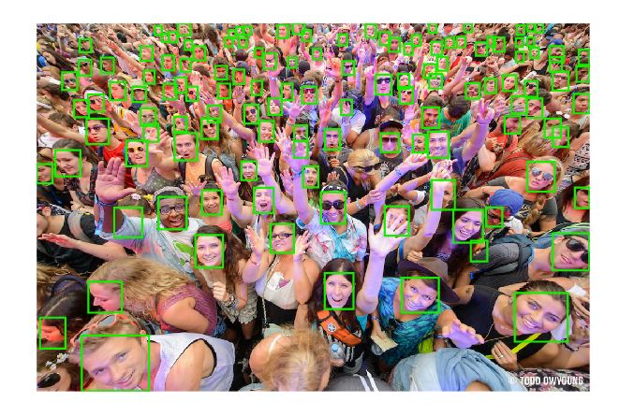
Introduction
employs single stage run for detecting tiny faces. Classification and Regression on proposed boxes done simultaneously without any proposal stage.
scale invariant, as it does not generate an input pyramid of scaled images, uses 3 detection modules M1, M2, M3 with steps 8,16, 32 respectively for detecting small, medium and large faces.
Light -weight network achieved by removing the fully-connected layers at the “head” of the network. Also, it contains lesser parameters for detection and context modules than Faster RCNN’s proposal generation

Slide 5
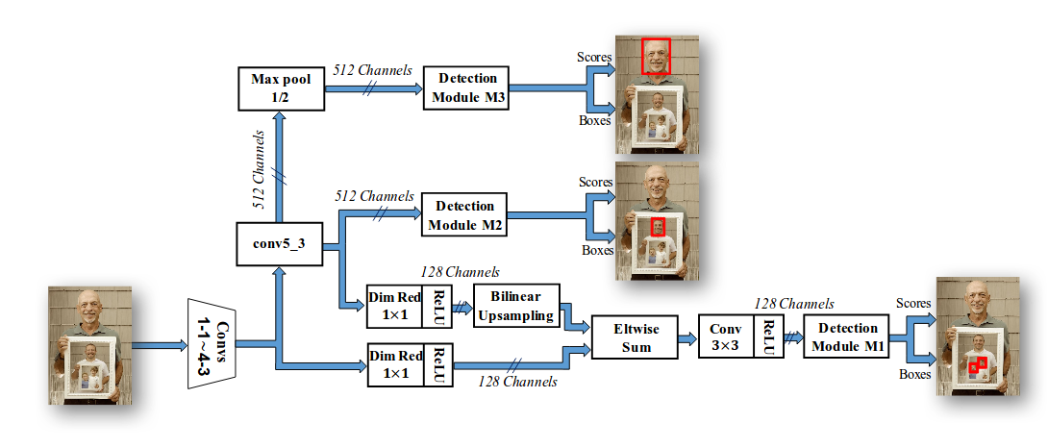
Architecture
Base Network : VGG16 with the fully connected layers removed.

Slide 6
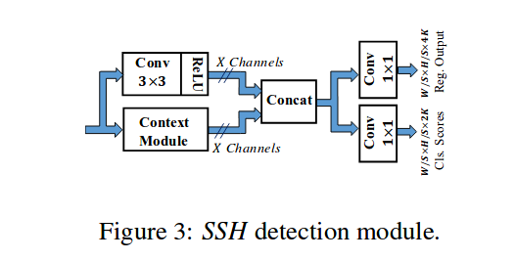
Architecture
Base Network : VGG16 with the fully connected layers removed.
Detection Module: 3 detection modules for different scales [M1, M2, M3]
use RPN to build set of anchors. Each location defines K anchors with different scales.
consists of a binary classifier and regressor.

Slide 7
Architecture
Base Network : VGG16 with the fully connected layers removed.
Detection Module: 3 detection modules for different scales [M1, M2, M3]
use RPN to build set of anchors. Each location defines K anchors with different scales.
consists of a binary classifier and regressor.
Context Module: incorporating context by enlarging the window around the candidate proposals.

Slide 8
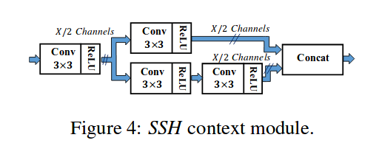
Architecture
Base Network : VGG16 with the fully connected layers removed.
Detection Module: 3 detection modules for different scales [M1, M2, M3]
use RPN to build set of anchors. Each location defines K anchors with different scales.
consists of a binary classifier and regressor.
Context Module: incorporating context by enlarging the window around the candidate proposals.

Slide 9
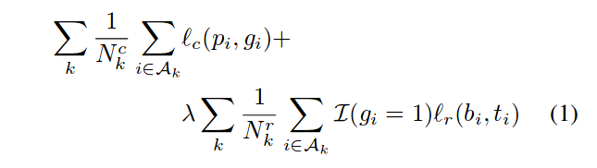
Multi-task Loss function
Loss is calculated based on face classification loss and bounding-box regression loss.

Slide 10
Multi-task Loss function
Loss is calculated based on face classification loss and bounding-box regression loss.
Face Classification Loss: calculated as multinomial logistic loss(cross-entropy) on predicted class scores(p_i) and ground truth labels(g_i) per anchor (k)

Slide 11
Multi-task Loss function
Loss is calculated based on face classification loss and bounding-box regression loss.
Face Classification Loss: calculated as multinomial logistic loss(cross-entropy) on predicted class scores(p_i) and ground truth labels(g_i) per anchor (k)
Bounding Box Regression Loss: calculated as SmoothL1Loss on predicted (x,y,w,h) bbox representation (b_i) and ground truth regression targets(t_i) on the anchors representing the face class per anchor (k).

Slide 12
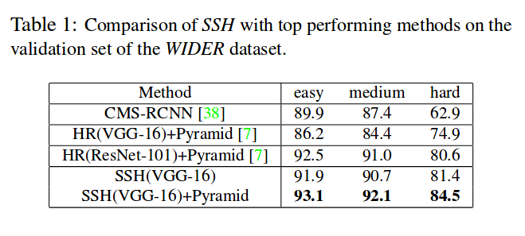
Results (Precision, Recall*)
Trained on 3 Datasets:
WIDER dataset (Training, Testing)
FDDB dataset (Testing only)
Pascal Faces (Evaluation)
Validation and Test sets are divided into easy, medium and hard subsets of the data.

Slide 13
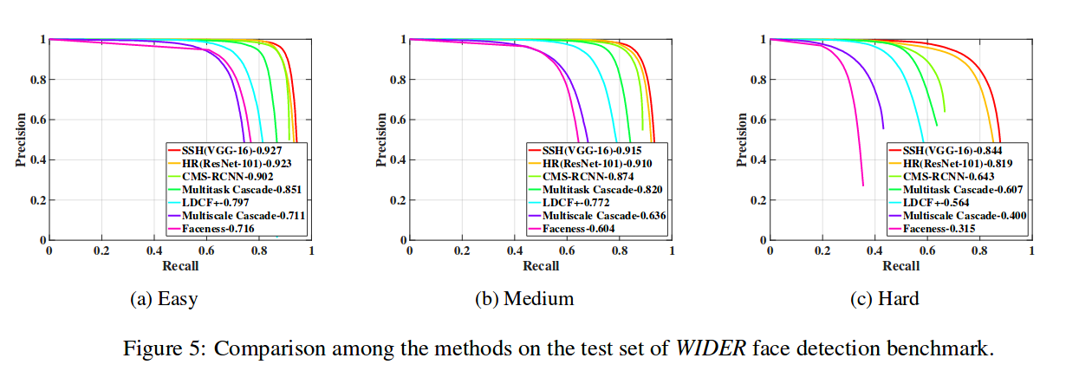
More Results (WIDER test set)

Slide 14
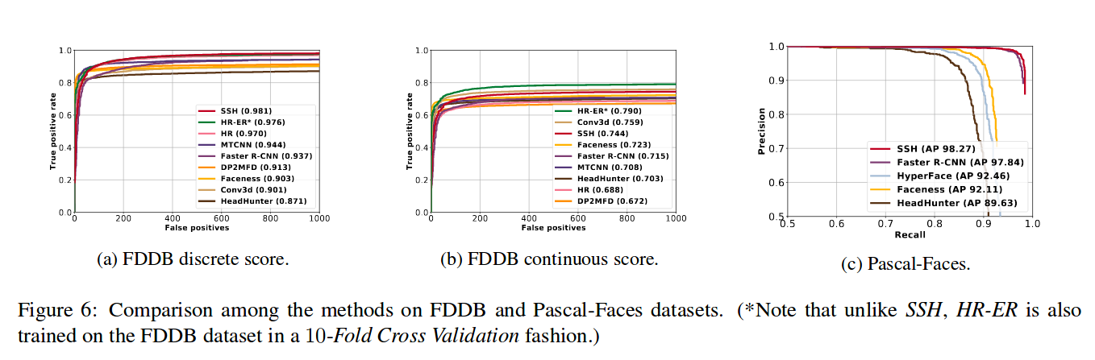
More Results (FDDB, Pascal faces)

Slide 15
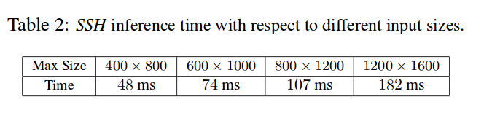
More Results (Timing)
Timinig Results are based on WIDER validation set.
Max Size (m x M) where image is resized to “m” pixels while the longest side is < “M” pixels.

Slide 16
Conclusion
SSH is single stage, scale invariant face detector with low memory requirements.
Achieves state-of-the-art without using “head” of the base network
Uses efficient convolution based context model in contrast to using image pyramid
Uses detection modules to identify faces of varying scales in an image
Tested against WIDER dataset, FDDB dataset & Pascal-Faces with reduced detection time

Slide 17
Additional Slides

Slide 18
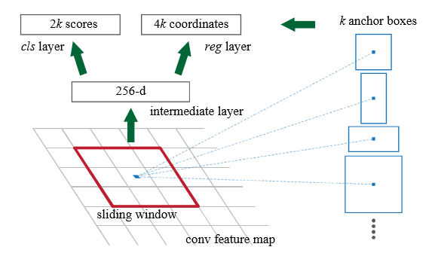
Region Proposal Network
Contains anchors as a dense grid of boxes with various scales and aspect ratios,centered at each location in the feature map
RPN predicts the possibility of an anchor being background or foreground, and refine the anchor.

Slide 19
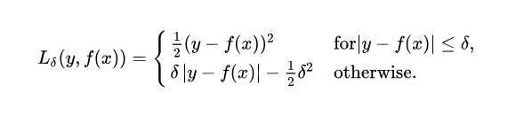
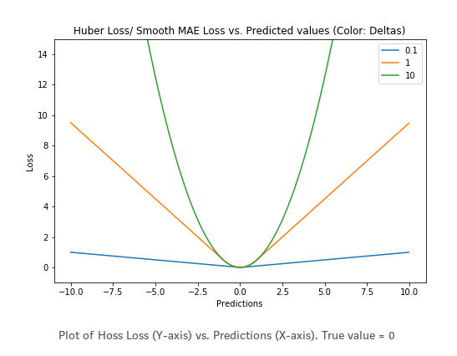
SmoothL1Loss
Also known as Huber Loss or Smooth Mean Absolute Error
Less sensitive to outliers than L₂ loss
Differentiable at 0
Hyperparameter: 𝛿 (delta), determines the threshold to consider an outlier
for 𝛿 ~ 0, SmoothL1Loss ~ MAE
for 𝛿 ~ inf. , SmoothL1Loss ~ MSE
+ Using MSE can lead to missing minima when training NN with Large Gradients. Combines the goodness of both MSE & MAE.
- Need to train the hyperparameter which can be an iterative process.

