Slide 1
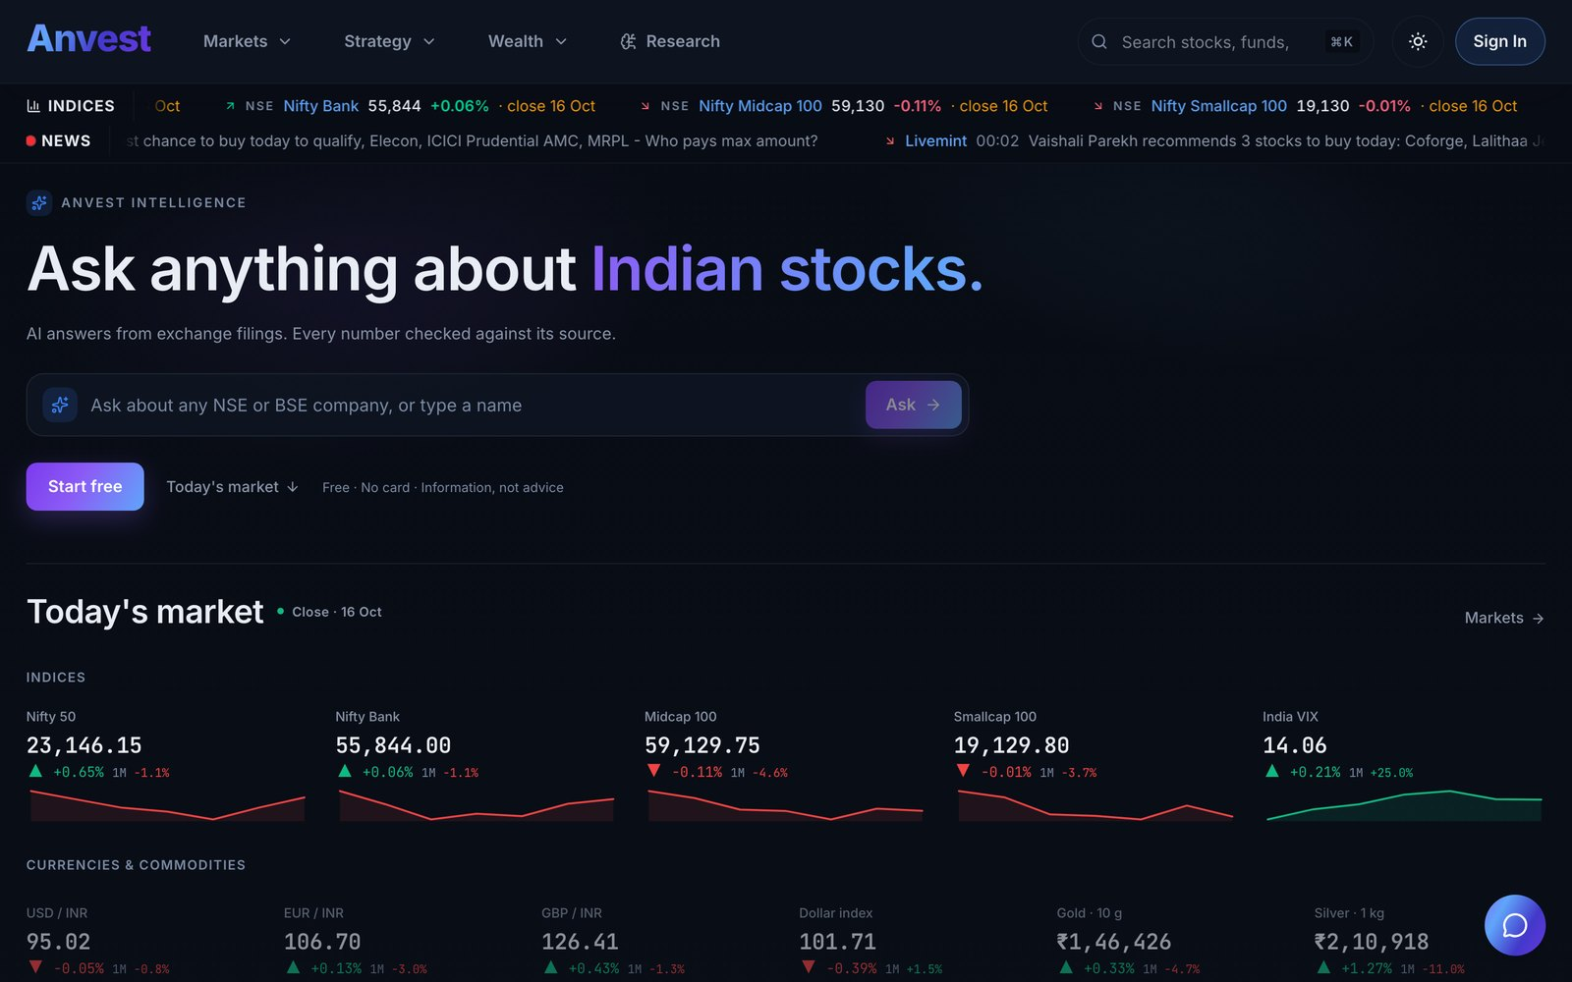
Anvest
India's AI investing co-pilot
Ask anything. Verify every filing. Test before you invest.
6,137
2.89M
1.35M
5,405
listed companies
corporate announcements
indexed filing passages
active AI profiles
Live at anvest.in · for professional desks & active investors
Harsh Bhardwaj, Founder · harsh@anvest.in · anvest.in · Seed round, October 2026
Notes:
Anvest is India's AI research and investing co-pilot, built for both SEBI-registered professionals and active investors. One plain-English question produces a source-cited filing answer, an editable stock screen, a costed backtest, and a portfolio plan. All warehouse metrics on this slide reflect live production coverage as of October 2026.

Slide 2



13.4Cr investors & 3,900 desks lack verified data
THE PROBLEM
9 in 10
Scattered
Unverified
active traders lose money
research, backtest & desk tools
answers from general-purpose AI
SEBI's FY25–FY26 studies show ₹1.06 lakh crore in annual net losses. Retail and prosumer decisions rely on tips and hunches rather than backtested fundamentals.
Analysts and investors jump between scanned exchange PDFs, ratio screeners, backtesters and spreadsheets—losing hours and context at every hop.
General-purpose chatbots sound confident but hallucinate figures on Indian filings. Without a verified XBRL and filing warehouse, AI cannot be trusted.
Investors don't lack information. They lack a trustworthy way to turn it into a decision.
SEBI equity derivatives studies (FY25–FY26) · NSE Market Pulse, Jul 2026: 13.4 Cr registered investors · SEBI intermediary directory (Oct 2026)
Notes:
The problem spans both active investors and professional research desks. SEBI's FY25 and FY26 studies confirm ~90% of individual traders lose money trading on unverified tips. Meanwhile, SEBI-registered analysts, advisers, and PMS desks waste hours piecing together fragmented PDFs, screeners, and spreadsheets, while generic LLMs hallucinate numbers on Indian corporate filings.

Slide 3



Anvest: one AI that researches, tests and plans with you
THE SOLUTION
Ask: grounded answers
Plain-English questions answered from exchange filings and results, with the sources shown. If the data isn't there, Anvest says so.
Test: ideas become evidence
AI turns an idea into an explicit screen, backtests it with real Indian trading costs, then lets you practise with virtual money.
Allocate: one unified workspace
Evaluate stocks, IPOs, mutual funds, bonds and macro stress scenarios on the same verified data engine.
“Every number checked against its source”: live workspace at anvest.in for desks & prosumers
Notes:
Three core workflows—Ask, Test, and Allocate—run on a single verified data warehouse. The AI translates natural-language intent into deterministic queries and backtests, ensuring every figure is reproducible and linked directly to its exchange filing.

Slide 4
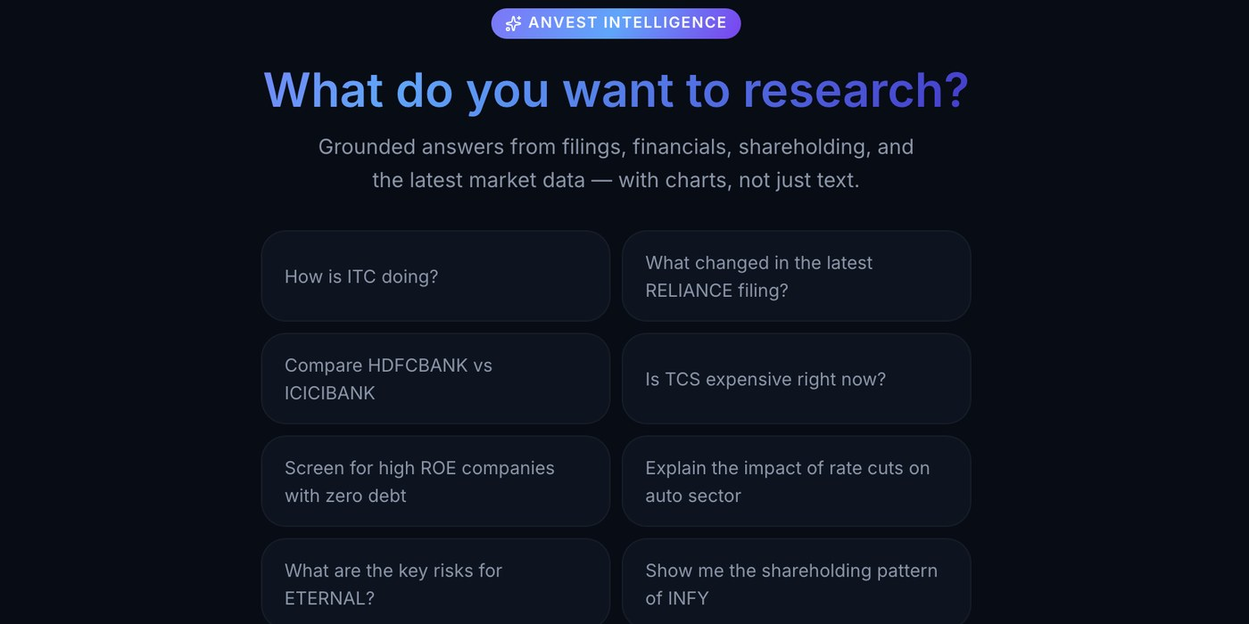
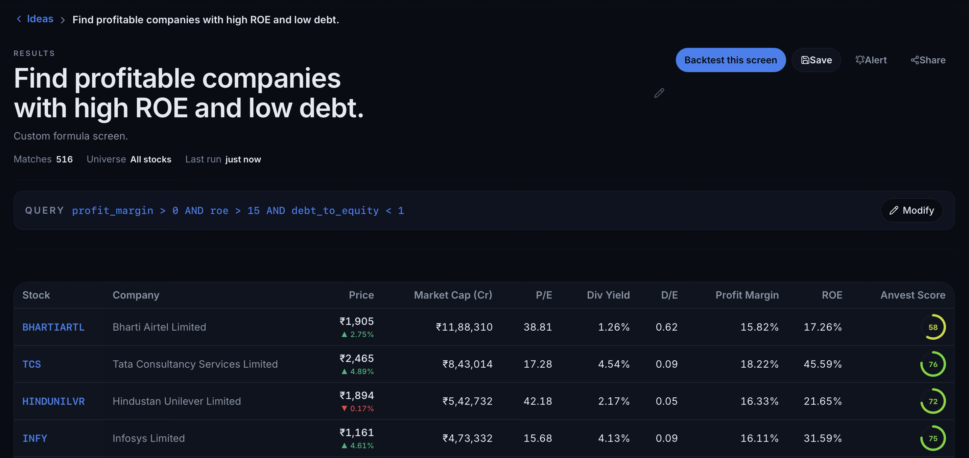
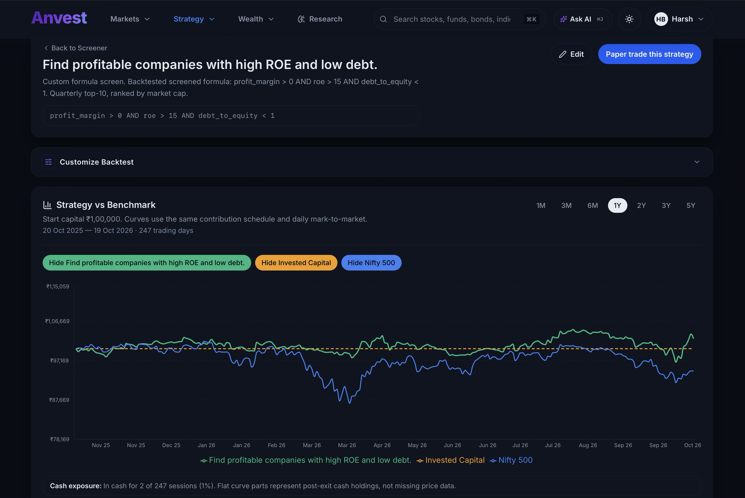
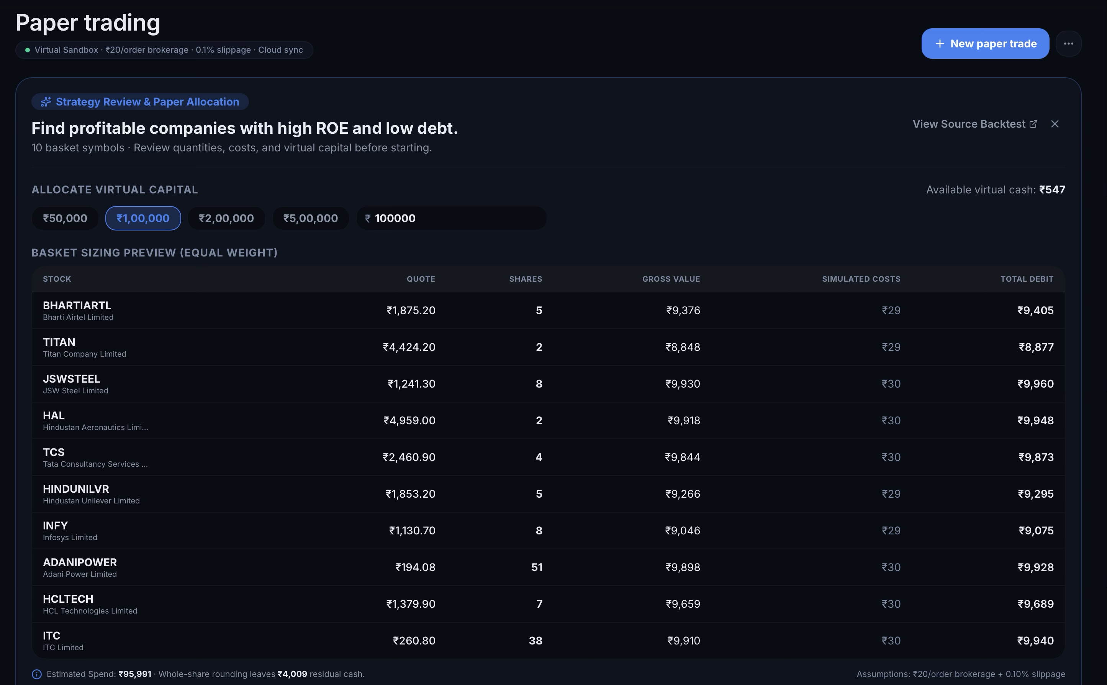


From a question to a tested strategy, in one flow
HOW IT WORKS
1
ASK
2
SCREEN
3
BACKTEST
4
PRACTISE
Ask in plain English
AI builds the screen
Test it on history
Practise, then act
“Find profitable companies with high ROE and low debt.”
Intent becomes explicit, editable filters across 6,137 companies, with a one-click backtest.
Brokerage, STT, stamp duty and slippage built in; alpha, drawdown and Sharpe reported, with every rule shown.
Paper-trade the strategy with virtual cash and review every decision in a journal.
Verified live on 19 Oct 2026: this prompt generated a 516-stock screen (ROE > 15%, D/E < 1), a 1Y costed backtest and a 10-stock paper basket.
AI interprets. Engines compute: the model never does the arithmetic, and answers link back to their sources.
Notes:
Live end-to-end product flow verified on 19 Oct 2026: asking 'Find profitable companies with high ROE and low debt' translates into the explicit formula (profit_margin > 0 AND roe > 15 AND debt_to_equity < 1), matching 516 companies. One click runs a 1-year historical backtest net of Indian brokerage, STT, stamp duty, and slippage against the Nifty 500, and converts the top 10 holdings into an equal-weight virtual paper-trading basket.

Slide 5
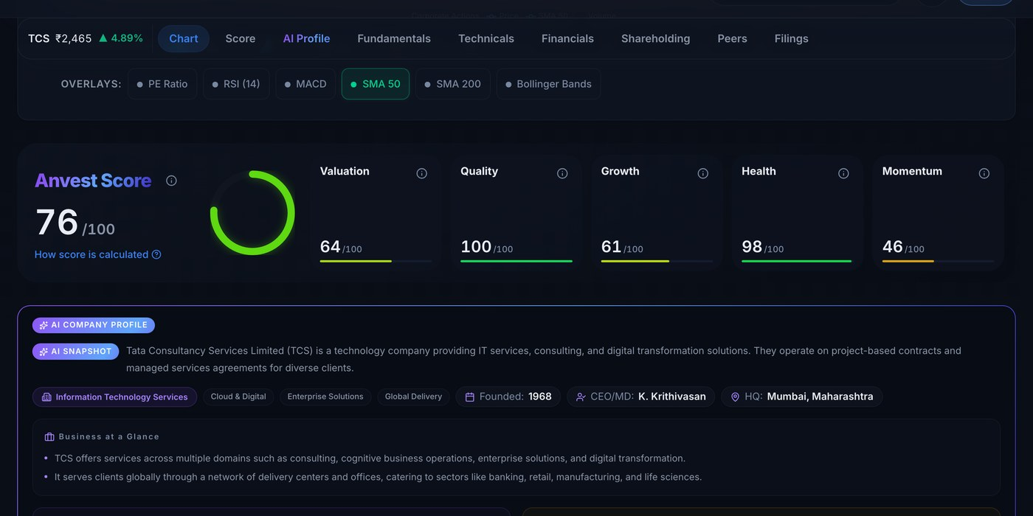
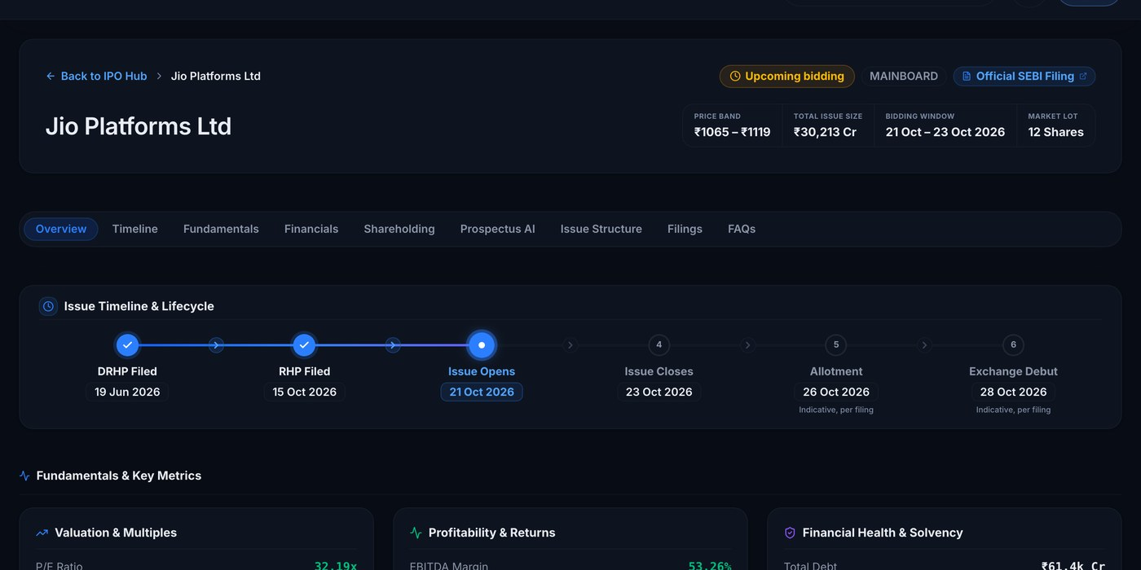
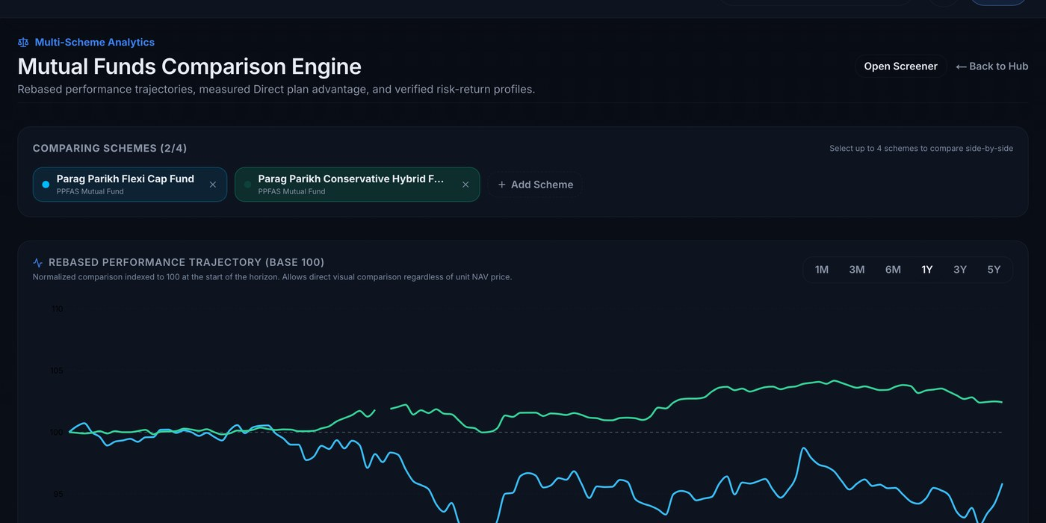
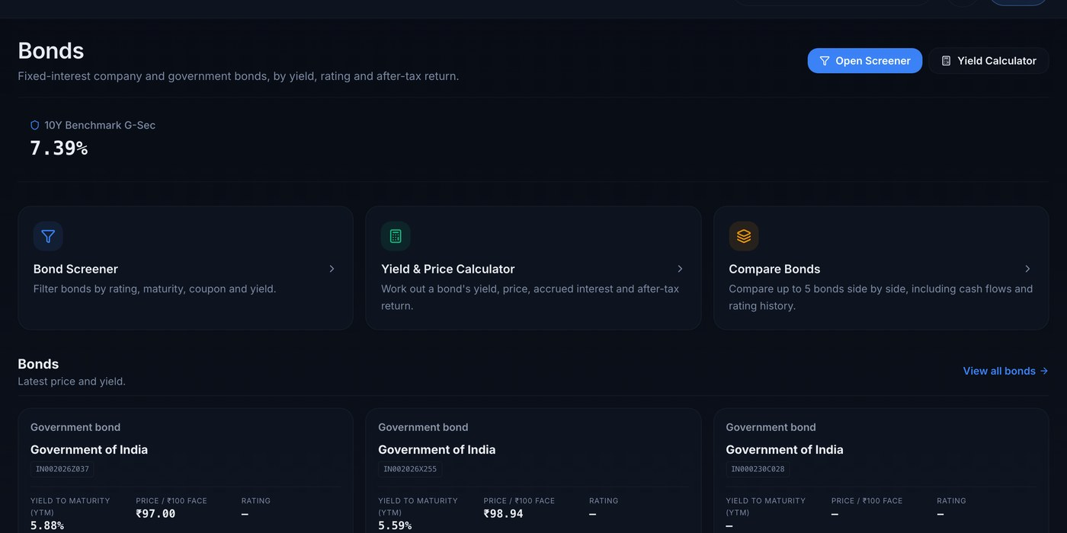
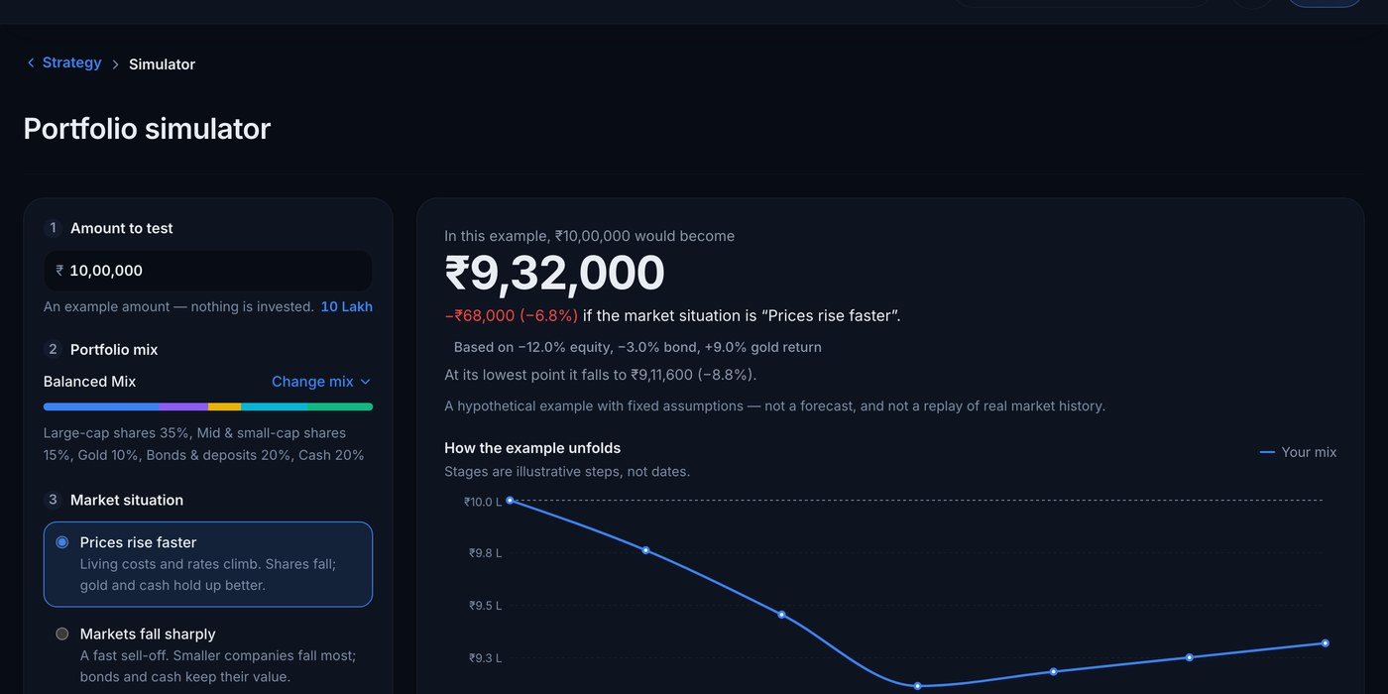
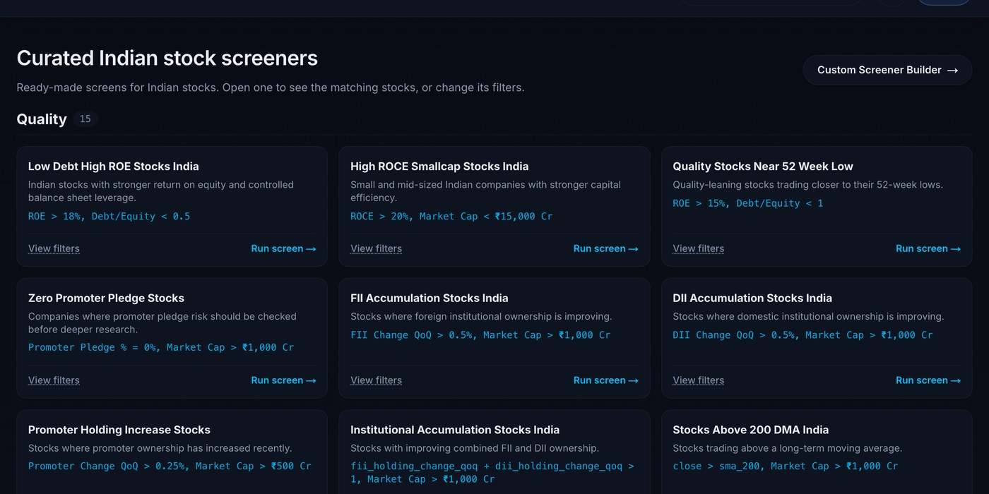
One unified data engine powering six live workflows
LIVE TODAY
Stock intelligence
IPO hub
Mutual fund X-ray
Anvest Score, AI profile, financials and filings
Timeline, restated RHP financials and prospectus Q&A
991 schemes compared on returns, cost, risk and overlap
Bonds and fixed income
Market stress simulator
Curated screens
Yields, after-tax returns and the G-Sec benchmark
How a portfolio behaves in a sell-off or an inflation shock
Promoter buying, FII and DII accumulation, quality
Notes:
All six modules are live views powered by the same underlying XBRL and filings warehouse, eliminating multi-product maintenance overhead. Free discovery tools (IPO hub, bond calculators, and curated screens) drive zero-CAC organic acquisition that funnels active investors and analysts into paid Pro and Desk tiers.

Slide 6




Four shifts make this the moment
WHY NOW
AI can finally read filings
Retail algo trading is now regulated
Language models can now read and explain filings. Trust depends on verified, citable data underneath, which is what Anvest has built.
SEBI's April 2026 framework mandates exchange-registered algos and SEBI RA registration for strategy providers—creating a compliant moat.
Brokers are going agent-native
A new generation of investors
Zerodha's Kite MCP and peers now expose accounts to AI agents. Those agents need a grounded research brain behind them.
13.4 crore unique investors are registered with NSE, while regulators push for explained, accountable research.
Proven willingness to pay for grounded AI: AlphaSense reached $600M+ ARR at a $7.5B valuation (Jun 2026). Anvest delivers institutional filing intelligence at Indian Desk & Pro price points.
SEBI retail algo circular (Feb 2025; glide path Sep 2025) · Zerodha Kite MCP · NSE Market Pulse, Jul 2026 · fintech.global (Jun 2026)
Notes:
Four structural tailwinds converge now: (1) LLMs can parse complex corporate disclosures when grounded in a verified database; (2) SEBI's April 2026 retail algo regulations require white-box transparency and RA registration; (3) Indian brokers (e.g., Zerodha Kite MCP) are opening agentic interfaces that require a trusted research engine; and (4) AlphaSense proves massive global demand for source-cited financial AI, which Anvest localizes for Indian price points.

Slide 7
A $1.3B annual market across desks and active traders
MARKET
₹12,269 Cr · $1.3B / yr
TAM
4.6 Cr active NSE investors on Plus, plus 3.55L SEBI advisers, analysts and MF distributors on Desk
₹2,363 Cr · $247M / yr
96L active equity/F&O traders on Plus & Pro, plus 3,900 SEBI RA, RIA and PMS firms (and top MF distributors) on Desk
SAM
₹29.9 Cr · $3.1M ARR
Year-5 scenario across all four engines: ~1.3% of SAM (₹14.6 Cr core SaaS + ₹15.2 Cr partners/algos)
SOM
2,304
1,057
539
3.5 lakh
SEBI research analysts
investment advisers
portfolio managers
MF distribution professionals
List prices: Plus ₹2,388/yr, Desk ₹35,988/seat-yr. NSE Market Pulse (Aug 2026) · SEBI FY25 F&O study · SEBI intermediary directory (Oct 2026) · ARN+EUIN holders, Jun 2026 (Cafemutual)
TAM: Total Addressable Market, SAM: Serviceable Available Market, SOM: Serviceable Obtainable Market
Notes:
Bottom-up market sizing at list prices (Plus at ₹2,388/yr; Desk at ₹35,988/seat-yr). While active traders form the broadest volume pool in SAM, SEBI-registered research analysts (2,304), investment advisers (1,057), portfolio managers (539), and 3.5 lakh mutual fund distributors provide high-ACV B2B entry seats and institutional credibility.

Slide 8

Why a customer chooses Anvest
COMPETITION
Customer task | Anvest | Screener.in / Tijori | Trendlyne | StockGro / Streak | General AI chat
Explain a filing, with its sources | Live: cited answers from XBRL & filings | Metered AI credits (₹500 in Premium); filing alerts | Earnings call summaries; no full-filing Q&A | Stoxo AI chat; Streak has no filing Q&A | Unverified; hallucinates on Indian filings
Turn an idea into editable filters | Live: plain English to editable formula screen | Manual ratio queries; AI screen assistant | AI screener creation (Premium) | Technical scanners only (Streak) | No live screening database
Test it with stated costs | Live: STT, brokerage, stamp duty & slippage built in | No historical strategy backtesting | Screener backtesting (excludes custom slippage) | Technical candle backtests; no XBRL rules | No backtesting engine
Practise with virtual money | Live: virtual capital basket + trade journal | Watchlists only; no paper trading | Watchlists only; no paper trading | Technical paper trades; no Stoxo paper trading | No paper trading
See portfolio and planning effects | Live: portfolio X-ray, MF overlap, bonds & stress test | Equity watchlists; no MF overlap or bond analytics | Portfolio health report & basket execution | Analyst trade calls & technical baskets | Generic text guidance only
One account takes a question from cited evidence to a costed test and a paper trade
Investing and planning together: stocks, IPOs, funds, bonds and retirement
Unmetered AI filing research included in Pro and Desk tiers
Verified across live platforms (Oct 2026): screener.in · tijorifinance.com · trendlyne.com · streak.tech · stockgro.club. 100% match on spot-checked Q2 FY27 NSE XBRL filings.
Notes:
Direct capability comparison across Indian fundamental tools (Screener.in, Tijori Finance, Trendlyne), technical/AI tools (Streak, StockGro Stoxo), and general-purpose LLMs. Anvest uniquely connects verified XBRL/filing Q&A directly to fundamental backtesting (with Indian statutory transaction costs) and multi-asset portfolio analytics in a single workflow.

Slide 9







The moat is the data engine beneath the AI
THE MOAT
Ingest
Repair and OCR
Verify
Ground
Serve
Prices, filings, XBRL, NAVs and prospectuses, every night
Fixes malformed exchange filings; reads scanned small-cap PDFs
Identity checks, cross-validation and sector-aware rules
Cite the filing, or say the data isn't there
One AI across research, screens, backtests and plans
6,137
2.89M
1.35M
5,405
991
listed companies, full-universe XBRL
corporate announcements
indexed passages, refreshed daily
active AI company profiles
mutual fund schemes
NSE's post-FY23 XBRL carries malformed context dates. Annual figures hide inside Q4 filings. Small-cap filings are often scans. Our deterministic repair + OCR pipeline resolves these across 6,137 companies with 100% source traceability.
Notes:
Any wrapper can call an LLM API, but raw Indian exchange filings contain systematic structural defects—malformed post-FY23 XBRL context dates, Q4-embedded annuals, and non-searchable small-cap PDF scans. Anvest's ingestion, OCR, deterministic verification, and versioned release pipeline represents 12 months of compounding data-engineering domain edge.

Slide 10





Retail trading is going algorithmic. Anvest is the on-ramp
THE FUTURE OF TRADING
54%
Idea
Ask in plain English
LIVE
of NSE cash-market turnover is algorithmic
Rules
AI writes transparent, white-box rules
LIVE
67%
Evidence
Backtest with real Indian costs
LIVE
of equity-derivatives turnover (73% in stock futures)
Practice
Paper-trade with virtual cash
LIVE
1 Apr 2026
SEBI's retail algo framework applies to all brokers
Live
Deploy through partner brokers, subject to empanelment and approvals
NEXT
Execution is regulated; pre-trade testing is the open white space.
The opportunity: bridge fundamental filing intelligence with rule-based strategy testing. Investors build and paper-trade white-box rules today; live deployment unlocks via partner brokers upon SEBI RA registration (funded this round) and exchange empanelment.
NSE Market Pulse, Dec 2025 (turnover share, FY26 to Nov) · SEBI retail algo circulars of 4 Feb 2025 and 30 Sep 2025
Notes:
Algorithmic orders already drive 54% of NSE cash turnover and 67% of equity derivatives. With SEBI's retail algo framework fully active since 1 April 2026, Anvest owns the compliant pre-trade funnel—helping users turn fundamental and technical hypotheses into white-box rules, costed backtests, and paper trades before deploying via empanelled partner brokers.

Slide 11


Four revenue engines on one platform
BUSINESS MODEL
Anvest Plus and Pro
Anvest Desk
Intelligence API and MCP
Strategies, baskets and algo
₹199–₹599 / month
₹2,999 / seat / month
Licence + usage
Subscription + revenue share
Self-serve tiers: unmetered AI filing Q&A, costed backtests, alerts and portfolio X-ray. Pro matches Screener's ₹4,999/yr with AI included.
For SEBI RAs, RIAs, PMS desks and distributors: coverage-list filing digests, cited research and shared workspaces (1-to-5+ seat tiers).
Brokers, wealth apps and AI agents embed Anvest's grounded answers, or license its cleaned filings data.
RA-backed model baskets and exchange-registered strategies, deployed through partner brokers.
SELF-SERVE SAAS
FIRST REVENUE
PILOT-READY
AFTER APPROVALS
Rollout sequence: Desk B2B seats and self-serve Pro first, followed by broker MCP/API licensing and post-RA strategies.
Notes:
Anvest monetizes through a disciplined sequence: (1) high-ACV Anvest Desk subscriptions for SEBI-registered analysts, advisers, and PMS teams (supporting both solo practitioners and 5+ seat desks); (2) self-serve Plus and Pro tiers for active prosumers; (3) B2B Intelligence API and MCP licensing for brokers and wealth platforms; and (4) RA-registered strategy subscriptions post-approvals.

Slide 12

Built, live and growing without a marketing rupee
TRACTION
SHIPPED AND LIVE
~100
early organic sign-ups (Oct 2026) with zero CAC; Desk pilot outreach underway
Grounded AI research copilot
Natural-language stock screener
6,137 stock pages with Anvest Score and AI profiles
Strategy backtesting with Indian costs
Nightly
ingestion of prices, filings, NAVs and news
Paper trading and trade journal
IPO hub with prospectus analysis
9 tools
live across stocks, IPOs, MFs, bonds, backtesting & paper trading
Mutual fund X-ray: cost and overlap
Bonds, G-Secs and yield calculators
Wealth, retirement and stress simulators
12 months
from first commit to full platform, no outside capital
Next 90 days: convert first 10 paid Desk pilots · public checkout launch · full 6,137-page SEO indexing · first broker MCP pilot
Notes:
In 12 months with zero outside capital and zero marketing spend, Anvest shipped the complete end-to-end platform across 9 live modules, ingesting and verifying nightly exchange filings on Google Cloud (Mumbai). Over the next 90 days, focus shifts strictly to commercial validation: converting our first 10 paid Desk pilots, opening self-serve checkout, indexing all 6,137 stock pages for organic search, and launching our first broker MCP integration.

Slide 13


Land with professionals. Compound through partners
GO-TO-MARKET
Professional seats
SUBSCRIPTION TIERS
Founder-led sales to 3,900 SEBI-registered RA, RIA and PMS firms (starting with 1-to-5 seat boutique desks), expanding to 3.5L distribution professionals.
Free
Public pages, screens, 3 AI queries/month
Search built from source data
6,137 stock, 991 mutual fund, IPO and bond pages answer long-tail filing queries for high-intent, zero-CAC organic acquisition.
Plus ₹199/mo
Weekly researchers: portfolio X-ray & alerts
Partners and AI agents
Pro ₹599/mo
Broker and wealth-app integrations through API and MCP reach millions of investors without paid acquisition.
Unmetered AI Q&A, backtests & paper trading
Shareable answers and creators
Desk ₹2,999/seat
Every cited answer, screen and backtest is a shareable link. Education creators join on referral terms, within SEBI's finfluencer rules.
Analyst & adviser desks (1 to 5+ seat teams)
Screener Premium charges ₹4,999/yr with metered ₹500 AI credits; Anvest Pro includes unmetered grounded AI answers and costed strategy backtesting.
Notes:
Our go-to-market lands with high-intent SEBI-registered professionals (offering flexible 1-to-5+ seat Desk plans to shorten initial sales cycles), while our 7,100+ programmatic stock and fund pages capture long-tail organic search traffic. Shareable verification links and broker API/MCP integrations compound distribution without paid consumer CAC.

Slide 14
A base plan for this round, and a path to ~₹30 Cr ARR
FINANCIAL PLAN
THIS ROUND · MONTH 15
$400K base
$700K upsize
ARR run-rate
₹83 L
₹1.2 Cr
Desk teams
43
62
Paying partners
2
3
Total cash runway
~22 months
~30 months
SCENARIO CONDITIONS
Series A near Month 18 funds 13 sellers by Year 5
Strategies launch after SEBI RA & broker empanelment
Partner API contracts use tiered per-user pricing
Bottom-up operating plan: core SaaS (Desk + Retail) reaches ₹14.6 Cr ARR by Year 5; B2B API partners and RA strategies add ₹15.2 Cr as gates clear.
Notes:
This round funds an 18-month execution plan with ~22 months of total cash runway on the $400K base raise (~30 months on the $700K upsize), extending to 25–40 months at Month-18 net burn as subscription revenue scales. Core SaaS (Desk + Retail) reaches ₹14.6 Cr ARR by Year 5 on its own, with Partner APIs and regulated Strategies providing ₹15.2 Cr of expansion upside.

Slide 15

A founder who has already built the hard part
TEAM
Harsh Bhardwaj
FIRST HIRES FROM THIS ROUND
Founder
1
Growth and partnerships lead
Sells Desk pilots and broker integrations
B.Tech, Electronics and Communication, IIT Guwahati (2015–19)
2
Data engineer
Senior Engineering Lead building production agentic LLM systems
Owns ingestion, coverage and data quality
Seven years building high-throughput backend and distributed systems at New Relic, Shiprocket, Weave and Jaguar Land Rover.
3
Full-stack and quant engineer
Strategies, alerts and the path to live algos
Solo-built Anvest's XBRL repair pipeline, verification engine and 9-module platform in 12 months with zero outside capital
With $700K upsize: adds second B2B seller in Month 8. Onboarding SEBI compliance counsel and capital-markets advisory bench.
Domain edge already earned in production: malformed XBRL dates, Q4-only annual figures and scanned PDFs, all solved.
Notes:
Harsh brings 7 years of distributed systems and production AI architecture experience at New Relic, Shiprocket, Weave, and Jaguar Land Rover, and solo-built the entire Anvest data warehouse and application suite in 12 months. This seed round adds dedicated B2B sales leadership, data engineering, and SEBI compliance advisory depth.

Slide 16
Raising $400K–$700K Seed: what each amount proves
THE ASK
$3.5M post-money cap · CCD/CCPS · identical terms for every investor
$155K
Team
$400K BASE PROVES BY MONTH 15
$700K UPSIZE ADDS
Growth lead, data engineer, full-stack and quant engineer
₹83 L
₹1.2 Cr
38.75% of $400K
ARR run-rate (~$87K)
ARR run-rate (~$124K)
$70K
Compliance and infrastructure
43
Desk teams (~227 seats)
62
Desk teams, with a second seller
SEBI RA registration, exchange data licence, scaled serving and inference
2
3
17.50% of $400K
paying partner integrations
paying partner integrations
$175K
Growth, founder and reserve
RA
SEBI research-analyst registration
~30 mo
total cash runway
Desk pilots, launch, CAC tests, founder salary and a 17.5% reserve
43.75% of $400K
Public
head-to-head benchmark, published
Plan spend M1–18: $330K (₹2.85 Cr) base · $410K (₹3.55 Cr) upsize.
Base raise provides ~22 months of total cash runway (~25+ months at Month-18 net burn), leaving the 17.5% reserve untouched.
Series A-ready in 15–18 months
Notes:
We are raising $400K to $700K on a $3.5M post-money cap via CCD/CCPS with identical terms for all investors. Allocation totals exactly 100% ($155K Team / 38.75%, $70K Compliance & Infra / 17.50%, $175K Growth, Founder & 17.5% Reserve / 43.75%). By Month 15, the base plan delivers ₹83L ARR across 43 Desk teams and 2 partner integrations, positioning Anvest for a strong Series A.

Slide 17
Every Indian investor deserves an analyst, a quant and a planner.
Anvest puts all three behind one question.
Institutional depth. Retail reach. One verified data engine.
Explore live at anvest.in · Book a live workflow demo and data-room walkthrough: harsh@anvest.in
Harsh Bhardwaj · harsh@anvest.in · live at anvest.in
Notes:
Close on the core vision: institutional research depth and quantitative testing made accessible to every Indian desk and investor. Invite investors to test live queries at anvest.in and walk through the data room.

Slide 18





Trust and compliance, built in
APPENDIX
Data accuracy
Answers show the filings they draw on and pass a numerical check against that evidence before they are returned. Coverage gaps are shown, not estimated. Corrections ship as versioned releases.
Regulation
Informational by design: no buy, sell or hold calls and no target prices. SEBI RA registration is funded in this round and positions Anvest for the retail algo framework.
Market data
End-of-day exchange data today; licensed institutional & delayed feeds budgeted this round for Desk teams and public pages, plus broker OAuth for retail.
Verification proof
100% exact match on spot-checked Q2 FY27 NSE XBRL filings; publishing a 100-task head-to-head benchmark (accuracy, latency, cost) vs. Screener, Tijori & Trendlyne.
Key-person depth
Runbooks, health-checked nightly jobs and documented architecture. The first hires add data and customer-facing depth.

Slide 19
Operating model: the month-15 bridge
APPENDIX
Engine | Base drivers ($400K) | Base | Upsize ($700K)
Desk seats | Founder 1 team/mo; seller 3 teams/mo once ramped; 2% monthly churn; 1–5 seat Desk plans averaging ~₹2,245 net/seat | ₹5.1 L | ₹7.3 L
Partners | 2 integrations live (months 10 and 14); 4,000 active users each, growing 6%/month, at ₹15 per user | ₹1.4 L | ₹2.2 L
Retail | 10,192 monthly users; 0.3% convert each month; 5% monthly churn; ~₹200 net per subscriber | ₹0.4 L | ₹0.5 L
Net MRR at month 15 | After 18% GST and launch discounts; ARR run-rate = MRR × 12 | ₹6.9 L | ₹9.9 L
Unit economics (base): gross margin ~44% at Month 15 (amortizing fixed data/serving base), scaling to ~85% by Year 5 · Desk CAC ≈ ₹0.85 L per 5-seat team (~8-month payback)
Bottom-up monthly operating model factoring 18% GST, payment gateway fees, semantic query caching and exchange data licensing.

Slide 20
Long-term scenario: drivers and conditions
APPENDIX
Exit | Sellers | Monthly users | Retail subs | Desk seats | Partners (users) | Strategy subs | ARR
Month 15 | 2 | 10,192 | 186 | 227 | 2 (9,593) | — | ₹83 L
Year 2 | 5 | 24,015 | 496 | 464 | 4 (38,832) | 374 | ₹2.2 Cr
Year 3 | 9 | 84,016 | 1,746 | 1,391 | 6 (1,06,700) | 3,056 | ₹7.0 Cr
Year 4 | 12 | 1,69,058 | 4,519 | 2,810 | 8 (2,45,235) | 8,487 | ₹15.6 Cr
Year 5 | 14 | 3,40,177 | 9,635 | 4,571 | 10 (5,23,995) | 19,298 | ₹29.9 Cr
Sellers include the founder.
Series A near month 18
Partner contracts
Strategies
Funds sellers and Series A marketing; monthly-user growth 11% a month to month 36, then 6%
Eight more integrations from Month 20, using tiered per-active-user and enterprise licensing as partner volume scales
Start at month 22 only after SEBI RA registration, exchange empanelment and a partner broker; ₹250 a month net per subscriber

Slide 21
Every capability has a commercial job
APPENDIX
Product capability (live today) | Commercial role to test | Engine
AI research and screening | Frequent research tasks that support subscription demand | Plus, Pro, Desk
Backtesting, paper trading and journal | Repeated strategy evaluation and a reason to upgrade | Pro
Wealth planning, calculators and guides | Broader acquisition and recurring planning needs | Free to Plus
Professional coverage lists and team workspaces | Higher-value team subscriptions | Desk
Broker and API integration | Paid distribution of proven research capabilities | Partners and API
Approved strategy execution (future) | Later monetisation of an established testing workflow | Strategies
Product-led funnel: free calculators, IPO hub and curated screens drive zero-CAC organic discovery, converting power users and analysts into Pro and Desk tiers.

Slide 22
Expansion roadmap
APPENDIX
THIS ROUND: 0–18 MONTHS
H1
Launch and validate
M1–M6: First 10 paid Desk teams, public checkout, 100-task benchmark & SEBI RA filing · M7–M12: First broker MCP/API pilot & 25 Desk teams · M13–M18: RA approval & ₹83L–₹1.2Cr ARR.
SERIES A
H2
Scale the platform
Wealth and learning depth, more partners and AI-agent distribution, team plans for advisers and distributors, alerts on every holding.
GROWTH
H3
From insight to execution
Exchange-registered strategies through partner brokers, a strategy marketplace, more markets, and advanced quant research for professional desks.
Each new business line carries its own approvals and business case; this round's budget funds H1.

