Slide 1
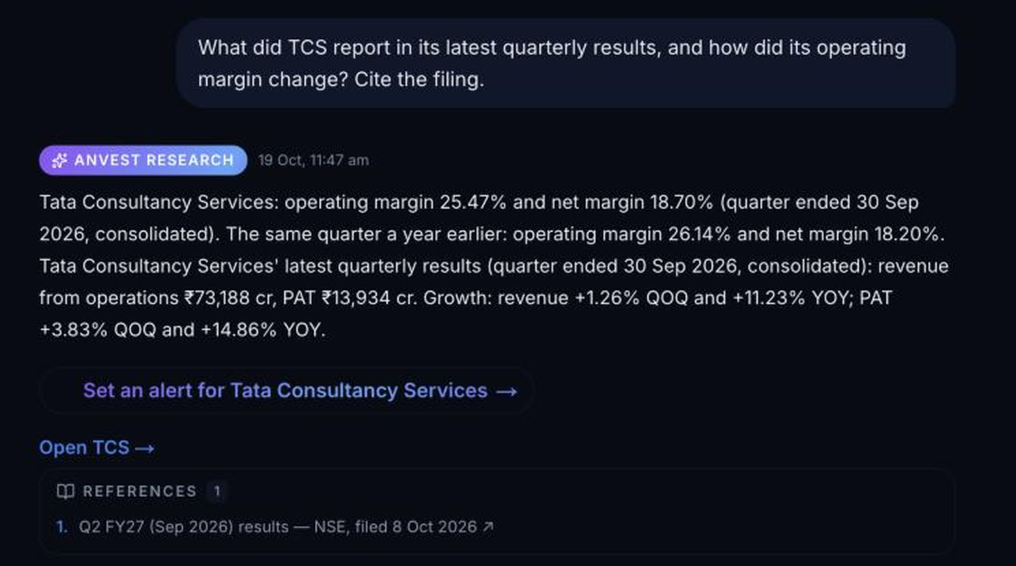
Anvest
India's AI research co-pilot
Cited filing answers, costed backtests and portfolio impact, for SEBI-registered professionals and serious investors.
6K+
2.94M
1.35M
~49K
Live answer, 19 Oct: net margin = PAT / total income (₹74,525 Cr). Operating margin fell 67 bps YoY.
listed companies
corporate announcements
indexed filing passages
announcements/month, Q2 FY27
Harsh Bhardwaj, Founder · harsh@anvest.in · anvest.in · Seed round, October 2026
Notes:
Anvest is India's AI research co-pilot. Professionals and serious investors ask in plain English and get answers built from exchange filings, with the source one click away; the same question flows into an editable screen, a costed backtest and portfolio planning. The screenshot is a real answer from 19 October: TCS's September-quarter revenue (₹73,188 cr) and profit (₹13,934 cr) match the NSE XBRL filing exactly.

Slide 2



Advisers and investors decide without verified research
THE PROBLEM
~49,000
Scattered
Unverified
announcements/month, Q2 FY27
research, backtest and desk tools
answers from general-purpose AI
Results, pledges and board notices land on NSE and BSE daily. Analysts, advisers and PMS desks still read them by hand, often as scanned PDFs.
Professionals and investors jump between exchange PDFs, ratio screeners, backtesters and spreadsheets, losing hours and context at every hop.
Chatbots sound confident but can invent figures on Indian filings. Without a verified filings warehouse underneath, their answers can't be checked.
3,900 SEBI-registered firms and 13.4 crore investors don't lack information. They lack a trustworthy way to turn it into a decision.
Warehouse, announcement date: Jul 45,997 · Aug 61,875 · Sep 38,558 (2026) · Q2 FY27 average 48,810/month · extracted 20 Oct 2026
Notes:
The first buyer is the professional: 2,304 research analysts, 1,057 investment advisers and 539 portfolio managers registered with SEBI, plus distribution professionals, who track a constant stream of filings by hand. Serious investors face the same scattered workflow without the time. General AI can't fix this on its own because it has no verified Indian filings underneath.

Slide 3
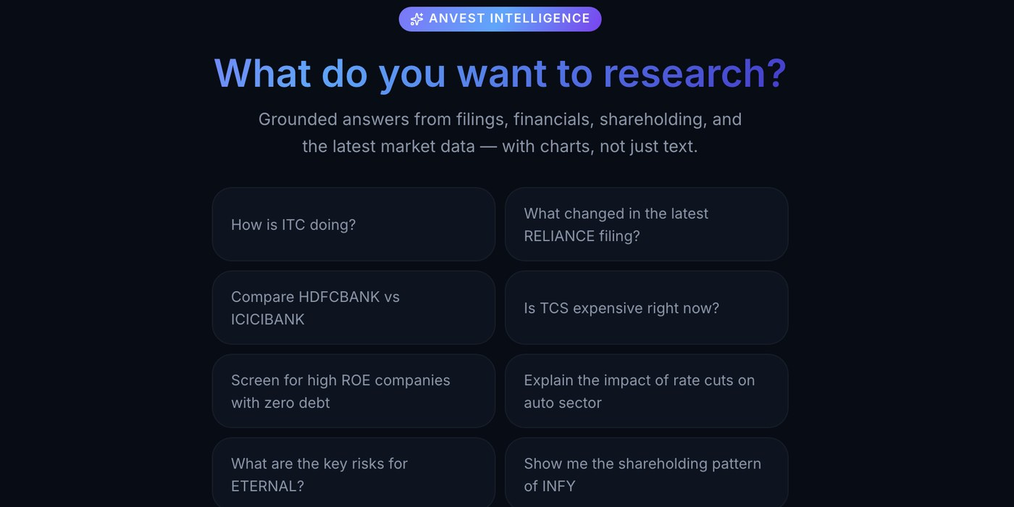
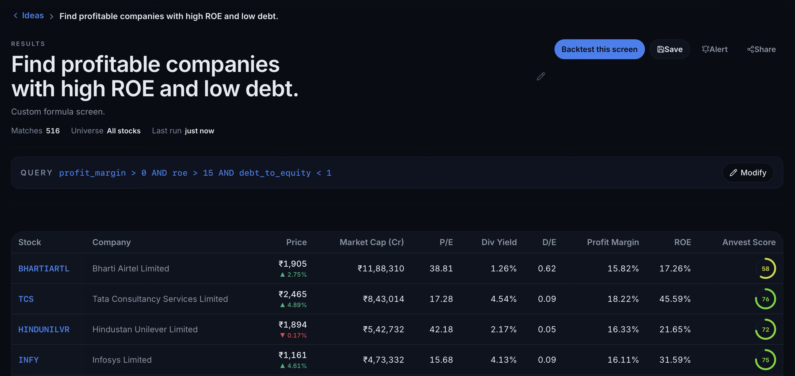
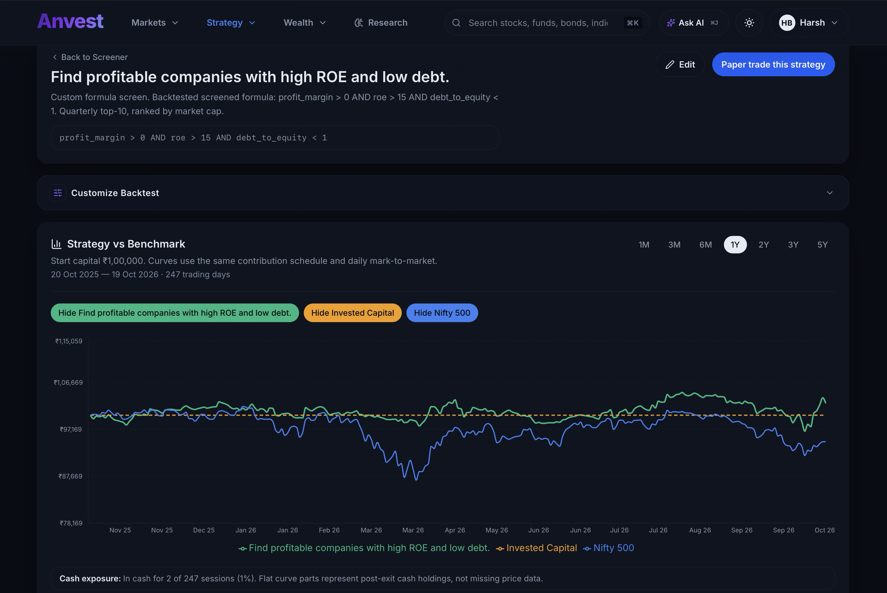
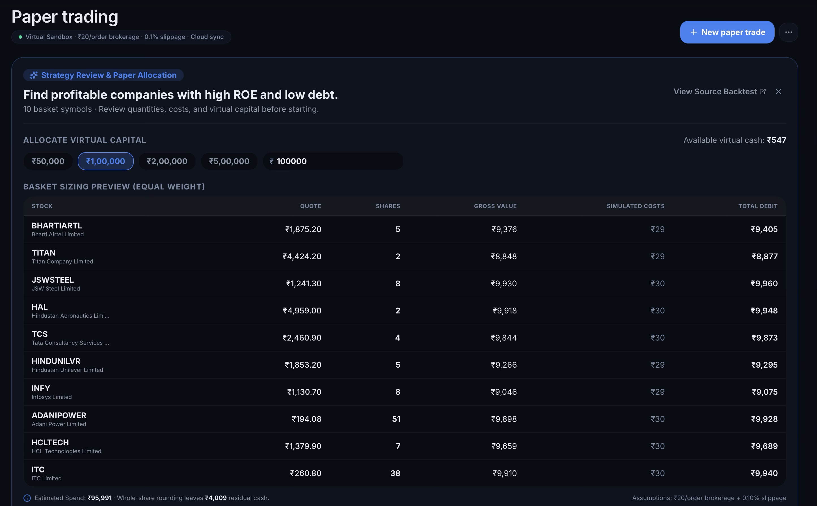


From a question to a tested strategy, in one flow
THE SOLUTION
1
ASK
2
SCREEN
3
BACKTEST
4
PRACTISE
Ask in plain English
AI builds the screen
Test it on history
Practise, then act
“Find profitable companies with high ROE and low debt.”
Intent becomes explicit, editable filters across 6K+ companies, with a one-click backtest.
Brokerage, STT, stamp duty and slippage built in; alpha, drawdown and Sharpe reported, with every rule shown.
Paper-trade the strategy with virtual cash and review every decision in a journal.
Verified live on 19 Oct 2026: this prompt generated a 516-stock screen (ROE > 15%, D/E < 1), a 1Y costed backtest and a 10-stock paper basket.
AI interprets. Engines compute: the model never does the arithmetic, and answers link back to their sources.
Notes:
Live end-to-end product flow verified on 19 Oct 2026: asking 'Find profitable companies with high ROE and low debt' translates into the explicit formula (profit_margin > 0 AND roe > 15 AND debt_to_equity < 1), matching 516 companies. One click runs a 1-year historical backtest net of Indian brokerage, STT, stamp duty, and slippage against the Nifty 500, and converts the top 10 holdings into an equal-weight virtual paper-trading basket.

Slide 4
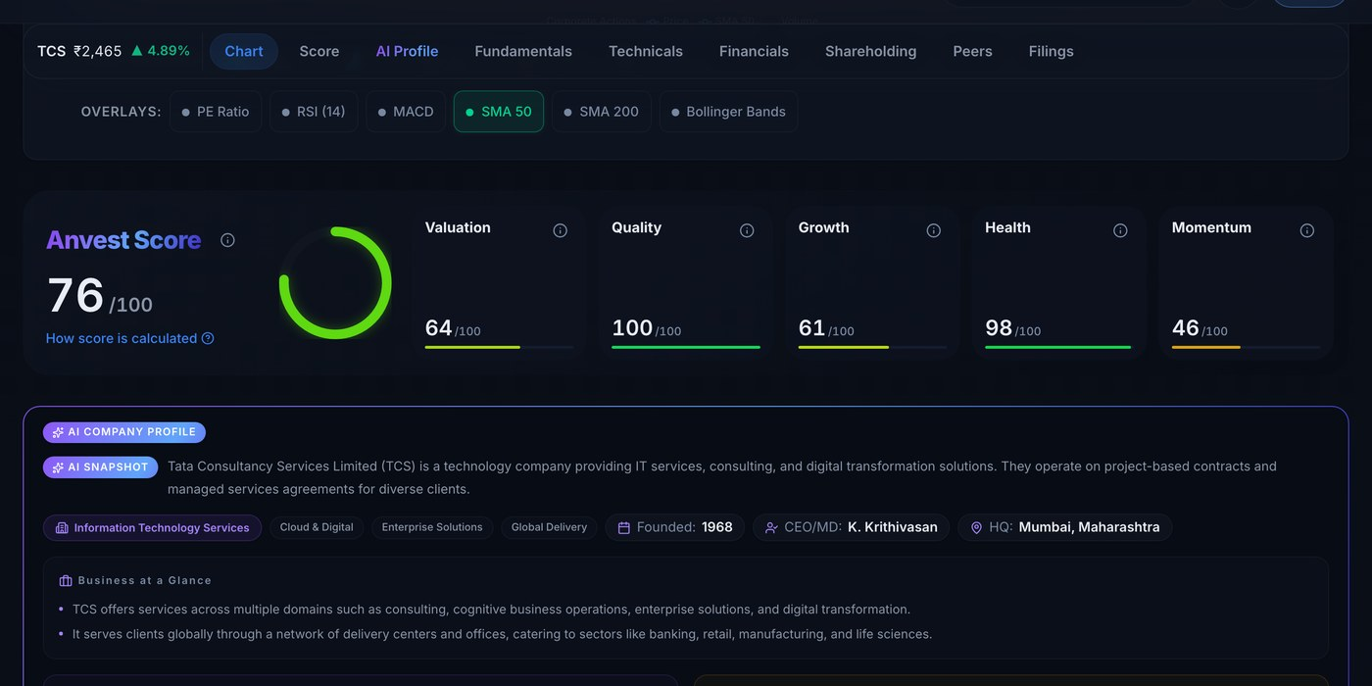
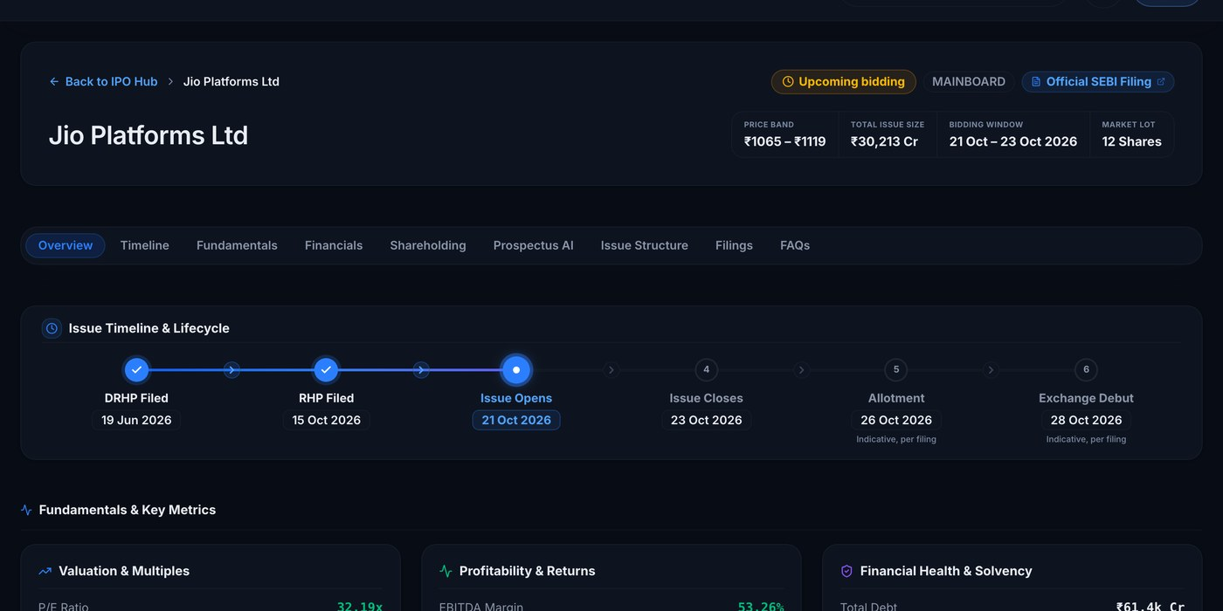
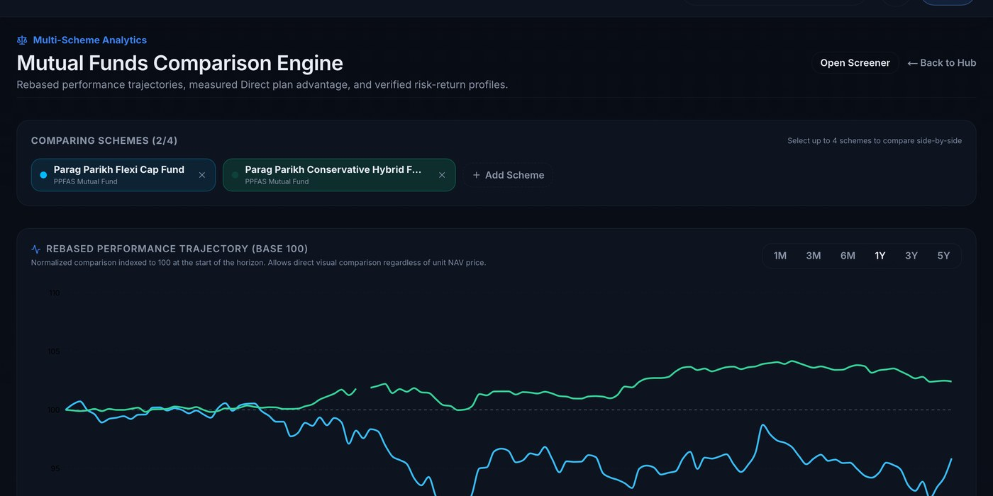
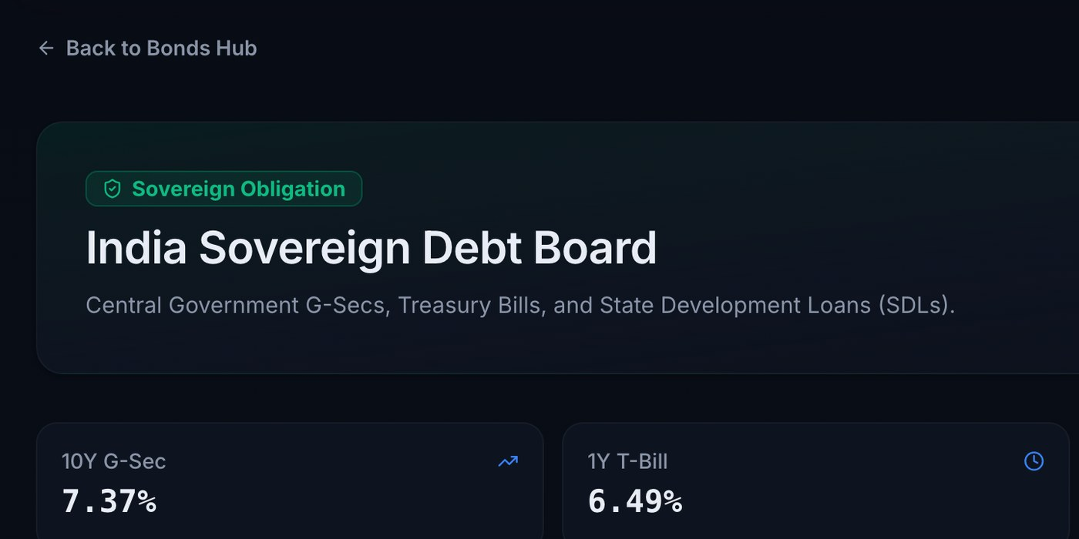
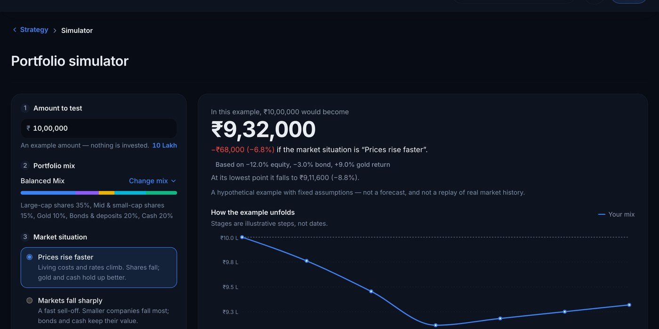
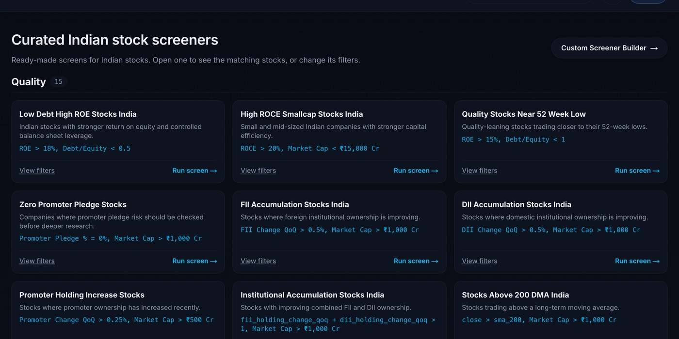
One verified data engine, six live workflows
LIVE TODAY
Every module is a view on the same filings warehouse, not a separate product to maintain.
Stock intelligence
IPO hub
Mutual fund X-ray
Anvest Score, AI profile, financials and filings
Jio Platforms: band, size and dates from its RHP (Oct 2026)
991 schemes compared on returns, cost, risk and overlap
Bonds and fixed income
Market stress simulator
Curated screens
G-Sec board, T-bill yields and the 10Y benchmark
How a portfolio behaves in a sell-off or an inflation shock
Promoter buying, FII and DII accumulation, quality
Notes:
Six live workflows, all reading the same verified warehouse, which is why one founder could build them. The free modules (IPO hub, fund X-ray, bond board, curated screens) bring people in at no acquisition cost; research, backtesting and Desk features are what they pay for. The IPO tile shows Jio Platforms' issue, whose ₹1,065–1,119 band and ₹30,213 Cr size come from its red herring prospectus.

Slide 5

Built and live, with auditable source checks
TRACTION
50 / 50
recent filings: revenue and PAT matched NSE XBRL (20 Oct 2026)
SHIPPED AND LIVE
Grounded AI research copilot
Natural-language stock screener
418
research queries logged across 16 accounts, including internal testing
6K+ stock pages; 6,119 AI profiles
Backtesting with Indian costs
Paper trading and trade journal
IPO hub with prospectus analysis
238
saved backtest records, including internal testing
Mutual fund X-ray: cost and overlap
Bonds, G-Secs and yield tools
Wealth, retirement and stress simulators
12 months
from first commit to full platform, no outside capital
Production snapshot, 20 Oct 2026: 31 accounts, 2 saved screens. Usage includes founder/testing. Source checks measure extraction, not AI answer accuracy.
Notes:
Production snapshot, 20 October 2026: 31 registered accounts, 418 logged research queries across 16 accounts, 238 saved backtest records and 2 saved screens. These totals include founder and testing activity and do not establish retention or paying demand. Revenue and PAT matched the original NSE XBRL for 50 recent consolidated results. The audit measures source-data extraction, not 50 complete AI answers. The earlier four-question live spot-check remains separate.

Slide 6




Four shifts make this the moment
WHY NOW
AI can finally read filings
SEBI has set the algo rules
Language models can now read and explain filings. Trust depends on verified, citable data underneath, which is what Anvest has built.
SEBI's framework (in force April 2026) requires exchange empanelment for algo providers and RA registration for black-box strategies. Anvest works in white-box research and backtesting today.
Brokers are going agent-native
A new generation of investors
Zerodha's Kite MCP and peers now expose accounts to AI agents. Those agents need a grounded research brain behind them.
13.4 crore unique investors are registered with NSE, while regulators push for explained, accountable research.
Investors already pay for source-cited AI research: AlphaSense reached $600M+ ARR at a $7.5B valuation (Jun 2026) on enterprise seats. Anvest Desk brings it to Indian desks at ₹2,999 a seat a month (~$380 a year).
SEBI circulars of 4 Feb 2025 and 30 Sep 2025 · Zerodha Kite MCP · NSE Market Pulse, Jul 2026 · fintech.global, Jun 2026
Notes:
Four tailwinds: grounded AI makes filing research automatable; SEBI's retail algo framework formalises strategy providers (RA registration, funded this round, is what opens the regulated strategy layer later); brokers are exposing accounts to AI agents through MCP; and India's investor base keeps growing. AlphaSense shows professionals pay for source-cited AI research; Anvest offers it at an Indian price point with near-zero marginal data cost.

Slide 7
A $1.3B market, starting with professional teams
MARKET
₹12,269 Cr · $1.3B / yr
TAM
Investors ₹10,985 Cr (4.6 Cr active NSE clients on Plus) + professionals ₹1,284 Cr (3.55 lakh SEBI firms and distributors on Desk)
₹2,371 Cr · $250M / yr
Active investors ₹2,292 Cr (~96 lakh active traders) + professionals ₹78 Cr (3,900 SEBI firms and 3,350 top distributors, 3 seats each)
SAM
₹23 Cr · $2.4M ARR
Year-5 scenario across all engines: ~1% of SAM. Desk expands beyond the initial professional segment.
SOM
Why professionals first: a small, high-intent SAM (₹78 Cr) we can reach with two sellers, paying from month 3, who make the product credible. Scale then comes from active investors and partner distribution.
List prices: Plus ₹2,388/yr, Desk ₹35,988/seat-yr. NSE Market Pulse (Aug 2026) · SEBI FY25 trader study · SEBI directory (Oct 2026) · ARN+EUIN holders and FY26 top MFDs (Cafemutual)
Notes:
Bottom-up at list prices. The professional segment is the entry: 2,304 RAs, 1,057 IAs and 539 PMS firms, plus distributors, are high-intent buyers we can reach directly, but at Indian prices their SAM is about ₹78 Cr. The venture-scale pool is active investors (about ₹2,292 Cr SAM) reached through self-serve and partner distribution. The year-5 scenario needs about 1% of SAM.

Slide 8
Others own a slice. Anvest connects the whole task
COMPETITION
 | Cited filing answers | Plain English → screen | Backtest with costs | Paper trading | Portfolio & planning | Live execution
Anvest | Yes | Yes | Yes | Yes | Yes | Next: after approvals
Screener.in | Partial: metered AI credits | Partial: query language | — | — | — | —
Tijori | Partial: filing timeline | Yes: natural language | — | — | Partial: stock & MF tracking | —
Trendlyne | Partial: AI concall summaries | Yes: AI screener | Partial: screener backtests | — | Partial: portfolio report | Partial: baskets
Tickertape | — | Partial: filter screeners | — | — | Partial: MF tools | —
StockGro (Stoxo) | Partial: AI research | — | Partial: strategy builder | — | — | —
Streak | — | Partial: technical scanners | Yes: technical rules | Yes | — | Yes: via Zerodha
General AI chat | Partial: no verified Indian data | — | — | — | — | —
Anvest carries one question from cited filing evidence to an editable screen, a costed backtest and a paper trade, with fund, bond and retirement planning in the same account.
Yes = core feature · Partial = limited or adjacent · — = not found on the vendor's public product pages, checked 19 Oct 2026
Notes:
Built from each vendor's public product pages on 19 October 2026. Closest alternatives: Trendlyne (AI screener creation, screener backtests, portfolio reports, baskets) and Tijori (natural-language screener and filing timeline) on research; Streak on technical strategies and execution through Zerodha. None connects cited filing answers to costed backtests and paper trading in one account. Our accuracy spot-check matched 3 of 3 answers to the NSE filings; a published head-to-head benchmark is a month-15 milestone.

Slide 9







The moat is the data engine beneath the AI
THE MOAT
Ingest
Repair and OCR
Verify
Ground
Serve
Prices, filings, XBRL, NAVs and prospectuses, every night
Fixes malformed exchange filings; reads scanned PDFs
Identity checks, cross-validation, sector-aware rules
Cite the filing, or say the data isn't there
One AI across research, screens, backtests and plans
15,899
3,608
10 of 10
2.94M
1.35M
cash-flow rows recovered from malformed XBRL
conflicting source figures flagged across 1,022 companies
tier-1 bank results in a Q1 FY27 sample were scans
corporate announcements in the warehouse
indexed passages, refreshed daily
Why incumbents can't simply bolt this on: a screener built on structured data feeds would have to re-ingest, OCR and repair the raw filing corpus to cite at passage level. NSE's post-FY23 XBRL mislabels its periods, annual figures hide inside Q4 filings, and many filings are scans; each fix took production queries to find.
Internal data-quality audits, Jul–Sep 2026
Notes:
The chatbot is replaceable; the verified corpus is not. Internal audits: 15,899 cash-flow rows recovered from filings the exchange's own context labels broke (zero non-reconciling); 3,608 figures where two sources disagreed across 1,022 companies, 1,521 of them 10x scaling errors, flagged by a cross-source audit (spot checks confirmed the exchange XBRL side); and every tier-1 bank result in a 21-filing Q1 FY27 sample was a scanned PDF. Each fix compounds and is hard to rediscover.

Slide 10




Two engines fund the seed stage; two more scale it
BUSINESS MODEL
THIS ROUND
SELF-SERVE AND LATER
Anvest Plus and Pro
LAUNCH PRICING
₹199–₹599 / month (Pro ₹4,999 / year)
Anvest Desk
Intelligence API and MCP
Self-serve upside from free pages and tools: 150–600 AI questions a month included, plus backtests, alerts and portfolio X-ray.
₹2,999 / seat / month · 1–5+ seats
Licence, tiered per active user
For RAs, IAs, PMS desks and distributors: coverage-list filing digests, cited research and shared workspaces. Paying from month 3.
Brokers, wealth apps and AI agents embed Anvest's grounded answers. Pilot in weeks; first paid partner at month 10.
Strategies, baskets and algo
AFTER APPROVALS
Subscription + revenue share
RA-backed model baskets and exchange-registered strategies through partner brokers, after RA registration and empanelment (post-Series A).
FIRST REVENUE
PILOT-READY
Month-15 revenue mix at $500K: Desk 75%, partners 20%, self-serve 5%. Checkout goes live in the first 90 days.
Notes:
Two engines carry this round: Desk seats (1–5+ seats, so solo RAs and IAs can start small) and API/MCP licences for brokers and wealth apps, priced per active user with volume tiers. Plus and Pro are self-serve upside from the free funnel; strategies come after RA registration and empanelment, post-Series A. Pricing is launch pricing; checkout goes live in the first 90 days.

Slide 11


Land with professionals. Compound through partners
GO-TO-MARKET
Professional seats
FIRST 90 DAYS AFTER CLOSE
Founder-led sales to 3,900 SEBI-registered firms, starting with 1–5 seat boutiques, then distribution professionals.
200
Search built from source data
target RA, IA and PMS firms
6K+ stock, 991 fund, IPO and bond pages answer long-tail filing queries; the full sitemap ships in the first 90 days.
40
live demos
Partners and AI agents
10
Broker and wealth-app integrations through API and MCP reach investors without paid acquisition.
paid Desk pilots
Shareable answers and creators
Also: checkout live · full sitemap submitted · first broker MCP pilot
Every cited answer, screen and backtest is a shareable link; education creators join on referral terms within SEBI's rules.
Notes:
Professionals first: a short list of 200 firms, 40 demos and 10 paid pilots in the first 90 days, with seats from month 3. Search pages, partner integrations and shareable answers compound distribution without paid consumer acquisition.

Slide 12




Retail trading is going algorithmic. Anvest is the on-ramp
WHERE THIS GOES
54%
Idea
Ask in plain English
LIVE
of NSE cash-market turnover is algorithmic
Rules
Transparent rules on fundamentals and technicals (P/E, ROE, RSI, SMA)
LIVE
67%
Evidence
Costed backtests with periodic rebalancing, not intraday
LIVE
of equity-derivatives turnover (73% in stock futures)
1 Apr 2026
Practice
Paper-trade with virtual cash
LIVE
SEBI's retail algo framework applies to all brokers
Live
Deploy through partner brokers after RA registration and empanelment
NEXT
Execution is automated and regulated; pre-trade research and testing is the open space.
Anvest's lane: fundamental and filing-driven rules, rebalanced periodically, built and tested in the open. Exchange algo volumes are mostly intraday and high-frequency; this is the investor-grade layer before them.
NSE Market Pulse, Dec 2025 (turnover share, FY26 to Nov) · SEBI retail algo circulars, 4 Feb 2025 and 30 Sep 2025
Notes:
Algorithms already run more than half of NSE cash turnover. SEBI's framework, in force since April 2026, formalises retail algo trading through registered, tagged algos. Anvest owns the pre-trade layer: rules that combine fundamentals, filings and technicals (P/E, ROE, RSI, moving averages), costed backtests and paper trading, rebalanced periodically. Live deployment comes later through partner brokers once RA registration and empanelment are in place; providers and brokers may share disclosed subscription revenue.

Slide 13
Default-alive on $500K, Series A path to ~₹23 Cr ARR
FINANCIAL PLAN
THIS ROUND · MONTH 15
$400K
$500K
$700K
ARR run-rate
₹68 L
₹87 L
₹1.06 Cr
Desk teams
55
77
88
Paying partners
2
2
3
Net burn / month
₹13.9 L
₹15.4 L
₹15.6 L
Break-even month
M48*
M42
M40
*$400K funds months 1–31; break-even then needs a top-up. $500K and $700K need no new funding.
SERIES A SCENARIO
Series A near month 18 adds sellers (15 incl. founder by year 5)
Strategies only after RA registration and empanelment
Partner licences tiered: ₹15 → ₹10 → ₹6 per user
No-new-funding path: M42 break-even on $500K. Series A scenario: ₹13.4 Cr Desk/retail + ₹9.7 Cr partners/strategies ≈ ₹23.1 Cr Year-5 ARR. ₹95 = $1.
Notes:
Bottom-up monthly model: users, conversion and churn; sellers and their productivity; partner users with tiered pricing; salaries, serving, data licence, compliance and growth spend. On the $500K plan, revenue covers costs by about month 42 with cash never below about ₹51 L, even without new funding; on $400K, cash lasts about 31 months. The year-5 scenario assumes a Series A near month 18.

Slide 14

A founder who has already built the hard part
TEAM
Harsh Bhardwaj
FIRST HIRES FROM THIS ROUND
Founder · full-time on Anvest from the close of this round
1
Growth and partnerships lead
Sells Desk pilots and broker integrations
B.Tech, Electronics and Communication, IIT Guwahati (2015–19)
2
Data engineer
Owns ingestion, coverage and data quality
Senior Engineering Lead building production agentic LLM systems
3
Full-stack and quant engineer
Strategies, alerts and the path to live algos
Seven years building high-throughput backend and distributed systems at New Relic, Shiprocket, Weave and Jaguar Land Rover
4
Second seller (with $500K)
Joins in month 9 to scale Desk sales
Solo-built Anvest's XBRL repair pipeline, verification engine and nine-module platform in 12 months, with no outside capital
Adviser bench in SEBI compliance and capital markets: being built this round.
Domain edge already earned in production: malformed XBRL periods, Q4-only annual figures and scanned PDFs, all solved.
Notes:
Harsh goes full-time on Anvest when this round closes. Seven years in backend and distributed systems and current work on production agentic LLM systems; built the whole data engine and platform alone. The round adds a growth and partnerships lead, a data engineer, a full-stack and quant engineer and, at $500K, a second seller; the compliance and capital-markets adviser bench is being assembled.

Slide 15
Raising $500K to prove Desk demand and partner reach
THE ASK
$3.5M post-money cap · CCD/CCPS · identical terms · first close at $400K, room to $700K
$185K
Team
$500K DELIVERS BY MONTH 15
37%
Growth lead, data engineer, full-stack and quant engineer, second seller from month 9
₹87 L
77
$65K
Compliance and infrastructure
ARR run-rate (~$92K)
Desk teams (~243 seats)
13%
SEBI RA registration, exchange data licence, serving and inference
2
RA
$100K
Growth and founder
paying partner integrations
SEBI research-analyst registration
20%
Desk pilots, launch, CAC tests and founder salary
Public
M42
$150K
Reserve and runway
head-to-head accuracy benchmark
break-even without new funding
30%
Keeps cash above ₹51 L on the path to break-even
$400K first close: ₹68 L ARR at month 15, cash for ~31 months · $700K: ₹1.06 Cr ARR, second seller from month 6
Series A-ready in 15–18 months
Notes:
We are raising $500K on a $3.5M post-money cap through CCD/CCPS, identical terms for every investor, with a first close at $400K and room to $700K. Use of funds sums to $500K: team $185K, compliance and infrastructure $65K, growth and founder $100K, reserve and runway $150K. By month 15 the plan delivers ₹87 L ARR from 77 Desk teams and two paying partners, plus RA registration and a published benchmark.

Slide 16

Every Indian investor deserves an analyst, a quant and a planner.
Anvest puts all three behind one question.
Institutional depth. Retail reach. One verified data engine.
Book a live demo and data-room walkthrough: harsh@anvest.in
Scan: a live screen, no sign-in
Harsh Bhardwaj · harsh@anvest.in · live at anvest.in
Notes:
Close on the vision, then invite a live demo. The QR code opens the live 'profitable companies with high ROE and low debt' screen without sign-in, so investors can try the product immediately.

Slide 17




Trust and compliance, built in
APPENDIX
Data accuracy
Answers show the filings they draw on and pass a numerical check against that evidence before they are returned. Coverage gaps are shown, not estimated. Corrections ship as versioned releases.
Verification proof
Source audit, 20 Oct 2026: revenue and PAT matched 50 of 50 recent consolidated NSE XBRL filings. This checks extraction, not full AI answers. A separate four-question live spot-check and a future independent benchmark cover answer quality.
Regulation
Informational by design: no buy, sell or hold calls and no target prices. SEBI RA registration is funded in this round and positions Anvest for the retail algo framework.
Market data
End-of-day exchange data today; licensed exchange and delayed feeds budgeted this round for Desk teams and public pages, plus broker links for retail portfolios.
Key-person depth
Runbooks, health-checked nightly jobs and documented architecture. The first hires add data and customer-facing depth.

Slide 18
Operating model: the month-15 bridge
APPENDIX
Engine | Drivers | $400K | $500K | $700K
Desk seats | Founder 1 team/month; each seller 4 teams/month once ramped; 1–5 seat plans averaging 3 seats; 2% monthly churn; ~₹2,245 net per seat | ₹3.9 L | ₹5.5 L | ₹6.2 L
Partners | Paid from months 10 and 14 ($700K: 9, 12, 15); 4,000 active users each growing 6%/month; tiered ₹15 → ₹10 → ₹6 per user | ₹1.4 L | ₹1.4 L | ₹2.2 L
Retail | 10,192 monthly users; 0.3% convert each month; 5% monthly churn; ~₹200 net per subscriber | ₹0.4 L | ₹0.4 L | ₹0.5 L
Net MRR, month 15 | After 18% GST and launch discounts; ARR run-rate = MRR × 12 | ₹5.7 L | ₹7.3 L | ₹8.8 L
Unit economics ($500K): gross margin ~46% at month 15 (fixed serving and data costs on a small base), ~83% at year-5 scale · Desk CAC ≈ ₹0.73 L per team, repaid by ~11 months of team revenue · net burn ₹15.4 L/month at month 15; break-even ~month 42.
Bottom-up monthly operating model: 18% GST, payment fees, AI serving per answer, exchange data licence, compliance, salaries by hire month. ₹95 = $1.

Slide 19
Long-term scenario: drivers and conditions
APPENDIX
Exit | Sellers | Monthly users | Retail subs | Desk seats | Partners (users) | Strategy subs | ARR
Month 15 | 3 | 10,192 | 186 | 243 | 2 (9,593) | — | ₹87 L
Year 2 | 6 | 24,015 | 496 | 532 | 4 (37,466) | 362 | ₹2.3 Cr
Year 3 | 10 | 84,016 | 1,746 | 1,395 | 6 (94,213) | 2,810 | ₹6.5 Cr
Year 4 | 13 | 1,69,058 | 4,519 | 2,634 | 8 (1,97,638) | 7,296 | ₹13.2 Cr
Year 5 | 15 | 3,40,177 | 9,635 | 4,132 | 10 (3,83,373) | 15,349 | ₹23.1 Cr
Sellers include the founder. By Years 3–5, Desk targets broader distributors, family offices and CA/wealth practices, beyond the initial 21,750-seat SAM (4,132 seats would be 19% of it).
Series A near month 18
Partner contracts
Strategies
Funds sellers and marketing; monthly-user growth 11% a month to month 36, then 6%
Eight more integrations from month 20 at 10,000 users each, growing 5% a month; tiered ₹15 → ₹10 → ₹6 per active user
From month 22 only after SEBI RA registration, exchange empanelment and a partner broker; ₹250 a month net per subscriber
Notes:
By Years 3–5 the Desk sales assumption expands beyond the initial 7,250 firms into broader distributors, family offices and CA/wealth practices. 4,132 seats equal 19% of the initial 21,750-seat segment, so this expansion is a condition of the scenario. The model includes salaries for all added sellers and higher marketing spend. Scenario cash excludes an unpriced Series A.

Slide 20
Every capability has a commercial job
APPENDIX
Product capability and roadmap | Commercial role | Engine
AI research and screening | Frequent research tasks that drive subscriptions | Plus, Pro, Desk
Backtesting, paper trading and journal | Repeated strategy evaluation and a reason to upgrade | Pro
Wealth planning, calculators and guides | Organic discovery and recurring planning needs | Free to Plus
Coverage lists; team workspaces planned | Higher-value team subscriptions | Desk
Broker and API integration | Paid distribution of proven research capabilities | Partners and API
Approved strategy execution (future) | Monetising an established testing workflow | Strategies
Free calculators, IPO pages and curated screens support organic discovery. Conversion into Pro and Desk will be measured after launch.

Slide 21
Roadmap
APPENDIX
M1–6
THIS ROUND
Checkout live, 10 paid Desk pilots, ~16 Desk teams, full sitemap, benchmark published, SEBI RA application filed.
Launch
M7–12
THIS ROUND
~54 Desk teams, second seller from month 9, first paid broker or wealth-app integration live (month 10), SEBI RA approval.
Scale Desk, first partner
M13–18
THIS ROUND
~99 Desk teams, second paid partner, ₹1.12 Cr ARR run-rate at month 18; raise the Series A.
Series A-ready
H2
SERIES A
More partners and AI-agent distribution, team plans for advisers and distributors, alerts on every holding.
Scale the platform
H3
GROWTH
Exchange-registered strategies through partner brokers, a strategy marketplace and advanced quant research for desks.
From insight to execution
This round funds months 1–18; each later business line carries its own approvals and business case.

