Slide 1
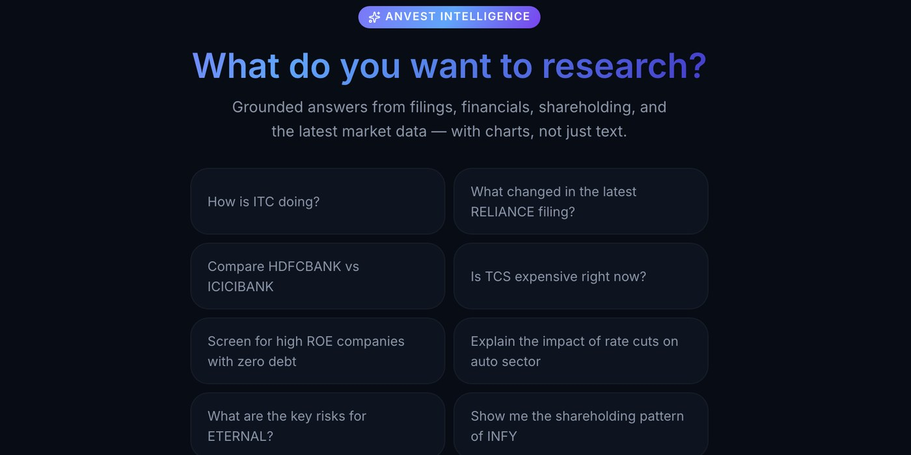
Anvest
The grounded AI research layer for your users
Cited answers, portfolio-aware research and tested strategies, inside the product your users already trust.
6K+
2.94M
1.35M
listed companies
corporate announcements
indexed filing passages
Prepared for Zerodha
Harsh Bhardwaj, Founder · harsh@anvest.in · anvest.in
Notes:
Partner-specific: the cover, slide 4 and the closing slide name Zerodha and Kite. Rewrite them before sending to another broker. There is no equity component to this conversation.

Slide 2



Your users own companies. Few read what they file
THE OPPORTUNITY, FROM YOUR SIDE
~49,000
What, not why
Explained
announcements/month, Q2 FY27
is all a ratio table can say
research backed by sources
Results, pledges and board notices land on the exchanges daily. The filing behind a price move seldom reaches the user who holds the stock.
Charts and ratios show what changed. Why it changed still sits in a PDF the user has to find and read.
SEBI's AI-disclosure rules make transparent research important. Anvest links filing answers to their source evidence.
The broker that best explains its users' holdings earns their trust and their daily attention.
Warehouse, announcement date: Jul 45,997 · Aug 61,875 · Sep 38,558 (2026) · Q2 FY27 average 48,810/month · SEBI AI-disclosure amendments, Dec 2024

Slide 3




A grounded answer, not another dashboard
WHAT WE BRING
“How did TCS's operating margin change last quarter?”
A full-universe warehouse, already built
6K+ NSE/BSE companies with filings OCR'd and indexed: a data-engineering investment your team would otherwise fund.
SOURCE-CHECKED RESULTS · Q2 FY27
Grounded or silent
Operating margin 25.47%, down 67 bps YoY. Revenue ₹73,188 Cr and PAT ₹13,934 Cr. Net margin 18.70% uses total income of ₹74,525 Cr (Q2 FY27, consolidated).
If coverage is missing, Anvest says so rather than estimating: the property that matters most when your logo is beside the answer.
Portfolio-aware, on a read-only link
Answers ranked by what the user owns, through your approved API, with token handling agreed with you.
Source: Q2 FY27 results, NSE, filed 8 Oct 2026 →
From answer to action
Numbers are read from the warehouse. The model never calculates.
Answers link to prepared screens, backtests with real costs and paper trading.

Slide 4




Kite MCP opened the door. Anvest adds the research
THE INTEGRATION
Kite Connect exposes account data to authorised software, and Kite MCP makes it readable by AI agents. Anvest is built to sit exactly behind that interface.
Live account link
Grounded reasoning layer
Agent-native surface
Kite Connect / Kite MCP
Anvest warehouse + retrieval
Your assistant, or a user's own agent
Holdings, positions and orders: read-only and user-authorised, on terms agreed with you.
Every holding is matched to the filing that explains it, which turns generic research into personal research.
An AI agent asks Anvest about a position it already sees and gets a cited answer, not a guess.
A user asks their Kite-connected assistant: “What did the companies I hold disclose this week?” The answer comes from Anvest's filing-grounded warehouse, with each point cited to its filing.

Slide 5
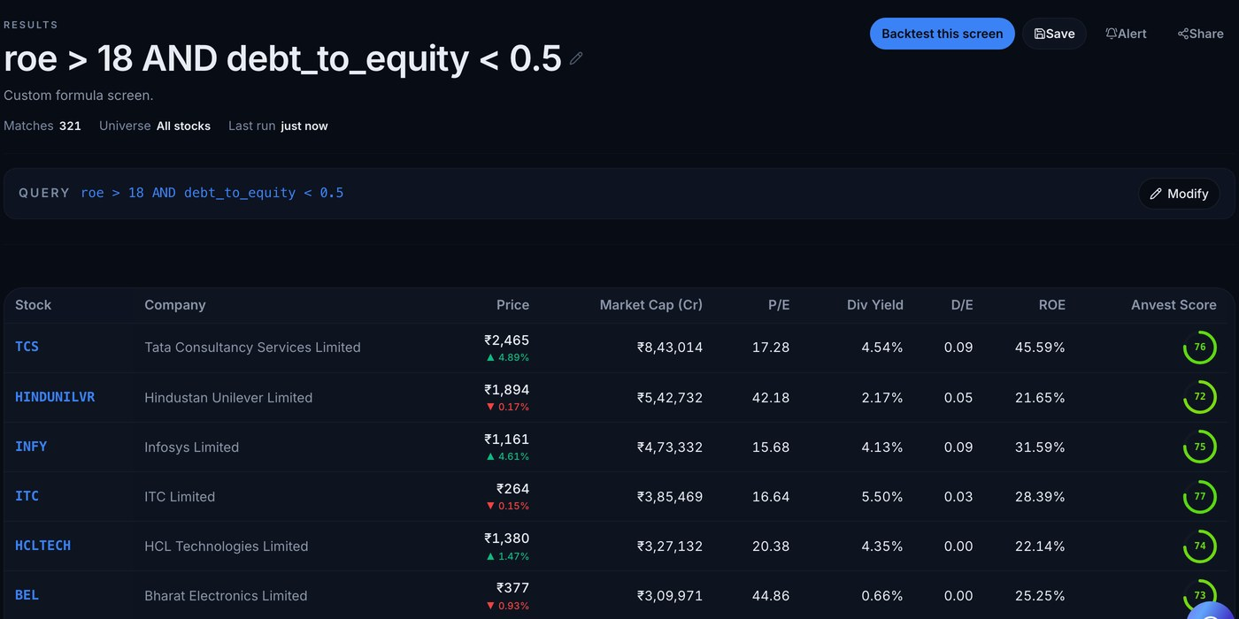
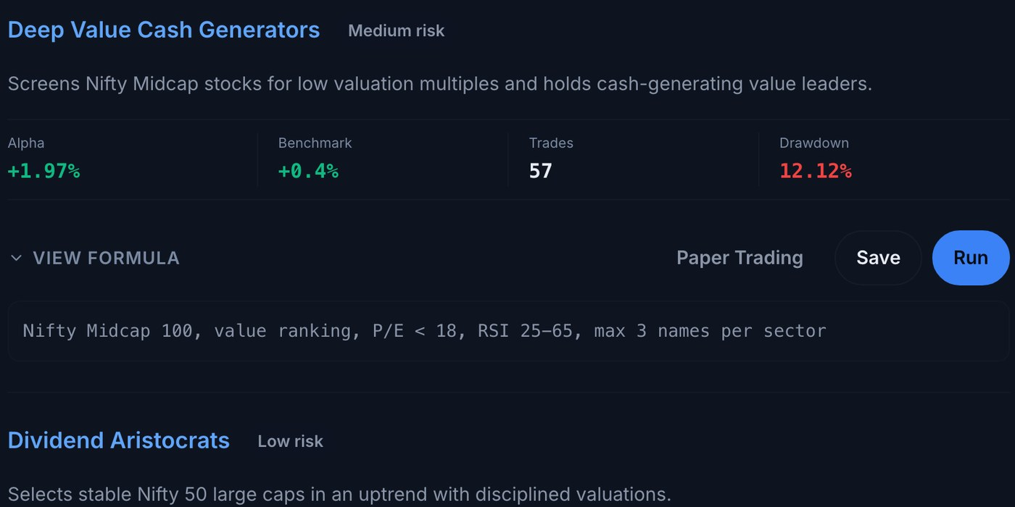
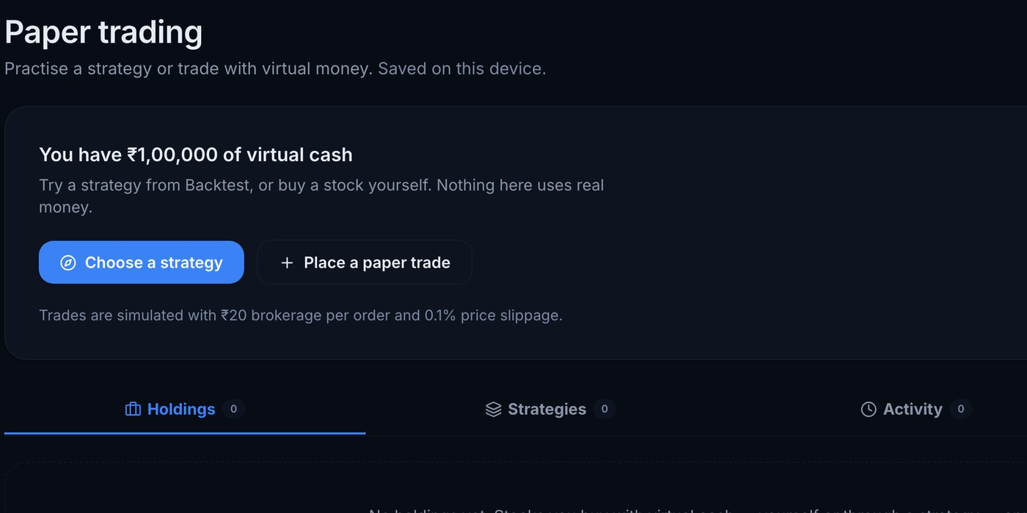

From insight to disciplined action
BEYOND RESEARCH
Screens users can test
Backtests with real Indian costs
Practice before real money
Natural-language criteria become editable filters across 6K+ companies.
Brokerage, STT, stamp duty and slippage built in, with the formula visible.
Paper-trade a strategy with virtual cash and keep a journal of every decision.
Under SEBI's retail algo framework, tested strategies could later run on your platform as exchange-registered algos, inside your risk controls, subject to empanelment and approvals.
Notes:
Production snapshot, 20 October 2026: 31 registered accounts, 418 logged research queries across 16 accounts, 238 saved backtest records and 2 saved screens. These totals include founder and testing activity and do not establish retention or paying demand. Revenue and PAT matched the original NSE XBRL for 50 recent consolidated results. The audit measures source-data extraction, not 50 complete AI answers. The earlier four-question live spot-check remains separate.

Slide 6
Partnering is the faster path to an AI research layer
PARTNER OR BUILD
 | Build in-house | Partner with Anvest
Time to launch | About a year of ingestion, OCR and verification work | A pilot in weeks, on a live system
Data engine | A new team and new pipelines | 6K+ companies, 2.94M announcements and 1.35M indexed passages, refreshed nightly
Edge cases | Rediscover malformed XBRL, Q4-only annual figures and scanned PDFs | Already solved in production
Accountability | Build citation and verification from scratch | Grounded or silent, by design
Your research surface | Unchanged | Complemented: your ratios and charts show what changed; Anvest answers why
A scoped pilot measures exactly this, on answer accuracy, citation quality, coverage of difficult filings and cost per answer, so the decision rests on evidence.

Slide 7

Built, live and ready to pilot
WHERE WE ARE
SHIPPED AND LIVE
Live
anvest.in on Google Cloud (Mumbai) and Vercel
Full-universe filings warehouse, nightly ingestion
OCR and vector index over filings
Nightly
prices, filings, NAVs and news
Grounded copilot with verify-and-repair loops
Natural-language stock screener
Backtesting and paper trading
Portfolio X-ray on a read-only broker link
Read-only
Zerodha and Groww link pattern built; partner access agreed with you
IPO, mutual fund and bond analytics
Wealth planning and calculators
No tips
no target prices: research, explained and cited
Next 90 days: live filing alerts · broker-connected portfolios · professional seats

Slide 8




What your users and your business gain
PARTNER VALUE
A daily reason to open the app
Trust you can show
A digest of what each holding disclosed, grounded in filings rather than price alerts, with the source one tap away.
Answers traceable to filings, with gaps disclosed. Research your compliance team can stand behind.
Ready for AI agents
Investors who test first
A grounded research layer for Kite MCP and assistants, ahead of the shift to agent-native investing.
Screens, backtests and paper trading let users check assumptions and scenarios before they risk money.
Whether users value each of these is exactly what the pilot measures.

Slide 9
A scoped pilot, not a big commitment
THE PROPOSAL
8–12 weeks · a small opted-in cohort of your users · read-only · success criteria agreed up front
8–12 weeks
Read-only
3 metrics
PILOT WINDOW
ACCESS PATH
SUCCESS CRITERIA
A small opted-in cohort. Dates and cohort size set together.
Your approved API or sandbox. Token handling and approvals agreed up front; no unofficial access.
Accuracy and citation quality · weekly repeat use · cost per answered question.
IF THE RESULTS JUSTIFY IT
Commercial terms follow the evidence: a per-active-user licence, API usage pricing or a white-label research layer. Nothing about equity is part of this proposal.

Slide 10
Kite MCP means you are already building for an agent-native brokerage.
Anvest is the grounded research layer that future needs.
Let's scope a pilot inside your product.
Harsh Bhardwaj · harsh@anvest.in · anvest.in

