Slide 1

Basic Details of the Team and Problem Statement
Ministry/Organization Name/Student Innovation: Helpfy Problem Statement Title: WebApp for Data labeling And Small poll like tasks. Team Name: Byte Coders Team Leader Name: Harsh Sharma Institute Code (AISHE): U-0702
Institute Name: SHREE GURU GOBIND SINGH TRICENTENARY UNIVERSITY, GURGAON
Theme Name: Web3 And Block Chain

Slide 2
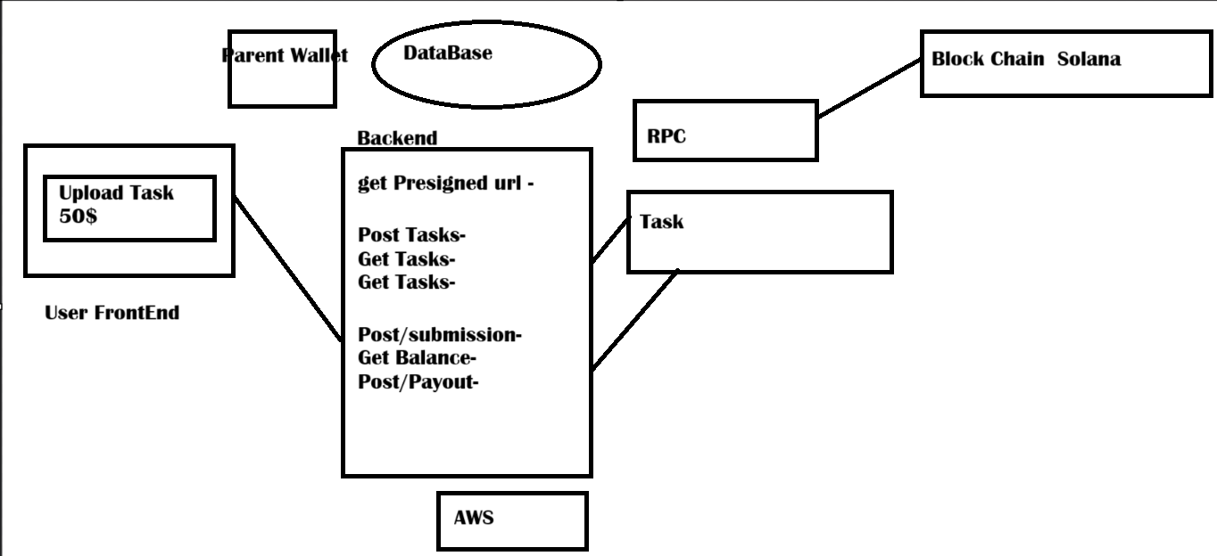
Idea/Approach Details
Describe your idea/Solution/Prototype here:
A webApp where different companies can place some small tasks with some amount of money which was converted in form of solana (block chain).
And all these tasks can be done by the Workers.
It includes data labeling , write stuff , Give suggestion
Here Workers can withdraw their money.
Describe your Technology stack here:
For frontend and backend we are using Nextjs , Web3 and solana for payments.
Uploading Assets on S3(AWS) & Handling Payments via Solana.
For Database we are using neon which is noSQL Database through prisma+postgras.

Slide 3
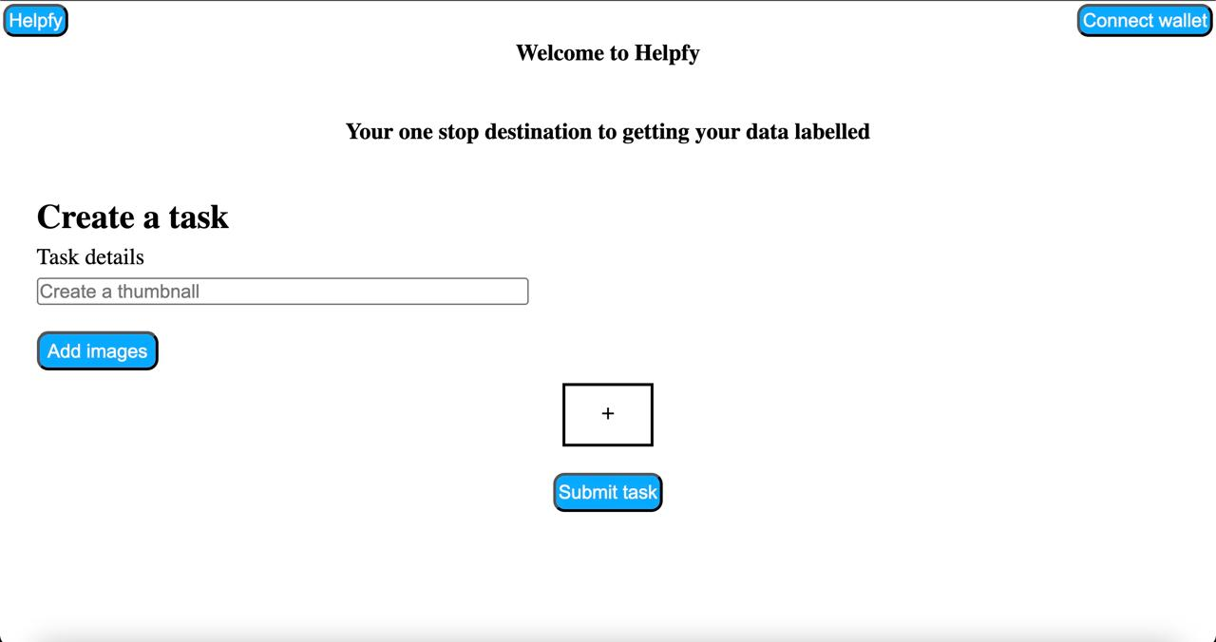
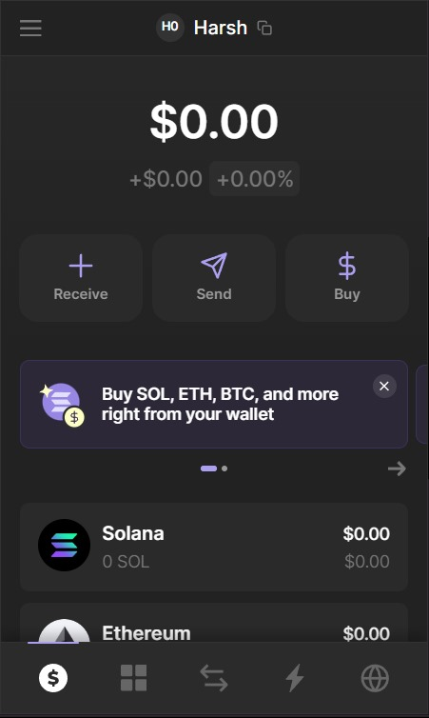
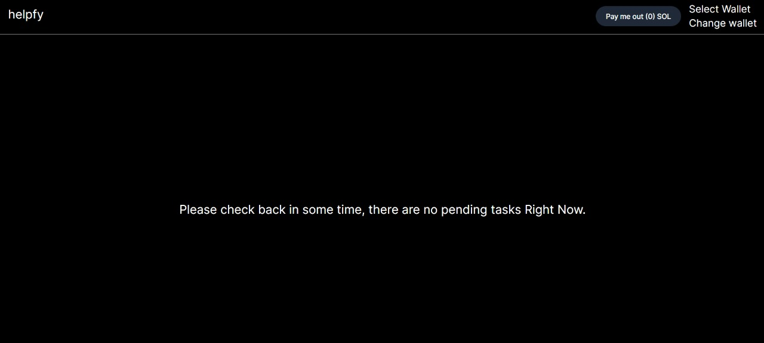
User-Frontend
Workers-Frontend
We Have Implemented Blockchain and Web3 As our theme And we have tried to make a webApp. where users can place a small task such As data Labeling and tasks where humans as Worker on the WebApp can Decide the result by more number of Click on A specific Image such as choosing A best thumbnail from a group of photos.
TechStack Explaination:-
The language we used for backend is type script where a using and workers and signin by JWT(jsonwebtokens) And For creating presigned url We have used AWS S3 credentials Also we have used AWS S3 Bucket for saving the uploaded data in the form of AWS urls . And for payments and payouts we are using solana with the help of fantom Wallet. And for database We have used postgrap+prisma along with NEONDB.

Slide 4


Slide 5
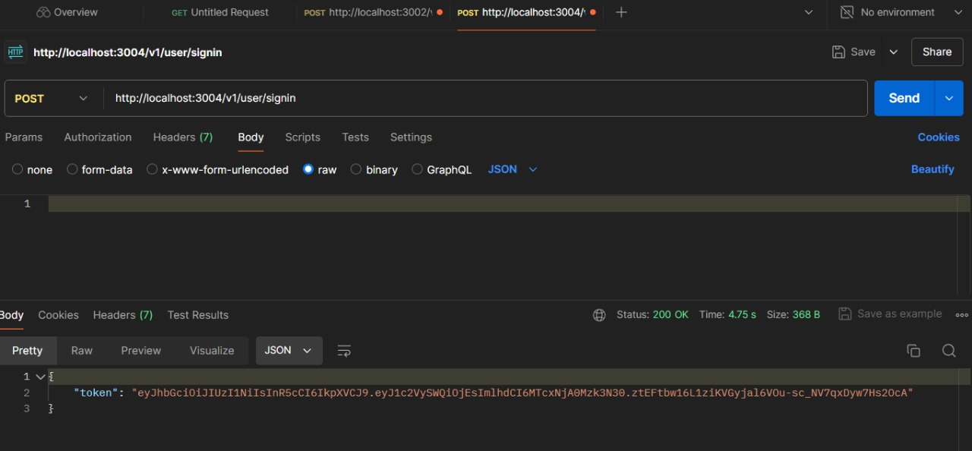
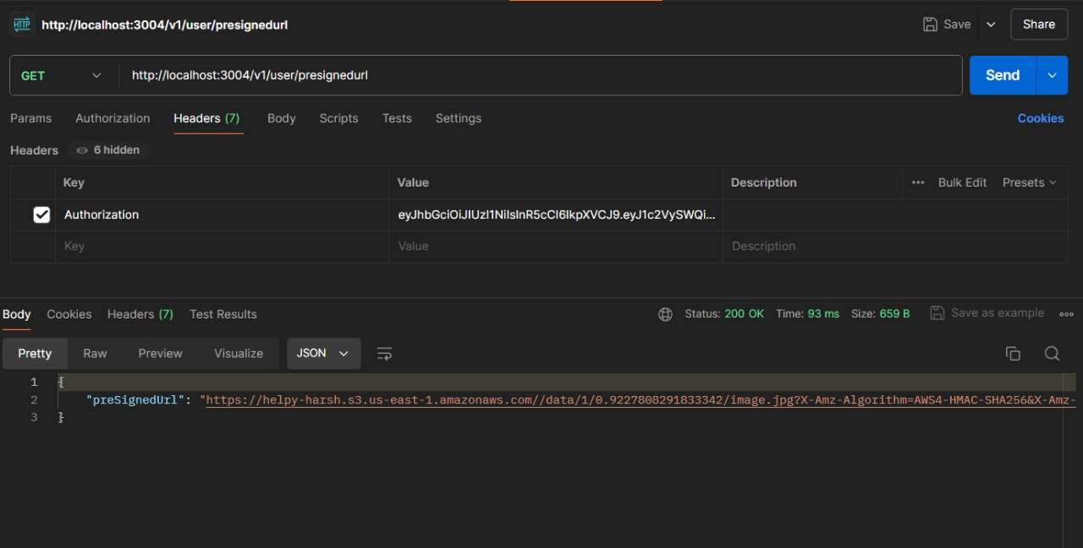
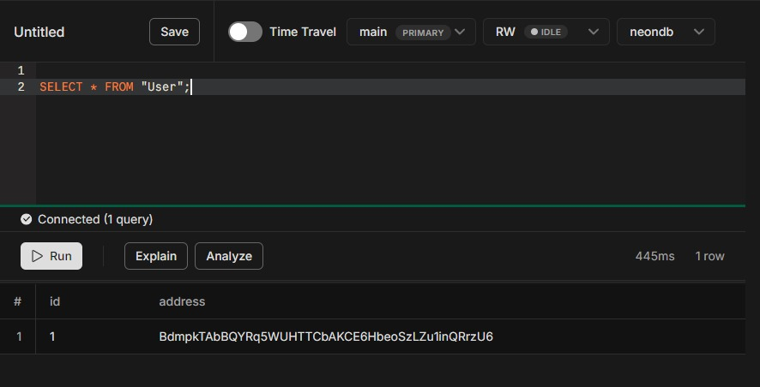
Working Flow (POSTMAN)
Signin of user through JWT token (jsonwebtokens)
Getting presignrd urls through Aws bucket S3
Showing the entry of user through neonDatabase

Slide 6
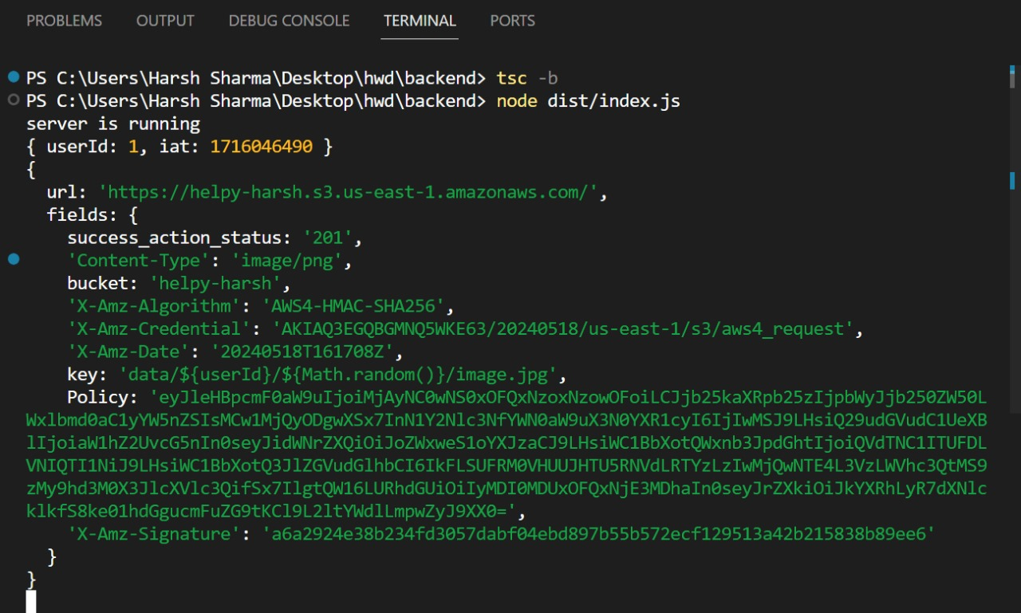
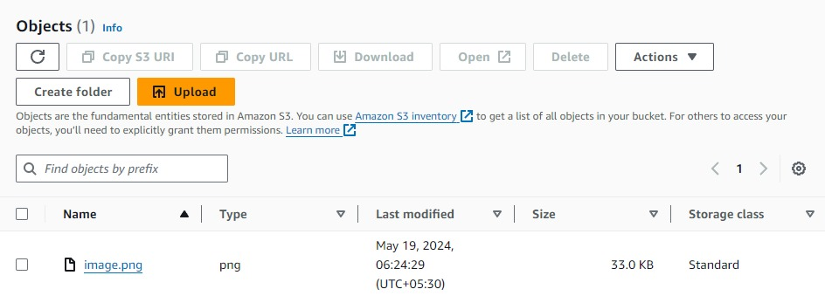
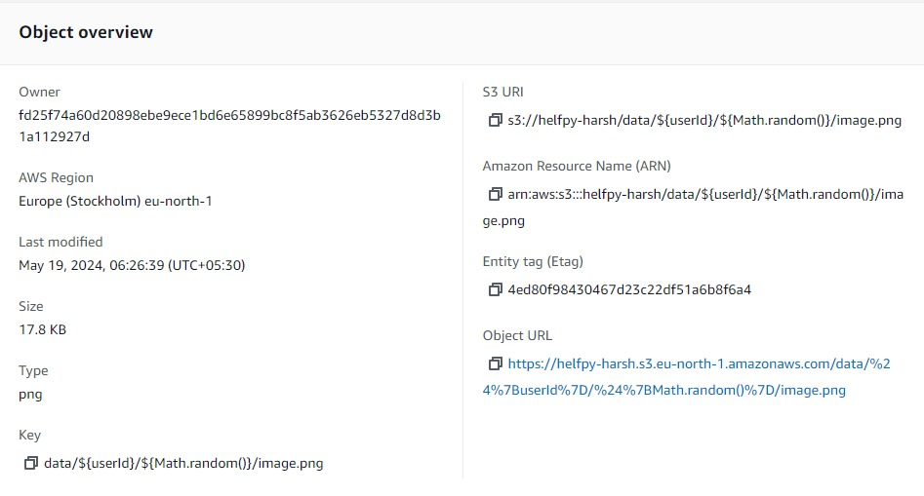
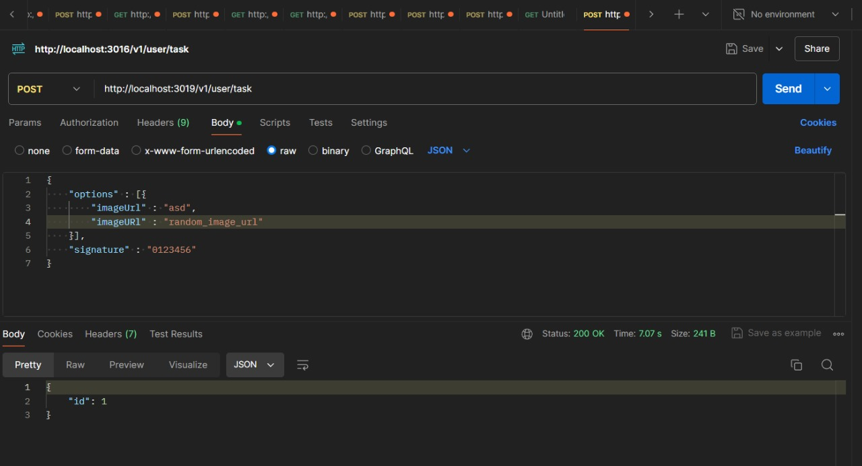
Image Uploaded to S3 bucket
AWS credentials For uploading a task to S3 to the AWS S3 bucket (not saving in Backend)
Image Data In S3 bucket
Creating a Task For Workers

Slide 7
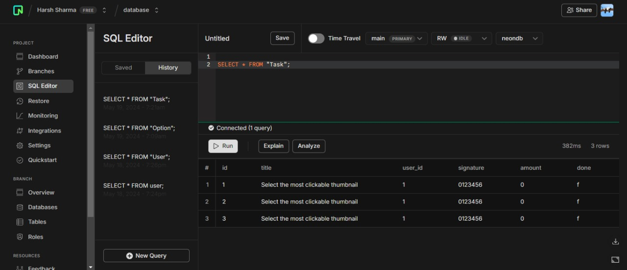
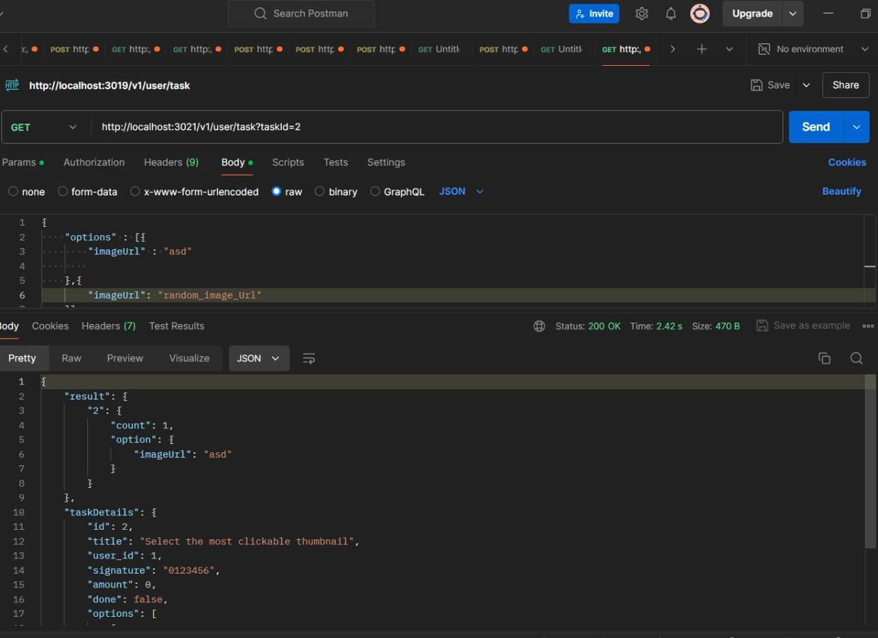
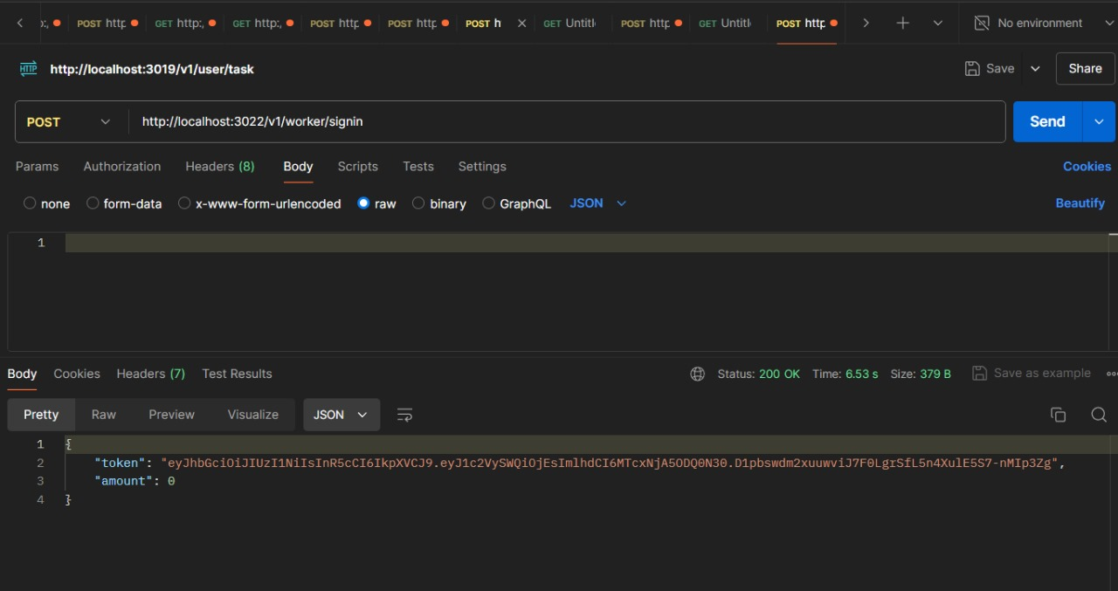
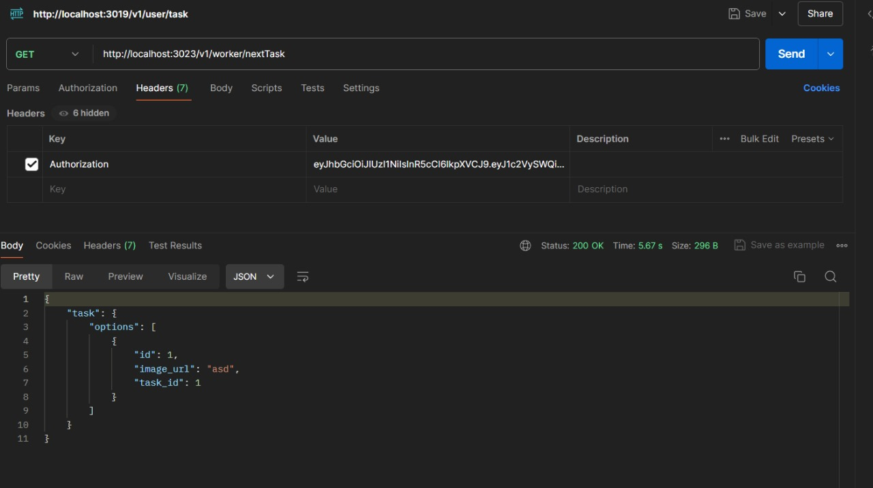
Task Details in DATABASE
Worker Solving the Task
Worker Signin with their amount in their Wallet
Worker Solving the another Task

Slide 8
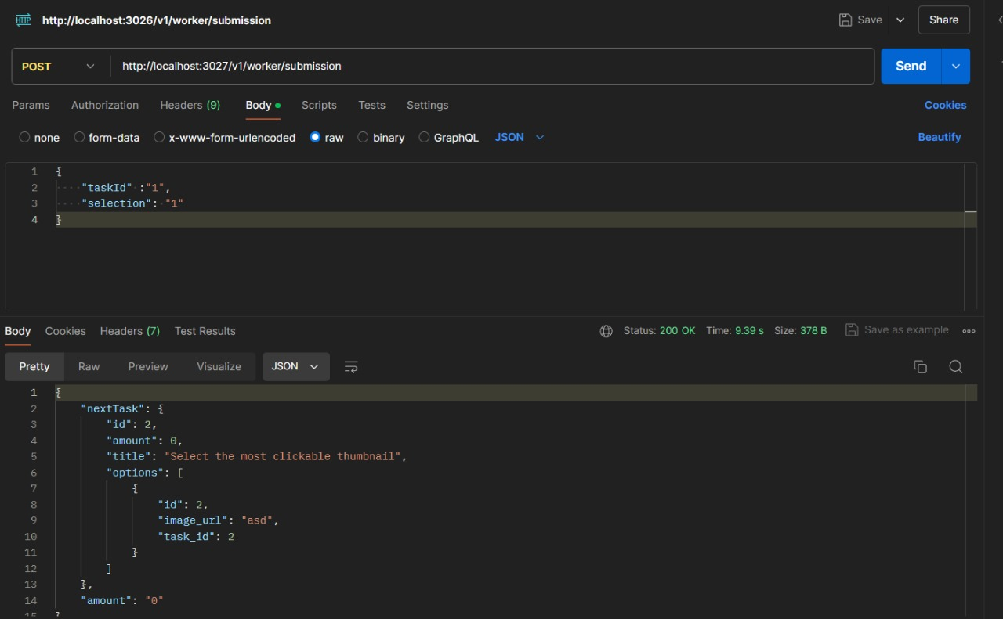
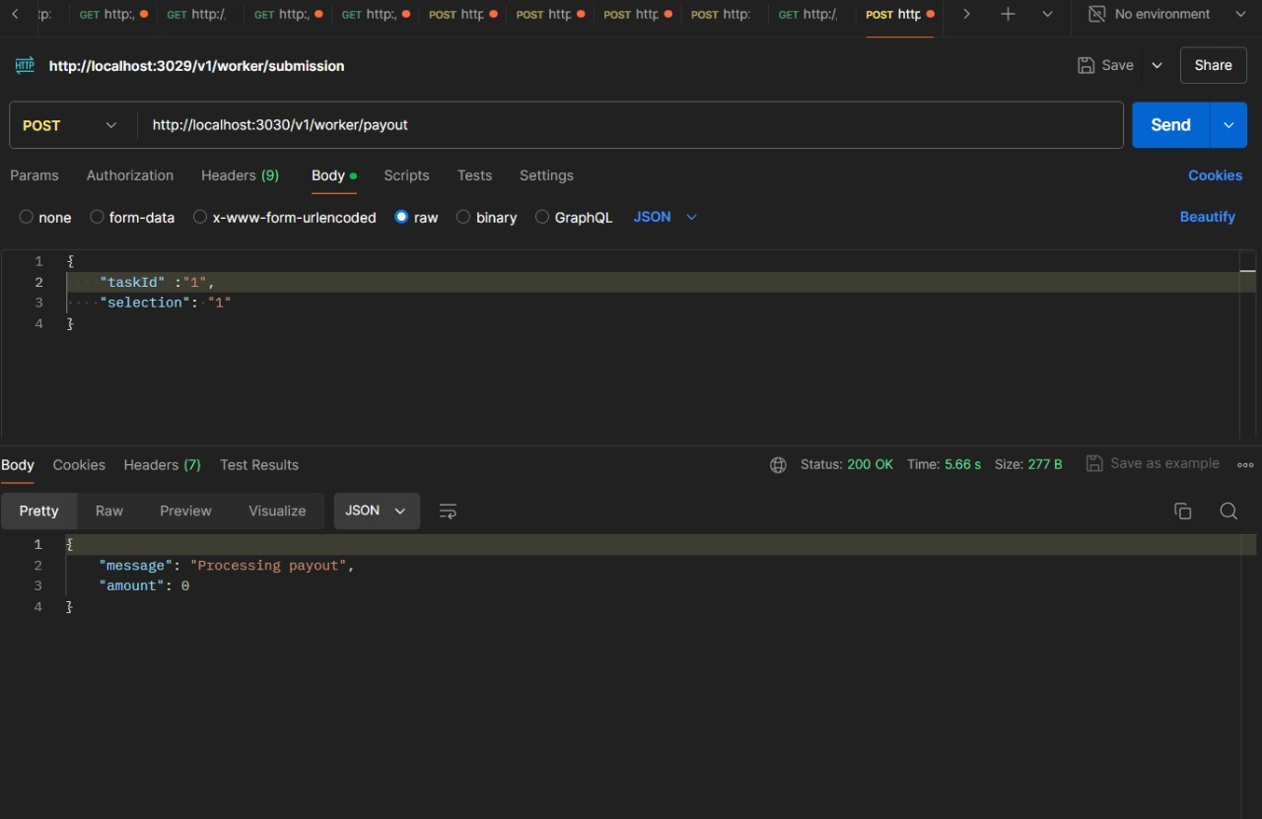
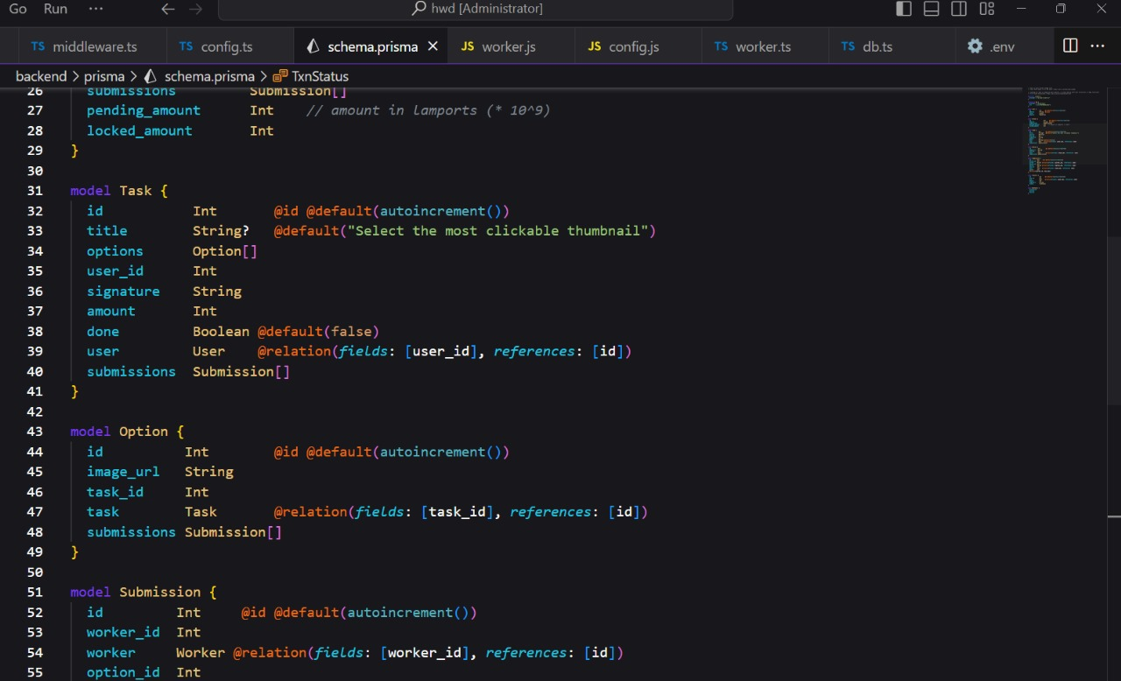
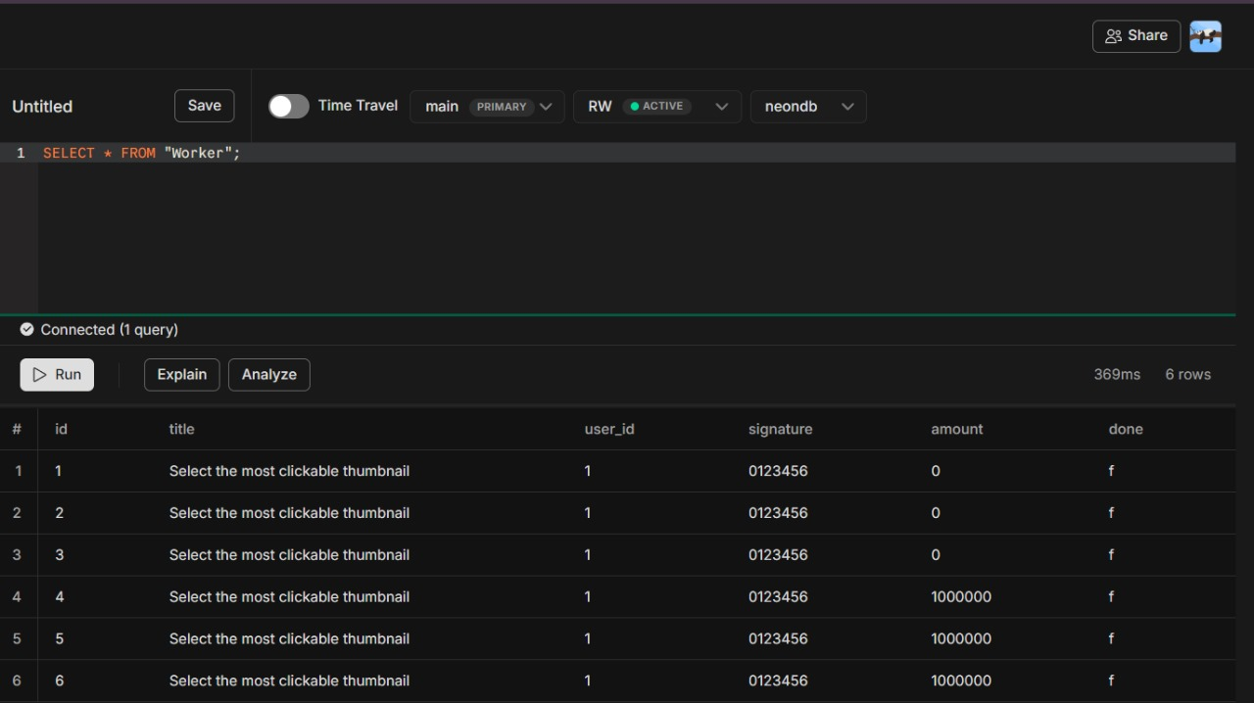
Worker Making A payout.
Worker Solving the Task With Amount .
Worker With their TaskId Their Amount
DataBase = Postgrap + Prisma (noSQL)

Slide 9
Team Member Details
Team Leader Name: Harsh Sharma
Branch (Btech): Stream (CSE ): Year (I):
Team Member 1 Name: Shubham Singh
Branch (Btech): Stream (CSE ): Year (I):
Team Member 2 Name: Dushyant Vasisht
Branch (Btech): Stream (CSE): Year (I):
Team Member 3 Name: Himanshu Soni
Branch (Btech): Stream (CSE): Year (I):

Slide 10
Thankyou

