Slide 1
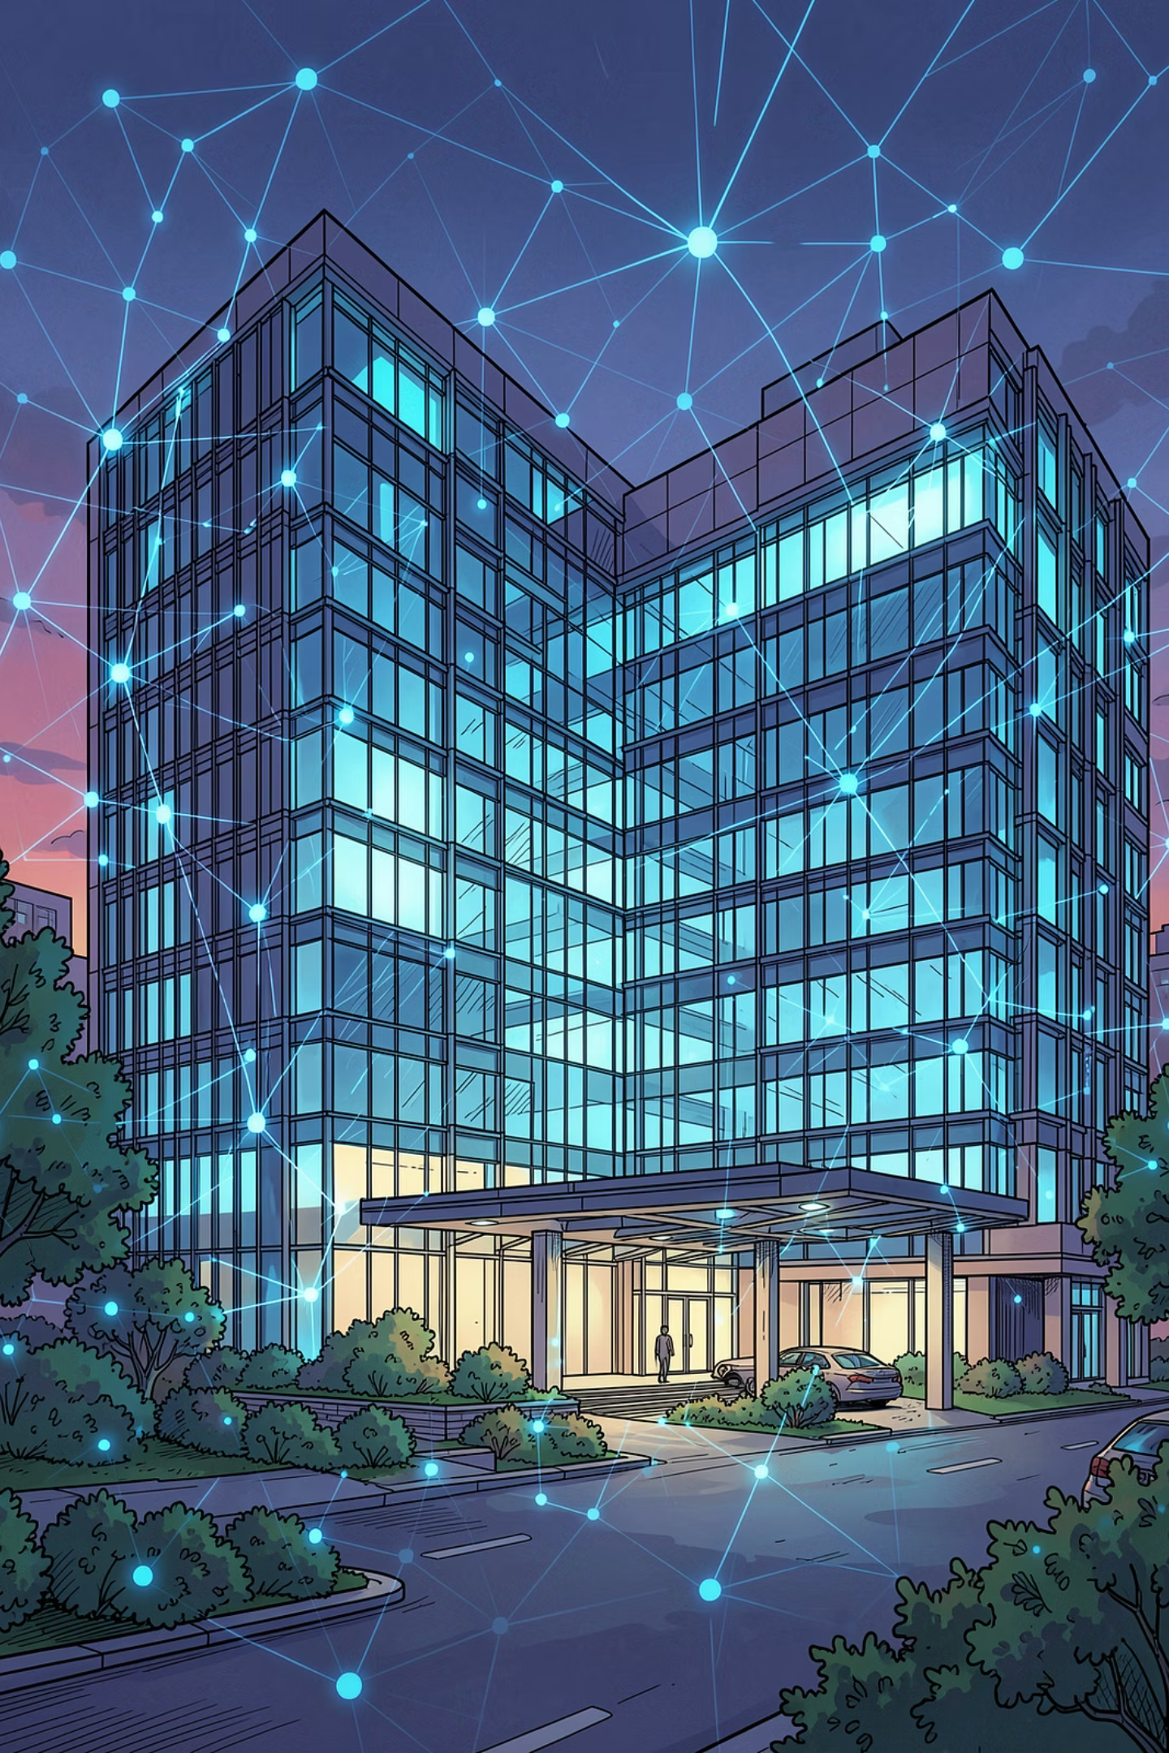
Life+Link System
Healthcare & Organ Donation Management Platform

Slide 2

Introduction
Healthcare and organ donation systems rely on timely, accurate coordination across hospitals, organ banks, and patients. A centralized digital platform bridges critical gaps in communication, donor matching, and emergency response.
The Challenge
The Need
Fragmented records, delayed communication, and manual processes hinder life-saving decisions.
A unified platform for real-time donor matching, inventory tracking, and emergency coordination.
The Impact
Faster response times, reduced paperwork, and improved patient outcomes across the healthcare ecosystem.

Slide 3
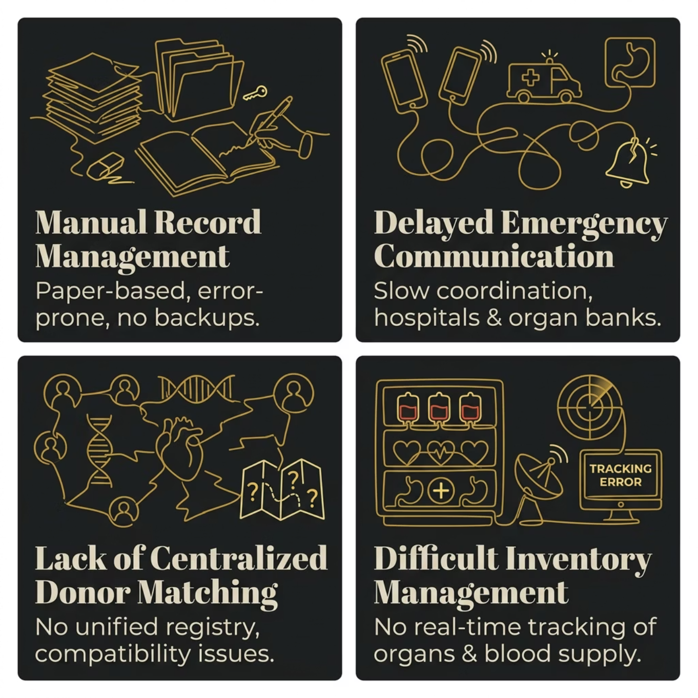

Problem Statement
Why It Matters
Every delay in donor matching or emergency communication can cost lives. Current systems are siloed, manual, and lack the infrastructure to respond in real time.
No Central Registry
Manual Processes
Slow Emergency Response
Donor and hospital data exist in isolated systems.
Paper records introduce errors and slow retrieval.
No automated alerts or rapid coordination tools.

Slide 4
Proposed Solution
LifeLink is a web-based centralized healthcare platform that unifies donor registration, emergency request handling, organ inventory management, and real-time analytics into a single secure system.
Donor Registration
Emergency Requests
Secure online registration with blood group and compatibility data.
Instant request submission and automated hospital notification.
Organ Inventory
Analytics Dashboard
Real-time tracking of organ and blood bank stock levels.
Visual insights into donations, requests, and system performance.

Slide 5
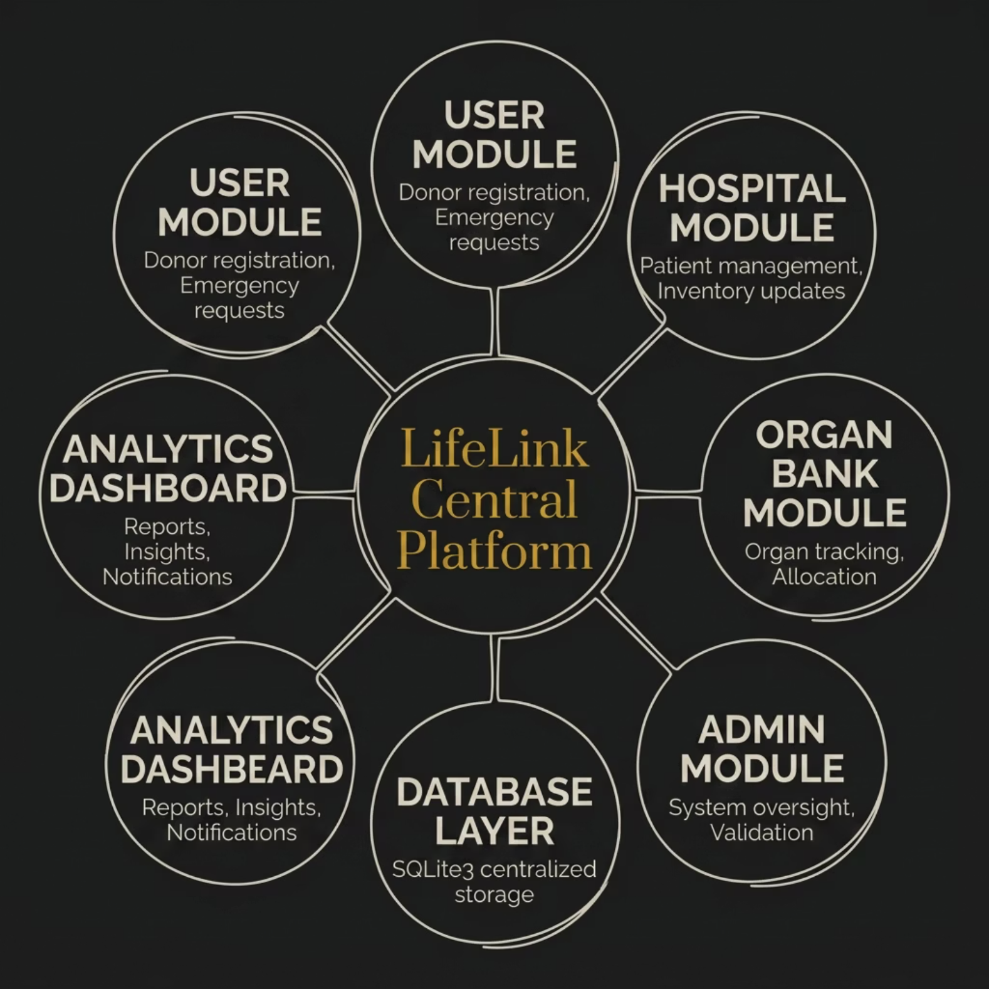

System Architecture
LifeLink follows a multi-tier architecture connecting five key stakeholders through a centralized SQLite database. Each module communicates via a secure Python backend, with Streamlit providing the interactive frontend layer.
Users — Register as donors, submit emergency requests
Hospitals — Manage patient needs, update inventory
Organ Banks — Track and allocate organ supply
Admin — Oversee system, validate records
Database — Centralized SQLite3 data store

Slide 6
Core Modules
User Module
Donor registration, profile management, and emergency request submission.
Hospital Module
Patient records, inventory updates, and request fulfillment tracking.
Organ Bank Module
Organ stock management, compatibility checks, and allocation workflows.
Admin Module
System oversight, user validation, and audit trail management.
Donor Matching Module
Automated blood group and compatibility matching algorithm.

Slide 7
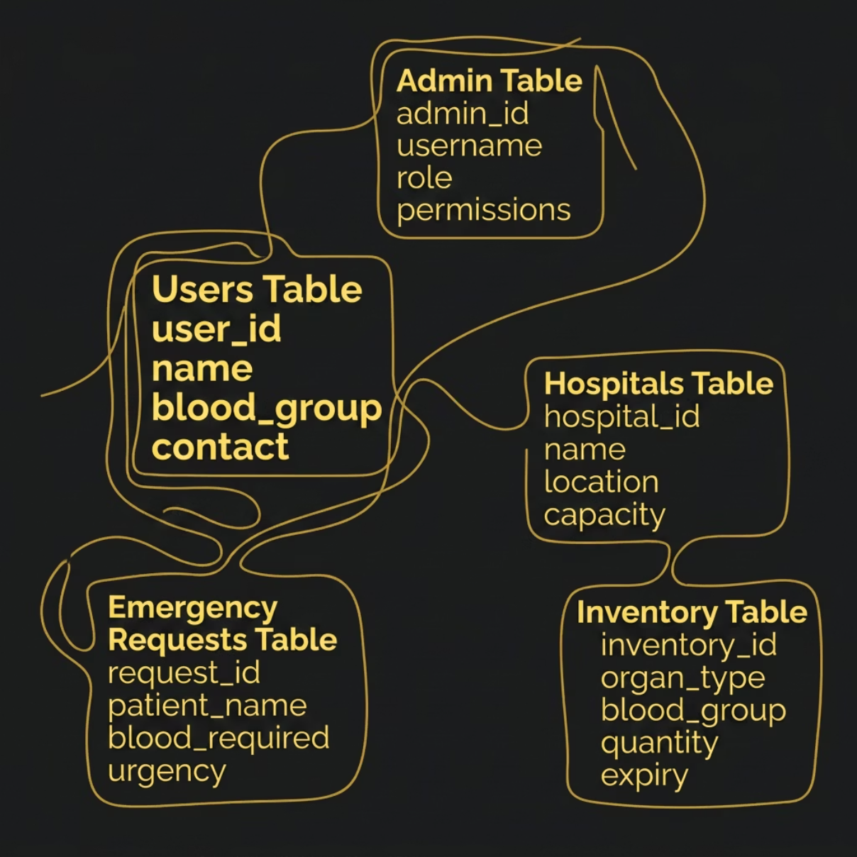

Database Design
LifeLink uses a relational SQLite3 database with five core tables ensuring data integrity, referential consistency, and fast query performance across all modules.
Users Table
Hospitals Table
Inventory Table
Emergency Requests
Name, blood group, contact, registration status
Location, capacity, inventory levels, contact
Organ type, blood group, quantity, expiry
Patient details, urgency, required blood/organ
Admin Table
Admin credentials, permissions, audit logs

Slide 8

Algorithms & Workflows
Donor Match
Receive request; filter by blood group; notify donor.
Emergency Flow
Login
Enter credentials; validate; grant role-based access.
Submit request; validate; alert hospitals; track status.
Each workflow is designed for speed and accuracy — automated validation reduces human error, while role-based access ensures data security at every step.

Slide 9
Features & Technology Stack
Key Features
Technology Stack
Secure Login
Python
Streamlit
Role-based authentication with input validation
Backend logic
Frontend UI
Blood Group Matching
Automated compatibility algorithm
SQLite3
Pandas
Database
Data processing
Certificate Generation
Automated donor recognition certificates
Matplotlib
VS Code
Analytics Dashboard
Visualization
Development
Visual reports powered by Matplotlib

Slide 10


Advantages, Future Scope & Conclusion
Advantages
Future Scope
Reduces manual paperwork
Faster emergency response
Centralized healthcare management
Efficient donor matching
AI-based donor prediction
Mobile application
Cloud database integration
SMS and Email notifications
Real-time hospital tracking
Conclusion
LifeLink demonstrates how a centralized, automated platform can transform healthcare coordination — reducing delays, improving donor matching, and saving lives through technology.
References: Python Documentation · Streamlit Documentation · SQLite Documentation · Pandas Documentation · Matplotlib Documentation

Slide 11
What We Achieved !!
Our project successfully delivered a robust web-based platform, addressing critical needs in healthcare and organ donation management.
Web Application
Developed a comprehensive web-based healthcare management platform.
Donor Matching
Implemented an efficient and automated donor matching system.
Core Modules
Created dedicated modules for Users, Hospitals, and Organ Banks.
Analytics Dashboard
Integrated a powerful dashboard for data visualization and reporting.
Tech Stack
Utilized Python, Streamlit, and SQLite3 for robust development.
User-Friendly Design
Built an intuitive and beginner-friendly system for ease of use.

