Slide 1
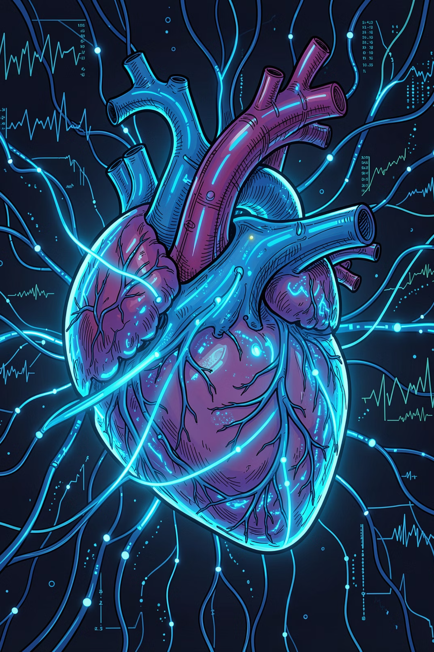
LIFE + LINK
Smart Organ Donation and Request Management System
"Connecting Donors, Patients, Hospitals, and Organ Banks Through Technology"
Department of Computer Science & Engineering · Academic Year 2025-26

Slide 2

Introduction
Healthcare and organ donation systems rely on timely, accurate coordination across hospitals, organ banks, and patients. A centralized digital platform bridges critical gaps in communication, donor matching, and emergency response.
The Challenge
The Need
Fragmented records, delayed communication, and manual processes hinder life-saving decisions.
A unified platform for real-time donor matching, inventory tracking, and emergency coordination.
The Impact
Faster response times, reduced paperwork, and improved patient outcomes across the healthcare ecosystem.

Slide 3
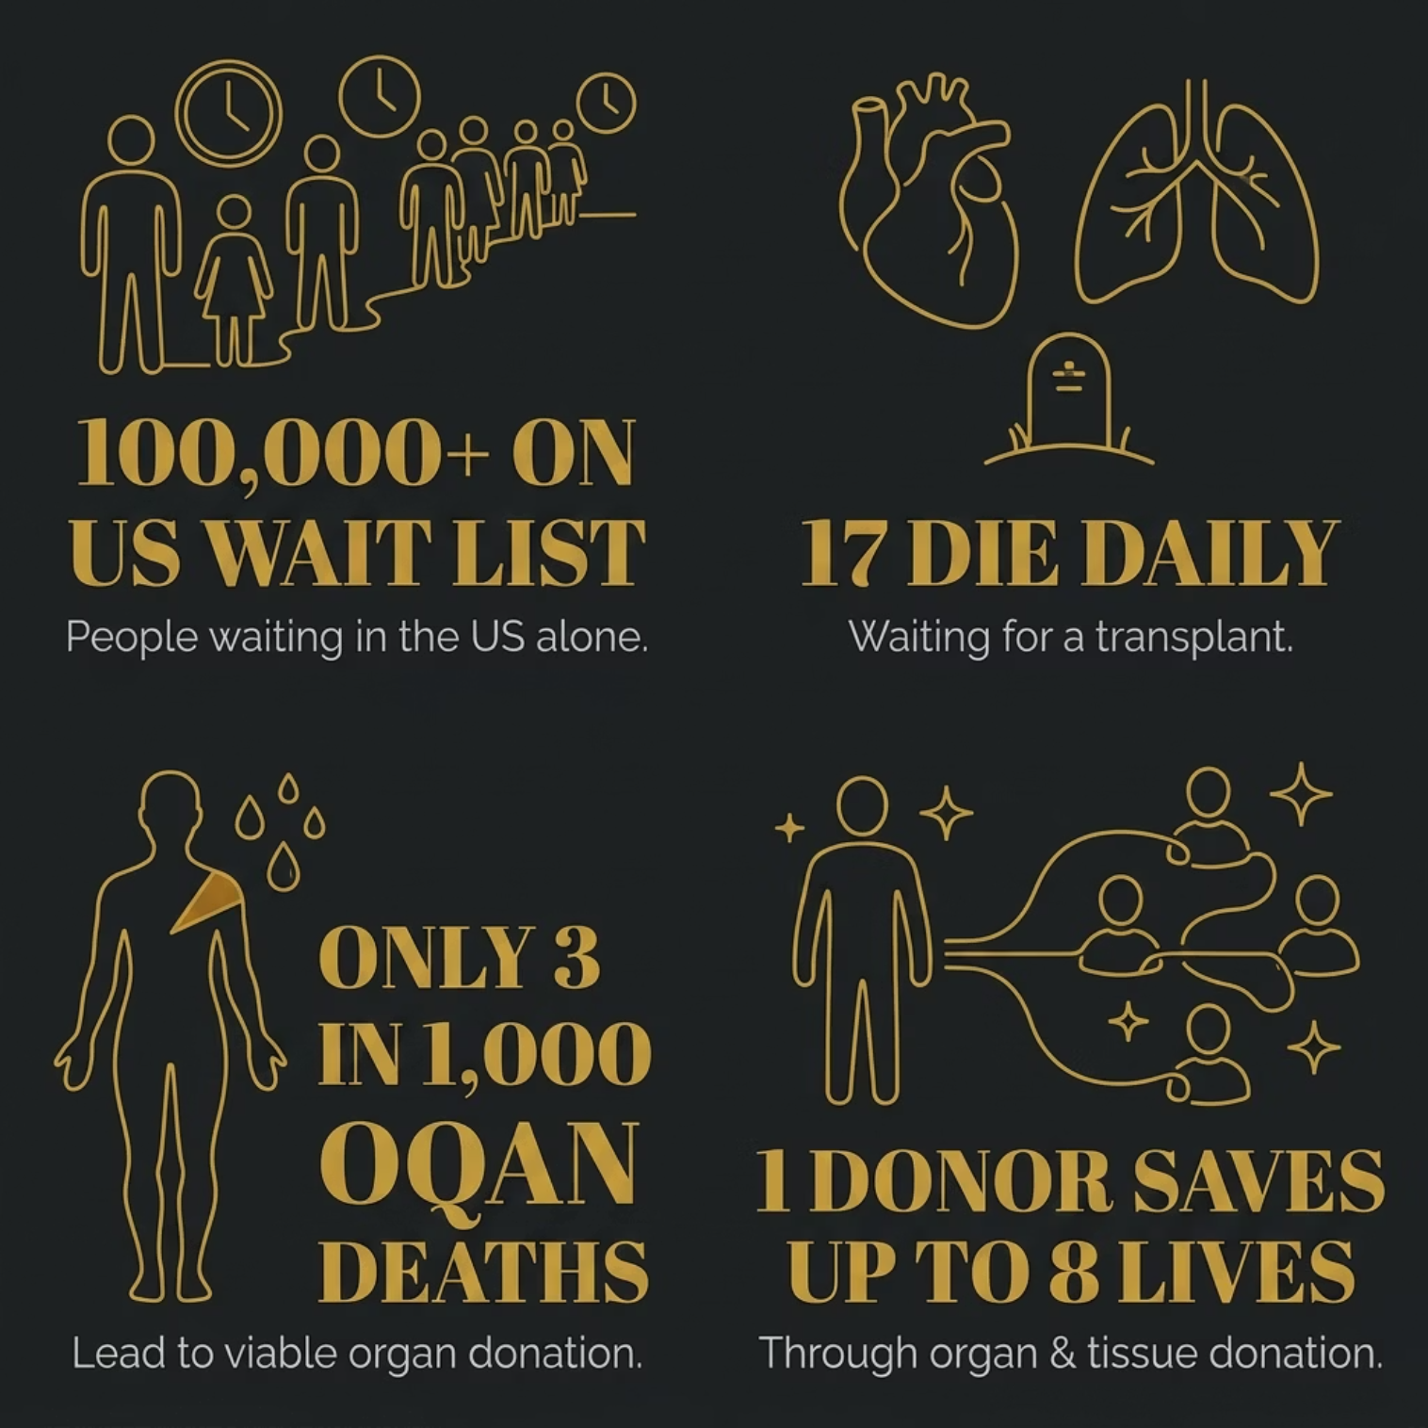
Organ Donation: By the Numbers
Every day, lives are lost waiting for organs. The gap between supply and demand is widening — and without efficient management, even willing donors cannot reach those in need in time.
Thousands on waiting lists with no centralized coordination
Hours lost to manual verification during critical windows
Fragmented hospital records delaying life-saving decisions
No real-time visibility into organ availability or request status

Slide 4
PROJECT OBJECTIVES
Centralized Platform
Digitize Requests
One secure system connecting all stakeholders
Replace paperwork with streamlined digital workflows
Emergency Handling
Auto Certificates
Prioritized workflows for time-critical organ requests
QR-based donor certificates generated and delivered instantly
Secure Access
Analytics Dashboard
Role-based authentication and encrypted record management
Real-time monitoring of donations, requests, and system activity

Slide 5
PROBLEM STATEMENT
Manual Paperwork
Delayed Communication
Physical forms introduce errors and slow critical approvals
No real-time alerts between hospitals, organ banks, and patients
Scattered Records
No Transparency
Disconnected hospital systems prevent unified donor-patient matching
Stakeholders lack visibility into request status and organ availability
Inefficient Emergency Handling
Limited Coordination
No dedicated workflow for time-sensitive emergency organ requests
Donors, hospitals, organ banks, and patients operate in silos

Slide 6
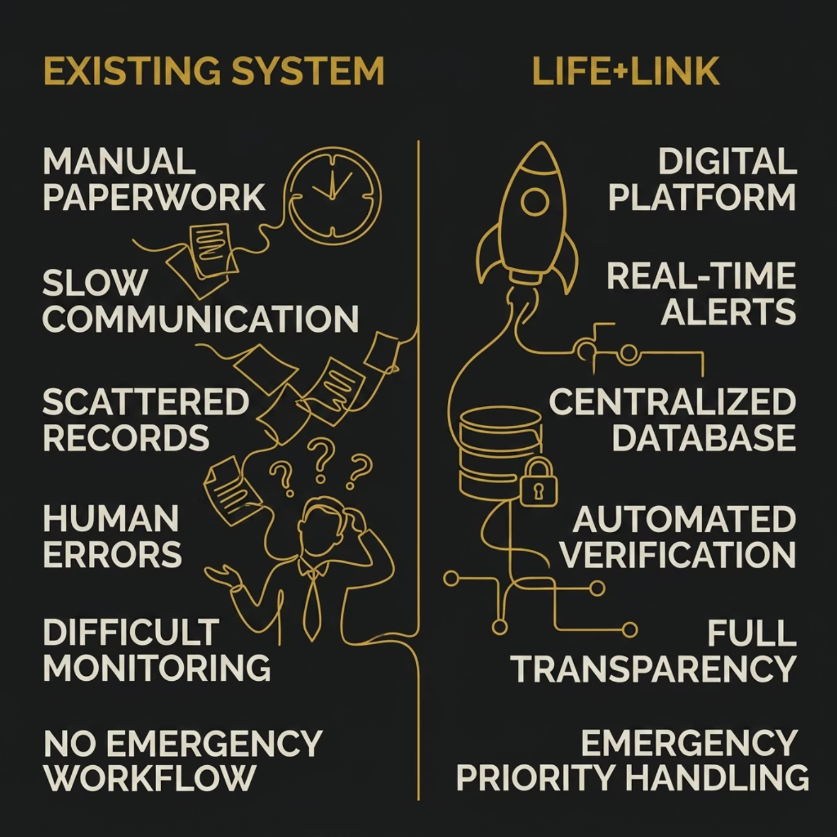
Existing System vs. Life + Link
The existing organ donation management system primarily relies on manual processes and separate hospital records for maintaining donor and patient information. Most hospitals and healthcare organizations manage organ donation requests through paperwork, phone calls, and independent databases, making coordination difficult and time-consuming.
In the traditional system, organ donors, hospitals, organ banks, and patients are not connected through a centralized platform. As a result, information sharing is slow, emergency requests are difficult to process, and record management becomes complex. The absence of a unified system often leads to delays in organ allocation and inefficient tracking of donation activities.
Donor
Hospital
Manual Records
Patient
Organ Bank
Traditional Workflow

Slide 7
Proposed Solution
Life+Link is a web-based centralized healthcare platform that unifies donor registration, emergency request handling, organ inventory management, and real-time analytics into a single secure system.
Donor Registration
Emergency Requests
Secure online registration with blood group and compatibility data.
Instant request submission and automated hospital notification.
Organ Inventory
Analytics Dashboard
Real-time tracking of organ and blood bank stock levels.
Visual insights into donations, requests, and system performance.

Slide 8
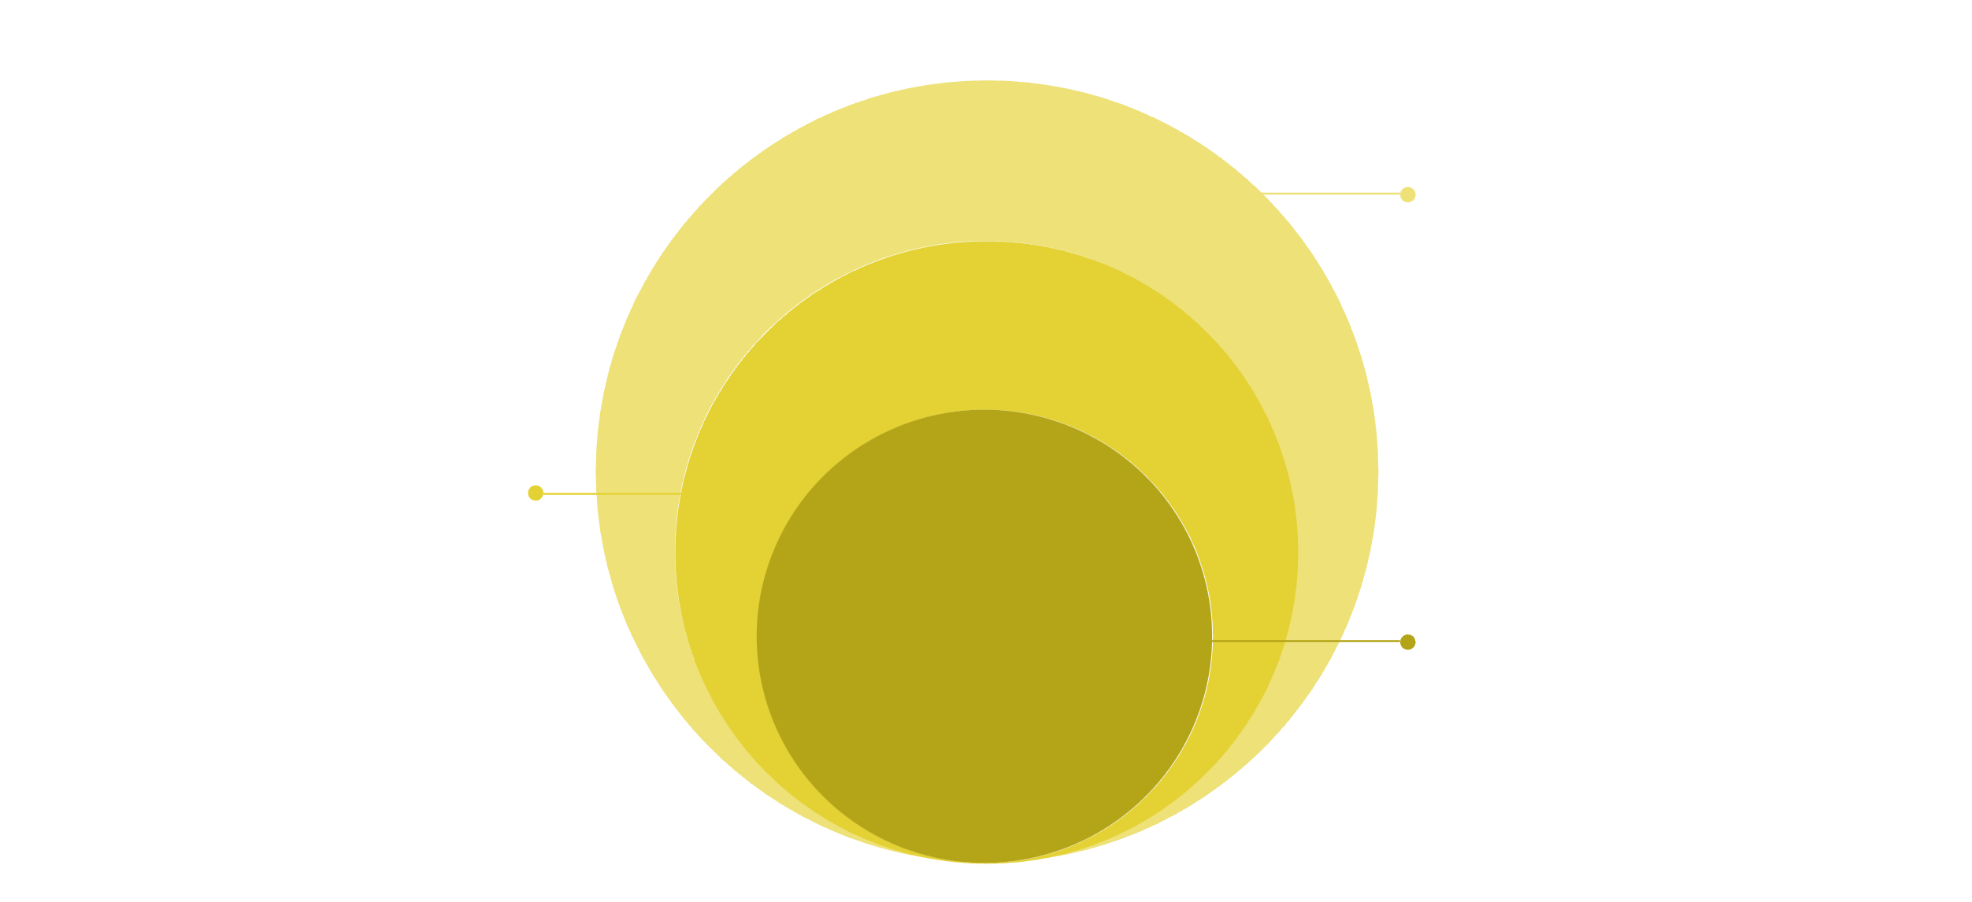
System Architecture
Hospital & Organ Bank
Clinical and supply modules
Admin Module
Role-based management and audits
Core Database
SQLite central datastore
Life + Link uses a clean four-tier architecture — from end users through role-based modules to a centralized SQLite database — ensuring secure, auditable data flow across all stakeholders.
Frontend
Backend
Streamlit — responsive, interactive UI
Python
Database
Libraries
SQLite — lightweight, embedded storage
Pandas · ReportLab · QRCode · Pillow · Hashlib

Slide 9
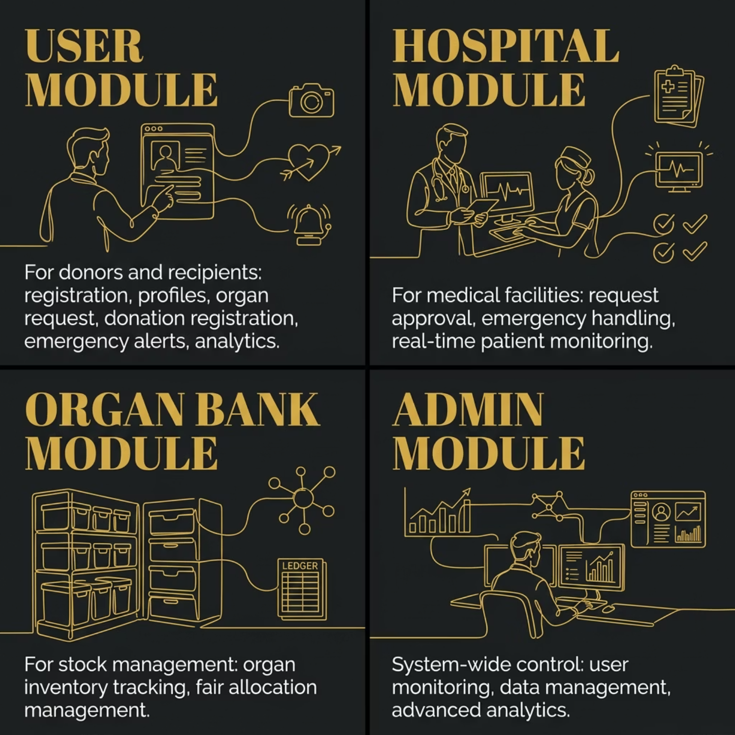
Modules & Advanced Features
Advanced Features
QR-Based Certificates — Auto-generated PDF certificates with embedded QR codes
Camera Integration — Live capture and cropping for profile images
Secure Sessions — Hashed passwords and managed authentication
Analytics Dashboard — Live monitoring of all platform activity

Slide 10
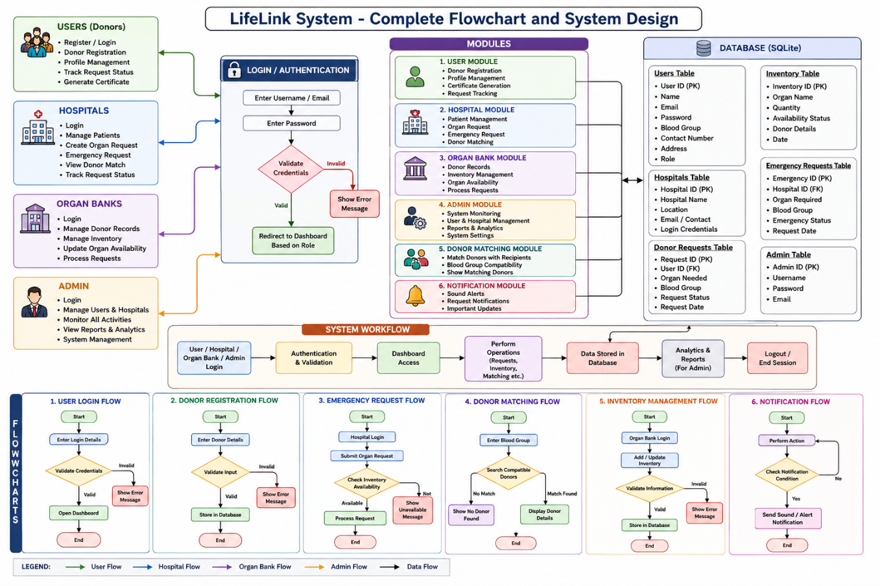

Slide 11
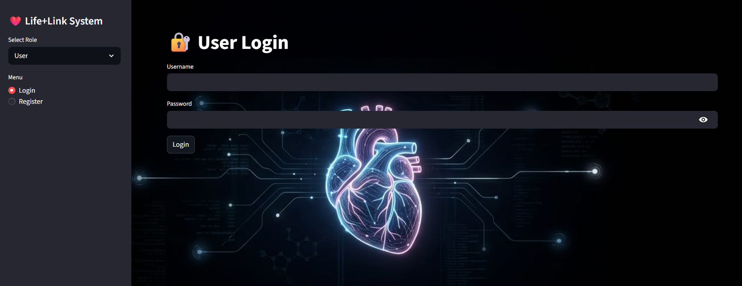
RESULTS
Platform Screenshots & Testing
Key Screens
Login & Registration with secure authentication
User Dashboard with donation and request management
Hospital Dashboard with approval workflows
Analytics Dashboard with real-time activity monitoring
Generated QR-based donor certificate (PDF download)
Testing & Validation
Registration, login, and session management verified
Organ request and donation workflows error-free
Certificate generation and database integrity confirmed
All modules validated for accurate data storage

Slide 12
Future Scope
Mobile Application Development
Develop Android and iOS applications for easier access to organ donation and request services.
Cloud Database Integration
Replace SQLite with cloud databases such as MySQL, PostgreSQL, or Firebase for large-scale deployment.
Email and SMS Notifications
Send automatic notifications for donation requests, approvals, emergency alerts, and status updates.
Multi-Hospital Connectivity
Connect multiple hospitals and organ banks on a single platform for faster coordination and organ allocation.
National Organ Donation Network Integration
Integrate with government and national organ donation systems to improve organ availability and management.
Advanced Organ Matching System
Implement intelligent matching based on blood group, medical compatibility, age, and urgency level.
Real-Time Organ Availability Tracking
Provide live updates on organ inventory and request status across hospitals and organ banks.

Slide 13
Applications of Life + Link
Hospitals
  Manage organ requests and donor information efficiently.
  Monitor patient requirements and request status.
Organ Banks
  Maintain organ inventory records.
  Process and allocate organs based on requests.
Healthcare Organizations
  Support organ donation awareness and management activities.
  Maintain centralized donor databases.
Government Health Departments
  Monitor organ donation programs and statistics.
  Improve transparency in organ allocation processes.
NGOs and Organ Donation Campaigns
  Register donors and promote organ donation initiatives.
  Manage donation-related records digitally.
Emergency Healthcare Services
  Handle urgent organ requests quickly.
  Improve coordination among hospitals and organ banks.

Slide 14
Conclusion
The Life + Link – Smart Organ Donation and Request Management System successfully provides a centralized digital platform for managing organ donation and organ request activities. The system simplifies communication between donors, patients, hospitals, organ banks, and administrators through an interactive and user-friendly interface.
The project implements essential features such as user registration and authentication, organ donation management, organ request processing, emergency request handling, analytics dashboards, image management, and QR-based certificate generation. By replacing traditional manual processes with a digital solution, the system improves efficiency, transparency, data management, and accessibility.
The use of Python, Streamlit, SQLite, ReportLab, Pandas, and image processing technologies enables the development of a reliable and scalable platform. Overall, the Life + Link system contributes toward better healthcare management by streamlining organ donation workflows and supporting life-saving medical services through technology.

Slide 15
Thank You

