Slide 1

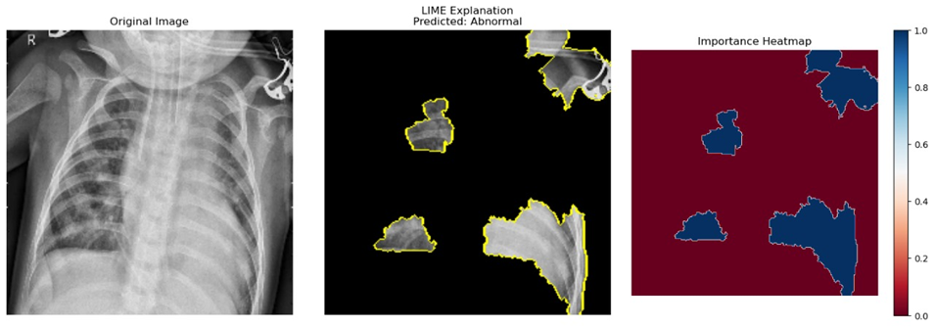
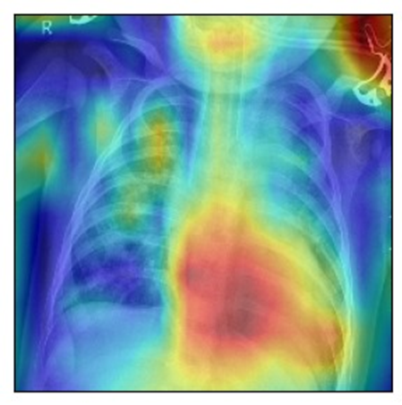
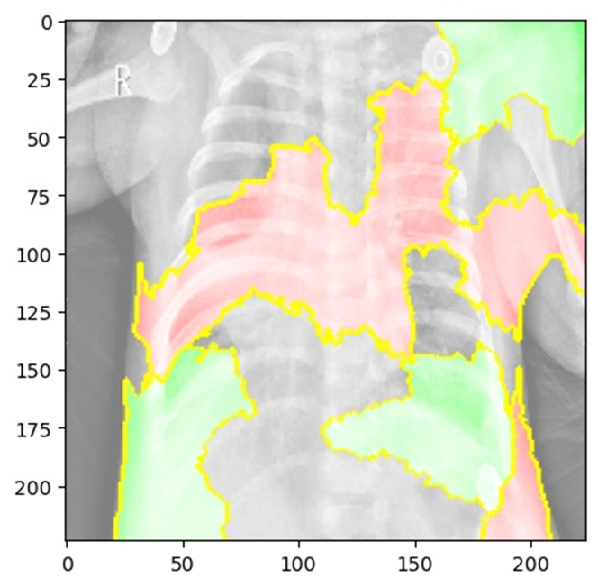
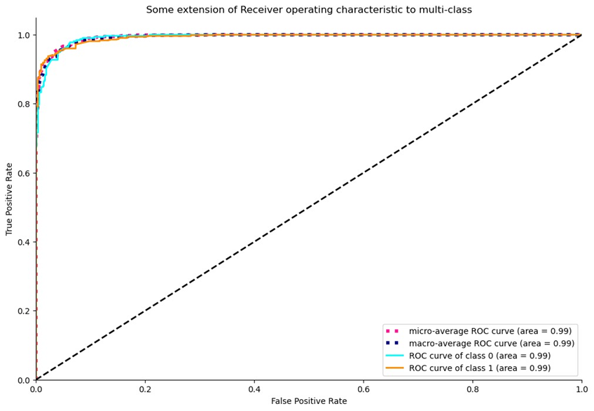
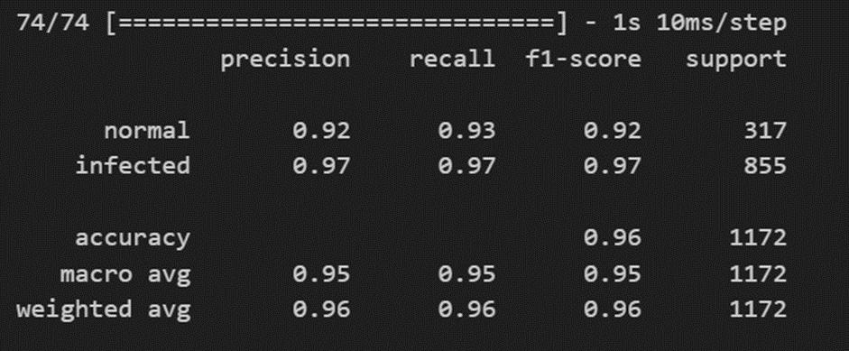
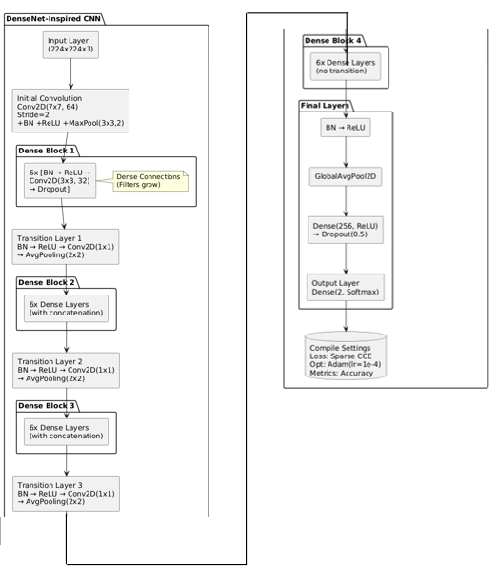
EXPLAINABLE ARTIFICIAL INTELLIGENCE IN PNEUMONIA DETECTION
Harsh Raj Anand|Dr. Anil Kumar K| School of Computer Science and Engineering
Introduction
Results
Existing studies demonstrate that XAI techniques like Grad-CAM, and LIME enhance interpretability in pneumonia detection using chest X-rays. However, gaps persist due to limited real-time clinical integration, lack of standardized evaluation metrics. This study addresses these gaps by evaluating ensemble XAI models and promoting clinical relevance.
The developed system successfully detected pneumonia from chest X-ray images using a deep learning model integrated with Explainable AI (XAI) techniques. The DenseNet-based model achieved a high classification accuracy of approximately 96.4%, demonstrating strong performance across evaluation metrics such as precision, recall, F1-score, and AUC-ROC, indicating its reliability in clinical diagnostics. Explainability was a key feature, with Grad-CAM and LIME providing visual interpretations of the model’s predictions. Grad-CAM effectively highlighted lung regions associated with pneumonia, while LIME offered pixel-level relevance explanations. These visualizations aligned well with radiologist assessments, improving the system’s trustworthiness and clinical acceptability. The user interface allowed seamless image uploads, prediction display, and interpretability overlays. Feedback from a consulting clinician confirmed that the system’s predictions were medically relevant, further validating its real-world applicability. Despite its success, the integration of XAI increased computational complexity slightly, affecting prediction time. In cases of poor image quality, explanations were occasionally ambiguous, suggesting areas for further refinement. Overall, the system bridged the gap between high-performance AI and clinical usability. It demonstrated how integrating explainability enhances medical decision-making, fosters clinician trust, and paves the way for responsible AI deployment in healthcare environments. The feedback loop supports continuous improvement, ensuring long-term adaptability and effectiveness.
LIME Result
Motivation
Pneumonia poses a significant global health risk, especially in low-resource areas where timely diagnosis is vital. This project aims to enhance diagnostic transparency through explainable AI, fostering trust and ethical medical adoption.
Scope of the Project
The project aims to develop an AI-based system for pneumonia detection from chest X-ray images, integrating Explainable Artificial Intelligence (XAI) techniques such as Grad-CAM, LIME, and saliency maps. Its scope includes improving model transparency, interpretability, and clinical trust in AI-driven diagnostics. By bridging the gap between high-accuracy deep learning models and medical decision-making, the system supports ethical AI deployment, facilitates real-time diagnosis, and sets a foundation for broader applications in medical imaging.
Methodology
The methodology involves a structured, modular approach to building an end-to-end AI-based pneumonia detection system using chest X-ray images. It begins with data collection and preprocessing, where labeled X-ray images from datasets like NIH ChestX-ray8 are resized, normalized, and enhanced using techniques like CLAHE for better image clarity. Next, the deep learning model is developed using architectures such as DenseNet and CNN. The model is trained to classify images as “Normal” or “Pneumonia” and evaluated using metrics like accuracy, precision, recall, F1-score, and AUC-ROC. To address the black-box issue of AI, Explainable AI (XAI) techniques—Grad-CAM and LIME—are incorporated to generate heatmaps and visual cues highlighting key image regions that influenced predictions. A web-based user interface allows clinicians to upload X-ray images and view predictions with interpretability overlays. The feedback module enables users to validate predictions and contribute to a continuous learning loop, improving future model accuracy. Extensive testing is performed, including unit, integration, and usability testing, along with validation of XAI outputs against clinical standards. relevance.
AUC-ROC for Combined Classes
GradCam Heatmap
LIME Explanation
Conclusion
The project successfully demonstrated the integration of Explainable Artificial Intelligence (XAI) techniques into a deep learning model for pneumonia detection using chest X-ray images. By employing methods like Grad-CAM and LIME, the system achieved not only high diagnostic accuracy (~96.4%) but also enhanced interpretability, making AI predictions transparent and trustworthy for clinical use. The inclusion of a feedback mechanism and user-friendly interface further supported real-time application and continuous learning. This approach addressed the critical challenge of AI’s black-box nature in healthcare, promoting ethical and responsible deployment. Overall, the project bridges the gap between AI accuracy and medical trust, contributing meaningfully to the field of explainable medical diagnostics.
DenseNet Model
Architecture
References
Ruga, T., Vocaturo, E., & Zumpano, E. (2024). Explainable deep learning for chest X-ray classification. In Proceedings of the 2024 International Conference on Bioinformatics and Biomedicine (BIBM) (pp. 6561–6566). IEEE.
Liu, Y.-K., & Tsai, Y.-C. (2024). Explainable AI for trustworthy clinical decision support: A case-based reasoning system for nursing assistants. In Proceedings of the 2024 IEEE International Conference on Big Data (Big Data) (p. 6502). IEEE.

