Slide 1
Explainable Artificial Intelligence in Pneumonia Detection
BCSE498J
21BCE2881 KUSHAGRA R PRADHAN
21BCE2906 HARSH RAJ ANAND
21BCE2907 DEVANSHI TRIVEDI
Project Supervisor: Dr. ANIL KUMAR K

Slide 2
OUTLINE
Introduction
Literature Review, Research Gap, Objectives, Problem Statement
Technical Specifications (Functional/Non-Functional Requirements, Feasibility, Hardware/Software)
System Architecture and Design
Methodology and Testing
Project Demonstration
Results and Discussion
Conclusion and Future Enhancements
References

Slide 3
INTRODUCTION
Overview:
•Explainable AI (XAI) enhances the transparency and interpretability of AI models used in pneumonia detection from chest X-rays, ensuring trust and reliability in medical diagnostics.
Project Objective:
•To develop an AI-driven pneumonia detection system that provides explainable predictions, enabling healthcare professionals to understand and validate model decisions.
Scope:
•The project focuses on implementing and evaluating XAI techniques like LIME and SHAP in deep learning models for pneumonia diagnosis.

Slide 4
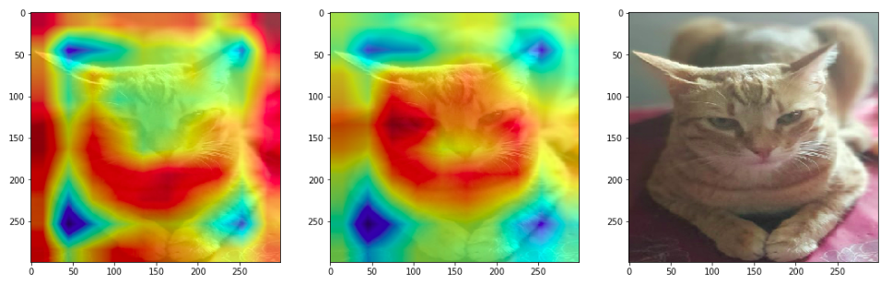
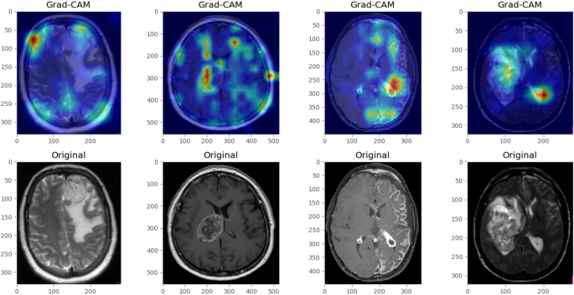
INTRODUCTION

Slide 5
LITERATURE REVIEW
Introduction. Explainable AI (XAI) is crucial in medical imaging for building trust in AI diagnoses. In pneumonia detection from chest X-rays, XAI helps clinicians understand model decisions.
Explainable AI in Medical Imaging. Deep learning models like CNNs are accurate but lack interpretability. XAI techniques such as SHAP, Grad-CAM, and LIME enhance transparency, making them suitable for clinical use.
Ensemble XAI Models for Pneumonia Detection. An ensemble XAI model, originally developed for COVID-19 detection, effectively combines methods like Grad-CAM++ and SHAP. Its approach is applicable to pneumonia due to similar imaging characteristics.

Slide 6
LITERATURE REVIEW
Comparative Effectiveness of XAI Techniques.
· Grad-CAM++: Heatmaps to visualize important regions.
· SHAP: Pixel-wise contribution scores.
· LIME: Local decision approximations.
The ensemble approach outperforms individual methods by leveraging their combined strengths.
Future Directions. Key challenges include the need for standardized explainability metrics, clinical workflow integration, and more diverse datasets. Future work should refine ensemble models and incorporate clinical feedback.
Conclusion. XAI improves trust in AI-driven pneumonia diagnosis. Ensemble techniques offer robust, interpretable solutions, but further validation in real-world settings is necessary.

Slide 7
PROBLEM STATEMENT
Challenges:
•Ensuring high accuracy while maintaining interpretability in AI predictions.
•Handling data bias and variability in chest X-ray images.
•Balancing model complexity with real-time explainability and efficiency.
Goals:
•Improve transparency in AI-driven medical diagnostics for better clinical adoption.
•Integrate XAI techniques like LIME and GradCAM to provide interpretable predictions.

Slide 8
PROJECT OBJECTIVES
• To explore the role of Explainable Artificial Intelligence (XAI) in improving the transparency of pneumonia detection models.
• To analyze various XAI techniques, such as Grad-CAM, and LIME, in interpreting AI-driven pneumonia diagnoses.
• To evaluate the effectiveness of ensemble XAI models in enhancing decision support for medical practitioners.
• To identify existing gaps and challenges in implementing XAI for pneumonia detection in clinical settings.
• To propose future directions for improving the integration of XAI techniques in pneumonia diagnosis workflows.

Slide 9
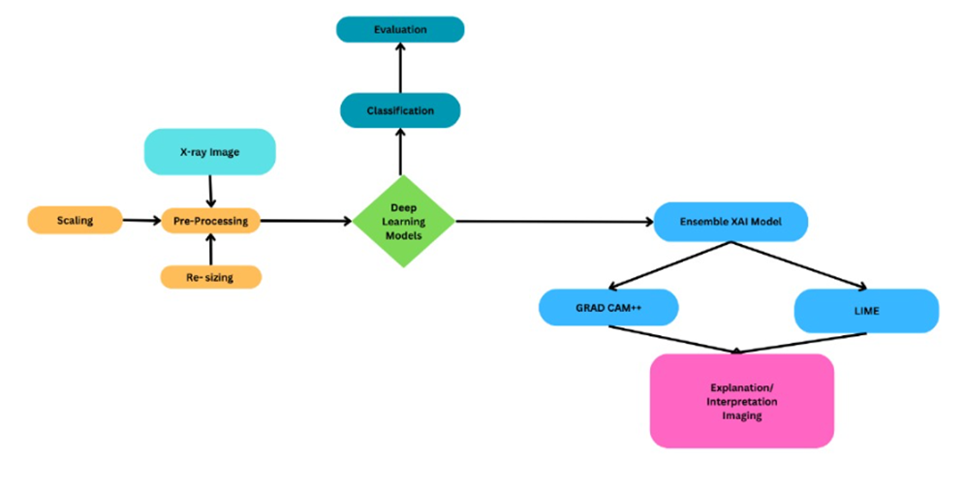
SYSTEM ARCHITECTURE

Slide 10
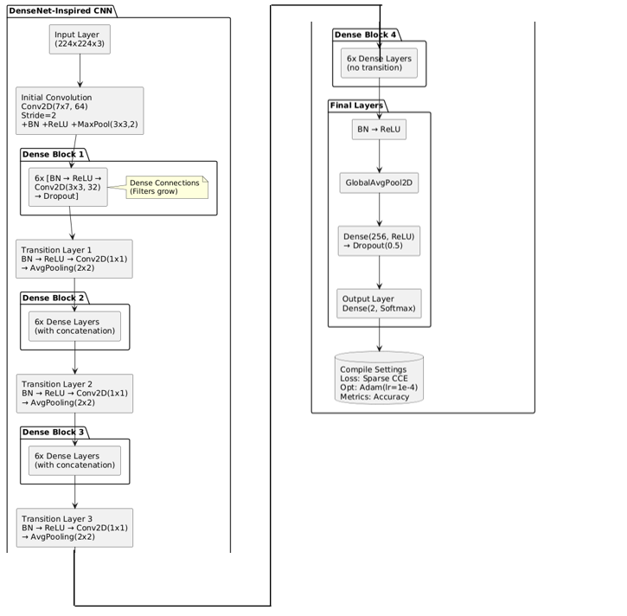
MODEL ARCHITECTURE

Slide 11
ANALYTICAL AND THEORETICAL DESCRIPTION
Analytical and Theoretical Description in brief:
Model Architecture: Utilizes DenseNet and CNN architectures for effective pneumonia classification from chest X-ray images.
Feature Reuse: DenseNet enables dense connections for improved gradient flow and reduced parameter count.
Explainable AI (XAI):
Grad-CAM: Generates heatmaps to highlight image regions influencing model predictions.
LIME: Provides local, interpretable approximations by perturbing inputs.
Preprocessing Techniques: Includes CLAHE and white balancing to enhance image quality and model focus.
Evaluation Metrics: Accuracy, precision, recall, F1-score, and AUC-ROC used to assess performance.
Clinical Validation: Explanations aligned with medical knowledge, increasing clinician trust in AI outputs.
Ethical & Reliable AI: Ensures transparency and accountability in healthcare diagnostics.

Slide 12
HARDWARE AND SOFTWARE TOOLS
Hardware:
NVIDIA GPUs (GTX/RTX)
Intel/AMD CPUs
SSD storage and high-RAM systems
Software:
Python, TensorFlow, Keras, OpenCV, Scikit-learn
Visualization: Matplotlib
Platforms: Jupyter, Google Colab, VS Code
Dataset: open source chest Xrays
Tools for XAI: Grad-CAM, LIME

Slide 13
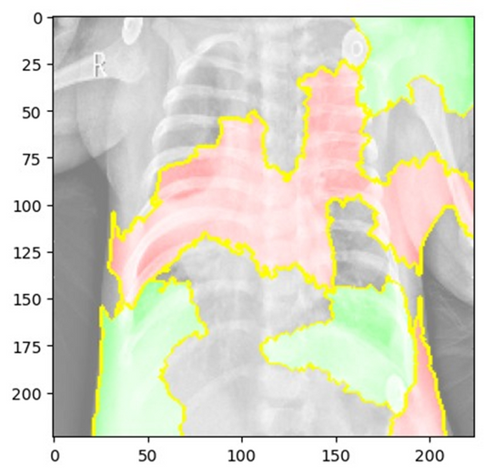
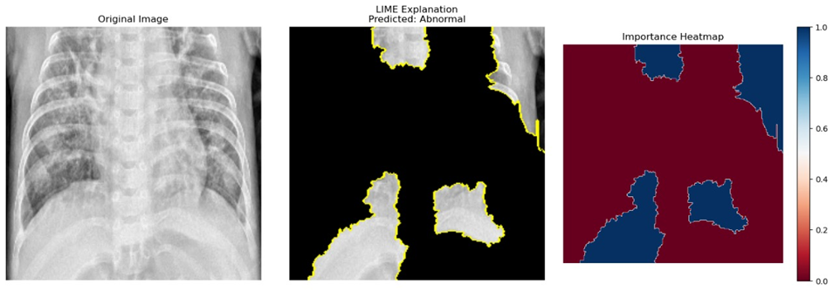
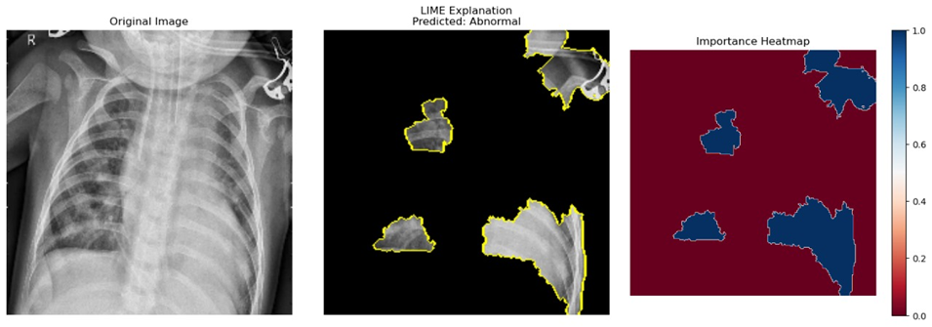
SIMULATION AND RESULTS
LIME:
LIME explanation offering local feature relevance.

Slide 14
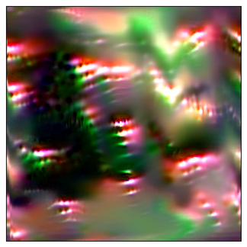
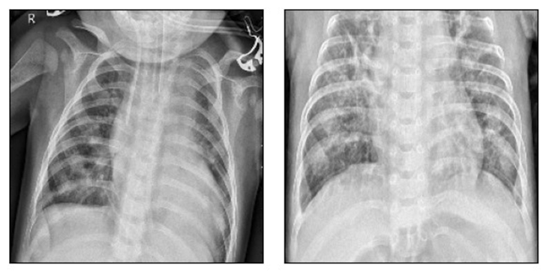
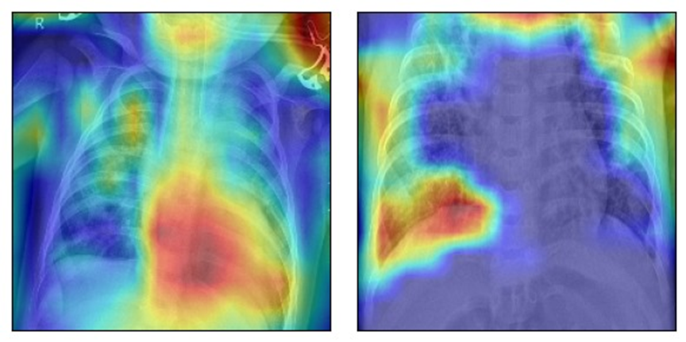
SIMULATION AND RESULTS
GradCAM:
Grad-CAM Heatmap overlaid on the chest X-ray to highlight influential regions.

Slide 15
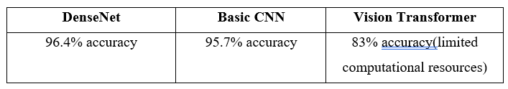
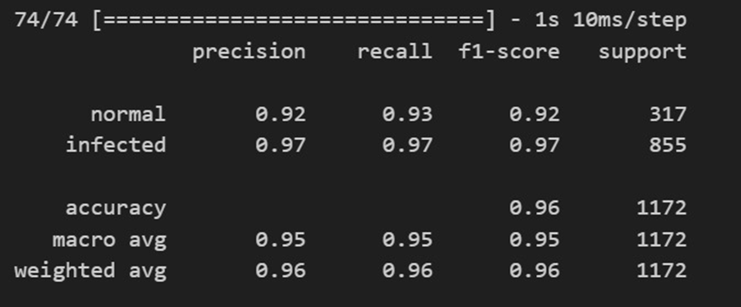
SIMULATION AND RESULTS
Accuracy: DenseNet – 96.4%, CNN – 95.7%

Slide 16
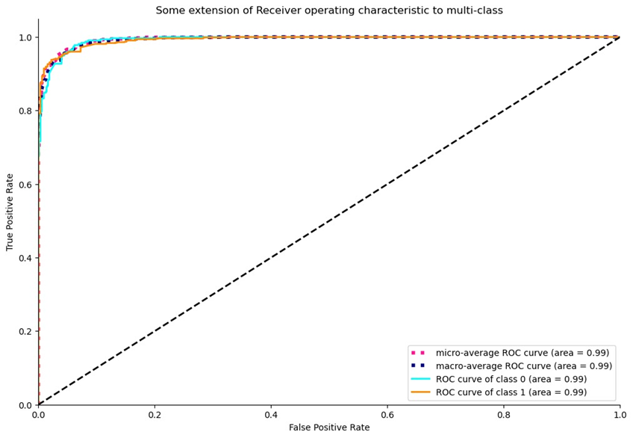
SIMULATION AND RESULTS
AUC-ROC and F1-scores validated model effectiveness.

Slide 17
CONCLUSION
This project successfully demonstrated the integration of Explainable Artificial Intelligence (XAI) techniques into a deep learning-based pneumonia detection system using chest X-ray images. The model, primarily built on DenseNet architecture, achieved high accuracy (~96.4%) while maintaining interpretability through the application of XAI methods such as Grad-CAM, LIME. These techniques enabled visual and analytical transparency, empowering clinicians to better understand and trust the AI’s diagnostic decisions.

Slide 18
CONTRIBUTION OF INDIVIDUAL TEAM MEMBERS
Kushagra Pradhan (21BCE2881): Model architecture, preprocessing pipeline.
Harsh Raj Anand (21BCE2906): Grad-CAM implementation, LIME explainability.
Devanshi Trivedi (21BCE2907): Literature review, documentation, evaluation metrics.

Slide 19
IMPACT OF THE PROJECT ON SOCIETY AND ENVIRONMENT
Social Impact: Reduces diagnostic disparity in low-resource settings. Increases clinician trust in AI.
Environmental Impact: Promotes cloud-based or portable X-ray solutions, reducing the need for extensive hospital infrastructure.
Ethical Impact: Promotes responsible AI use in healthcare.

Slide 20
REFERENCES
Ruga, T., Vocaturo, E., & Zumpano, E. (2024). Explainable deep learning for chest X-ray classification. In Proceedings of the 2024 International Conference on Bioinformatics and Biomedicine (BIBM) (pp. 6561–6566). IEEE.
Liu, Y.-K., & Tsai, Y.-C. (2024). Explainable AI for trustworthy clinical decision support: A case-based reasoning system for nursing assistants. In Proceedings of the 2024 IEEE International Conference on Big Data (Big Data) (p. 6502). IEEE.
Pandey, K. M., & Baloni, D. (2024). Ensemble explainable artificial intelligence model for COVID-19 detection using chest X-ray images. In Proceedings of the 2024 1st International Conference on Advanced Computing and Emerging Technologies (ACET). IEEE.
Hasan, M. Z., Montaha, S., Khan, I. U., Hassan, M. M., Mahmud, A. A., Rafid, A. K. M. R. H., Azam, S., Karim, A., Prountzos, S., Alexopoulou, E., Ashraf, U. B., & Islam, S. M. S. (2024). Fast and efficient lung abnormality identification with explainable AI: A comprehensive framework for chest CT scan and X-ray images. IEEE

Slide 21
Thank you!

