Slide 1


Gujarat Technological University
G . H . Patel College of Engineering and Technology
PROJECT(2170001)
Topic :- Daily job helper
Submitted By:-
Harsh Fadiya (140110107015)
Guided By:-
Prof. Priyanka Israni

Slide 2
Problem Description :
As we know that , the workers like plumbers , masons , sweepers , repairing workers are daily job seekers.
They daily work and daily earn. For that , everyday they have to find out new customers.
As well as if a person have some problem like pipe leakage or some electric wiring problem or some mason work. Then they have to put an effort to find them to do their job.

Slide 3
Abstract
Daily Job Helper provides help to Daily Job Seekers like plumbers, etc by providing them new customers.
It bridges the gap between daily job seekers(workers) and clients.
Daily job seekers always easily want to connect with new clients. Clients also want to connect with daily worker whenever they require. So, an effective solution can be provided by Daily Job Helper.
It is completely automated web based application that enable one to get a real time notifications.

Slide 4
Application
Daily Job Helper will bridge the gap between Daily worker and client.
Daily job seekers will easily get new clients and their work will become easy.
Clients will also easily get daily workers whenever they require.

Slide 5
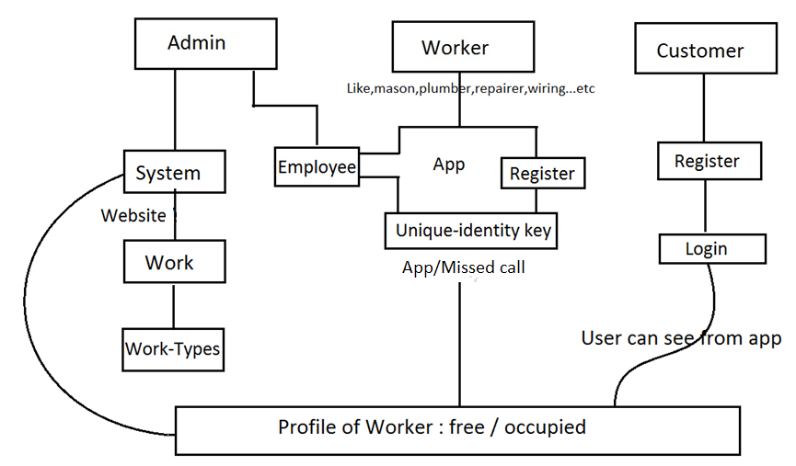
Structure of my project

Slide 6
Working
Today in this digital world, everyone has phone.
So when a worker is free, he will select free(from android app) or missed call to the system.
So, the system will identify that a worker is free and also record his number, call date and time. And add him in a list of free workers of specific work type.
Whenever customer needs a worker, by specifying area and work type, he will be able to see the list of free workers along with their contact no.
Thus, by using Daily Job Helper both(worker-client) can be connected easily.

Slide 7
Referred System
Indeed :- https://www.indeed.com/q-Daily-jobs.html
It a website related to jobs like daily, part-time, full-time or on contract bases.
For that we have to specify job title and city or zip code of area.
And it will show list of available jobs. And anyone can apply for that jobs.
On daily bases it provides jobs like bakers, printing, maintained, drilling etc.
Limitations :
This website only hire workers. It does not bridge the gap between daily worker and client.
Clients are not able to contact the worker whenever they require.

Slide 8
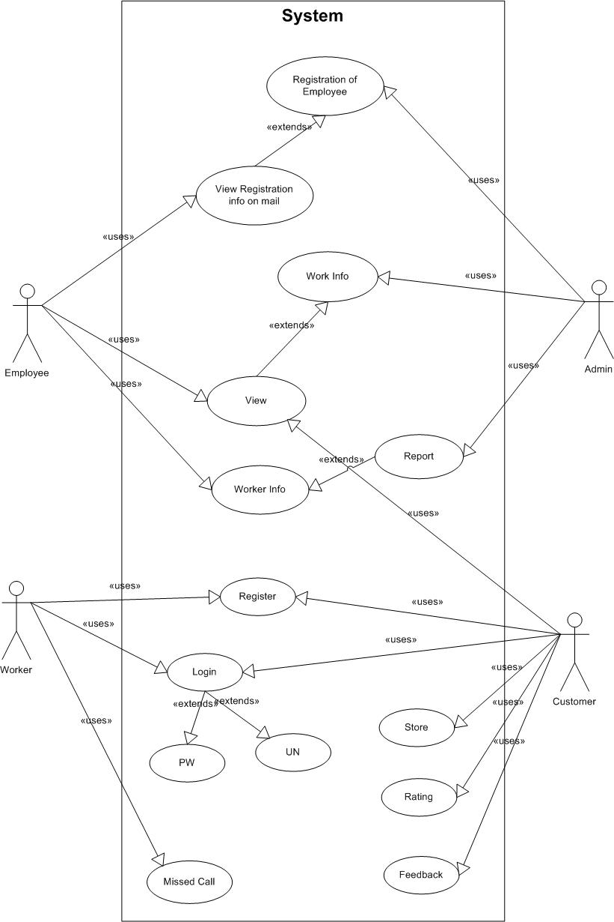
Diagram
Use case diagram for
Admin, Employee,
Customer, Worker.

Slide 9
Implementation
Tools : Netbeans , Android
I have started implementation of project by defining the database structure and collection of tables which are required for my system.
Then developed few jsp pages for website at admin side.

Slide 10
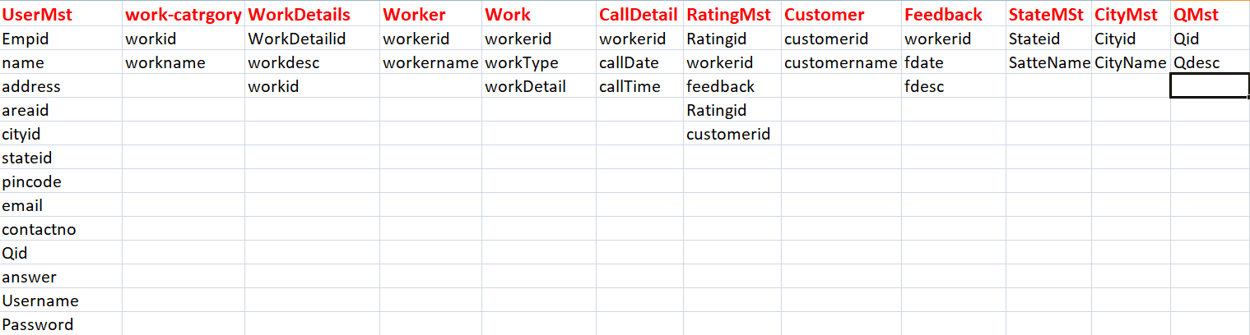
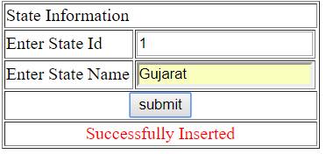
Implementation(Cont...)
Collection of Tables
State Table

Slide 11
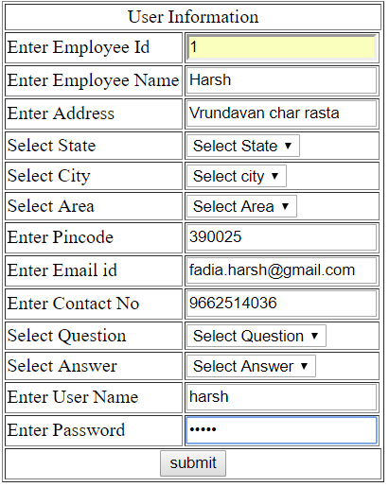
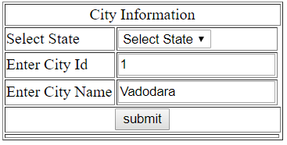
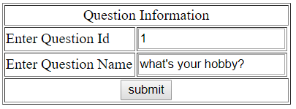
City Table
Question Table
UserMst Table

Slide 12


