Slide 1
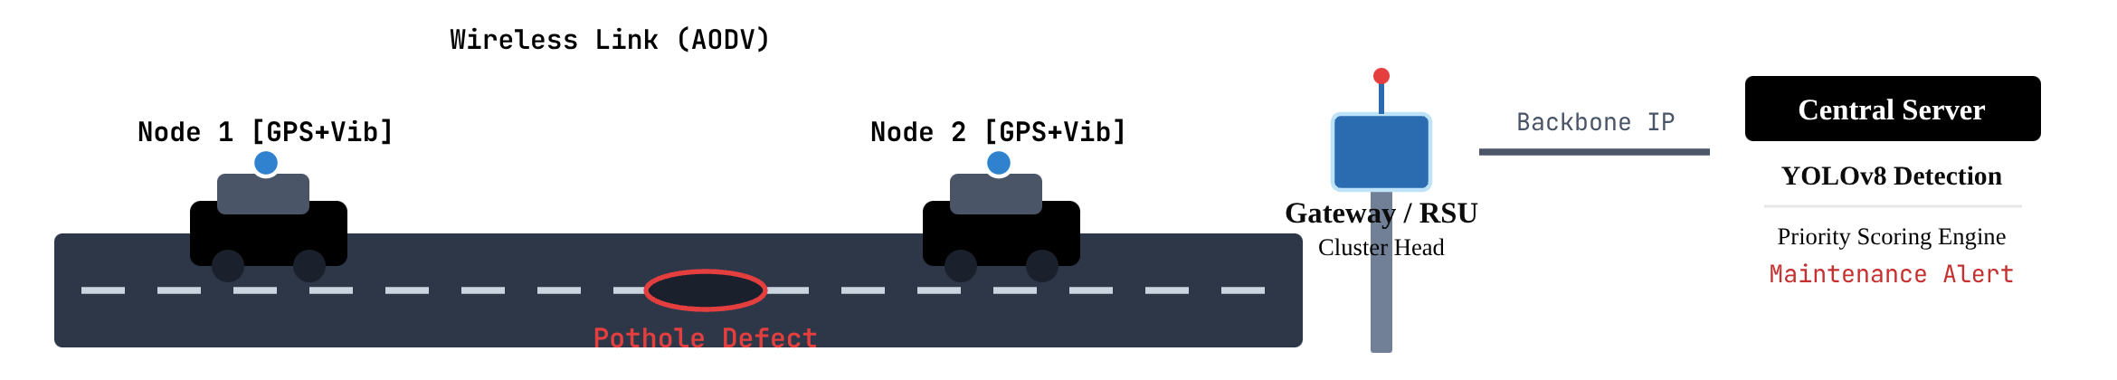
SUBJECT BASED PROJECT · WIRELESS SENSOR NETWORKS
WSN-Based Intelligent Road Pothole Detection
and Priority Monitoring System Using Machine Learning
Harsh Gupta (RA2311003010866) · Debabrata Bhattacharya (RA2311003010892)
A distributed vehicular sensing network coupled with edge aggregation and server-side machine learning for automated road safety management.

Slide 2
SYSTEM MOTIVATION & SCOPE
Problem Statement and Objectives
PROBLEM & PROPOSED SOLUTION
OBJECTIVES
Problem: Traditional manual road inspection is slow, subjective, highly localized and labour-intensive; it does not provide continuous monitoring, resulting in delayed maintenance, vehicular damage and potential safety hazards.
Proposed solution: A WSN-based monitoring architecture: vehicle sensor nodes report road events wirelessly to a central system; dashcam images reach the server separately over 4G/Wi-Fi, where machine learning detects potholes and prioritizes maintenance.
Enable distributed road-condition sensing.
Collect vibration and GPS information using vehicle-mounted sensors.
Transmit sensor information wirelessly to a gateway or sink.
Detect potholes in dashcam images using YOLOv8.
Assign maintenance priority based on pothole size, road characteristics, traffic and location.
END-TO-END WORKFLOW PIPELINE
1
2
3
4
5
6
7
Road Conditions
Vehicle Sensor Nodes
Wireless Sensor Network
Gateway/Base Station
YOLOv8 on Dashcam Images
Priority Ranking
Maintenance Monitoring
2

Slide 3
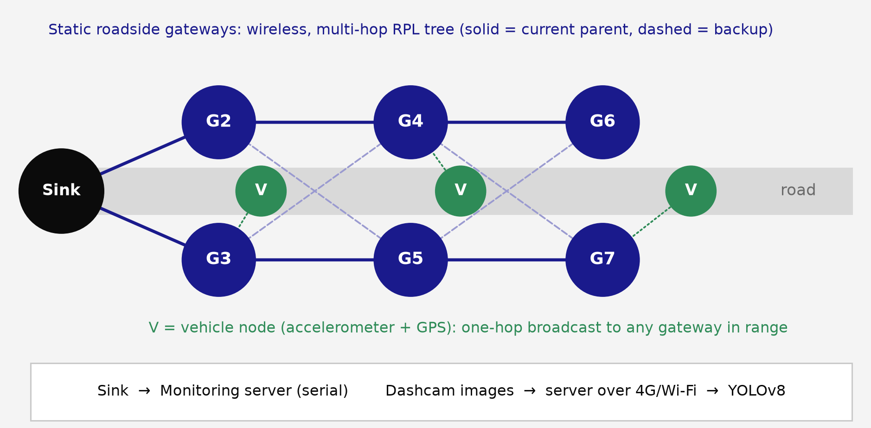
RUBRIC CRITERION 1 · NETWORK DESIGN
WSN Topology: Hierarchical Tree-Cluster Network Design
Hierarchical / tree-cluster topology: localized aggregation of data from mobile vehicle nodes before transmission to the central monitoring server.
NETWORK TOPOLOGY DIAGRAM
Vehicle Sensor Nodes: collect vibration and GPS information; mounted on vehicles travelling through different road sections for distributed coverage.
Gateway / Cluster Head: six static roadside units, in redundant pairs, aggregate reports and relay them wirelessly over multi-hop RPL.
Sink / Base Station: receives aggregated data and connects the WSN to the central system.
Monitoring Server: combines WSN events with dashcam images for YOLOv8 detection.
Justification: paired gateways give every node an alternate parent; vehicles stay one hop from the tree, so their movement never breaks a route.
3

Slide 4
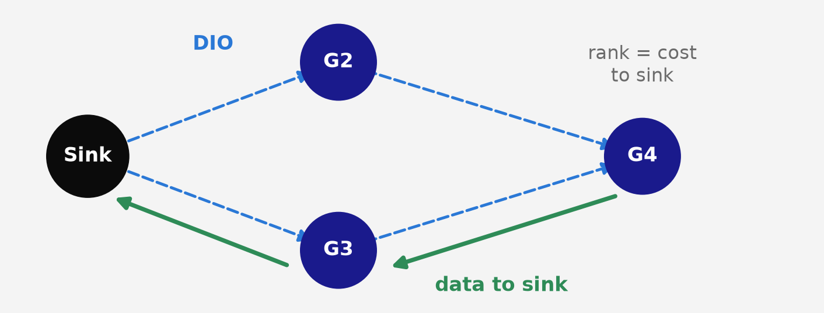
RUBRIC CRITERION 2 · ROUTING PROTOCOL SELECTION
Routing Strategy: RPL Suits a Static Roadside Tree
Selected protocol: RPL (IPv6 Routing Protocol for Low-Power and Lossy Networks), a proactive protocol that builds a tree rooted at the sink. Static gateways form the tree; moving vehicles stay out of it.
RPL PROTOCOL CYCLE
1
DODAG Formation: the sink broadcasts DIO messages advertising its rank.
Feature | RPL (Selected) | AODV (Alternative)
Routing Type | Proactive, DODAG-based | Reactive, on-demand
Route Establishment | Maintains routing structure | When required
Mobility Handling | Weak for mobile routers; vehicles kept out of the tree | Can rediscover broken routes
Energy Efficiency | Designed for constrained devices | Avoids periodic route maintenance when idle
Scalability | Supports large LLN topologies | Depends on network size and discovery overhead
Proposed Application | Static roadside gateway backbone | Not in Contiki 3.0’s IPv6 stack
2
Parent Selection: each gateway picks the neighbour with the lowest cost to the sink.
3
Data Forwarding: packets travel upward through preferred parents.
4
Local Repair: when a parent fails, the node switches to its next-best parent.
Justification: the gateway tree is static, RPL is native to Contiki, and it recovered in 5–7 s in Cooja. AODV was not simulated, so no measured superiority is claimed.
4

Slide 5
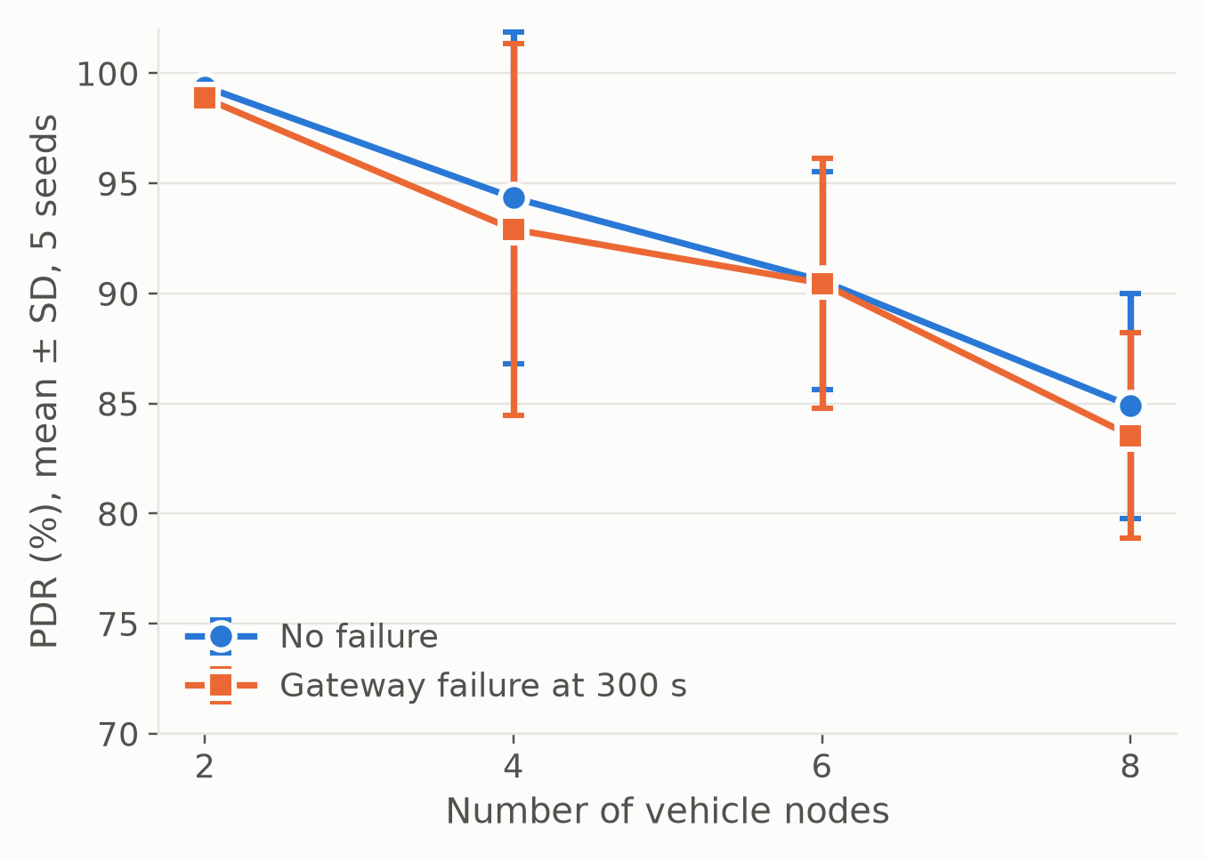
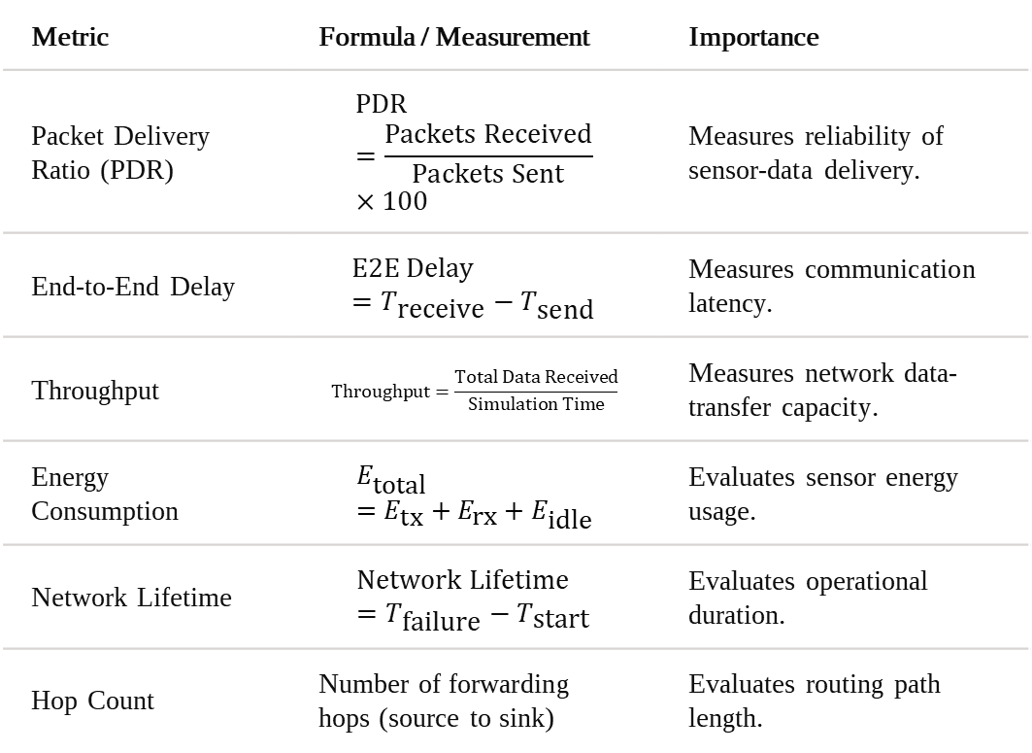
RUBRIC CRITERION 3 · SYSTEM EVALUATION FRAMEWORK
Performance Analysis: Measured in Cooja
FORMAL BENCHMARK SUITE
COOJA RESULTS: PDR VS VEHICLE NODES
Metric | Formula / Measurement | Importance
Packet Delivery Ratio (PDR) | $$\text{PDR}=\frac{\text{Packets Received}}{\text{Packets Sent}}×100$$ | Measures reliability of sensor-data delivery.
End-to-End Delay | $$\text{E2E Delay}=T_{\text{receive}}−T_{\text{send}}$$ | Measures communication latency.
Throughput | $$\text{Throughput}=\frac{\text{Total Data Received}}{\text{Simulation Time}}$$ | Measures network data-transfer capacity.
Energy Consumption | $$E_{\text{total}}=E_{\text{tx}}+E_{\text{rx}}+E_{\text{idle}}$$ | Evaluates sensor energy usage.
Network Lifetime | $$\text{Network Lifetime}=T_{\text{failure}}−T_{\text{start}}$$ | Evaluates operational duration.
Hop Count | Number of forwarding hops (source to sink) | Evaluates routing path length.
40 Cooja runs. PDR falls from 99.4% (2 vehicles) to 84.9% (8) as vehicle broadcasts compete; mean delay stays under 1.4 s.
5

Slide 6
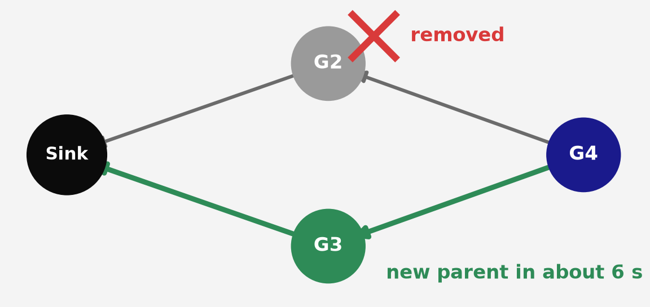
RUBRIC CRITERION 4 · RESILIENCE & FAULT TOLERANCE
Failure Analysis and Route Recovery
NETWORK FAULT MATRIX
RPL ROUTE RECOVERY TOPOLOGY
Failure | Effect | Solution
Sensor Node Failure | Sensor stops transmitting | Redundant sensing through multiple vehicles
Wireless Link Failure | Packet transmission interrupted | Link-layer retransmission and alternate parents
Route Breakage | Existing route becomes unavailable | RPL parent switching
Gateway Failure | Data aggregation is interrupted | Paired gateways, alternate parents (tested)
Gateway removed mid-run · Its children see link-layer transmissions fail.
Each child switches to its next-best parent · Data resumes through the twin gateway.
Suggested improvements (proposed): data buffering during temporary disconnections and further gateway redundancy.
Measured in Cooja: slowest child re-parents in 5–7 s (mean).
6

Slide 7
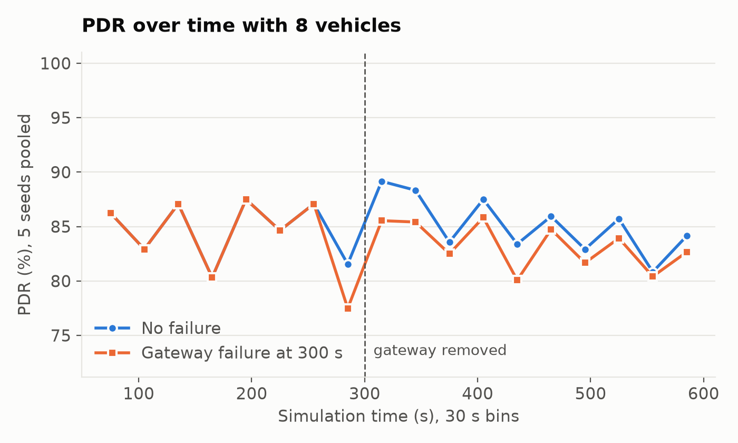
RUBRIC CRITERION 4 · MEASURED IMPACT OF NODE FAILURE
Performance With and Without Gateway Failure
8 VEHICLES, MEAN OF 5 RANDOM SEEDS
PDR OVER TIME
Metric | No failure | Gateway failure
PDR (%) | 84.9 | 83.5
End-to-end delay (s) | 0.77 | 0.78
Mean hop count | 2.24 | 2.26
Throughput (bit/s) | 162 | 159
Gateway power (mW) | 3.03 | 3.22
Vehicle power (mW) | 2.33 | 2.34
Route recovery (s) | – | 5.4
Across all vehicle counts, the failure cost at most 1.4 PDR points.
7

Slide 8
RUBRIC CRITERION 5 · SYSTEM INTEGRATION
Integrated WSN + Machine Learning Architecture
WSN MODULE
ML MODULE
Distributed sensing, wireless communication, resilient roadside routing, fault-tolerant data collection.
Pothole detection, size classification, maintenance priority estimation.
1
2
1
2
Vehicle Sensor Nodes
Wireless Sensor Network
YOLOv8 ML Processing
Geospatial Mapping
Collect vibration and GPS information.
Distributed wireless communication.
Detects potholes in dashcam images (4G/Wi-Fi). Test mAP@50: 0.93.
Associates potholes with coordinates and road information.
3
4
RPL Routing
Gateway / Sink
3
4
Static gateway tree with parent switching.
Receives and aggregates sensor information.
Priority Ranking
Maintenance Decision
Pothole size, traffic, confidence, location/road characteristics.
Prioritized information for road-maintenance authorities.
WSNs provide the sensing and communication infrastructure; machine learning provides intelligent detection and prioritization.
8

Slide 9
Conclusion and Rubric Summary
Distributed Monitoring: vehicle-mounted nodes cover multiple road sections.
Resilient Routing: RPL rerouted around a failed gateway in 5–7 s.
Intelligent Detection: YOLOv8 reached mAP@50 of 0.93 on held-out images.
Priority-Based Maintenance: road conditions are ranked to support decisions.
Fault Tolerance: paired gateways limited PDR loss to 1.4 points or less.
Final takeaway: The project demonstrates how Wireless Sensor Networks and Machine Learning work together to enable distributed road monitoring, intelligent pothole detection and prioritized maintenance planning.
Evaluation Criterion | Project Implementation
1. WSN Topology / Network Design | Hierarchical tree-cluster architecture with vehicle nodes, roadside gateways and sink.
2. Routing Strategy Selection | RPL routing, compared against AODV.
3. Performance Analysis | PDR, delay, throughput, energy, network lifetime and hop count, measured in Cooja.
4. Problem Solving / Failure Analysis | RPL parent switching and redundant gateways, tested in Cooja.
5. Presentation & Technical Communication | Technical diagrams, accurate terminology and integrated architecture.
Thank You
9

