Slide 1

E-Commerce Website for Pharmacy
Harsh Gajera-22104099
Sekhar Gauda-22104044
Aditya Gupta-22104155
Paresh Gupta-22104089
Project Guide
Ms. Geetanjali Kalme

Slide 2
Contents
Introduction
Objectives
Scope
Literature Survey
Proposed System
Project Outcomes
Block Diagram
Use Case/DFD
Technology Stack
Result And Discussion
Conclusion and Future Scope
References

Slide 3
1. Introduction
Problem statement :
Addresses limited healthcare access by offering an online platform for easy, home-based purchase of medical products, enhancing accessibility and convenience.
Solution:
To meet this challenge, we've introduced the 'Request a Medicine' feature. Users can request unavailable medicines, and our admin team assesses requests, enhancing our product range with a user-driven approach.

Slide 4
2. Objectives
To simplify the process for amateur person.
To build trust between user and supplier by providing product details and ratings while viewing a product.
To let users easily request unavailable medicines, enhancing convenience.
To ensure efficient request verification and add requested medicines, expanding our product catalog based on user needs.

Slide 5
3. Scope
It can be used in various E-commerce domain.
It can be also used by a local medical to supply medicine distributor to expand their business.
User can create profiles to manage their personal information, prescription history and preferences
The scope can extend to serving customers in specific regions like villages

Slide 6
4. Literature Survey
Sr no. | Title of Research Paper | Author | Publication Year | Summary
1. | The rise of E-pharmacy in India | Alison C. Dcruz, Vinay N. Mokashi, Sreedhar Ranganath Pai and Dharmagadda Sreedhar | 2022 | This research paper explores the growth of the E-pharmacy sector in India over the past 3–5 years, examining the distinctions between online and offline pharmacies
2. | Consumer Preference and Buying pattern of Medicines through E-Pharmacy during the COVID-19 pandemic | Dipankar Dutta, Bedanta Bhattacharjee | 2021 | This research paper introduces a study on consumer behavior and buying patterns related to e-pharmacies website in the context of the COVID-19 pandemic in India.
3 | E-Pharmacy: A Study of the Growth of Digital App-Based Pharmacy Delivery Services | Harshali Bhalerao , Dr. Dhananjay Mandalik | 2022 | This study explores the growth and impact of digital app-based pharmacy delivery services, commonly known as e-pharmacies.

Slide 7
5. Proposed System
Product Description: Detailed information about a product, including specifications, features, and benefits, helping customers make informed purchasing decisions.
Product Request Form: The feature in an e-pharmacy website where users can request a product that is currently unavailable is typically called a "Product Request Form."
Shopping cart and checkout: Enable users to add items to their cart and implement a secure checkout process with multiple payment options
User reviews and ratings: Creates a comprehensive FAQ section to address common queries

Slide 8
6. Outcome of Project
User can log in, create a profile & store their delivery address together.
User can search for product availability.
User can view product details while buying it.
User can request for the product which is not available.

Slide 9
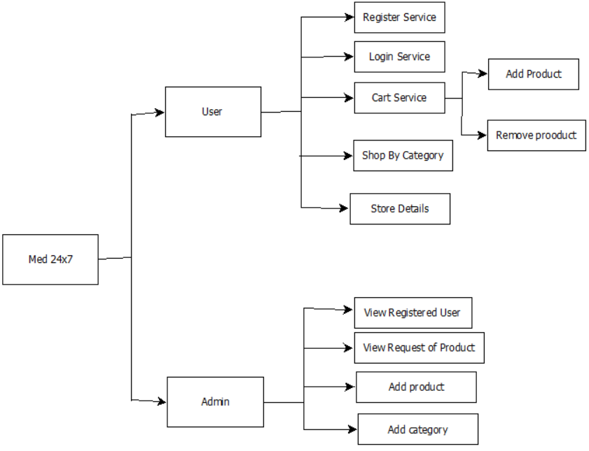
7. Block Diagram

Slide 10
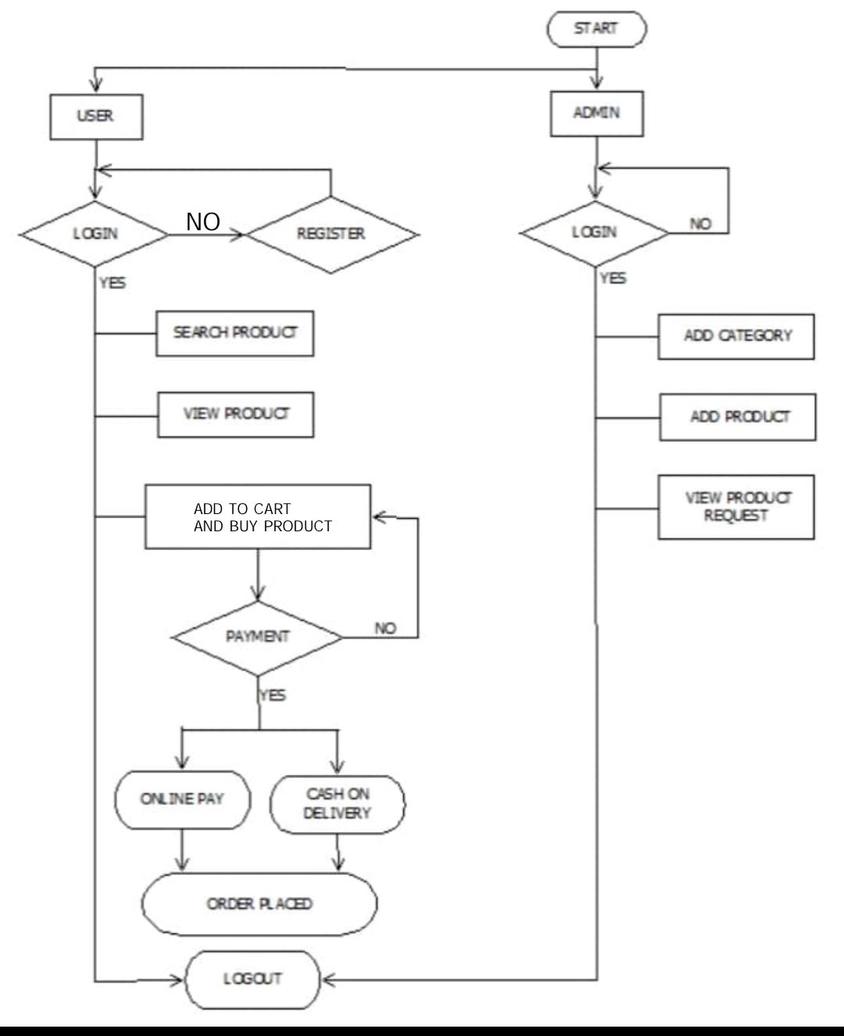
8. Use Case/Data Flow Diagram

Slide 11
9.TECHNOLOGY STACK
Frontend: HTML, CSS, and JavaScript are the core technologies responsible for creating the user interface and interactivity of a web application.
Backend: Java, Servlets, JSP, and JDBC collectively handle server-side logic, dynamic content generation, and database connectivity.
Database: MySQL serves as the relational database management system (RDBMS) for storing and managing data.
Server: Apache Tomcat 10.1 functions as the web server and servlet container responsible for hosting and serving the Java-based web application.

Slide 12
10.Result and Discussion
The E-Pharmacy Website project has successfully implemented a range of key features, as outlined
1. Product Request Form
The system includes a "Product Request Form" feature that allows users to request pharmaceutical products that are currently unavailable in the inventory.
2. Shopping Cart and Secure Checkout
The website enables users to add products to their shopping cart and proceed with a secure checkout process that offers multiple payment options.
3. User Reviews and Ratings
The system incorporates user reviews and ratings, effectively creating a comprehensive FAQ section to address common queries.
4. Regional Expansion
The scope of the project extends to serving customers in specific regions, including villages, making essential healthcare products more accessible to underserved populations.

Slide 13
11.Conclusion and Future Scope
To provide easy and simple accessibility of medical supplies to customers in rural areas .
Future Scope:
AI-Powered Recommendations
Expanded Geographic Coverage
Inventory Management System
Health Monitoring Features
Pharmacist Consultation
Blockchain for Drug Authentication

Slide 14
13.References
"E-Pharmacy 2020" by Kenneth C. Laudon and Carol Guercio Traver
World Health Organization (WHO)
"Telemedicine and E-Health" - A peer-reviewed journal
"Don't Make Me TOnline communities like Stack Overflow, GitHub, and Reddithink" by Steve Krug

Slide 15
THANK YOU...!!

