Slide 1
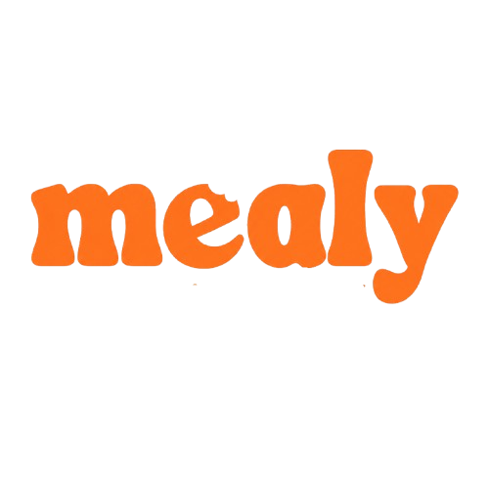
READY PRODUCT
CAMPUS FOOD OPERATIONS PLATFORM
01
Order anywhere
Every campus canteen, connected.
02
Operate through outages
Student ordering, counter POS, kitchen execution, offline continuity and demand forecasting in one deployable system.
03
Predict tomorrow’s demand
04
Manage every outlet
Business + Technology Overview

Slide 2
Campus canteens lose time and food every day
MEALY
The rush is predictable, but most operations still run on disconnected tools
LUNCH RUSH
SHARED ORDER STATE
PRODUCTION GUESSWORK
15 min
Zero
Daily
Students crowd the counter between lectures. Manual ordering makes the same queue repeat every day.
Student orders, counter bills and kitchen tickets often live in separate systems or paper slips.
Popular dishes sell out while other food becomes leftover stock at closing.
Mealy creates one operational record from order placement to collection, even when the internet fails.
02

Slide 3
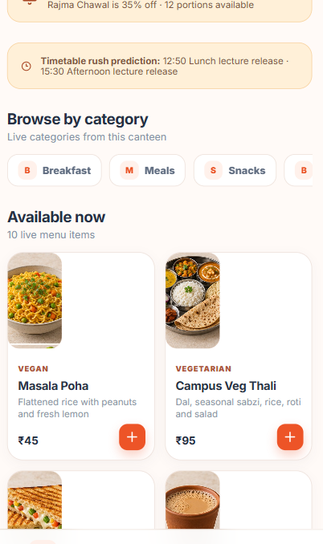
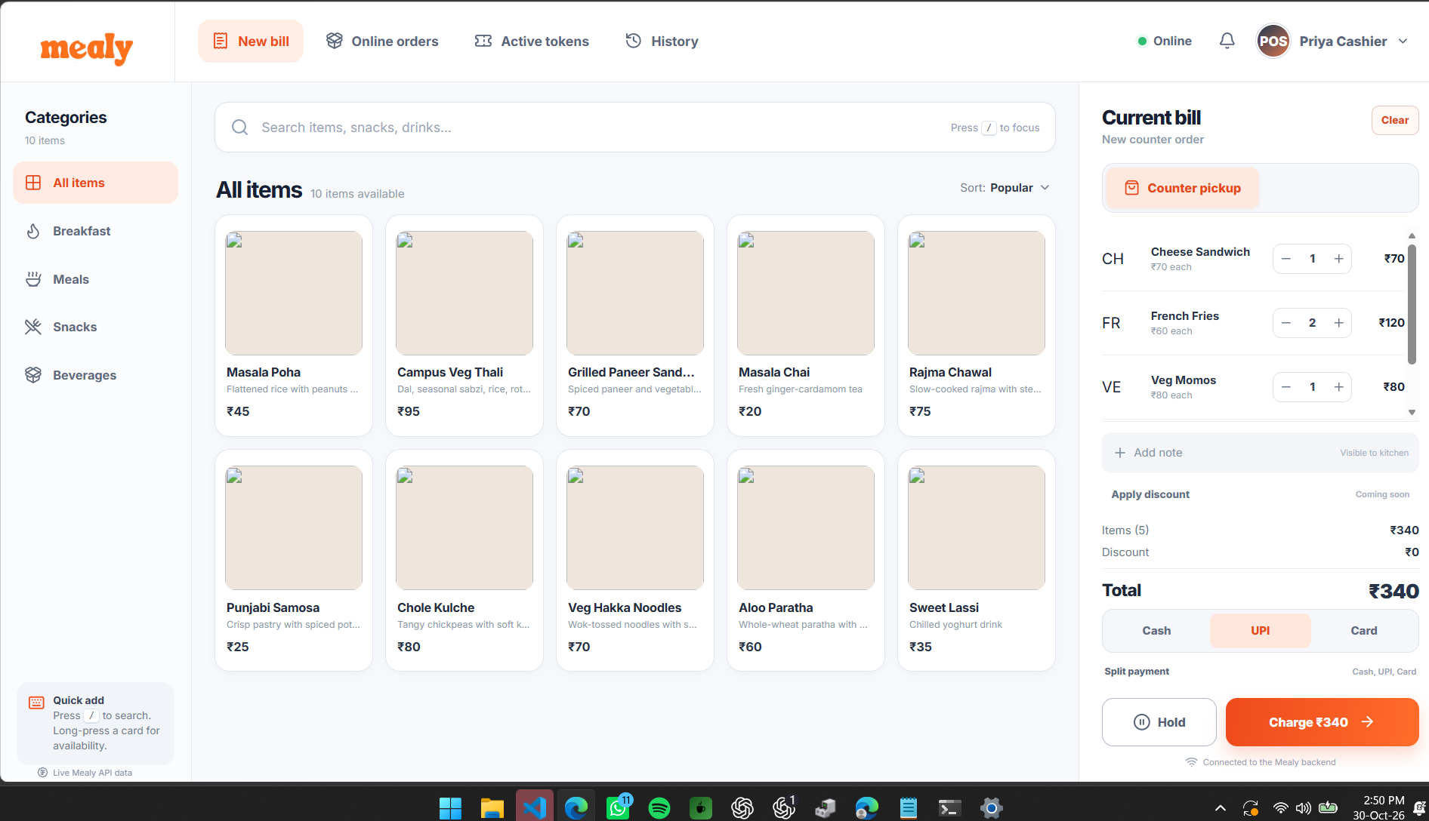
One product across the complete canteen operation
MEALY
Four dedicated screens share one order, token and kitchen state
KDS / KOT
Kitchen receives every approved order and controls preparation.
MANAGER
Rush board, leftovers, surplus offers and tomorrow’s forecast.
COUNTER POS
Walk-ins, online orders, billing and collection
STUDENT
Pre-order, pickup slot, live token
03

Slide 4
A single order state from phone to pickup
MEALY
Every screen reads the same order, while ownership stays clear
1
2
3
4
5
Student or cashier
POS and gateway
Kitchen
Student
Counter
Creates the order and chooses a pickup slot
Allocates the token and persists the transaction
Moves the ticket through preparation and ready
Receives the ready alert and shows the token
Marks collection and closes the operational loop
Placed
Confirmed
Preparing
Ready
Collected
04

Slide 5
Each canteen operates independently on one platform
MEALY
Cloud control connects campuses while each outlet keeps its own local operating unit
Mealy cloud
Catalogs, student orders, reporting, forecasting, permissions and secure event delivery
CAMPUS A
CAMPUS A
CAMPUS B
Main Canteen
Hostel Canteen
Food Court
Local gateway
Local gateway
Local gateway
POS • KDS • printer
POS • KDS • printer
POS • KDS • printer
Tenant-scoped data and permissions prevent one canteen from seeing or changing another canteen’s operation.
05

Slide 6
Offline continuity
MEALY
The canteen keeps serving even when the campus internet drops
1
Internet available
Cloud sends accepted orders to the outlet gateway through an authenticated persistent connection.
2
Connection lost
POS, KDS and kitchen printing continue across the outlet’s local network. Cash counter orders remain available.
3
Local persistence
The gateway stores orders and actions durably before showing or printing them.
4
Connection restored
Queued events upload idempotently. Sequence cursors replay anything the outlet missed.
The cashier never needs to choose between serving students and preserving data.
06

Slide 7
Wait time responds to live outlet load
MEALY
The current estimate stays transparent enough for staff and students to trust
CURRENT LOGIC
Estimated wait
=
Outlet prep time
+
2 min per 6 active orders
configured per location
placed, confirmed or preparing
ACTIVE ORDERS
STUDENT ESTIMATE
0
10 min
WHAT CHANGES LIVE
1–6
12 min
New order raises active load
7–12
14 min
Kitchen readiness removes load
13–18
16 min
Pickup slots expose remaining capacity
19–24
18 min
Next: learn dish and station preparation times from completed tickets.
07

Slide 8
Tomorrow’s cooking plan learns from 28 days
MEALY
A lightweight ridge regression runs inside the backend with no separate ML server
HISTORY
SIGNALS
MODEL
OUTPUT
Orders prepared
Leftover kg
Portion weight
›
Weekday pattern
Four-week trend
Lecture rush
›
Ridge regression
Regularized for
small datasets
›
Dish quantity
Confidence
Food saved estimate
LEARNING TARGET
BUSINESS CONTRIBUTION
Consumed portions = prepared quantity − leftover portions
Managers receive a recommended quantity for every dish before the next service day.
The model does not mistake overproduction for genuine demand.
Recent leftovers lower the recommendation while weekday rush patterns raise it.
08

Slide 9
Recurring software revenue from each operating outlet
MEALY
The commercial model aligns with the canteen’s daily use of the platform
SETUP AND ONBOARDING
₹5k–₹15k
Menu import, device configuration, staff access and training
PLATFORM SUBSCRIPTION
₹2k–₹6k / month
Student ordering, POS, KDS, manager tools and reporting
OPTIONAL SERVICES
Usage based
Payment integration, hardware support and multi-campus operations
Revenue grows by outlet count. Student data remains operational data, not an advertising product.
09

Slide 10
READY FOR CANTEEN ONBOARDING
A deployable operating system for campus food.
CLOUD
OUTLET
Student app, management and forecasting
POS, KDS, gateway and printer routing
OPERATIONS
BUSINESS
Tokens, pickup slots, live status and recovery
Per-outlet recurring revenue with setup services
Mealy connects every participant without making internet reliability the canteen’s problem.
MEALY

