Slide 1

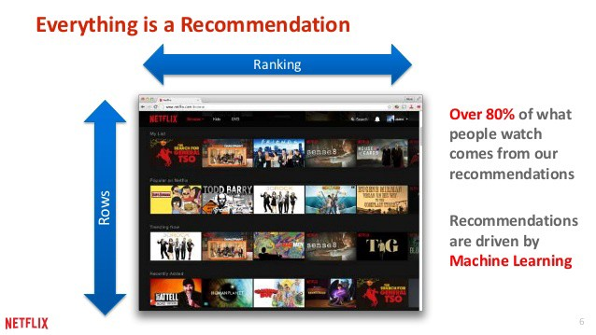
BIRLA VISHVAKARMA MAHAVIDYALAYA (ENGINEERING COLLEGE)
Department of Information Technology • An Autonomous Institution • Vallabh Vidyanagar
FINAL PROJECT PRESENTATION
Movie Recommender System
on MovieLens Dataset
Knowledge-Based, Collaborative Filtering (KNN), SVD Matrix Factorization & Softmax DNN
PRESENTED BY
Harsh Gondaliya
ID No: 23IT405
B.Tech Information Technology
PROJECT MENTOR
Prof. Dhruvin R. Kotak
Assistant Professor
Information Technology Department

Slide 2
SLIDE 2 • MOVIELENS RECOMMENDER SYSTEM • BVM ENGINEERING COLLEGE
Introduction to Recommender Systems
The algorithmic backbone of personalized digital media and content discovery
DEFINITION & ESSENCE
What is a Recommender System?
• Information filtering algorithms that predict user ratings, preferences, and affinities for unrated items.
• Transforms massive catalogs into personalized candidate sets tailored to individual taste profiles.
• Powers modern digital consumption: drives >80% of hours watched on Netflix and >70% of views on YouTube.
MOTIVATION & RELEVANCE
Why Recommenders Matter
• Solves 'Choice Paralysis': Users face thousands of options and quickly abandon platforms without personalization.
• Surfaces the Long-Tail: Uncovers hidden gems beyond mainstream blockbusters for diverse user tastes.
• Drives Business Value: Maximizes user retention, platform engagement, session duration, and satisfaction.
MULTI-PARADIGM APPROACH
Core Methodologies Implemented
• Knowledge-Based: Cold-start filtering via genre, watch count, and weighted ratings.
• Collaborative KNN: User-based & item-based similarity using Cosine distance.
• Matrix Factorization (SVD): 50 latent taste dimensions resolving extreme matrix sparsity.
• Softmax Deep Neural Network: Learned embedding layers with multi-class probabilities.
PROJECT DELIVERABLES
Project Scope & Objectives
• Benchmark Evaluation: Trained and evaluated on MovieLens 100K (100,000 ratings, 943 users, 1,682 movies).
• Comparative Insights: Evaluates cold-start handling, neighbor proximity, latent representations, and neural scoring.
• Full-Stack Interactive Dashboard: Real-time web application (Flask + JS/CSS) and CLI for live testing.

Slide 3
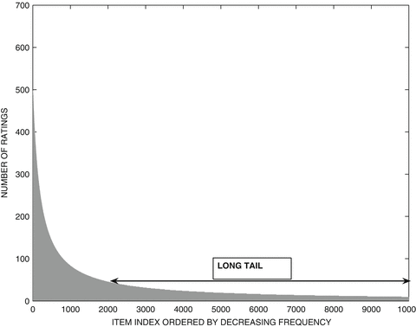
SLIDE 3 • MOVIELENS RECOMMENDER SYSTEM • BVM ENGINEERING COLLEGE
Problem Statement & The Long-Tail Challenge
Why simple recommendation methods fail in real-world platforms
• Information Overload: Thousands of movies exist, making it difficult for users to find titles matching their specific taste.
• The Cold-Start Problem: New users have zero watch history, preventing traditional collaborative models from making recommendations.
• Data Sparsity: Over 93% of the movie-user interaction matrix is empty because users only rate a tiny fraction of catalog movies.
• Popularity Bias (The Long Tail): Naive systems only push blockbusters. High-margin and niche movies in the 'long tail' remain unrecommended without matrix factorization.

Slide 4
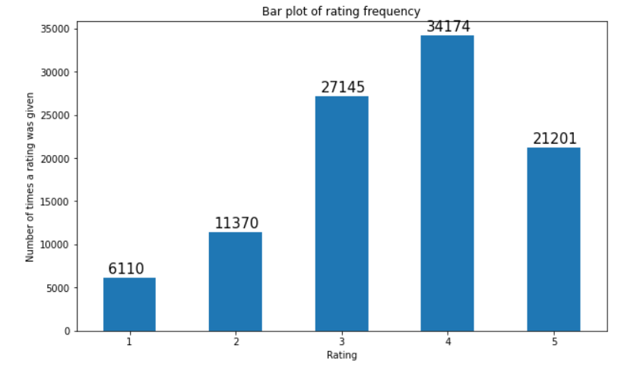
SLIDE 4 • MOVIELENS RECOMMENDER SYSTEM • BVM ENGINEERING COLLEGE
MovieLens 100K Dataset & Data Insights
Benchmark rating dataset collected by the GroupLens Research Project
• Dataset Scale: 100,000 ratings from 943 users across 1,682 movies.
• Rich Metadata: Includes 19 genre indicators, release dates, titles, and user demographics (age, gender, occupation).
• Active Participation: Each user in the dataset has rated at least 20 movies.
• Rating Distribution: Users predominantly reward movies with 4-star ratings, followed by 3-star and 5-star ratings. Rarely do users rate below 2 stars.

Slide 5
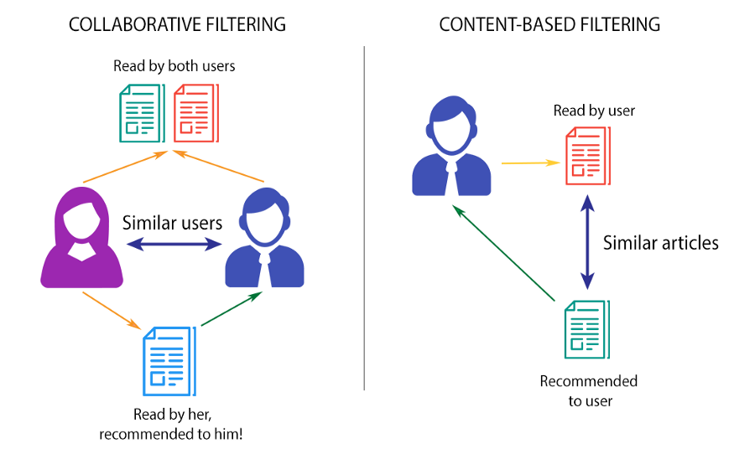
SLIDE 5 • MOVIELENS RECOMMENDER SYSTEM • BVM ENGINEERING COLLEGE
Recommendation Approaches: Content vs Collaborative
Comparing how different algorithms make predictions
• Content-Based Filtering: Recommends items based on discrete characteristics (e.g. genre, actors, director). Suggests movies similar to what the user liked in the past.
• Collaborative Filtering: Assumes users who agreed in the past will agree in the future. Uses user-item interaction profiles without needing item metadata.
• Item-to-Item Similarity: Finds companion movies that have similar rating patterns across all viewers.
• User-to-User Neighborhood: Finds like-minded peers and surfaces movies highly rated by those peers.

Slide 6
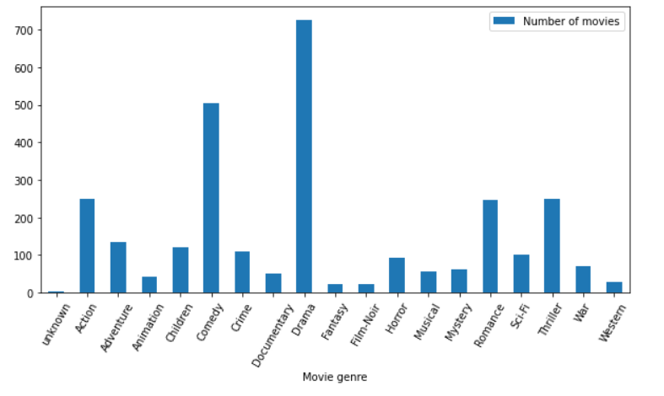
SLIDE 6 • MOVIELENS RECOMMENDER SYSTEM • BVM ENGINEERING COLLEGE
Model 1 & 2: Knowledge-Based & K-Nearest Neighbors
Instant cold-start resolution and memory-based collaborative filtering
• Knowledge-Based Recommender: Filters by genre, popularity (watch count > 300), and top average rating (> 4.0). Completely eliminates the Cold-Start hurdle for new visitors.
• KNN Item-Based Filtering: Constructs a sparse [movies x users] matrix and computes Cosine Distances to find nearest movie neighbors in seconds.
• KNN User-Based Filtering: Finds K closest users to target user ID, excludes already watched movies, and assigns distance-weighted scores to candidate films.
• Dynamic Suggestor: Typo-tolerant string search suggests correct movie titles when users misspell query names.

Slide 7
SLIDE 7 • MOVIELENS RECOMMENDER SYSTEM • BVM ENGINEERING COLLEGE
Model 3 & 4: SVD Matrix Factorization & Deep Learning
Uncovering latent factors and capturing complex non-linear interactions
Singular Value Decomposition (SVD)
• Decomposes Utility Matrix A into U Σ V^T.
• Reduces dimensions to 50 latent factors representing hidden movie and user tastes.
• Approximates missing entries to predict unobserved ratings across the entire catalog.
• Overcomes data sparsity and handles the long-tail problem effectively.
Softmax Deep Neural Network (DNN)
• Extracts latent features of users & movies using learned Embedding Layers.
• Passes representations through Dense layers with Dropout to prevent overfitting.
• Softmax output layer predicts rating probabilities (1 to 5 stars) for unseen items.
• Captures non-linear user-movie relationships that linear matrix factorization misses.

Slide 8
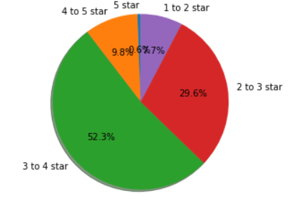
SLIDE 8 • MOVIELENS RECOMMENDER SYSTEM • BVM ENGINEERING COLLEGE
Interactive Web Application & Key Takeaways
Real-time evaluation dashboard and summary of achievements
• Unified Web Dashboard: Built an interactive modern UI (http://127.0.0.1:5050) allowing users to test all 4 models in real-time.
• Multi-Paradigm Solution: Knowledge-based handles cold-start, KNN handles immediate similarity, SVD solves sparsity, and DNN models complex interactions.
• Dynamic Movie Suggestor: Real-time fuzzy search prevents typos and delivers smooth user experience.
• Conclusion: Combining statistical heuristics, neighborhood collaborative filtering, and latent space factorization delivers an optimal, highly scalable movie recommendation engine.

Slide 9
Thank You!
Movie Recommender System on MovieLens Dataset
Birla Vishvakarma Mahavidyalaya (Engineering College) • An Autonomous Institution
PRESENTED BY
Harsh Gondaliya
ID No: 23IT405
Department of Information Technology
BVM Engineering College
UNDER THE MENTORSHIP OF
Prof. Dhruvin R. Kotak
Assistant Professor
Department of Information Technology
BVM Engineering College

