Slide 1
CRAFT N CODE 2.0
BAHI
Member-Witnessed Verification Layer for the SHG Digital Ledger
Title
The person who records the money is no longer the only proof.
Track
PS-17 SHG Digital Ledger - Tamper-Evident Financial Logs
Team Name (as registered)
Team 511 (confirm against portal at login)

Slide 2
CRAFT N CODE 2.0
BAHI | R1
Problem Statement
1 crore+ SHGs still run on handwritten registers.
Bookkeeping errors, disputes over who owes what, and embezzlement by office-bearers often go undetected until the savings are gone.
Scale: 10.03 crore women members (DAY-NRLM), 144.22 lakh savings-linked SHG bank accounts (NABARD).
LokOS already digitizes the books (94.16 lakh SHGs). But it is server-authoritative: a member cannot verify a single entry about her own money, offline, ever.
The gap is not digitization. It is verification.
02

Slide 3
CRAFT N CODE 2.0
BAHI | R1
Technical Approach
Stack and method, chosen for the 7h window
Tech Stack
Methodology
Python 3.11+ stdlib only, zero dependencies
SHA-256 hash chain (append-only)
HMAC-SHA256 witness MACs, demo-mode label
SQLite transactional state
Static HTML/CSS/JS UI, loopback server
QR receipts, printable, byte-short
Fully offline, zero APIs at runtime
4-icon entry (contribution, loan, repayment, correction) + voice repeat
Green-tick confirm before any event enters the chain
Append-only: no UPDATE, no DELETE. Corrections = reversal + replacement
2 witness keys sign the meeting-close root
Member receipt: root + witnesses, QR or text
Verification recomputes every hash, offline: MATCH or FORK AT EVENT n
Deterministic: same files, same bytes, same verdict
03

Slide 4
CRAFT N CODE 2.0
BAHI | R1
Implementation and Flow
Member taps icon
Voice repeat, green tick
Event appended
Meeting close, 2 witnesses sign
Receipt QR to member
Secretary exports chain files
Auditor recomputes roots
MATCH
FORK AT n
receipt verifies
tamper detected
Implementation: chain.py, witness.py, receipt.py, loader.py; attack test matrix (edit, delete, reorder, double-spend)
Failure drill: no-network, corrupt fixture, port conflict, repeat reset. Reproducibility is auditability.
04

Slide 5
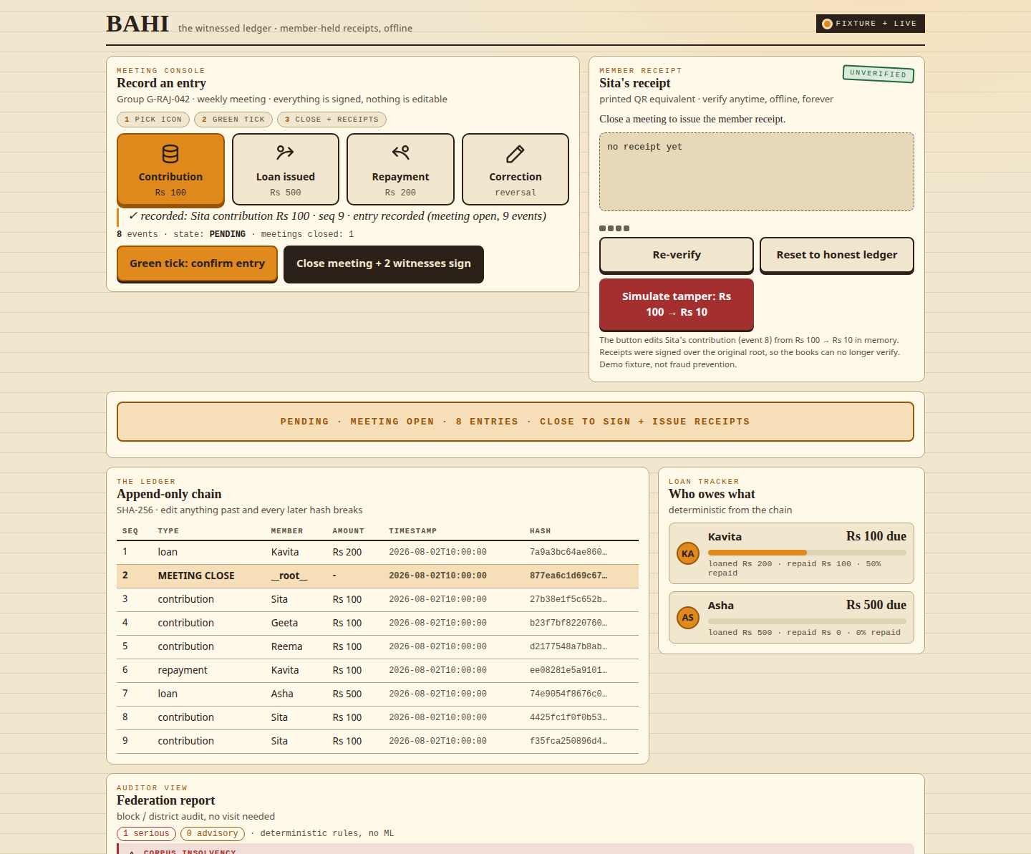
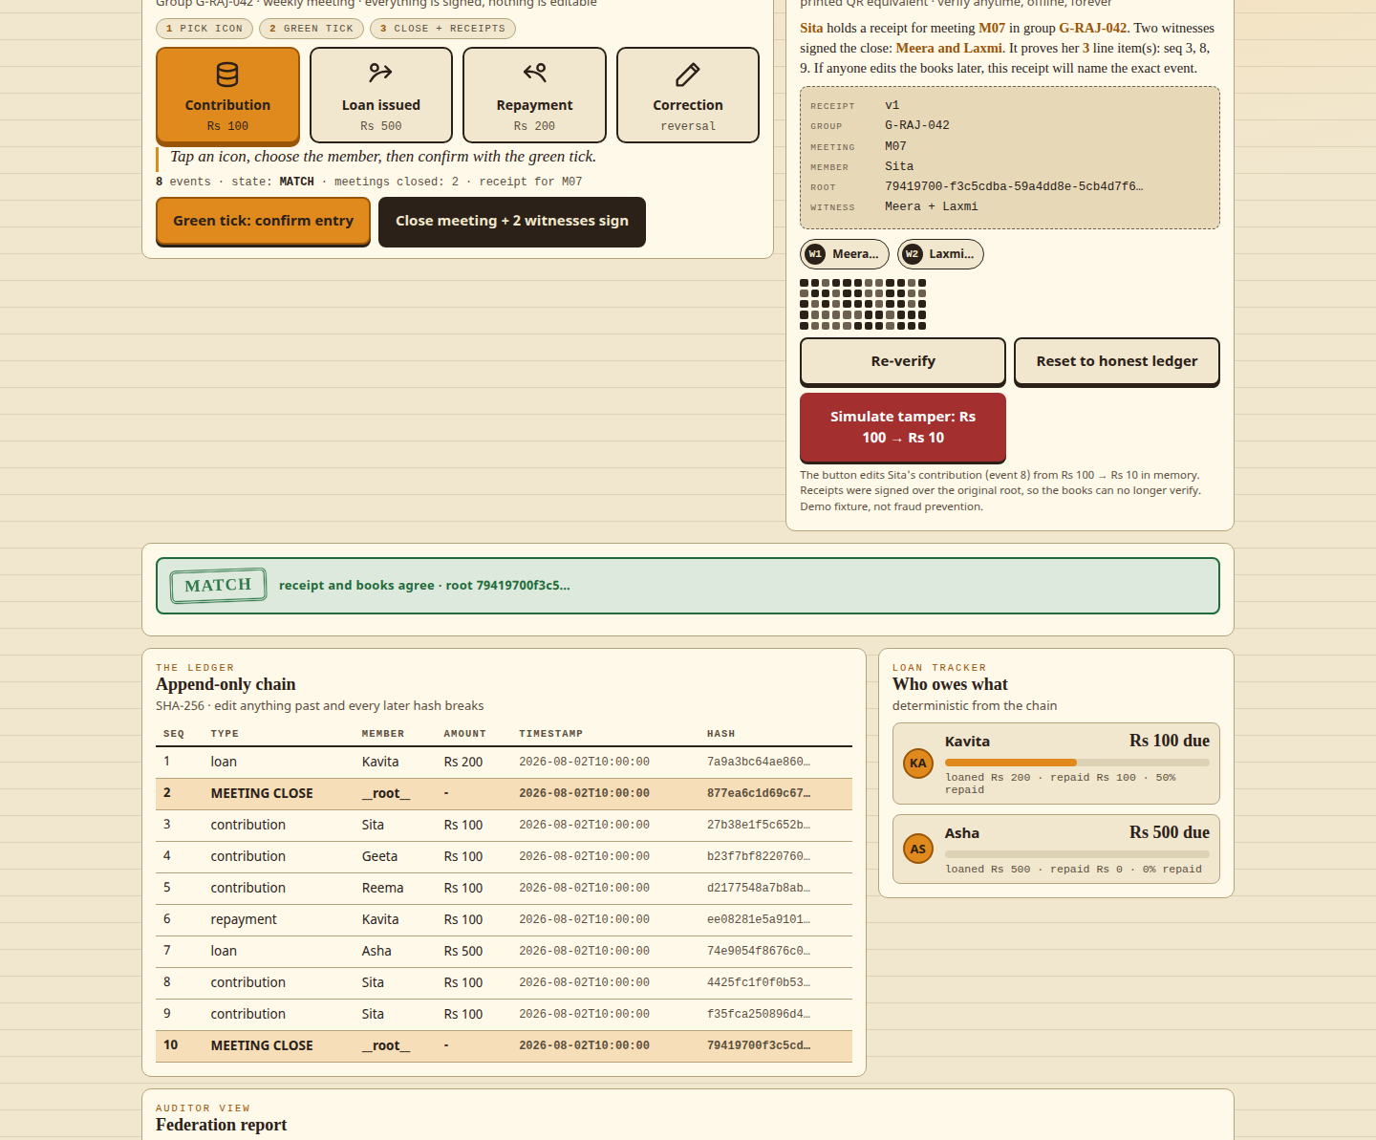
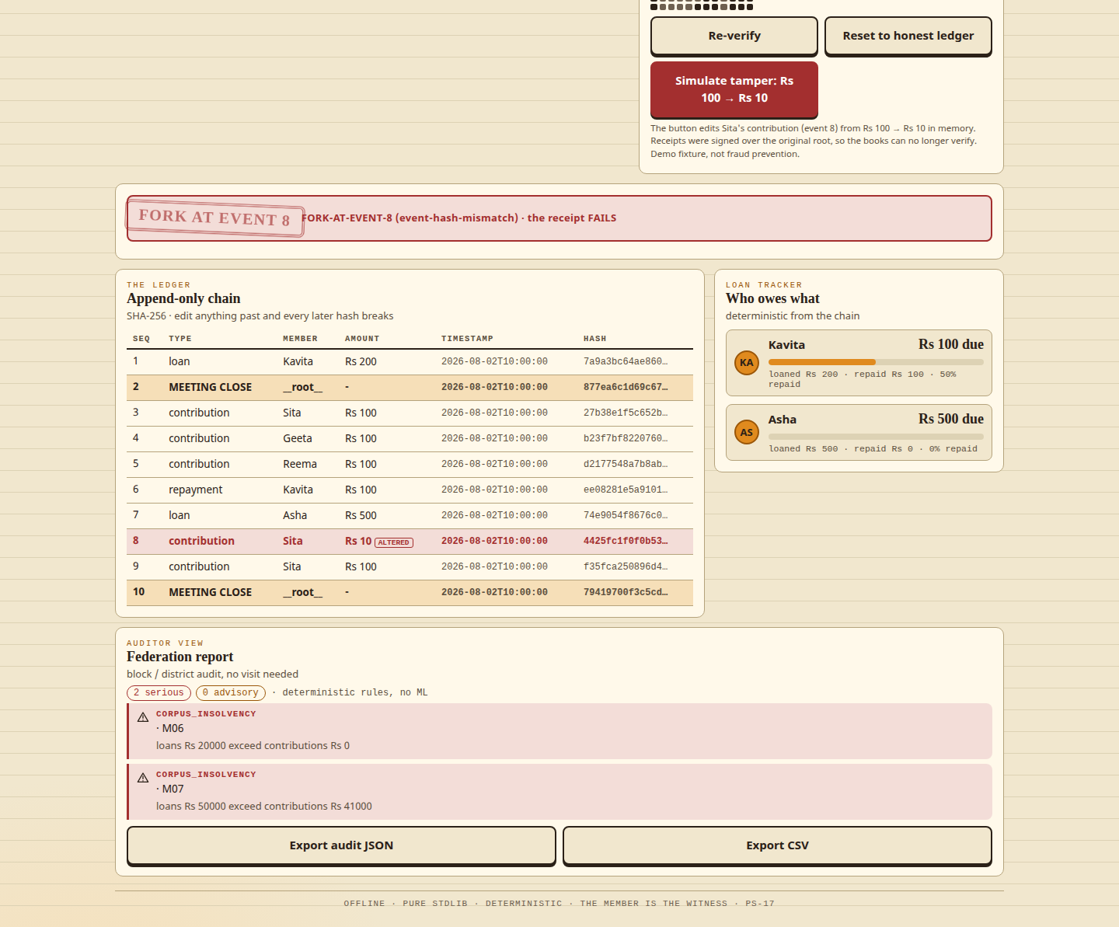

CRAFT N CODE 2.0
BAHI | R1
Prototype
Real demo, captured from the running app before freeze
4-icon entry + voice confirm
Member receipt (QR + root)
Fork alert: FORK AT MEETING M07
Auditor view + export
Every screenshot is the real running app: entry, receipt, fork alert, auditor. Nothing is photoshopped.
05

Slide 6
CRAFT N CODE 2.0
BAHI | R1
Challenges and Risks
What we do NOT claim
Build risks and mitigations
No security audit claim
No embezzlement detection claim
No PKI-grade signatures (witness MAC, labeled)
No Aadhaar / OTP / KYC
No server persistence, no live LokOS sync
No ML. Honesty is the product
Not fraud prevention: detection with a member-held artifact
QR on feature phones: byte-short payload, text fallback
Voice confirm on low-end audio: constrained repeat, icon fallback
Frozen data drift: all sources saved with SHA-256 in manifest
7h window: stdlib only, deterministic fixtures, one-command reset
Attack button in demo proves the detection claim live
06

Slide 7
CRAFT N CODE 2.0
BAHI | R1
Impact and Benefits
Member
Federation and system
Owns verifiable evidence of her own money
Receipt catches alteration instantly, offline
No trust in bookkeeper, vendor, cloud, or chain
Works on basic phones: print QR or copied text
Block/district audit remotely, no visit
Standardized audit report, exportable
Verification layer over LokOS: replaces nothing, audits everything
Tamil Nadu special audit: Rs 107.94 crore deficiencies (186 BLFs)
Scale: 10.03 crore members | 144.22 lakh savings-linked accounts | 94.16 lakh SHGs on LokOS (sources on slide 8)
07

Slide 8
CRAFT N CODE 2.0
BAHI | R1
Research and References
[1] PIB PRID 2280986 (2026-07-04): LokOS 94.16 lakh SHGs, 10.03 crore members
[2] NABARD SHG-Bank linkage stats: 144.22 lakh savings-linked accounts
[3] sa-dhan Bharat Microfinance Report FY 2024-25: group counts and flows
[4] v5 startup-diligence report, war1v5-ps-17: LokOS, DreamSave, Chomoka, Ensibuuko, Mifos, autopsies, M&A
[5] FAILED-STARTUP AUTOPSIES and COMPLAINT MINING verbatim rows in repo docs/RESEARCH.md
Method: every number labeled VERIFIED or ESTIMATE with source URL + date. AI tooling used and disclosed per rulebook. Full ledger in repo docs/PROOF-LEDGER.md
08

Slide 9
CRAFT N CODE 2.0
BAHI | R1
What the Demo Proves
90 seconds, offline, deterministic
ENTRY
WITNESS
ATTACK
AUDIT
4 icons + voice repeat + green tick. No typing, no literacy barrier.
2 keys sign the meeting root. Receipts are QR/text, member-held.
Simulated tamper rewrites Rs 100 to Rs 10. Chain forks. Receipts fail.
Federation view lists the fork, the event, and which receipts still match.
Counter-fact: honest re-entry verifies green. The same receipt is the audit trail.
09

Slide 10
Thank You
The person who records the money is no longer the only proof.
Team 511 | Track PS-17 | github.com/harshgounder/craft-n-code-bahi
CRAFT N CODE 2.0 | ROUND 1 | 2026-08-23

