Slide 1




INTERNATIONAL INNOVATION CHALLENGE 3.0
Theme: Cybersecurity & Digital Sovereignty
KAVACH · India's Hindi-First Anti-Digital-Arrest Shield
Recognize → Interrupt → Verify → Package → Report
Team: 511
₹4,057.7 cr lost · 2,97,727 complaints · no Hindi consumer shield (2022 to May 2026)
01

Slide 2

INDIA'S LARGEST QUANTIFIED FRAUD · ₹4,057.7 CRORE
AND THE VICTIM'S PHONE IS UNGUARDED
₹4,057.7 cr
HOW THE SCAM WORKS
lost to digital-arrest scams (2022 · May 2026)
01
Fake 'CBI / police' call · arrest threat, stay on the line
2,97,727
02
Victim isolated · forbidden from telling anyone
₹
complaints filed · I4C / NCRP
03
Life savings moved via UPI within minutes
3×
04
The truth surfaces hours later · or never
digital-arrest complaints 2022 → 2024
Fraud completes at ONE moment · the UPI payment. Nobody guards it.
02

Slide 3
KAVACH · THE PRODUCT LOOP
Recognize → Interrupt → Verify → Package → Report
RECOGNIZE
INTERRUPT
VERIFY
PACKAGE
REPORT
ON THE CALL · BEFORE THE PIN
AFTER THE CALL · EVIDENCE
1
AI flags scam talk + pressure · in Hindi
1
One-tap report to 1930 / Chakshu
2
2
Tamper-evident evidence packet (sha256 chain)
PAUSE screen fires · call held, elder warned
3
Timestamps, transcript spans, risk reasons
3
Family confirms, challenges, or kills the payment
★
Premium tier: cloud-first-answer (roadmap)
Call-state + UPI-tripwire + evidence fusion · nobody guards this moment
03

Slide 4
THE MARKET · AND THE GRAVEYARD
₹22,846 cr lost in 2024 alone · 2.27M complaints · every incumbent misses the moment
2,268,346
₹22,845.7 cr
WHO'S IN THE LANE
cyber-fraud complaints 2024 · 5× in 3 years
reported losses 2024 · 10× in 3 years
×
Truecaller · 450M MAU (Apr 2025)
caller ID + post-call recording · no live fusion
×
Pixel / Galaxy Scam Detection
English-first, device-locked, no evidence
137.9 M
47%
elders 60+ · smartphone access ≠ elder capability
Indians hit by AI voice-clone scams · 83% lost money (McAfee)
×
Hiya / Pindrop
US-only consumer app · no India product
×
SeniorShield.ai
user-invoked alerts + education · no fusion
THE ELDER-FINTECH GRAVEYARD
✕
Charlie · $23M raised, DEAD (Jan 2026)
×
PhonePe Protect
payment-time FRI checks · no call context
✕
Kalgera · pivoted consumer → B2B
✕
True Link · SURVIVED 250K+ families: control in the payment path
★
KAVACH · AASIST-family; adapted: 4.18% EER on NASK real-fraud (WACV 2026)
no public Hindi ASVspoof-style benchmark (MLAAD: Hindi inside a 23-language TTS set)
×
Attacker tooling: voice clones from ~3s of audio (McAfee) · RVC / SoVITS real-time
Global proof: US $9.3B (60+, IC3 2024) · Arup $25.6M deepfake meeting · not India-only
04

Slide 5

WHERE THE CALL GOES · AND WHERE IT GETS HACKED
Every hop is a trust boundary · nobody owns the phone moment but us
ATTACKER
⚡ CLI spoofing · number faked
⚡ AI-cloned voice, minutes, pennies
⚡ SIM box / grey routes
⚡ OTP social engineering
cost of attack ≈ ₹0
CARRIER NETWORK
⚡ SS7 / Diameter abuse
⚡ SIP header forgery
⚡ call-forwarding reroute
DoT blocked 1.35 cr spoofed calls in the first 24h after Oct 2024 launch
IMS SIP · VoLTE · 5G VoNR
LAST MILE
⚡ false base station (IMSI catcher)
⚡ 2G downgrade
⚡ caller ID = a CLAIM, not proof
STIR/SHAKEN proves a provider, not a person
identity ≠ fraud risk
PHONE · OUR ZONE
L0 pre-ring screening, elder primed
L1 2s voice + coercion verdict
L2 payment tripwire before PIN
L3 evidence capsule → 1930
T1 cloud answer · T2 FRI hold · T3 OEM
L0
WHO ELSE COULD STOP IT HERE? Truecaller · caller ID + post-call recording, no live fusion · Carriers · block numbers, not voices · Banks · act AFTER money moves
NOBODY owns the seconds between 'scam detected' and 'payment made' · that gap is Kavach
PRE-RING
FIRST SECONDS
DURING
PAYMENT MOMENT
HANG-UP
Our loop runs on every hop we can reach: pre-ring (L0) → first seconds (L1) → payment (L2) → hang-up (L3) · cloud tier (T1)
05

Slide 6





TECHNICAL APPROACH · BUILT & FEASIBLE
Measured, not promised · and honest about the platform wall
THE STACK
Python
PyTorch
AASIST
faster-whisper (Hindi)
Coercion lexicon
sha256 evidence
THE FLOW
audio
anti-spoof
coercion
verdict
PAUSE
evidence
1930 report
<500ms
0.9919
226/226
warm verdict · 66.3ms median 3-crop
held-out acc · 0/100 FP
aggressive stress tests passed
TESTED HARD: audio 31/31 · stress 226/226 · 29/29 real documented scam incidents replayed (BBC/NDTV/TOI/FPJ) · NASK real-fraud: adapted AASIST 4.18% EER (paper result)
THE WALL · and how we beat it: consumer apps can't record live calls (VOICE_CALL is privileged).
We own the moments Android allows: pre-ring · payment screen · notification · post-call file · L0 to L4 + CPaaS tiers
06

Slide 7
IMPACT · SECONDS TO INTERVENTION
Measured on outcomes, not model scores
SECONDS
0.37%
of ₹56,087cr reported was refunded · prevention is the only answer
RBI consulting on small-value fraud compensation (Mar 2026) · prevention stays the only reliable defence
to intervention · vs minutes-to-loss. Every second is a payment that didn't move. The ₹4,057.7cr runway is the market.
0.37%
SOCIAL
ECONOMIC
NATIONAL
elders stay independent · families stay connected
feeds ₹7,130cr-saved reporting rails (1930 / CFCFRMS) + DoT FRI (~₹660 cr, reported)
digital sovereignty · privacy-first by architecture
EVERY DOCUMENTED SCAM WE REPLAY IS A CASE WE DETECT IN TESTS · 29/29 flagged (BBC/NDTV/TOI/FPJ registry)
against 1,23,672 digital-arrest complaints on record (SC order, Aug 4 2026)
07

Slide 8
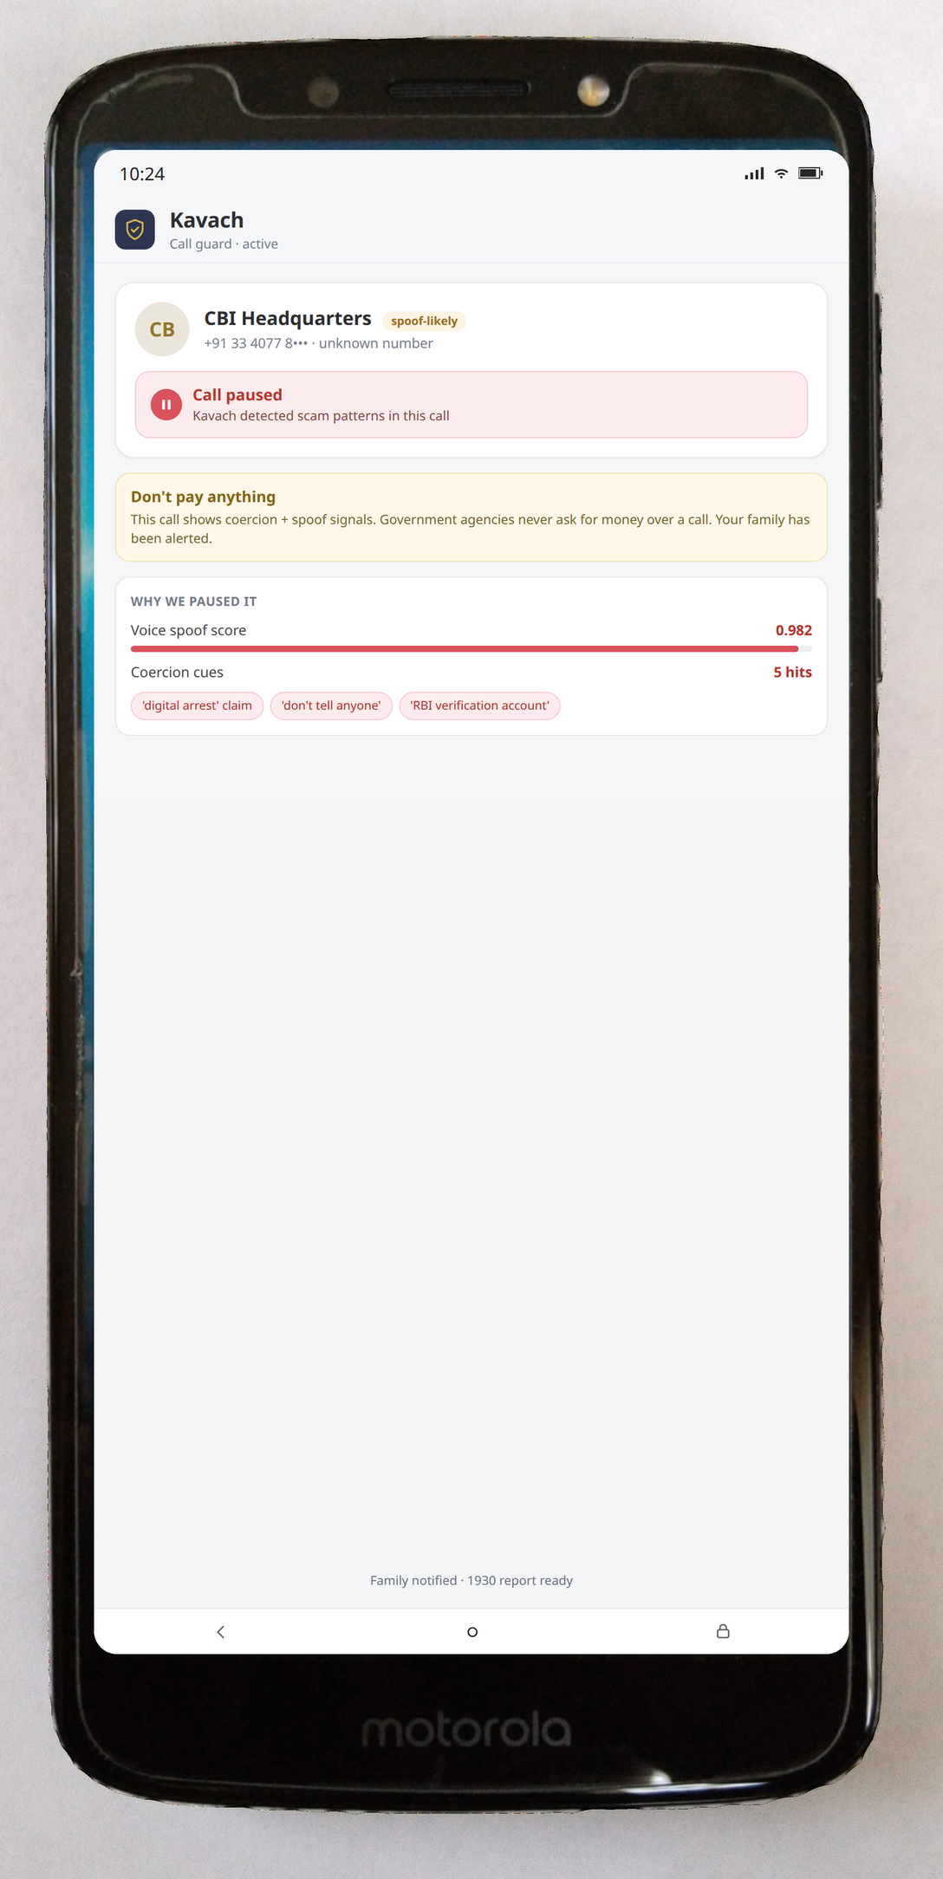
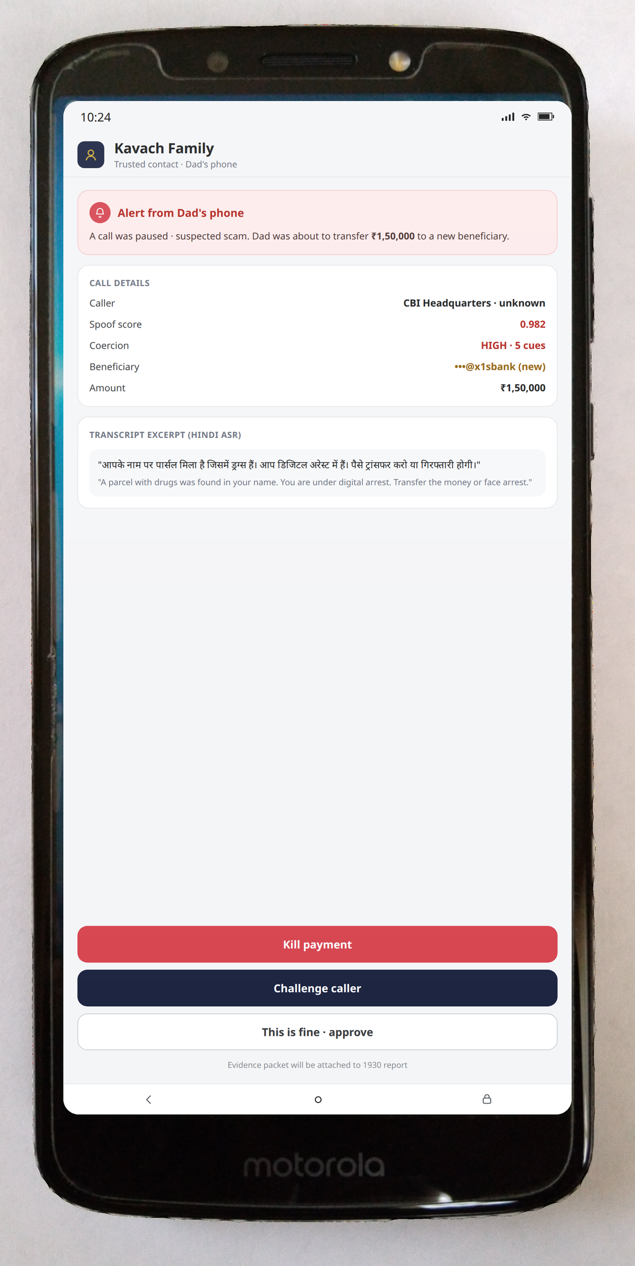
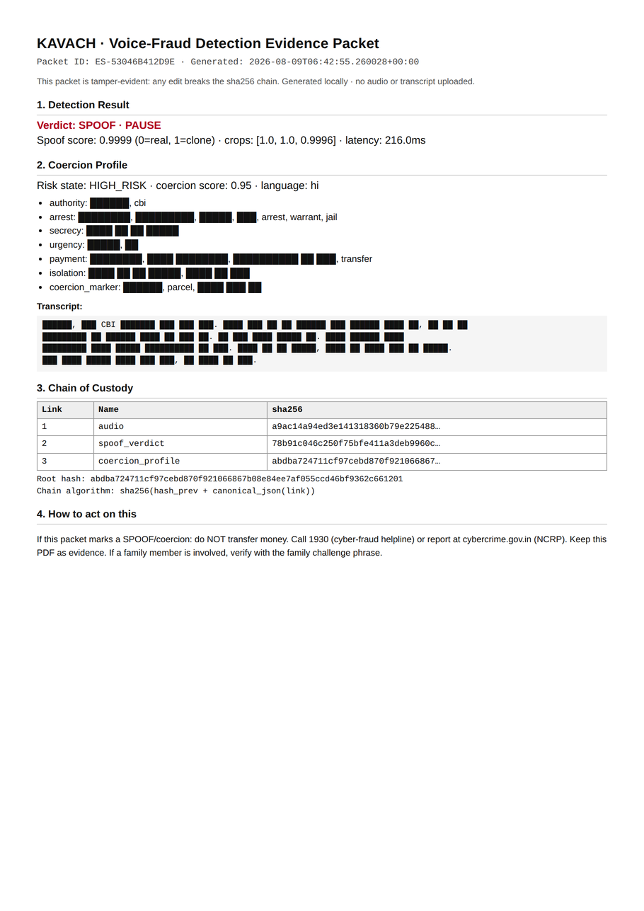
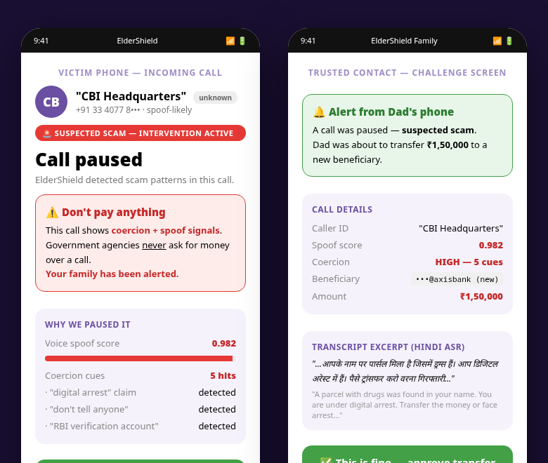
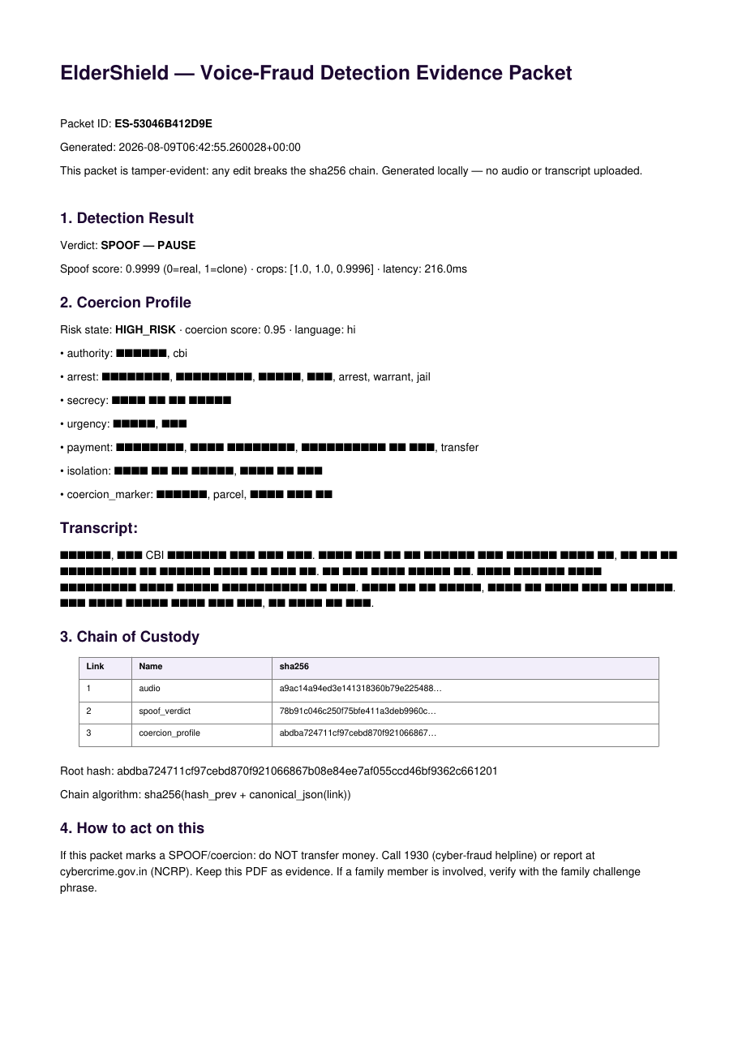
WORKING PROTOTYPE · ENGINE REAL, UI IN BUILD
What exists is real and measured · the screens show the spec, on a real device
CONCEPT UI
ENGINE · BUILT & VERIFIED
0.9919 acc · 0/100 FP · <500ms
AASIST-hindi · 3-crop vote · held-out + real-case registry 29/29
EVIDENCE PACKET
tamper-evident sha256 chain → 1930-ready PDF
70 packets · 90% tamper-catch
github.com/harshgounder/kavach
engine · coercion · evidence · battery tests · public repo (click to open)
Real device photo · spec screens composited. Final design under build.
08

Slide 9
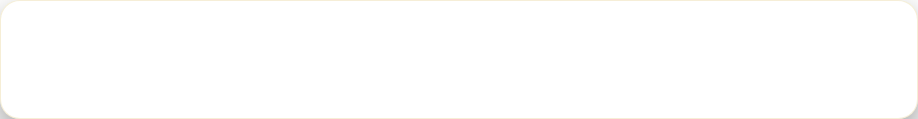
RESEARCH AND REFERENCES
1. RBI/2024-25/105 · voice/SMS fraud safeguards (Jan 2025) · rbi.org.in
2. RBI Auth Directions 2025 (RBI/2025-26/79) · 2FA mandatory Apr 2026 · rbi.org.in
3. CERT-In CIAD-2024-0060 · Deepfakes: threats & countermeasures · cert-in.org.in
4. DoT FRI: 1000+ banks/TPAPs · ~₹660 cr potential losses prevented, reported (Dec 2025) · pib.gov.in
5. SC order Aug 4 2026 · digital-arrest complaints 1,23,672 → 16,377 (I4C data) · thehindubusinessline.com
6. ASVspoof 2021 LA (zenodo) + NASK real-fraud (WACV 2026, CVF open access) · dataset restricted
KAVACH · THE SHIELD EVERY INDIAN FAMILY DESERVES
Recognize → Interrupt → Verify → Package → Report · Team 511
GenAI used for support only · every output cross-verified by our QA process. Model training, evaluation and this submission's technical claims are our own work.
09

