Slide 1
Regularized Evolution for Image Classifier Architecture Search

Slide 2
History
Until recently, most state-of-the-art image classifier architectures have been manually designed by human experts.
To speed up the process, researchers have looked into automated methods(using Evolution, Random Search and Reinforcement Learning). These methods are now collectively known as architecture-search algorithms.
Yet, the architectures produced by evolutionary algorithms / genetic programming have not reached the accuracy of those directly designed by human experts. Now Image classifiers are evolved that surpass hand-designs.

Slide 3
Introduction
This paper presents the first comparative case study of architecture-search algorithms for the image classification task.
Case study demonstrates that evolution can attain similar results with a simpler method.
In all the experiments, evolution searched faster than RL and random search, especially at the earlier stages.
Despite its simplicity, approach works well in benchmark against RL. It also evolved a high-quality model, which is named as AmoebaNet-A. This model is competitive with the best image classifiers obtained by any other algorithm today at similar sizes.

Slide 4
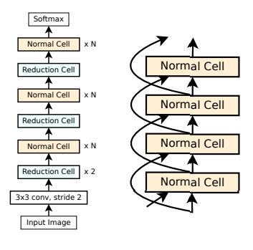
Model Architecture
The goal of the architecture-search process is to discover the architectures of the normal and reduction cell.
All experiments use the NASNet search space.
Two types of cell:
  Normal Cell
  Reduction Cell
Both the cells have same architecture with just once difference is that every application of the reduction cell is followed by a stride of 2 that reduces the image size, whereas normal cells per-serve the image size.
Image classifiers have fixed outer structure(Figure 1).
A feed-forward stack of Inception-like modules called cells. Each cell receives a direct input from the previous cell (as depicted) and a skip input from the cell before it (Figure 2).
Figure 1
Figure 2

Slide 5
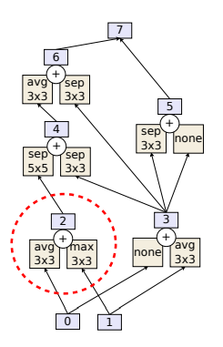
Model Architecture
Both the cells take 2 input/hidden state say 0 and 1.
More hidden state through pairwise combination (Figure 3) and different operation.
After exactly five pairwise combinations, any hidden states that remain unused (hidden states 5 and 6 in Figure 3) are concatenated to form the output of the cell (hidden state 7).
Once the architecture is fixed, the model still has two free parameters that can be used to alter its size (and its accuracy):
  The number of normal cells per stack (N)
  The number of output filters of the convolution ops (F).
  N and F are determined manually.
Figure 3

Slide 6
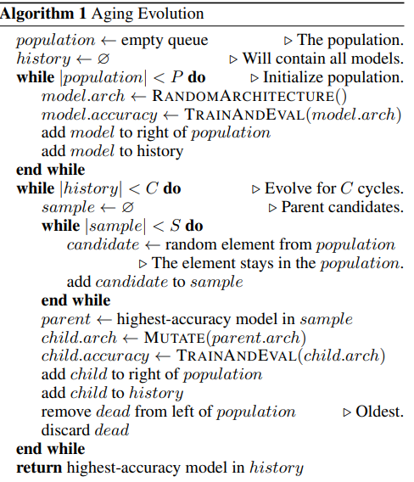
Evolutionary Algorithm
Different from tournament selection
It allows to explore search space instead of zooming in the models too early, as non aging evolution does.

Slide 7
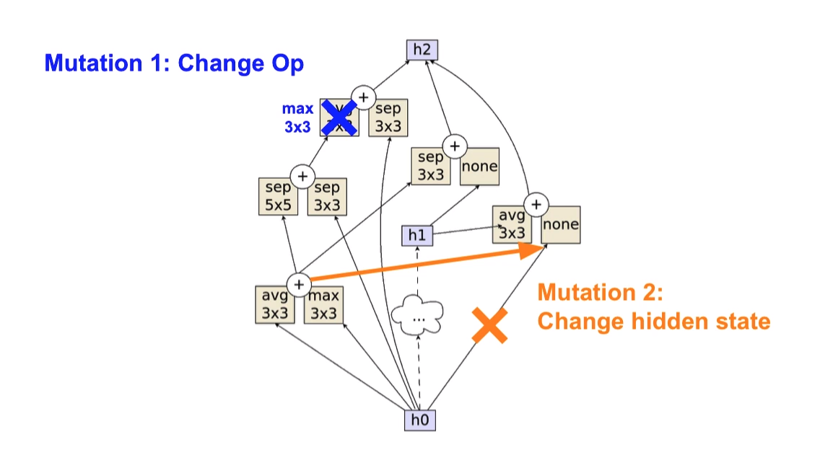
Mutations
Two main mutations:
  Hidden state mutation
  Op mutation
Only one of these mutations is applied in each cycle, choosing between them at random.
Steps for hidden state mutation:
  first making a random choice of whether to modify the normal cell or the reduction cell.
  Once a cell is chosen, the mutation picks one of the five pairwise combinations uniformly at random.
  Once the pairwise combination is picked, one of the two elements of the pair is chosen uniformly at random.
  The chosen element has one hidden state. This hidden state is now replaced with another hidden state from within the cell, subject to the constraint that no loops are formed (to keep the feed-forward nature of the convnet). Figure 4 shows an example.
The op mutation behaves like the hidden state mutation.
Figure 4

Slide 8
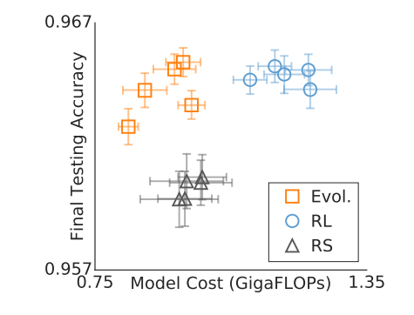
Case Study Results
Final augmented models on CIFAR-10
Figure 5

Slide 9
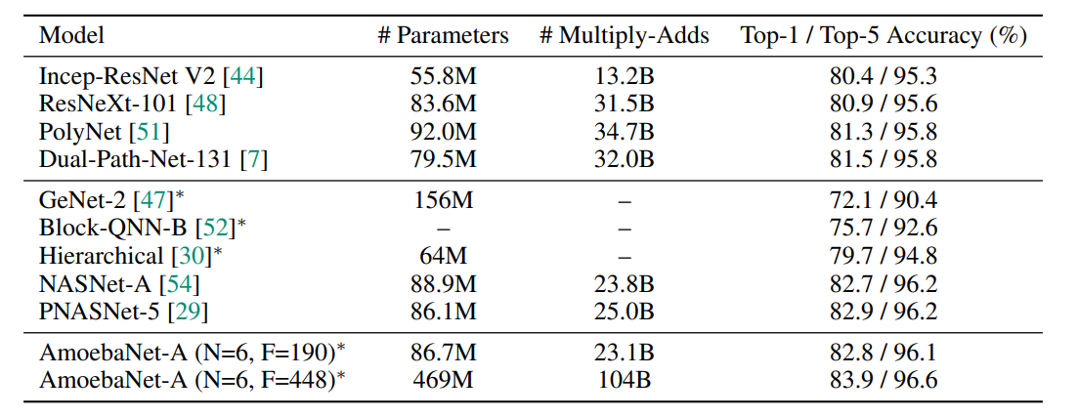
AmoebaNet-A(state-of-the-art)
Figure 6
Matching size, AmoebaNet-A has comparable accuracy to current state-of-the-art ImageNet models discovered with more complex architecture-search methods.
Scaled to larger size, AmoebaNet-A sets a new state-of-the-art 83.9% top-1 / 96.6% top-5 ImageNet accuracy.

Slide 10
Advantage & Disadvantage
Advantage
  Simple
  Faster results against RL and RS especially at the earlier stages of the search. This is relevant when fewer compute resources are available.
Disadvantage
  Architecture was discovered on GPU and large model was trained on TPU. What if we do both the things on TPU, it may give better results. As they did in AmoebaNet B.

Slide 11
Summary
The effort devoted to hand-crafting neural network image classifiers has motivated the use of architecture search to discover them automatically.
AmoebaNet-A - that surpasses hand-designs for the first time.
To do this, the tournament selection evolutionary algorithm is modified by introducing an age property to favor the younger genotypes
Matching size, AmoebaNet-A has comparable accuracy to current state-of-the-art ImageNet models discovered with more complex architecture-search methods
Scaled to larger size, AmoebaNet-A sets a new state-of-the-art 83.9% top-1 / 96.6% top-5 ImageNet accuracy.
Faster results against RL and RS especially at the earlier stages of the search. This is relevant when fewer compute resources are available.

