Slide 1
Deep learning for global ocean wind speed monitoring

Slide 2
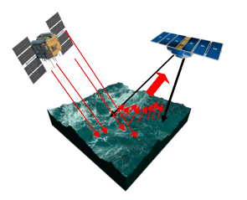
Introduction
The wind speed at the ocean surface is of interest in weather and climate applications.
Though, challenging to obtain measurements from the ground.
CyGNSS satellite mission fills that gap by remote sensing.
It provides two-dimensional image data along with other observation parameters which can be used to predict wind speed.
Notes:
The satellites measure the signals of global positioning satellites (GPS) that are reflected off the ocean surface (see figure). Wind influences the roughness of the ocean surface, which in turn shows up in the reflected signal.

Slide 3
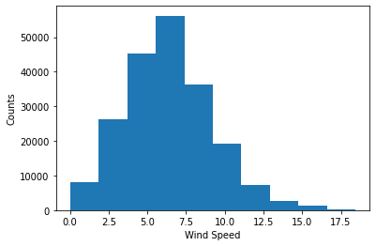
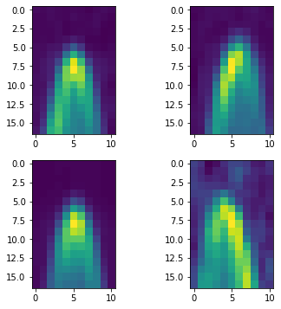
Dataset
We used cygnss dataset and used only good quality images which were given by quality column with value 1.
Brcs column in dataset - 17 x 11 array of DDM were used as X.
Windspeed column was used as Y.
Dataset contained good and bad images: Bad: 582338, Good: 202715
Dataset distribution
DDM – Delay doppler maps

Slide 4
Methodology
Used following deep neural networks:
MLP(Multilayer perceptron)
We can convert the images to one dimensional vector and can be given to MLP network to predict the wind speed.
Convolutional neural network (CNN)
We can use CNN as they are good with Images.
Used
Small CNN Network
Pre-Trained Network– ResNet50
CNN-LSTM(Long short term memory)
This data carries time series properties.
We can used CNN and pass those sequence of images to LSTM to predict current wind speed from sequence of previous images.

Slide 5
Experimentations
Did experimentations on Google Colab by combining following things with previous described multiple neural networks.
To stop underfitting:
Image augmentation
Transfer learning
To stop overfitting:
Regularization
Early stopping
Dropouts
For Data Imbalance:
Weighted random sampler
For faster convergence:
Batch Norm
Learning rate scheduler
Hyper-parameter tuning (learning-rate, epochs, num_layers, different optimizers, different losses,

Slide 6
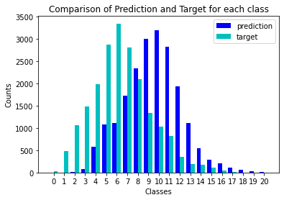
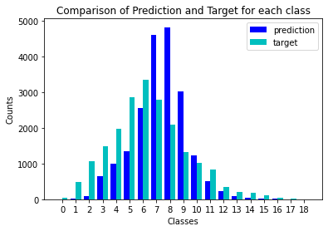
MLP - with and without Weighted Sampler
With Sampler
without Sampler

Slide 7
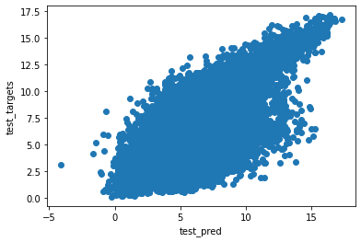
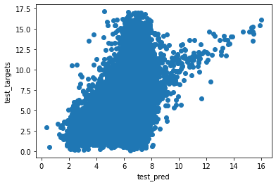
MLP - Results
Scatter Plot
MLP
with Sampler – MSE(mean square error)
train : 3.245
val : 4.0366
test : 4.046
MLP without Sampler - MSE:
train loss: 3.81
val loss: 3.96
test loss: 3.96
With Sampler
Without Sampler

Slide 8
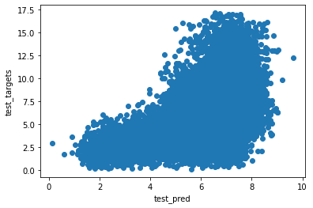
CNN - Results
CNN (without Sampler)
MSE
train : 5.2
val : 5.3
test : 5.3

Slide 9
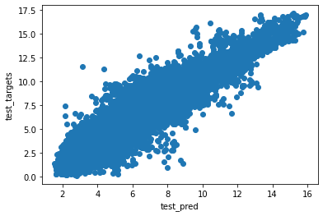
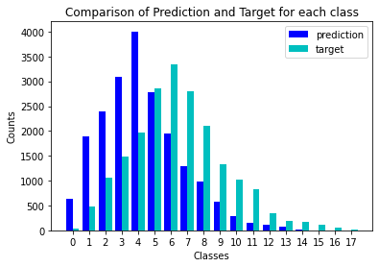
CNN -LSTM Results(Best Results)
CNN-LSTM (without Sampler)
MSE
train : 1.767
val : 1.23
test : 1.233

Slide 10
Conclusion
Ocean wind prediction using images
Used various neural networks – MLP, CNN, CNN-LSTM
CNN-LSTM performed best.
Though CNN and should have performed better because of images.
Reason could be that images are not so big and feature rich for CNN’s to extract enough information.
We can per-process images as done in this paper to make image more feature rich. [https://ieeexplore.ieee.org/document/7903642]
And we can also use super resolution to increase image size as done by this paper: https://www.mdpi.com/2072-4292/12/6/916

