Slide 1
PAPER DEEP DIVE | LITERATURE REVIEW
Deep Learning for Fast Glioma Growth Modeling
Martens et al. (2022) – Parameter estimation of the Fisher-KPP model using 3D U-Net & Conv-Encoder
Harsh Gupta (23U01011) & Mayank Kumar Verma (23U01026)
Supervisor: Dr. Kamlesh Kumar Chauhan | Dept. of ECE, IIIT Bhopal
Project: HybridTumorNet – Hybrid DL + PINN for Brain Tumor Growth Prediction

Slide 2
ROADMAP
Aaj hum kya discuss karenge
▸ Problem: GBM ka growth model karna itna slow kyun hai?
▸ Math: Fisher-KPP equation – D aur ρ kya batate hain
▸ Synthetic data: brain anatomy + DTI + sampling (Fig 1–4)
▸ Do neural networks: 3D U-Net (Task 1) aur Conv-Encoder (Task 2) (Fig 5–6)
▸ Results: MAE, ASSD, Hausdorff, CCC (Fig 7–11)
▸ Real GBM patient par test (Fig 12)
▸ Hamare HybridTumorNet se relation aur next steps
Martens et al. (2022) | HybridTumorNet | IIIT Bhopal
2

Slide 3
MOTIVATION
Clinical problem: GBM ko model karna slow hai
▸ Glioblastoma (GBM) sabse aggressive brain tumor hai – median survival ~15 months.
▸ MRI me sirf dikhta hai tumor ka visible hissa; infiltrating cells (jo MRI me nahi dikhte) radiotherapy margin ke liye important hain.
▸ Fisher-KPP PDE se tumor growth simulate hota hai, par patient-specific D aur ρ nikalna iterative optimization maangta hai – ghanton ka kaam.
▸ Martens ka idea: ek neural network train karo jo seconds me D aur ρ de de.
Key numbers
▸ Classical solver: hours per patient
▸ Neural network: < 1 second
▸ Training data: synthetic Fisher-KPP simulations
▸ Test: synthetic + 1 real GBM
Martens et al. (2022) | HybridTumorNet | IIIT Bhopal
3

Slide 4
MATHEMATICS
Fisher-KPP model: D aur ρ
▸ ∂u/∂t = ∇·(D ∇u) + ρ u (1 − u)
▸ u(x,t): tumor cell density (0 se 1). D: diffusion (cells kitni tezi se failte hain). ρ: proliferation rate (kitni tezi se badhte hain).
▸ Grey matter me D chhota, white matter me D bada – isliye DTI tensor se anisotropic diffusion lete hain.
▸ Inverse problem: u ke snapshots se (D, ρ) wapas nikalna – yahi network ka kaam hai.
▸ Hamari HybridTumorNet me bhi yehi PDE loss ke roop me use hota hai (RK4 integration).
Intuition
▸ D ↑ → tumor fail jata hai
▸ ρ ↑ → density jaldi saturate
▸ Dono alag-alag identify karna mushkil – ill-posed
Martens et al. (2022) | HybridTumorNet | IIIT Bhopal
4

Slide 5
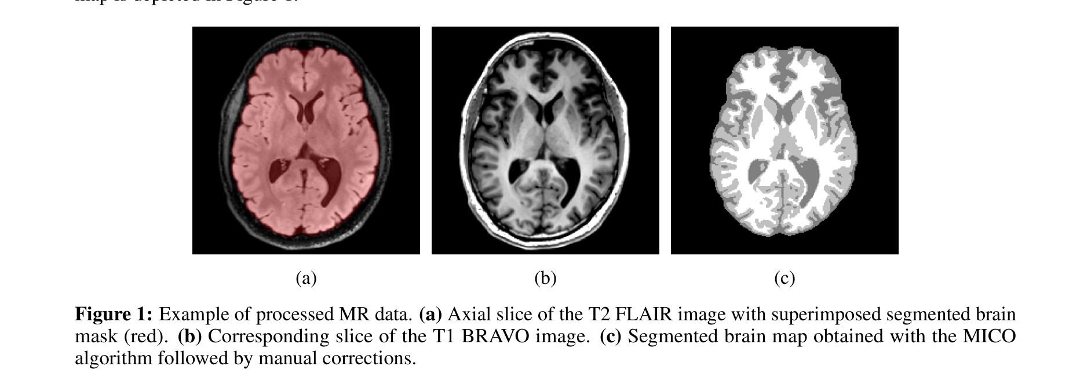
SYNTHETIC DATA PIPELINE
Brain tissue segmentation: anatomy ka base
Figure 1 – Samajh kya aaya
▸ Real brain MRI (T1) se White Matter, Grey Matter, CSF alag kiye gaye.
▸ Tumor sirf brain tissue me grow kar sakta hai, CSF me nahi – isliye mask zaroori.
▸ Ye mask Fisher-KPP simulation ka domain banta hai.
Paper Fig. 1: Tissue segmentation of the brain used for simulations.
Martens et al. (2022) | HybridTumorNet | IIIT Bhopal
5

Slide 6
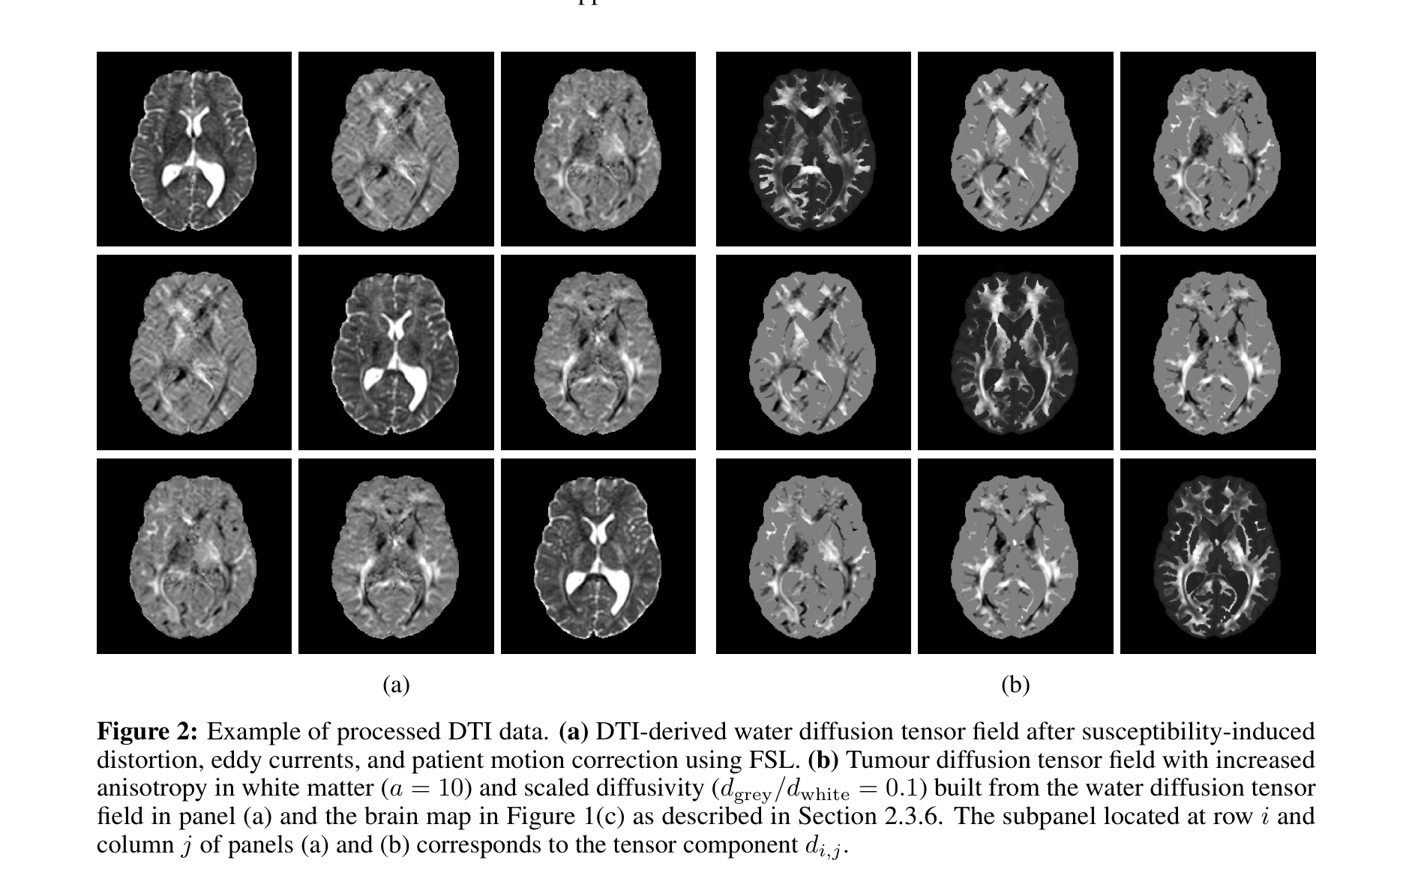
SYNTHETIC DATA PIPELINE
DTI tensor processing: white-matter tracts
Figure 2 – Samajh kya aaya
▸ Diffusion Tensor Imaging se har voxel ka diffusion tensor milta hai.
▸ Tensor ko tumor-diffusion tensor me convert karte hain – cells fibre direction me jaldi fail hoti hain.
▸ Isse simulation realistic ho jata hai.
Paper Fig. 2: Processing of DTI for anisotropic tumor diffusion.
Martens et al. (2022) | HybridTumorNet | IIIT Bhopal
6

Slide 7
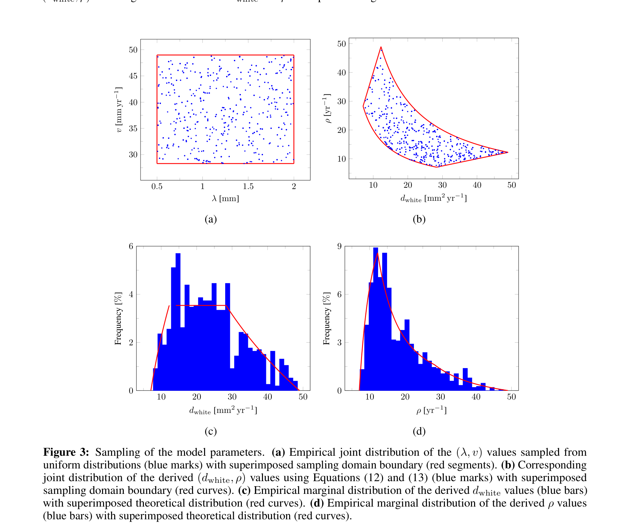
SYNTHETIC DATA PIPELINE
Parameter sampling: D, ρ aur tumor start point
Figure 3 – Samajh kya aaya
▸ Har simulation ke liye D, ρ aur initial tumor location random sample hoti hai.
▸ Distributions biologically plausible ranges se li gayi hain.
▸ Isse network ko wide variety of tumors dekhne ko milti hai.
Paper Fig. 3: Distributions used to sample simulation parameters.
Martens et al. (2022) | HybridTumorNet | IIIT Bhopal
7

Slide 8
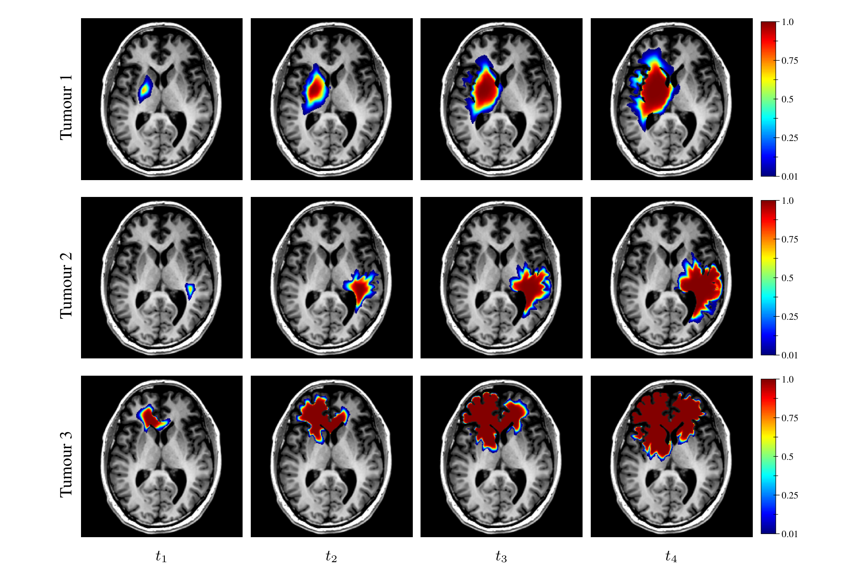
SYNTHETIC DATA PIPELINE
Synthetic tumor evolution: t1 se t4 tak
Figure 4 – Samajh kya aaya
▸ Ek hi parameter set se 4 timepoints ka tumor density evolve hota hai.
▸ Time ke saath tumor boundary diffuse hoti jati hai.
▸ Ye sequences network ke training input/target bante hain.
Paper Fig. 4: Tumor evolution at four timepoints of a simulation.
Martens et al. (2022) | HybridTumorNet | IIIT Bhopal
8

Slide 9
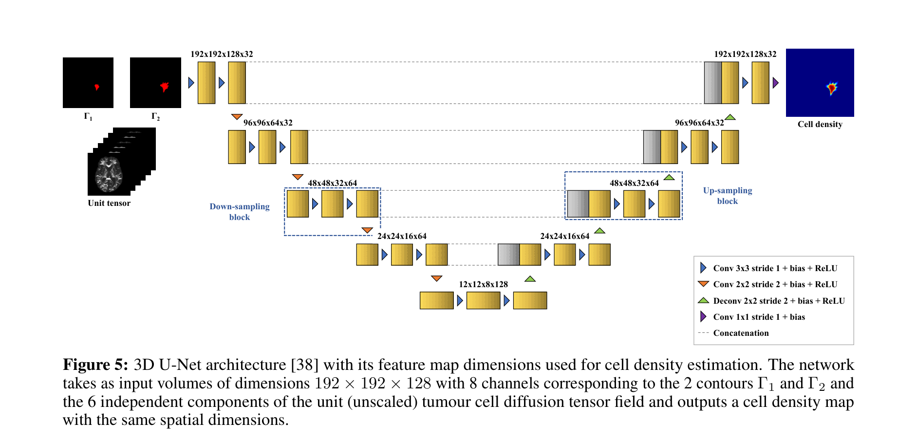
NETWORK ARCHITECTURE
Task 1: 3D U-Net – tumor density predict karna
Figure 5 – Samajh kya aaya
▸ Input: 2 time ke tumor snapshots + anatomy; output: future tumor density.
▸ Encoder–decoder with skip connections, 3D convolutions.
▸ Task 1 me network seedha density map predict karta hai.
▸ Hamari segmentation backbone ka concept isse milta hai.
Paper Fig. 5: 3D U-Net used for tumor density prediction.
Martens et al. (2022) | HybridTumorNet | IIIT Bhopal
9

Slide 10
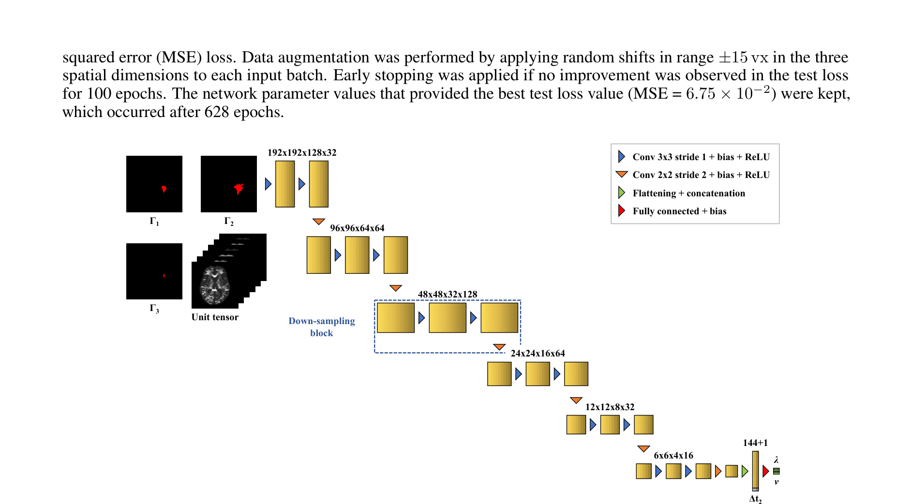
NETWORK ARCHITECTURE
Task 2: Conv-Encoder – D aur ρ regress karna
Figure 6 – Samajh kya aaya
▸ Convolutional encoder volume ko compress karke 2 numbers deta hai: D aur ρ.
▸ Output head fully-connected layers se.
▸ Yehi part HybridTumorNet ke PINN parameter head jaisa hai.
Paper Fig. 6: Conv-Encoder for estimating D and ρ.
Martens et al. (2022) | HybridTumorNet | IIIT Bhopal
10

Slide 11
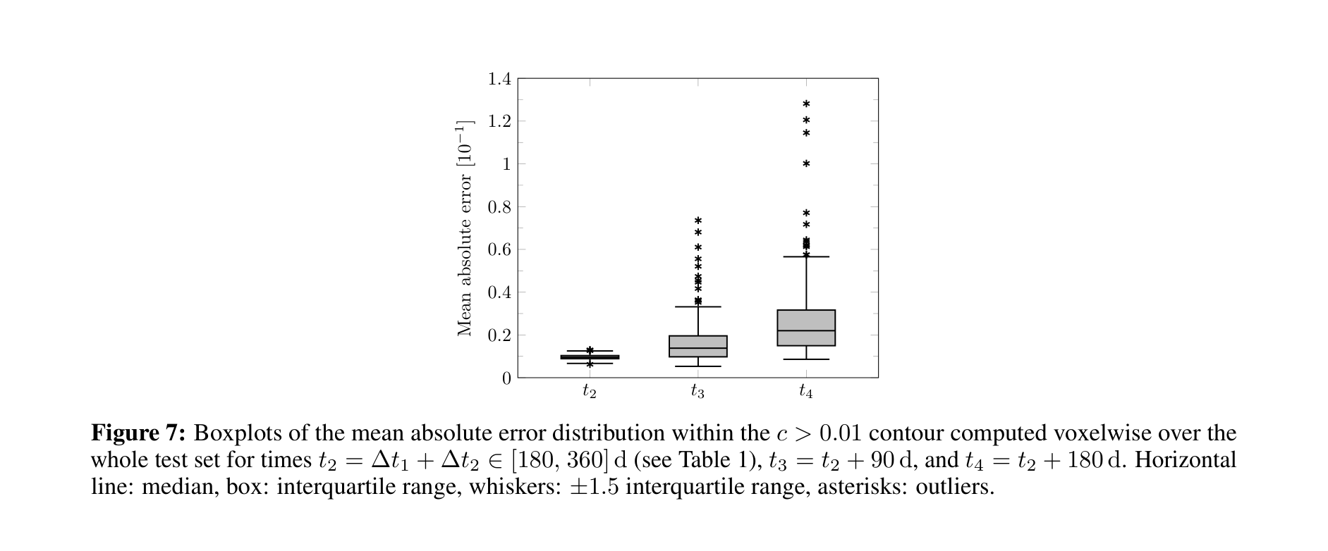
RESULTS
Results: Mean Absolute Error boxplots
Figure 7 – Samajh kya aaya
▸ Voxel-wise MAE of predicted vs true density.
▸ Median error bahut kam – network accurate hai.
▸ Outliers kuch cases me, mostly low-signal tumors.
Paper Fig. 7: MAE of predictions across test set.
Martens et al. (2022) | HybridTumorNet | IIIT Bhopal
11

Slide 12
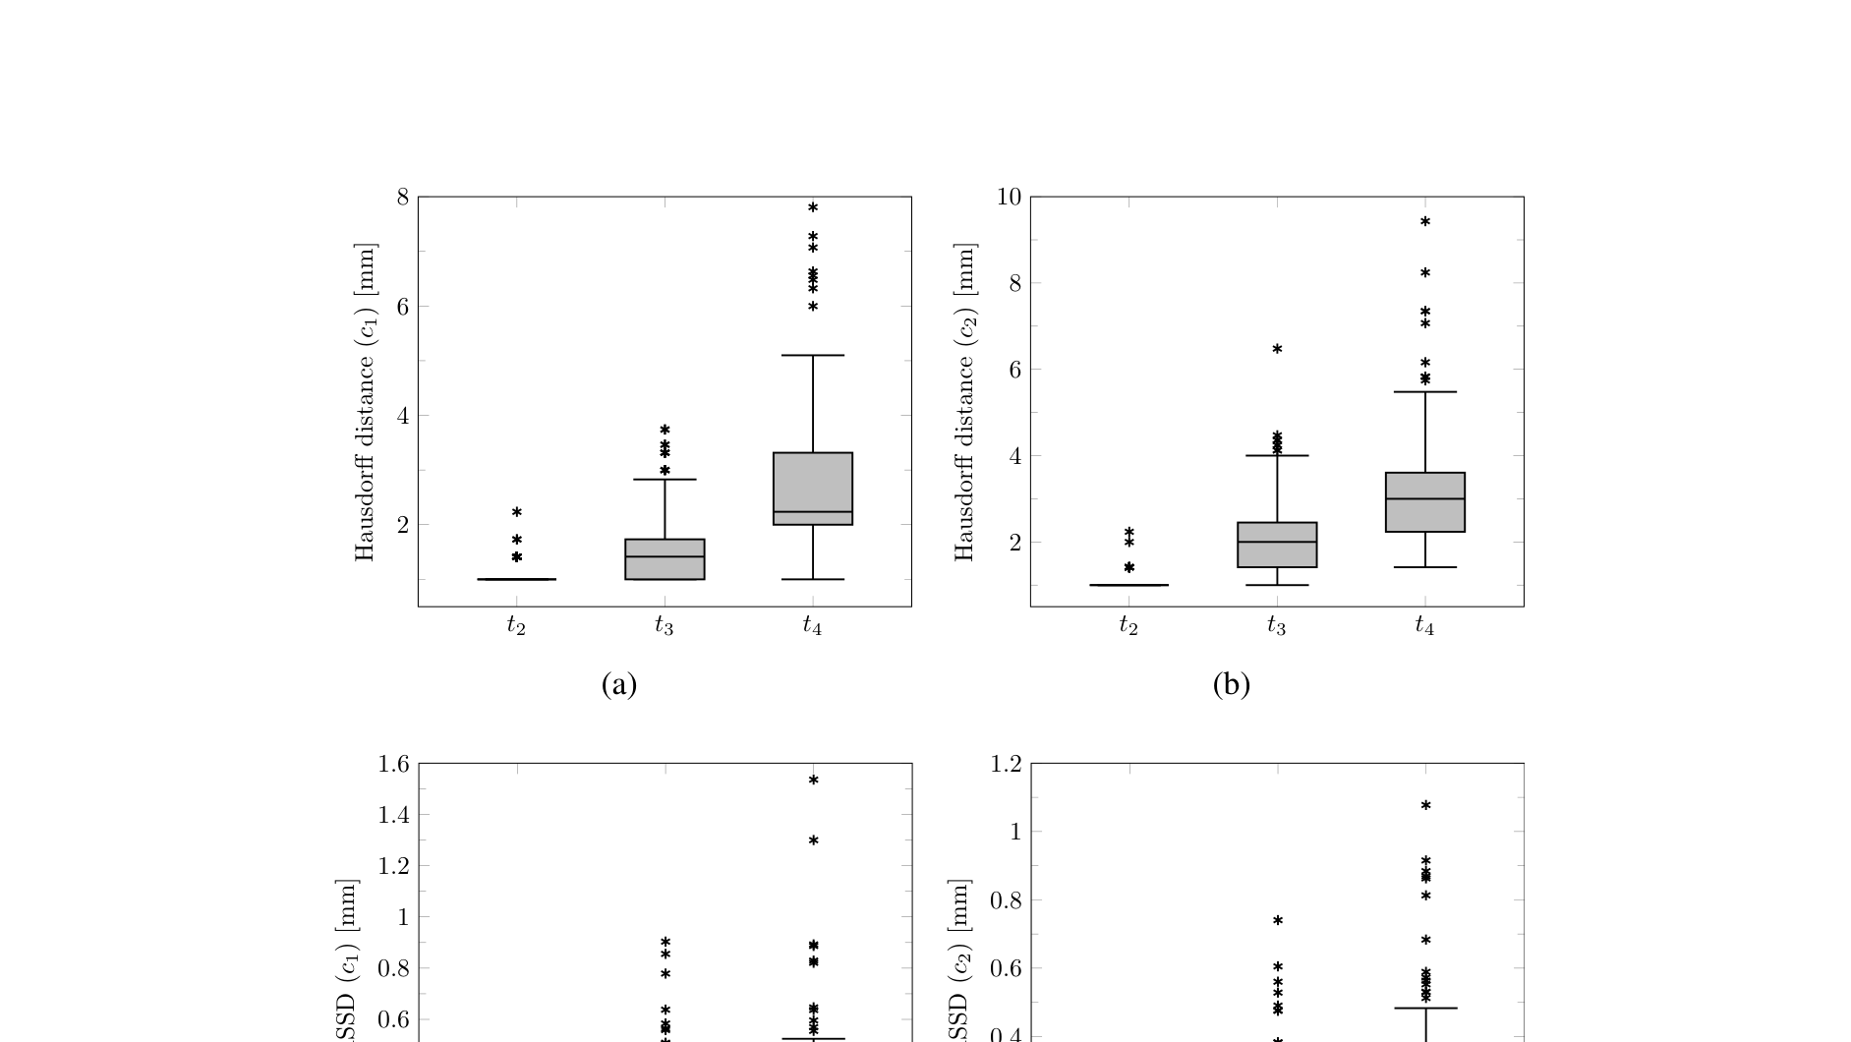
RESULTS
Results: ASSD aur Hausdorff distance
Figure 8 – Samajh kya aaya
▸ ASSD average surface distance – boundary kitni sahi hai.
▸ Hausdorff worst-case boundary error batata hai.
▸ Sub-voxel level ke errors – clinically useful precision.
Paper Fig. 8: ASSD and Hausdorff distance.
Martens et al. (2022) | HybridTumorNet | IIIT Bhopal
12

Slide 13
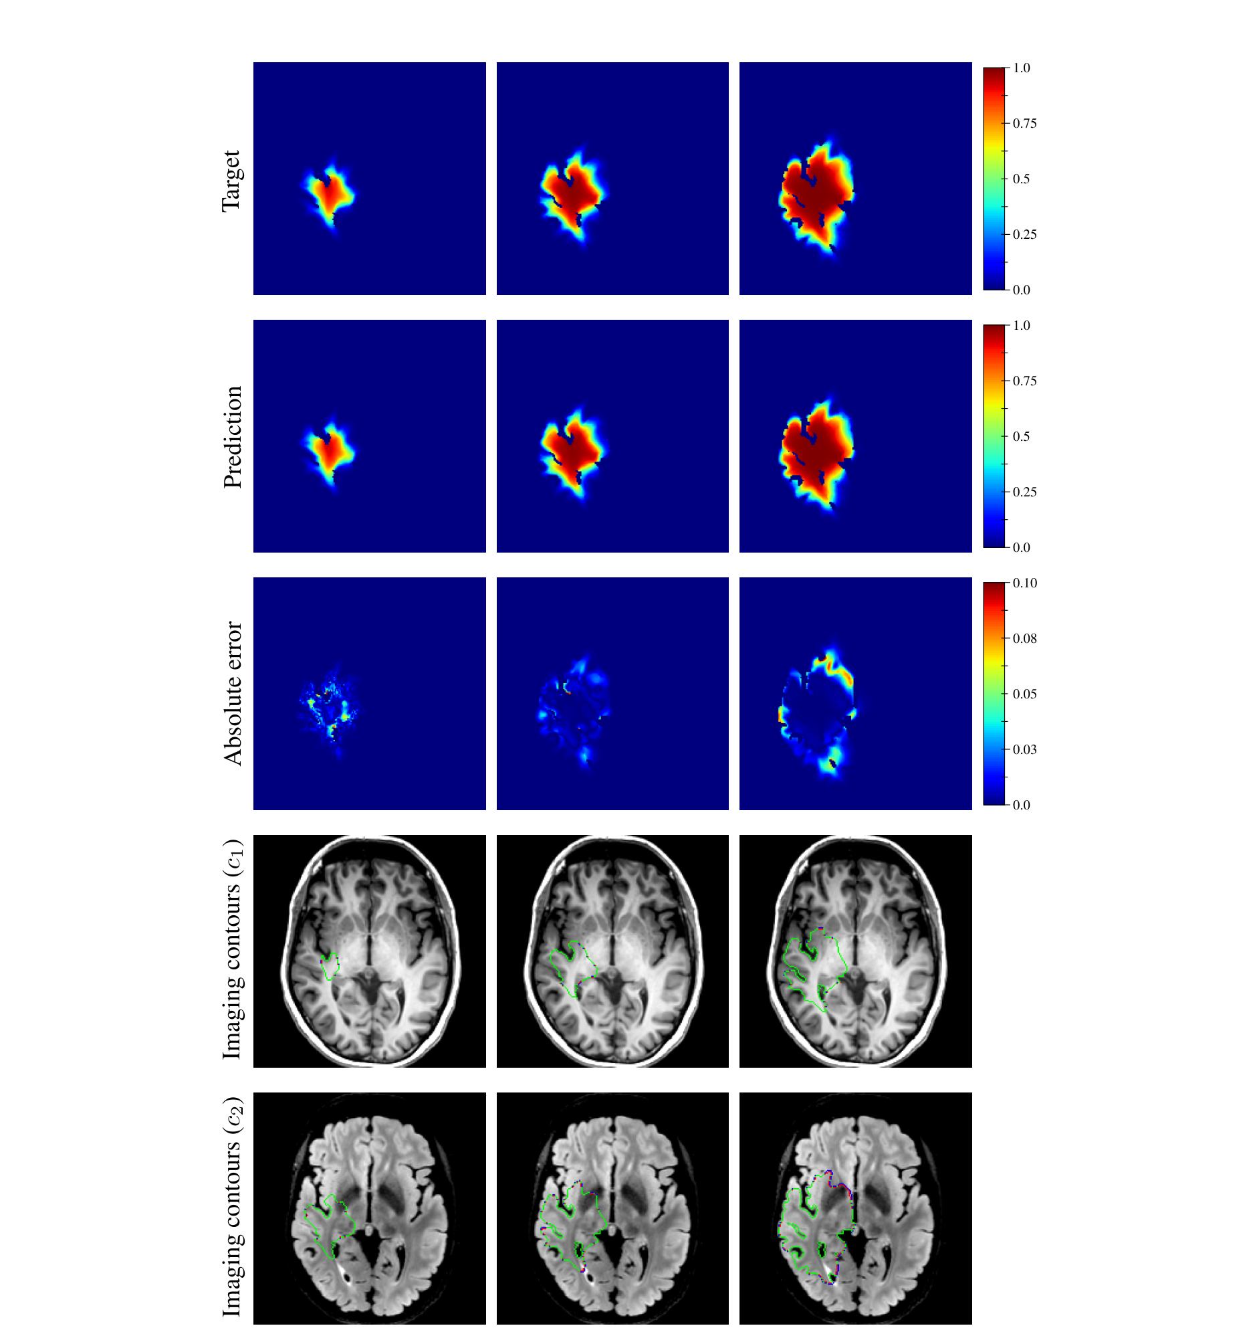
RESULTS
True vs predicted tumor density (forward simulation)
Figure 9 – Samajh kya aaya
▸ Row-wise: ground truth, prediction, difference.
▸ Predicted tumor ground truth se visually almost identical.
▸ Difference maps me error sirf boundary par thoda dikhta hai.
Paper Fig. 9: Comparison of true and predicted tumor density.
Martens et al. (2022) | HybridTumorNet | IIIT Bhopal
13

Slide 14
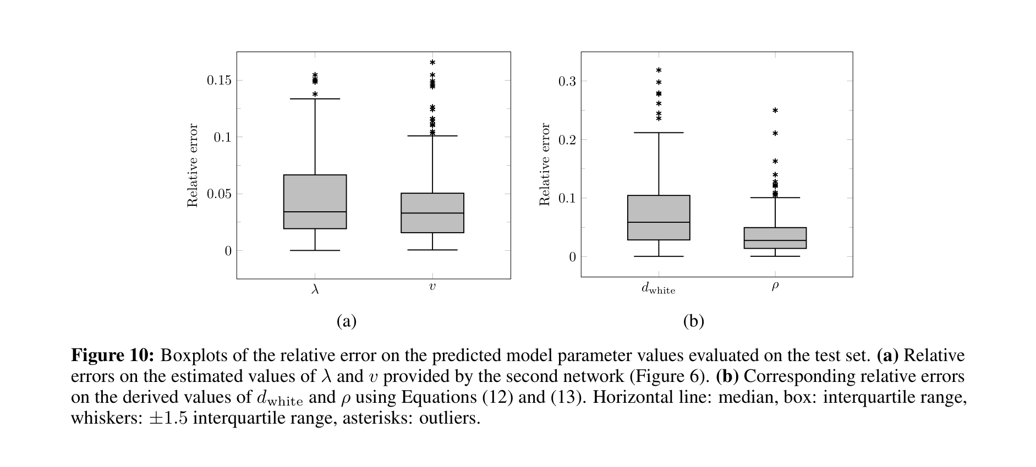
PARAMETER ACCURACY
Relative error on D aur ρ
Figure 10 – Samajh kya aaya
▸ Network se nikle D aur ρ ka relative error plot.
▸ Dono parameters alag-alag precisely identify nahi hote – par product-like combination stable hai.
▸ Ye ill-posedness ka asli evidence hai.
Paper Fig. 10: Relative errors for estimated D and ρ.
Martens et al. (2022) | HybridTumorNet | IIIT Bhopal
14

Slide 15
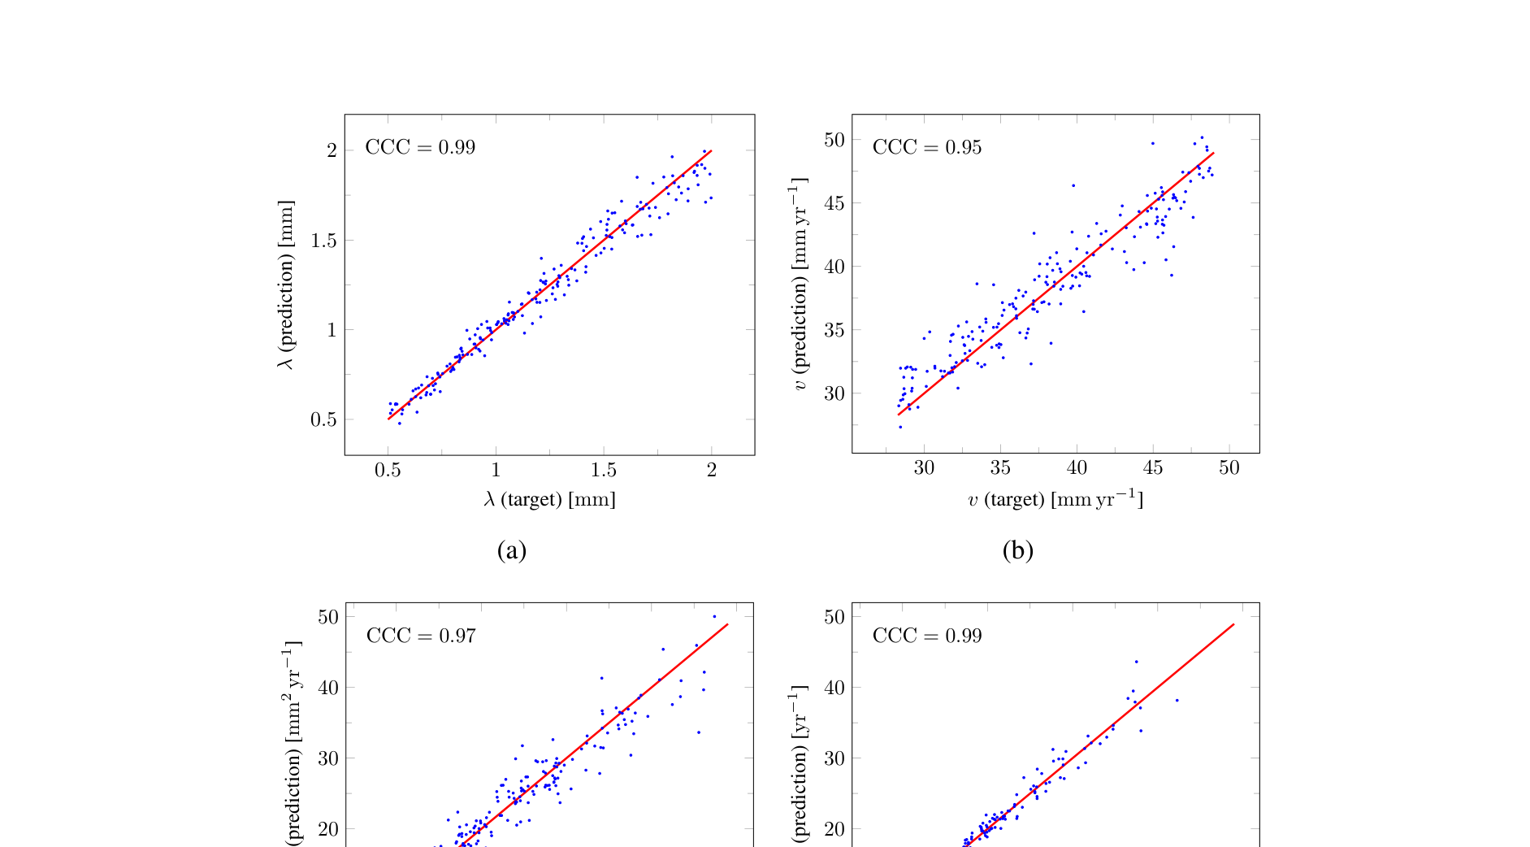
PARAMETER ACCURACY
Scatterplots aur CCC (agreement)
Figure 11 – Samajh kya aaya
▸ True vs predicted D aur ρ ka scatter.
▸ Concordance Correlation Coefficient high – strong agreement.
▸ Points diagonal ke paas – bias kam hai.
Paper Fig. 11: True vs. predicted parameters with CCC.
Martens et al. (2022) | HybridTumorNet | IIIT Bhopal
15

Slide 16
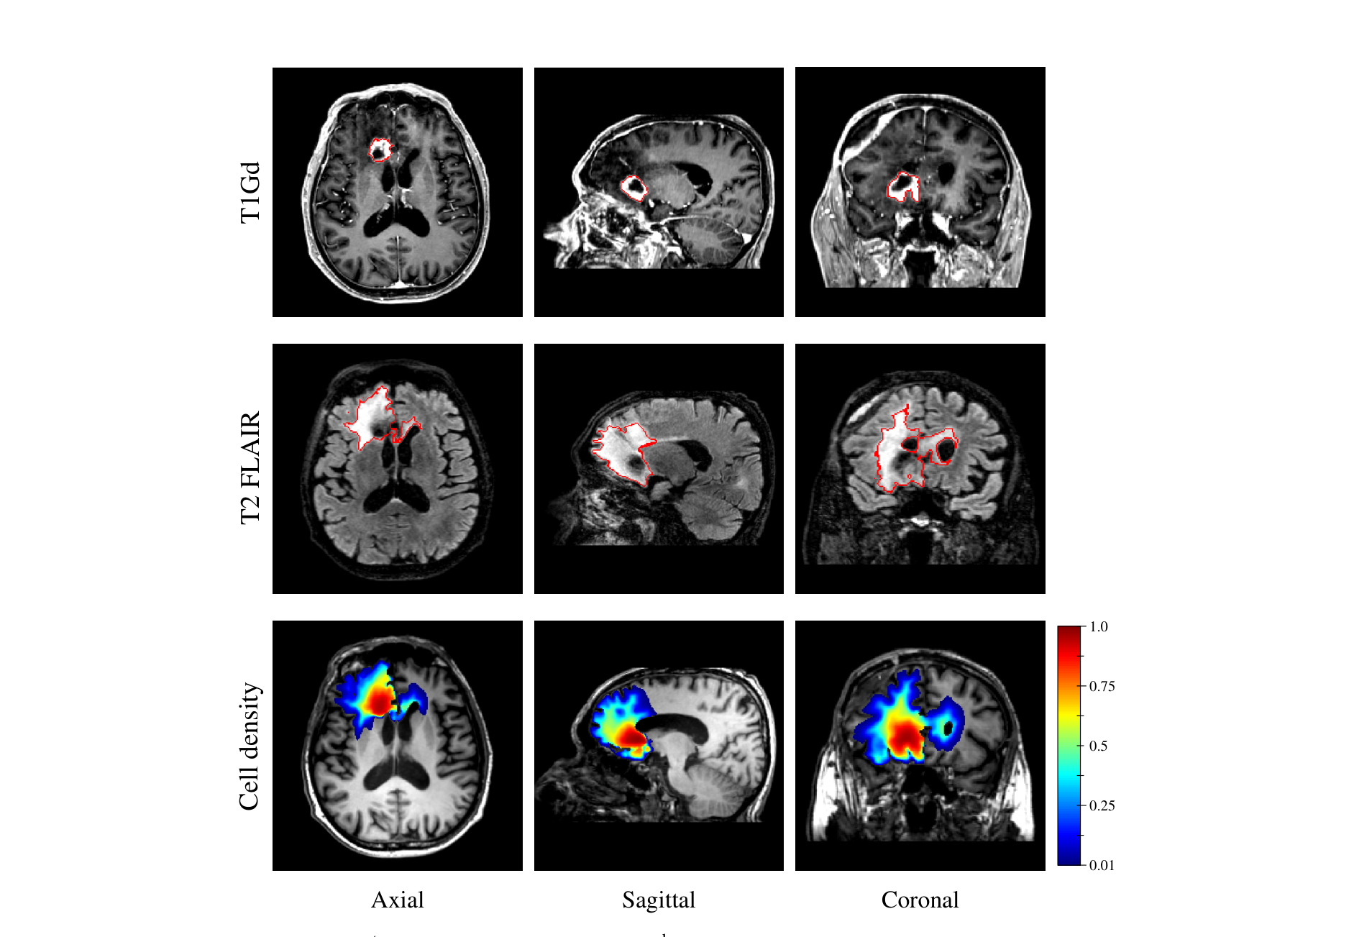
CLINICAL VALIDATION
Real GBM patient par test
Figure 12 – Samajh kya aaya
▸ Ek real patient ke MRI se tumor segment karke network ko diya gaya.
▸ Network ne seconds me D, ρ nikale aur growth simulate kiya.
▸ Sirf ek patient hai – isliye paper khud bolta hai ki aur validation chahiye.
Paper Fig. 12: Application to a real glioblastoma patient.
Martens et al. (2022) | HybridTumorNet | IIIT Bhopal
16

Slide 17
CRITICAL ANALYSIS
Paper ki limitations (honest view)
▸ Training poori tarah synthetic data par – real tumors Fisher-KPP se alag behave kar sakte hain.
▸ Real validation sirf ek patient – statistical claim nahi ban sakta.
▸ D aur ρ identifiability weak – ek snapshot se dono alag nikalna ill-posed.
▸ Treatment effect (surgery, chemo) model nahi hota.
▸ Fisher-KPP simplified model hai – mass effect, necrosis ignore.
Martens et al. (2022) | HybridTumorNet | IIIT Bhopal
17

Slide 18
RELEVANCE TO OUR PROJECT
Hamare HybridTumorNet se kya relation hai
▸ Martens: network D, ρ predict karta hai → HybridTumorNet bhi PDE parameters predict karta hai.
▸ Martens: synthetic Fisher-KPP data → hamare paas bhi RK4-based FisherKPPSolver hai.
▸ Difference: hum segmentation + PINN physics loss end-to-end combine karte hain.
▸ Difference: hamare paas real longitudinal LUMIERE data hai (91 GBM patients) – Martens ke paas sirf 1 real patient.
▸ Isliye hamara contribution: real longitudinal validation.
Comparison
▸ Martens: 3D U-Net + Conv-Encoder
▸ Ours: ResNet-10 + PINN loss
▸ Martens: 1 real patient
▸ Ours: LUMIERE 91 patients
Martens et al. (2022) | HybridTumorNet | IIIT Bhopal
18

Slide 19
OUR EVALUATION ON LUMIERE
Hamare abhi tak ke results
▸ MONAI SegResNet (SOTA) LUMIERE par: avg Whole-Tumor Dice 89.7%, median 93.1%, peak 96.1%.
▸ Hamara ResNet-10 HybridTumorNet pretrained: avg WT Dice ~49.2% (10 patients), peak 70%.
▸ Gap ka reason: chhota backbone + synthetic pretraining; fine-tuning on real data pending.
▸ Pipeline ne coordinate mismatch bug fix karke atlas-space data par evaluate kiya.
Takeaway
▸ SOTA benchmark ready
▸ Gap clearly measured
▸ Next: fine-tune on LUMIERE
Martens et al. (2022) | HybridTumorNet | IIIT Bhopal
19

Slide 20
ROADMAP
Next steps & conclusion
▸ Backbone upgrade: SegResNet / SwinUNETR ko HybridTumorNet me use karna.
▸ LUMIERE longitudinal pairs par growth-prediction fine-tuning (t_i → t_{i+1}).
▸ Metrics: Dice, ASSD, Hausdorff aur parameter CCC – Martens ke jaise.
▸ Uncertainty quantification (MC dropout / ensembles).
▸ Conclusion: Martens ne fast parameter estimation ka proof of concept diya; hum usse real longitudinal data par extend kar rahe hain.
Martens et al. (2022) | HybridTumorNet | IIIT Bhopal
20

