Slide 1
PAPER DEEP DIVE | LITERATURE REVIEW
Deep Learning for Fast Glioma Growth Modeling
Martens et al. (2022): cell density aur Fisher-KPP parameters (D, ρ) ko 3D CNN se estimate karna
Harsh Gupta (23U01011) & Mayank Kumar Verma (23U01026)
Supervisor: Dr. Kamlesh Kumar Chauhan | Dept. of ECE, IIIT Bhopal
Project: HybridTumorNet – Hybrid DL + PINN for Brain Tumor Growth Prediction

Slide 2
ROADMAP
Is presentation ko kaise padhein
Part A: Basics (slide 3–6): MRI, tumor, PDE, CNN. Agar pehli baar padh rahe ho to yahan se shuru karo.
Part B: Paper ka idea (slide 7–9): kaunsa problem, kaunsa solution, pipeline.
Part C: Data banana (slide 10–14): Figure 1–4 aur Table 1–2.
Part D: Networks (slide 15–18): Figure 5–6, training details.
Part E: Results (slide 19–25): Figure 7–12, numbers ke saath.
Part F: Critical analysis (slide 26–32): limitations, humare project se relation, glossary, teacher Q&A.
▸ Har figure slide par: left me asli figure, right me panel-wise explanation + key numbers.
Martens et al. (2022) | HybridTumorNet | IIIT Bhopal
2

Slide 3
PART A | BASICS
Basics 1: Brain tumor aur MRI
Glioma / Glioblastoma (GBM) kya hai?
▸ Brain me glial cells se bana tumor. GBM sabse aggressive type hai; ye ek gend jaisa nahi, balki tentacles ki tarah aas-paas ke tissue me ghus jata hai (infiltration).
MRI me kya dikhta hai?
▸ MRI scan sirf wahi hissa dikhata hai jahan tumor cells bahut zyada hain. Jahan cells kam hain wahan scan normal dikhta hai, par cells waha hote hain.
Isse kya problem hoti hai?
▸ Surgery/radiotherapy sirf visible tumor par ho to bache hue invisible cells se tumor wapas aa jata hai. Isliye invisible cells ka map chahiye.
Chhota glossary
▸ T1Gd: contrast wala MRI, tumor ka enhancing core dikhata hai
▸ T2 FLAIR: oedema (sujan) wala area dikhata hai
▸ DTI: nerve fibres ki direction batane wala MRI
▸ Voxel: 3D pixel (yahan 1mm³)
Martens et al. (2022) | HybridTumorNet | IIIT Bhopal
3

Slide 4
PART A | BASICS
Basics 2: PDE aur Fisher-KPP model
PDE kya hai? Ek rule jo batata hai ki koi quantity space aur time me kaise badalti hai.
Fisher-KPP: ∂u/∂t = ∇·(D∇u) + ρu(1−u)
▸ u = tumor cell density (0 se 1). Pehla part fail na (diffusion), dusra part badhna (proliferation).
▸ D = diffusion: cells kitni tezi se faile. ρ = proliferation: kitni tezi se divide ho.
▸ u(1−u): jab u chhota hai to growth tez; jab u→1 (voxel bhar gaya) to growth ruk jati hai.
Analogy: paani me syahi (diffusion) + syahi ka khud ko multiply karna (reaction).
Forward vs Inverse
▸ Forward: D, ρ, starting tumor pata hain → future tumor simulate karo (aasaan).
▸ Inverse: MRI dikh raha hai → D, ρ aur invisible cells nikalo (mushkil).
▸ Paper ka goal inverse problem fast solve karna hai.
Martens et al. (2022) | HybridTumorNet | IIIT Bhopal
4

Slide 5
PART A | BASICS
Basics 3: Wave speed aur front width (λ, v)
▸ Fisher-KPP ka tumor ek travelling wave ki tarah aage badhta hai: front ek constant speed se chalta hai aur edge exponentially girti hai.
Infiltration depth: λ = √(D/ρ) (mm). Matlab front kitni chaudi/dhundhli hai.
Front velocity: v = 2√(Dρ) (mm/year). Matlab tumor ki boundary kitni tezi se badh rahi hai.
▸ Ulta karke: D = λv/2 aur ρ = v/(2λ) (paper ke Eq. 12, 13).
▸ Isliye network seedha D, ρ predict nahi karta; wo λ aur v predict karta hai, jo images se naapna aasaan hai, phir D, ρ nikalte hain.
Pehchaan
▸ λ: do contours ke beech ki doori se pata chalta hai
▸ v: ek hi contour ke do alag time par shift se pata chalta hai
Martens et al. (2022) | HybridTumorNet | IIIT Bhopal
5

Slide 6
PART A | BASICS
Basics 4: CNN aur U-Net kya hota hai
CNN: image me patterns (edges, shapes) khud seekhne wala neural network. 3D CNN poore 3D volume par kaam karta hai.
U-Net: encoder (image chhoti karke context samajhna) + decoder (wapas bada karke output banana) + skip connections (details na khona).
Convolutional Encoder: sirf encoder + last me fully-connected layer. Image se kuch numbers (regression) nikalta hai.
Loss: MAE (average |error|) ya MSE (average error²). Adam optimizer weights update karta hai.
Training data: synthetic tumors, kyunki asli tumor ki true cell density kisi ko nahi pata.
Martens et al. (2022) | HybridTumorNet | IIIT Bhopal
6

Slide 7
PART B | IDEA
Paper ka problem aur contribution
Problem: Reaction-diffusion models decades se hain, par patient par use nahi hote kyunki (1) starting condition (invisible cells) aur (2) D, ρ estimate karna mushkil hai.
Contribution: do deep CNNs jo dono problems ek saath solve karte hain, seconds me.
▸ Network 1 (3D U-Net): contours → poora cell density map.
▸ Network 2 (Conv-Encoder): contours + time gap → λ, v → D, ρ.
▸ Phir model se future tumor simulate karte hain (90 aur 180 din aage).
▸ Training: 1,200 synthetic tumors, 6 healthy volunteers ke asli brains par.
Ek line me
▸ MRI ke visible contours → CNN → invisible cells ka map + D, ρ → future growth
Martens et al. (2022) | HybridTumorNet | IIIT Bhopal
7

Slide 8
PART B | IDEA
Pipeline ek nazar me
Step 1 (Data): healthy volunteers ka MRI + DTI → brain map aur tumor-diffusion tensor (Fig 1, 2).
Step 2 (Simulate): random λ, v, seed, time gaps → Fisher-KPP se tumor grow karo (Fig 3, 4).
Step 3 (Contours): t₂ par density ko threshold karke 2 contours (c₁=0.80, c₂=0.16) banao; t₁ par ek (c₂).
Step 4 (Train): Network 1 aur Network 2 alag-alag train (Fig 5, 6).
Step 5 (Validate): t₂ par density, phir simulation se t₃, t₄ predict karke true se compare (Fig 7–11).
Step 6 (Real): ek real GBM patient par Network 1 lagana (Fig 12).
Martens et al. (2022) | HybridTumorNet | IIIT Bhopal
8

Slide 9
PART B | IDEA
Imaging contours aur thresholds (c₁, c₂)
▸ MRI tumor ka exact density nahi dikhata; wo ek threshold par boundary dikhata hai: jahan density threshold se zyada, wo andar.
c₁ = 0.80: T1Gd ka enhancing core (dense tumor).
c₂ = 0.16: T2 FLAIR ka oedema outline (bahar ki boundary).
▸ Ye threshold values Swanson et al. (2008) se li gayi hain (paper ref [5]).
▸ Synthetic data me same thresholds par density ko binary mask me badalte hain; wahi network ka input hai.
▸ Caveat: oedema asli invasion zone nahi hota, isliye c₂ wali assumption approximate hai (paper ka discussion).
Terms
▸ Γ₁: c=0.80 contour at t₂
▸ Γ₂: c=0.16 contour at t₂
▸ Γ₃: c=0.16 contour at t₁
Martens et al. (2022) | HybridTumorNet | IIIT Bhopal
9

Slide 10
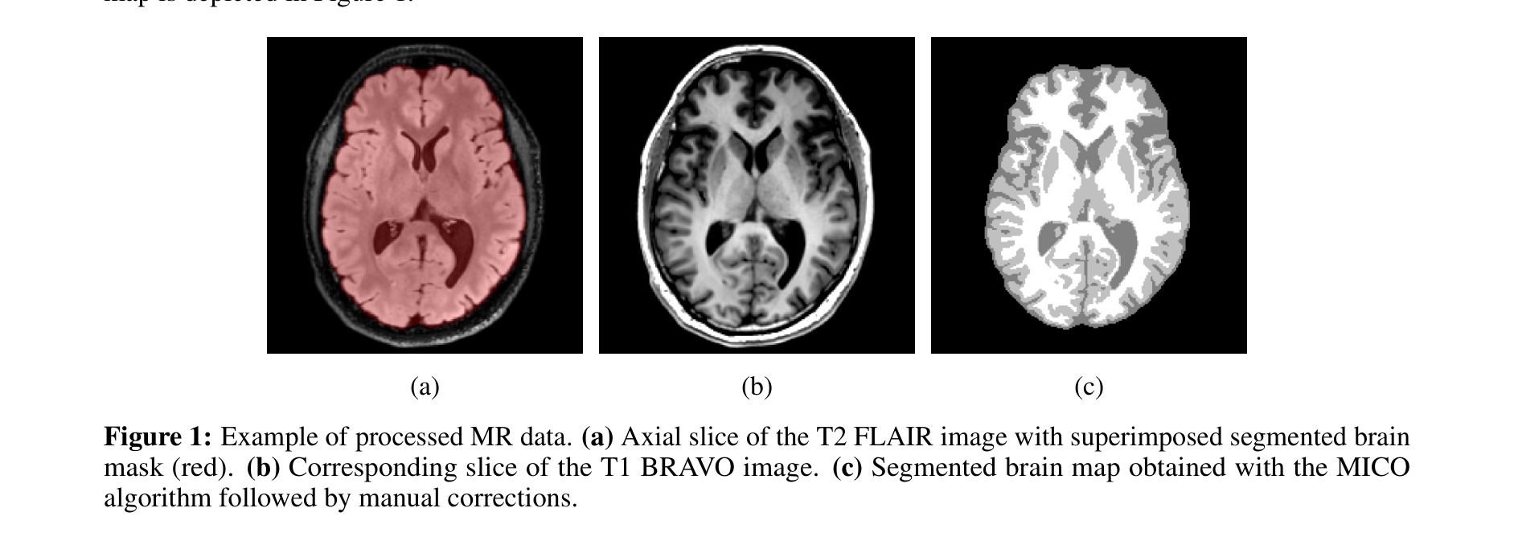
PART C | DATA SYNTHESIS
Figure 1: Brain ko tissue types me baantna
Panels
▸ (a) T2 FLAIR slice + red brain mask: simulation sirf is region me chalegi.
▸ (b) Usi slice ki T1 BRAVO image: anatomy saaf, skull bhi dikhta hai.
▸ (c) Segmented map: white matter, grey matter, CSF alag labels.
Kaise bana
▸ MICO algorithm (bias field hata kar clustering) + manual correction.
Kyun zaroori
▸ Tumor CSF me nahi failta; WM aur GM me D alag hota hai.
▸ Ye map Figure 2 ke diffusion tensor ko banane me use hota hai.
Paper Fig. 1: processed MR data.
Martens et al. (2022) | HybridTumorNet | IIIT Bhopal
10

Slide 11
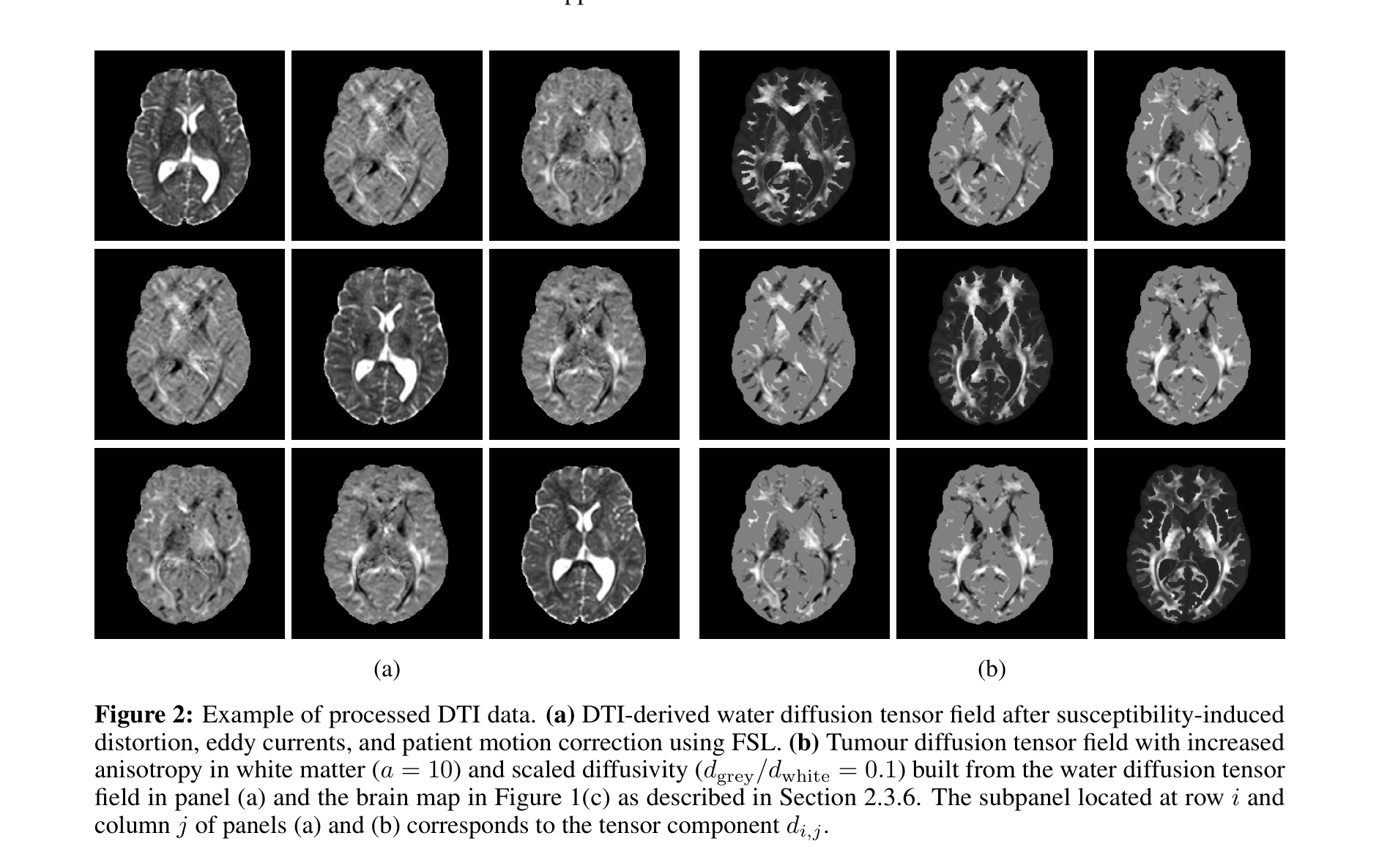
PART C | DATA SYNTHESIS
Figure 2: DTI se tumor diffusion tensor
Grid kya hai
▸ 3×3 grid = tensor ke 9 components d(i,j). Symmetric hai, isliye 6 independent.
(a) Water tensor
▸ Asli DTI scan, FSL se distortion, eddy current, motion correct. Ventricles bright.
(b) Tumor tensor
▸ (a) + brain map se: WM me anisotropy a=10, GM me d_grey/d_white=0.1, CSF hata diya.
Fark
▸ (a) paani ka diffusion, (b) tumor cells ka diffusion. Simulation (b) use karti hai.
Paper Fig. 2: processed DTI data.
Martens et al. (2022) | HybridTumorNet | IIIT Bhopal
11

Slide 12
PART C | DATA SYNTHESIS
Table 1: Synthetic tumors ke parameter ranges
Parameter | Min | Max | Unit | Matlab
λ (infiltration depth) | 0.5 | 2.0 | mm | front kitni chaudi
v (front velocity) | 28.28 | 48.99 | mm/year | boundary kitni tez badhti
Δt₁ (t₀ se t₁ tak) | 90 | 180 | days | pehli scan tak ka time
Δt₂ (t₁ se t₂) | 90 | 180 | days | do scans ke beech ka gap
▸ Sab uniform distribution se random. Δt₃ = Δt₄ = 90 din validation ke liye fixed.
▸ D = λv/2 aur ρ = v/(2λ). D aur ρ ko independent sample karne se bahut chhote ya bahut bade tumors ban jate, isliye λ, v sample kiye.
▸ Seed: white matter me 3×3×3 voxel block, jahan c=1 set hota hai. Total 200 tumors per volunteer × 6 volunteers = 1,200.
Martens et al. (2022) | HybridTumorNet | IIIT Bhopal
12

Slide 13
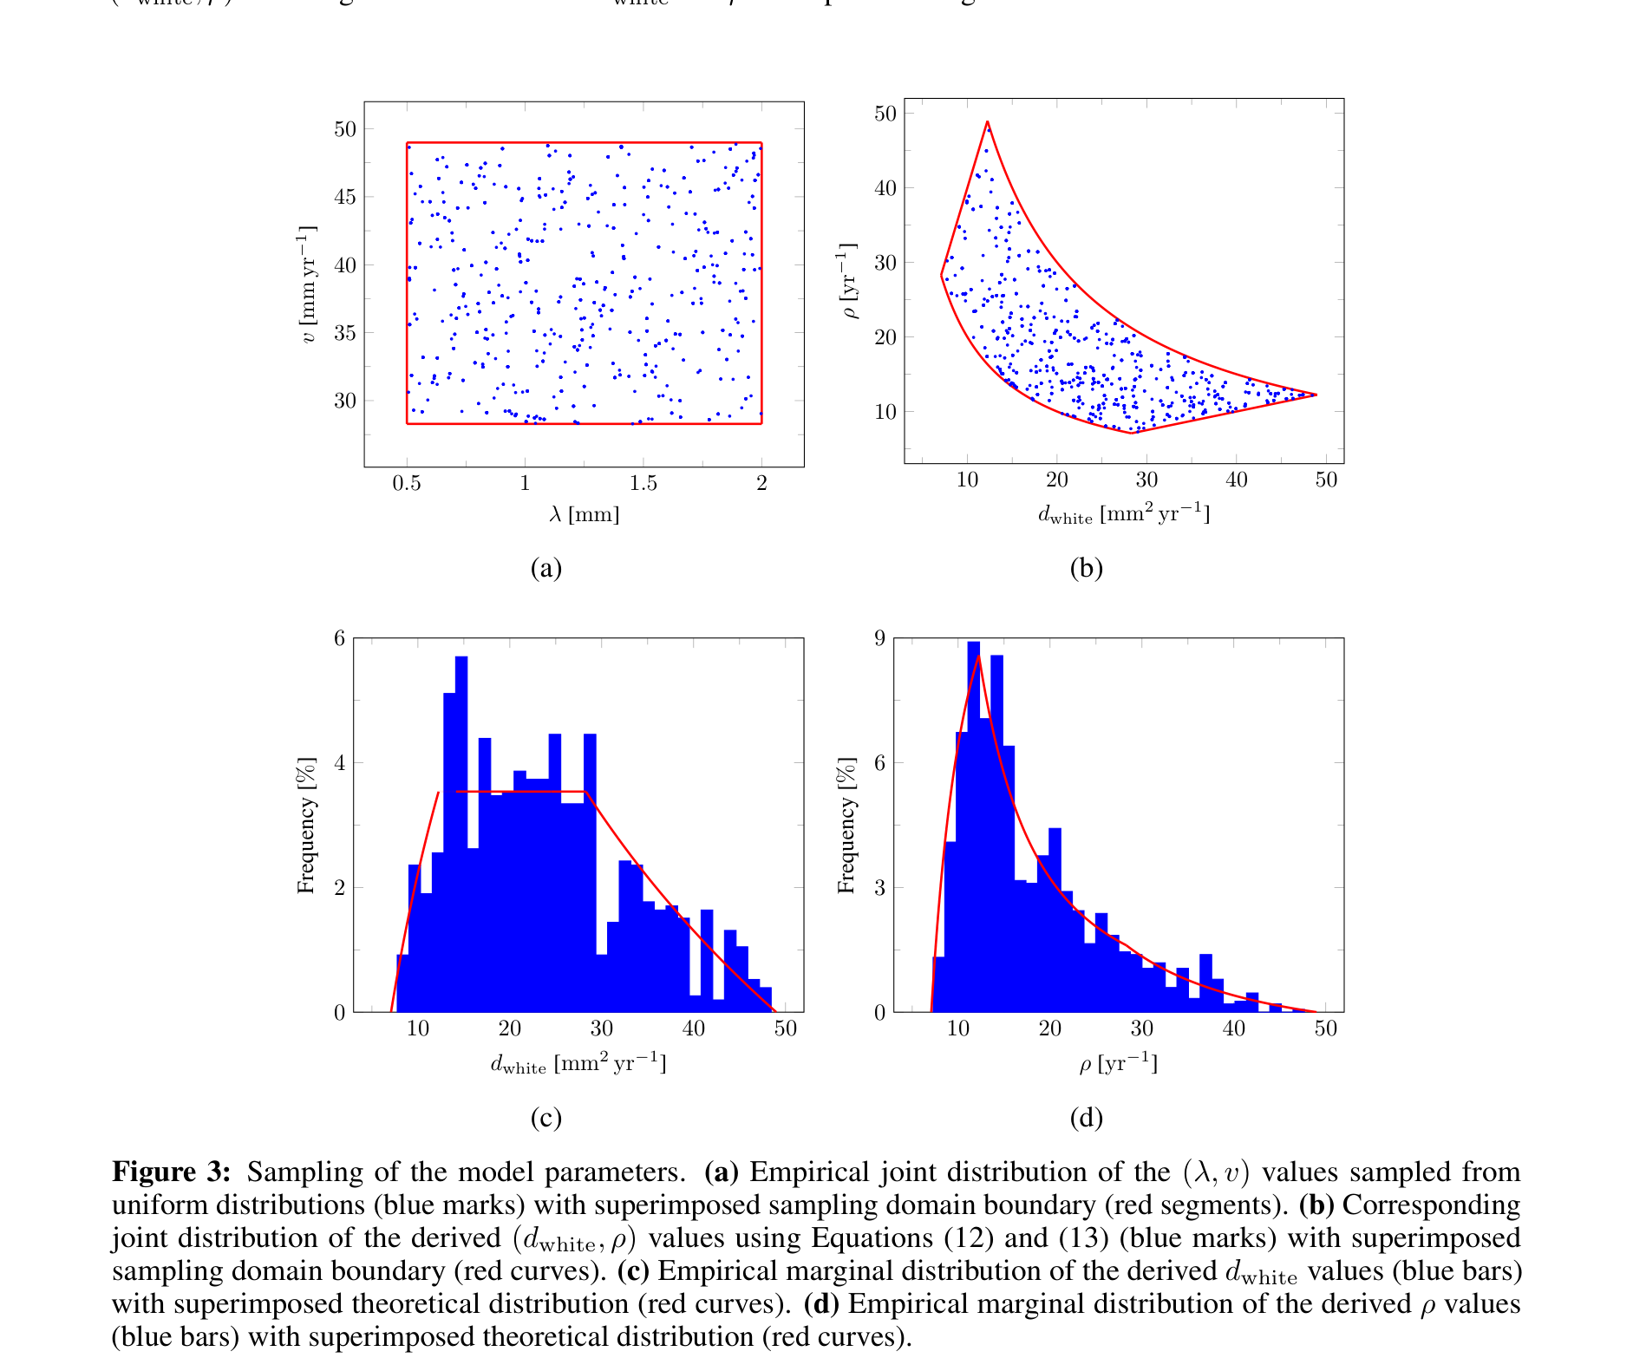
PART C | DATA SYNTHESIS
Figure 3: Parameters kaise sample hue
(a) (λ, v) scatter
▸ Blue dot = ek tumor. λ 0.5–2 mm, v 28–49 mm/yr me uniform. Red box = boundary.
(b) (d_white, ρ) scatter
▸ Wahi points Eq. 12, 13 se D, ρ me. Rectangle curved shape ban gaya (non-linear map).
(c) d_white histogram
▸ Blue = sampled, red = theoretical. d_white lagbhag 7–49 mm²/yr.
(d) ρ histogram
▸ Right-skewed: peak ~10–12 /yr, lambi tail. Zyada tumors slow, kuch bahut fast.
Takeaway
▸ Network ko slow se aggressive tak sab type ke tumors dikhte hain.
Paper Fig. 3: sampling of model parameters.
Martens et al. (2022) | HybridTumorNet | IIIT Bhopal
13

Slide 14
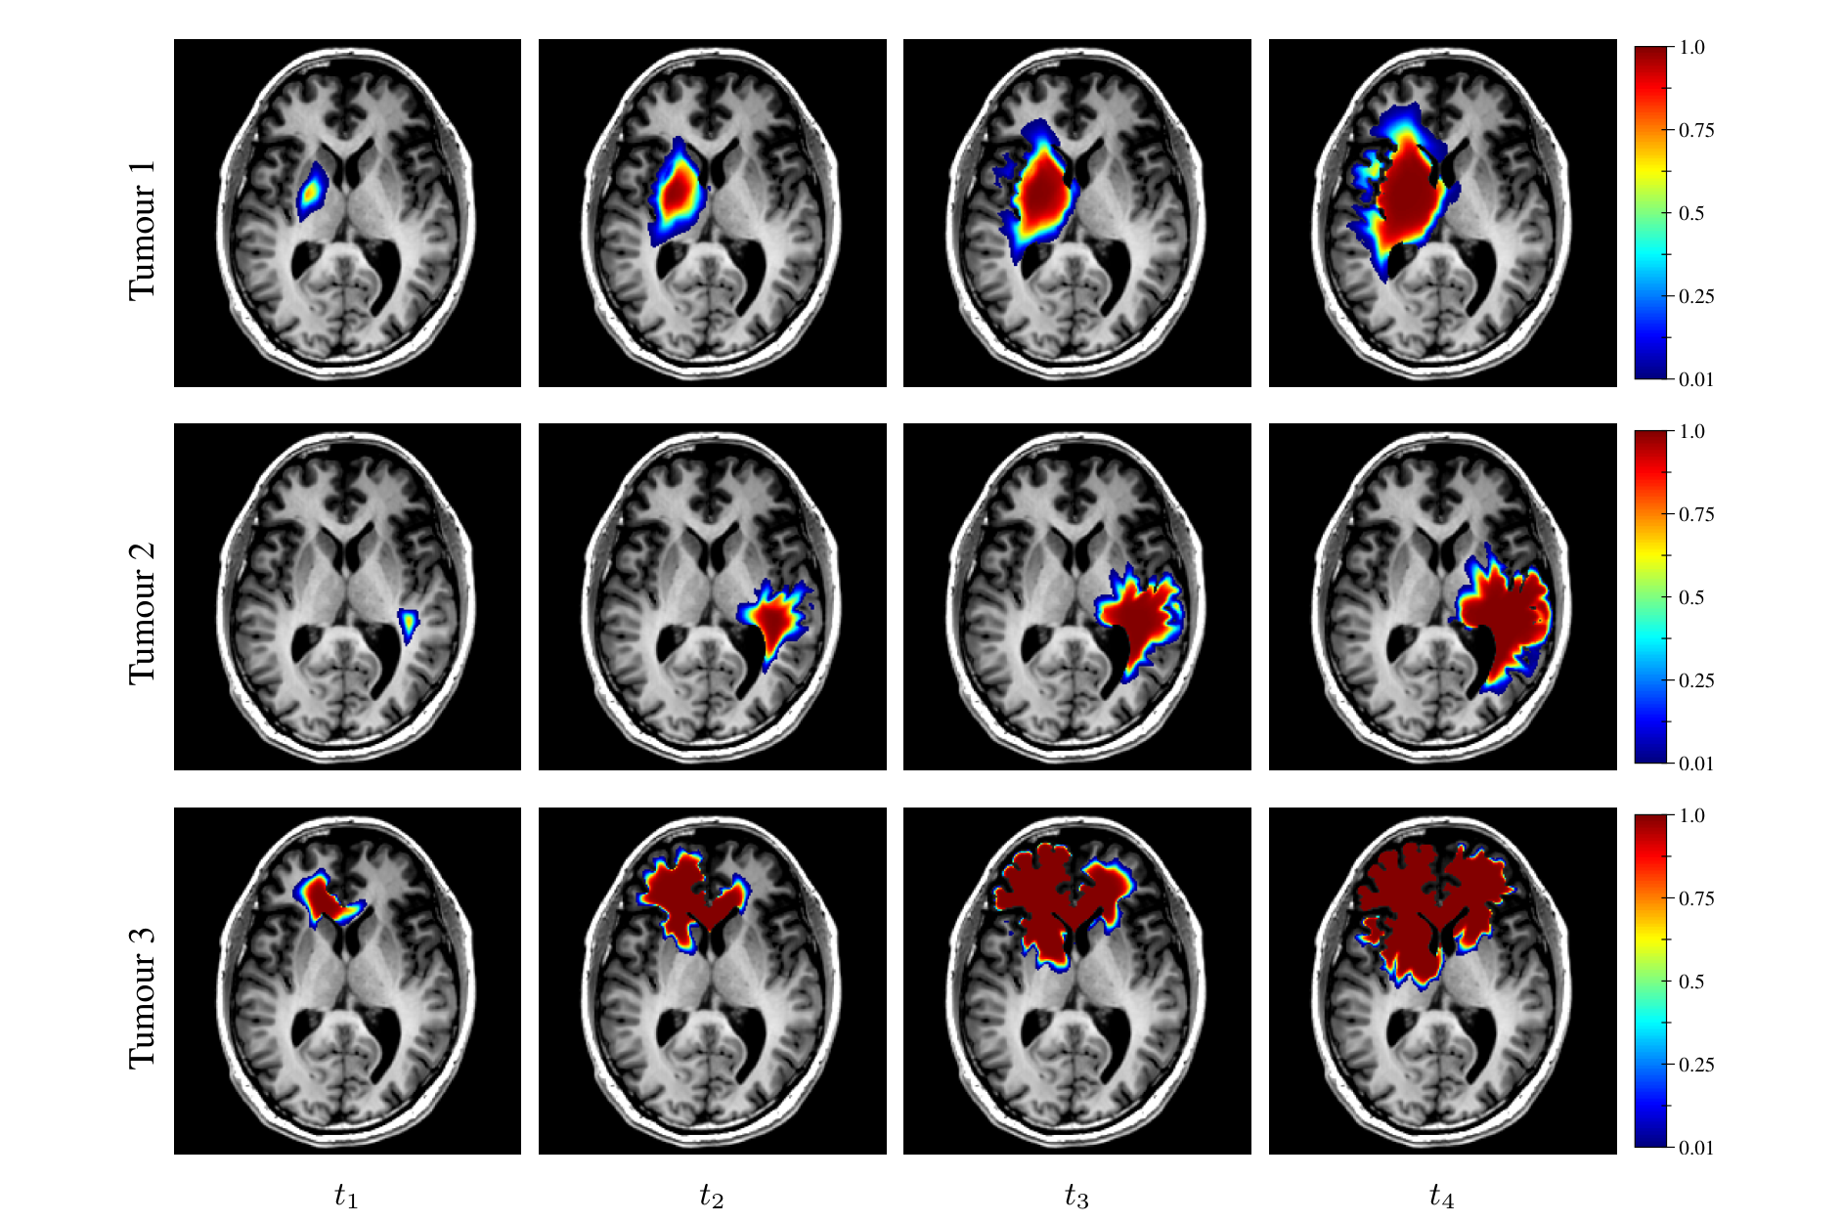
PART C | DATA SYNTHESIS
Figure 4: Synthetic tumors ka evolution (t₁→t₄)
Kya hai
▸ 3 tumors (rows), 4 time points t₁–t₄ (columns), axial slices. Colour = cell density 0.01→1.
Table 2 values
▸ T1: d=10.87, ρ=31.77, λ=1.71, v=37.16
▸ T2: d=15.07, ρ=13.95, λ=0.96, v=29.00
▸ T3: d=41.49, ρ=11.31, λ=0.52, v=43.33
Observation
▸ Chhota λ → sharp front, bada λ → dhundhla front. Time ke saath tumor badhta hai.
▸ Solver: forward Euler, Δt=0.5 din, GPU par ~1 s per tumor.
Paper Fig. 4: simulated cell density at t₁–t₄.
Martens et al. (2022) | HybridTumorNet | IIIT Bhopal
14

Slide 15
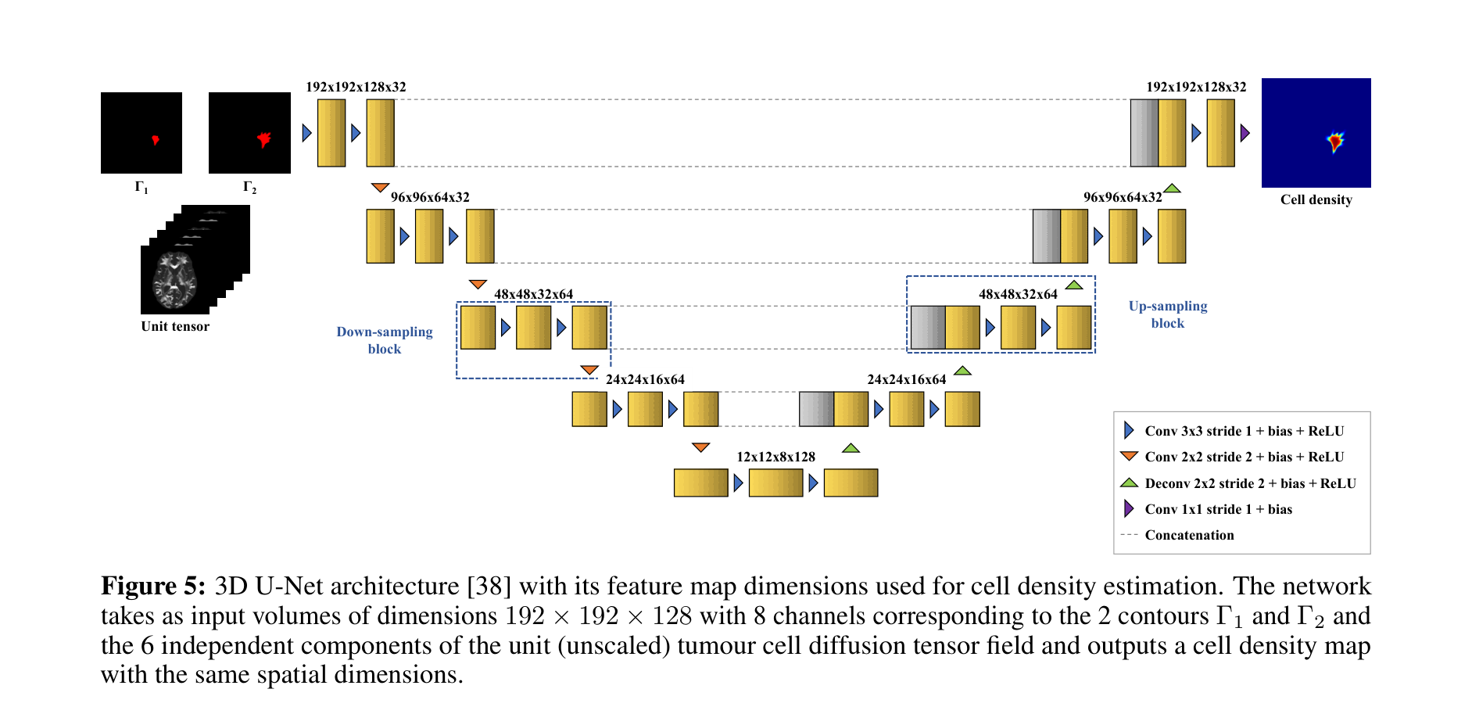
PART D | NETWORKS
Figure 5: Network 1 – 3D U-Net (cell density)
Input (8 channels)
▸ 2 binary contour masks (Γ₁, Γ₂) + 6 unit tensor components. Size 192×192×128.
Output
▸ Cell density map (same size). Har voxel me u.
Structure
▸ 4 down blocks, 4 up blocks, 1 output block. Features 32→64→128 bottom par.
▸ Grey boxes = skip connections (concatenation).
▸ Arrows: Conv3×3, Conv2×2 stride 2 (shrink), Deconv2×2 (grow), Conv1×1 (final).
Goal
▸ Visible contours se invisible tumor cells ka map banana.
Paper Fig. 5: 3D U-Net.
Martens et al. (2022) | HybridTumorNet | IIIT Bhopal
15

Slide 16
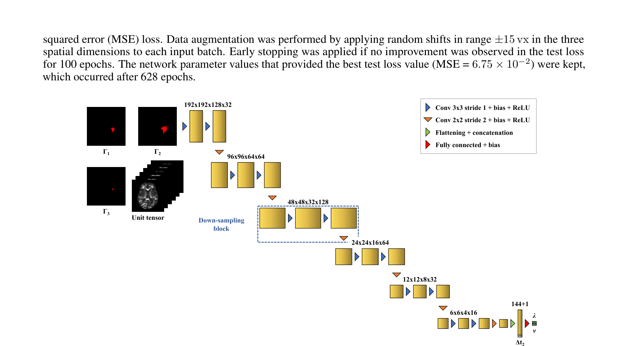
PART D | NETWORKS
Figure 6: Network 2 – Conv-Encoder (λ aur v)
Input (9 channels + Δt₂)
▸ 3 contours (Γ₁, Γ₂ at t₂; Γ₃ at t₁) + 6 tensor components, plus time gap Δt₂.
Structure
▸ 6 down-sampling blocks → flatten (144 features) + Δt₂ → 1 fully connected layer.
Output
▸ 2 numbers: λ aur v. Phir Eq. 12, 13 se d_white aur ρ.
Kyun 3 contours
▸ λ do contours ki doori se, v ek contour ke do time par shift se nikalta hai.
Paper Fig. 6: convolutional regressor.
Martens et al. (2022) | HybridTumorNet | IIIT Bhopal
16

Slide 17
PART D | NETWORKS
Dono networks ki training details
 | Network 1 (U-Net) | Network 2 (Conv-Encoder)
Task | Cell density estimation | λ, v estimation
Input | 192×192×128×8 | 192×192×128×9 + Δt₂
Loss | MAE | MSE (targets standardised)
Optimizer | Adam, lr 1e-4, batch 1 | Adam, lr 1e-4
Augmentation | Random shifts ±15 voxels | Random shifts ±15 voxels
Best test loss | MAE 1.24e-4 (epoch 876) | MSE 6.75e-2 (epoch 628)
Split | 5 volunteers train / 1 test (83%/17%) | same
▸ Framework: TensorFlow 2.5.0, GPU: RTX 3090. Early stopping: 100 epochs bina improvement. Rotation augmentation nahi, kyunki tensor components bhi rotate karne padte.
Martens et al. (2022) | HybridTumorNet | IIIT Bhopal
17

Slide 18
PART D | NETWORKS
Validation protocol aur post-processing
Experiment: Network 1 se t₂ par density, Network 2 se d_white aur ρ. Phir Fisher-KPP se t₃ (t₂+90 din) aur t₄ (t₂+180 din) simulate karo.
Compare with truth (true density + true parameters): MAE sirf c>0.01 area me, Hausdorff distance aur ASSD contours ke beech.
Hausdorff = sabse bura boundary error (max). ASSD = average boundary error.
Post-processing: (1) CSF/background density = 0. (2) density > 1 ko 1 par clip. (3) sabse bade connected region ke bahar ke chhote maxima hata do.
▸ Reason: network ke chhote artefacts simulation me naye tumor foci bana dete hain.
Test set
▸ 200 tumors, ek unseen volunteer ke brain par.
▸ Thresholds: c₁=0.80, c₂=0.16
Martens et al. (2022) | HybridTumorNet | IIIT Bhopal
18

Slide 19
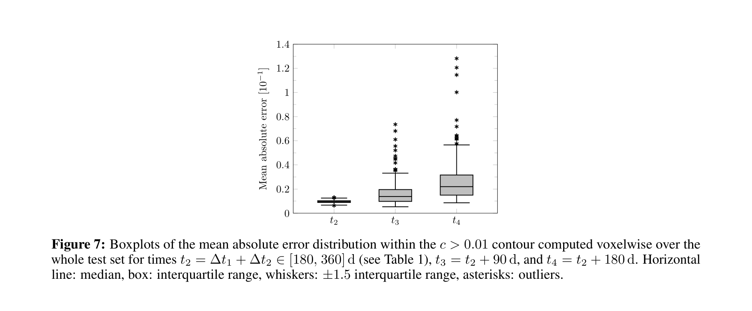
PART E | RESULTS
Figure 7: Density error (MAE) boxplot
Axes
▸ Y: mean absolute error [10⁻¹], X: t₂, t₃ (+90 d), t₄ (+180 d).
▸ Box = middle 50%, line = median, whiskers = 1.5×IQR, dots = outliers.
Medians
▸ t₂: 9.58×10⁻³ | t₃: 1.38×10⁻² | t₄: 2.20×10⁻²
Samajh
▸ Jitna aage predict karo error badhta hai (errors accumulate hote hain).
▸ Phir bhi median error 0.03 se kam.
Paper Fig. 7: MAE within c>0.01.
Martens et al. (2022) | HybridTumorNet | IIIT Bhopal
19

Slide 20
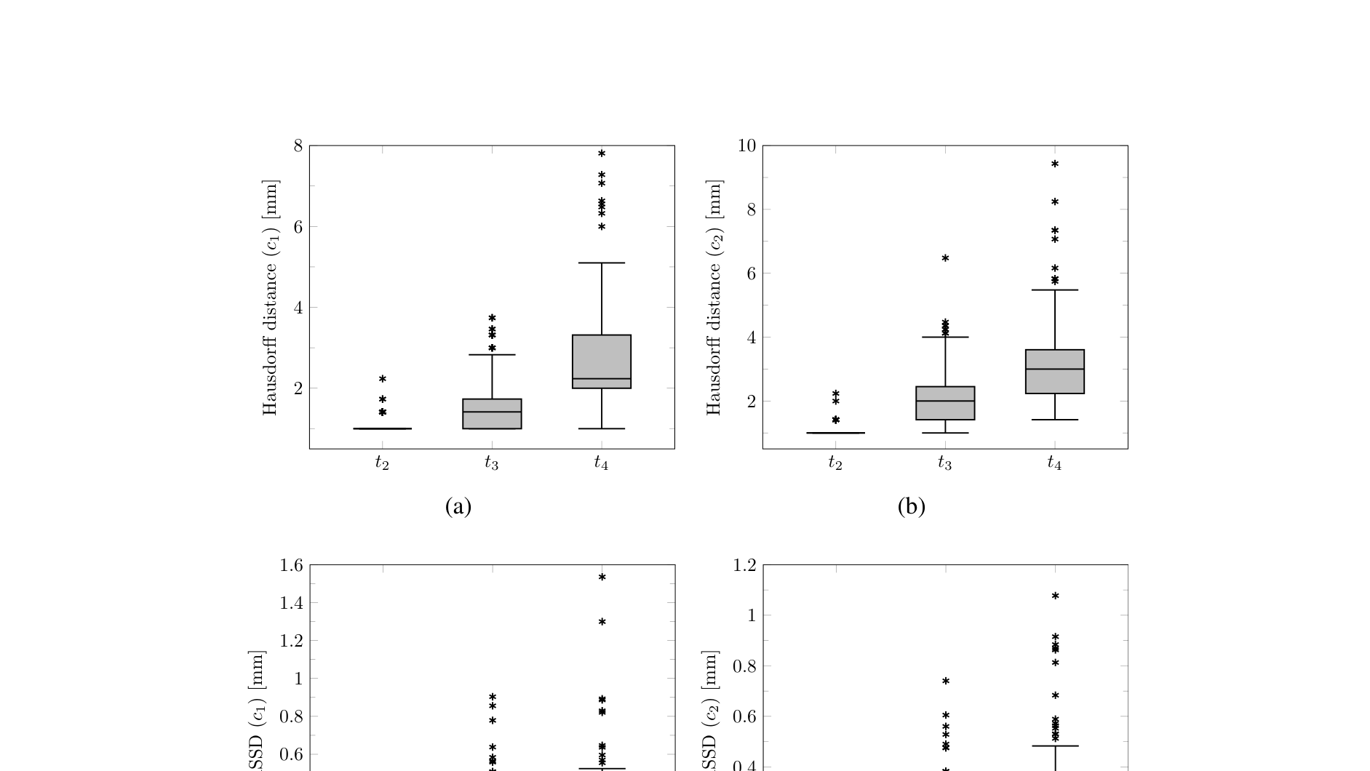
PART E | RESULTS
Figure 8: Hausdorff aur ASSD
Panels
▸ (a) Hausdorff, c₁=0.80 (b) Hausdorff, c₂=0.16
▸ (c) ASSD, c₁=0.80 (d) ASSD, c₂=0.16. Y in mm.
Kya batata hai
▸ Predicted aur true contour kitni door hain. Hausdorff = worst point, ASSD = average.
Paper ka claim
▸ ASSD zyada tar cases me ≤ 1 mm (voxel size).
▸ Kuch outliers me Hausdorff bada par ASSD chhota: artefact foci ki wajah se.
Paper Fig. 8: Hausdorff and ASSD.
Martens et al. (2022) | HybridTumorNet | IIIT Bhopal
20

Slide 21
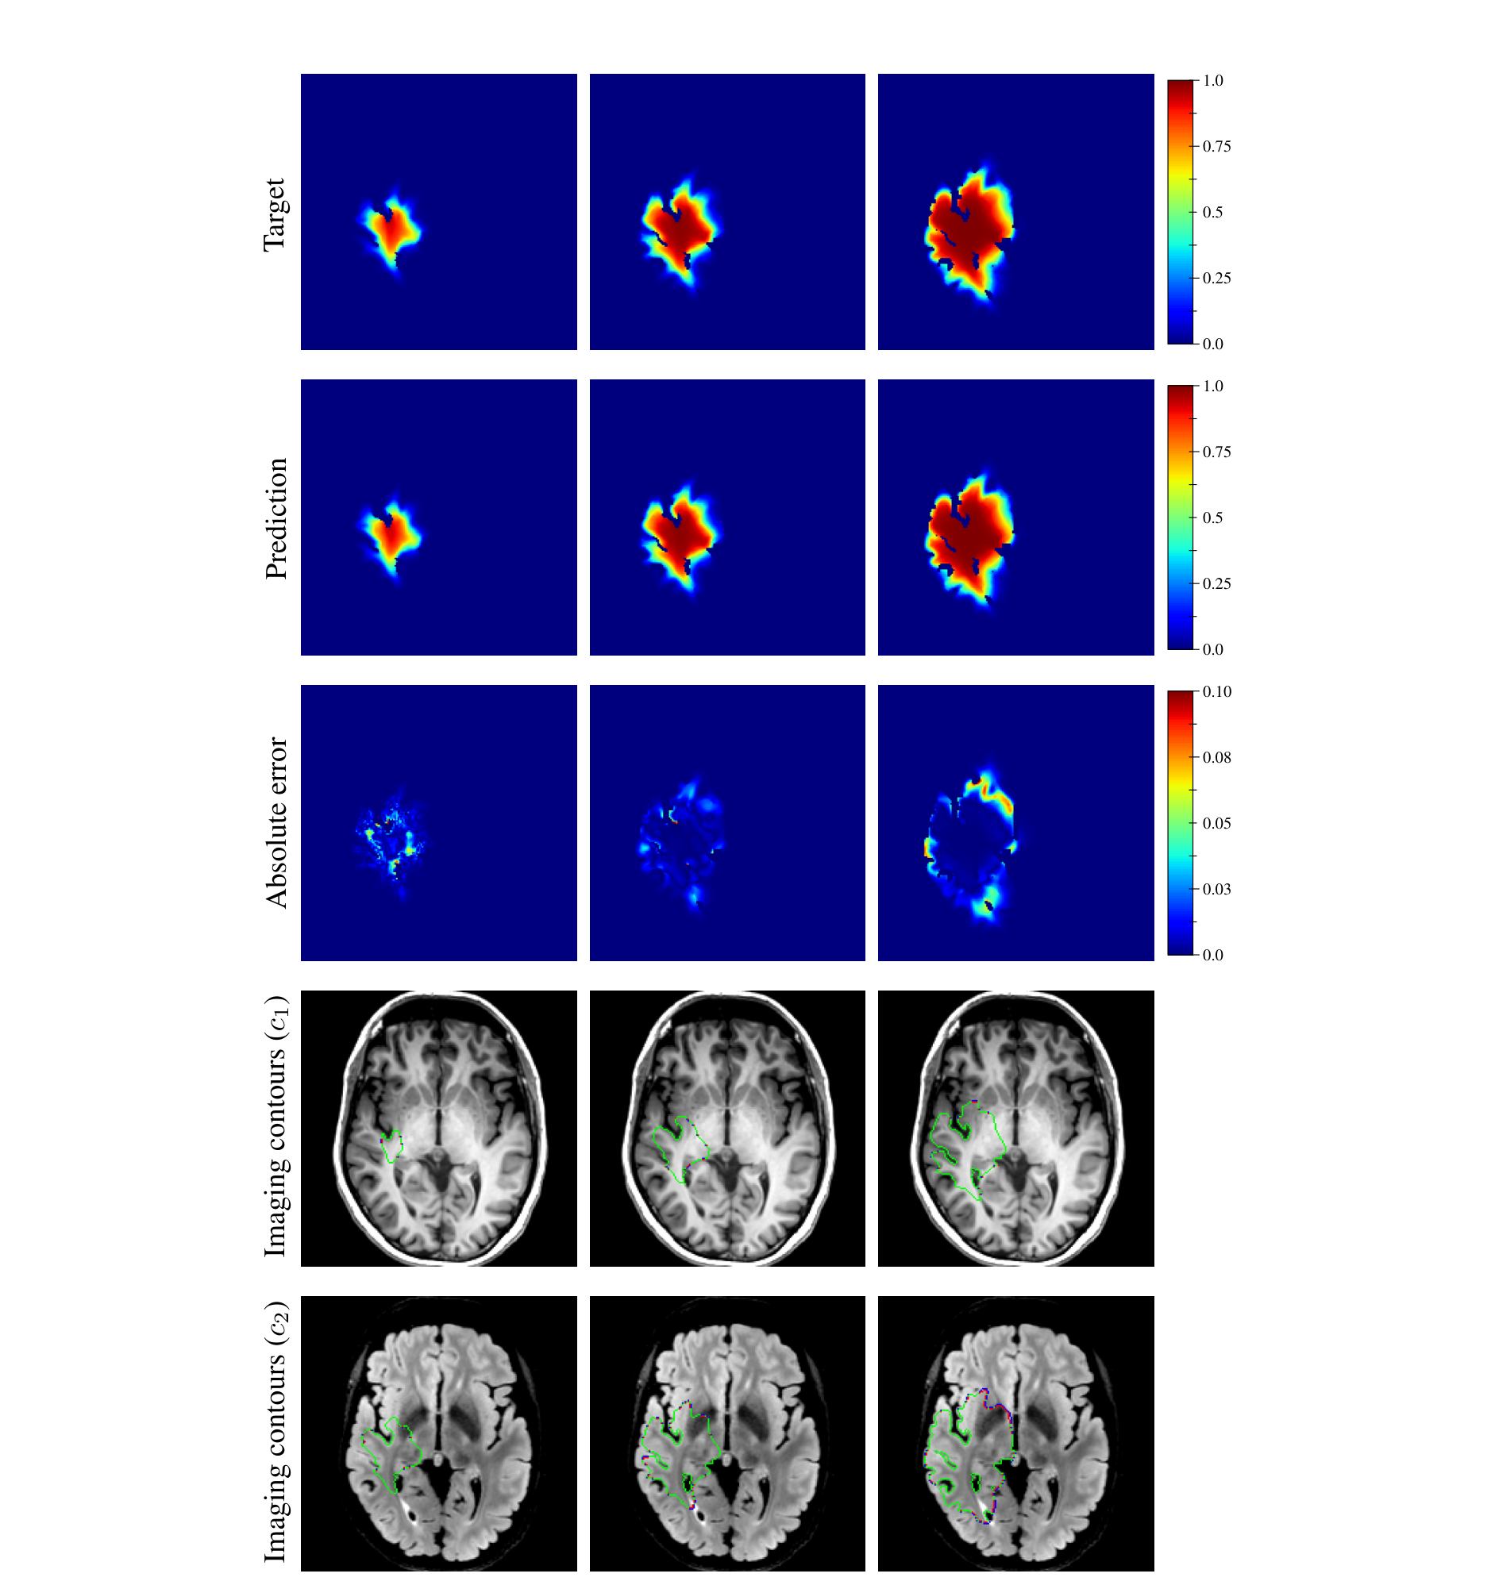
PART E | RESULTS
Figure 9: True vs predicted density (ek example)
Rows
▸ 1: target density, 2: predicted density, 3: absolute error (0–0.10).
▸ 4 aur 5: contours on T1 aur T2 FLAIR. Blue=target, red=prediction, green=overlap.
Columns
▸ t₂, t₃, t₄ (axial).
Example
▸ d=43.47 mm²/yr, ρ=11.22 /yr, t₁=94 d, t₂=264 d.
Dhyan
▸ t₂ par density Network 1 se; t₃, t₄ simulation se (Network 2 ke parameters).
▸ Error time ke saath badhta hai, mostly boundary par.
Paper Fig. 9: true vs estimated density.
Martens et al. (2022) | HybridTumorNet | IIIT Bhopal
21

Slide 22
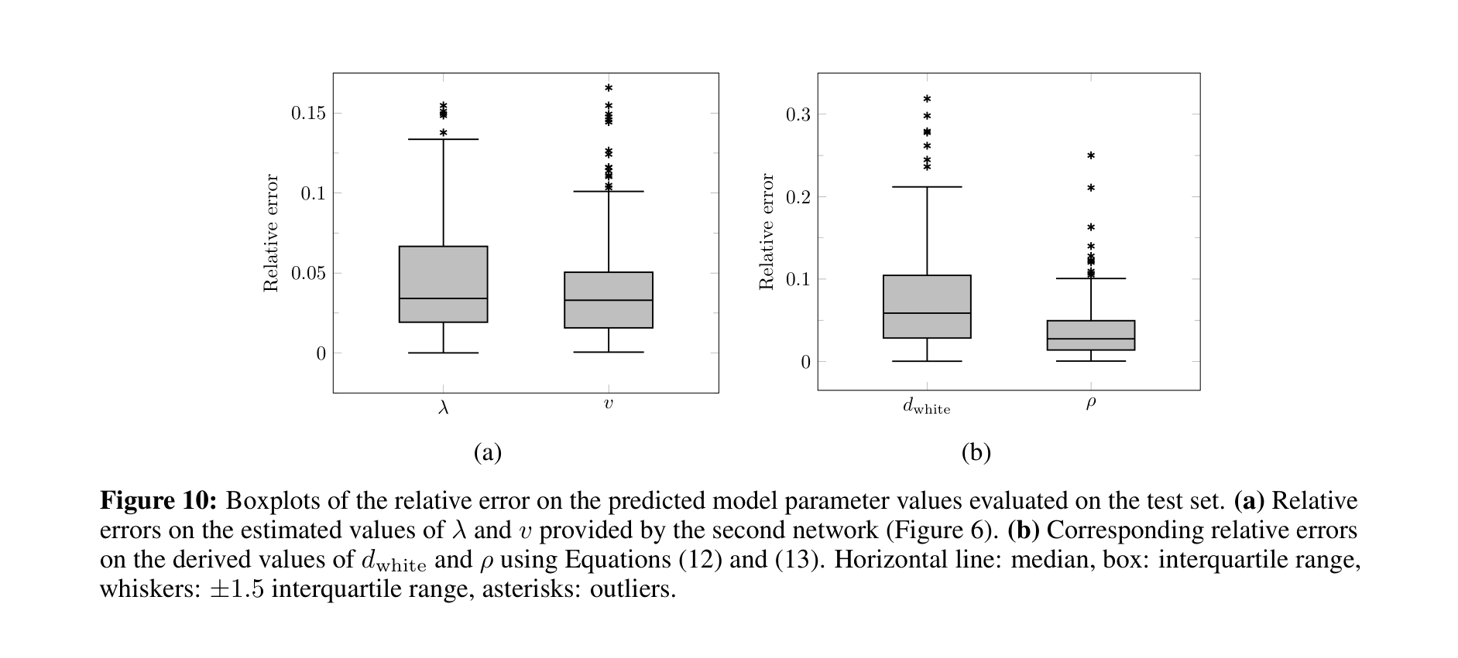
PART E | RESULTS
Figure 10: Parameters ka relative error
Panels
▸ (a) λ aur v ka relative error (Network 2 ka direct output).
▸ (b) d_white aur ρ ka relative error (Eq. 12, 13 se derived).
Median errors
▸ λ: 3.41% v: 3.30%
▸ d_white: 5.86% ρ: 2.75%
Samajh
▸ Parameters bahut accurately nikle. d_white ka error thoda zyada, kyunki λ aur v ke errors multiply hote hain.
Paper Fig. 10: relative error of parameters.
Martens et al. (2022) | HybridTumorNet | IIIT Bhopal
22

Slide 23
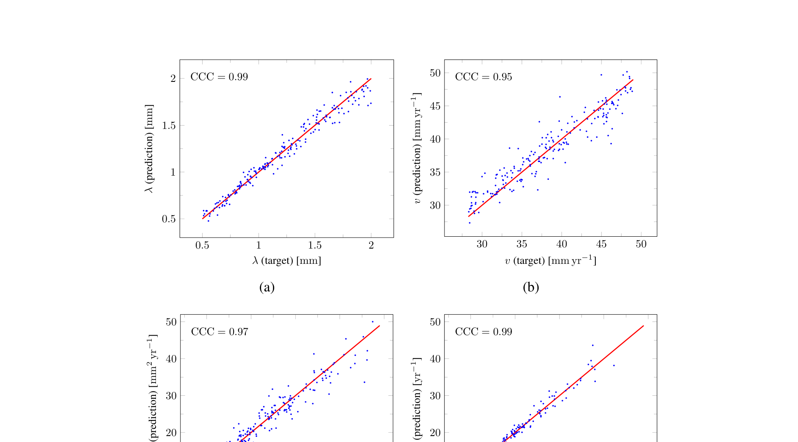
PART E | RESULTS
Figure 11: True vs predicted scatter (CCC)
Panels
▸ (a) λ (b) v (c) d_white (d) ρ. X = true, Y = predicted. Red line = perfect (y=x).
CCC (Lin)
▸ λ: 0.99, v: 0.95, d_white: 0.97, ρ: 0.99.
▸ CCC 1 matlab perfect agreement; ye correlation + bias dono check karta hai.
Samajh
▸ Points diagonal ke paas → network ke predictions true values se match karte hain.
▸ Ye sirf synthetic data par hai.
Paper Fig. 11: true vs predicted parameters.
Martens et al. (2022) | HybridTumorNet | IIIT Bhopal
23

Slide 24
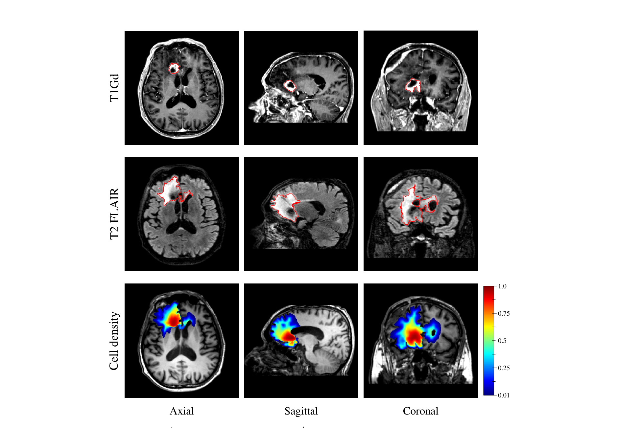
PART E | RESULTS
Figure 12: Real GBM patient
Layout
▸ Rows: T1Gd, T2 FLAIR, estimated cell density. Columns: axial, sagittal, coronal.
▸ Red contour = segmented enhancing core (T1Gd) aur oedema (T2 FLAIR).
Patient
▸ IDH-wildtype glioblastoma (Network 1 hi use hua).
Important
▸ Biopsy nahi hai aur patient ka treatment ho chuka hai, isliye result validate nahi hua.
▸ Dense region (c~1) necrotic area se match karta hai: paper khud kehta hai ye counter-intuitive hai (necrosis model me nahi).
Paper Fig. 12: real GBM patient.
Martens et al. (2022) | HybridTumorNet | IIIT Bhopal
24

Slide 25
PART E | RESULTS
Results ka summary
Metric | Value | Meaning
Density MAE at t₂ (median) | 9.58×10⁻³ | very accurate density
Density MAE t₃ / t₄ (median) | 1.38×10⁻² / 2.20×10⁻² | error slowly accumulates
Median rel. error λ, v | 3.41% / 3.30% | direct outputs
Median rel. error d_white, ρ | 5.86% / 2.75% | derived parameters
CCC λ, v, d_white, ρ | 0.99, 0.95, 0.97, 0.99 | strong agreement
ASSD | ≤ 1 mm mostly | contour within voxel size
▸ Ye saare numbers synthetic test tumors par hain (200 tumors, 1 unseen volunteer brain).
Martens et al. (2022) | HybridTumorNet | IIIT Bhopal
25

Slide 26
PART F | CRITICAL ANALYSIS
Paper ki limitations (khud authors ke hisaab se)
Synthetic validation: model ye maanta hai ki Fisher-KPP asli gliomas ko sahi describe karta hai; ye extensively proven nahi hai.
Real validation nahi: ek GBM patient, bina biopsy, treatment ke baad.
Mass effect aur necrosis model me nahi hain.
Treatment effects (surgery, chemo, radiotherapy) model me nahi.
Fixed thresholds: c₁, c₂ badle to networks retrain karne padenge.
Constant D, ρ assumption: untreated patient me time ke saath constant maana.
Error accumulation: lambe time par artefact foci aur error badhta hai.
Martens et al. (2022) | HybridTumorNet | IIIT Bhopal
26

Slide 27
PART F | CRITICAL ANALYSIS
Hamare HybridTumorNet se relation
Same: dono PDE parameters (D, ρ) predict karte hain aur Fisher-KPP use karte hain.
Same: dono synthetic Fisher-KPP simulations se train hote hain.
Difference (solver): Martens forward Euler (Δt=0.5 d), humare code me RK4.
Difference (loss): Martens me PDE sirf data banane me; hamare me PDE physics loss ke roop me training me.
Difference (data): Martens: 6 healthy brains + 1 GBM; hamare paas LUMIERE ke 91 real GBM patients.
Hamara contribution: real longitudinal data par validation, jo Martens ne future work bataya.
Comparison
▸ Martens: U-Net + Conv-Encoder, TensorFlow
▸ Ours: ResNet-based HybridTumorNet, PyTorch/MONAI
▸ Martens: contours input
▸ Ours: MRI modalities input
Martens et al. (2022) | HybridTumorNet | IIIT Bhopal
27

Slide 28
PART F | CRITICAL ANALYSIS
Hamare abhi tak ke results (LUMIERE)
▸ MONAI SegResNet (SOTA bundle) LUMIERE par: avg Whole-Tumor Dice 89.7%, median 93.1%, peak 96.1%.
▸ Hamara ResNet-10 HybridTumorNet pretrained: avg WT Dice ~49.2% (10 patients), peak ~70%.
▸ Gap: chhota backbone + synthetic pretraining; real-data fine-tuning abhi baaki hai.
▸ Pipeline: atlas-space (skull-stripped, 1 mm) data par evaluate kiya, coordinate mismatch bug fix karke.
▸ Note: ye segmentation Dice hai, growth prediction ka metric nahi. Growth ke liye Martens jaise ASSD/Hausdorff aur parameter CCC chahiye.
Takeaway
▸ SOTA benchmark ready
▸ Gap measured
▸ Next: fine-tune on LUMIERE
Martens et al. (2022) | HybridTumorNet | IIIT Bhopal
28

Slide 29
PART F | CRITICAL ANALYSIS
Next steps
▸ Backbone upgrade: SegResNet / SwinUNETR ko HybridTumorNet me lagana.
▸ LUMIERE longitudinal pairs par growth prediction (tᵢ → tᵢ₊₁) fine-tuning.
▸ Metrics Martens ke jaise: MAE, ASSD, Hausdorff, parameter CCC.
▸ Uncertainty quantification (MC dropout / ensembles).
▸ Martens ki limitation address karna: real data, mass effect, treatment (agar data ho).
Martens et al. (2022) | HybridTumorNet | IIIT Bhopal
29

Slide 30
PART F | CRITICAL ANALYSIS
Glossary: terms ek jagah
Term | Simple matlab
GBM | Glioblastoma, sabse aggressive brain tumor
Voxel | 3D pixel (1 mm³)
DTI | MRI jo nerve fibre ki direction naapta hai
WM / GM / CSF | White matter (fibres) / Grey matter (neurons) / Brain fluid
MICO | MRI ko tissues me baantne wala algorithm jo brightness bias bhi theek karta hai
MAE | Average absolute error
Hausdorff / ASSD | Boundary error: worst / average
CCC | Agreement score (1 = perfect)
Anisotropy a=10 | WM me fibre direction me diffusion 10 guna
Martens et al. (2022) | HybridTumorNet | IIIT Bhopal
30

Slide 31
PART F | CRITICAL ANALYSIS
Teacher ke liye possible questions
Q: Network seedha D, ρ kyun nahi deta? A: λ, v images se directly naap sakte hain; D, ρ sirf unke combination hain.
Q: Sirf synthetic data par kyun? A: Real tumor ki true cell density kisi ko pata nahi, isliye ground truth sirf simulation me milta hai.
Q: Result bharosemand hai? A: Synthetic par hai; real patient par validate nahi hua, authors khud maante hain.
Q: Humara kaam alag kaise? A: Hamare paas real longitudinal LUMIERE data hai aur physics loss training me hai.
Q: Error time ke saath kyun badhta hai? A: Initial density aur parameter errors simulation me accumulate hote hain.
Martens et al. (2022) | HybridTumorNet | IIIT Bhopal
31

Slide 32
SUMMARY
Conclusion
▸ Martens et al. ne dikhaya ki deep CNNs MRI contours se cell density aur Fisher-KPP parameters seconds me nikaal sakte hain (median rel. error 2.75–5.86%, CCC ≥ 0.95).
▸ Par poora validation synthetic data par hai; real glioma validation baaki hai.
▸ Hamara HybridTumorNet isi idea ko real longitudinal LUMIERE data aur physics-informed training se aage badhata hai.
▸ Thank you! Questions?
Martens et al. (2022) | HybridTumorNet | IIIT Bhopal
32

