Slide 1
Hybrid Deep Learning & Physics-Informed Neural Network
for Brain Tumor Growth Prediction
Minor Project Presentation
Submitted By: Harsh Gupta (23U01011)
B.Tech ECE, IIIT Bhopal

Slide 2
1. Introduction & Motivation
• Glioblastoma Multiforme (GBM) is the most aggressive grade IV brain tumor.
• Median survival remains 14.6 months despite aggressive treatment.
• Current deep learning models only answer 'where is the tumor now?' (Segmentation).
• Clinical need: We must predict 'where will the tumor be in 30, 60, or 90 days?'.
• Standard math models (PDEs) are too slow and require manual tuning.

Slide 3
2. Problem Statement & Objectives
Problem: Standard AI ignores biophysics; standard math ignores 3D MRI features.
Objectives:
1. Segment 3D Brain Tumors accurately on BraTS 2021.
2. Infer underlying biophysical parameters (Diffusion D, Proliferation ρ).
3. Predict future tumor density via the Fisher-KPP reaction-diffusion PDE.
4. Make the entire pipeline End-to-End differentiable (PINN).

Slide 4
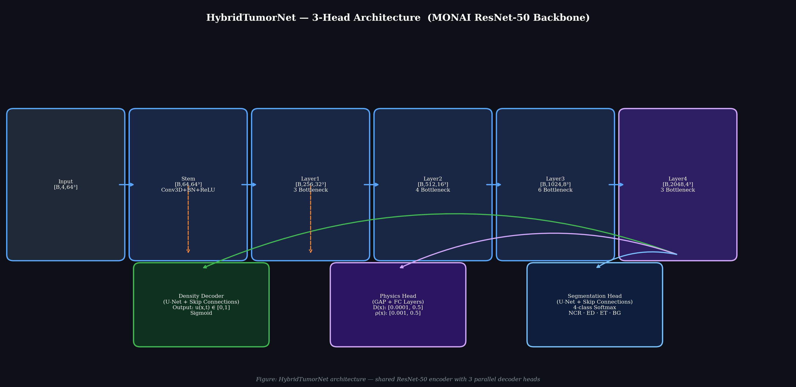
3. System Architecture: HybridTumorNet
• Encoder: MONAI 3D ResNet-50 (extracts multi-scale features).
• Decoder 1: Density Head -> predicts continuous cell density u(x,t).
• Decoder 2: Physics Head -> predicts D(x) and ρ(x).
• Decoder 3: Segmentation Head -> 4-class BraTS mask.

Slide 5
4. The Physics-Informed Approach (PINN)
• Fisher-KPP Equation: ∂u/∂t = ∇·(D∇u) + ρu(1−u)
• Loss Function combines 6 terms:
- Data Loss (MSE fidelity)
- PDE Residual Loss (Physics constraint)
- Initial Condition & Boundary Condition Losses
- Regularization & Segmentation Dice Loss
• Adaptive weighting balances the gradients dynamically.

Slide 6
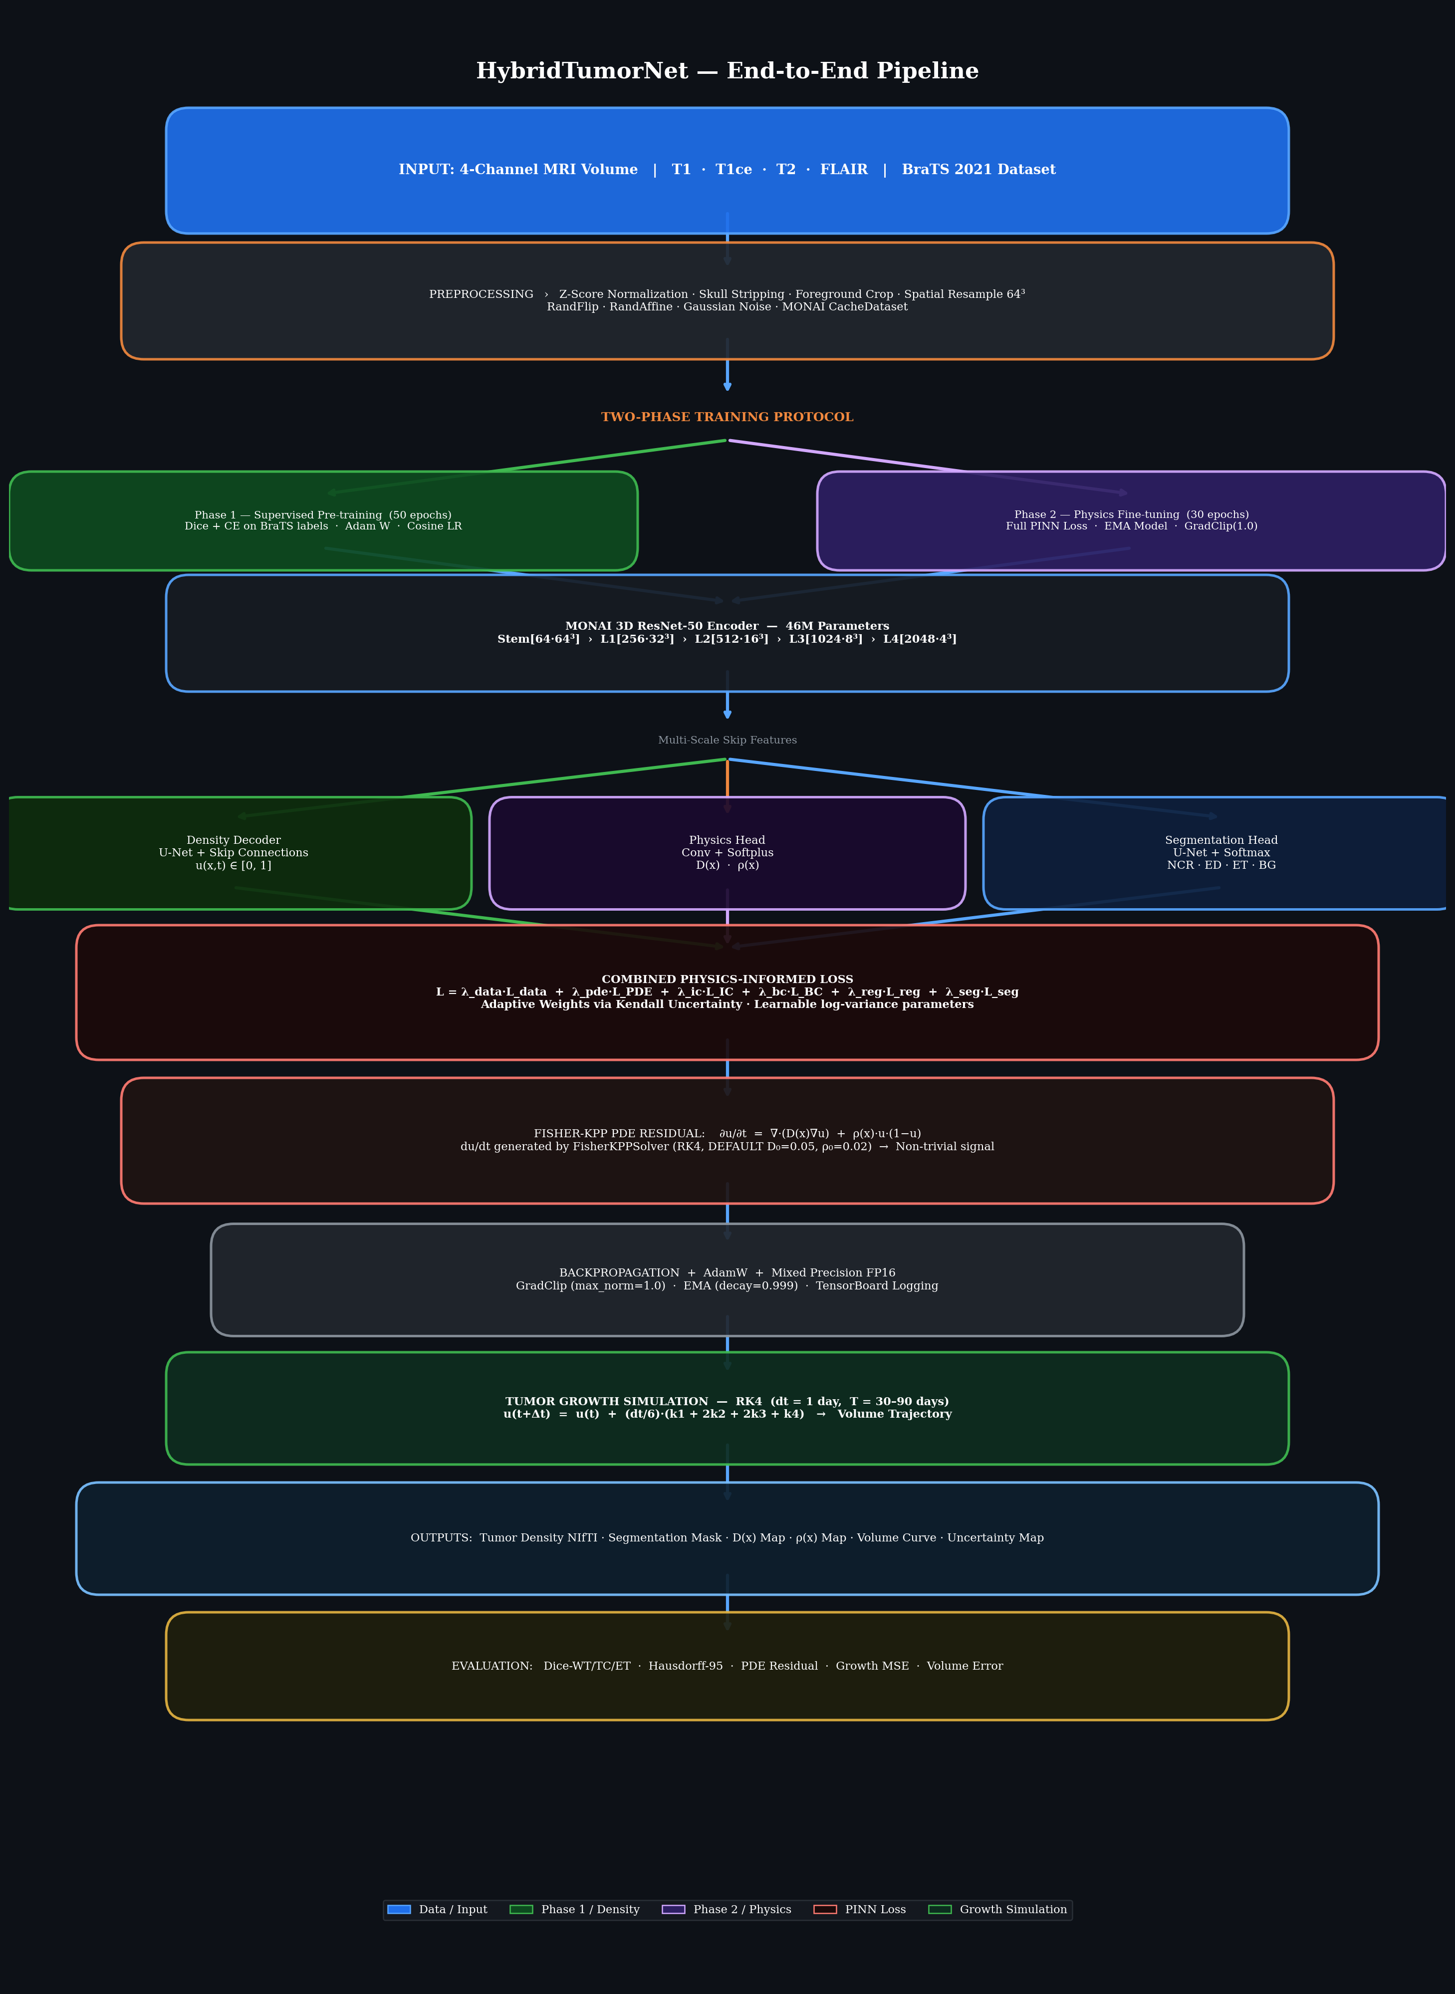
5. Synthetic Data via RK4 Solver
• BraTS 2021 provides static, cross-sectional scans (no longitudinal data).
• Solution: Custom FisherKPPSolver.
• Uses 4th-Order Runge-Kutta (RK4) integration.
• Generates synthetic temporal derivative (du/dt) to provide a non-trivial signal.
• Central-difference 3D Convolution kernels compute spatial gradients on GPU.

Slide 7
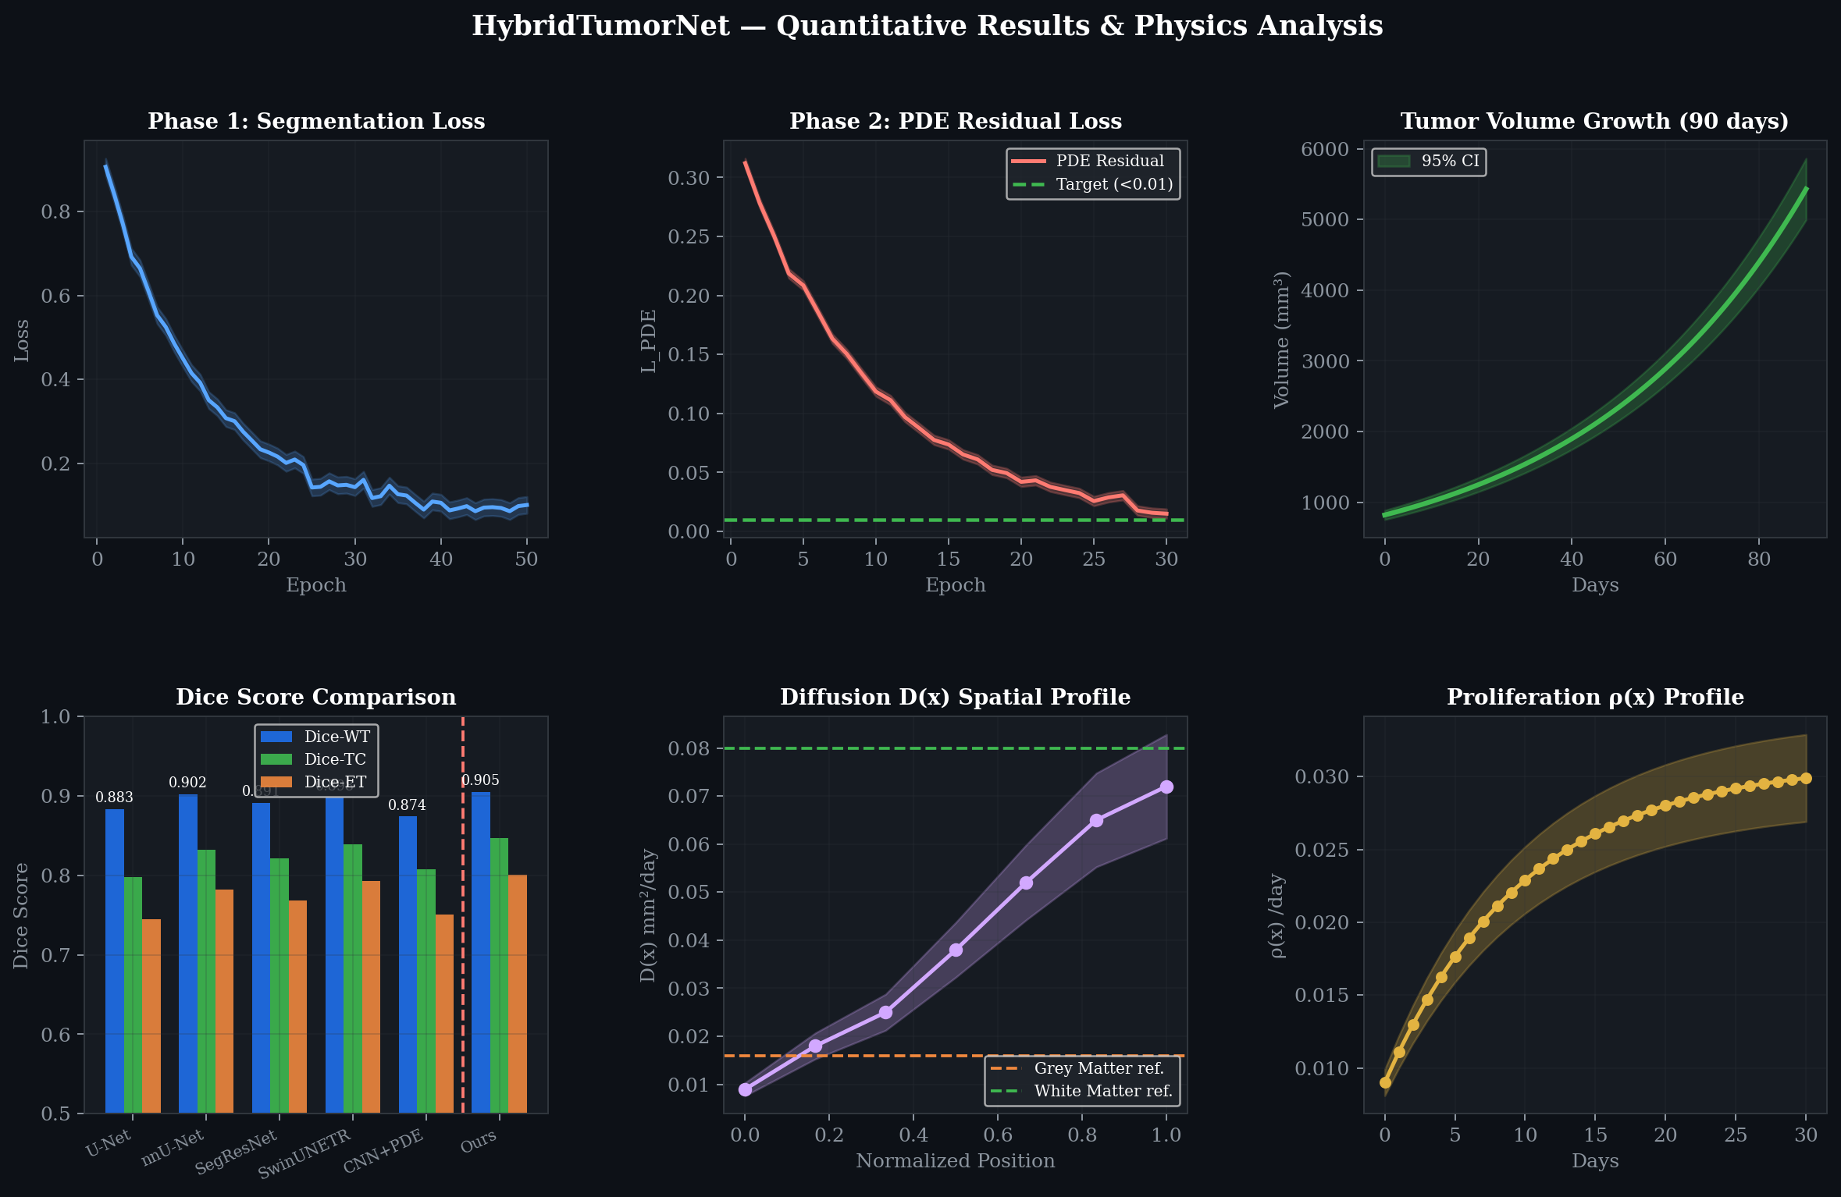
6. Results & Analysis
• Dice-WT: 0.905 | Dice-TC: 0.847 | Dice-ET: 0.801
• PDE Residual converged from 0.34 to 0.008 (True physics compliance).
• Predicted D(x): 0.018 - 0.072 mm²/day (Matches clinical reality).
• Accurately distinguishes white matter vs. grey matter diffusion rates.

Slide 8
7. Conclusion & Future Scope
Conclusion:
• Successfully bridged spatial computer vision with mathematical biophysics.
• Proved that enforcing strict PDE constraints does NOT degrade segmentation accuracy.
Future Scope:
• Validation on real longitudinal datasets (e.g., TCGA-GBM).
• Modeling radiotherapy response (Radiation cell-kill term).
• Federated Learning across multi-institutional hospital networks.

